Slide 1
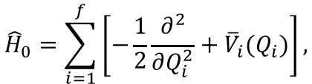
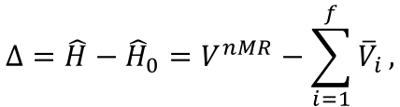
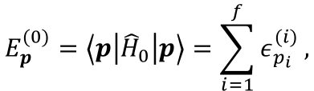

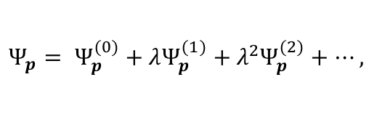
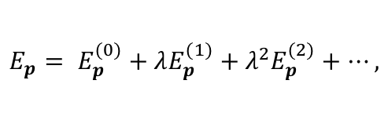

Vibrational Møller Plesset Perturbation Theory
Zero-th order Hamiltonian and Energy
$${\hat{H}}_{0}=\sum_{i=1}^{f}{\left[−\frac{1}{2}\frac{∂^{2}}{∂Q_{i}^{2}}+{\overline{V}}_{i}(Q_{i})\right]},$$
(1)
$$Δ=\hat{H}−{\hat{H}}_{0}=V^{nMR}−\sum_{i=1}^{f}{{\overline{V}}_{i}},$$
(2)
$$E_{p}^{(0)}=\left\langle p | {\hat{H}}_{0} | p\right\rangle =\sum_{i=1}^{f}{ε_{p_{i}}^{(i)}},$$
(3)
Perturbative expansion
$$Ψ_{p}= Ψ_{p}^{(0)}+λΨ_{p}^{(1)}+λ^{2}Ψ_{p}^{(2)}+⋯,$$
(4)
$$E_{p}= E_{p}^{(0)}+λE_{p}^{(1)}+λ^{2}E_{p}^{(2)}+⋯,$$
(5)
1st-order energy
$$E_{p}^{(1)}=\left\langle p | Δ | p\right\rangle ,$$
(6)
$$E_{p}^{(0+1)}=\left\langle p | {\hat{H}}_{0}+Δ | p\right\rangle =\left\langle p | \hat{H} | p\right\rangle =E_{p}^{VSCF},$$
(7)

Slide 2
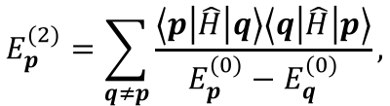

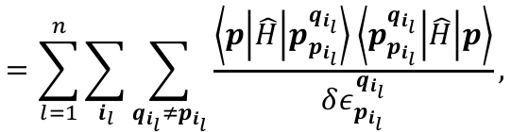
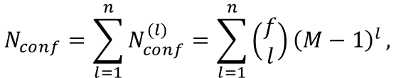
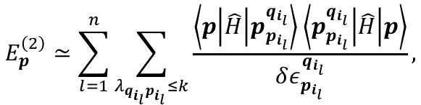
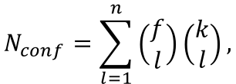
VMP2 energy
$$E_{p}^{VMP2}=E_{p}^{(0+1)}+E_{p}^{(2)},$$
(8)
$$E_{p}^{(2)}=\sum_{q≠p}{\frac{\left\langle p | \hat{H} | q\right\rangle \left\langle q | \hat{H} | p\right\rangle }{E_{p}^{(0)}−E_{q}^{(0)}}},$$
(9)
$$=\sum_{l=1}^{n}{\sum_{i_{l}}{\sum_{q_{i_{l}}≠p_{i_{l}}}{\frac{\left\langle p | \hat{H} | p_{p_{i_{l}}}^{q_{i_{l}}}\right\rangle \left\langle p_{p_{i_{l}}}^{q_{i_{l}}} | \hat{H} | p\right\rangle }{δε_{p_{i_{l}}}^{q_{i_{l}}}}}}},$$
(10)
$$N_{conf}=\sum_{l=1}^{n}{N_{conf}^{(l)}}=\sum_{l=1}^{n}{\left(\begin{matrix}f \\ l\end{matrix}\right){\left(M−1\right)}^{l}},$$
(11)
VMP2-(k) energy
$$E_{p}^{\left(2\right)}≃\sum_{l=1}^{n}{\sum_{λ_{q_{i_{l}}p_{i_{l}}}≤k}{\frac{\left\langle p | \hat{H} | p_{p_{i_{l}}}^{q_{i_{l}}}\right\rangle \left\langle p_{p_{i_{l}}}^{q_{i_{l}}} | \hat{H} | p\right\rangle }{δε_{p_{i_{l}}}^{q_{i_{l}}}}}},$$
(12)
$$N_{conf}=\sum_{l=1}^{n}{\left(\begin{matrix}f \\ l\end{matrix}\right)\left(\begin{matrix}k \\ l\end{matrix}\right)},$$
(13)

Slide 3
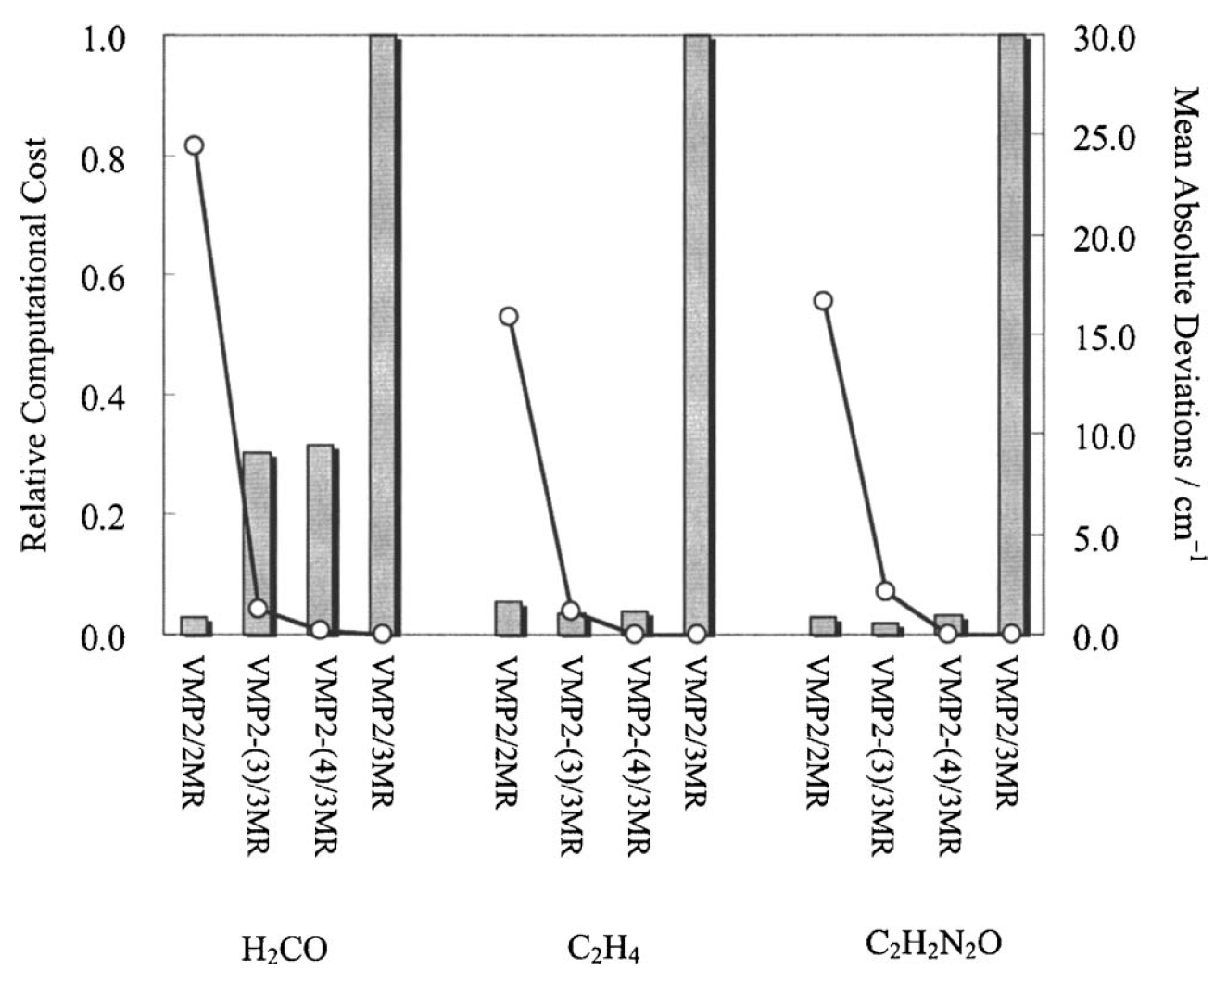
# of configurations in the VMP2 summation.
 | H₂CO | C₂H₄ | C₂H₂N₂O
VMP2 | 21,500 | 226,600 | 465,500
VMP2-(3) | 78 | 324 | 633
VMP2-(4) | 240 | 1,065 | 2,178
(n = 3, M = 11)
(bars)
(open circles)
K. Yagi, S. Hirata, and K. Hirao, JCP 127, 034111 (2007).

Slide 4
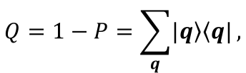



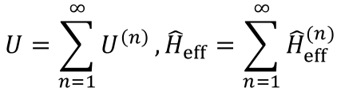

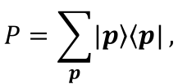
Vibrational Quasi-degenerate Perturbation Theory
B. Kirtman, J. Chem. Phys. 49, 3890 (1968).
I. Shavitt and L. T. Redmon, J. Chem. Phys. 73, 5711 (1980).
K. Yagi, S. Hirata, and K. Hirao, PCCP 10, 1781 (2008).
P and Q space
$$P=\sum_{p}{\left.|p\right\rangle \left\langle p|\right.},$$
(14)
$$Q=1−P=\sum_{q}{\left.|q\right\rangle \left\langle q|\right.},$$
(15)
Similarity transform
$${\hat{H}}_{eff}=U^{−1}\hat{H}U,$$
(16)
$${\left({\hat{H}}_{eff}\right)}_{D}≡P{\hat{H}}_{eff}P+Q{\hat{H}}_{eff}Q,$$
(17)
$${\left({\hat{H}}_{eff}\right)}_{X}≡P{\hat{H}}_{eff}Q+P{\hat{H}}_{eff}Q=0.$$
(18)
Perturbative expansion
$$U=\sum_{n=1}^{∞}{U^{\left(n\right)}},{\hat{H}}_{eff}=\sum_{n=1}^{∞}{{\hat{H}}_{eff}^{(n)}}$$
(19)
Approximate solution in the P space
$${\hat{H}}_{eff}^{(n)}Ψ_{p}^{(n)}=E_{p}^{(n)}Ψ_{p}^{(n)}$$
(20)

Slide 5
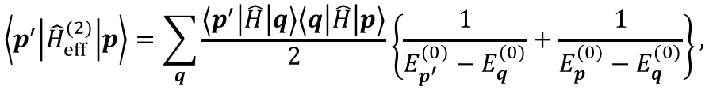
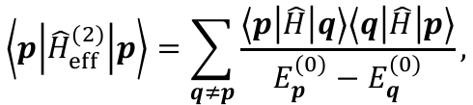

1st-order QDPT = truncated VCI
$$\left\langle p^{′} | {\hat{H}}_{eff}^{(0+1)} | p\right\rangle =\left\langle p^{′} | \hat{H} | p\right\rangle ,$$
(21)
2nd-order QDPT
$$\left\langle p^{′} | {\hat{H}}_{eff}^{(2)} | p\right\rangle =\sum_{q}{\frac{\left\langle p^{′} | \hat{H} | q\right\rangle \left\langle q | \hat{H} | p\right\rangle }{2}\left\{\frac{1}{E_{p^{′}}^{(0)}−E_{q}^{(0)}}+\frac{1}{E_{p}^{(0)}−E_{q}^{(0)}}\right\}},$$
(22)
If P space component is only one (p), QDPT2 reduces to PT2,
$$\left\langle p | {\hat{H}}_{eff}^{(2)} | p\right\rangle =\sum_{q≠p}{\frac{\left\langle p | \hat{H} | q\right\rangle \left\langle q | \hat{H} | p\right\rangle }{E_{p}^{(0)}−E_{q}^{(0)}}},$$
(23)

Slide 6
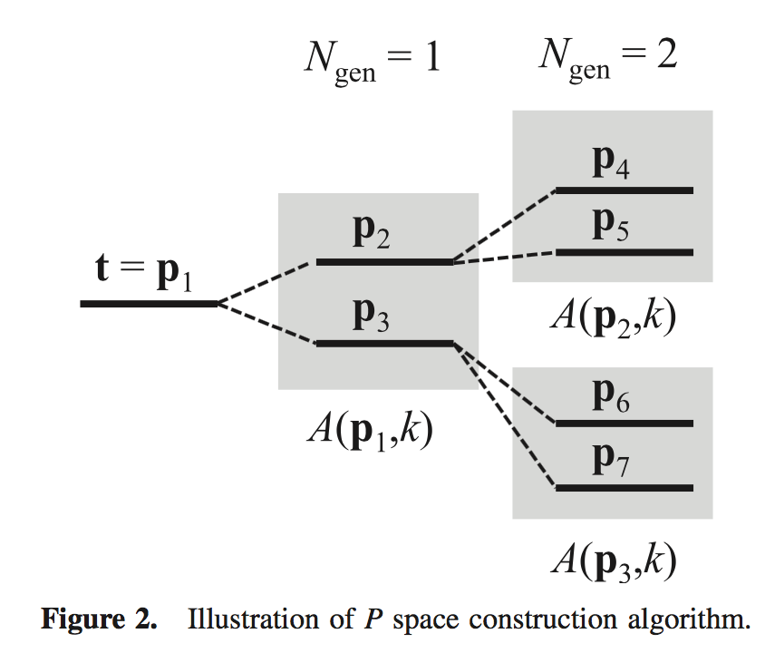



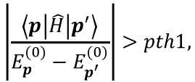

P and Q space construction based on λ_{pq}
K. Yagi and H. Otaki, JCP 140, 084113 (2014).
Target state(s): t
P space (degenerate states)
1. For p’ such that
$$λ_{pp^{′}}≤k,$$
Discard if
$$\left|\frac{\left\langle p | \hat{H} | p^{′}\right\rangle }{E_{p}^{(0)}−E_{p^{′}}^{(0)}}\right|>pth1,$$
$$\left|E_{p}^{(0)}−E_{p^{′}}^{(0)}\right|>pth0,$$
Select if
2. Pruning based on VCI in P space
if
then set
if
then discard p’
3. Repeat this procedure for N_{Gen} times.
Q space (non-degenerate states)

Slide 7
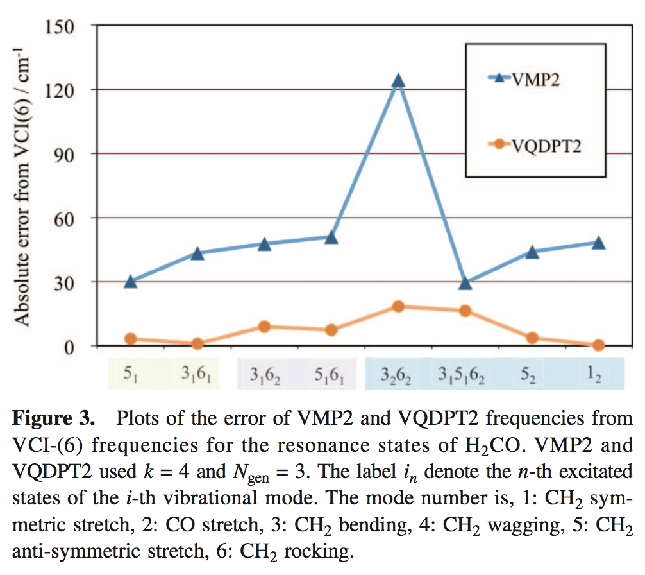
K. Yagi, S. Hirata, and K. Hirao, PCCP 10, 1781 (2008).
ν₁₂ ⇔ ν₁₃+ν₁₆ ⇔ ν₂+ν₁₃+ν₁₈
(CH str.)
(CCH bend)
(Ring deformation)
−40
+40
-31
(3079)
+22
-29
3059
+39
QFF (B3LYP/cc-pVDZ)
Multiresolution PES
Notes:
H2COに対する結果をお示しします。
H2COは４原子分子なので、変分法による高精度計算を実行できます。
グラフの縦軸は変分法からの誤差を示しており、横軸はH2COの振動状態を示しています。
ご覧のとおり、通常の摂動論は誤差が大きく、最大で120 cm-1を超え、平均誤差は54 cm-1です。
一方、私達の方法はどの振動状態も一様に精度よく計算できており、平均誤差は7 cm-1まで縮まりました。
本方法により、高精度計算である変分法とほぼ同等の精度を保ちつつ、400倍高速化を達成しました。

