Slide 1
How to Install JSindo
Kiyoshi Yagi
kiyoshi.yagi@riken.jp
Theoretical Molecular Science Laboratory
RIKEN Cluster for Pioneering Research
2022/08/28

Slide 2
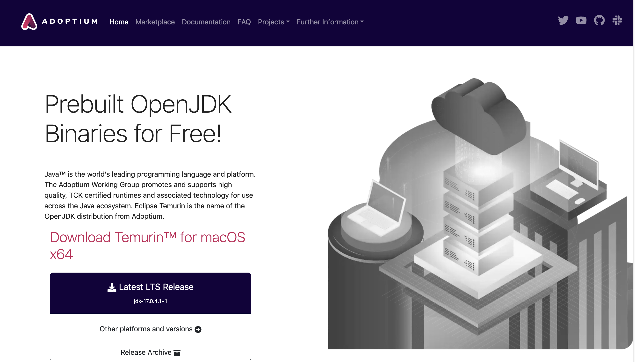
Windows/MacOS
Download OpenJDK version 11
https://adoptium.net/index.html
Click here

Slide 3
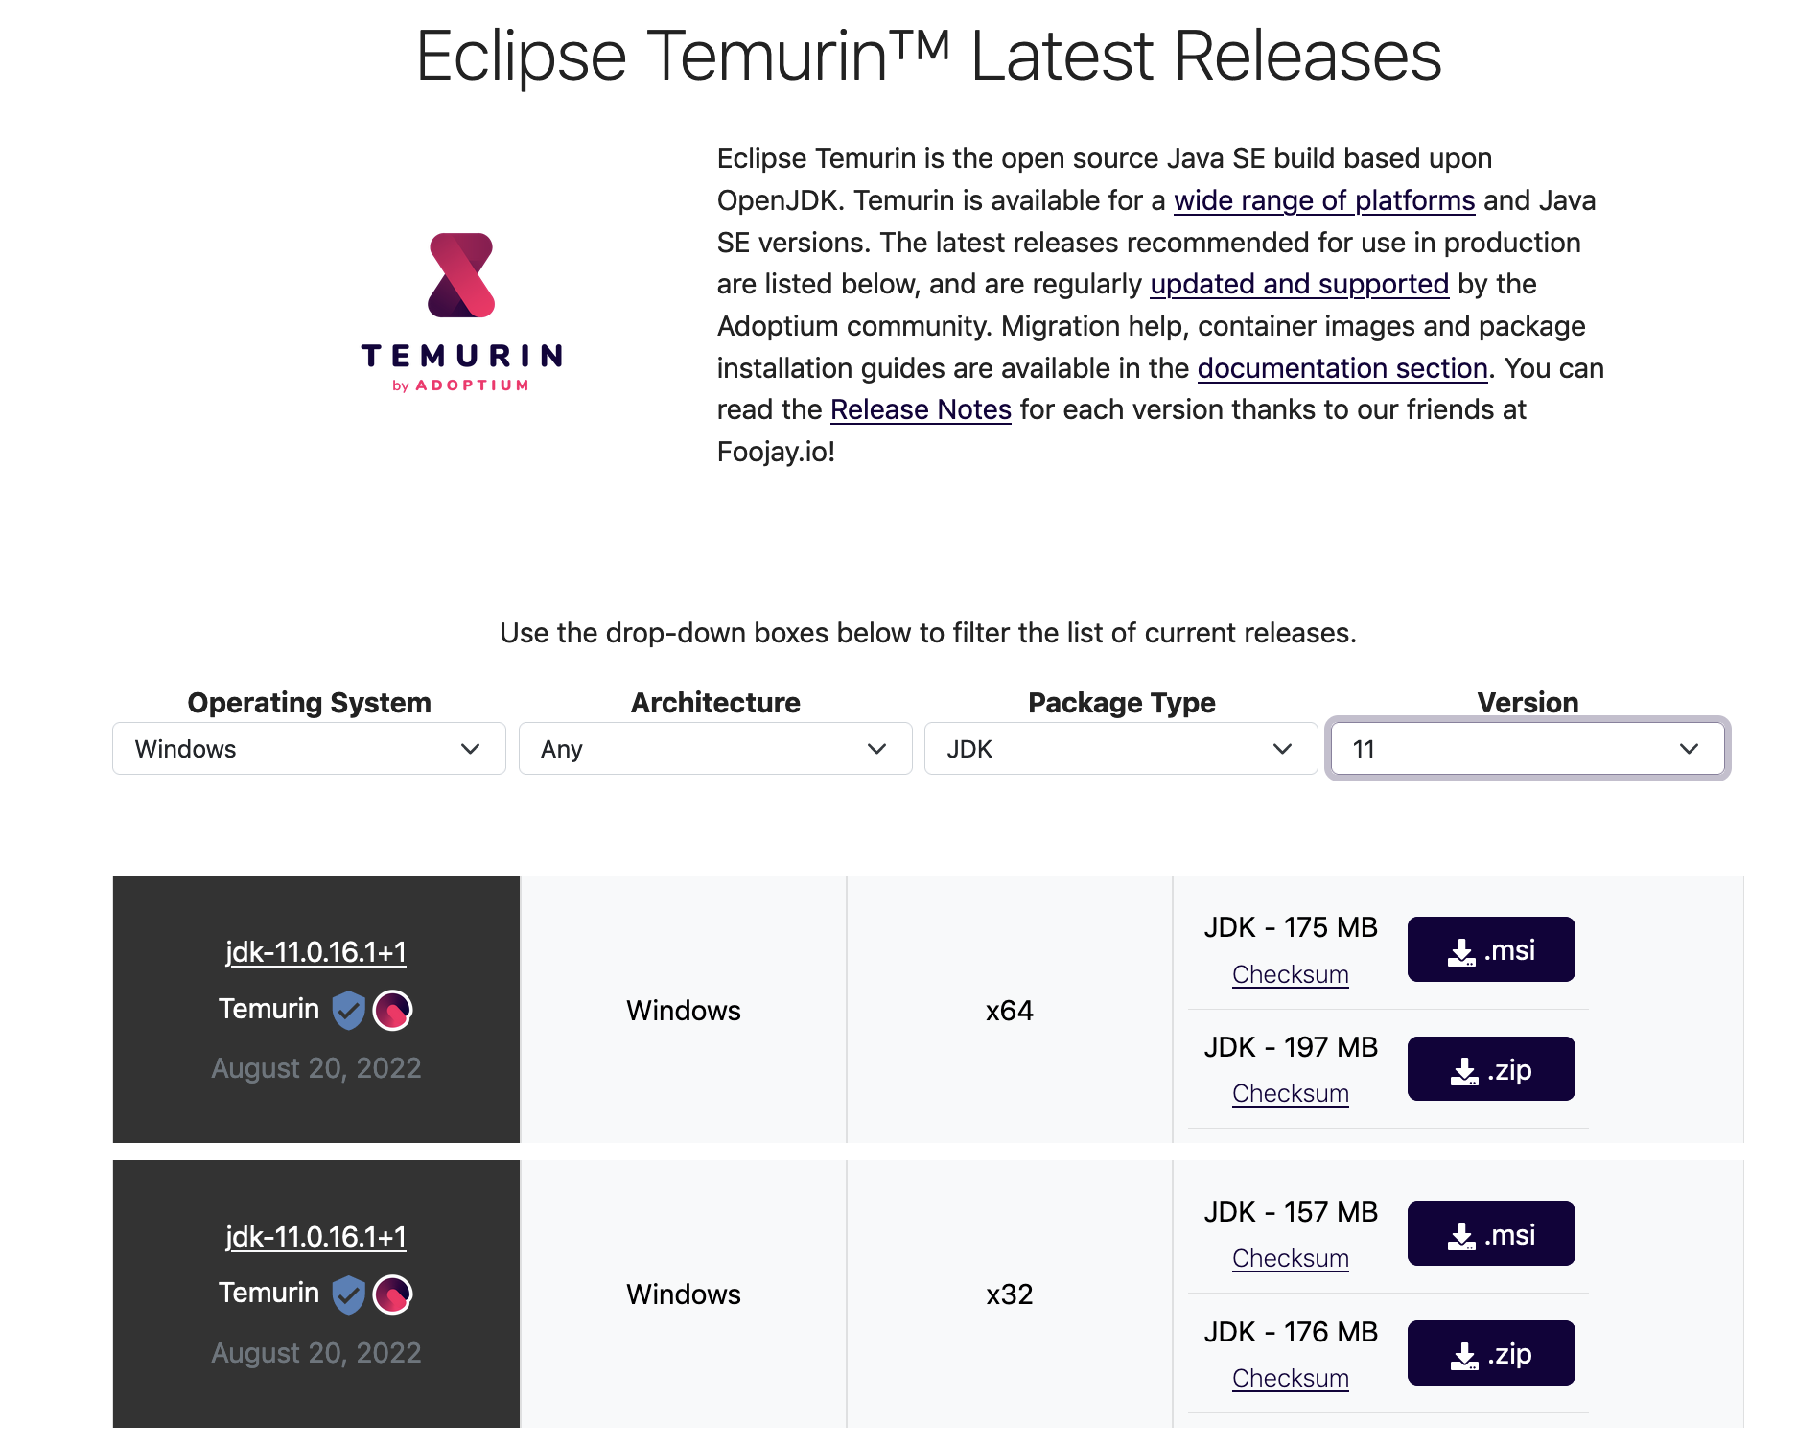
Windows
Choose Windows
Choose Version 11
Click to download
Execute (double click) the downloaded file, and follow the instruction.

Slide 4
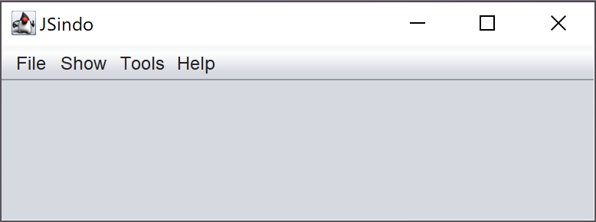
Download sindo-4.0_xxxx.zip from our website:
https://tms.riken.jp/en/research/software/sindo
Unzip (double click ) the file, and then double click a jar file,
sindo-4.0_xxxx/JSindo/jar/JSindo-4.0_fat.jar
You will see a control panel of JSindo.
You can copy this file to any place (e.g., Desktop), so that you can easily start up the program.

Slide 5
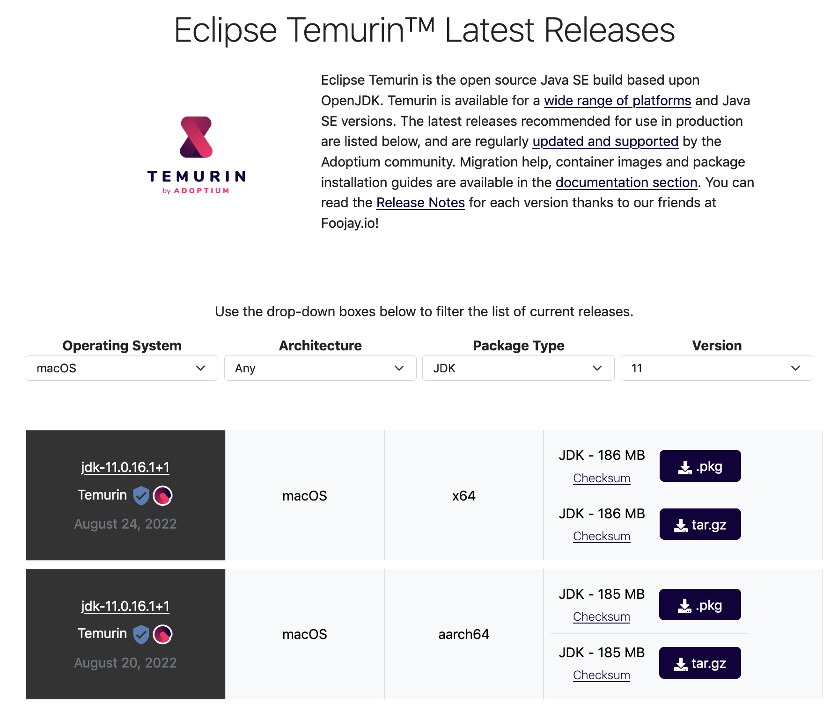
MacOS
Choose MacOS
Choose Version 11
Click to download
(Intel)
Click to download
(ARM)
Execute (double click) the downloaded file, and follow the instruction.

Slide 6
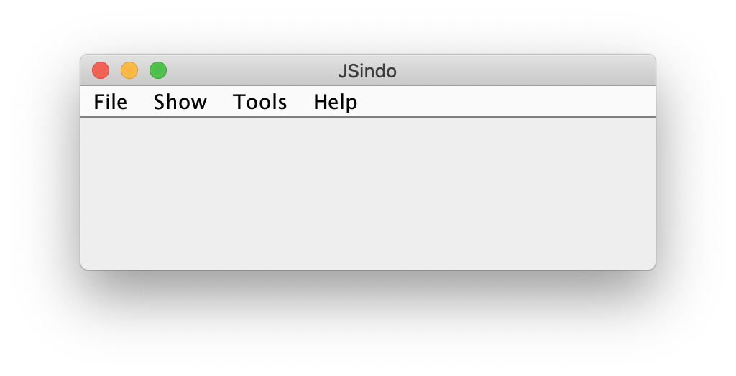
Download sindo-4.0_xxxx.zip from our website:
https://tms.riken.jp/en/research/software/sindo
Unzip (double click ) the file, open a terminal, then type the following command:
java -jar /path/to/sindo-4.0_xxxx/JSindo/jar/JSindo-4.0_fat.jar
or
java -cp /path/to/sindo-4.0_xxxx/JSindo/jar/JSindo-4.0_fat.jar JSindo
You will see a control panel of JSindo.
You may add the following line in your ~/.bashrc,
alias jsindo=‘java -jar /path/to/sindo-4.0_xxxx/JSindo/jar/JSindo-4.0_fat.jar’
After source, you can invoke the program by typing “jsindo” in the command.
> . ~/.bashrc
> jsindo

Slide 7
Linux
Download OpenJDK
Install Java 8 or Java 11 using the following command:
yum install java-1.8.0-openjdk
(CentOS)
apt install openjdk-8-jdk
(Debian, Ubuntu)
The newer version, Java 17, is also available through package tools, but currently JSindo doesn’t work with Java 17.
Alternatively, you may obtain OpenJDK from here,
https://adoptium.net/index.html
This site provides a tarball. Extract the tarball and set the environment variables:
export JAVA_HOME=/path/to/jdk-11.0.14.1+1
export PATH=${JAVA_HOME}/bin:${PATH}

Slide 8
Download sindo-4.0_xxxx.zip from our website:
https://tms.riken.jp/en/research/software/sindo
Unzip (double click ) the file, open a terminal, then type the following command:
java -jar /path/to/sindo-4.0_xxxx/JSindo/jar/JSindo-4.0_fat.jar
or
java -cp /path/to/sindo-4.0_xxxx/JSindo/jar/JSindo-4.0_fat.jar JSindo
You will see a control panel of JSindo.
You may add the following line in your ~/.bashrc,
alias jsindo=‘java -jar /path/to/sindo-4.0_xxxx/JSindo/jar/JSindo-4.0_fat.jar’
After source, you can invoke the program by typing “jsindo” in the command.
> . ~/.bashrc
> jsindo

Slide 9
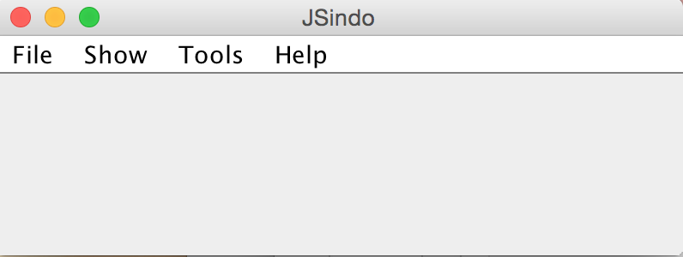
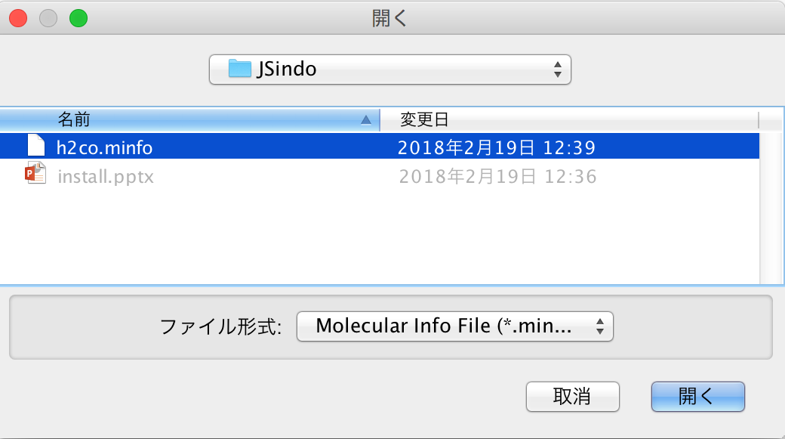
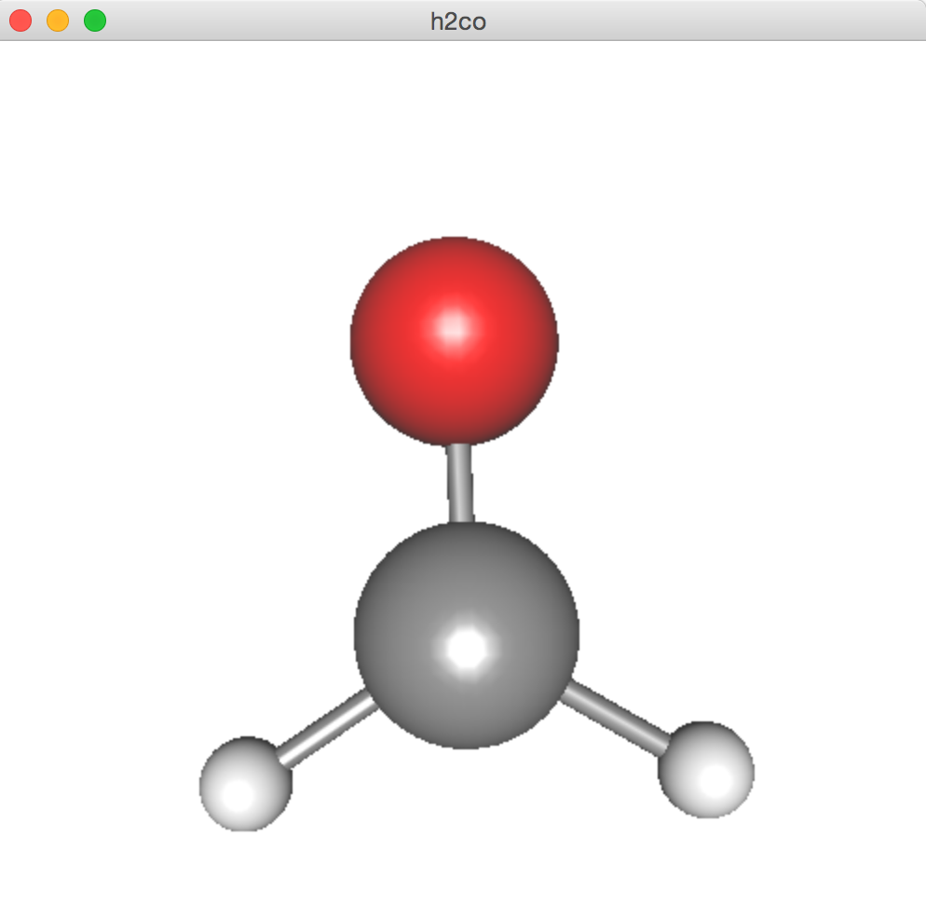
Verify installation
Open
Download doc-4.0_xxxx.zip from our website:
https://tms.riken.jp/en/research/software/sindo
Let’s test the program. Sample files are included in
doc-4.0_xxxxxx/JSindo/sample_JSindo.
In JSindo control panel, click File -> Open, choose “h2co.minfo”, and click Open.
click to choose

Slide 10
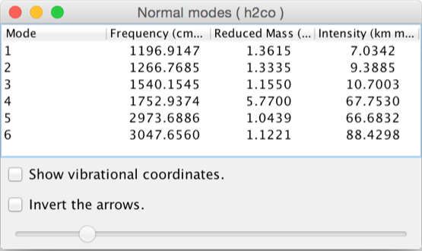
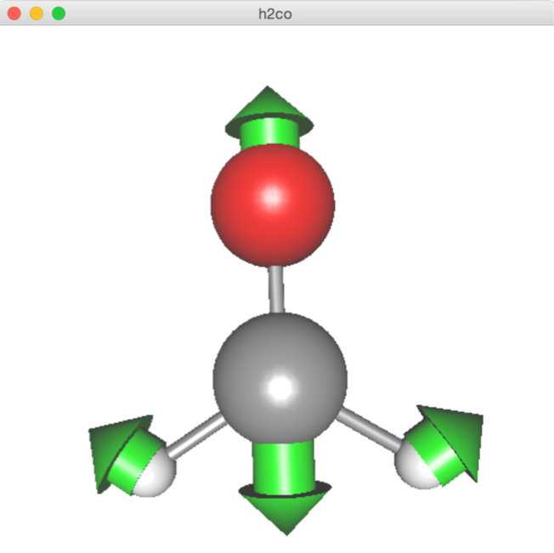
Then, goto Tools -> Harmonic Analysis. This should create a panel of “Normal modes”.
If the panel appears, you’re all set! Congratulations!
Check on ”show vibrational coordinates”, and choose a mode you want to see. Vibrational motion will be indicated by arrows. You can “Invert the arrows” by a check box, and change the magnitude using a slider.
Thanks for using JSindo!
Enjoy!
Harmonic Analysis

Slide 11
FAQ
ALL
Which version of Java should I use?
Here is a table of available combination as far as I could check.
 | Win | MacOS | Linux
Java8 | NO | YES | YES
Java11 | YES | YES | YES
Java17 | NO | YES | NO
Note that this is far from complete.
The result may also depend on the version of OS.

Slide 12
Linux
JSindo stops with the following error:
Exception in thread "main" java.awt.HeadlessException
at java.awt.GraphicsEnvironment.checkHeadless(GraphicsEnvironment.java:204)
…
Some distrubutions have a headless version of Java by default. Try the following command to install OpenJDK
yum install java-1.8.0-openjdk
(CentOS)
apt install openjdk-8-jdk
(Debian, Ubuntu)
Win
I get JSindo start up, but fonts and icons are too tiny.
This is a general issue of Java/Swing applications when using Java 8 or older with a high DPI diplay. It is fixed after Java 9, so try with a newer version.

Slide 13
Linux
I get JSindo start up, but cannot open minfo file with the following error:
Exception in thread "AWT-EventQueue-0" java.lang.InternalError: XXX0 profile[1]: GL3bc -> profileImpl GL4bc !!! not mapped
…
This error happened to me when I didn’t have the right driver installed for my GPU card (Quadro K600). It was solved after installing a NVIDIA driver.
MacOS, Linux
How can I switch the version of Java?
The version can be specified by setting a variable $JAVA_HOME and a path to it.
In MacOS, OpenJDK is installed to /Library/Java/JavaVirtualMachines, so,
export JAVA_HOME=/Library/Java/JavaVirtualMachines/temurin-11.jdk/Contents/Home/
export PATH=${JAVA_HOME}/bin:${PATH}
In Linux, OpenJDK is installed to /usr/lib/jvm, so
export JAVA_HOME=/usr/lib/jvm/java-11-openjdk-xxx
export PATH=${JAVA_HOME}/bin:${PATH}

