Slide 1
Anharmonic vibrational calculations based on a QM/MM potential
Kiyoshi Yagi
kiyoshi.yagi@riken.jp
Theoretical Molecular Science Laboratory
RIKEN Cluster for Pioneering Research
2019/11/10

Slide 2
In this guide, I will illustrate how to combine MakePES and GENESIS to generate anharmonic potential energy surface (PES) for complex systems using QM/MM, and how to calculate the vibrational spectrum using sindo.
MakePES and sindo are command line based programs. This guide assumes that you are familiar with basic commands in UNIX. Shell scripts are given for Bourne Shell (bash).
This guide also assumes that you have installed the program. Change “/path/to” to your installation directory when you see a command like this,
This sample is based on a QM/MM tutorial of GENESIS,
https://www.r-ccs.riken.jp/labs/cbrt/tutorials2019/tutorial-16-1/
where QM/MM calculations are carried out for an alanine tripeptide (Ala₃) in water solvent. It is recommended to go through this tutorial (and other GENESIS tutorials) before starting this guide.
sindo_jar=/path/to/sindo-4.0/jar
java –cp ‘$sindo_jar/*' RunMakePES

Slide 3
Contents of Sample Files
The following folders are included in this sample:
toppar Force field parameters
2_setup/snapshot50.crd, pdb, psf Setup files
4_qmm-min/qmmm_min.rst Optimized geometry
5_qmmm-vib/qmmm_vib.minfo Normal modes
6_mkqff QFF generation
7_mkgrid1 1MR-Grid generation
8_mrpes 2MR-MRPES generation
9_anharm Vibrational calculations

Slide 4
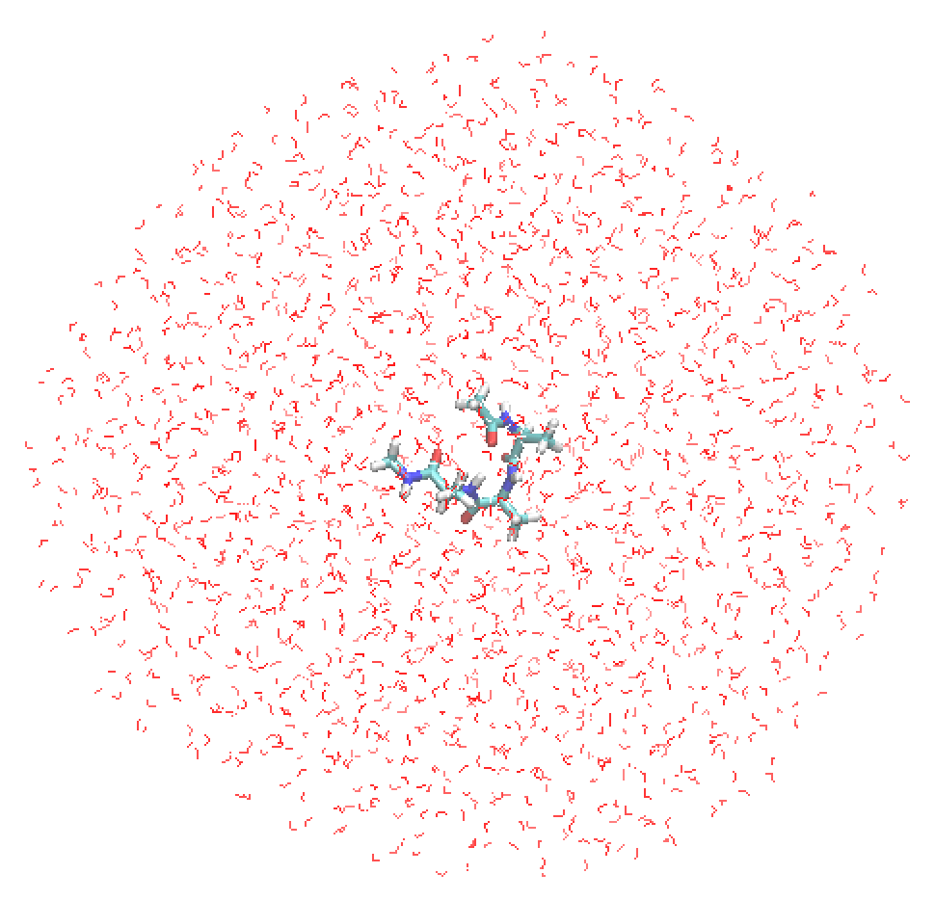
Files from the GENESIS tutorial
This sample is based on a QM/MM tutorial of GENESIS,
https://www.r-ccs.riken.jp/labs/cbrt/tutorials2019/tutorial-16-1/
where QM/MM calculations are carried out for an alanine tripeptide (Ala₃) in water solvent. The first residue is treated by QM (B3LYP-D3/cc-pVDZ) and the others by MM (CHARMM36m, TIP3P). The following files are taken from the tutorial.
2_setup/snapshot50.psf, pdb, crd
The files prepared by qmmm_generator
Ala₃ + 1999 water molecules (6039 atoms)
4_qmmm-min/qmmm_min.rst
GENESIS restart file containing the QM/MM optimized structure
5_qmmm-vib/qmmm_vib.minfo
A minfo file containing the normal modes and harmonic frequencies
toppar
CHARMM 36m force field for Ala and TIP3P for water
2_setup/ snapshot50.pdb

Slide 5
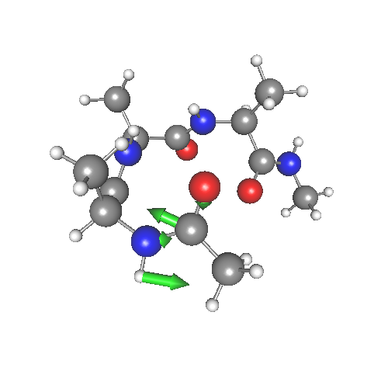
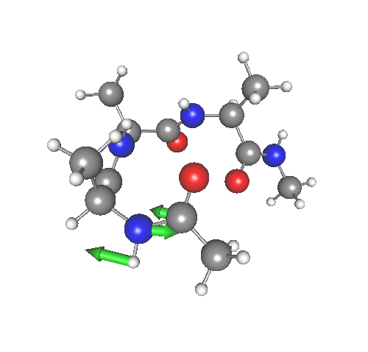
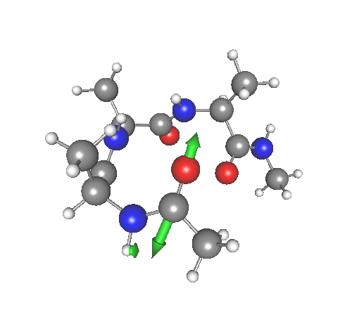
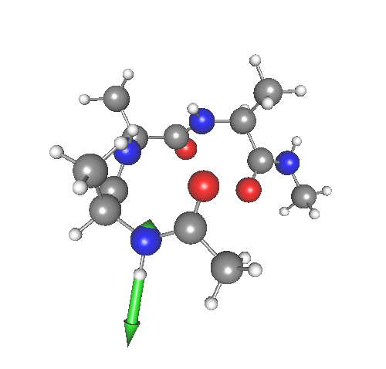
5_qmmm-vib
Before anharmonic calculations, let’s review what we‘ve got from the harmonic normal mode analysis. In the GENESIS tutorial, we obtained partial normal modes of an amide group at the c-terminal. Open 5_qmmm-vib/qmmm_vib.minfo using JSindo. The amide modes looks as follow:
Amide III
(CN str + CNH bend)
1315.0 cm⁻¹
Amide II
(CN str + CNH bend)
1576.5 cm⁻¹
Amide I
(CO str)
1704.2 cm⁻¹
Amide A
(NH str)
3487.4 cm⁻¹
We will use these modes (mode 9 -12) in the following anharmonic calculations.

Slide 6
6_mkqff
Proceed to 6_mkqff to find input files to generate quartic force field (QFF) for Ala₃,
> cd 6_mkqff
> ls
gaussian.com makePES.xml runGau.sh* script.sh*
log/ qmmm_mkqff.inp
We first run MakePES in generic mode. makePES.xml looks as follow:
makePES.xml
specify the minfo file
<makePES>
<minfoFile value="../5_qmmm-vib/qmmm_vib.minfo" />
<MR value="3" />
<activemode value="9-12" />
<qchem>
<program value=”generic" />
<title value="B3LYP-D3/cc-pVDZ" />
<xyzfile value="makeQFF" />
</qchem>
<qff>
<stepsize value="0.5" />
<ndifftype value="grad"/>
<mopfile value="prop_no_1.mop" />
</qff>
</makePES>
3MR-QFF
set the Amide modes to active
the name of xyz file
set to gradient
the name of mop file

Slide 7
Running the program creates makeQFF.xyz,
sindo_jar=/path/to/sindo-4.0/jar
java –cp ‘$sindo_jar/*' RunMakePES –f makePES.xml >& makePES.out1
makeQFF.xyz is written in the usual xyz format,
makeQFF.xyz
The number of atoms
4
mkqff-eq
CY -4.0454035711 6.0518032658 -1.0542278638
OY -3.6124748284 6.0503734927 0.1129067982
N -3.2838770225 5.8998076018 -2.1586664849
HN -3.7438296522 6.0476346883 -3.0591784947
4
mkqff8-0
CY -4.0042961166 6.0463168527 -1.0649806269
OY -3.6218945397 6.0507865924 0.0984053428
name of the first point
xyz coordinates
name of the second point
xyz coordinates
Note that the coordinates are printed only for the atoms active in the vibrational analysis, that is, the amide group.
> grep -c mkqff makeQFF.xyz
41

Slide 8
Next, we run GENESIS to caluclate the energy and gradient at the grid points. In the input file, [VIBRATION] section looks as follow:
qmmm_mkqff.inp
[VIBRATION]
runmode = QFF
nreplica = 4
vibatm_select_index = 2
gridfile = makeQFF.xyz
[SELECTION]
group1 = atomno:1-14
group2 = atomno:5-8
runmode Set to QFF.
nreplica # of MPI processes to parallelize over the grid points.
vibatm_select_index Select VIB atoms through [SELECTION] section.
Note that the VIB atoms must match with the atoms in
the gridfile.
gridfile The name of xyz file.

Slide 9
The input for GENESIS also has [QM/MM] section with the following options:
qmmm_mkqff.inp
GENESIS
qmtyp
[QMMM]
qmtyp = gaussian
qmcnt = gaussian.com
qmexe = runGau.sh
qmatm_select_index = 1
workdir = qmmm_qff
basename = job
qmsave_period = 10
qmmaxtrial = 1
exclude_charge = group
[SELECTION]
group1 = atomno:1-14
group2 = atomno:5-8
“gaussian”
calc Ene &Force
qmcnt
“gaussian.com”
generate input
“job000xx.com”
qmexe
“runGau.sh”
call system
gaussian
read output
(ene, force, etc.)
“job000xx.log”
In this sample, we use Gaussian for the QM program. qmcnt and qmexe are a template input a and an execution script file, respectively. qmatm_select_index specifies the QM region to be atomno:1-14, that is, the first residue of Ala₃.

Slide 10
The template file looks as follow. #coordinate#, #charge#, and #elec_field# are replaced by the program. Note that we need to set a “force” option to obtain the gradient.
gaussian.com
%chk=gaussian.chk
...
Charge Force Prop=(Field,Read) pop=mk
Gaussian run for QMMM in genesis
0 1
#coordinate#
#charge#
#elec_field#
The name of chk file is fixed. Don’t change!
These keys are replaced by GENESIS.
The first part of runGau.sh is as follow. Make sure that the path to Gaussian and a local scratch directory are set correctly.
runGau.sh
# --- Set the path for Gaussian ---
export g09root=/path/to/gaussian
...
# --- Set the path for a scratch folder ---
scratch=/scr/$USER

Slide 11
Now, we run GENESIS. The following command invokes 4 MPI processes using 8 thread. The number of MPI processes must match with “nreplica” in [VIBRATION] section of the input.
> export QM_NUM_THREADS=8
> export OMP_NUM_THREADS=8
> mpirun -np 4 --map-by node:pe=8 atdyn qmmm_mkqff.inp >& qmmm_mkqff.out
You will see the following message in the output if the jobs are running,
Compute energy at grid points: minfo files created in [ minfo.files ]
Done for mkqff8-0 : replicaID = 3
Done for mkqff8-2 : replicaID = 1
Done for mkqff-eq : replicaID = 2
Done for mkqff8-1 : replicaID = 4
and the results are stored in a “minfo.files” directory,
> ls minfo.files
mkqff-eq.minfo mkqff10_9-0.minfo mkqff11_10-1.minfo
mkqff10-0.minfo mkqff10_9-1.minfo mkqff11_10-2.minfo
...

Slide 12
When the GENESIS job is done, we run MakePES again,
sindo_jar=/path/to/sindo-4.0/jar
java –cp ‘$sindo_jar/*' RunMakePES –f makePES.xml >& makePES.out2
Then, it will create a mop file, where the information of QFF coefficients are included.
prop_no_1.mop
SCALING FREQUENCIES N_FRQS=12
8.2309152545488990000000e-04
1.3157446189111168000000e-03
...
DALTON_FOR_MIDAS B3LYP-D3/cc-pVDZ
-3.7152377587419910000000e-05 9
2.9957574984083245000000e-03 9 9
-4.3574279250144276000000e-05 9 9 9
8.7827684324674090000000e-06 9 9 9 9
7.7816868733945820000000e-06 10
3.5915650302996167000000e-03 10 10
...

Slide 13
7_mkgrid1
Proceed to 7_mkgrid1 to find input files to generate 1MR-Grid PES for Ala₃,
> cd 7_mkgrid1
We again run MakePES in generic mode, but now for Grid PES. makePES.xml looks as follow:
makePES.xml
<makePES>
<minfoFile value="../5_qmmm-vib/qmmm_vib.minfo" />
<MR value=”1" />
<activemode value="9-12" />
<dipole value="true" />
<qchem>
<program value=”generic" />
<title value="B3LYP-D3/cc-pVDZ" />
<xyzfile value="makeGrid" />
</qchem>
<grid>
<ngrid value="11" />
<fullmc value="true"/>
</grid>
</makePES>
1MR-Grid
calculate dipole mement surfaces
the name of a xyz file
the number of grid points in each coordinate
generate all 1MR terms

Slide 14
Running the program creates makeGrid.xyz,
sindo_jar=/path/to/sindo-4.0/jar
java –cp ‘$sindo_jar/*' RunMakePES –f makePES.xml >& makePES.out1
makeGrid.xyz is written in the usual xyz format,
makeGrid.xyz
The number of atoms
4
mkg-eq
CY -4.0454035711 6.0518032658 -1.0542278638
OY -3.6124748284 6.0503734927 0.1129067982
N -3.2838770225 5.8998076018 -2.1586664849
HN -3.7438296522 6.0476346883 -3.0591784947
4
mkg-q9-11-0
CY -3.9448692389 6.0383854347 -1.0805253292
OY -3.6355121192 6.0513837888 0.0774413538
The name of the first point
xyz coordinates
The name of the second point
xyz coordinates
Again, the coordinates are printed only for the atoms active in the vibrational analysis, that is, the amide group. You can count the number of grid points by,
> grep -c mkg makeGrid.xyz
41

Slide 15
Next, we run GENESIS to caluclate the energy at the grid points. In the input file, [VIBRATION] section looks as follow:
qmmm_mkgrid.inp
[VIBRATION]
runmode = GRID
nreplica = 4
vibatm_select_index = 2
gridfile = makeGrid.xyz
datafile = makeGrid.dat
[SELECTION]
group1 = atomno:1-14
group2 = atomno:5-8
runmode Set to GRID.
nreplica # of MPI processes to parallelize over the grid points.
vibatm_select_index Select VIB atoms through [SELECTION] section.
Note that the VIB atoms must match with the atoms in
the gridfile.
gridfile The name of xyz file.
datafile The name of dat file.

Slide 16
The [QMMM] section is the same as before. The template file looks almost the same, but now we don’t need a “force” option.
gaussian.com
%chk=gaussian.chk
...
Charge Force Prop=(Field,Read) pop=mk
Gaussian run for QMMM in genesis
0 1
#coordinate#
#charge#
#elec_field#
Save your time without the “force” option.
NOTE: In fact, we don’t use the field (the gradient for MM atoms), so “Prop=(Field, Read)” is not needed either. However, this option must be present in the input due to a restriction of the current program. This will be fixed in the near future.
Run GENESIS as before,
> export QM_NUM_THREADS=8
> export OMP_NUM_THREADS=8
> mpirun -np 4 --map-by node:pe=8 atdyn qmmm_mkgrid.inp >& qmmm_mkgrid.out

Slide 17
The results are written to makeGrid.dat,
makeGrid.dat
mkg-q9-11-2, -320.8464503280177, 1.321597380E-01, -3.002390620E-01, -2.168002760E+00
mkg-q9-11-7, -320.8542021292724, -1.709368340E-01, -2.895848650E-01, -2.172469420E+00
mkg-q10-11-0, -320.8051387191676, 3.831866730E-01, -3.561197620E-01, -2.486635390E+00
mkg-q10-11-4, -320.8577802419054, 1.532576170E-02, -3.033454440E-01, -2.225068920E+00
ID
Energy
Dipole moment (dx, dy, dz)
When the GENESIS job is done, we run MakePES again,
sindo_jar=/path/to/sindo-4.0/jar
java –cp ‘$sindo_jar/*' RunMakePES –f makePES.xml >& makePES.out2
which will create pot and dipole files,
> ls *.pot
eq.pot q10.pot q11.pot q12.pot q9.pot
> ls *.dipole
eq.dipole q10.dipole q11.dipole q12.dipole q9.dipole

Slide 18
8_mrpes
Proceed to 8_mrpes. Here, we will generate 2MR-Grid PES for Ala₃ by a multiresolution method. We first copy the QFF and 1MR-Grid files to current directory.
> cd 8_mrpes
> cp ../6_mkqff/prop_no_1.mop .
> cp ../7_mkgrid1/*pot ./
> cp ../7_mkgrid1/*dipole ./
We run MakePES in generic mode. makePES.xml looks as follow:
makePES.xml
<makePES>
<minfoFile value="../5_qmmm-vib/qmmm_vib.minfo" />
<MR value=”2" />
...
<grid>
<ngrid value="9" />
<mcstrength value="10"/>
<mopfile value="prop_no_1.mop"/>
</grid>
</makePES>
2MR-Grid
the number of grid points in each coordinate
generate all 2MR terms if mode coupling strength (MCS) is larger than 10.0. MCS is evaluated from QFF coefficients in a mopfile.

Slide 19
Running the program creates makeGrid.xyz,
sindo_jar=/path/to/sindo-4.0/jar
java –cp ‘$sindo_jar/*' RunMakePES –f makePES.xml >& makePES.out1
In the output, you will find a message,
makePES.out1
Setup MakeGrid module
o Setup MCS: Read QFF Data via ../6_mkqff/prop_no_1.mop ... [OK]
o ngrid = 9
o 1MR Grid:
12 9 10
o 2MR Grid:
(9,12) (10,12)
which detects that Q12Q9 and Q12Q10 are coupled with MCS > 10.0. The grid points are written to makeGrid.xyz. You can count the number of grid points by,
> grep -c mkg makeGrid.xyz
128

Slide 20
The input file for GENESIS is the same as before. Run GENESIS by,
> export QM_NUM_THREADS=8
> export OMP_NUM_THREADS=8
> mpirun -np 4 --map-by node:pe=8 atdyn qmmm_mrpes.inp >& qmmm_mrpes.out
When the GENESIS job is done, we run MakePES again,
sindo_jar=/path/to/sindo-4.0/jar
java –cp ‘$sindo_jar/*' RunMakePES –f makePES.xml >& makePES.out2
which will create pot and dipole files,
> ls *.pot
eq.pot q10.pot q11.pot q12.pot q12q10.pot q12q9.pot q9.pot
> ls *.dipole
eq.dipole q10.dipole q11.dipole q12.dipole q12q10.dipole q12q9.dipole q9.dipole

Slide 21
9_anharm
Finally, we perform vibrational calculations. Proceed to 9_anharm to find the input files for sindo.
> cd 9_anharm
> ls
log/ runSindo.sh vci.inp vmp2.inp vqdpt2.inp vci-IR.gpi
These input files run VCI[4]-(8), VMP2-(4), VQDPT2-(4). The calculation is invoked by a script, runSindo.sh:
runSindo.sh
> cat runSindo.sh
SINDO=/path/to/FSindo/bin/sindo
export POTDIR=../8_mrpes
${SINDO} < vmp2.inp > vmp2.out 2>&1
${SINDO} < vqdpt2.inp > vqdpt2.out 2>&1
${SINDO} < vci.inp > vci.out 2>&1
set the path to SINDO
Note that we read the information of the PES from 8_mrpes (specified by POTDIR).

Slide 22
From the output file, we obtain a table like this:
 | HARM | VSCF | VMP2 | VQDPT2 | VCI
ZPE | 4041.58 | 4016.35 | 4012.44 | 4012.44 | 4012.01
Amide III (9_1) | 1314.99 | 1316.74 | 1307.31 | 1307.31 | 1305.71
Amide II (10_1) | 1576.51 | 1572.46 | 1559.88 | 1559.88 | 1560.42
Amide I (11_1) | 1704.22 | 1698.11 | 1691.15 | 1691.15 | 1691.25
Amide A (12_1) | 3487.43 | 3305.84 | 3358.45 | 3347.85 | 3347.26
We may also plot the IR spectrum using gnuplot,
> gnuplot vci-IR.gpi
Amide I
Amide II
Amide A
Amide III

Slide 23
If we magnify the high frequency region, we see overtones and combination tones of the amide I, II, and III.
Amide A
II + III
I + III
II x 2
I + II
I x 2

