Slide 1
Users’ guide of MakePES
Kiyoshi Yagi
kiyoshi.yagi@riken.jp
Theoretical Molecular Science Laboratory
RIKEN Cluster for Pioneering Research
2019/05/14

Slide 2
Contents of Sample Files
Sample files are found in sindo-4.0/doc/MakePES/sample_MakePES
0.harmonic_h2co
Generating minfo file from Gaussian output.
1.qff_h2co
Generation of a quartic force field for H₂CO.
1-1.standard
makePES.xml、コメントアウト
QM計算用のTemplateファイル
並列計算：resources.info
QFF・・インプットとmopファイルの形式
1-2. dryrun
1-3. generic
2.grid_h2co/
3MR-Grid・・インプットとpotファイルの形式
3MR-mrpes
3.water-hexamer/
activemodeとlocal modeの使い方
QFF_normal
QFF_local

Slide 3
NOTE
MakePES is a command line based program. This manual assumes that you are familiar with the commands in UNIX, and that you are working on Bourne Shell (bash).

Slide 4
0.harmonic_h2co
Proceed to 0.harmoic_h2co and find an input file to perform harmonic vibrational analysis for formaldehyde using Gaussian.
> cd 0.harmonic_h2co
> ls
h2co-b3lyp-dz.inp log/
“log” folder contains sample output files.
h2co-b3lyp-dz.inp is the input file. Run Gaussian by the following command:
> runGaussian.sh ./ h2co-b3lyp-dz.inp
review the installation if you cannot run Gaussian with this command.
the two arguments are (working folder) and (input file), respectively.
You will obtain the following output files when the job ends.
> ls h2co-b3lyp-dz.*
h2co-b3lyp-dz.chk h2co-b3lyp-dz.fchk h2co-b3lyp-dz.inp h2co-b3lyp-dz.out
.fchk is a formatted check point file, which archives the result of quantum chemistry calculations.

Slide 5
Let us convert the fchk file to minfo file,
> java -cp "/path/to/sindo-4.0/jar/*" Fchk2Minfo h2co-b3lyp-dz
the argument after Fchk2Minfo is the basename of output files.
You will find a minfo file,
> ls h2co-b3lyp-dz.*
h2co-b3lyp-dz.chk h2co-b3lyp-dz.fchk h2co-b3lyp-dz.inp h2co-b3lyp-dz.out
h2co-b3lyp-dz.minfo
Minfo file includes the equilibrium geometry, harmonic frequencies, and vibrational displacement vectors. The same result can be obatined by JSindo; refer to the usage manual of JSindo. You can find details about the format of minfo file therein, too.

Slide 6
1.qff_h2co
1-1.standard
Proceed to 1.qff_h2co/1-1.standard to find input files to generate quartic force field (QFF) for formaldehyde,
> cd 1.qff_h2co/1-1.standard
> ls
GaussianTemplate makePES.xml resources.info log/
makePES.xml
makePES.xml is the main file. The input options are specified in xml format (like in html tags). The section is specified by
<makePES> … </makePES>, <qchem> … </qchem>
and so on. The options is specified in each section by,
<key value=“value” />
Comment out is possible by
<!-- … -->

Slide 7
<makePES>
<minfoFile value="../../0.harmonic_h2co/h2co-b3lyp-dz.minfo" />
<MR value="3" />
<qchem>
<program value="gaussian" />
<dryrun value="false"/>
<removefiles value="true" />
<title value="B3LYP/cc-pVDZ" />
<template value="GaussianTemplate" />
</qchem>
<qff>
<stepsize value="0.5" />
<ndifftype value="hess"/>
<mopfile value="prop_no_1.mop" />
</qff>
</makePES>

Slide 8
<key value=“value” />
key and value are case insensitive unless noted.
<makePES>
<qchem>
id: ID of this qchem (default = the number it appears in the file)
<template>
xml: yes or no (default no)
<xyzfile>
xml: yes or no (default no)
<qff>

Slide 9
1. Basic Usage
1.1. Preparing an input file
This section lists the keys and values used in RunMakePES program. They appear in makePES.xml in the form of,
<entry key=‘‘key’’> key value </entry>
The keys in red indicate that they are mandatory. The values are case insensitive except when it is noted.
In the following, the keys are divided into four sections. General Keys (Sec. 1.1) are common input for all types of run, while those in QFF Keys (Sec. 1.2), Grid Keys (Sec. 1.3), and Hybrid Keys (Sec. 1.4) are relevant input parameters for generating the QFF, grid potential, and hybrid potential, respectively.

Slide 10
List of all keys
General keys
runtype: QFF/GRID/HYBRID
The type of run. One of the following must be specified.
molecule: file name
The name of minfo file containing the vibrational data. The value is case sensitive.
MR: 1/2/3
The order of mode coupling expansion. Can take 1, 2, or 3. (default = 3)
activemode: string of mode index
Specifies active modes for PES generation. All modes are active by default. The mode numbers should be separated by camma or space. A hyphen can be used for a sequence of mode number. For example,
<entry key="activemode"> 1,2,3,5 </entry>
is equivalnet to,
<entry key="activemode"> 1-3 5 </entry>
which means Q₁,Q₂,Q₃, and Q₅ are active, and Q₄ isn’t.
dipole: true/false
Generates the dipole moment surface in addition to the PES, when true. (default = false)

Slide 11
interdomain: true / false
Calculates inter-domain coupling terms, when true. (default = false)
QFF計算では、実行された量子化学計算の情報から、Gradientで数値微分の場合はtiij, uiiij、Hessianで数値微分の場合は3MRまでドメイン間カップリングが計算可能だが、interdomain = falseではこれらは出力されない。出力したい場合は、interdomain=trueで再計算する。
Hessianの場合、minfo.filesからデータを読み込めば、追加の量子化学計算なく3MRまで計算できため、実は計算負荷の軽減にはならない。4MRは追加計算が必要となる。

Slide 12
removefiles: true/false
Removes the input/output files of the quantum chemistry program, when true. (default = false)
dryrun: true/false
Generates the input files for the quantum chemistry program and exits without execution, when true. (default = false)
xyzfile: filename
Name of a xyz file, where the coordinates are written. (default = makeQFF for QFF and makeGrid for GRID)
qchem: command lines (see below)
In each line after the entry tag of this key follows the type of the quantum chemistry program, a template file to generate input files for the program, and a label. The three components may be separated by space or camma. For example, the input looks like,
<entry key="qchem">
Gaussian GaussianInput.xml MP2/aug-cc-pVTZ (11)
</entry>
The first value (Gaussian) specifies the quantum chemistry program, which may take one of the following:
Gaussian : Gaussian03/09/16
Generic : Generic (see below)
The second value (GaussianInput.xml) is the name of the XML file, which contains the information to generate the input files for the program. This value is case sensitive.

Slide 13
The third value (MP2/aug-cc-pVTZ (11)) is a label that is tagged to the PES data files. This name will be printed in the output of SINDO, so it is recommended to give a name, for example, the level of the electronic structure calculation, the number of grid points, etc.
This key extends to two lines when the hybrid PES is specified for the runtyp. The first and the second lines specify the quantum chemistry calculations for the QFF and Grid PES generation, respectively. In this case, the input would look like,
<entry key="qchem">
Gaussian, MP2Input.xml, MP2/cc-pVDZ
Gaussian, CCInput.xml, CCSD(T)/aug-cc-pVTZ (11)
</entry>
When the first value is specified as “generic”, MakePES creates a file (ending with .xyz), which contains the xyz coordinates of all grid points. This option is intended for users who want to create input files in their own way for the electronic structure calculation. In this case, the work flow is the following,
Execute RunMakePES with qchem = generic to create a xyz file.
Get the grid ID and xyz coordinates from the xyz file, and create by yourself input files for the electronic structure program.
Run the electronic structure calculations.
Convert by yourself the output information to a minfo format, and save as (grid ID).minfo. Note that only the [ Electronic Data ] section is needed.
Place the minfo files to minfo.files folder.
Re-run RunMakePES.
Then, one should obtain the mop file and pot files for QFF and Grid, respectively.

Slide 14
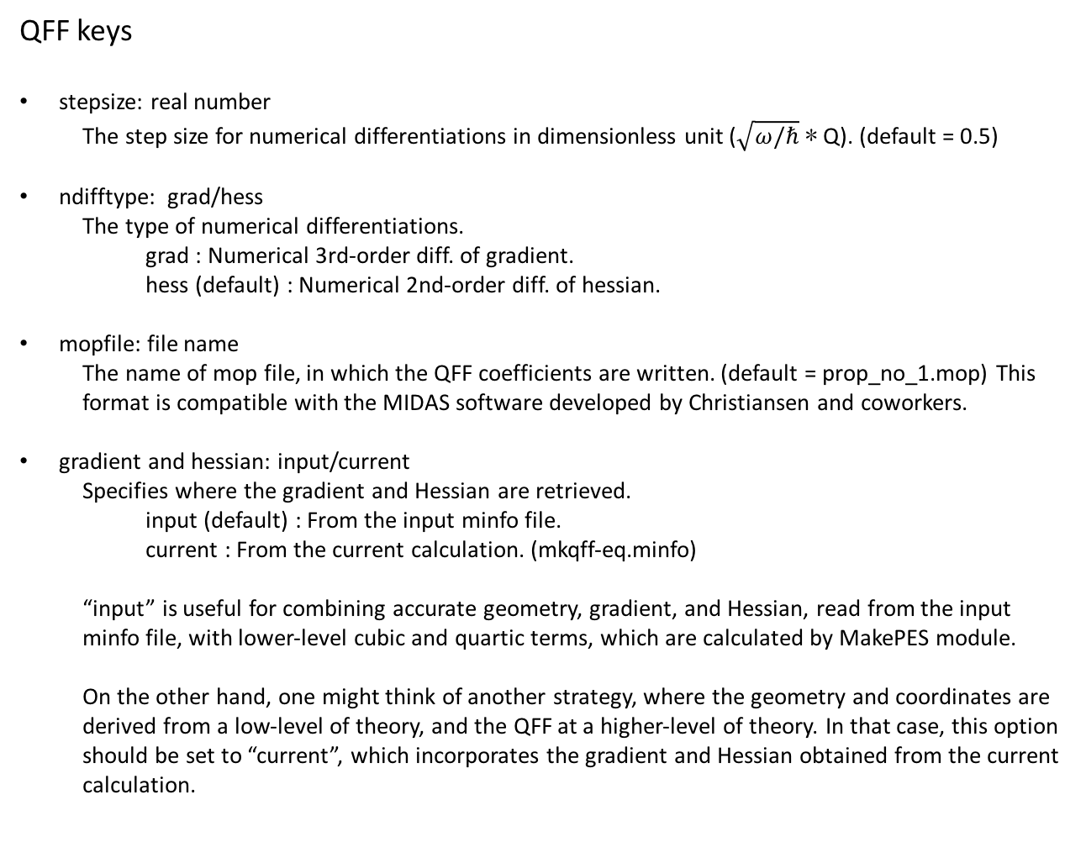
QFF keys
stepsize: real number
The step size for numerical differentiations in dimensionless unit ($\sqrt{ω/ℏ}$ ∗ Q). (default = 0.5)
ndifftype: grad/hess
The type of numerical differentiations.
grad : Numerical 3rd-order diff. of gradient.
hess (default) : Numerical 2nd-order diff. of hessian.
mopfile: file name
The name of mop file, in which the QFF coefficients are written. (default = prop_no_1.mop) This format is compatible with the MIDAS software developed by Christiansen and coworkers.
gradient and hessian: input/current
Specifies where the gradient and Hessian are retrieved.
input (default) : From the input minfo file. current : From the current calculation. (mkqff-eq.minfo)
“input” is useful for combining accurate geometry, gradient, and Hessian, read from the input minfo file, with lower-level cubic and quartic terms, which are calculated by MakePES module.
On the other hand, one might think of another strategy, where the geometry and coordinates are derived from a low-level of theory, and the QFF at a higher-level of theory. In that case, this option should be set to “current”, which incorporates the gradient and Hessian obtained from the current calculation.

Slide 15
interdomain_hc: true/false
Prints the harmonic coupling, when true. (default = true)
genhs: true/false
Generate the 001.hs file, when true. (default = false) 001.hs is a file which contains the QFF coefficients in the old format; however, this format is deprecated and not recommended to use unless for a debugging purpose to compare the result with the previous version of SINDO.

Slide 16
GRID keys
ngrid: integer number
The number of grid points along each coordinates. (default = 11)
fullmc: true/false
All the mode coupling up to the MR-th order is generated, when true. (default = false)
mc1, mc2, mc3: string of mode index
The 1, 2, or 3MR terms separated by camma or space. For example,
mc1:
<entry key="mc1"> 1,2,3,5 </entry>
or
<entry key="mc1"> 1-3 5 </entry>
generates grid points for Q1,Q2,Q3, and Q5.
mc2:
<entry key="mc2"> 1,2, 1,4, 2,4, 3,4 </entry>
or
<entry key="mc2"> 1,2, 1-3,4 </entry>
generates the grid points for (Q2, Q1),(Q4, Q1),(Q4, Q2), and (Q4, Q3).
mc3:
<entry key="mc3"> 1,2,3, 1,2,4 </entry>
generates the grid points for (Q3, Q2, Q1) and (Q4, Q2, Q1).
NOTE: One of fullmc, mc1, mc2, or mc3 must be present in the input file.

Slide 17
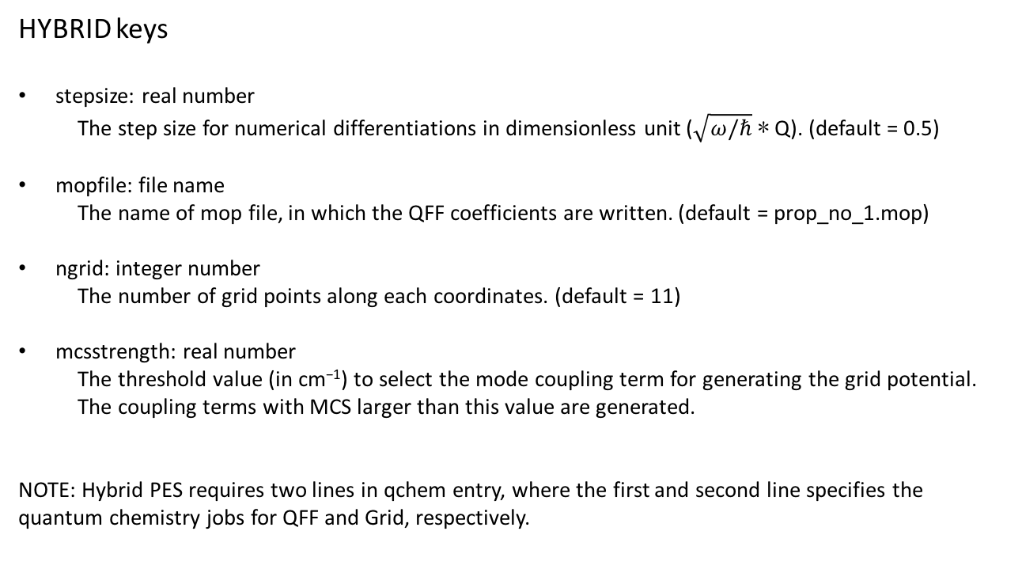
HYBRID keys
stepsize: real number
The step size for numerical differentiations in dimensionless unit ($\sqrt{ω/ℏ}$ ∗ Q). (default = 0.5)
mopfile: file name
The name of mop file, in which the QFF coefficients are written. (default = prop_no_1.mop)
ngrid: integer number
The number of grid points along each coordinates. (default = 11)
mcsstrength: real number
The threshold value (in cm⁻¹) to select the mode coupling term for generating the grid potential. The coupling terms with MCS larger than this value are generated.
NOTE: Hybrid PES requires two lines in qchem entry, where the first and second line specifies the quantum chemistry jobs for QFF and Grid, respectively.

