Slide 1
Users’ guide to FSindo
Kiyoshi Yagi
kiyoshi.yagi@riken.jp
Theoretical Molecular Science Laboratory
RIKEN Cluster for Pioneering Research
2022/03/15

Slide 2
In this guide, I will illustrate how to use “sindo” to perform VSCF, VCI, VMP2, and VQDPT2 calculations.
“sindo” is a command line based program. This guide assumes that you are familiar with basic commands in UNIX. Shell scripts are given for Bourne Shell (bash).
This sample also assumes that you have sourced “sindovars.sh” and setup the path to “sindo”,
where “/path/to/sindo” indicates your installation directory, for example,
In this guide, we will use the potential energy surface (PES) that are already pre-computed. To see how to generate the PES data, look into the usage of the MakePES program.
. /path/to/sindo/sindovars.sh
sindo < vci.inp > vci.out
/path/to/sindo -> /home/yagi/pgm/sindo-4.0_220312

Slide 3
Contents
1. Basic usage (1.water)
1.1. VSCF
1.2. VCI
1.3. VMP2
1.4. VQDPT2
1.5. Summary
2. Infrared spectrum of H₂CO (2.h2co)
3. Optimized coordinate VSCF (3.ethylene)
4. References
Appendix: List of all options
Sample files are found in sindo-4.0/doc/FSindo/sample_FSindo

Slide 4
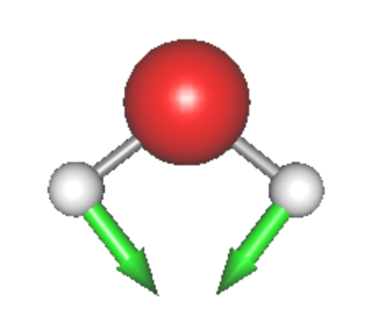
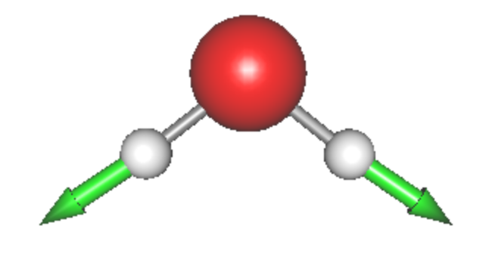

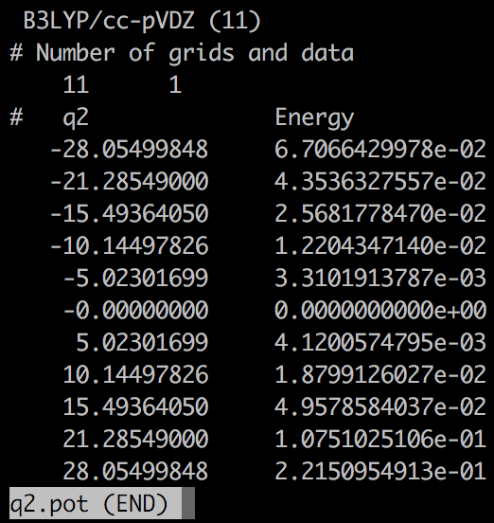
1. Basic usage
In this section, I will demonstrate the basic usage of sindo with a water molecule as an example. Proceed to 1.water,
> cd 1.water
> ls
h2o.minfo q0.pot q2.pot q3.pot q3q2.pot …
h2o.minfo includes the equilibrium geometry, harmonic frequencies, and vibrational displacement vectors. They can be visualized by JSindo.
Q1
HOH bending
Q2
Sym. OH stretching
Q3
Asym. OH stretching
*.pot includes the information of the grid potential.
eq. q0.pot
1MR q1.pot, q2.pot, q3.pot
2MR q2q1.pot, q3q1.pot, q3q2.pot
3MR q3q2q1.pot

Slide 5
1-1. Vibrational self-consistent field method
vscf.inp is an input file to carry out VSCF calculations.
#--- [ INPUT PARAMETER ]
&mol minfofile='h2o.minfo' /
&sys maxmem=10 /
#--- [ VIB ]
&vib MR=3 vmaxAll=10 vscf=.t. /
#--- [ TARGET STATES ]
&states fund=.t. /
#--- [ VSCF ]
&vscf Maxitr=20 Ethresh=1.D-03 /
input minfo file
max memory in MB
MR : Mode coupling order of the PES
vmaxAll : Max num of quanta of harmonic oscillator basis sets
for all modes.
vscf : true invokes VSCF.
Targets all fundamental levels.
Maxitr : Max iteration for VSCF
Ethresh : Threshold of convergence in cm⁻¹.

Slide 6
The options are given in a free format using the namelist of Fortran, that is, you can put space and new lines as you like as long as the options are defined in a section between &name … /. For example,
#--- [ VIB ]
&vib MR=3 vmaxAll=10 vscf=.t. /
and
#--- [ VIB ]
&vib
MR=3
vmaxAll=10
vscf=.t.
/
are the same, but
#--- [ VIB ]
&vib MR=3 vmaxAll=10 /
vscf=.t.
is different because “vscf = .t.” is out of &vib … /.

Slide 7
Run the job by,
> sindo < vscf.inp > vscf.out
The output, vscf.out, looks as follow:
>> BASIS FUNCTIONS
MODE : 1 2 3
MAXV : 10 10 10
FREQ : 1659.40 3752.61 3853.49
Setting of HO basis sets. Frequencies are taken from the minfo file.
>> POTENTIAL
[ OPTIONS ]
MR = 3
MCS_CUTOFF = 0.10E-03
MCS_GRID = -.10E+01
POTDIR = ./
1MR-PEF
o GRID PEF
MODE= 1, GRID= 11 B3LYP/cc-pVDZ (11)
MODE= 2, GRID= 11 B3LYP/cc-pVDZ (11)
MODE= 3, GRID= 11 B3LYP/cc-pVDZ (11)
The information of the PES is printed. pot files in the current directory are read by the program. It’s a good practice to check if the PES is specified in the way you intended.
1MR grid PES with 11 grid points.

Slide 8
2MR-PEF
o GRID PEF
MODE= 2 1, GRID= 11 11 B3LYP/cc-pVDZ (11)
MODE= 3 1, GRID= 11 11 B3LYP/cc-pVDZ (11)
MODE= 3 2, GRID= 11 11 B3LYP/cc-pVDZ (11)
3MR-PEF
o GRID PEF
MODE= 3 2 1, GRID= 11 11 11 B3LYP/cc-pVDZ (11)
2MR grid PES with 11 grid points.
3MR grid PES with 11 grid points.
o INITIAL GUESS FROM (CONTRACTED) HARMONIC OSCILLATOR
-- (ITERATION) -------- (EOLD) -------- (ENEW) ----- (DELTA E) --
1 4687.67 4589.42 -0.983D+02
2 4589.42 4586.72 -0.270D+01
3 4586.72 4586.64 -0.809D-01
4 4586.64 4586.64 -0.254D-02
5 4586.64 4586.64 -0.800D-04
--------------------------------------------------------------------------------
E(VSCF)= 4586.63552176
VSCF iteration
Zero-point Energy

Slide 9
>> VIRTUAL VSCF ENERGIES
o VSCF STATES TOTAL ENERGY E-E0
1_1 6184.36878830 1597.73326654
2_1 8220.27988057 3633.64435881
3_1 8388.85466071 3802.21913894
Virtual VSCF energies for the fundamental levels.
“m_1” means the 1st excited state of mode m, that is, the fundamental excitation of mode m. The virtual states are specified by the &state group.
VSCF calculations with the grid PES correspond to the direct VSCF method. See Ref. [1] for more details.

Slide 10
1-2. Vibrational configuration interaction method
vci.inp is an input file to carry out VCI calculations.
#--- [ VIB ]
&vib MR=3 vmaxAll=10 vscf=.t. vci=.t. /
#--- [ VCI ]
&vci nstate=20 nCUP=3 maxSum=8 /
vscf = .t. and vci = .t. invokes VSCF/VCI.
nstate : Number of states to obtain.
nCUP : Max number of modes to excite.
maxSum : Max sum of quantum numbers to excite.
The level of VCI calculations is classified as VCI[n]-(m), where n is the maximum number of modes that are excited simultaneously, and m is the maximum number of quantum numbers excited. n and m are specified by nCUP and maxSum, respectively, in &vci group. In this example, nCUP=3 and maxSum=8, so that we carry out VCI[3]-(8).
Run the job by,
> sindo < vci.inp > vci.out

Slide 11
The output, vci.out, looks as follow:
o VCI SPACE SELECTION
- MAX NUM. OF MODES TO EXCITE : 3
- MAX SUM OF QUANTUM NUM. : 8
- MAX EXCITATION OF EACH MODE : 8 8 8
o VCI DIMENSION : 165
o NUM_OF_STATES : 20
VCI[3]-(8)
Dimension of VCI matrix
> STATE 00000: ZERO-POINT STATE
E(VCI) = 4567.81121
COEFF. WEIGHT CONFIG.
0.999 0.998 0_0
0.039 0.001 2_1 3_2
> STATE 00001: 1_1
E(VCI) = 6158.00730
E(VCI)-E0= 1590.19608
COEFF. WEIGHT CONFIG.
-0.998 0.996 1_1
-0.038 0.001 1_1 2_1 3_2
Zero-point energy
CI coeff.
1st excitation of the 1st mode
Total energy and excitation energy
CI coeff.

Slide 12
1-3. Vibrational Møller-Plesset perturbation method
vmp2.inp is an input file to carry out VMP2 calculations.
#--- [ VIB ]
&vib MR=3 vmaxAll=10 vscf=.t. vpt=.t. /
#--- [ TARGET STATES ]
&states fund=.t.
nstate=3
target_state(2,1)=2
target_state(2,2)=1, target_state(3,2)=1
target_state(3,3)=2
/
#--- [ VPT ]
&vpt maxSum=4 /
vscf = .t. and vpt = .t. invokes VMP2.
All fundamental levels
+
(020), (011), (002)
maxSum : Max quantum numbers for excitation.
The level of excitation is controled by selecting VSCF configurations according to the maximum difference in quantum numbers (n) with respect to target states. The method is designated as VMP2-(n). See Ref. [2] for more details. In the input, n is specified by maxSum.

Slide 13
Note that &vpt also has nCUP, which restricts the number of modes to excite simultaneously. The default is nCUP = MR. Usually, you don‘t need to change this number.
VMP2 is a state-specific approach, where we specify the states of interest in the input. In &state, “nstate” specifies the number of state, and an array,
target_state(i,ns) = mi
specifies the quantum number (mi) of the i-th mode for the ns-th state. In addition, fund = .t. specifies all the fundamental excitations. In the example, we specify the fundamentals and overtone / combination states of OH stretching modes.
Run the job by,
> sindo < vmp2.inp > vmp2.out

Slide 14
The output, vmp2.out, looks as follow:
>> VPT OPTIONS
o VPT WITH ZERO-POINT VSCF REFERENCE (VMP)
READ VSCF WFN : vscf-000.wfn
o VPT LEVEL:
NCUP = 3
MAXSUM = 4
VMP2-(4)
o STATE 000: ZERO-POINT STATE
…
E(VMP2) = 4567.73900
VMP2 energy for the zero-point state.
o STATE 001: 1_1
…
E(VMP2) = 6159.84114
…
E(VMP2)-E0 = 1592.10214
VMP2 total energy and excitation energy for the fundamental of mode 1.

Slide 15
1-4. Vibrational quasi-degenerate perturbation theory
vqdpt2.inp is an input file to carry out VQDPT2 calculations.
#--- [ VIB ]
&vib MR=3 vmaxAll=10 vscf=.t. vqdpt=.t. /
&states
fund=.t.
nstate=3
target_state(2,1)=2
target_state(2,2)=1, target_state(3,2)=1
target_state(3,3)=2
/
#--- [ VPT ]
&vqdpt nGen=3 maxSum=4 /
vscf = .t. and vqdpt = .t. invokes VQDPT2.
All fundamental levels
+
(020), (011), (002)
nGen : The number of iteration for generating the P space.
maxSum : Max quantum numbers for excitation.
The level of excitation is controled by maxSum. nGen is the number of iteration to find VSCF configurations that are quasi-degereate to target states (P space). See Ref. [3] and [4] for more details.

Slide 16
Run the job by,
> sindo < vqdpt2.inp > vqdpt2.out
The output, vqdpt2.out, looks as follow:
o P-SPACE CONSTRUCTION
NGEN = 3
THRESH_P0 = 0.50E+03
THRESH_P1 = 0.10E+00
THRESH_P2 = 0.50E-01
THRESH_P3 = 0.90E+00
P SET = 0
o Q-SPACE CONSTRUCTION
NCUP = 3
MAXSUM = 4
Parameters for the P space.
Parameters for the Q space.
o STATE 000: ZERO-POINT STATE
…
E(VMP2) = 4567.73900
VQDPT2 energy for the zero-point state. Note that VQDPT2 coinsides with VMP2 if no degerate state exists. This is usually the case for the zero-point state.

Slide 17
o GROUP 002: 2_1
--- P-SPACE COMPONENTS --------------------
* 1) 2_1
2) 1_2
--------------------------------------------------------
...
> STATE 002: 2_1
E(VQDPT2) = 8149.29727
E(VQDPT2)-E0= 3581.55827
COEFF. WEIGHT CONFIG.
-0.987 0.975 2_1
0.159 0.025 1_2
P space components, that is, quasi-degenerate VSCF configurations. “*” indicates the target states.
Total energy and excitation energy
CI coeff.

Slide 18
1-5. Summary
The results are summarized in a Table:
 | Harm | VCI[3]-(8) | VMP2-(4) | VQDPT2-(4) | Exp.
1 | 1659.4 | 1590.2 | 1592.1 | 1592.1 | 1595
2 | 3752.6 | 3577.7 | 3581.7 | 3581.6 | 3652
3 | 3853.5 | 3657.8 | 3656.6 | 3656.6 | 3756
2x2 | 7505.2 | 7047.2 | 7062.2 | 7062.3 | 7201
2+3 | 7606.1 | 7083.9 | 7099.7 | 7092.1 | 7249
3x2 | 7707.0 | 7254.9 | 7245.8 | 7245.8 | 7445
Harmonic frequencies are significantly higher than the anharmonic ones. VCI, VMP2, VQDPT2 methods give similar numbers.
The agreement with experiment is worse compared to the reported data in Ref. [1]. Can you tell where the error comes from?

Slide 19
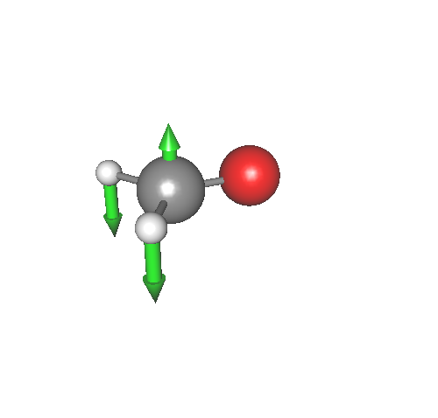
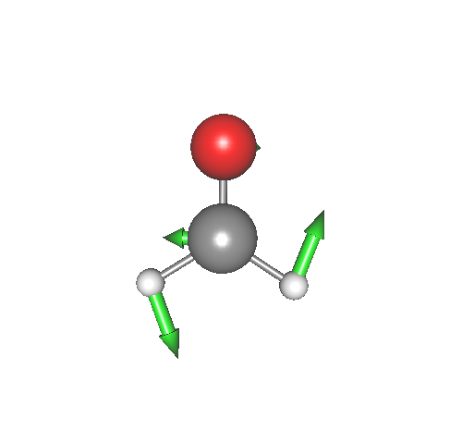
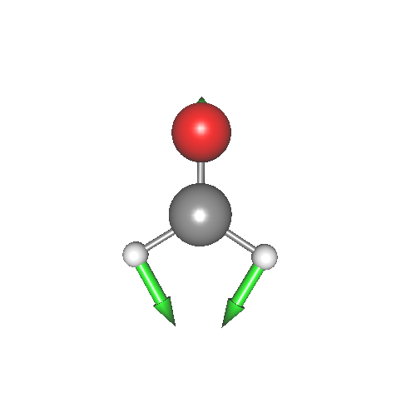
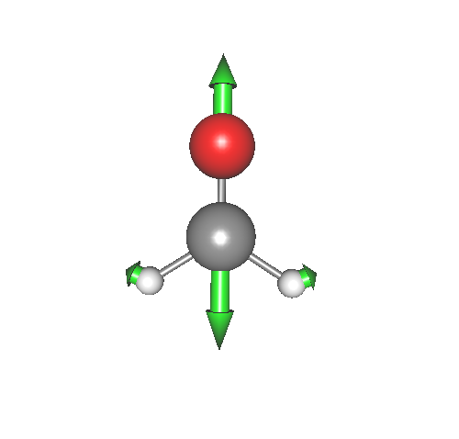
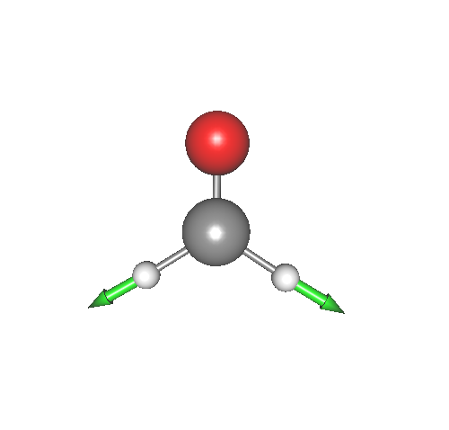
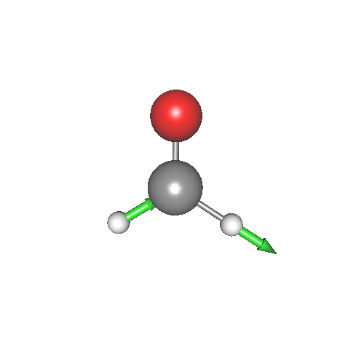
2. Infrared spectrum of H₂CO
In this section, we will calculate the infrared spectrum of formaldehyde (H₂CO). Proceed to 2.h2co,
> cd 2.h2co
> ls
h2co-b3lyp-dz.minfo pes_mrpes runSindo.sh* vqdpt2.inp
log/ plotIR.gpi vci.inp
h2co-b3lyp-dz.minfo includes the normal coordinates:
Q1
Out of plane
Q2
CH₂ rock
Q3
CH₂ bending
Q4
CO stretch
Q5
Sym. CH stretch
Q6
Asym. CH stretch

Slide 20
A multiresolution PES [5] is found in “pes_mrpes”:
> cd pes_mrpes
> ls *.pot
eq.pot q2q1.pot q4.pot …
The PES data has been generated at the following level:
 | Electronic Structure | Functional Form
1MR | CCSD(T)/cc-pVTZ | Grid-PES (11 points)
Strongly coupled terms (MCS>10) | CCSD(T)/cc-pVTZ | Grid-PES (9 points)
Weakly coupled terms (MCS>1) | B3LYP/cc-pVDZ | Grid-PES (7 points)
Other terms | B3LYP/cc-pVDZ | QFF
The data of dipole moment surfaces (DMS) are also stored in this directory, which have been generated at the B3LYP/cc-pVDZ level.
These data were generated in Section 3 of Users’ guide to MakePES. See the guide for further details.

Slide 21
We will calculate the infrared (IR) spectrum of H₂CO by VCI and VQDPT2 methods. The input files are vci.inp and vqdpt2.inp.
> ls *inp
vci.inp vqdpt2.inp
vci.inp has the following options in addition to those for VCI:
…
&mrpes
mopFile='prop_no_1.mop’
mcs_cutoff=-1.0D-03
/
&vib MR=3 vmaxAll=10 vscf=.t. vci=.t. prpt=.t. /
…
&prpt MR=3 vciprpt=.t. infrared=.t. /
&IRspectrum
minOmega=800.0 maxOmega=4000.0
delOmega=1.0 fwhm=5.0
/
The name of a mop file to read QFF data
A threshold value for MCS to cutoff the PES. A negative value turns off the cutoff.
Invokes the calculation of properties.
Invokes the calculation of IR spectrum for VCI wavefunction.
The IR spectrum for 800 - 4000 cm⁻¹ with a resolution of 1 cm⁻¹
Full width half maximum of Lorentz functions

Slide 22
vqdpt2.inp has the same options except that the VQDPT wavefunction is specified in &prpt:
&prpt MR=3 vqdptprpt=.t. infrared=.t. /
runSindo.sh is a script to run the job. “POTDIR” is an environment variable to tell the program where the PES and DMS data are located.
export POTDIR=./pes_mrpes
sindo < vqdpt2.inp > vqdpt2.out 2>&1
sindo < vci.inp > vci.out 2>&1
We now run the job:
> ./runSindo.sh

Slide 23
Let’s first check the information of the PES. We find the same output for both vci.out and vqdpt2.out as follow:
>> POTENTIAL
[ OPTIONS ]
MR = 3
MCS_CUTOFF = -.10E-02
MCS_GRID = -.10E+01
POTDIR = ./pes_mrpes/
MOPFILE = prop_no_1.mop
1MR-PEF
o GRID PEF
MODE= 1, GRID= 11 CCSD(T)/cc-pVTZ
MODE= 2, GRID= 11 CCSD(T)/cc-pVTZ
MODE= 3, GRID= 11 CCSD(T)/cc-pVTZ
MODE= 4, GRID= 11 CCSD(T)/cc-pVTZ
MODE= 5, GRID= 11 CCSD(T)/cc-pVTZ
MODE= 6, GRID= 11 CCSD(T)/cc-pVTZ
The PES data is retrieved from “pes_mrpes”. The QFF data is set to “prop_no_1.mop”.
1MR grid PES with 11 grid points obtained at the CCSD(T)/cc-pVTZ level.

Slide 24
2MR-PEF
o GRID PEF
MODE= 2 1, GRID= 7 7 B3LYP/cc-pVDZ
MODE= 3 2, GRID= 9 9 CCSD(T)/cc-pVTZ
MODE= 4 2, GRID= 9 9 CCSD(T)/cc-pVTZ
MODE= 4 3, GRID= 7 7 B3LYP/cc-pVDZ
MODE= 5 1, GRID= 9 9 CCSD(T)/cc-pVTZ
MODE= 5 2, GRID= 9 9 CCSD(T)/cc-pVTZ
MODE= 5 3, GRID= 9 9 CCSD(T)/cc-pVTZ
MODE= 5 4, GRID= 7 7 B3LYP/cc-pVDZ
MODE= 6 1, GRID= 9 9 CCSD(T)/cc-pVTZ
MODE= 6 2, GRID= 9 9 CCSD(T)/cc-pVTZ
MODE= 6 3, GRID= 9 9 CCSD(T)/cc-pVTZ
MODE= 6 4, GRID= 9 9 CCSD(T)/cc-pVTZ
MODE= 6 5, GRID= 9 9 CCSD(T)/cc-pVTZ
o QFF B3LYP/cc-pVDZ
MODE= 3 1
MODE= 4 1
Desciption of 2MR-PES
Strongly coupled terms
(MCS > 10)
Weakly coupled terms
(MCS >1)
Other terms (MCS < 1)

Slide 25
3MR-PEF
o GRID PEF
MODE= 5 4 3, GRID= 7 7 7 B3LYP/cc-pVDZ
MODE= 6 3 2, GRID= 9 9 9 CCSD(T)/cc-pVTZ
MODE= 6 4 2, GRID= 9 9 9 CCSD(T)/cc-pVTZ
o QFF B3LYP/cc-pVDZ
MODE= 3 2 1
MODE= 4 2 1
MODE= 4 3 1
…
A similar description for 3MR-PES. Note that many terms are now classified to “others”.
Note that the labels “B3LYP/cc-pVDZ” and “CCSD(T)/cc-pVTZ” come from the input file for MakePES, specifically, the <title> keyword of <qchem>. It is quite important to give an appropriate name here. For example, if you name B3LYP for CCSD(T) jobs, you may get screwed up at this stage.
<qchem id="ene">
<program value="gaussian" />
<dryrun value="false"/>
<removefiles value="true" />
<title value="CCSD(T)/cc-pVTZ" />
<template value="GaussianTemplate3" />
</qchem>

Slide 26
We may find the energy levels of the fundamentals as before. The results are summarized in a Table:
 | Harm | VCI[3]-(6) | VQDPT2-(4) | Exp.
1 | 1186.9 | 1162.4 | 1163.1 | 1167
2 | 1254.0 | 1248.7 | 1249.9 | 1249
3 | 1515.1 | 1507.5 | 1508.5 | 1500
4 | 1831.8 | 1750.3 | 1749.7 | 1746
5 | 2863.0 | 2767.0 | 2770.8 | 2782
6 | 2916.2 | 2834.7 | 2828.6 | 2843
Here, we see good agreement between experiment and theory (both VCI and VQDPT2), while the harmonic frequencies deviate from the experiment, in particular, for the high frequency modes (4, 5, 6).

Slide 27
After the output of energy levels, the program enters into PRPT module to calculate the infrared spectrum:
( ENTER PROPERTY MODULE )
>> RUN OPTIONS
MR = 3
...
There is an output for the DMS, which is similar to the PES:
>> PROPERTY SURFACE
MR = 3
EXT = .dipole
POTDIR = ./pes_mrpes/
1MR-PRPT SURFACE
MODE= 1, GRID= 11 B3LYP/cc-pVDZ
MODE= 2, GRID= 11 B3LYP/cc-pVDZ
MODE= 3, GRID= 11 B3LYP/cc-pVDZ
...

Slide 28
The results of IR calculations are written to *.data and *.spectrum,
> ls *data *spectrum
vci-IR.data vci-IR.spectrum
vqdpt-IR.data vqdpt-IR.spectrum
vci/vqdpt-IR.data look like follow:
Omega (cm-1) IR (km mol-1) Coeff. Weight Config.
1162.3774 0.165647E+01 -0.998 0.995 1_1
1248.7139 0.155453E+02 -0.997 0.995 2_1
1507.4970 0.379382E+01 0.996 0.992 3_1
…
excitation
energy
IR
intensity
CI coeff. and
weight
Main VSCF
configuration
vci/vqdpt-IR.spectrum has the frequency and the IR intensity in the first and second column, respectively. You can make a plot using gnuplot by,
> gnuplot plotIR.gpi

Slide 29
Then, we obtain the spectrum in “plotIR.pdf”. By looking at the peak positions in vci/vqdpt-IR.data, we can assign the fundamental bands.
Surprisingly or not, we see several more peaks in a high frequency range of the spectrum, most notably a strong peak around 2700 cm⁻¹.
“plotIR2.pdf” is a zoom up of a region, 2500 – 3500 cm⁻¹. The strong peak at 2724 cm⁻¹ comes from a combination of 2₁3₁, which is in Fermi resonance with 6₁. 2₁4₁ and 4₂ are also seen in the spectrum with much weaker intensity though.
6₁
4₁
5₁
2₁
1₁
3₁
6₁
2₁3₁
5₁
2₁4₁
4₂

Slide 30
VCI and VQDPT2 agree well for the fundamentals. However, the agreement becomes worse for the combination and overtones; in particular, 4₂ is not present in VQDPT2. This is because VQDPT2 is a state-specific scheme. The agreement will improve if we add those state to target states in &state.

Slide 31
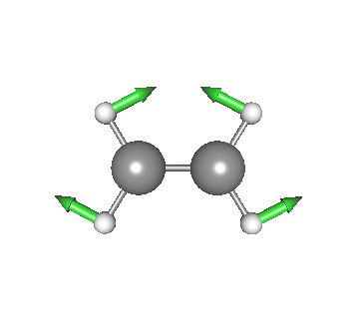
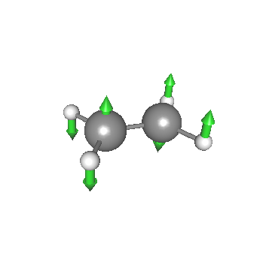
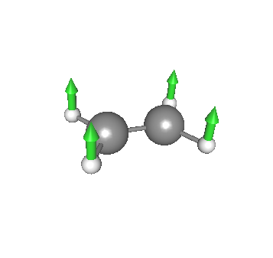
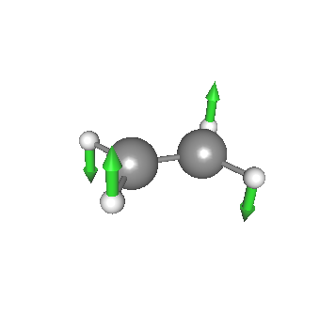
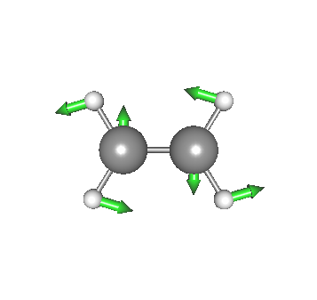
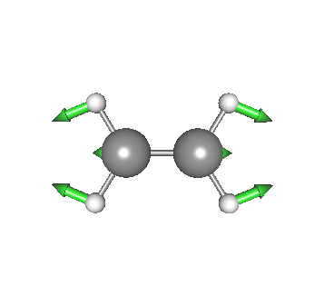
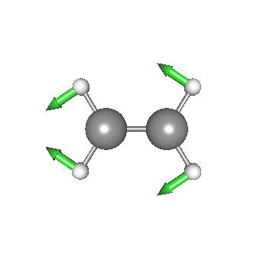
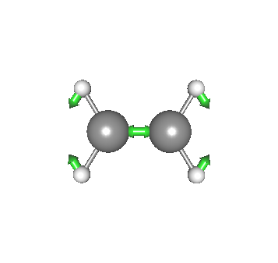
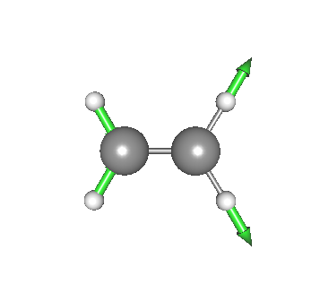
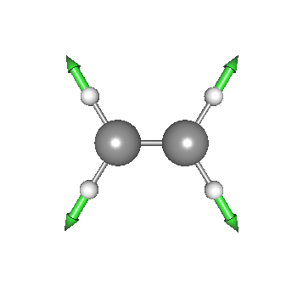
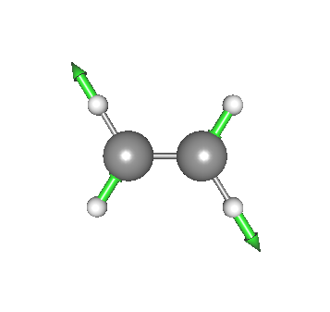
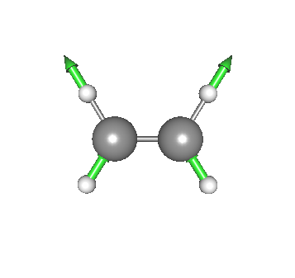
3. Optimized coordinate VSCF
In this section, we carry out optimized coordinate VSCF (oc-VSCF) [6] for ethylene (C₂H₄). Proceed to 3.ethylene,
> cd 3.ethylene
> ls
eq-mp2dz.minfo ncvci.inp ocvci.inp ocvscf.inp runSindo.sh*
log/ ncvqdpt2.inp ocvqdpt2.inp prop_no_1.mop
The normal coordinates of C₂H₄ looks like this:
Q1
Q2
Q3
Q4
Q5
Q6
Q7
Q8
Q9
Q10
Q11
Q12

Slide 32
In oc-VSCF, not only the one-mode function but also the coordinates are variationally optimized. For this purpose, the PES must be invariant to the coordinate transformation. The Taylor expansion PES fulfills this requirement. In SINDO, we can use a cubic force field (CFF) or a full quartic force field (4MR-QFF) for oc-VSCF calculations.
Here, we use a 4MR-QFF calculted at the MP2/cc-pVDZ level. “prop_no_1.mop” contains the QFF coefficients up to 4MR:
SCALING FREQUENCIES N_FRQS=12
3.7604565842336010000000e-03
4.2633781173158170000000e-03
4.4317087065806600000000e-03
…
-4.5104054238305110000000e-13 6 10 11 12
6.5048942246367230000000e-05 7 10 11 12
4.6335694968527480000000e-12 8 10 11 12
-1.1828490307864063000000e-03 9 10 11 12
4MR terms
Note that 4MR-QFF can be generated using MakePES by setting <MR> to 4 in the input. However, 4MR-QFF is far more costly than 3MR-QFF. If the calculation is prohibitive, we may use CFF which is a part of 3MR-QFF.
<makePES>
<MR value=”4" />
…
</makePES>

Slide 33
ocvscf.inp is an input file to carry out oc-VSCF calculations:
...
#--- [ VIB ]
&vib MR=4 ocvscf=.t. vscf=.f. vci=.f. vpt=.f. vmaxAll = 10 /
#--- [ OCVSCF ]
&ocvscf
mopfile='prop_no_1.mop’
icff=0
/
…
true invokes oc-VSCF.
the name of a mop file
icff = 0 : QFF, 1 : CFF
Run the program by,
> sindo < ocvscf.inp > ocvscf.out
Upon successful convergence, we find in the output:
> OPTIMIZATION CONVERGED!
> END OF OPTIMIZA
o TRANSFORMATION MATRIX WRITTEN TO : [ u1.dat ]
o FORCE CONSTANTS WRITTEN TO : [ prop_no_1.mop_ocvscf ]
o NEW COORDINATES WRITTEN TO : [ eq-mp2dz_ocvscf.minfo ]

Slide 34
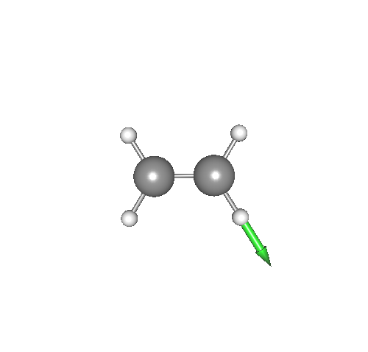
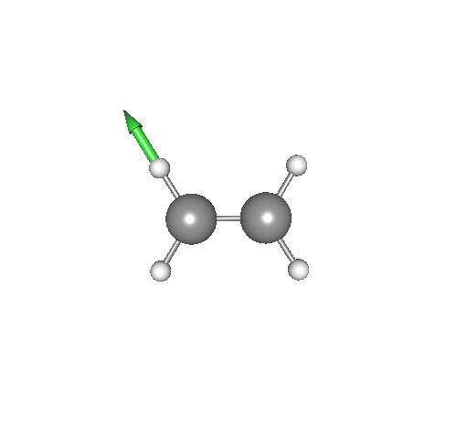
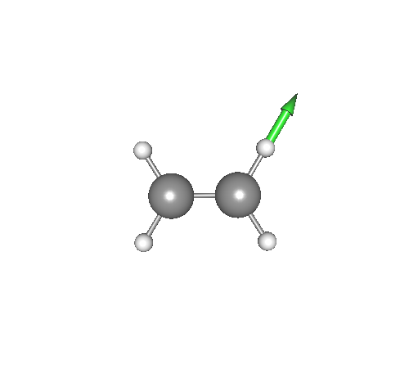
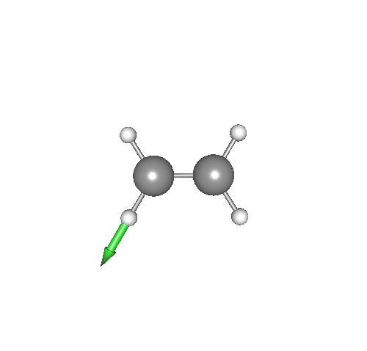
The optimized coordinates are written in “eq-mp2dz_ocvscf.minfo”. Modes 1 – 8 are almost the same. However, the CH stretching modes are drastically changed to local CH stretching modes.
Q9
Q10
Q11
Q12
The QFF coefficients in terms of optimized coordinates are written in “prop_no_1.mop_ocvscf”.
“u1.dat” contains a transformation matrix from normal to optimized coordinates, though we don’t use this file here.

Slide 35
We now perform vibrational calculations using QFF in terms of both normal and optimized coordinates. ncvci.inp and ncvqdpt2.inp are input files for VCI and VQDPT2 calculations based on normal coordinates, and ocvci.inp and ocvqdpt2.inp are those based on optimized coordinates. The difference is the mopfile of &mrpes:
&mrpes mopFile='prop_no_1.mop' mcs_cutoff=-1.0D-03 /
&mrpes mopFile='prop_no_1.mop_ocvscf' mcs_cutoff=-1.0D-03 /
The level of VCI excitations is VCI[6]-(6). The parameters for VQDPT2 are maxSum=4 and nGen=1.
We run the program by,
> sindo < ncvqdpt2.inp > ncvqdpt2.out
> sindo < ocvqdpt2.inp > ocvqdpt2.out
> sindo < ncvci.inp > ncvci.out
> sindo < ocvci.inp > ocvci.out
Note that the VCI calculation may take more than 10 minitues, since the VCI space is large (VCI dimension = 18,562).

Slide 36
Here, we summarize the results of CH stretching modes:
 | nc-VQDPT2 | oc-VQDPT2 | nc-VCI[6]-(6) | oc-VCI[6]-(6)
9 | 2996.6 | 3005.2 | 3008.5 | 3009.1
10 | 3063.9 | 3063.7 | 3069.6 | 3068.6
11 | 3121.5 | 3137.0 | 3140.2 | 3139.1
12 | 3139.2 | 3159.6 | 3161.6 | 3160.4
The results of nc-VCI and oc-VCI match within 2 cm⁻¹, indicating that the result is close to the exact solution, which is independent to the choice of coordinates. In constrast, nc- and oc-VQDPT2 results are not the same, because VQDPT2 is an approxiate, second-order perturbative approach. Nevertheless, oc-VQDPT2 is much closer to VCI than nc-VQDPT2. This result suggests that optimized coordinates give a faster convergence to the exact solution in post-VSCF calculations. See Ref. [4] and [6] for more discussion.

Slide 37
4. References
Direct VSCF/VCI
[1] Direct vibrational self-consistent field method: Applications to H₂O and H₂CO, K. Yagi, T. Taketsugu, K. Hirao, and M. S. Gordon, J. Chem. Phys. 113, 1005 (2000).
VMP2-(n)
[2] Efficient configuration selection scheme for vibrational second-order perturbation theory, K. Yagi, S. Hirata, and K. Hirao, J. Chem. Phys. 127, 034111 (2007).
VQDPT2
[3] Vibrational quasi-degenerate perturbation theory: Applications to Fermi resonance in CO₂, H₂CO, and C₆H₆, K. Yagi, S. Hirata, and K. Hirao, Phys. Chem. Chem. Phys. 10, 1781 (2008).
[4] Vibational quasi-degenerate perturbation theory with optimized coordinates: Applications to ethylene and trans-1,3-butadine, K. Yagi and H. Otaki, J. Chem. Phys. 140, 84113 (2014).
MRPES
[5] Multiresolution potential energy surfaces for vibrational state calculations, K. Yagi, S. Hirata, and K. Hirao, Thoer. Chem. Acc. 118, 681 (2007).
oc-VSCF
[6] Optimized coordinates for anharmonic vibrational structure theories, K.Yagi, M. Keçeli, and S. Hirata, J. Chem. Phys. 137, 204118 (2012).

Slide 38
List of all Options
&mol
Character(80) :: minfoFile
The name of the .minfo file, in which the information of molecule is written.
Integer :: Nat
The number of atoms
Real(8), dimension(Nat) :: Mass
The mass of each atoms (in atomic mass unit)
Real(8), dimension(3,Nat) :: x
The reference (equilibrium) geometry (in Angstrom)
Real(8), dimension(Nfree) :: omega
The frequencies for the HO basis sets (in cm−1)
Real(8), dimension(Nat*3,Nfree) :: L
The vibrational displacement vectors
[Note] ’minfoFile’ is mutually exclusive from others.
&sys
Integer(8) :: Maxmem
Maximum size of memory (MB)

Slide 39
&mrpes
Integer :: MR
Mode representation (MR=1-4)
Real(8) :: mcs_cutoff
Cutoff of QFF based on MCS in cm-1 (default = 1.d-04)
Logical :: au
The grid data in atomic unit (default = true)
Character(80) :: mopFile
The name of the mop file.
&vib
Integer :: Nfree
Number of degrees of freedom (default = 3Nat - 6)
Integer :: MR
Mode representation (MR=1-4)
Integer, dimension(Nfree) :: vmax
Number of basis functions for each mode (default=10)
Integer :: vmaxALL
Number of basis functions for all modes (default=10)
Integer :: vmax base
same as vmaxALL
Logical :: vscf, ocvscf, vci, vpt, vqdpt
invoke vscf/ocvscf/vci/vpt/vqdpt
Logical :: prpt
invoke property calculation
Logical :: readBasis
read the basis functions from cho.basis (default = false)
Logical :: ignoreImaginaryMode
ignores imaginary modes, i.e., those with negative frequencies in minfo (default = true)

Slide 40
&states
Integer :: Nstate
Number of states to calculate
Integer, dimension(Nfree,Nstate) :: target state
Labels of the target states
Logical :: fund
Compute fundamentals
&vscf
Logical :: state specific
State specific VSCF if true (default = .false.)
Logical :: restart
Restart from vscf xxx.wfn (default = .false.)
Integer :: Maxitr
Maximum number of iteration (default = 10)
Real(8) :: Ethresh
Threshold of convergence (default = 1e-03 cm−1)

Slide 41
&ocvscf
Integer :: maxOptIter
Maximum number of iteration (default = 30)
Real(8) :: ethresh
Threshold of the energy (default = 1e-06 cm−1)
Real(8) :: gthresh
Threshold of the gradient (default = 1e-06 cm−1 rad−1)
Integer :: pfit
Order of the Fourier fitting (default = 2)
Character(80) :: mopFile
The name of the mopfile
Character(80) :: u1File
The name of the file to write the transformation matrix (default = u1.dat)
Integer :: icff
Switch on CFF when icff = 1 and QFF when icff = 0 (default = 0)
Integer :: iscreen
Switch off/on pair selection when iscreen=0/1 (default = 1)
Real(8) :: eta12thresh
Threshold value for the pair screening (default = 500 cm−1)

Slide 42
&vci
Integer :: Nstate
Number of states to calculate
Integer :: nCI
Max CI dimension (cutoff based on the energy)
Integer(Nfree) :: maxEx
Max quantum number to excite for each mode
Integer :: maxExALL
Max quantum number to excite for all the modes
Integer :: maxSum
Max sum of quantum number
Integer :: nCUP
Max number of modes to excite
Logical :: geomAv
If true, calculate vibrationally averaged geometry
Logical :: dump
If true, dump the vci wavefunction to vci-w.wfn
Real(8) :: printWeight
Print the configuration with the weight larger than this threshold
Logical :: readCIbasis
If true, read CI basis from vci-w.wfn
Logical :: dumpHmat
If true, write the VCI hamiltonian matrix
Logical :: noDiag
If true, the diagonalization is skipped

Slide 43
&vpt
Integer :: maxSum
Max sum of quantum number to excite (default = -1)
Integer :: maxEx
Max quantum number to excite (default = -1)
Integer :: nCUP
Max number of modes to excite (default = MR)
Real(8) :: thresh ene
Threshold energy to avoid divergence (default=1e-04 Hartree)
Logical :: dump
Dump the information to vmp-w.wfn
&vqdpt
Integer :: nGen
The generation of P space (default=3)
Real(8) :: thresh p0
E0 pruning (default=500 cm−1)
Real(8) :: thresh p1
VPT based pruning (default=0.1)
Real(8) :: thresh p2
VCI pruning (default=0.05)
Real(8) :: thresh p3
VCI pruning (default=0.9)
Integer :: pset
Combine the p-space generated from several target states
=0 when the target states have an overlap (default)
=1 when the p-space components have an overlap

Slide 44
Integer :: maxSum
Max sum of quantum number to excite (default = -1)
Integer :: nCUP
Max number of modes to excite (default = MR)
Integer :: pqSum
P/Q interaction scheme
> 0 prune the interaction when λpq > maxSum (default)
< 0 full interaction
Integer :: vqdpt2 loop
=0 loop over q, then p, p’ (default)
=1 loop over p, then p’, q
Real(8) :: thresh ene
Threshold energy to avoid divergence (default=1e-04 Hartree)
Real(8) :: printWeight
Print the configuration with the weight larger than this threshold (default=0.001)
Logical :: dump
Dump the information to vqdpt-w.wfn (default=true)

Slide 45
&prpt
Logical :: vscfprpt, vciprpt, vptprpt, vqdptprpt
Invoke property calculation for vscf, vci, vpt, vqpdt wavefuncion
Integer :: MR
Mode representation (default = 3)
Character :: extn(*)
The extension of the property files
Integer :: matrix(*)
= 0 calculate only the average
> 0 calculate the matrix
Logical :: infrared
If true, calculate the IR intensity.
&prptvci
Integer :: Nstate
The number of states
&IRspectrum
Real(8) :: minOmega, maxOmega
Min/Max value of the spectrum (default = 100 - 4000 cm−1)
Real(8) :: delOmega
Interval of the data (default = 1 cm−1)
Real(8) :: fwhm
Full-width half maximum of the Lorentz function for convolutions (default = 20 cm−1)
Real(8) :: cutoff
Cutoff of the band (default = -1 km mol−1)

