Slide 1
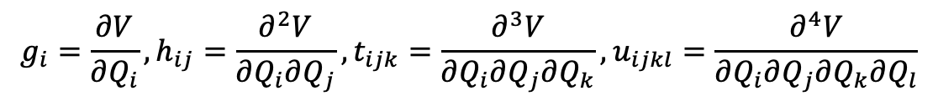
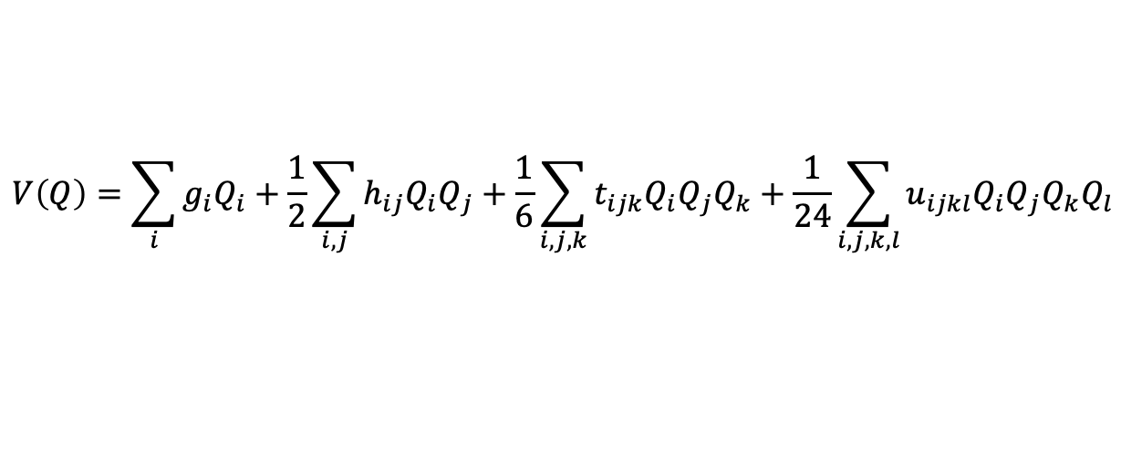
Notes on QFF coefficients
$$V\left(Q\right)=\sum_{i}{g_{i}Q_{i}}+\frac{1}{2}\sum_{i,j}{h_{ij}Q_{i}Q_{j}}+\frac{1}{6}\sum_{i,j,k}{t_{ijk}Q_{i}Q_{j}Q_{k}}+\frac{1}{24}\sum_{i,j,k,l}{u_{ijkl}Q_{i}Q_{j}Q_{k}Q_{l}}$$
$$g_{i}=\frac{∂V}{∂Q_{i}},h_{ij}=\frac{∂^{2}V}{∂Q_{i}∂Q_{j}},t_{ijk}=\frac{∂^{3}V}{∂Q_{i}∂Q_{j}∂Q_{k}},u_{ijkl}=\frac{∂^{4}V}{∂Q_{i}∂Q_{j}∂Q_{k}∂Q_{l}}$$

Slide 2

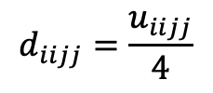
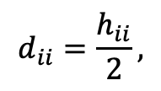
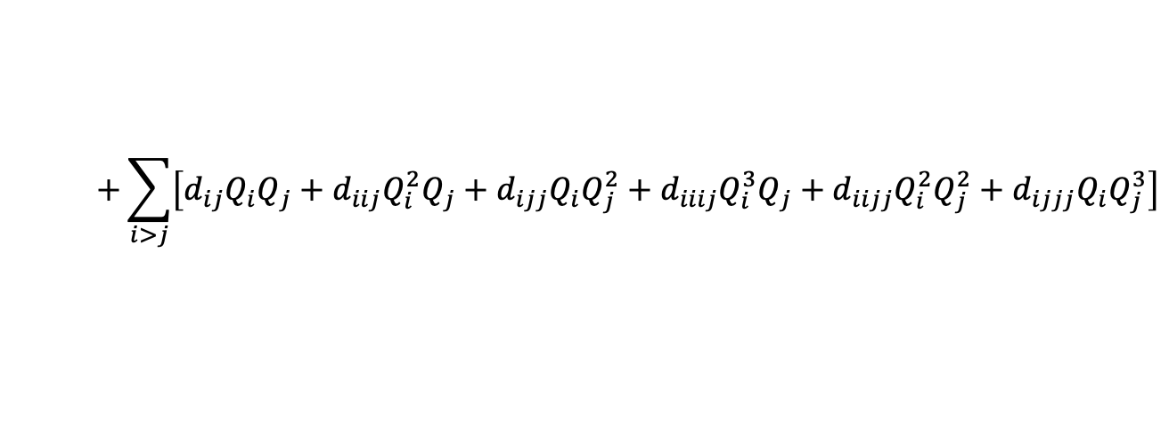
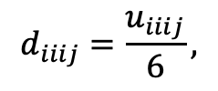


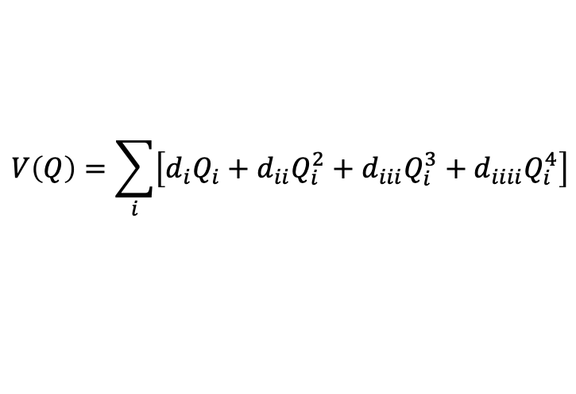
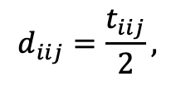
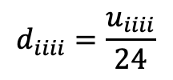
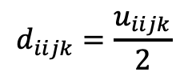

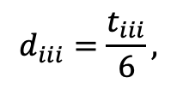
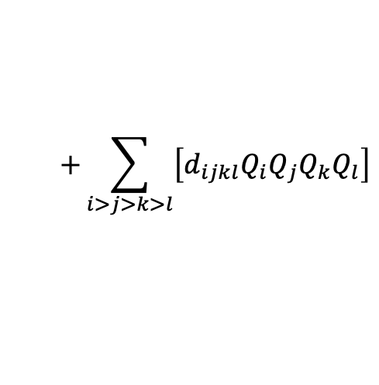

nMR展開：SINDOの内部で使用する係数
$$V\left(Q\right)=\sum_{i}{\left[d_{i}Q_{i}+d_{ii}Q_{i}^{2}+d_{iii}Q_{i}^{3}+d_{iiii}Q_{i}^{4}\right]}$$
$$+\sum_{i>j}{\left[d_{ij}Q_{i}Q_{j}+d_{iij}Q_{i}^{2}Q_{j}+d_{ijj}Q_{i}Q_{j}^{2}+d_{iiij}Q_{i}^{3}Q_{j}+d_{iijj}Q_{i}^{2}Q_{j}^{2}+d_{ijjj}Q_{i}Q_{j}^{3}\right]}$$
$$+\sum_{i>j>k}{\left[d_{ijk}Q_{i}Q_{j}Q_{k}+d_{iijk}Q_{i}^{2}Q_{j}Q_{k}+d_{ijjk}Q_{i}Q_{j}^{2}Q_{k}+d_{ijkk}Q_{i}Q_{j}Q_{k}^{2}\right]}$$
$$+\sum_{i>j>k>l}{\left[d_{ijkl}Q_{i}Q_{j}Q_{k}Q_{l}\right]}$$
$$d_{i}=g_{i},$$
$$d_{ii}=\frac{h_{ii}}{2},$$
$$d_{iii}=\frac{t_{iii}}{6},$$
$$d_{iiii}=\frac{u_{iiii}}{24}$$
$$d_{ij}=h_{ij},$$
$$d_{iij}=\frac{t_{iij}}{2},$$
$$d_{iiij}=\frac{u_{iiij}}{6},$$
$$d_{iijj}=\frac{u_{iijj}}{4}$$
$$d_{ijk}=t_{ijk},$$
$$d_{iijk}=\frac{u_{iijk}}{2}$$
$$d_{ijkl}=u_{ijkl}$$

Slide 3
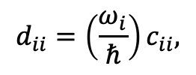
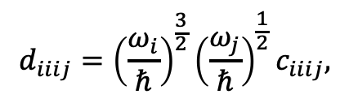
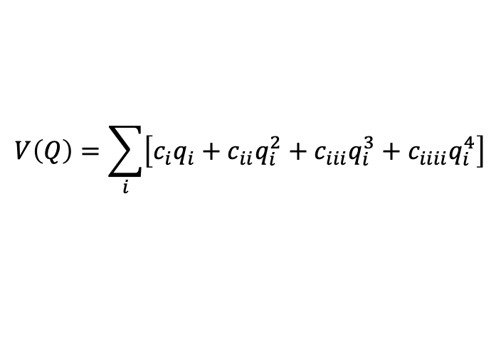
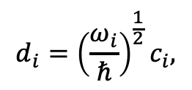
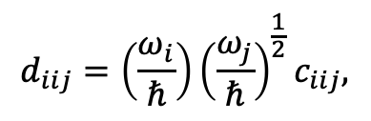
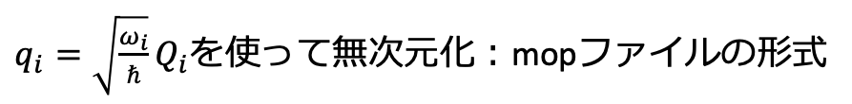
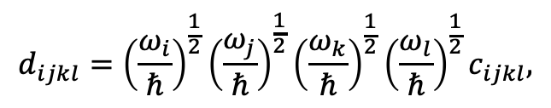
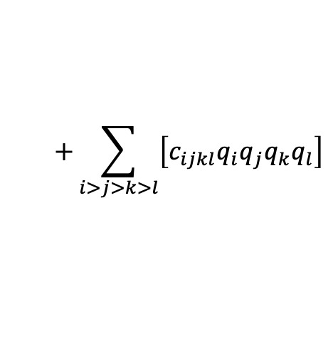
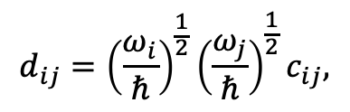
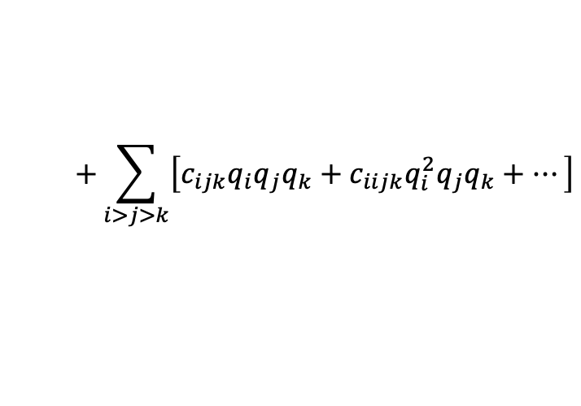
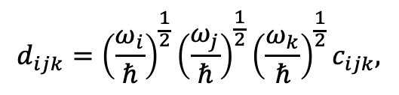
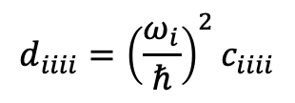
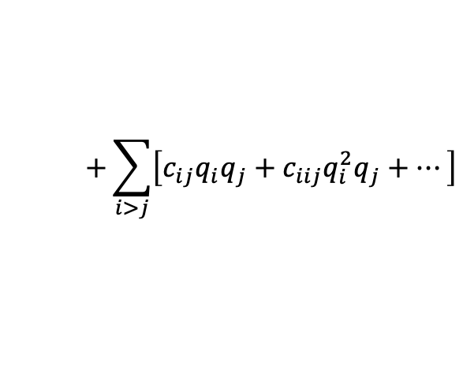
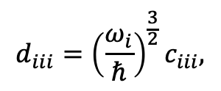
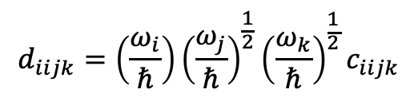
$q_{i}=\sqrt{\frac{ω_{i}}{ℏ}}Q_{i}$を使って無次元化：mopファイルの形式
$$V\left(Q\right)=\sum_{i}{\left[c_{i}q_{i}+c_{ii}q_{i}^{2}+c_{iii}q_{i}^{3}+c_{iiii}q_{i}^{4}\right]}$$
$$+\sum_{i>j}{\left[c_{ij}q_{i}q_{j}+c_{iij}q_{i}^{2}q_{j}+⋯\right]}$$
$$+\sum_{i>j>k}{\left[c_{ijk}q_{i}q_{j}q_{k}+c_{iijk}q_{i}^{2}q_{j}q_{k}+⋯\right]}$$
$$+\sum_{i>j>k>l}{\left[c_{ijkl}q_{i}q_{j}q_{k}q_{l}\right]}$$
係数の変換（mop → sindo）
$$d_{i}={\left(\frac{ω_{i}}{ℏ}\right)}^{\frac{1}{2}}c_{i},$$
$$d_{iii}={\left(\frac{ω_{i}}{ℏ}\right)}^{\frac{3}{2}}c_{iii},$$
$$d_{iiii}={\left(\frac{ω_{i}}{ℏ}\right)}^{2}c_{iiii}$$
$$d_{ii}=\left(\frac{ω_{i}}{ℏ}\right)c_{ii},$$
$$d_{ij}={\left(\frac{ω_{i}}{ℏ}\right)}^{\frac{1}{2}}{\left(\frac{ω_{j}}{ℏ}\right)}^{\frac{1}{2}}c_{ij},$$
$$d_{iij}=\left(\frac{ω_{i}}{ℏ}\right){\left(\frac{ω_{j}}{ℏ}\right)}^{\frac{1}{2}}c_{iij},$$
$$d_{iiij}={\left(\frac{ω_{i}}{ℏ}\right)}^{\frac{3}{2}}{\left(\frac{ω_{j}}{ℏ}\right)}^{\frac{1}{2}}c_{iiij},$$
$$d_{ijk}={\left(\frac{ω_{i}}{ℏ}\right)}^{\frac{1}{2}}{\left(\frac{ω_{j}}{ℏ}\right)}^{\frac{1}{2}}{\left(\frac{ω_{k}}{ℏ}\right)}^{\frac{1}{2}}c_{ijk},$$
$$d_{iijk}=\left(\frac{ω_{i}}{ℏ}\right){\left(\frac{ω_{j}}{ℏ}\right)}^{\frac{1}{2}}{\left(\frac{ω_{k}}{ℏ}\right)}^{\frac{1}{2}}c_{iijk}$$
$$d_{ijkl}={\left(\frac{ω_{i}}{ℏ}\right)}^{\frac{1}{2}}{\left(\frac{ω_{j}}{ℏ}\right)}^{\frac{1}{2}}{\left(\frac{ω_{k}}{ℏ}\right)}^{\frac{1}{2}}{\left(\frac{ω_{l}}{ℏ}\right)}^{\frac{1}{2}}c_{ijkl},$$

Slide 4
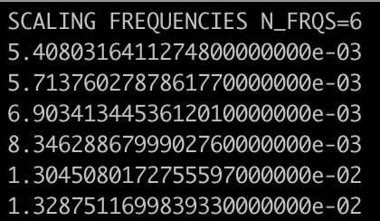
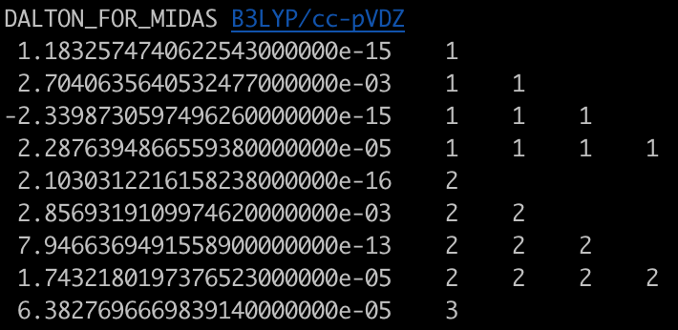


mopファイルの形式
$ω_{i}$ in au
→$\sqrt{ω_{i}}$ を計算し、変換に使う
係数（c）とモード番号
→dに変換し、SINDO内部で使う

Slide 5

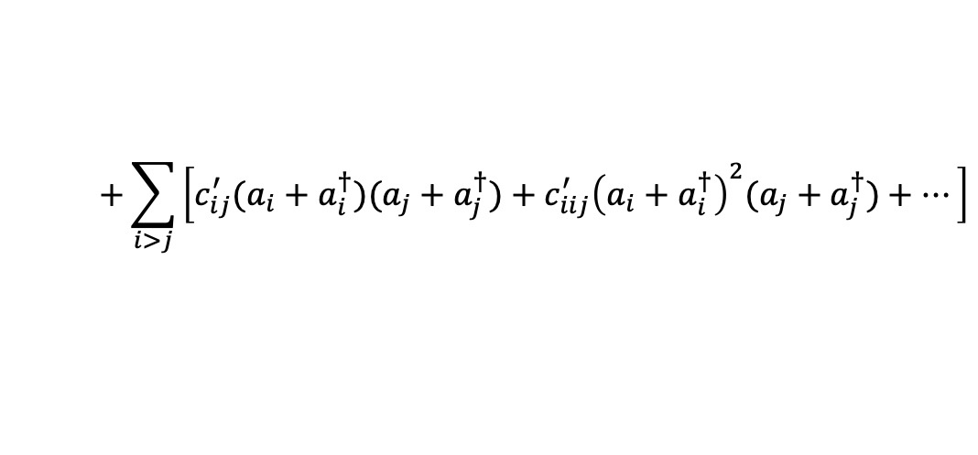


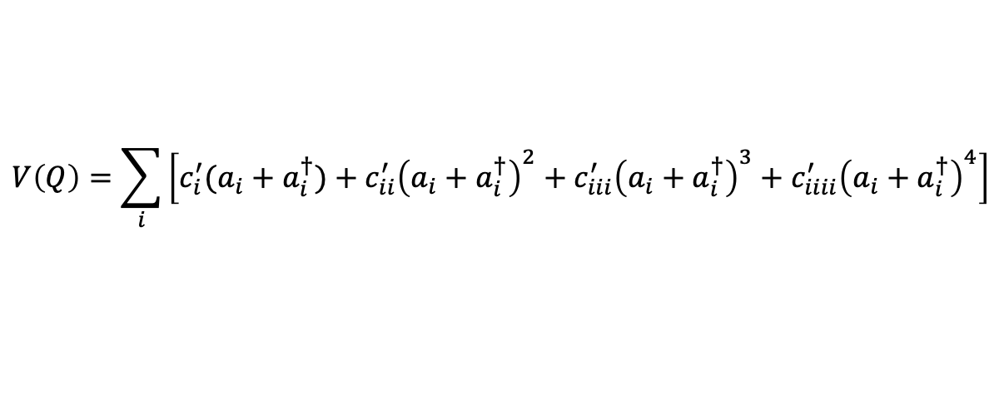
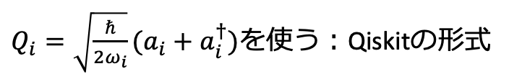



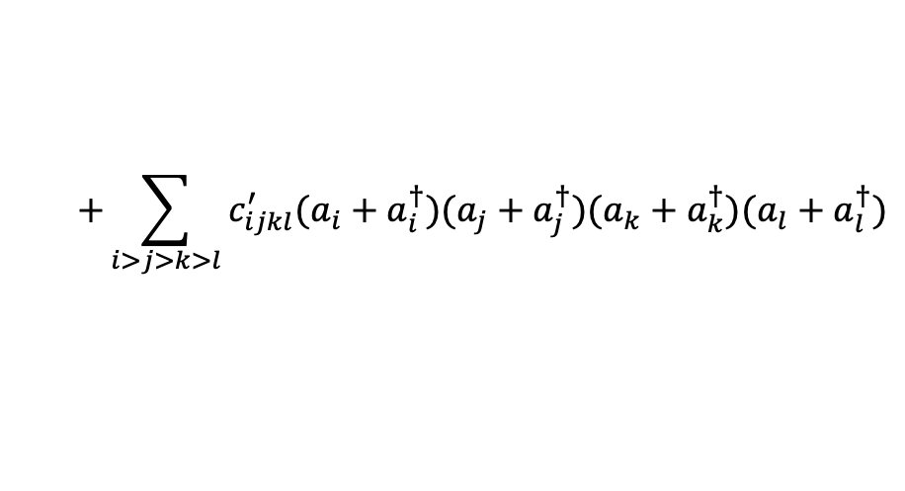



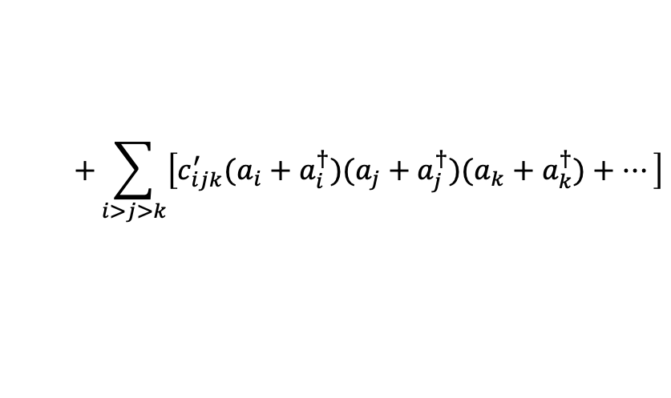
$Q_{i}=\sqrt{\frac{ℏ}{{2ω}_{i}}}(a_{i}+a_{i}^{†})$を使う：Qiskitの形式
$$V\left(Q\right)=\sum_{i}{\left[c_{i}^{′}(a_{i}+a_{i}^{†})+c_{ii}^{′}{\left(a_{i}+a_{i}^{†}\right)}^{2}+c_{iii}^{′}{\left(a_{i}+a_{i}^{†}\right)}^{3}+c_{iiii}^{′}{\left(a_{i}+a_{i}^{†}\right)}^{4}\right]}$$
$$+\sum_{i>j}{\left[c_{ij}^{′}(a_{i}+a_{i}^{†})(a_{j}+a_{j}^{†})+c_{iij}^{′}{\left(a_{i}+a_{i}^{†}\right)}^{2}(a_{j}+a_{j}^{†})+⋯\right]}$$
$$+\sum_{i>j>k}{\left[c_{ijk}^{′}(a_{i}+a_{i}^{†})(a_{j}+a_{j}^{†})(a_{k}+a_{k}^{†})+⋯\right]}$$
$$+\sum_{i>j>k>l}{c_{ijkl}^{′}(a_{i}+a_{i}^{†})(a_{j}+a_{j}^{†})(a_{k}+a_{k}^{†})(a_{l}+a_{l}^{†})}$$
係数の変換（mop → qiskit）
$$c_{i}^{′}=\sqrt{2}c_{i},$$
$$c_{ii}^{′}=2c_{ii},$$
$$c_{iii}^{′}=\sqrt[3]{2}c_{iii},$$
$c_{iiii}^{′}=2^{2}c_{iiii}$,
$$c_{ij}^{′}=2c_{ij},$$
$$c_{iij}^{′}=\sqrt[3]{2}c_{iij},$$
$$c_{iiij}^{′}=2^{2}c_{iiij},$$
$$c_{ijk}^{′}=\sqrt[3]{2}c_{ijk},$$
$c_{iijk}^{′}=2^{2}c_{iijk}$,
など

