Slide 1



ScheduleSolver_Sharepoint
View in Power BI
Last data refresh:
4/13/2022 8:11:35 PM UTC
Downloaded at:
4/13/2022 8:14:57 PM UTC

Slide 2
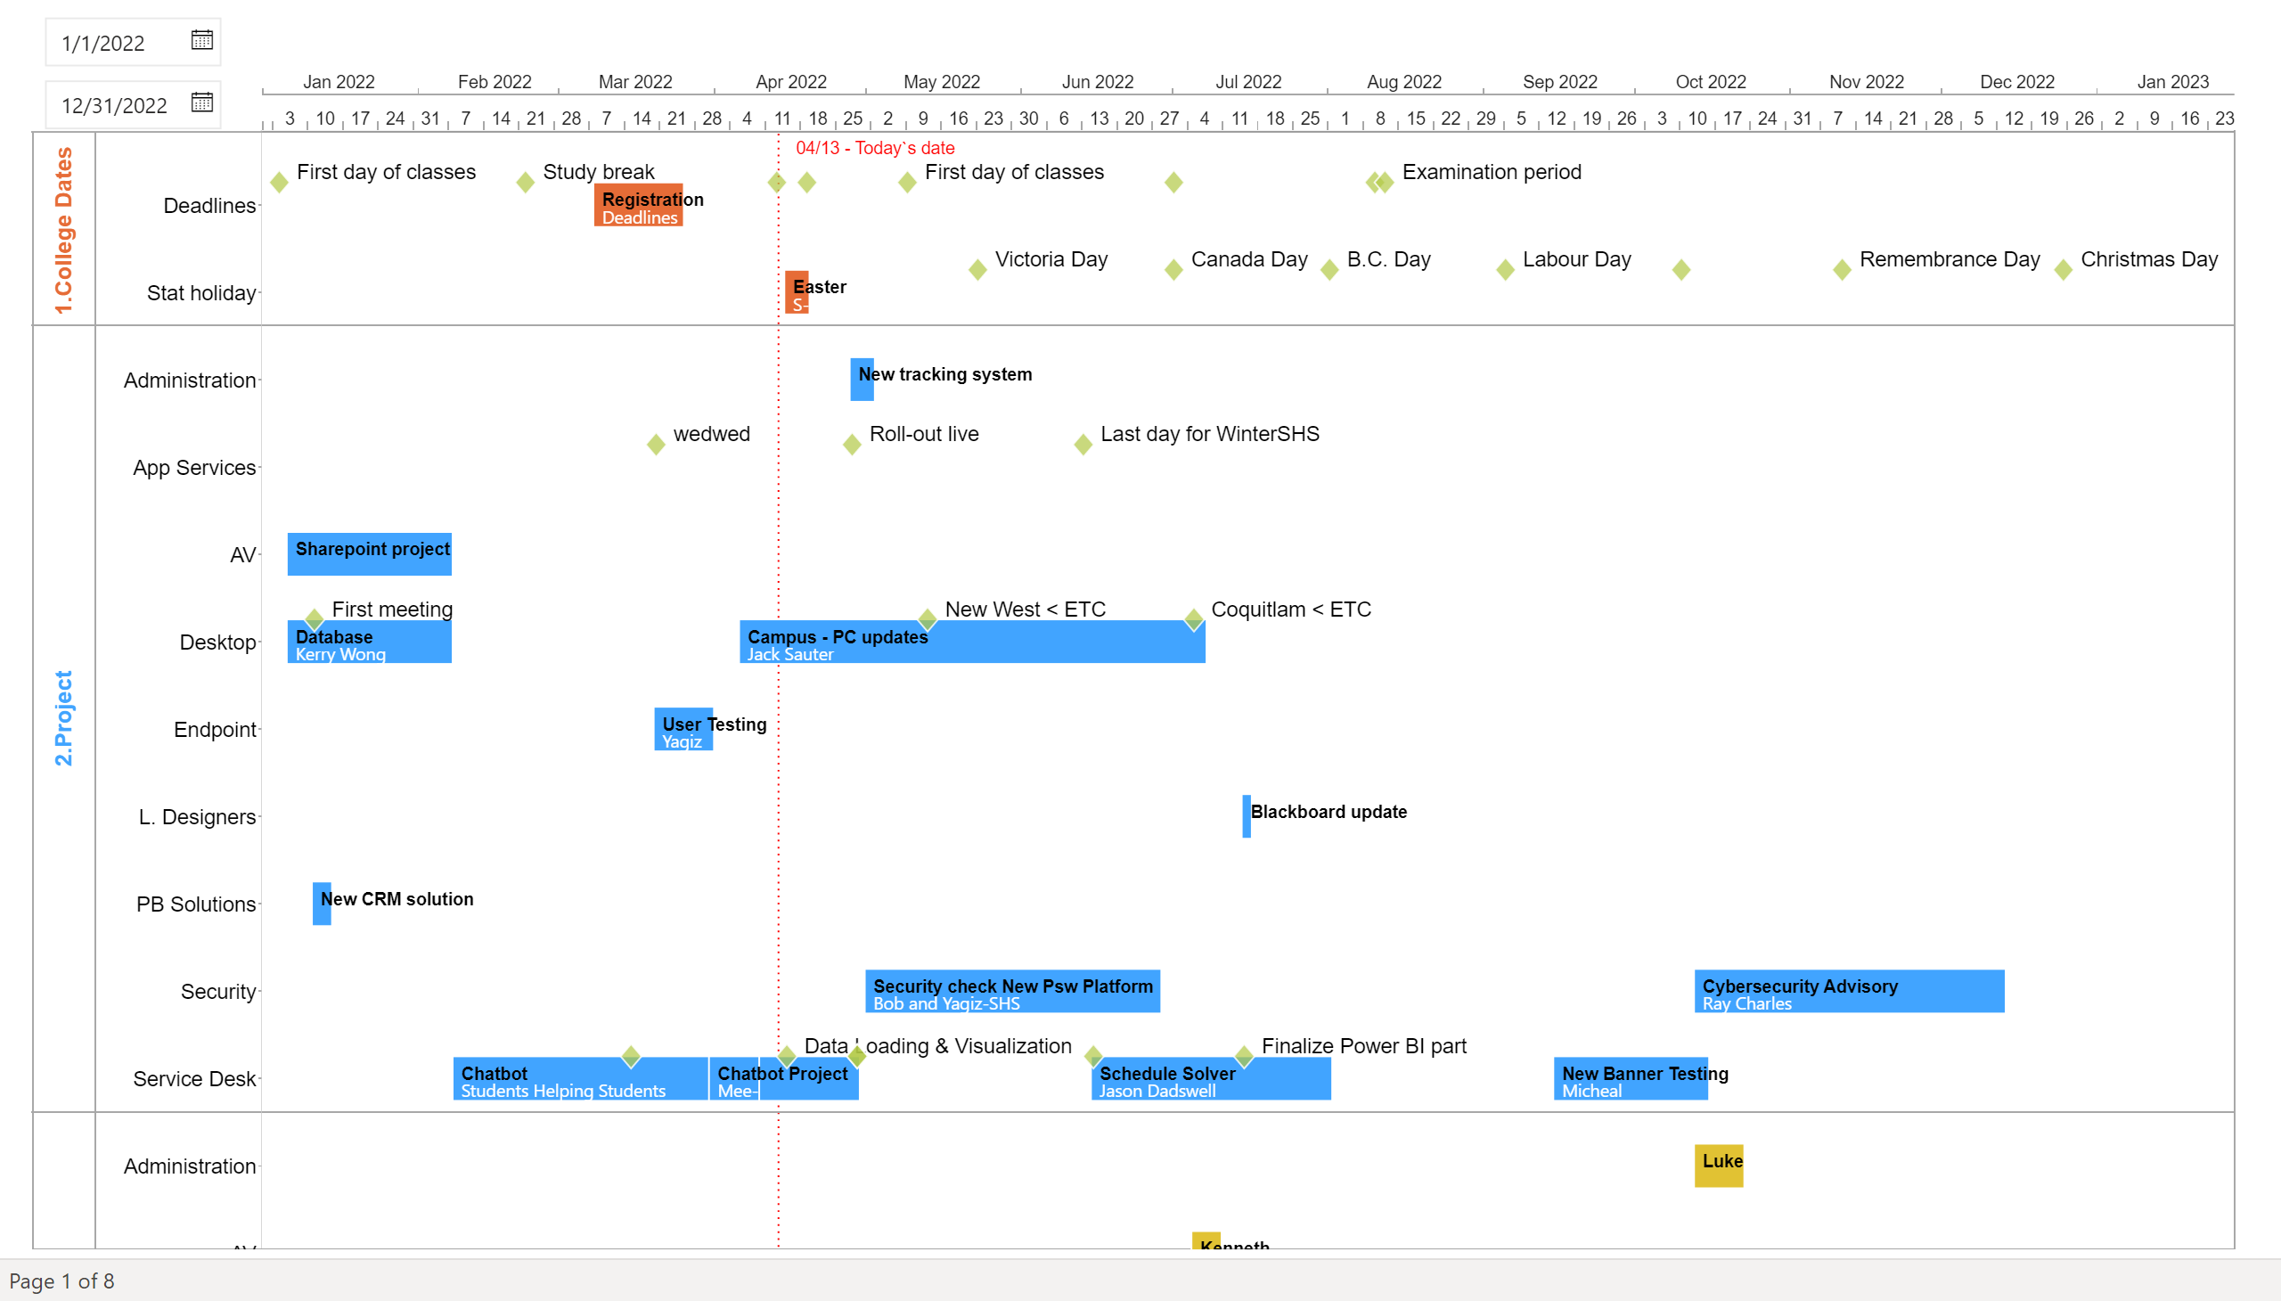
Yearly
Notes:
adwiseVisual73804AE4264848C8BCD67A31A0791911
No alt text provided
slicer
No alt text provided

Slide 3
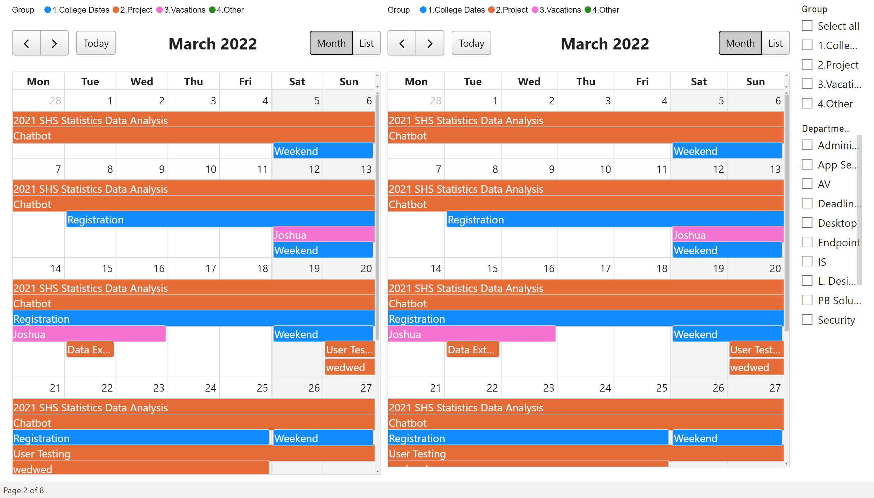
Calender
Notes:
calendarVisual74934D05B71F4C31B0F79D925EE89638
No alt text provided
calendarVisual74934D05B71F4C31B0F79D925EE89638
No alt text provided
slicer
No alt text provided
slicer
No alt text provided

Slide 4
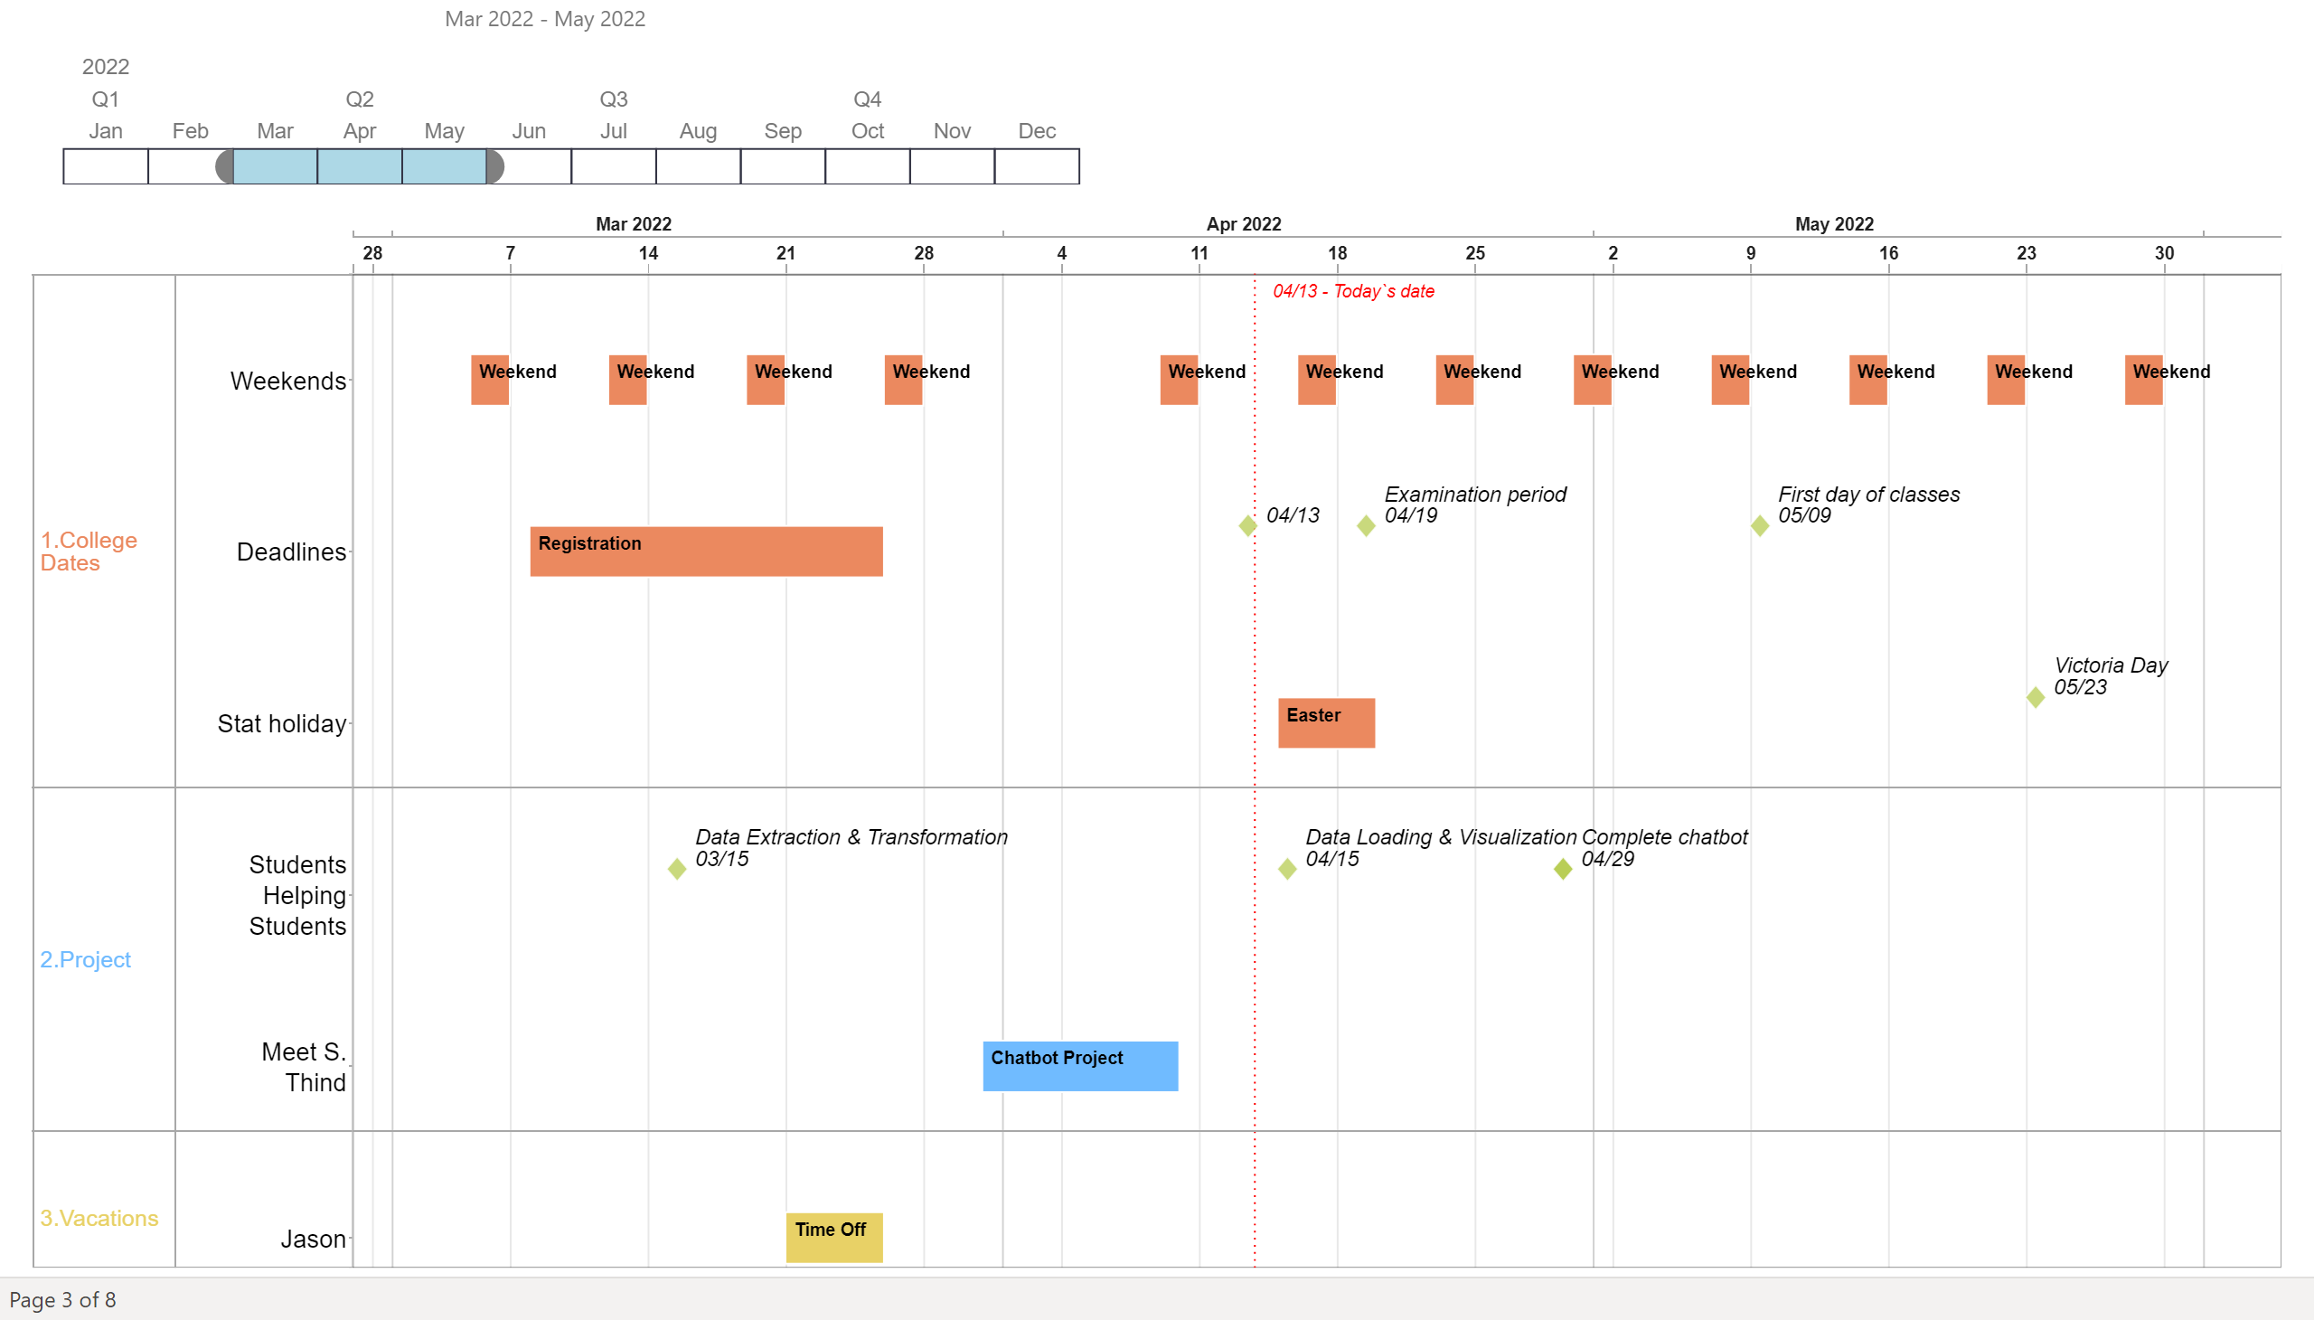
Service_Desk
Notes:
Timeline1447991079100
No alt text provided
adwiseVisual73804AE4264848C8BCD67A31A0791911
No alt text provided

Slide 5
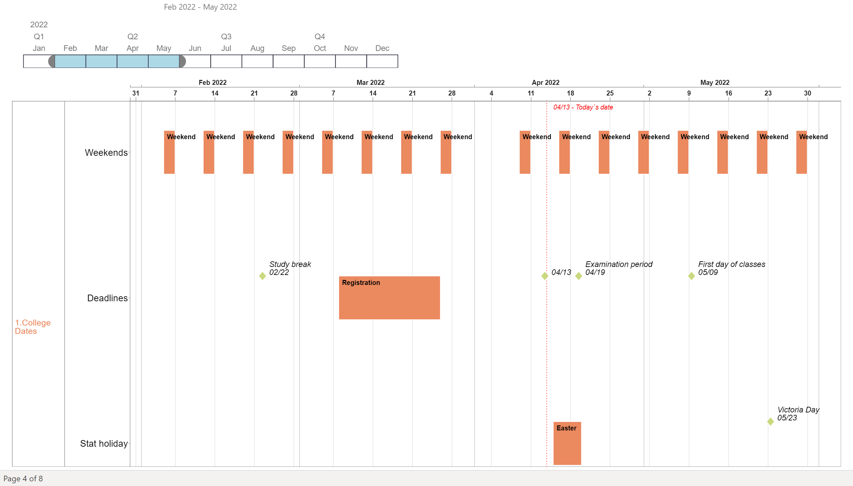
L.Designers
Notes:
Timeline1447991079100
No alt text provided
adwiseVisual73804AE4264848C8BCD67A31A0791911
No alt text provided

Slide 6
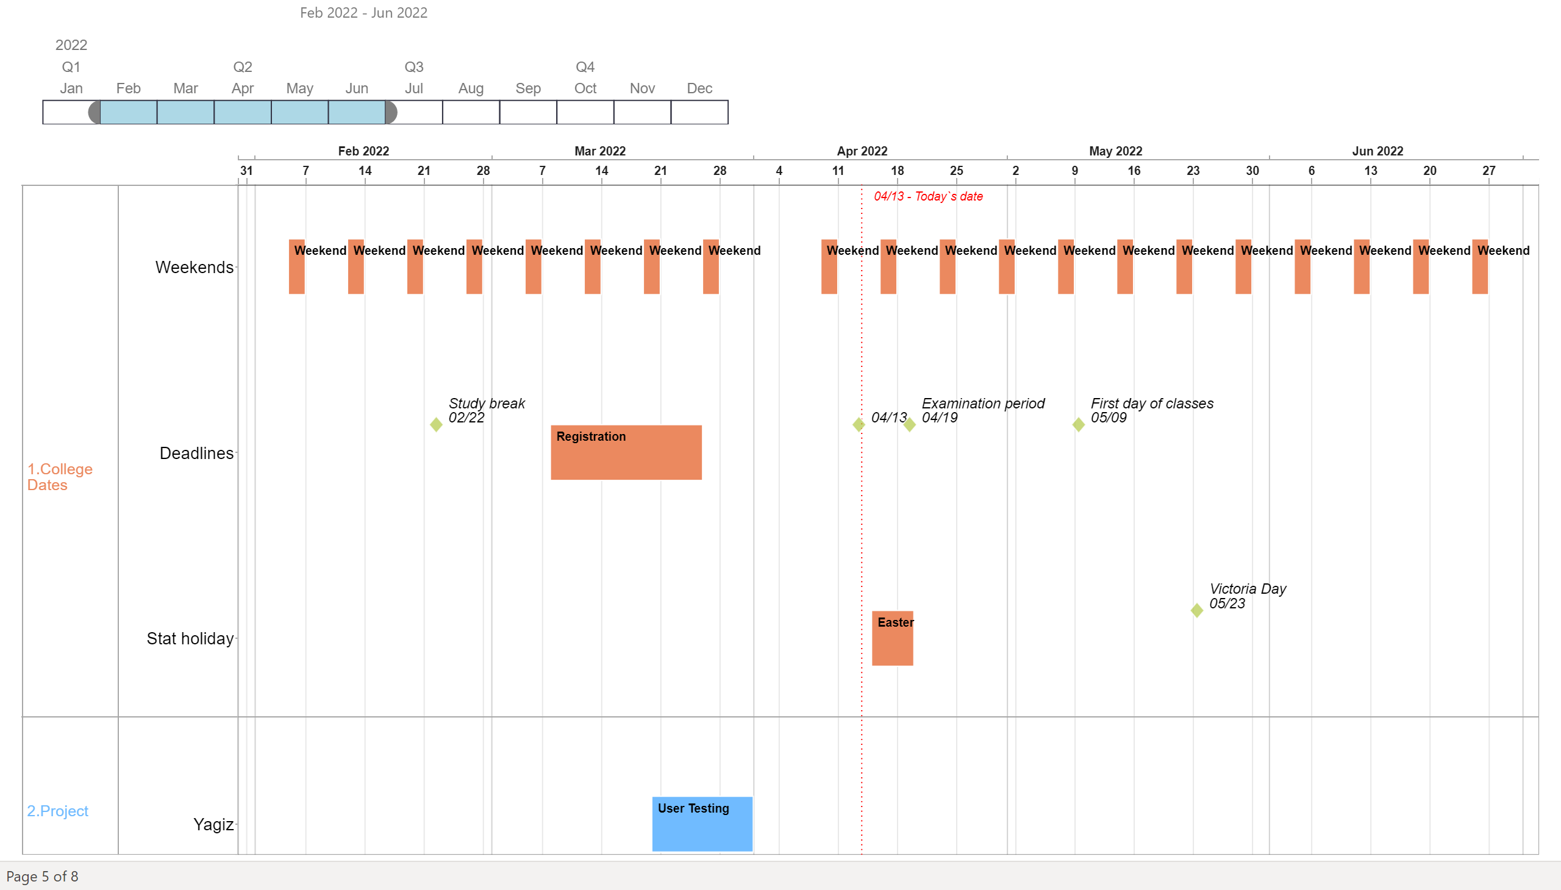
EndPoint
Notes:
Timeline1447991079100
No alt text provided
adwiseVisual73804AE4264848C8BCD67A31A0791911
No alt text provided

Slide 7
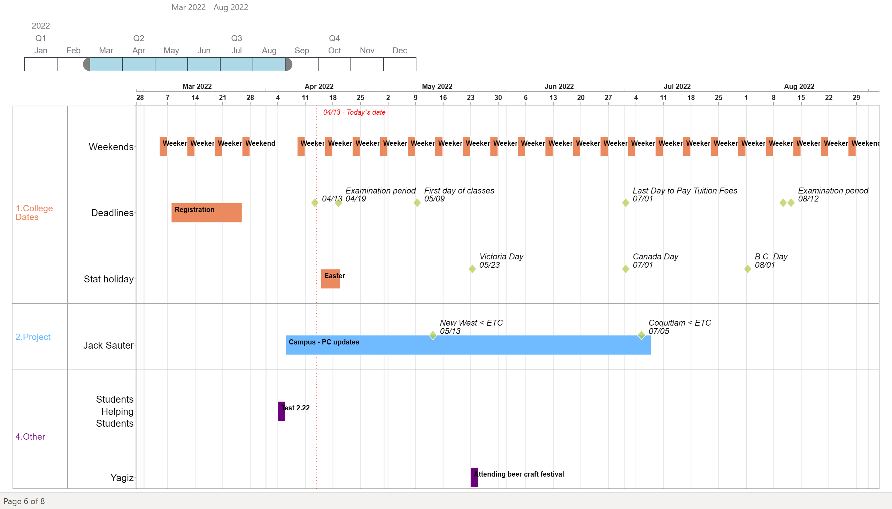
Desktop
Notes:
Timeline1447991079100
No alt text provided
adwiseVisual73804AE4264848C8BCD67A31A0791911
No alt text provided

Slide 8
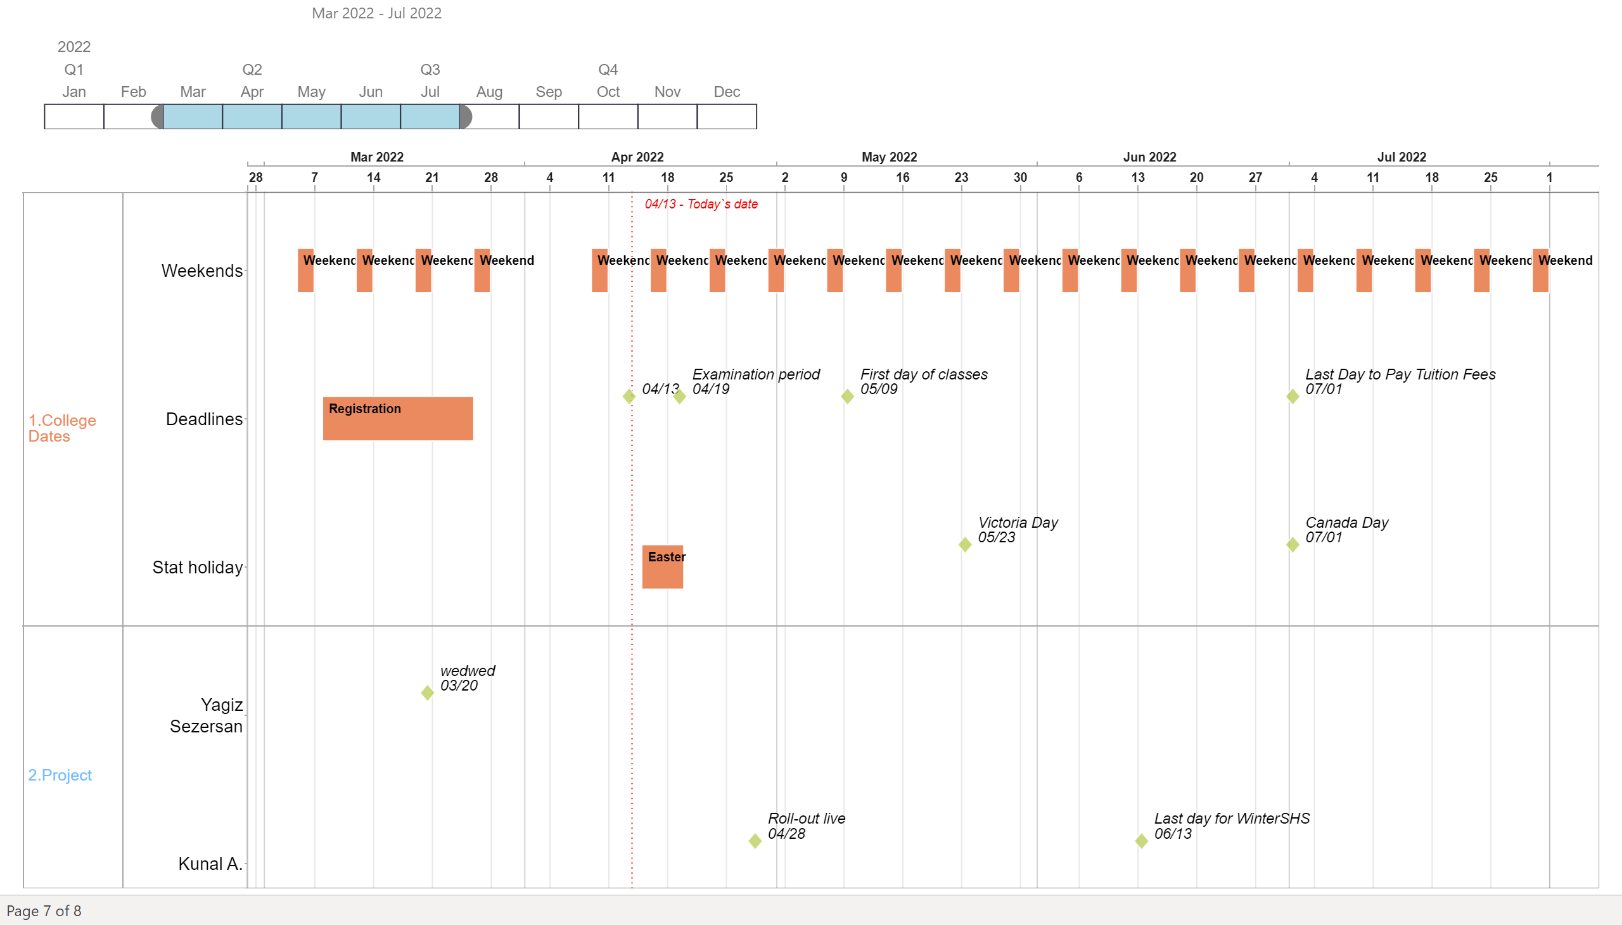
App_Services
Notes:
Timeline1447991079100
No alt text provided
adwiseVisual73804AE4264848C8BCD67A31A0791911
No alt text provided

Slide 9
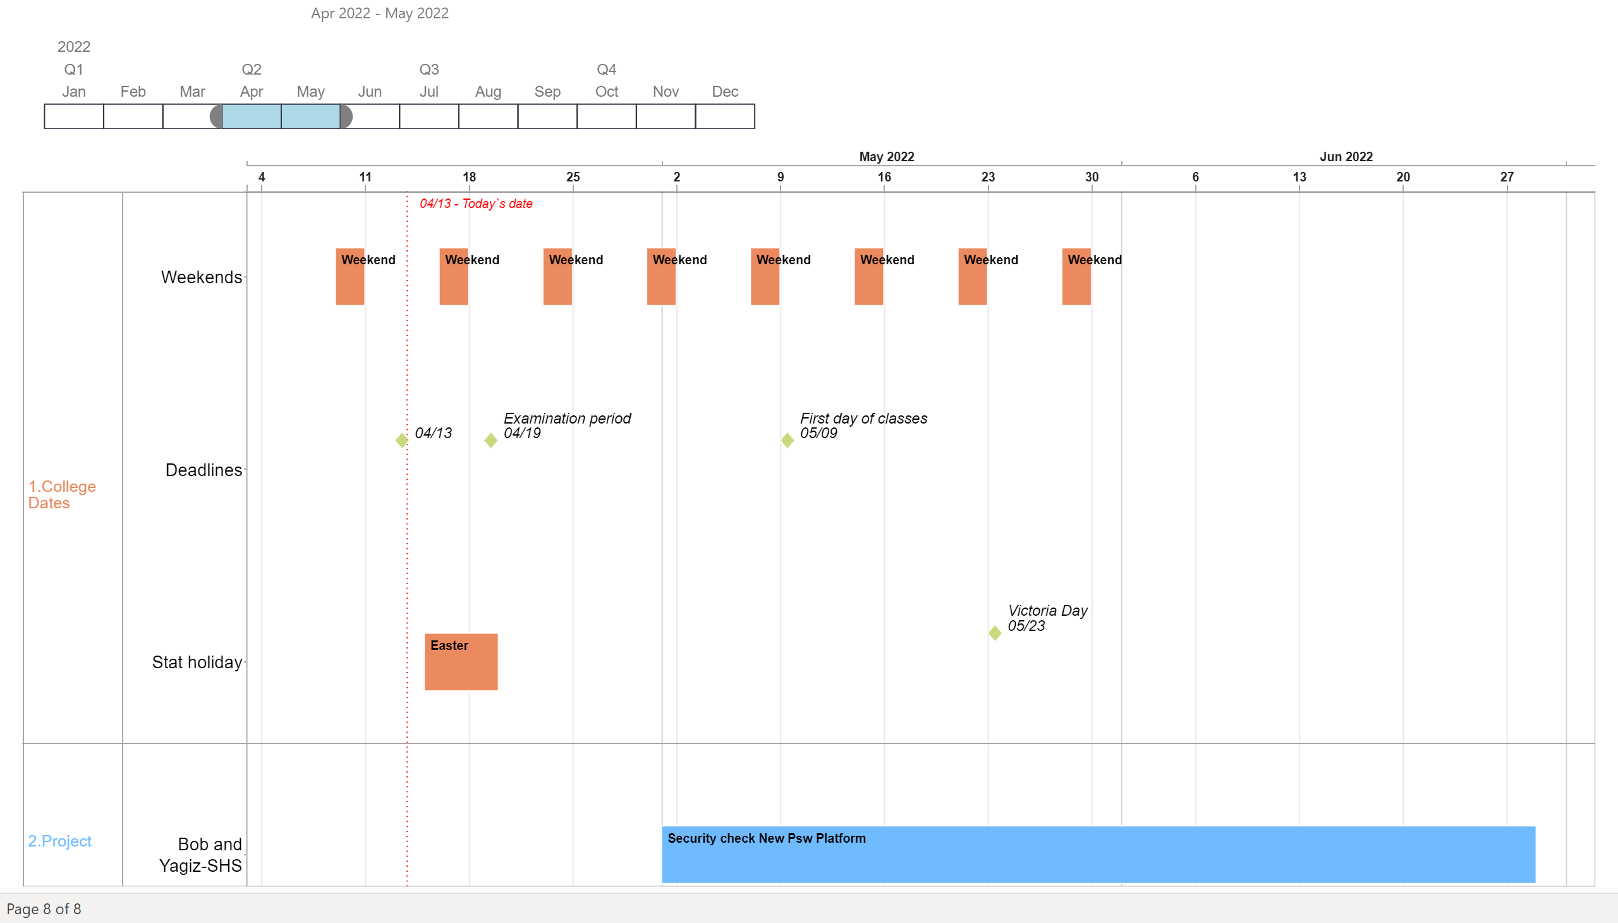
Security
Notes:
Timeline1447991079100
No alt text provided
adwiseVisual73804AE4264848C8BCD67A31A0791911
No alt text provided

