Slide 1
Simulating Inter-Cell Interference in 5G NR Research Internship
Yagiz Yalcintas
ge46yad@mytum.de

Slide 2
Contents
Why Time/Phase Synchronization is Neccessary
Causes of Time/Phase Offset
Interference in 5G TDD Systems
Downlink to Uplink Switching Point (BS2BS)
Uplink to Downlink Switching Point (BS2BS)
UE2UE Interference
Goal of the Internship
Aggressor-Victim Models
Simulation Setup
Results
Impact of UE Positions
Impact of gNB Positions
Impact of Bandwidth
Impact of number of UEs per Cell
Impact of Subcarriers Spacing
Impact of Time Synchronization
Conclusion

Slide 3
Why Time/Phase Synchronization is Neccessary
Synchronization errors at a single base station can lead to performance degradation of neighboring base stations
This is due to the interference caused by the neighboring base station. Hence, in TDD systems, it is essential that base stations receive accurate synchronization
The time/phase synchronization requirements are outlined in the ITU Telecommunication Standardization Sector Recommendation G.8271/Y.1366

Slide 4
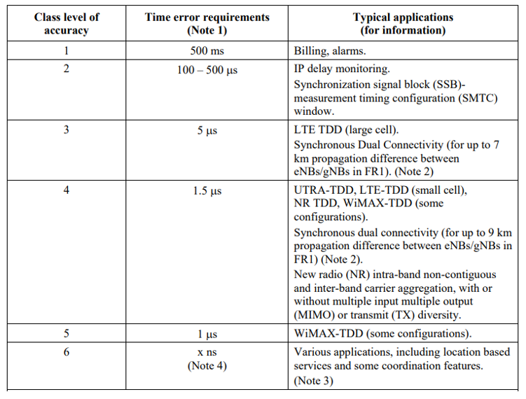

Source: Rec. ITU-T G.8271/Y.1366 (03/2020)

Slide 5
Causes of Time/Phase Offset
Time error accumulation in a chain of clocks (local oscillator phase errors)
Reference time error (interference from TV signals, GNSS jamming attacks etc.)
PHY latency variation and asymmetry ( Precision Time Protocol (PTP) errors due to link asymmetry)
Asymmetry due to the use of different wavelengths
Time stamping granularity
Error in distributing time inside a node

Slide 6
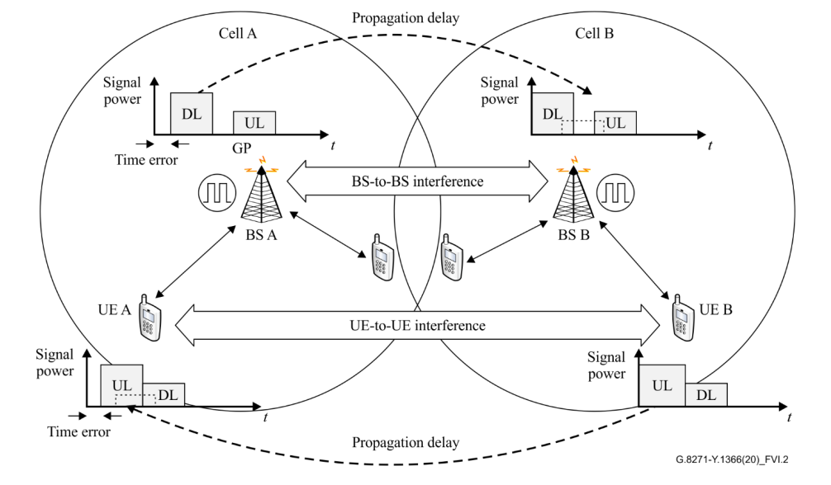
Interference in 5G TDD Systems
Source: Rec. ITU-T G.8271/Y.1366 (03/2020)

Slide 7
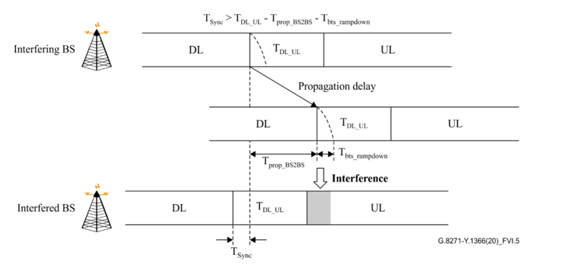
Downlink to Uplink Switching Point (BS2BS)
Source: Rec. ITU-T G.8271/Y.1366 (03/2020)

Slide 8
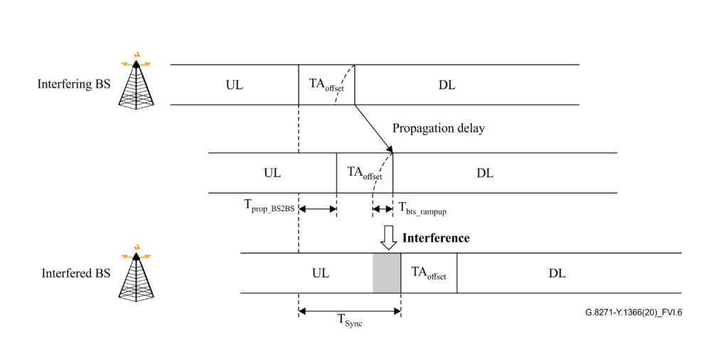
Uplink to Downlink Switching Point (BS2BS)
Source: Rec. ITU-T G.8271/Y.1366 (03/2020)

Slide 9
UE2UE Interference
Reachability of the signal in the case of UE-to-UE interference is lower than in the case of BS-to-BS interference. Thus, both UEs are located close to the cell edge can cause intra-operator interference.
On the other hand, UE-to-UE interference may occur anywhere in the cell in the case of inter-operator interference.
Similar relationship can be derived for BS-to-BS interference, where time synchronization error between base stations exceeding a certain threshold would cause interference between the UEs.

Slide 10

Goal of the Internship
Goal of interns is to build a simulation that implement interference between base station and evaluate the effect of time offset
We use 5G toolbox from Mathworks as our framework

Slide 11
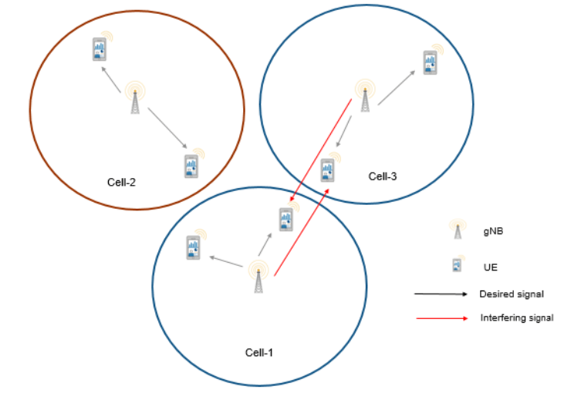
Aggressor-Victim Models
Aggressor-Victim Model is the class of simulations where the aggressor device is the source of the interference and the victim device suffer from this consequently.

Slide 12
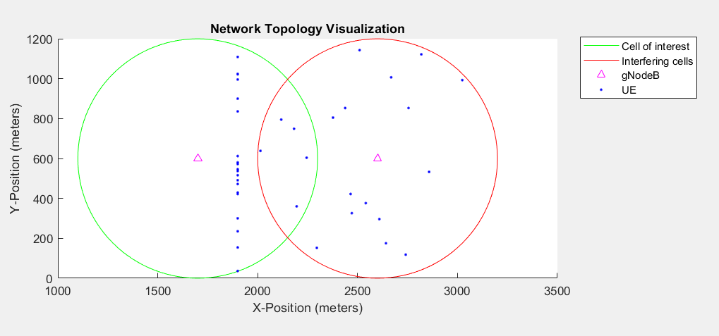
Simulation Setup
2 gNBs with UEs that are connected to a particualar BS
gNBs use the same center frequency
TDD
900 meters apart with a radius of 600
Round-robin scheduling

Slide 13
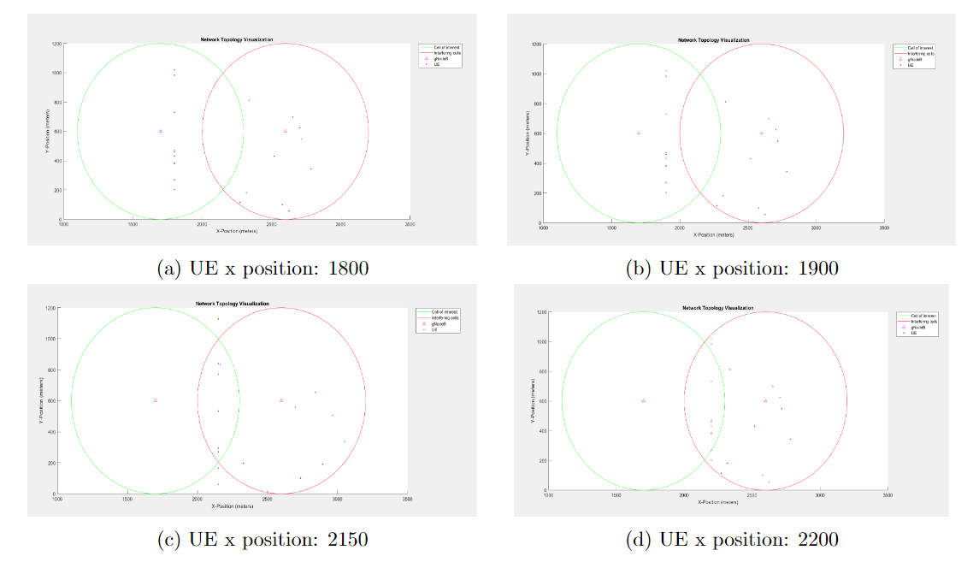
Impact of UE Positions

Slide 14
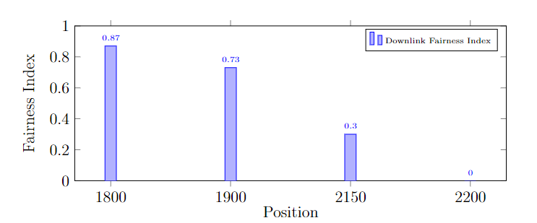
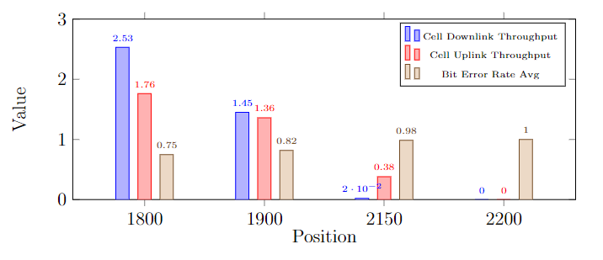
Impact of UE Positions
As the UEs get further away from the gNB of interest and closer to the interfering cell, we observe a much lower achieved throughput and higher bit error rate

Slide 15
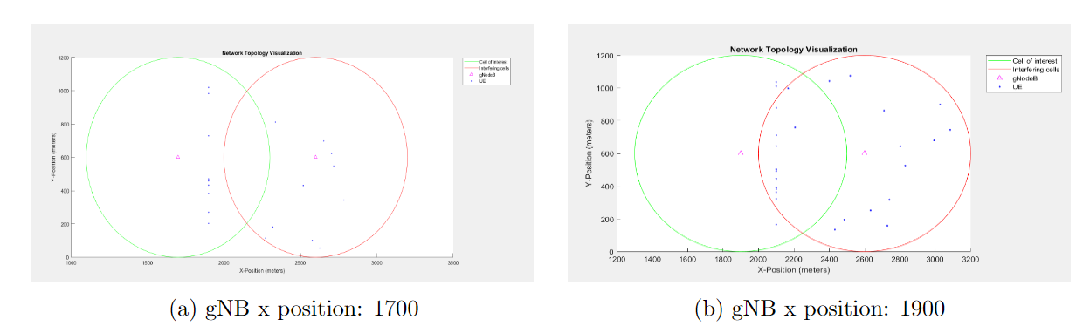
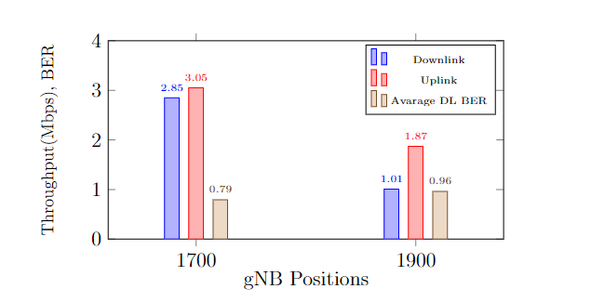
Impact of gNB Positions
(a) Distance between gNBs: 700
(b) Distance between gNBs: 500
As the aggressor cell get closer to the victim cell, with increased interference we observe a higher bit error rate while achieving less throughput and higher error rate

Slide 16
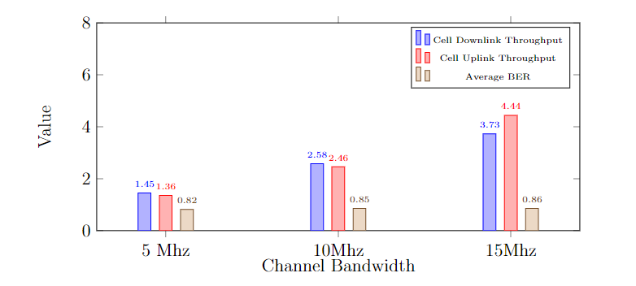
Impact of Bandwidth
Both Downlink and Uplink throughputs increase as more resources are available to the users while there is not a significant change in bit error rate

Slide 17
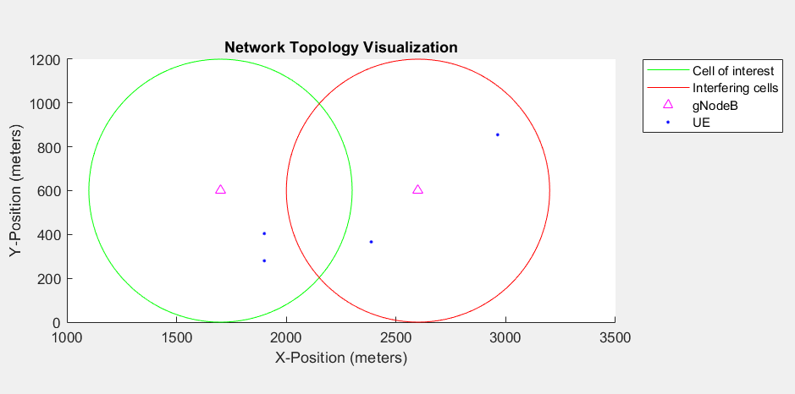
Impact of number of UEs per Cell
(UE positions on x-axis is set to 1900)

Slide 18
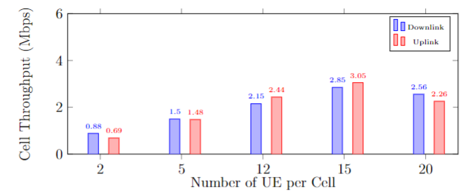
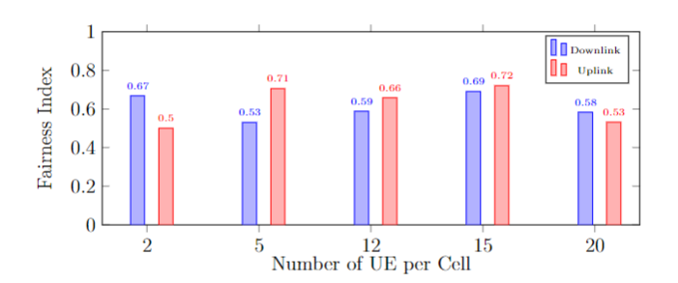
Impact of number of UEs per Cell
Up to 15 UEs, due to unused resources we observe an increase in achieved cell throughput.
However, as the number of UEs continue to grow, the resources are no longer sufficient hence throughput starts to decline.
We do not see a consistent correlation between number of UEs per cell and the resulted Jains fairness index

Slide 19
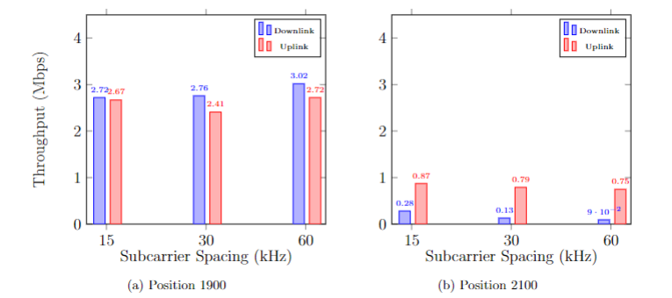
Impact of Subcarriers Spacing
Larger subcarrier spacing supports higher-frequency bands, along with a shorter symbol duration, enabling faster data transmission.
Also, a bigger subcarrier spacing is also less likely to have interference but also has less resources.
At UE x-axis position 1900, there is little interference. Hence with increased sub-carrier spacing, we observe a slight increase in downlink throughput, but uplink throughput fluctuated
At UE x-axis position 2100, Both uplink and downlink throughputs decrease with the increasing subcarrier spacing due to increased interference level

Slide 20
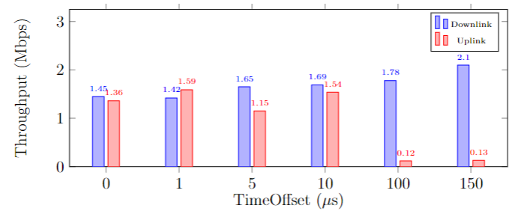
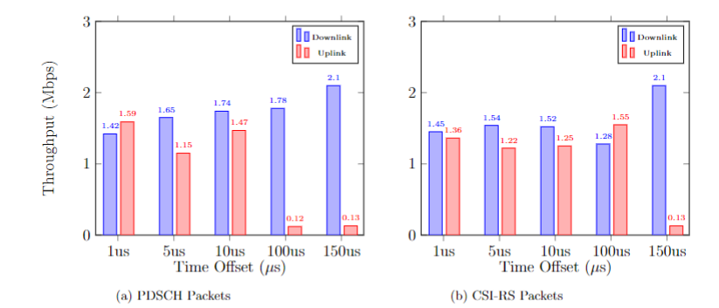
Impact of Time Synchronization
With increased time offset, we would expect decline in cell performance, yet the results of the simulation is not consistent with the expected outcome
Only beyond 100 μs offset, the uplink throughput decreases but this offset for TDD systems in 5G is not practical since it is much beyond the requirements mentioned in the Recommendation G.8271/Y.1366
Time offset for PDSCH(Physical Data Shared Channel) packets: Same effect on the cell performance with first scenerio except the 10 μs time offset
Offset for CSI-RS (Channel Start Information Reference Signal) Packets: The results are not consistent.
Drastic increase in uplink throughput with 100 μs offset appliead to CSI-RS packets compared to PDSCH offset, which is beyond practical offset range

Slide 21
Conclusion
While the requirements of time synchronization are clearly laid out by ITU-G8271, the exact effect of different time offsets on 5G NR TDD at the application layer remains an open question in this field
Based on 5G toolbox from mathworks, we created a testing framework for the time synchronization in a 5G NR TDD setting
The lack of UE2UE interference, Cell-selection multipath implementations might prevent us from achieving more accurate results, yet our framework proved to be a useful and versatile base for further research

Slide 22

Thank You For Listening!
Questions?

Slide 23
APPENDIX

Slide 24
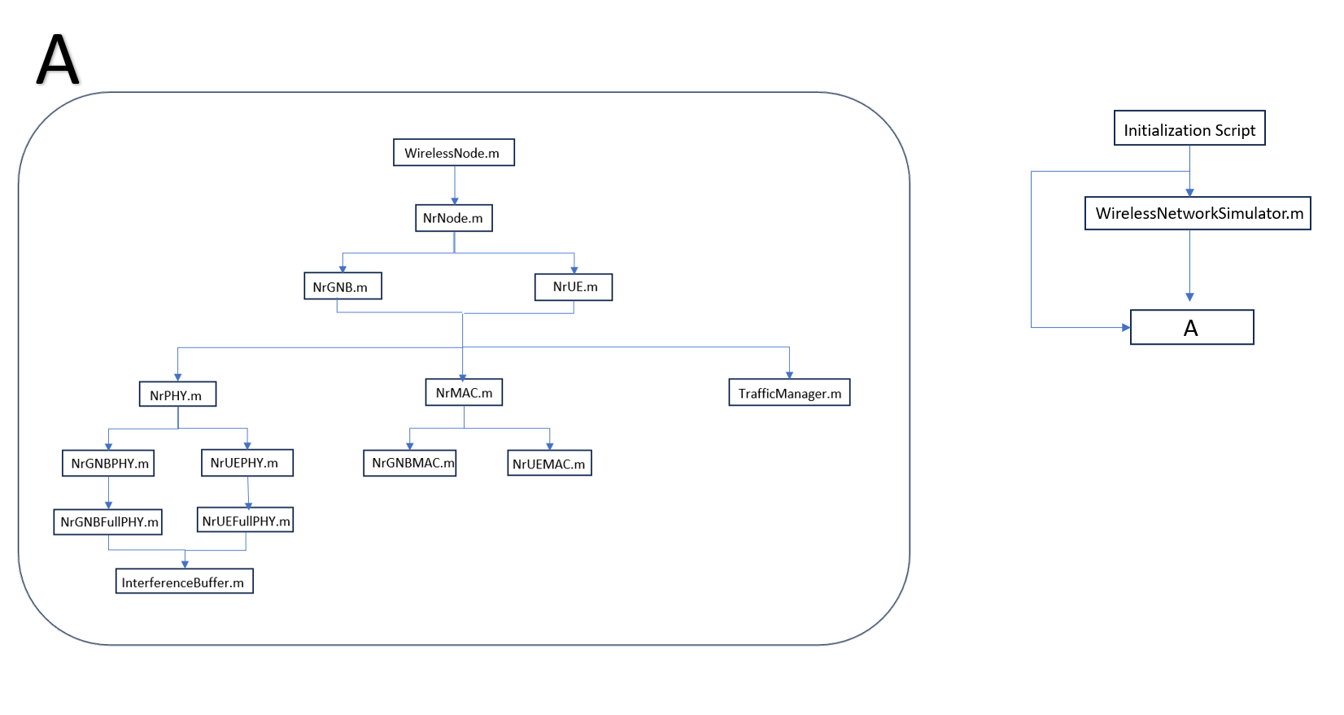

Slide 25
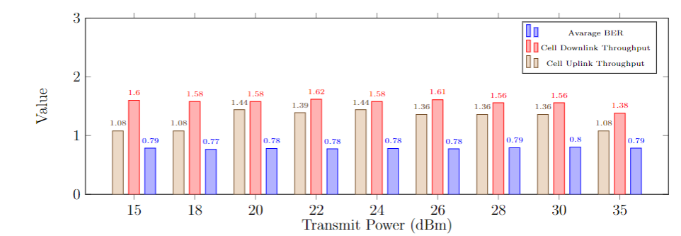
Impact of Transmit Power
Inconsistent behavior of achieved cell throughput with the increased transmit power.
The effect of transmit power on bit error rate can be considered negligible
(UE positions are set to 1900)

Slide 26
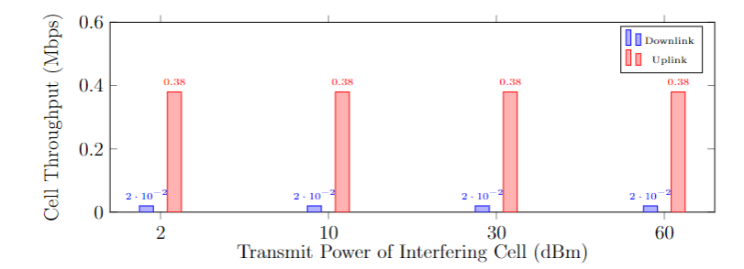
Impact of Transmit Power
Changing the transmit power of only the aggressor cell has no effect on the throughput despite the UEs of the victim cell being within the radius of the aggressor cell
(Cell of interest fixed to 18 dBm and UE positions are set to 2100)

Slide 27
Connect time sync with interference
(There is a range of bandwidths that dont interfere so increasing the bw range doesnt have an effect) → dont write in in the slide

