Slide 1

Week 5: Static methods, Enum types, Deeper in classes
week5
Ozacar Kasim, PhD | Assist. Prof. | Computer Engineering Department

Slide 2
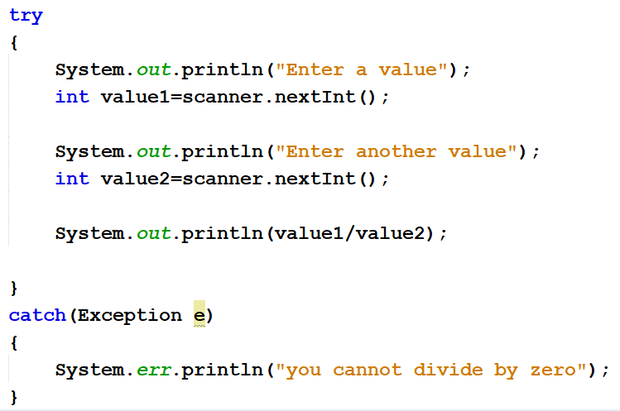
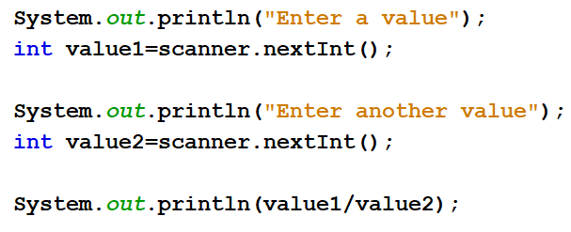
Exception Handling
Previously on OOP
Summary: week4
SYNTAX
USAGE
try{
//statements may cause an exception
}
catch (Exception(type) e(object))‏
{
//error handling code
}

Slide 3
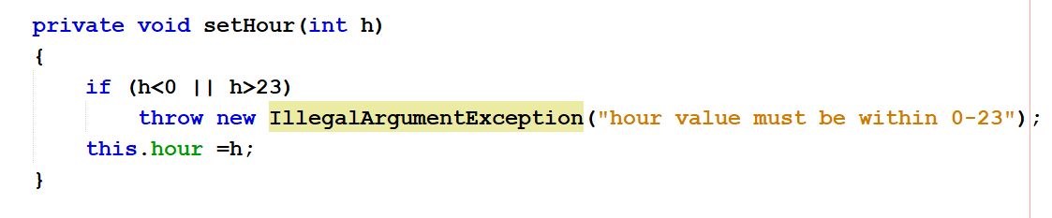
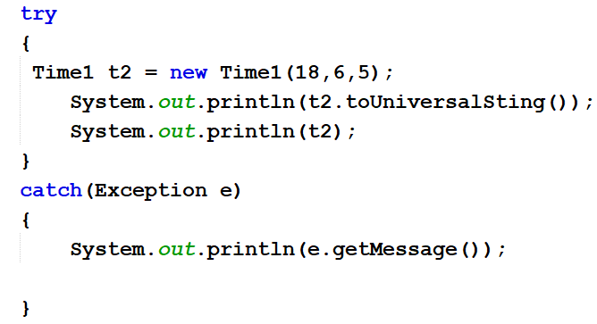
Throw a new custom Exception
Previously on OOP
Summary: week4
Time1Class
MainClass (Week4ThuDayClass)

Slide 4
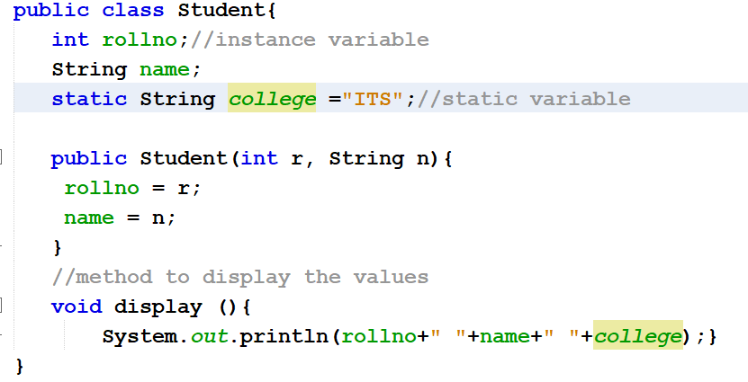
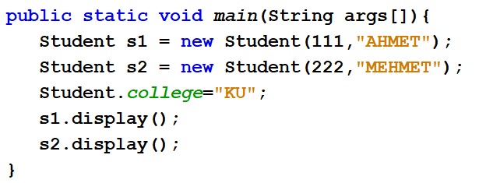
Static variable: An example
Previously on OOP
Summary: week4
The static variable can be used to refer to the common property of all objects (which is not unique for each object), for example, the company name of employees, college name of students, etc.
The static variable gets memory only once in the class area at the time of class loading.

Slide 5
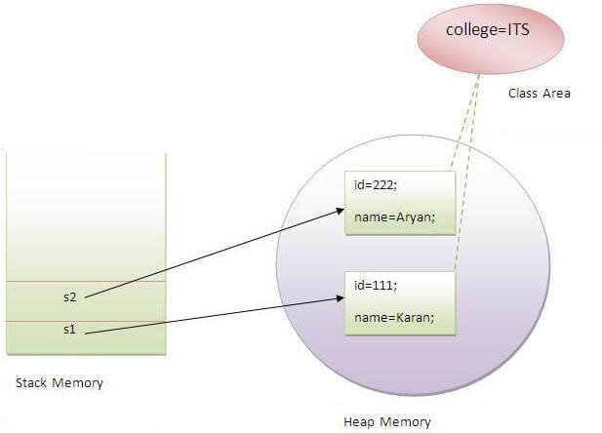
Visualization of static variable
Previously on OOP
Summary: week4
Notes:
Static variables are initialized before any object of that class is created. A static variable is initialized only, when the class is first loaded into the JVM, which happens the first time it is referenced in code, not when the instance is created.

Slide 6
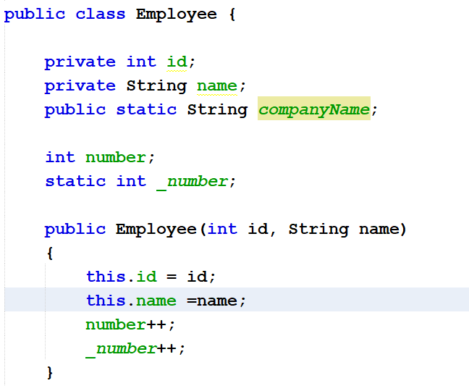
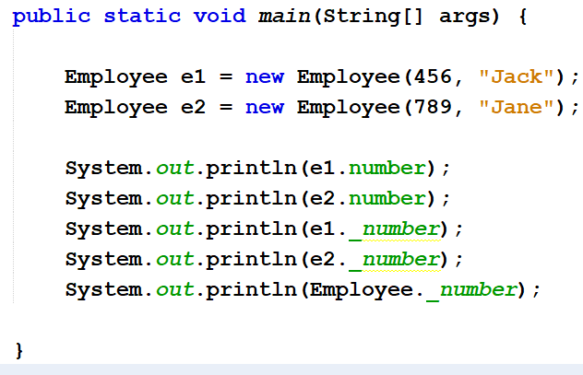
Static variable: An Exercise
Previously on OOP
Summary: week4

Slide 7
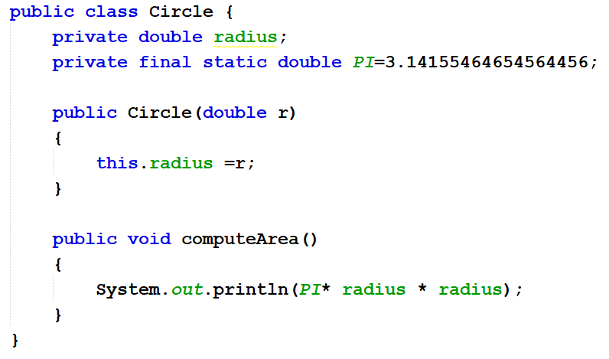
Java Constants : final Keyword for variables
Previously on OOP
PI
When a variable is declared with final keyword, its value can’t be modified, essentially, a constant.
This also means that you must initialize a final variable.
If you cannot change it then you must initialize it, right!
initializing
Summary: week4

Slide 8
Table of Contents
Static methods
Enum types
Deeper in Classes
Working with multiple object types

Slide 9
What is Static Method in Java?
Static method is a method which belongs to the class and not to the object(instance)
A static method can access only static data. It can not access non-static data (instance variables)
A static method can call only other static methods and can not call a non-static method from it.
A static method can be accessed directly by the class name and doesn’t need any object
A static method cannot refer to "this“ keyword.

Slide 10
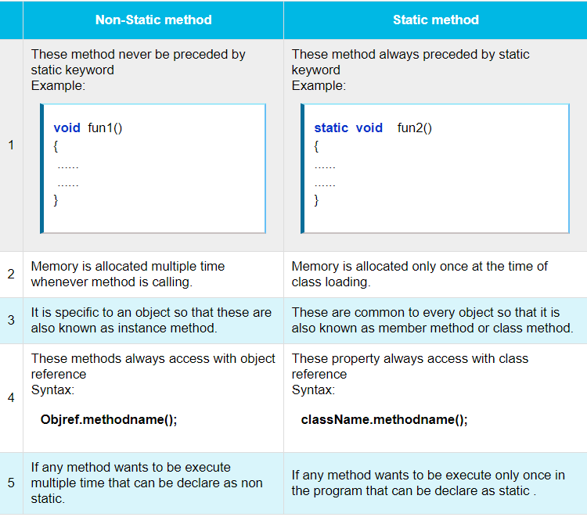
Notes:
Static methods are stored in Metaspace space of heap as they are associated to the class

Slide 11
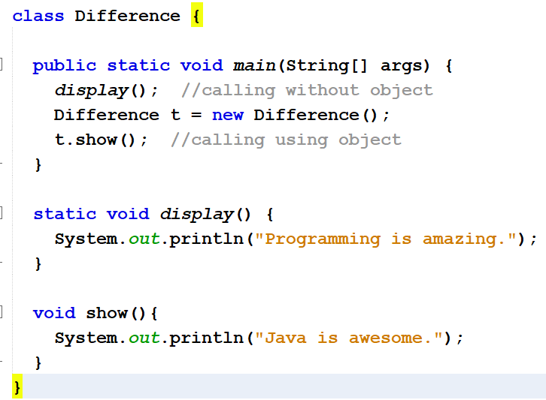
Static Method vs Non-Static (Instance) Method

Slide 12
Another Example
class MyClass{
private static int data;
public static void setData(int d) {
data = d;
}
public static int getData() {
return data;
}
}
public class JavaApp {
public static void main(String[] args) {
MyClass.setData(50);
System.out.println(MyClass.getData());
}
}
No need to create an object

Slide 13
We know the static keyword now.
So, why is the main method static?
Notes:
because keyword static allows main to be called without creating an object of the class in which the main method is defined.

Slide 14
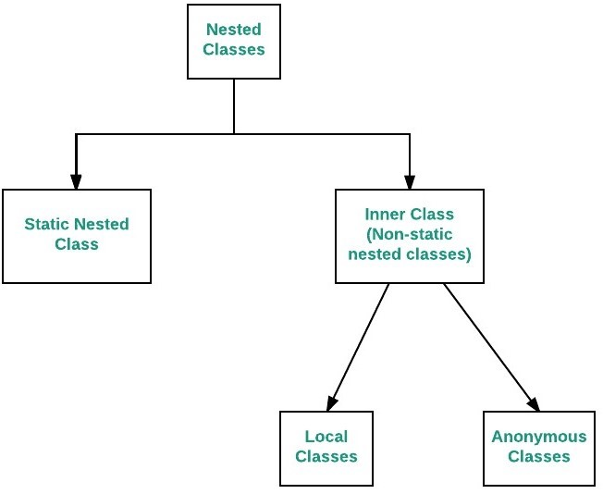
Nested Classes
The Java allows you to define a class within another class. Such a class is called a nested class
Nested classes are divided into two categories:
non-static. Non-static nested classes are called inner classes.
Static: Static nested classes are called static nested classes
class OuterClass {
...
static class StaticNestedClass {
...
}
}
class OuterClass {
...
class InnerClass {
...
}
}

Slide 15
Inner class
As with instance methods and variables, an inner class is associated with an instance of its enclosing class and has direct access to that object's methods and variables.
Also, because an inner class is associated with an instance, it cannot define any static members itself.
class OuterClass {
...
class InnerClass {
...
}
}
Inner classes
OuterClass outerObject = new OuterClass(); //you need to create an object first
OuterClass.InnerClass innerObject = outerObject.new InnerClass();

Slide 16
Static Nested Classes
As with class methods and variables, a static nested class is associated with its outer class.
And like static class methods, a static nested class cannot refer directly to instance variables or methods defined in its enclosing class: it can use them only through an object reference.
class OuterClass {
...
static class StaticNestedClass{
...
}
}
Static nested classes
//you do not need to create and object from OuterClass
OuterClass.StaticNestedClass nestedObject = new OuterClass.StaticNestedClass();

Slide 17
Why Use Nested Classes?
If a class is useful to only one other class, then it is logical to embed it in that class and keep the two together.
It increases encapsulation:
It can lead to more readable and maintainable code:
https://docs.oracle.com/javase/tutorial/java/javaOO/nested.html
Notes:
If a class is useful to only one other class, then it is logical to embed it in that class and keep the two together.
It increases encapsulation:
Consider two top-level classes, A and B, where B needs access to members of A that would otherwise be declared private. By hiding class B within class A, A's members can be declared private and B can access them. In addition, B itself can be hidden from the outside world.
It can lead to more readable and maintainable code:
Nesting small classes within top-level classes places the code closer to where it is used.

Slide 18
Inner Class
class OuterClass {
int x = 10;
class InnerClass {
int y = 5;
}
}
public class MyMainClass {
public static void main(String[] args) {
OuterClass myOuter = new OuterClass();
OuterClass.InnerClass myInner = myOuter.new InnerClass();
System.out.println(myInner.y + myOuter.x);
}
}
//what if this is private?

Slide 19
Static nested Class
class OuterClass {
int x = 10;
static class InnerClass {
int y = 5;
}
}
public class MyMainClass {
public static void main(String[] args) {
OuterClass.InnerClass myInner = new OuterClass.InnerClass();
System.out.println(myInner.y);
}
}

Slide 20
Enum Types
Syntax
An enum type is a special data type that enables for a variable to be a set of predefined constants.
The variable must be equal to one of the values that have been predefined for it.
Common examples include compass directions (values of NORTH, SOUTH, EAST, and WEST), the days of the week and so on.
enum Day {
SUNDAY,
MONDAY,
TUESDAY,
WEDNESDAY,
THURSDAY,
FRIDAY,
SATURDAY
}
//simple enum

Slide 21
Enum Types with Constructor
A Java enum type can have a private constructor that can be used to initialize instance variables(attributes).
public enum Branch {
MATH(001),
PHYSICS(002),
GEOMETY(003)
private int fieldId;
Branch(int fieldId){
this.fieldId =fieldId;
}
}
values() method can be used to return all values present inside enum
Looping through enum items
Branch[] brunches= Branch.values() ;
for(Branch b : brunches) {
System.out.println(b);
}

Slide 22
Enum types with Classes: Making CompanyName
enum CompanyName{
GOOGLE(1995, "Google was founded in 1998 by Larry Page and Sergey Brin while"),
MICROSOFT(1975, "Microsoft Corporation is a technology company with headquarters in Redmond, Washington");
final private String description;
private int createdYear;
private CompanyNames(int cYear, String desc) {
this.description = desc;
this.createdYear = cYear;
}
public String getDescription(){
return this.description;
}
}

Slide 23
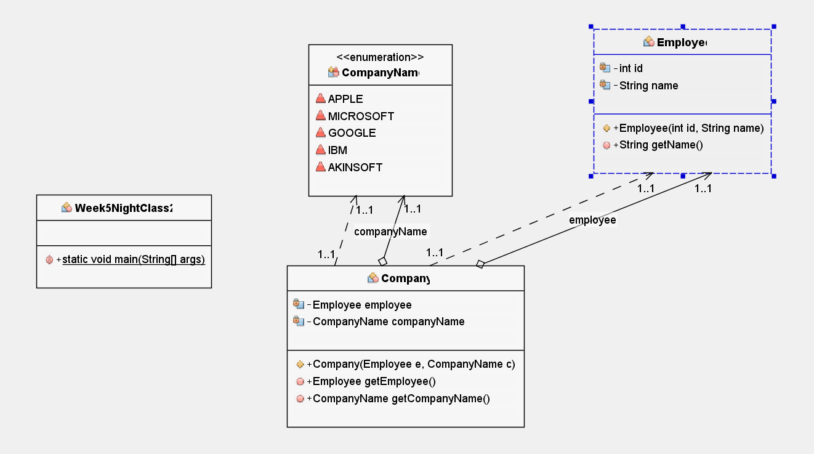
Example: Lets move to Editor!

Slide 24
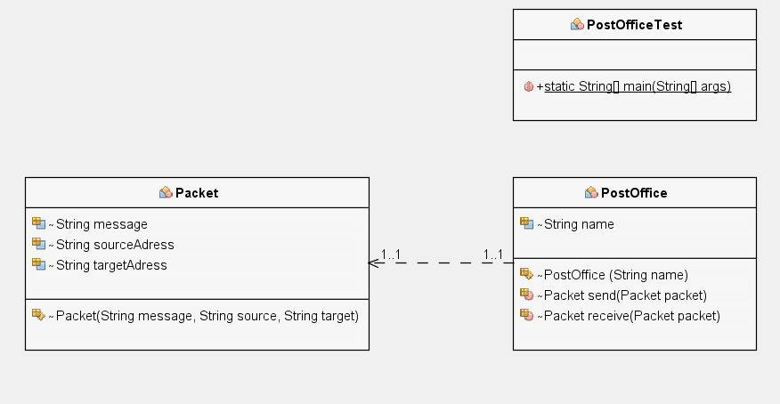
HW: Working with multiple object types
Post
Post send(Post post)
Post
Post receive(Post post)
HW: First create PostOffice and Post Classes. Then, create two-postOffice objects from PostOffice class. Then, create a post object in order to send it from PostOffice. send() post using a post office; and the other postoffice will receive() it

Slide 25
Lab Exercise-1: static keyword
Create a Circle class where
declare a private constant double variable PI has value of 3,141519
declare a private variable called radius.
class constructor will have an argument to set radius.
declare a method called computeArea() to compute area of a circle object.
create 3 different circle instances, with radiuses 5, 10, 15.
print all the areas using a foreach loop.

Slide 26
Lab Exercise-2: Enum types
Create Branch Enum type will contain following branches
MATH(“information regarding math”)
PHYSICS(“information regarding physics”)
CS(“information regarding cs”)
ENG(“information regarding eng”)
Create a Teacher Class which contains id (int), and branch (Enum) attributes. The class must have a constructor with these two parameters.
Create four teacher objects; each has different branch.
Put them all in an array, and print their branches using for loop.

