Slide 1

Week 6: Deeper in classes: this() & toString() + Alpha
Week 6
“practice makes perfect”
Ozacar Kasim, PhD | Assist. Prof. | Computer Engineering Department

Slide 2
Previously on OOP
Summary: week5
Static methods
Enum types

Slide 3
What is Static Method in Java?
Summary: week5
memory for static method is allocated only once at the time of class loading.
Static method in Java is a method which belongs to the class and not to the object
A static method can access only static data
A static method can be accessed directly by the class name and doesn’t need any object. So there is no need to create an object.

Slide 4
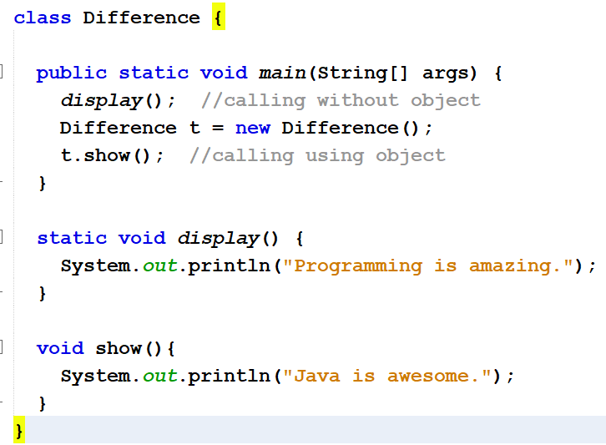
Static Method Usages
Summary: week5

Slide 5
Exercise
Summary: week5
class Student {
int a; //initialized to zero
static int b; //initialized to zero only when //class is loaded not for each object created.
Student(){
b++;
}
public void showData(){
System.out.println("Value of a = "+a);
System.out.println("Value of b = "+b);
}
public static void increment(){
a++;
}
}
public class Demo{
public static void main(String args[]){
Student s1 = new Student();
s1.showData();
Student s2 = new Student();
s2.showData();
Student.b++;
s1.showData();
}
}

Slide 6
Enum Types
Summary: week5
An enum type enables for a variable to be a set of predefined constants.
Constructor in enum can be used to initialize instance variables(attributes).
Just like classes, enums can have variables and methods
enum Branch {MATH,PHYSICS, GEOMETY}
enum Branch {
MATH(001),
PHYSICS(002),
GEOMETY(003);
private int fieldId;
Branch(int fieldId){
this.fieldId =fieldId;}
}
values() method can be used to return all values present inside enum
Looping through enum items
for(Branch b : Branch.values()) {
System.out.println(b);
}

Slide 7
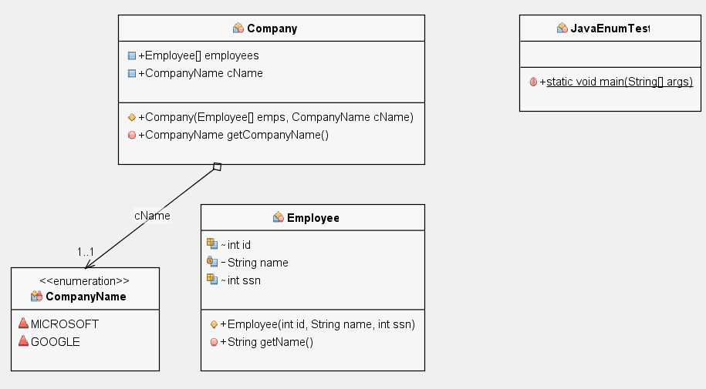
Example: Using multiple classes + Enum Types
Summary: week5

Slide 8
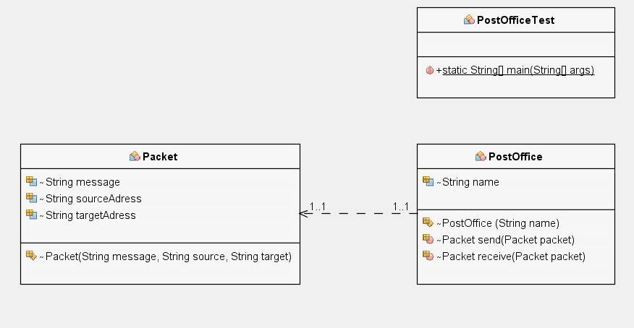
Summary: week5
HW: First create PostOffice and Post Classes.
Then, create two-postOffice objects from PostOffice class.
Then, create a post object in order to send it from PostOffice.
send() post using a post office; and the other postoffice will receive() it
Post
void send(Post post)
Post
void receive(Post post)

Slide 9
Table of Contents
Class exercises
Writing the PostOffice class
Using this() methods
Using toString() methods
Garbage Collection and Method finalize
Another Exercise
Rock Scissor Paper Game

Slide 10
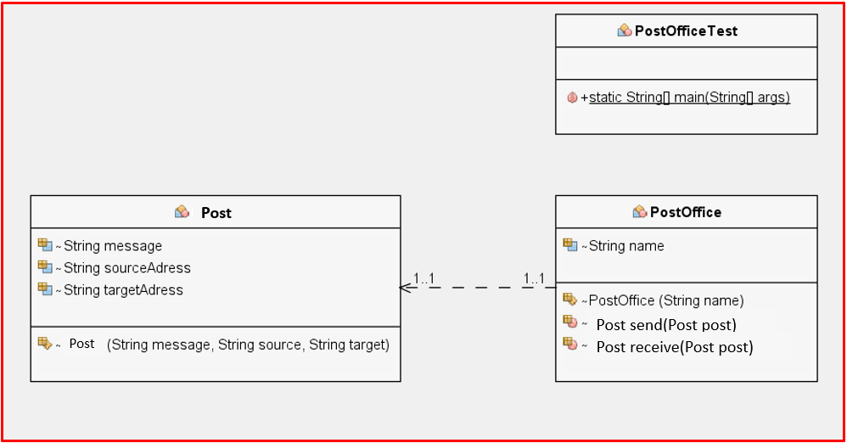
Let's solve PostOffice question

Slide 11
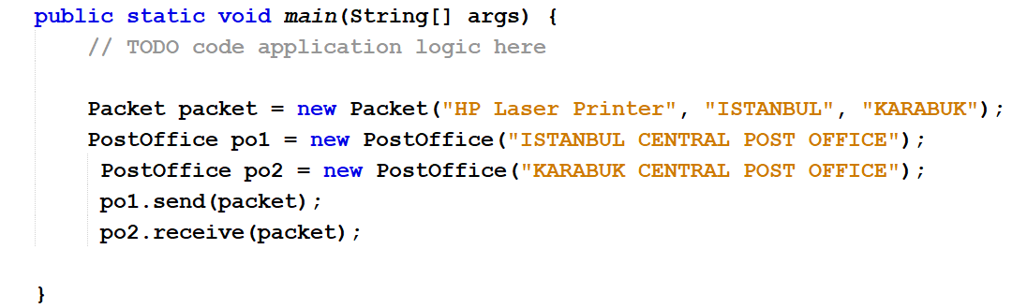
PostOfficeTest (The main class)
Post post = new Post
post
post

Slide 12
public class Rectangle {
private int x, y;
private int width, height;
public Rectangle() { //to create a unit rectangle(a square) at origin
this.x = 0; //user-defined rectangle at specific coordinates.
this.y = 0;
this.width = 1;
this.height = 1;
}
public Rectangle(int width, int height) { // to create user-defined this.x = 0; //user-defined rectangle at specific coordinates.
this.y = 0;
this.width = width;
this.height = height;
}
public Rectangle(int x, int y, int width, int height) { //to create a this.x = x; //user-defined rectangle at specific coordinates.
this.y = y;
this.width = width;
this.height = height;
}
}
.(0,0)
1
1
.(0,0)
height
width
.(0,0)
.(x,y)
height
width
12
THIS WAY OF WRITING IS NOT GOOD

Slide 13
Calling a Constructor From a Constructor
this() constructors are used to call (invoke) an alternate constructor of the same class.
public class Rectangle {
private int x, y;
private int width, height;
public Rectangle() { //to create a unit rectangle(a square) at origin
this(0, 0, 1, 1);
}
public Rectangle(int width, int height) { // to create user-defined this(0, 0, width, height); // rectangle at origin
}
public Rectangle(int x, int y, int width, int height) { //to create a this.x = x; //user-defined rectangle at specific coordinates.
this.y = y;
this.width = width;
this.height = height;
}
}
.(0,0)
.(0,0)
height
width
.(0,0)
.(x,y)
height
width

Slide 14
toString() method
class Student{
int rollno;
String name;
Student(int rollno, String name){
this.rollno=rollno;
this.name=name;
}
public String toString(){
return rollno+" "+name+" "+city;
}
public static void main(String args[]){
Student s1=new Student(101,“Jack",“Sparrow");
Student s2=new Student(102,“Johnny",“Cash");
System.out.println(s1); //compiler writes here s1.toString()
System.out.println(s2); //compiler writes here s2.toString()
}
}
OUTPUT:
If you want to represent any object as a string, toString() method comes into existence.
toString() returns a string representation of the object.
In general, the toString method returns a string that "textually represents" this object.
If you print any object, java compiler internally invokes the toString() method on the object.
We will mention it again in polymorphism.

Slide 15
Garbage Collection
Every object uses system resources, such as memory.
Wee need to give resources back to the system when they’re no longer needed; otherwise, “resource leaks” might occur. (OutOfMemoryErrors)
In C/C++, programmer is responsible for both creation and destruction of objects.
[int *ptr; ptr = (int *)malloc(sizeof(int)); *ptr = 25; free(ptr); ]
But, The JVM performs automatic garbage collection to destroys the objects no longer in use.
When there are no more references to an object, the object is eligible to be collected. Collection typically occurs when the JVM executes its garbage collector.
Main objective of Garbage Collector is to free heap memory by destroying unreachable objects.

Slide 16
Garbage Collection (conts.)
Every class in Java has the methods of class Object (package java.lang), one of which is method finalize.
finalize allows the garbage collector to perform termination housekeeping on an object just before reclaiming the object’s memory.
You should never use method finalize, because it can cause many problems and there’s uncertainty as to whether it will ever get called before a program terminates.

Slide 17
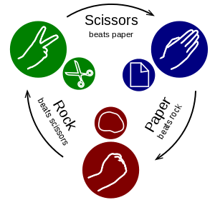
Yet Another Exercise: Rock Scissor Paper Game

Slide 18
Game Rules
Rock Scissor Paper Game
If the pair is player1 is paper and player2 is rock then player1 wins
If the pair is player1 is scissors and player2 is paper then player1 wins
If the pair is player1 is rock and player2 is scissors then player1 wins
If Player1 is same as player2, then draw!
Else player2 wins

Slide 19
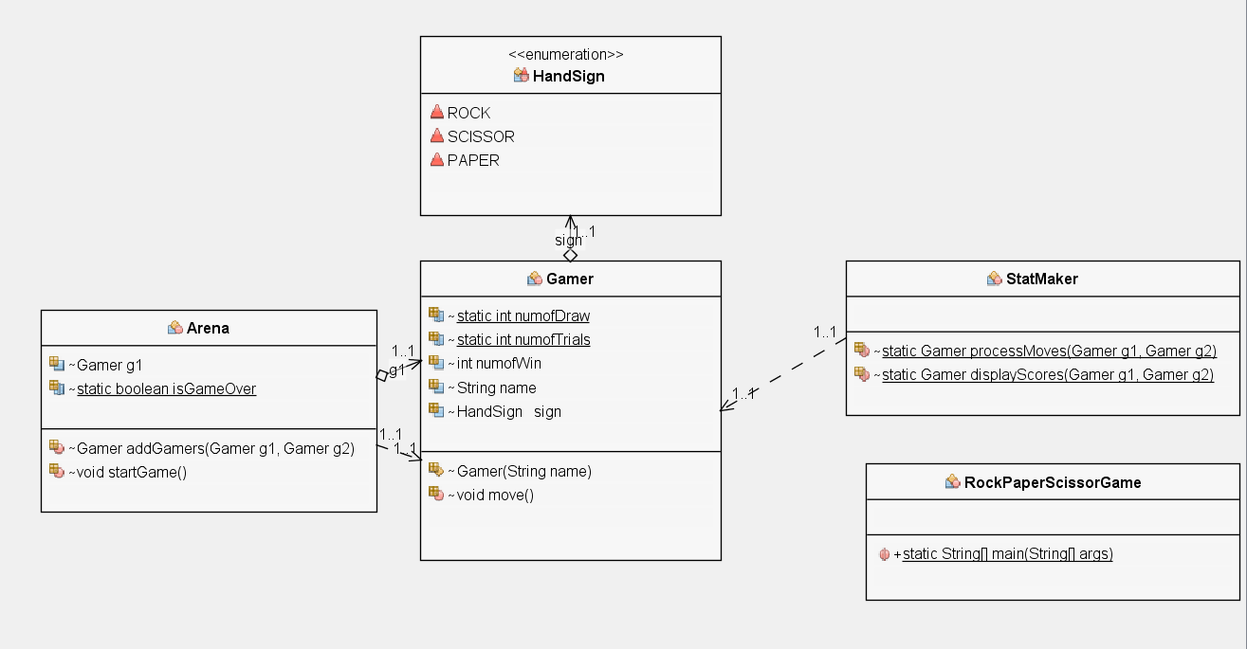
What we need are…
Rock Scissor Paper Game

Slide 20
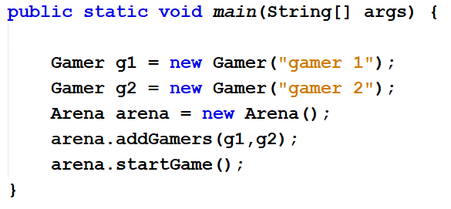
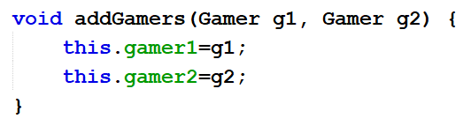
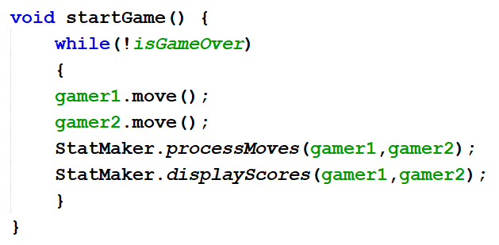
Game Logic
Rock Scissor Paper Game
RockScissorPaper Class (main class)
Arena Class

Slide 21
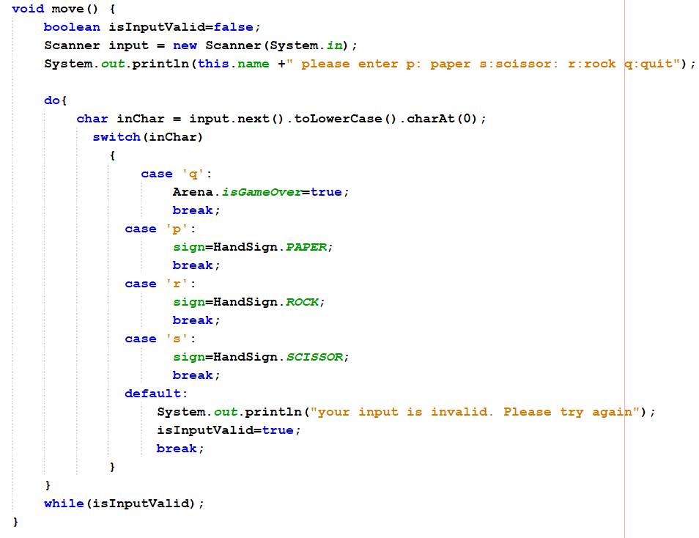
Game Logic
Rock Scissor Paper Game
Gamer Class

Slide 22
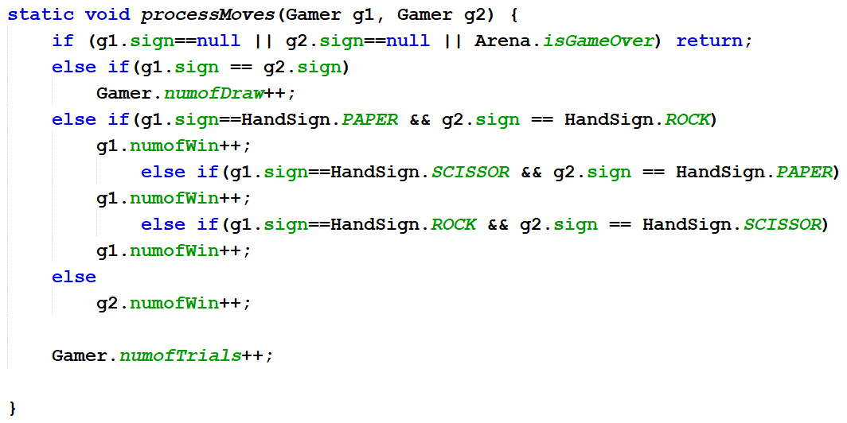
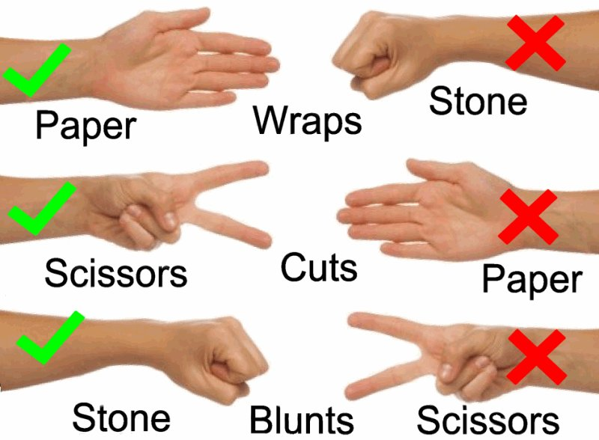
Rock Scissor Paper Game
StatMaker Class
Gamer 1
Gamer 2
Rock
Rock
Let's make this game.

