Slide 1
Factor Investing
Yağmur Seda Sankutlu Arda Demir Ege Kutlu
Boğaziçi University
EC 581 - Algorithmic Trading and Quantitative Strategies
10 June 2025

Slide 2
Agenda
Factor Models
Constructing FMP
Portfolio Approach
Cross Regression Approach
Presentation of Paper - Trend Factor
ROE Factor
P/E Factor
Momentum Factor
Volatility Factor
Composite Factor

Slide 3

Factor Models
Factor models are rooted in the idea that asset returns can be explained by a set of common factors.
By analyzing historical factor returns, investors can gain insights into the performance of different factors over time and assess their potential future behavior.
Factor investing targets specific, quantifiable factors that have historically been associated with higher returns or lower risk.
Notes:
Factor investing is an investment strategy that targets specific,

Slide 4
Ingredients of Factor Investing
Factor mimicking portfolios are investment portfolios designed to isolate and track the performance of a single investment factor.
Historical excess return generated by such a portfolio is known as the factor return or factor premium.
Factor exposure measures how sensitive a portfolio is to these distinct factor returns, quantifying its sensitivity to factors.

Slide 5


Why Factor Investing potentially successful?
Two main explanations:
Risk-Based: Some factors may provide higher returns because they compensate investors for taking on additional, specific types of risk.
Smaller companies might be riskier than larger ones, so investors demand a higher return for holding them.
Behavioral: Some factors may arise from persistent investor biases or market inefficiencies.
Investors may underreact to positive news, leading to momentum, or overreact to negative news, creating value opportunities.

Slide 6
Why Factor Investing potentially successful?
Risk-Based
Behavioral
Factors may arise from persistent investor biases or market inefficiencies.
Factors may provide higher returns because they compensate investors for taking on additional, specific types of risk.
Investors may underreact to positive news, leading to momentum, or overreact to negative news, creating value opportunities.
Smaller companies might be riskier than larger ones, so investors demand a higher return for holding them.

Slide 7
Constructing Factor Mimicking Portfolios
Portfolio Approach
Cross Sectional Regression Approach
Time Series Regression Approach
Statistical Factor Approach

Slide 8
Portfolio Approach
Identify a Factor: Choose a characteristic (e.g., momentum, value, size) that you believe predicts future stock returns.
Rank Stocks: At each period (e.g., monthly), rank all stocks in your investment universe based on their value for that chosen factor.
Form Portfolios: Divide the ranked stocks into 5 quantiles.
Go Long and Short Extremes: Construct a factor mimicking portfolio by going:
Long the portfolio of stocks with the highest (or most desirable) factor.
Short the portfolio of stocks with the lowest (or least desirable) factor values.
Calculate FMP Return: The return of this long-short portfolio is considered the return of the factor (the factor premium) for that period.
Long - Short

Slide 9
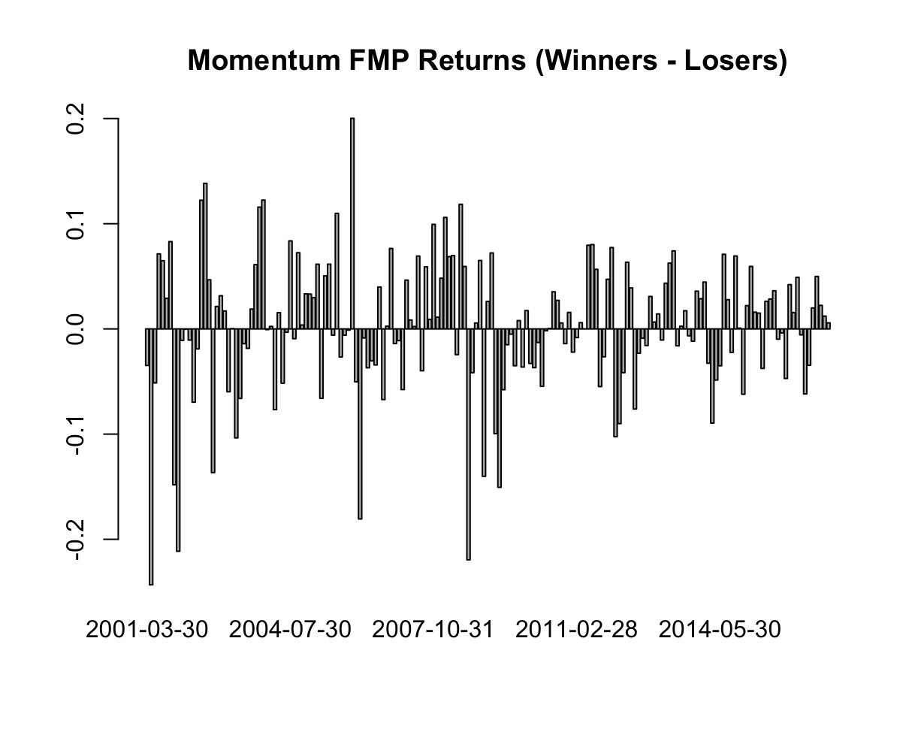
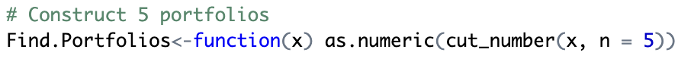
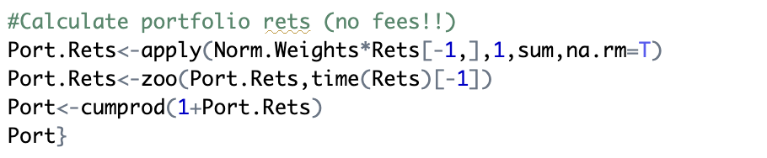
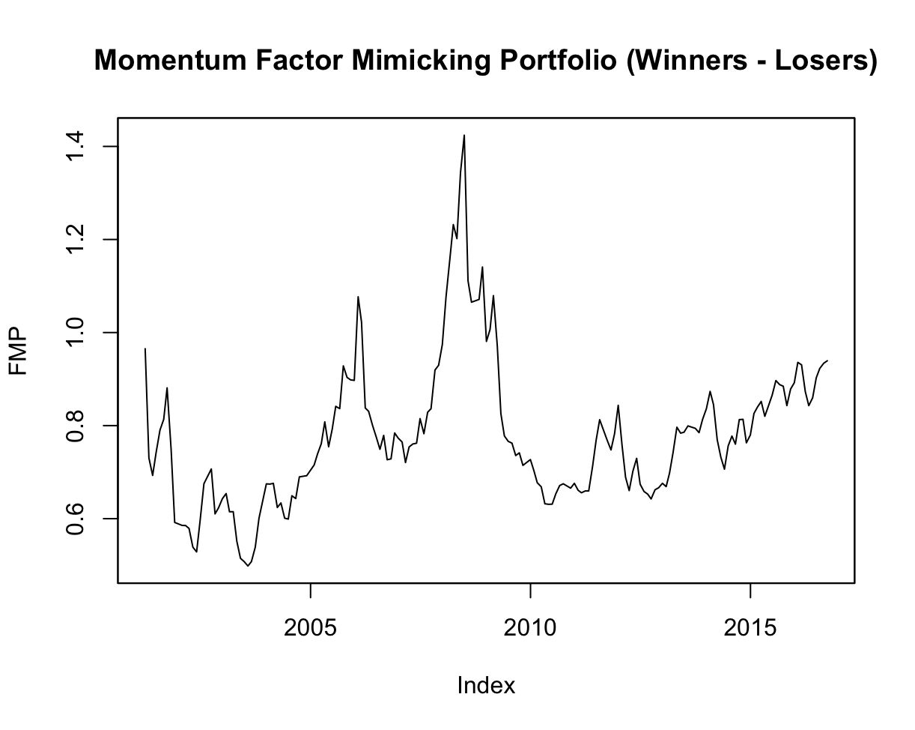
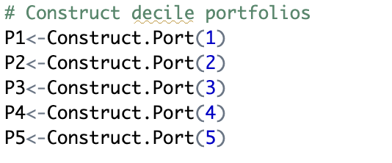
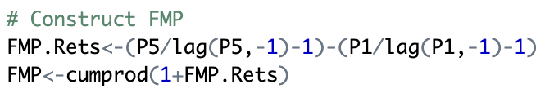
Sorting Approach
Notes:
Factor Premium:
The average positive return of FMP.Rets over time is considered the "momentum premium." If this is statistically significant and positive, it suggests that the momentum factor has historically provided a reward.

Slide 10
Cross Sectional Regression Approach
Identify a Factor: Choose a characteristic (e.g., momentum, value, size) that you believe predicts future stock returns.
Obtain Factor Exposures: For each stock at each end of month t-1, determine its exposure
Run Cross-Sectional Regressions: At each subsequent period t:
Regress the actual returns of all stocks in month t against their factor exposures from the end of month t-1.
Time Series of Factor Returns: By repeating step 3 for each month in our period, we obtain a time series of the estimated factor returns.

Slide 11
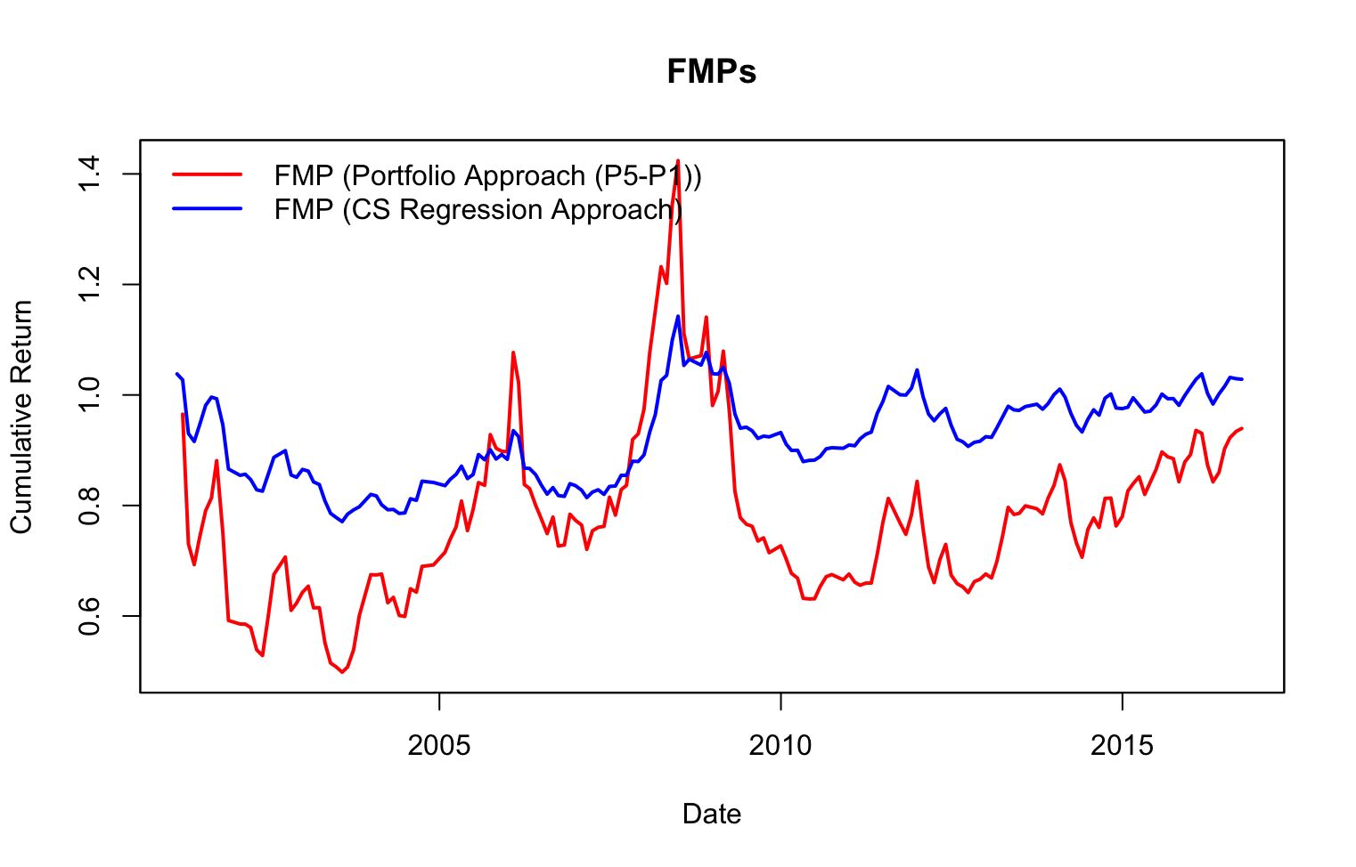
Comparison of Two Approachs
CS uses information from all stocks, not just the extremes like the sorting method.
Comparing CS FMP with the long/short FMP tests the robustness of the factor premium estimate.
If both methods yield similar performance profiles, it increases confidence that the observed factor premium is not just an artifact.

Slide 12
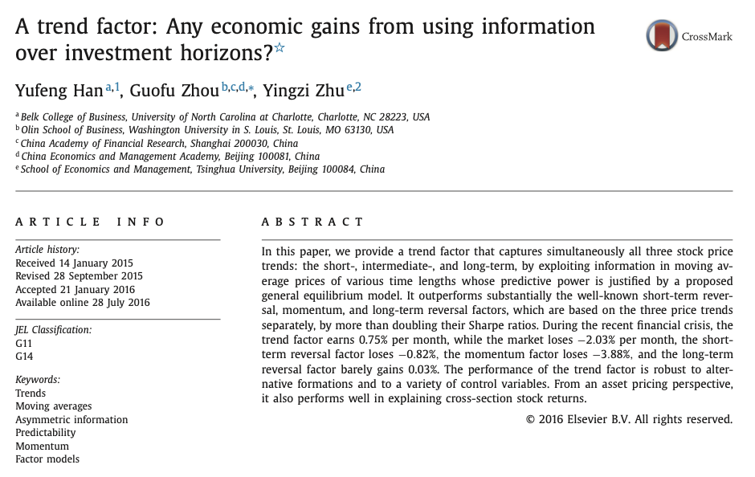
Trend Factor
Use Moving Averages across multiple horizons to forecast expected returns.
Moving Averages of:
Short Term
3 day
5 day
10 day
Intermediate Term
20 day
50 day
100 day
200 day
Long Term
400 day
600 day
800 day
1000 day

Slide 13
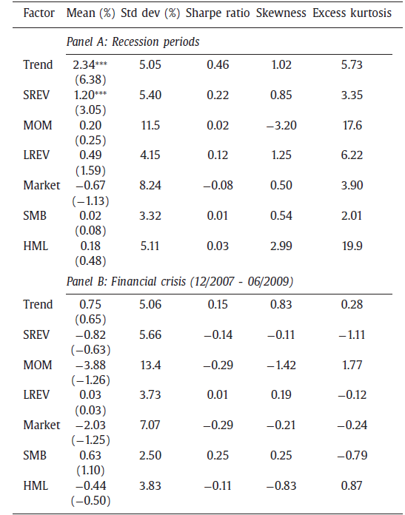
Trend Factor
Driven by behavioral biases: underreaction, herding, overconfidence.
Also seen as a risk premium: performs well during crisis periods.
Long-term Sharpe ratio: ~0.7–1.0 (robust across time and asset classes).
Cumulative return exceeds that of traditional buy-and-hold strategies.

Slide 14
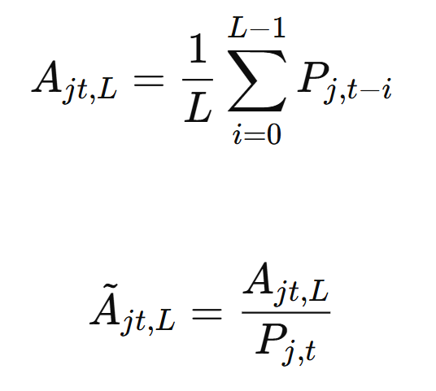
Trend Factor
Moving averages are calculated until the last trading day of months.
Then, the moving averages are normalized using the closing price during that month.

Slide 15
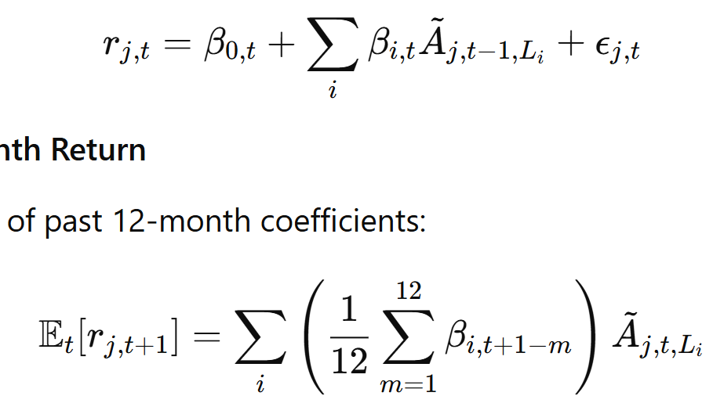
Trend Factor
Parameters are found using the real return.
Expected return for future months are calculated using the known parameters and moving averages.

Slide 16
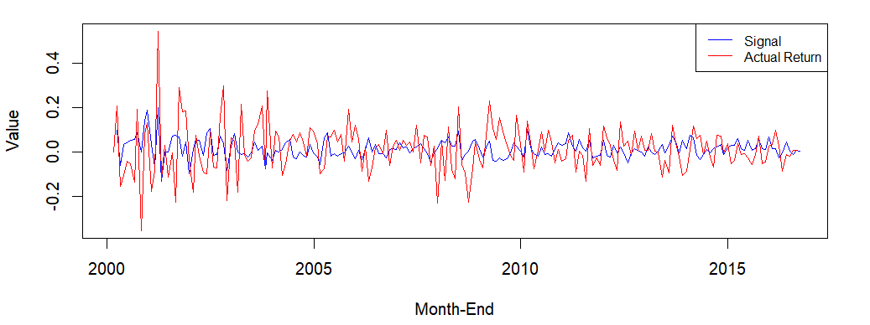
Trend Factor Construction
Parameters are calculated on BIST100 index. Not effective parameters are dropped to avoid overfitting.
Found parameters are used to calculate expected returns of remaining stocks.
Factors are next months predicted return.

Slide 17
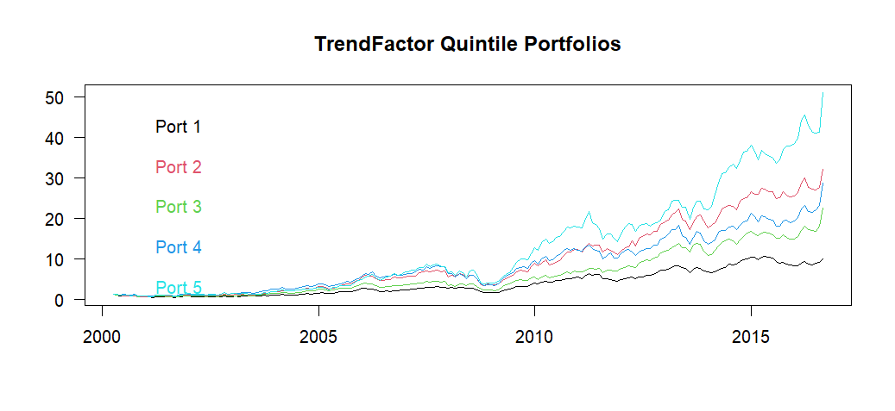
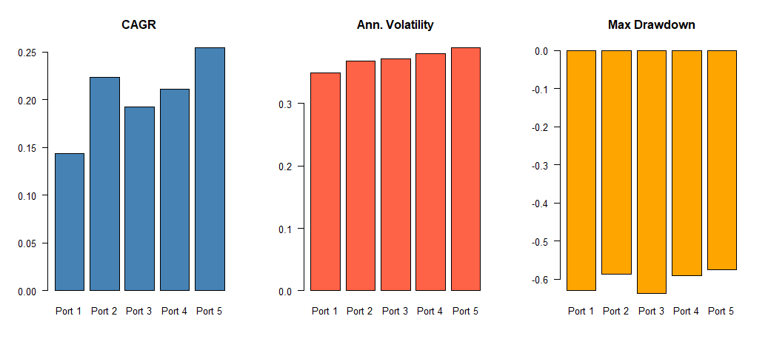
Trend Factor Performance

Slide 18
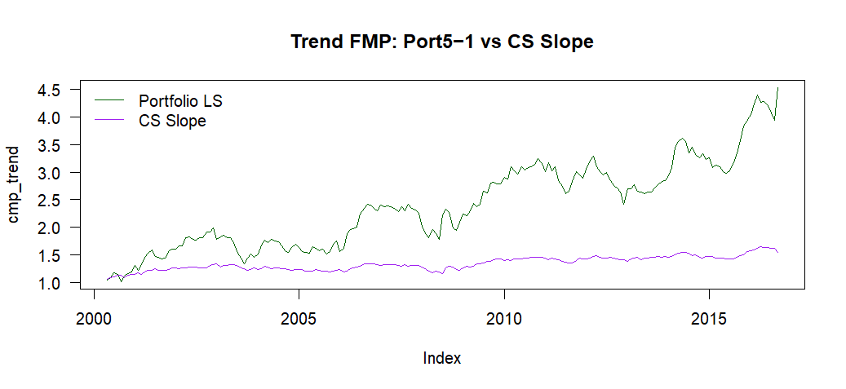
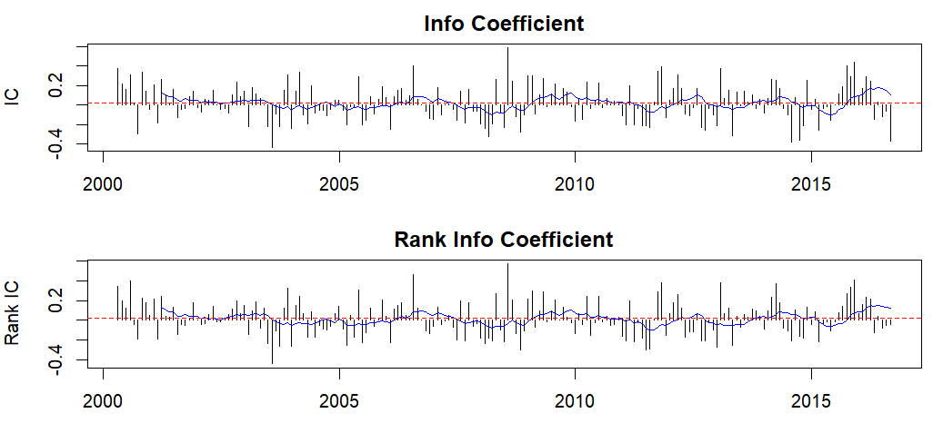
Trend Factor Returns and IC
Sharpe Ratio
FMP (Portfolio LS): 0.59
FMP (CS Regression): 0.43

Slide 19

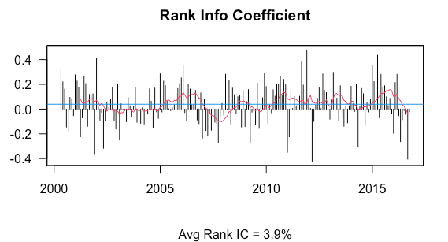
ROE Factor
It measures how efficiently a company uses its equity base to generate profits. A higher ROE indicates better management performance in turning equity into profits.
It shows the correlation between Returns and Our Factor.

Slide 20
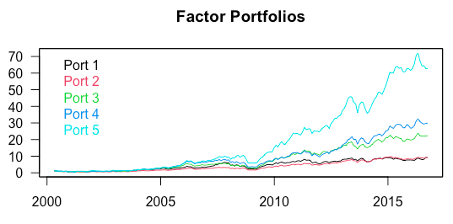
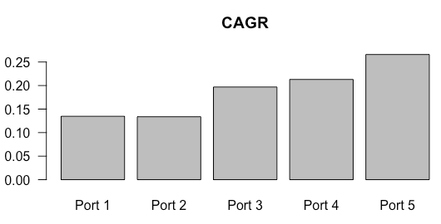
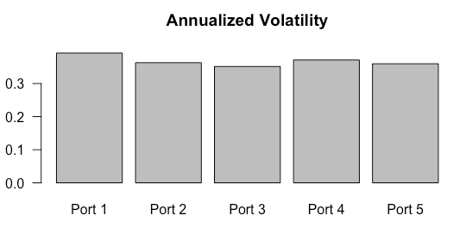
Compound Annual Growth Rate
CAGR is used for performance comparison. It represents cumulative return as if there were a constant rate of return.

Slide 21
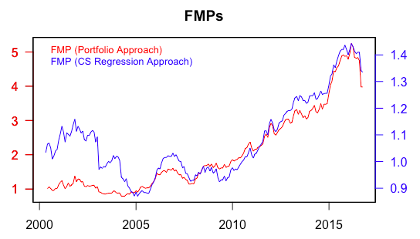
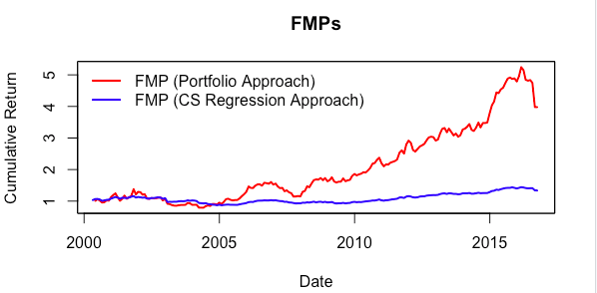
Factor Mimicking Portfolio Performances
Trend Comparison
Performance Comparison
Portfolio Sorting Approach vs CS Regression Approach

Slide 22
Portfolio Sorting Approach For ROE
We ranked the BIST 100 stocks we have according to their ROE and divided them into 5 different portfolios. These portfolios were updated and bought and sold monthly. As a result, the following statistics were created.
Portfolio | AvgRet | AnnRet | StdDev | PctOutPerf
P1 | 1.70 | 13.47 | 39.43 | 55.3
P2 | 1.60 | 13.37 | 36.59 | 51.8
P3 | 2.03 | 19.69 | 35.57 | 48.7
P4 | 2.20 | 21.29 | 37.77 | 57.4
P5 | 2.53 | 26.59 | 36.50 | 48.7
Long – Short Strategy
Avg Ret | 0.83%
Ann Ret | 8.75%
Std Dev | 17.49%
T-Statistic | 2.31
% OutPerf | 60.9%

Slide 23

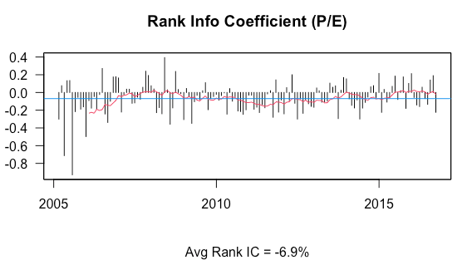
P/E Factor
It measures how expensive or cheap a stock is relative to its earnings. Here, P/E is actually inverse because it divides a company's share price by its earnings. If a company's share price is high relative to its earnings, its P/E will be high.
As we mentioned above, there is a strong but inverse relationship between returns and the P/E factor.

Slide 24
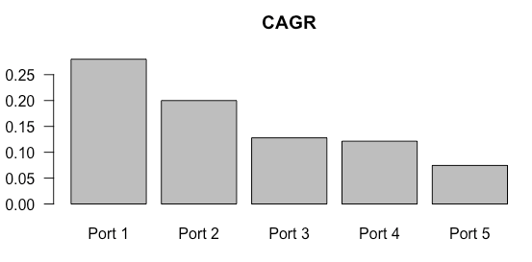
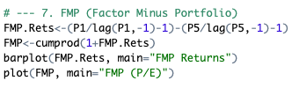
Compound Annual Growth Rate
As you can see here, we had to update our buy and sell strategy for the P/E factor. You can see this change below, this time we had to write a strategy to buy(Long) Portfolio 1 and sell(Short) Portfolio 5.

Slide 25
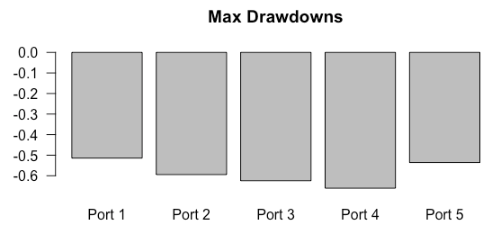
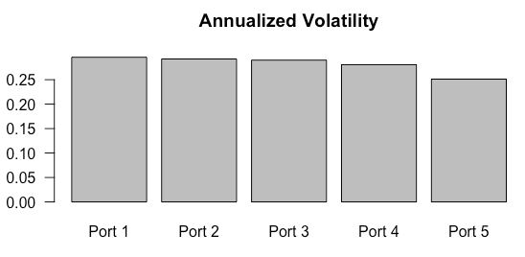
Factor Mimicking Portfolio Performances
Cheap Stocks Are Riskier. The P1 portfolio typically includes “deep value” stocks: companies that are very cheap and often troubled or punished by the market.
Cheap Stocks Are Riskier. The P1 portfolio typically includes “deep value” stocks: companies that are very cheap and often troubled or punished by the market.

Slide 26
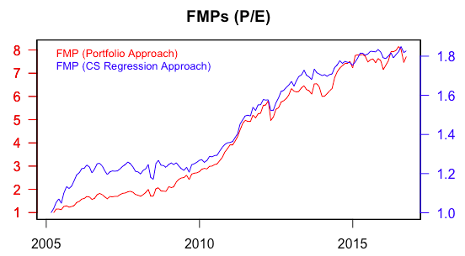
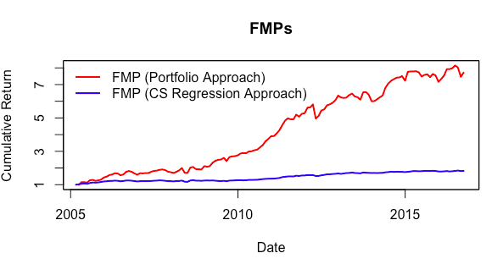
Factor Mimicking Portfolio for P/E
We can see that the P/E factor brings higher returns than the ROE factor in both approaches.

Slide 27

P/E Factor Statistics
When we compare it with the ROE Factor, we see that the P/E factor works much better in BIST 100.
more annual return
Portfolio | AvgRet | AnnRet | StdDev | PctOutPerf
P1 | 2.44 | 27.98 | 29.53 | 59.7
P2 | 1.89 | 19.99 | 29.06 | 55.8
P3 | 1.35 | 12.79 | 28.67 | 56.7
P4 | 1.28 | 12.27 | 27.61 | 52.4
P5 | 0.86 | 7.45 | 24.73 | 38.7
Long – Short Strategy
Avg Ret | 1.58%
Ann Ret | 19.52%
Std Dev | 15.79%
T-Statistic | 4.09
% OutPerf | 70.5%

Slide 28
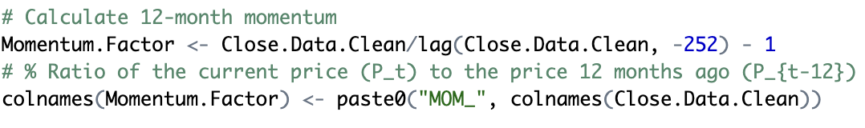
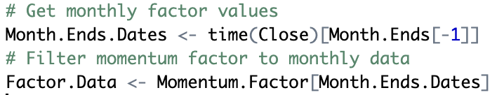
Momentum Factor
P_{t}
P_{t-12}
Momentum =
- 1
Measures the price performance of a stock over the past 12 months.
Momentum is based on the observation that winners tend to keep winning and losers tend to keep losing in the short to medium term.
Notes:
It captures the tendency of stocks’ performance in the past to continue performing the same in the future.
a "higher momentum" value represents a stock whose 12-month past return was significantly above the average 12-month past return of all other stocks in that same month, relative to the cross-sectional dispersion (standard deviation) of those past returns.

Slide 29
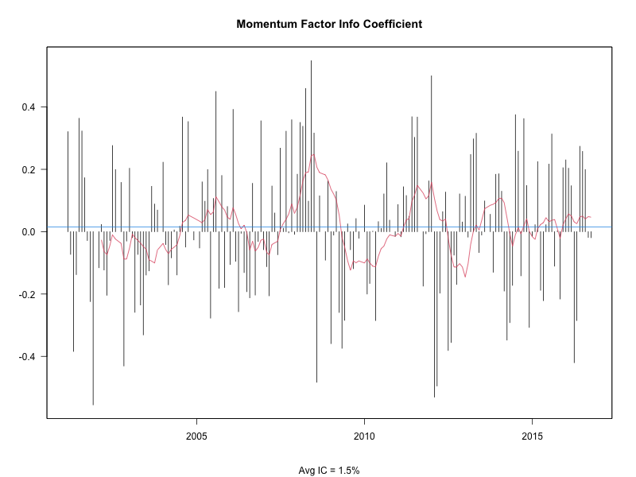
Factor Efficacy Test: IC
Information coefficient calculates the cross-sectional correlation between momentum factor values from month t-1 and the actual stock returns in month t.
A consistently positive average IC suggests that the factor has predictive power for next month's returns.
1.5 %
Low but compatible with
the momentum factor
Notes:
1.5% is on the lower end of what might be considered economically significant on its own.

Slide 30
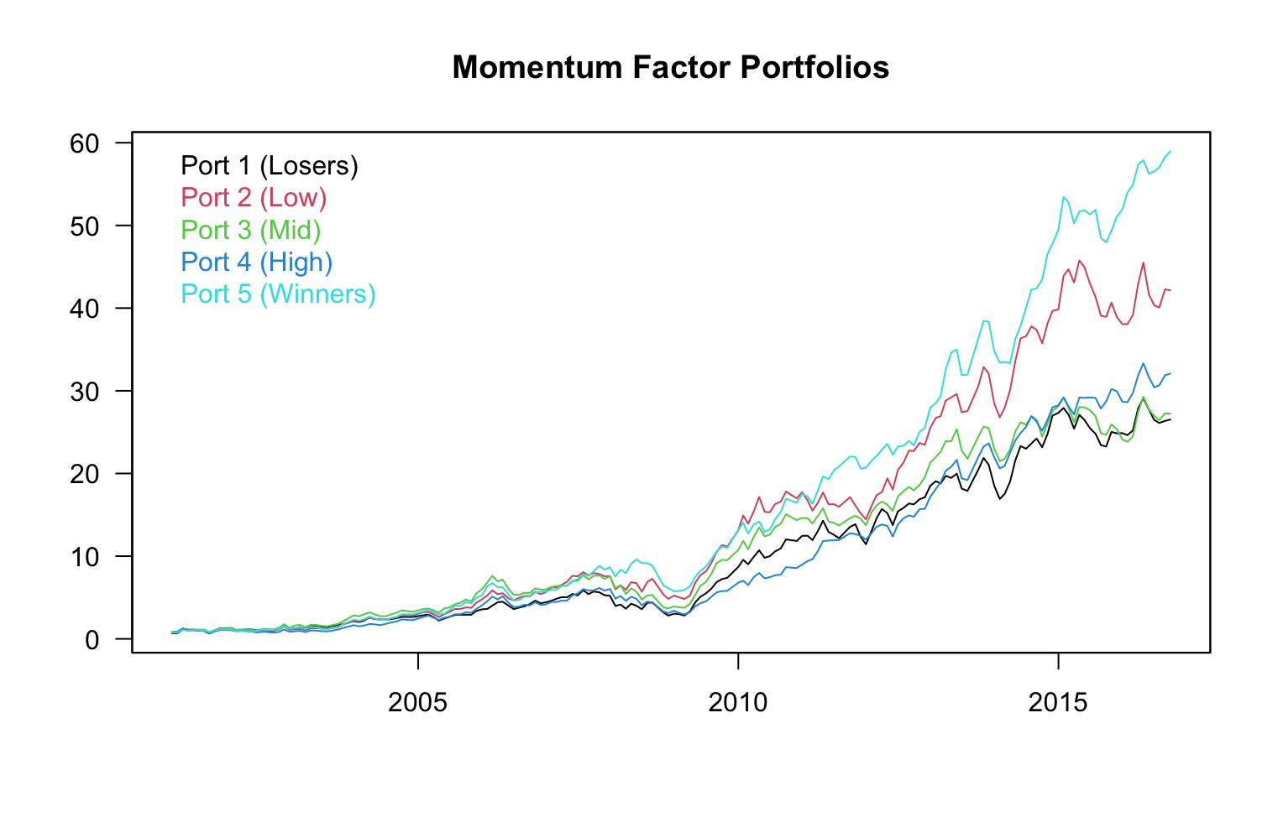
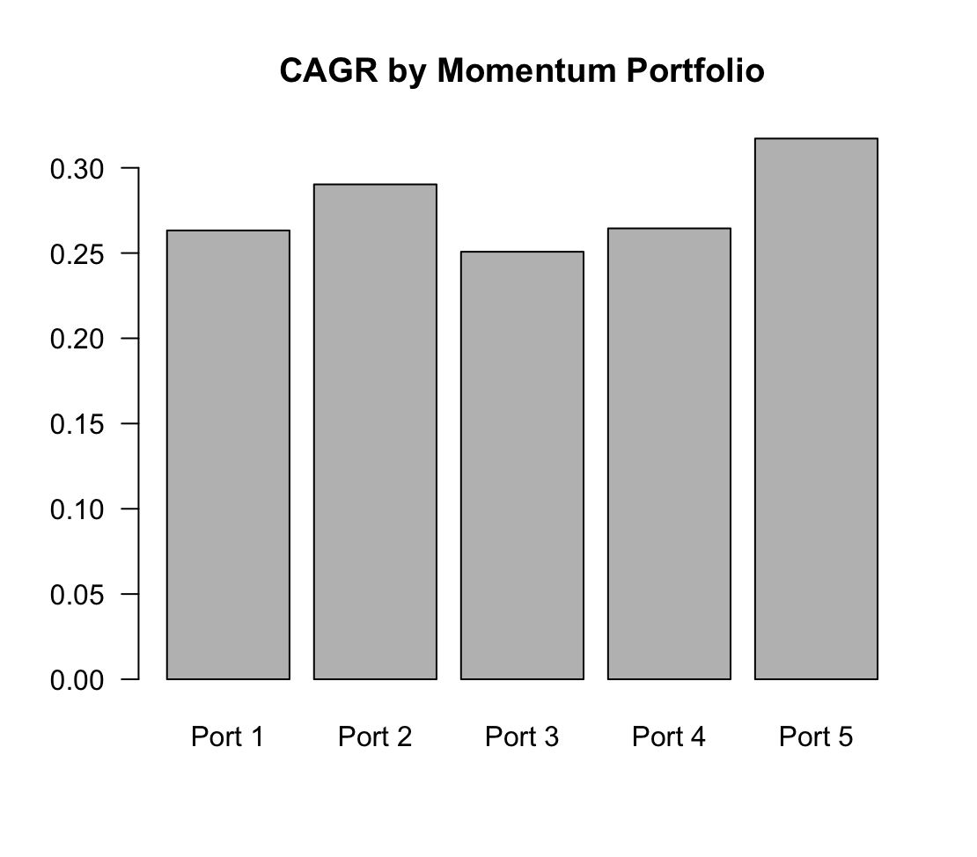
Quintile Portfolios and CAGR
If momentum works, you'd expect P5 (high past momentum portfolio) to have significantly higher future returns than P1
Winners portfolio (Port 5) shows the highest CAGR at approximately 32%,
Notes:
Unlike P/E ratio, momentum shows a positive relationship with future returns - higher momentum typically leads to higher future returns.

Slide 31
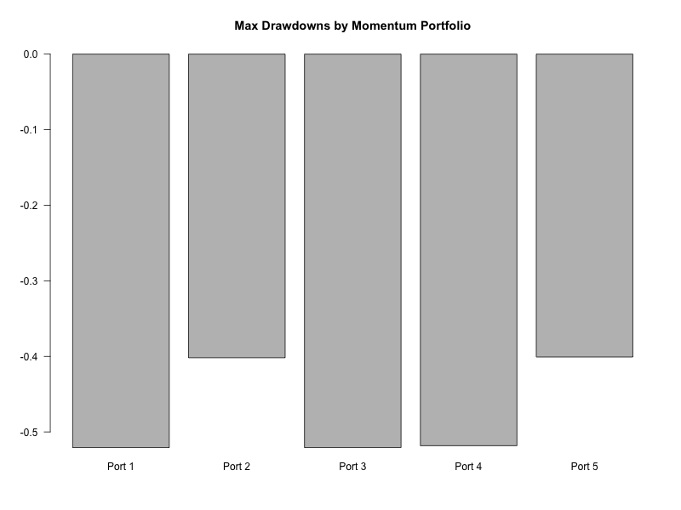
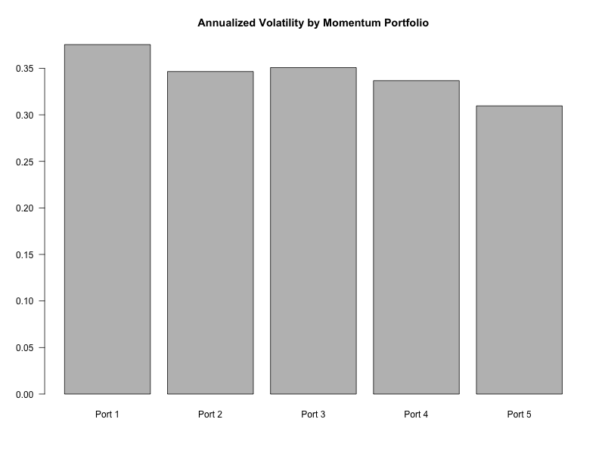
Factor Mimicking Portfolio Performances
Momentum does not significantly increase downside risk while enhancing returns.
First component explains most variance, indicating momentum is a dominant factor

Slide 32
Time Series Regression FMP (Macro Factor Hedging)
This approach aims to create a "Time-Series Optimized" Momentum FMP. It dynamically weights the five standard momentum quintile portfolios based on their relationship with a macro factor (monthly USD/TRY returns).
Using a 36-month rolling window, the strategy regresses monthly USD/TRY returns against the cumulative value levels of the P1-P5 portfolios. The resulting regression coefficients (slopes) for each P1-P5 portfolio are then normalized and used as their weights for that period.

Slide 33
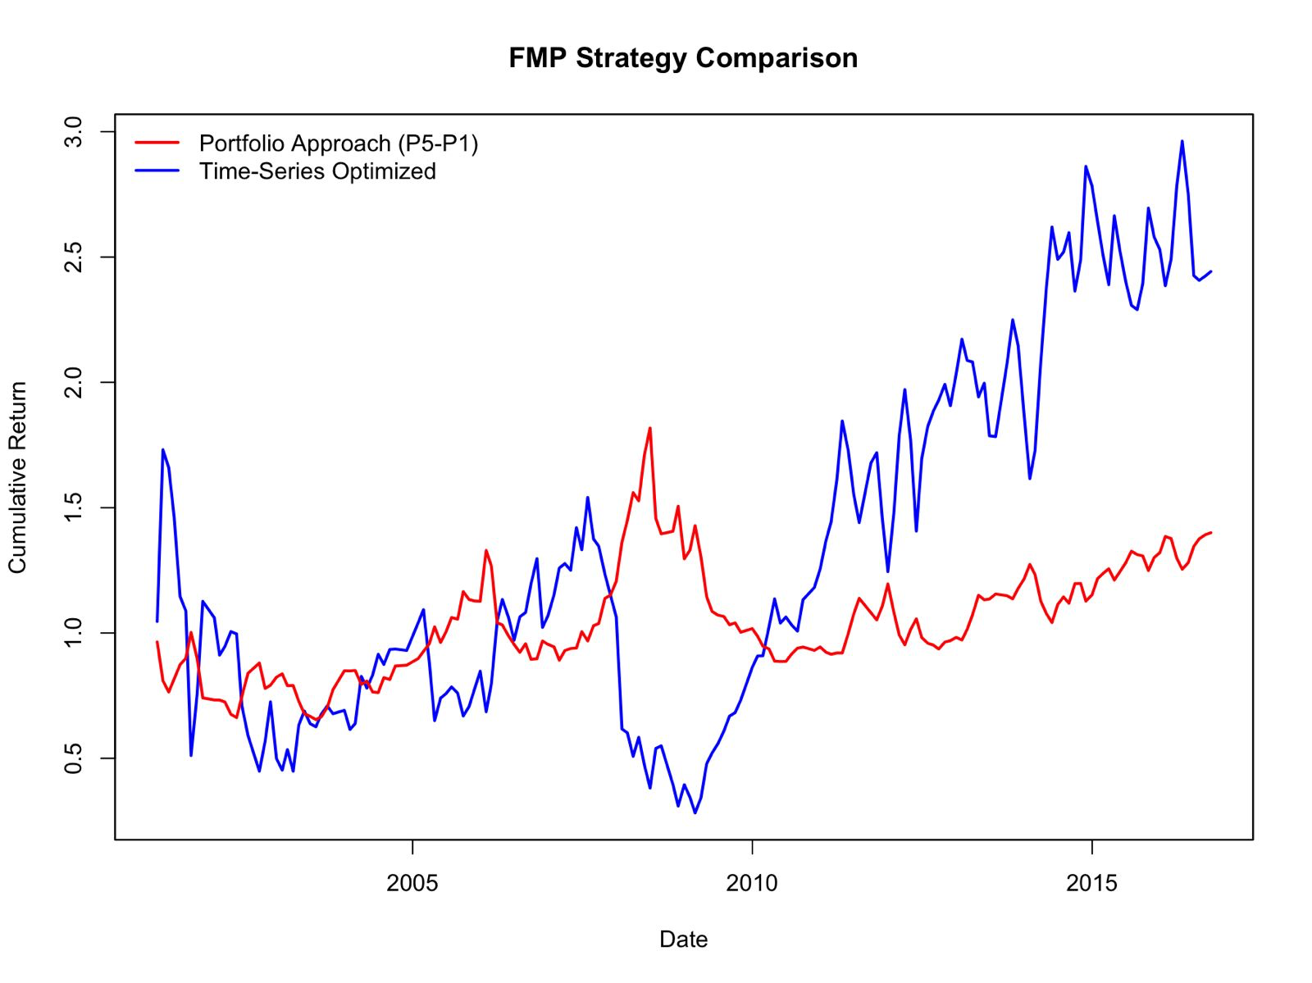
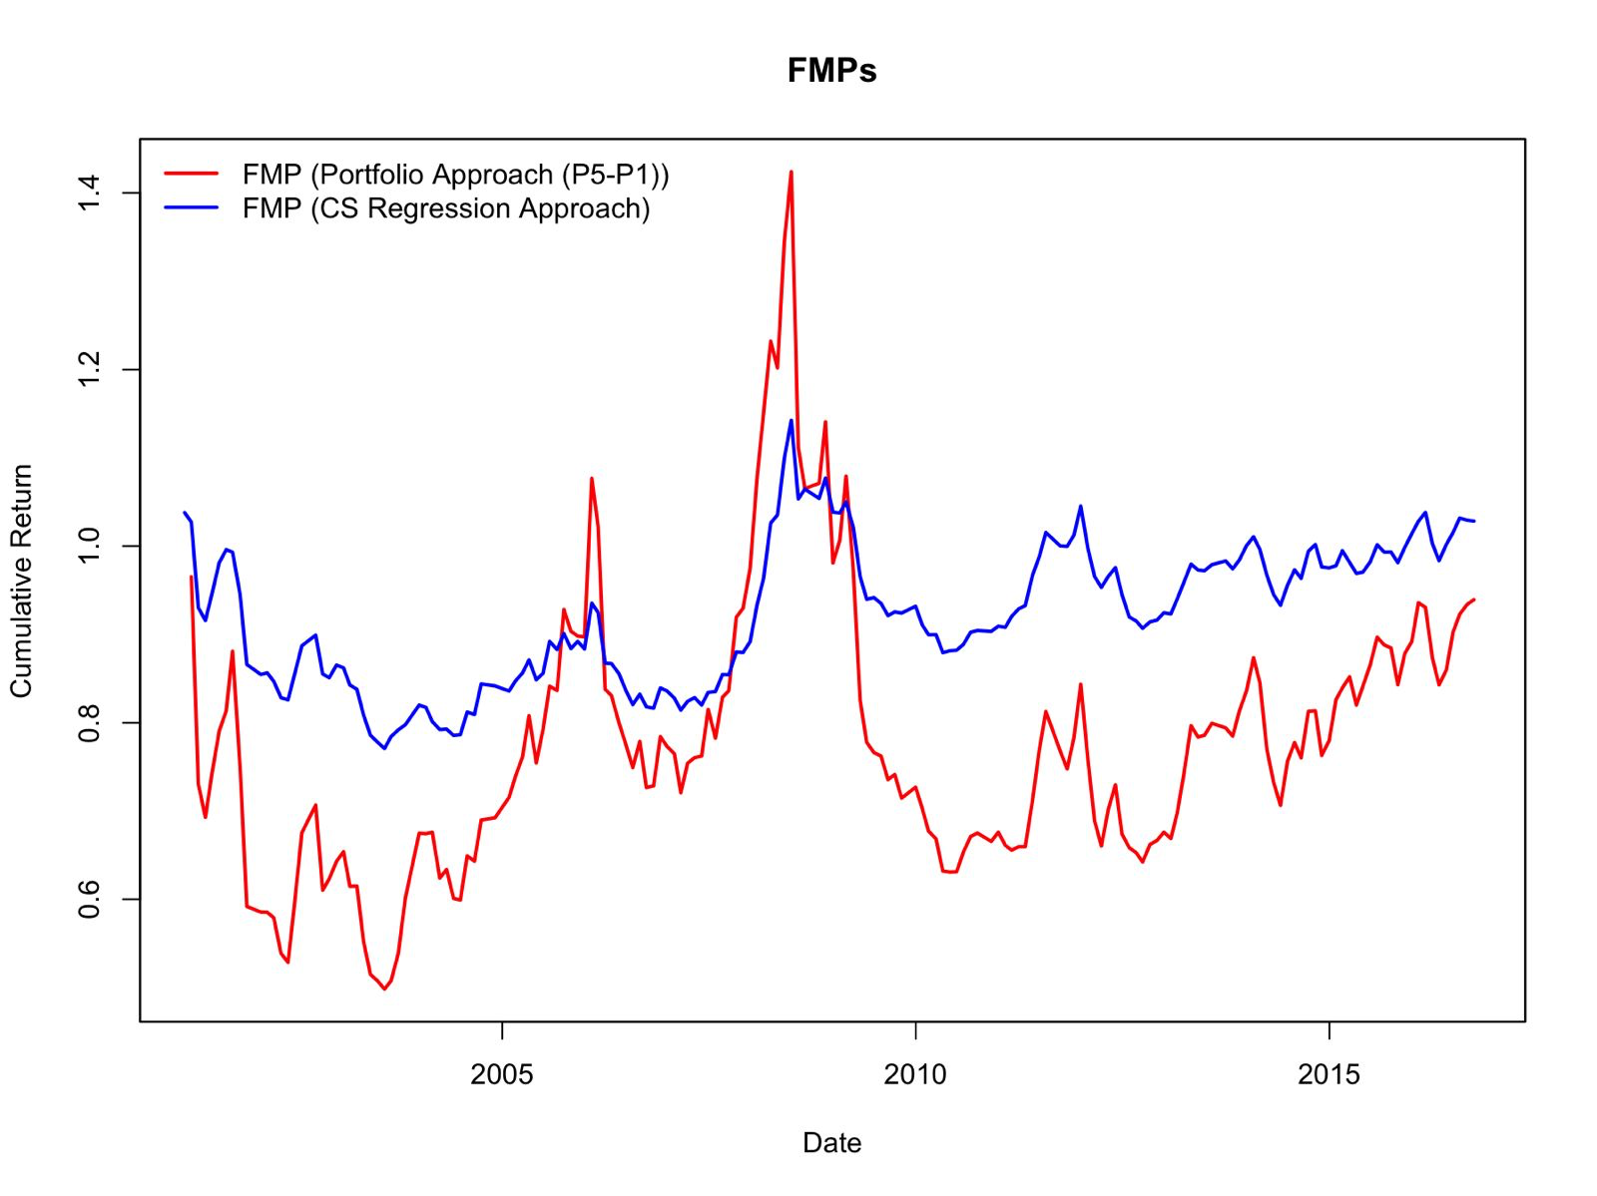
Factor Mimicking Portfolio Comparison
Long-short Momentum Factor Approach
Long-short Momentum Factor Approach
(P1-P5) are weighted based on a time-series
relationship with a macro factor (USDTRY)
Cross Sectional Regression Approach

Slide 34
Momentum Factor Statistics
Momentum-sorted portfolios shows a clear trend: the highest momentum quintile achieved the best annualized return of 31.72%
The long-short strategy isolates the momentum premium by going long P5 and short P1, yielded a positive annualized return of 3.37%.
With T-Statistic of 1.02, this premium is not statistically significant
Portfolio | AvgRet | AnnRet | StdDev | PctOutPerf
P1 | 2.69 | 26.33 | 39.67 | 53.7
P2 | 2.78 | 29.03 | 36.01 | 50.3
P3 | 2.51 | 25.08 | 35.96 | 53.1
P4 | 2.57 | 26.45 | 34.37 | 50.3
P5 | 2.86 | 31.72 | 31.91 | 53.7
Long – Short Strategy
Avg Ret | 0.35%
Ann Ret | 3.37%
Std Dev | 16.06%
T-Statistic | 1.02
% OutPerf | 54.08%

Slide 35
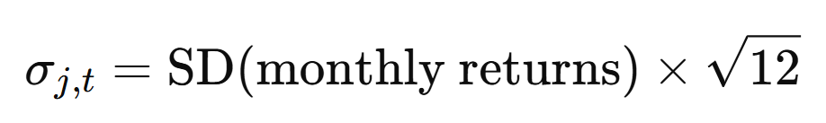
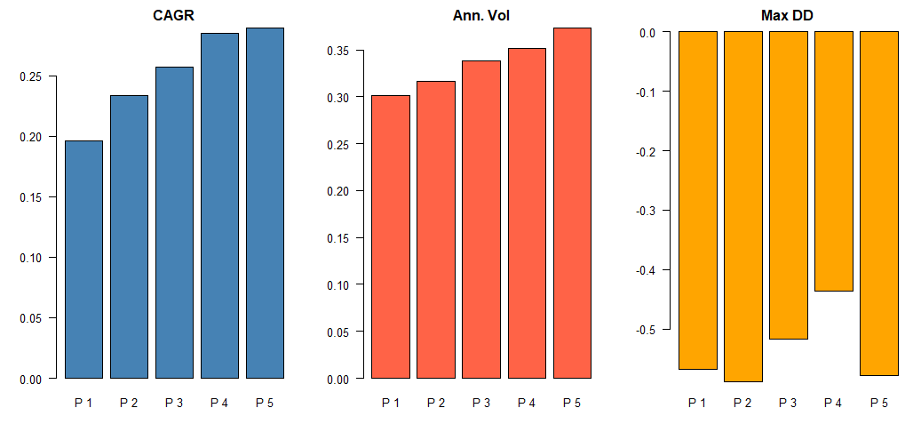
Volatility Factor
Measures how much a stock's returns fluctuate over time.
Higher-volatility stocks tended to have higher future returns.

Slide 36
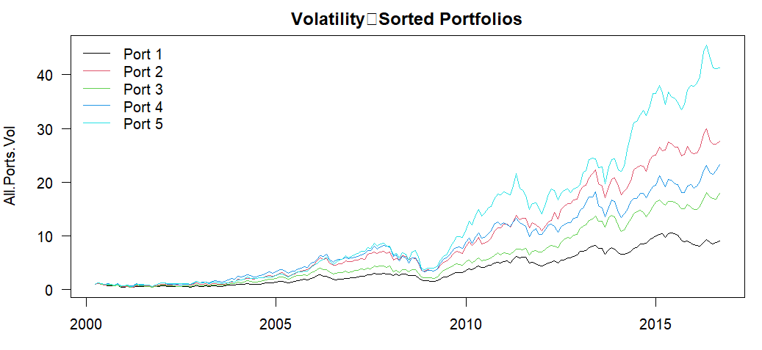
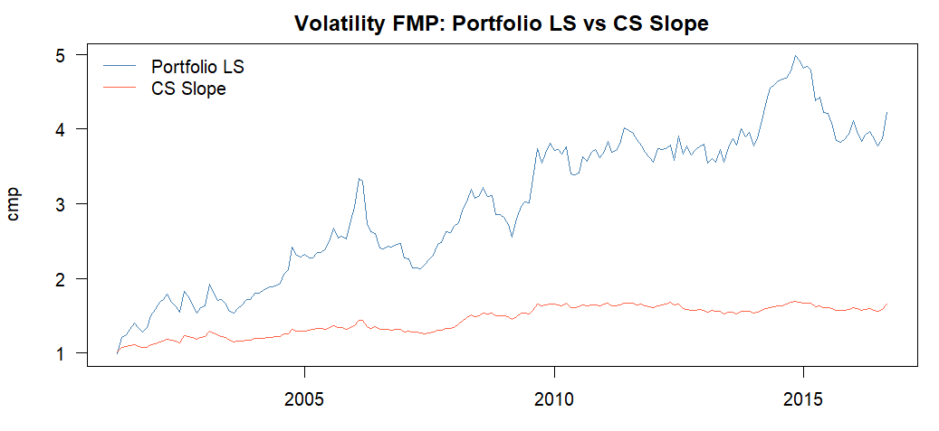
Volatility Factor
Average IC over sample: 1.81 %
Sharpe Ratio:
Porfolio LS: 0.60
CS Slope: 0.56

Slide 37
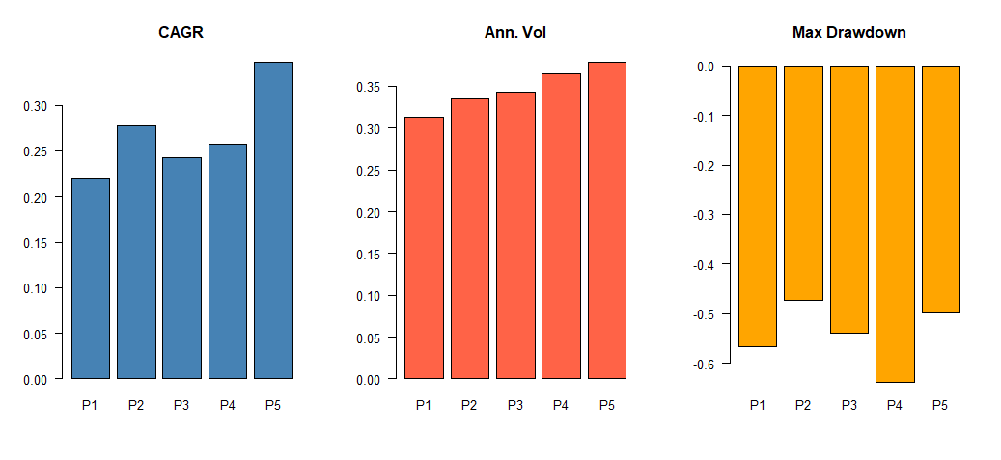
Composite Quant Factor – Trend & Volatility

Slide 38
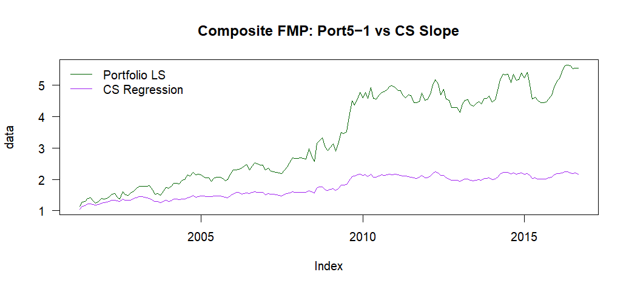
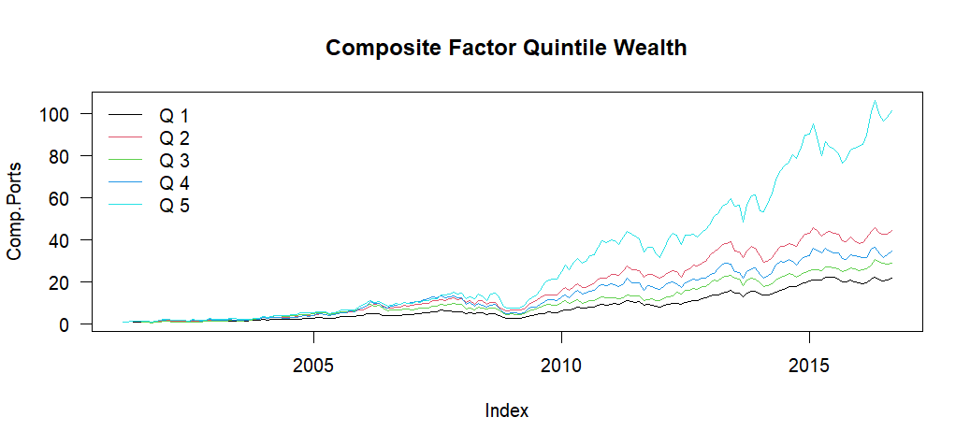
Composite Quant Factor – Trend & Volatility
Average Rank IC: 2.67
Sharpe Ratio:
Portfolio Approach: 0.73
CS Regression: 0.65

Slide 39
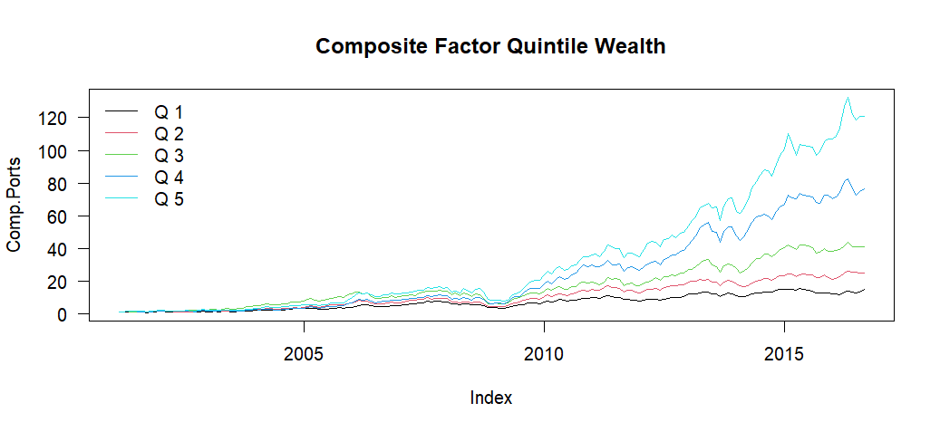
Composite Quant Factor Trend & Volatility & Return on Investment

Slide 40
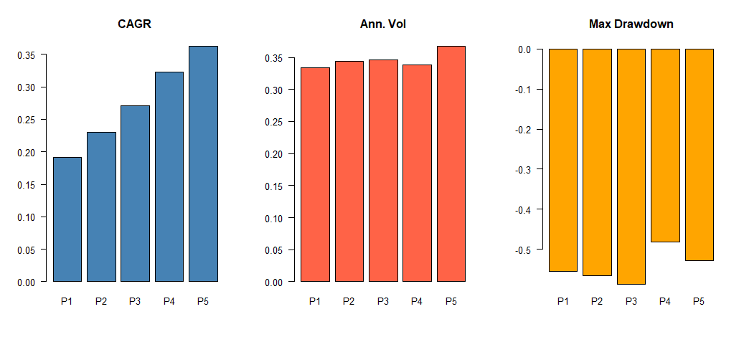
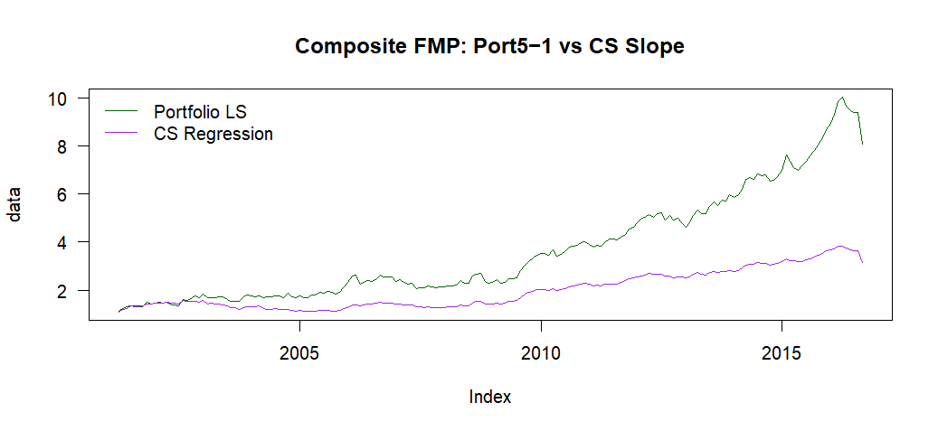
Composite Quant Factor Trend & Volatility & Return on Investment
Sharpe Ratio:​
Portfolio Approach: 0.89
CS Regression: 0.73

Slide 41
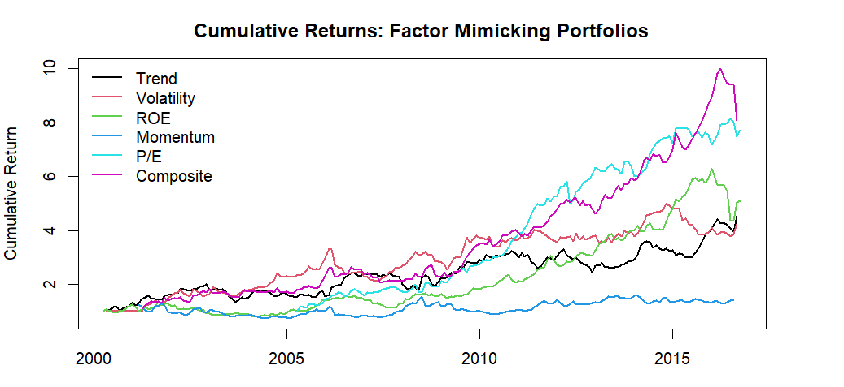
All Factors Comparison Portfolio Approach
Sharpe Ratio | Recession (2001-2003) | Crisis (2008-2009)
Trend | 0.396 | 0.102
Volatility | 0.318 | 0.159
ROE | -0.101 | 0.223
MoM | NaN | 0.032
P/E | NaN | 0.264
Comp | 0.321 | 0.162

Slide 42
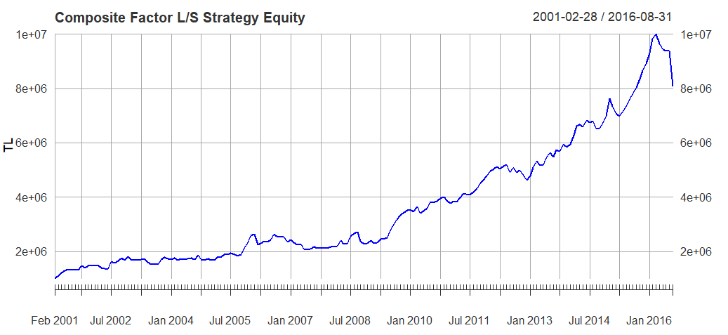
Initial Equity = 100000 Sharpe Ratio = 0.88

Slide 43

Monte Carlo – Same Constraints
Same number of:
Positions
Lag
Capital and Normalization
Length of Time Period and Stocks

Slide 44

Why Not Increase Factors in Composite Factor?
Observed increasing Sharpe ratios and returns with each additional factor (e.g., Trend, Volatility, ROE).
Too consistent performance improvement raised concerns of overfitting to in-sample data.
Adding more factors increases model complexity, which may:
Exploit noise rather than signal
Reduce out-of-sample reliability

Slide 45
Economical Interpretation
Despite theory, high-volatility stocks outperformed in our model.
Likely because these high-vol stocks also had strong ROE and Trend signals.
Shows that volatility effect is conditional — filtered volatility can still be profitable.
Together with ROE and Trend Factor, High Volatility stocks rewarded the investors for taking high risk.

