Slide 1

Smart Government Vehicle Allocation and Fleet Management System
GOVERNMENT TECHNOLOGY PROJECT
A Java-Based Application for Efficient, Transparent and Organized Government Vehicle Management.
Core Java | Object-Oriented Programming | Collections Framework
Presented by: Yagna Purush Neelam
Notes:
Introduce the project title, technologies and presenter.

Slide 2


Existing System – Problems and Limitations
Manually coordinated processes make it hard to maintain vehicle records and allocation requests.
Manual Coordination: paperwork, calls and repeated follow-ups.
Time-Consuming Process: finding vehicles and handling requests takes longer.
Lack of Centralized Records: data may be kept in separate places.
Poor Vehicle Utilization: some vehicles stay idle while requests wait.
Lack of Transparency: hard to verify allocation history and status quickly.
Difficulty Tracking Maintenance: servicing details are hard to access.
Risk of Conflicting Allocations: duplicate or clashing assignments may occur.
These limitations create the need for a centralized and organized vehicle allocation management system.

Slide 3









Our Proposed Solution
A Java application to manage politician records, vehicle information, vehicle requests and allocation operations.
Politician Management
Priority-Based Processing
Maintain ID, name, designation and constituency.
Process pending requests by assigned priority.
Vehicle Management
Allocation Management
Maintain vehicle information and availability.
Approve, reject or cancel requests as per rules.
Request Management
Record Management
Submit and manage vehicle allocation requests.
Organize information using Java Collections.
Illustrative dashboard (not a real screenshot)
A centralized Java application designed to make vehicle allocation more organized, consistent and easier to manage.

Slide 4



Project Objectives
01
02
03
04
Organize politician information in a structured format.
Maintain government vehicle details and availability.
Simplify the vehicle request submission process.
Support priority-based request processing.
05
06
07
Prevent conflicting allocations through validation checks.
Maintain allocation and request status.
Demonstrate practical use of Java OOP and Collections Framework.

Slide 5





Major Modules of the Application
MODULE 1
MODULE 2
MODULE 3
Politician Management
Vehicle Management
Request Management
Add politician records.
Display politician details.
Search using available identifiers.
Maintain designation and constituency.
Add vehicle details.
Display vehicle records.
Search vehicles.
Remove records where permitted.
Maintain availability information.
Submit vehicle requests.
Maintain request information.
Display pending requests.
Track request status.
MODULE 4
MODULE 5
Allocation Management
Input and Exception Handling
Process vehicle requests.
Check eligibility and availability.
Approve or reject requests.
Support cancellation operations.
Maintain allocation information.
Accept menu choices.
Validate user input.
Handle invalid entries and unexpected errors.

Slide 6
System Architecture and Application Structure
LAYER 1
Starts the application.
Displays the main menu.
Accepts user selections.
User Interface
Main.java
LAYER 2
Execute application operations.
Apply business rules.
Manage the relevant records.
Service Classes
PoliticianService
VehicleService
AllocationService
LAYER 3
Politician
MLA
MP
Minister
Represent the main entities.
Store related information.
Organize application data.
Domain Classes
Vehicle
VehicleRequest
Allocation
LAYER 4
HashMap
ArrayList
HashSet
Store records in memory.
Support searching and processing.
Maintain pending request order.
Data Management
PriorityQueue
TreeMap
A logical application structure within one Java program, not a deployed multi-tier enterprise system.

Slide 7




Technologies and Concepts Used
Object-Oriented Programming
Collections Framework
Abstraction
HashMap
Stores and retrieves politician records using unique IDs.
Politician is a common abstract form for all politician types.
Inheritance
ArrayList
Maintains vehicle records and request history.
MLA, MP and Minister inherit common properties from Politician.
HashSet
Keeps unique values such as vehicle registrations.
Encapsulation
Data and methods sit inside classes, with controlled field access.
PriorityQueue
Processes pending requests according to priority.
Polymorphism
A parent-class reference can represent different politician subclasses.
TreeMap
Keeps allocation records in sorted-key order.
Core Java: builds the application logic, classes, methods and menu-driven functionality.
Application type: console-based, menu-driven Java application.

Slide 8








How Does the System Work?
1
2
3
4
5
6
7
Identify Politician
Submit Vehicle Request
Validate Request
Priority Processing
Check Vehicle Availability
Process Allocation
Update Records
Select the registered politician.
Enter the request details.
Check details and eligibility.
Process pending requests by priority.
Verify a suitable vehicle is available.
Approve or reject per application rules.
Update request and allocation records.
Simple example: A registered politician submits a vehicle request. The system checks the request and vehicle availability, processes it according to priority, and records the resulting decision.

Slide 9
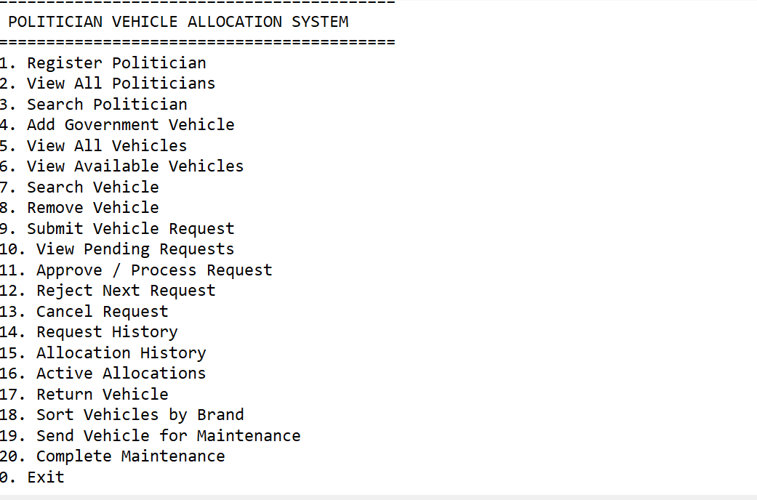
Application Demonstration – Console Output
The application runs through a menu-driven Java console interface.
1
Open the Java application.
2
Display the main menu.
3
Add or display politician information.
4
Add or display vehicle records.
5
Submit a vehicle request.
6
Process the request.
7
Show the resulting status.
Actual console output: main menu of the application.
20 menu options cover politicians, vehicles, requests, allocations and maintenance.

Slide 10



Project Outcomes and Future Scope
Advantages
Current Limitations
Future Enhancements
Organized politician and vehicle records.
Reduced manual coordination.
Structured request management.
Priority-based pending request processing.
Improved visibility of allocation information.
Practical use of Java OOP and Collections.
Console-based interface.
Data kept in in-memory collections.
No permanent database storage.
No live GPS tracking.
No web or mobile interface.
Database integration using MySQL.
Web application using Spring Boot.
Secure login and role-based access.
GPS-based real-time vehicle tracking.
Automated maintenance reminders.
Reports and analytics dashboard.
Notifications for allocation and return status.
The system shows how Java and object-oriented programming can organize politician records, vehicle information and allocation requests through a structured application, and provides a foundation for a more comprehensive digital fleet management platform.
THANK YOU
Questions and Discussion

