Slide 1
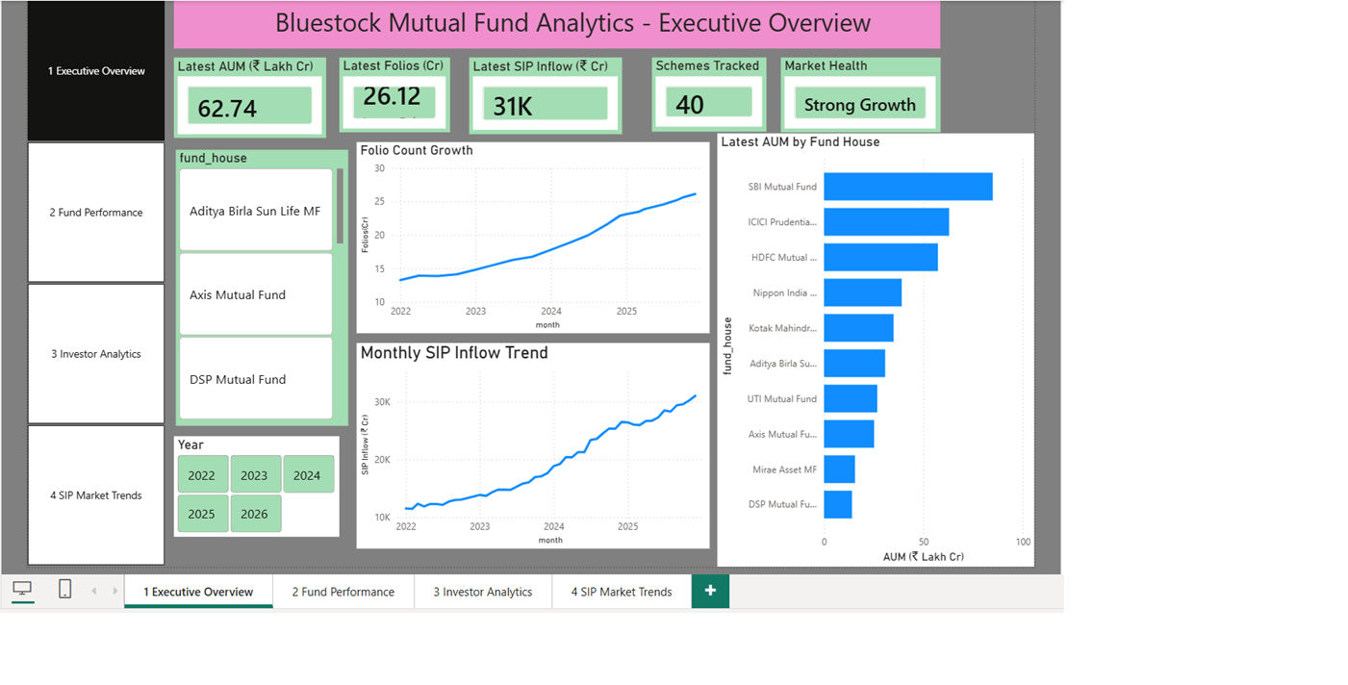
HR PRESENTATION | PROJECT REPORT
Bluestock Mutual Fund Analytics Platform
End-to-end data engineering, analytics, reporting, and dashboarding capstone for mutual fund insights.
Prepared for project review and HR discussion
Bluestock Mutual Fund Analytics Platform
01

Slide 2
BLUESTOCK MF CAPSTONE
Executive Snapshot
The project converts raw mutual fund files into a validated analytics platform: clean data, SQLite model, risk metrics, reports, and Power BI dashboard assets.
10
64,320
32,778
100%
source datasets processed across NAV, AUM, SIP, transactions, holdings, and benchmarks
processed NAV rows after calendar fill and validation
investor transactions analyzed for geography, demographics, and channel behavior
SQLite row audits matched processed outputs across all modeled tables
Core message
Business result
This is not only a charting exercise. It demonstrates the full analytics lifecycle: data ingestion, cleaning, modeling, metric design, insight generation, BI storytelling, and documentation.
The platform identifies industry momentum, investor behavior patterns, fund performance leaders, and risk pockets that can support product, advisory, and portfolio decisions.
Bluestock Mutual Fund Analytics Platform
02

Slide 3
BLUESTOCK MF CAPSTONE
Problem And Objective
Problem
Objective
Mutual fund information is spread across NAV history, AUM snapshots, SIP trends, investor transactions, portfolio holdings, scheme performance, and benchmark files. Without one clean model, it is hard to compare funds or explain investor behavior.
Build a reproducible analytics system that cleans the source data, stores it in a star schema, computes risk-adjusted performance, generates report visuals, and supports dashboard-based decision making.
1
Analytical coverage
2
Decision support
3
Presentation readiness
NAV trends, AUM movement, SIP inflows, folios, demographics, category flows, risk, return, and portfolio exposure.
Rank funds with scorecards, compare with benchmarks, assess risk appetite, and summarize insights for stakeholders.
Final outputs include notebooks, SQL, reports, dashboards, chart pack, and reusable semantic context.
Bluestock Mutual Fund Analytics Platform
03

Slide 4
BLUESTOCK MF CAPSTONE
Data Foundation And Quality
A dependable project story starts with data trust. The pipeline validates source coverage, positive values, row counts, and schema load consistency before analytics are presented.
40
46,000
18,320
0
AMFI schemes mapped from fund master into NAV history
raw NAV rows profiled before calendar expansion
weekend/holiday NAV rows forward filled for daily analysis
scheme performance anomaly rows flagged
Validation checks completed
Modeled tables
- All 40 AMFI codes in fund master exist in NAV history.
- NAV and transaction amounts remain positive after cleaning.
- Processed CSV row counts match SQLite row counts for every fact and dimension.
- NAV grain is normalized from trading days to calendar days.
dim_fund, dim_date, dim_investor
fact_nav, fact_transactions, fact_performance
fact_aum, fact_sip, fact_category_inflows
fact_folio_count, fact_portfolio_holdings, fact_benchmark_indices
Bluestock Mutual Fund Analytics Platform
04

Slide 5
BLUESTOCK MF CAPSTONE
End-To-End Architecture
The implementation is reproducible: one master runner profiles, cleans, loads, computes metrics, creates notebooks, and exports report assets.
1
Raw Inputs
2
Python ETL
3
SQLite
4
Analytics
5
Outputs
CSV datasets plus optional live NAV refresh.
Profile, clean, fill calendar dates, and validate.
Star schema with dimensions, facts, keys, and reusable SQL.
Risk metrics, scorecards, VaR, CVaR, tracking error, and HHI.
Charts, report, notebooks, Power BI blueprint, and final PPT.
Automation path
Review path
run_pipeline.py executes five ordered steps: profile raw datasets, clean and load SQLite, compute metrics, generate charts, and create notebooks/report starters.
The project can be reviewed from SQL files, processed CSVs, notebooks, dashboards, PDF/HTML report, and chart pack without relying on a hidden local state.
Bluestock Mutual Fund Analytics Platform
05

Slide 6
BLUESTOCK MF CAPSTONE
Analytical Framework
The project moves from descriptive market analysis to risk-adjusted fund selection and stakeholder-ready dashboards.
Exploratory analysis
Performance analytics
Portfolio view
NAV trends, AUM by AMC, SIP inflows, category inflow heatmap, folio growth, investor demographics, and geography.
CAGR, Sharpe, Sortino, alpha, beta, drawdown, VaR, CVaR, tracking error, and risk-return scatter.
Sector allocation, concentration through HHI, holdings exposure, and benchmark comparison.
Decision layer
BI layer
Composite fund scorecard and risk-appetite recommender translate analytics into selection guidance.
Power BI design organizes executive overview, fund performance, investor analytics, and SIP/market trends.
Bluestock Mutual Fund Analytics Platform
06

Slide 7
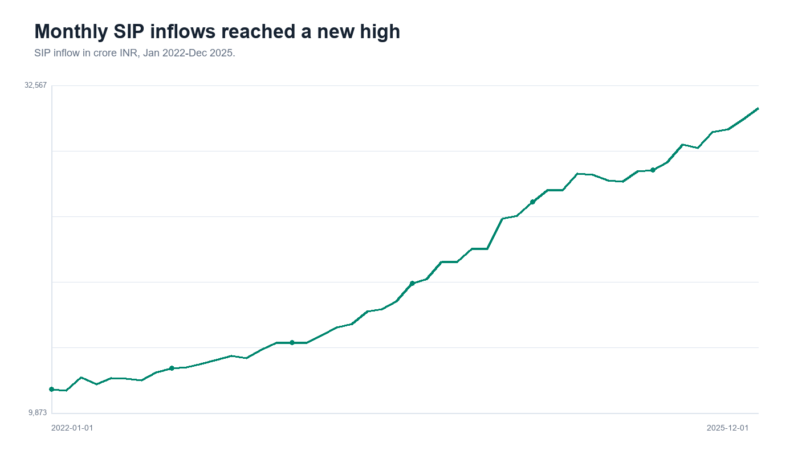
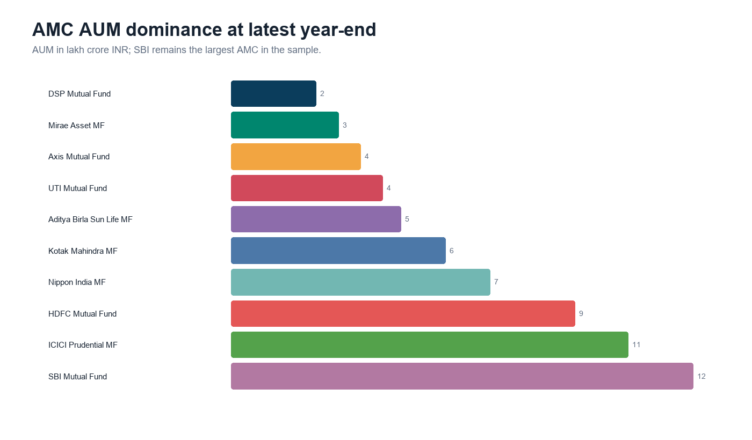
BLUESTOCK MF CAPSTONE
Industry Momentum Insights
The cleaned data shows a strong growth story in SIP participation, industry folios, and AMC scale.
SIP inflows grew to Rs 31,002 Cr by Dec 2025.
SBI Mutual Fund led latest AMC AUM at 12.50 lakh crore.
169.2%
97.0%
17.17%
SIP inflow growth from Jan 2022 to Dec 2025
total folio growth from Jan 2022 to Dec 2025
Dec 2025 year-on-year SIP growth
Bluestock Mutual Fund Analytics Platform
07

Slide 8
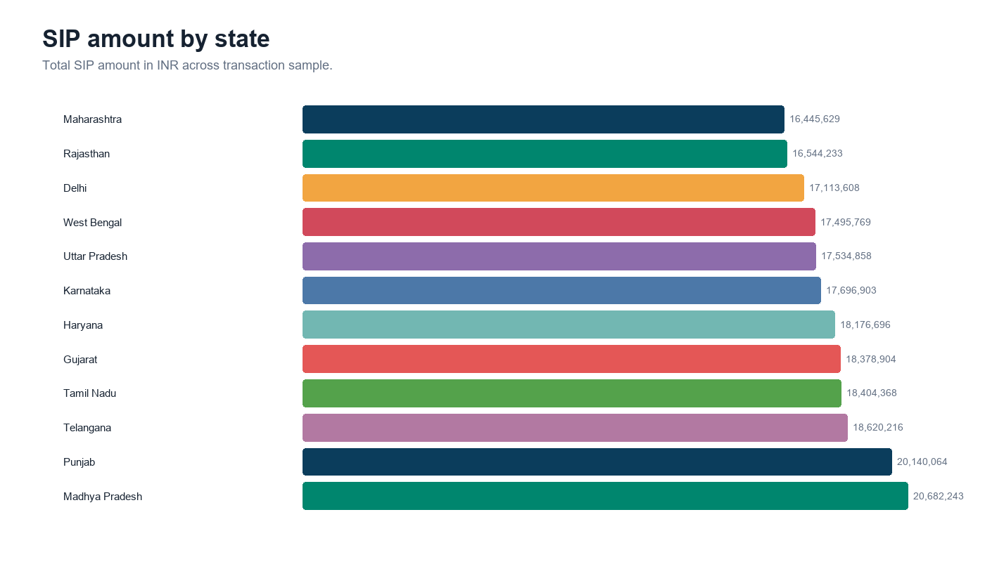
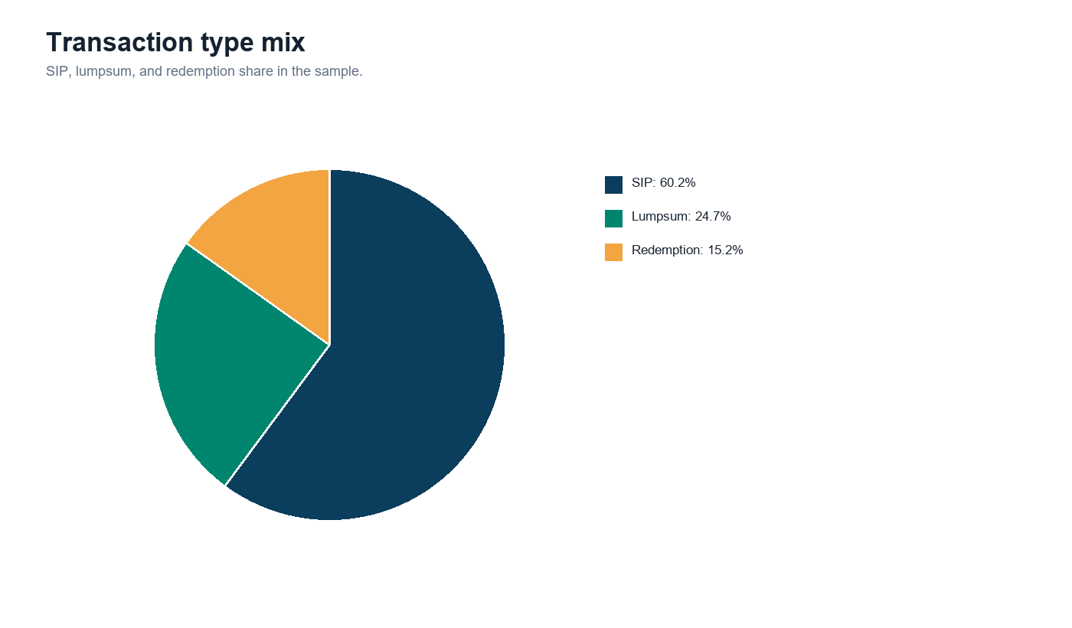
BLUESTOCK MF CAPSTONE
Investor Behavior Insights
The transaction layer turns individual activity into useful segments by state, transaction type, city tier, age group, gender, and payment mode.
Geography view: top states by processed transaction amount.
Transaction mix: SIP dominates count, lumpsum dominates value.
Transaction profile
Market signal
32,778 transactions, about Rs 352.16 Cr total. SIPs were 60.2% of count; lump-sum led value.
Top amount states included Punjab, Tamil Nadu, Madhya Pradesh, Rajasthan, Gujarat, and West Bengal.
Bluestock Mutual Fund Analytics Platform
08

Slide 9
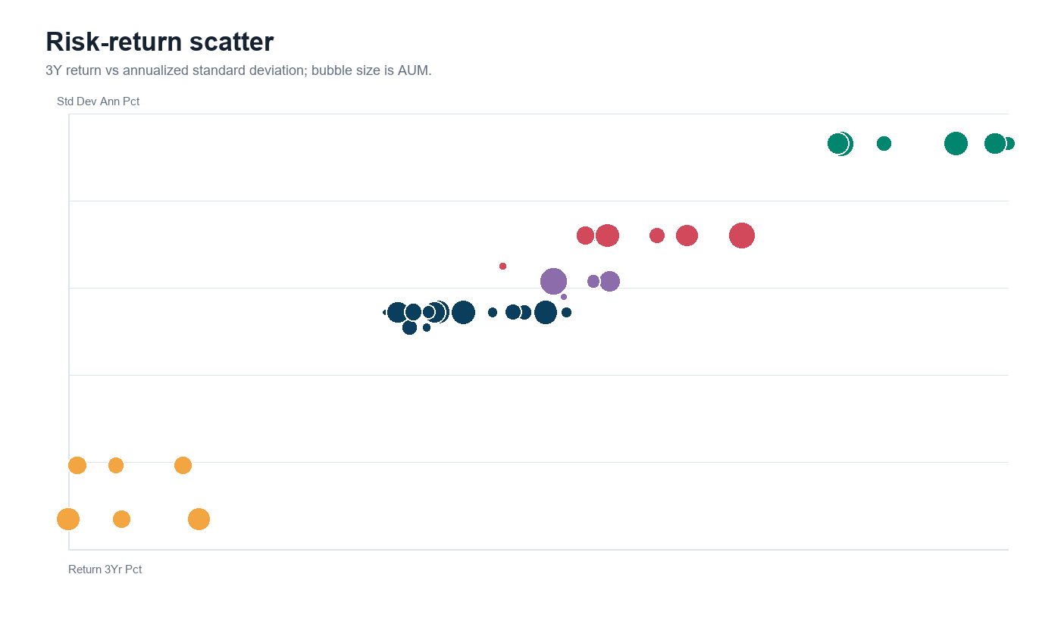
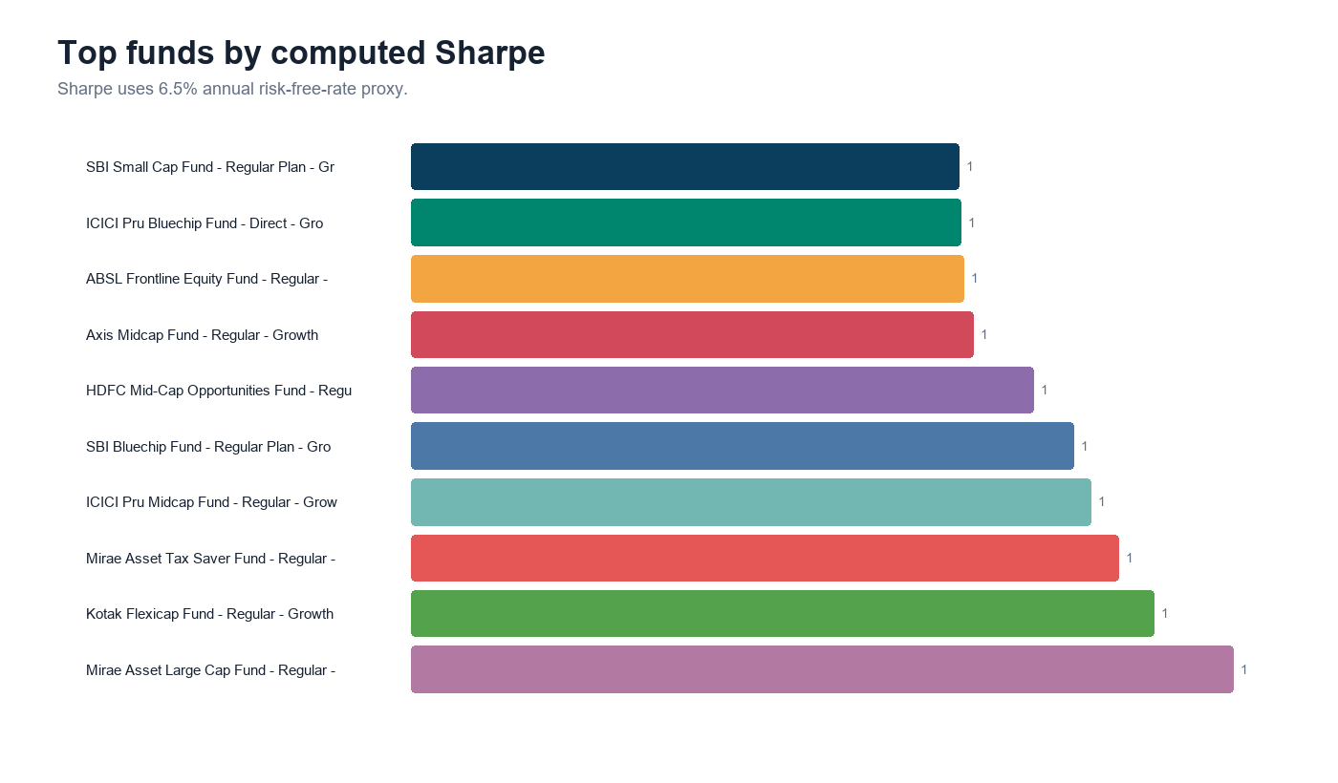
BLUESTOCK MF CAPSTONE
Fund Performance And Risk
The scorecard balances return, risk-adjusted performance, alpha, expenses, and drawdown instead of ranking funds on returns alone.
Risk-return scatter supports category-aware comparison.
Sharpe view highlights risk-adjusted leaders.
Top computed score
Small-cap schemes carried the deepest daily 95% VaR; liquid funds showed the lowest VaR.
Mirae Asset Large Cap Fund - Regular - Growth scored 86.25.
Bluestock Mutual Fund Analytics Platform
09

Slide 10
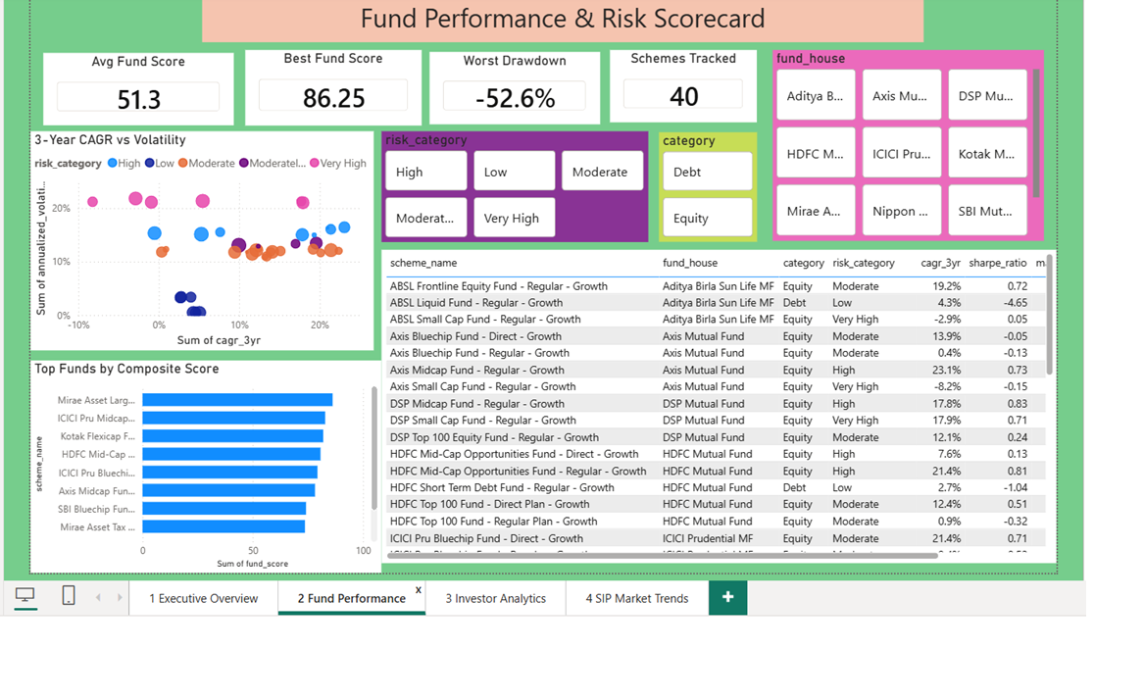
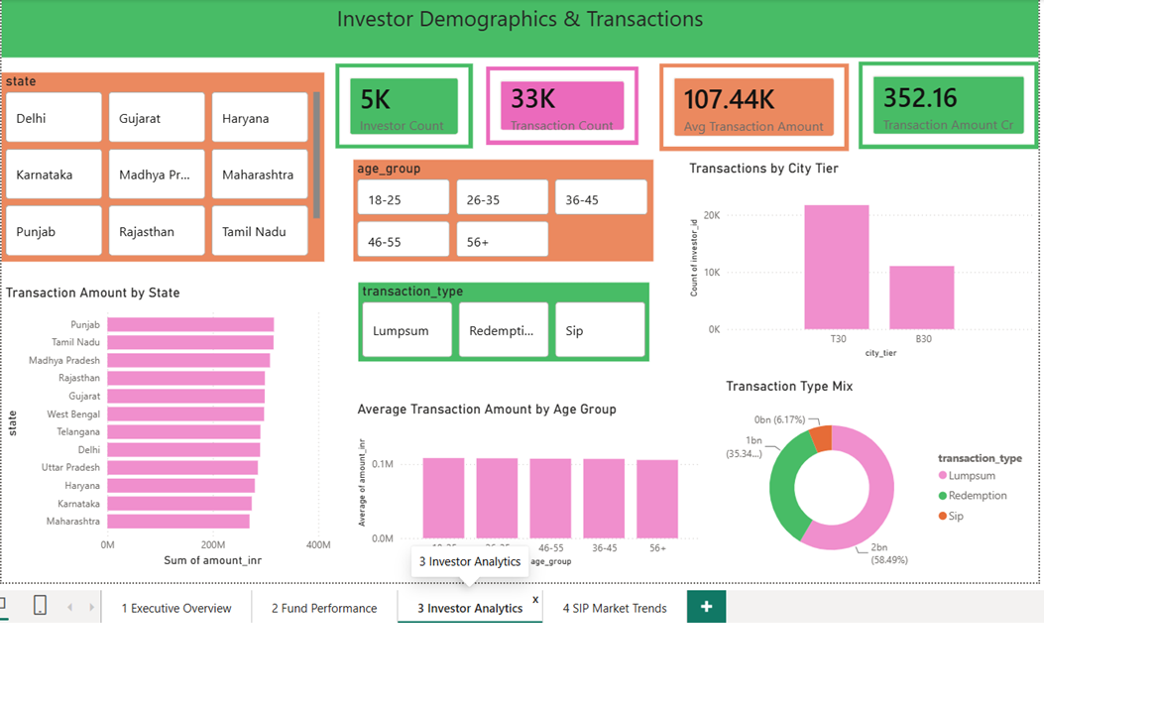
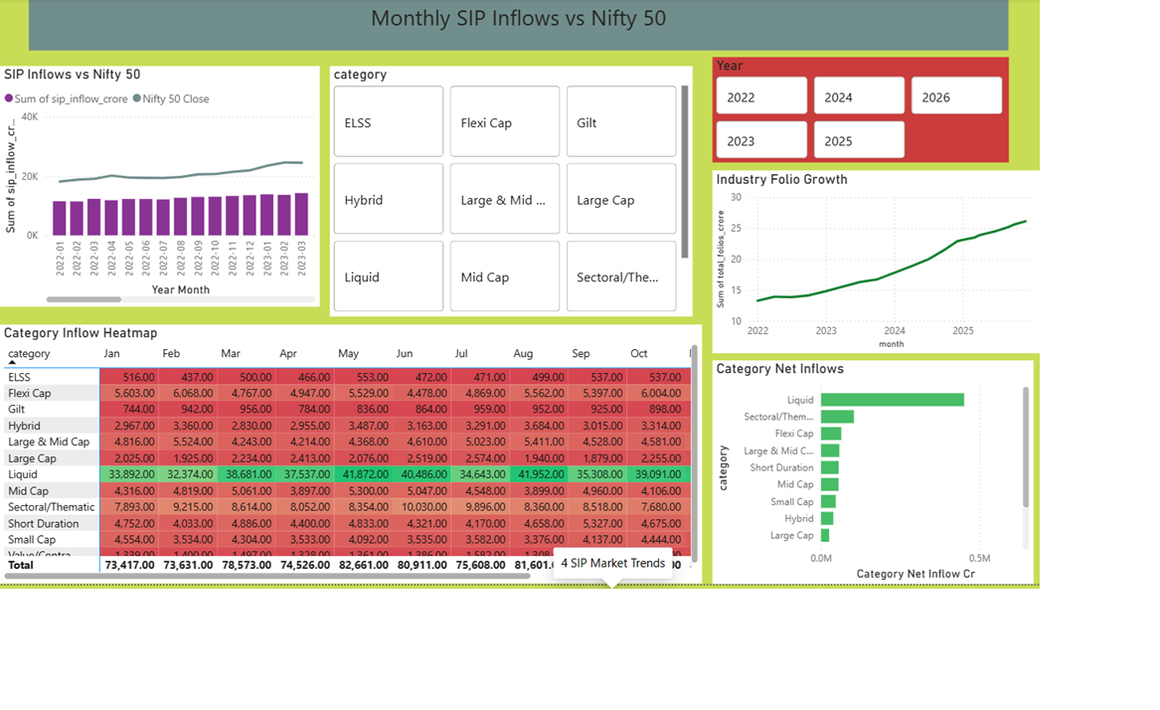
BLUESTOCK MF CAPSTONE
Dashboard Deliverable
The Power BI design converts the analytical model into four business-facing pages for review, filtering, and discussion.
1. Executive Overview
2. Fund Performance
3. Investor Analytics
4. SIP and Market Trends
Dashboard pages
Review controls
Deliverable depth
Executive Overview, Fund Performance, Investor Analytics, and SIP & Market Trends.
Slicers cover year, AMC, fund house, category, plan, risk, state, age group, city tier, gender, month, and benchmark.
Includes PBIX/PDF assets, page previews, chart pack, SQL, notebooks, and final report files.
Bluestock Mutual Fund Analytics Platform
10

Slide 11
BLUESTOCK MF CAPSTONE
Skills Demonstrated For HR Review
The project is valuable in an interview setting because it shows practical ownership from data to decision, not a single isolated notebook.
A
Data engineering
B
Analytics thinking
C
BI storytelling
Reusable Python pipeline, source profiling, cleaning rules, SQLite schema, row-count validation, and reproducible runs.
Metric design across CAGR, Sharpe, Sortino, alpha, beta, VaR, CVaR, drawdown, tracking error, and HHI.
Four-page dashboard blueprint with executive, performance, investor, and market trend views.
D
Communication
E
Business judgment
Final report, presentation outline, chart map, data dictionary, dashboard screenshots, and submission README.
Fund selection scorecard, risk-appetite recommender, limitations, and next-step recommendations.
Bluestock Mutual Fund Analytics Platform
11

Slide 12
BLUESTOCK MF CAPSTONE
Python Files And Outputs
This section makes the code output explicit: each Python file writes a clear reviewable artifact, not just internal calculations.
PYTHON FILE
PURPOSE
OUTPUT GENERATED
1
run_pipeline.py
Master runner that executes the full project flow in order.
Profiles data, cleans/loads SQLite, computes metrics, generates charts, creates notebooks and report starters.
2
data_ingestion.py
Reads and profiles all raw mutual fund datasets.
docs/ingestion_profile.md plus console dataset shape, dtypes, head, null columns, duplicate checks, and AMFI validation.
3
etl_pipeline.py
Cleans raw files, forward-fills NAV, builds date/investor dimensions, and loads the database.
15 processed CSVs, data/db/bluestock_mf.db, sql/schema.sql, sql/queries.sql, docs/data_dictionary.md, docs/data_quality_summary.md, sqlite_row_audit.csv.
4
compute_metrics.py
Calculates risk and performance metrics from NAV, benchmark, and holdings data.
daily_returns.csv, fund_metrics_computed.csv, fund_scorecard.csv, alpha_beta.csv, var_cvar_report.csv, tracking_error.csv, sector_hhi.csv, rolling Sharpe and benchmark charts.
Bluestock Mutual Fund Analytics Platform
12

Slide 13
BLUESTOCK MF CAPSTONE
More Python Output Artifacts
The remaining scripts turn the cleaned model into presentation-ready files and practical utilities.
PYTHON FILE
PURPOSE
OUTPUT GENERATED
5
generate_charts.py
Creates static visualizations for EDA, performance, investor behavior, category flows, and risk.
21 chart PNG files under reports/charts, including NAV trends, AUM growth, SIP trend, heatmap, demographic charts, risk-return scatter, drawdown, VaR, and SIP vs NIFTY50.
6
create_notebooks.py
Builds runnable notebook and documentation assets for review.
5 notebooks, Final_Report_Starter.md, Presentation_Outline.md, and Power BI dashboard blueprint text.
7
final_assets_fallback.py
Dependency-light fallback finalizer for report and presentation assets.
Regenerates chart pack, Final_Report.html, Final_Report.pdf, Bluestock_MF_Presentation.pptx, chart_map.md, and supporting CSV metric outputs.
8
recommender.py
live_nav_fetch.py
Runs risk-appetite recommendations and optional live NAV sample fetch.
Recommender Moderate output: Mirae Asset Large Cap score 86.25; Kotak Flexicap score 82.00; ICICI Pru Bluechip score 79.38. Live NAV fetch writes per-fund CSVs plus a combined sample when internet is available.
Bluestock Mutual Fund Analytics Platform
13

Slide 14
BLUESTOCK MF CAPSTONE
Generated Output Evidence
These are the concrete files produced by the Python project and used as evidence in the presentation.
15
12
21
5
processed CSV files written by the ETL/metrics layer
SQLite row-audit entries matching processed outputs
report chart PNGs generated for analysis slides
Jupyter notebooks generated for reusable review
Processed data examples
Report CSV examples
Presentation/report examples
fund_master.csv: 40 rows
nav_history.csv: 64,320 rows
investor_transactions.csv: 32,778 rows
benchmark_indices.csv: 8,050 rows
portfolio_holdings.csv: 322 rows
fund_scorecard.csv
alpha_beta.csv
var_cvar_report.csv
tracking_error.csv
sector_hhi.csv
fund_metrics_computed.csv
Final_Report.html
Final_Report.pdf
Bluestock_MF_Presentation.pptx
Presentation_Outline.md
Power BI dashboard previews
Bluestock Mutual Fund Analytics Platform
14

Slide 15
Recommendations And Next Steps
Automate refresh
Improve history
Deploy dashboard
Schedule the pipeline and connect live NAV refresh where internet access is available.
Add older NAV extracts to strengthen long-horizon CAGR and drawdown analysis.
Publish Power BI/Streamlit outputs with stakeholder filters and role-based views.
Closing statement
This capstone demonstrates a complete analytics workflow: reliable data preparation, technical modeling, meaningful financial metrics, dashboard execution, and clear presentation-ready reporting.
Thank you
Bluestock Mutual Fund Analytics Platform
15

