Slide 1


CryptoNotes
KADI SARVA VISHWAVIDYALAYA
LDRP INSTITUTE OF TECHNOLOGY AND RESEARCH
PROJECT-III(CT805-N)
GROUP NO.96
Prepared By:
Kishan Khirasariya (18BECE30087)
Yagni Patel (18BECE30185)
Guided By:
Prof. Jayana Kaneriya

Slide 2
CONTENTS
Abstract
Advantages
Scope
Requirements
Workflow
Implementation
Application
Conclusion

Slide 3
ABSTRACT
The main purpose of this project is to create an application CryptoNotes, that can store your notes and passwords without being tense about any malware attack.
CryptoNotes is an android application that stores your notes and passwords on your local storage. It has some cool features like
Add photo with an important note
Classify the note based on colour
Add external links for future reference
Any android user, be it a student or professional, often times find the difficulties to store notes and passwords due to security issues. As CryptoNotes is fast, efficient, and has a encryption algorithm before storing any note will play a game-changer in the note-taking applications.

Slide 4
ADVANTAGES
Encryption: Since CryptoNotes has built-in AES-256 encryption, only uncrackable encryption algorithm in world.
Friendly User Interface: CryptoNotes has a very simple user interface to ease down your navigation. Since the dark mode becoming more popular day by day, we thought to first bring dark mode and light mode later on.
Zero Cost: CryptoNotes is built to solve the problem, not to earn. It’s just our little effort to give back to society.

Slide 5
SCOPE
Application will be designed in way to ensure that the every user will get ultimate security on their data.
The proposed application will perform some series of operations to make the data more secure and efficient to store in local storage.

Slide 6
REQUIREMENTS
Hardware Requirements
Android 8.0 or above
128 MB RAM
256 MB Storage

Slide 7
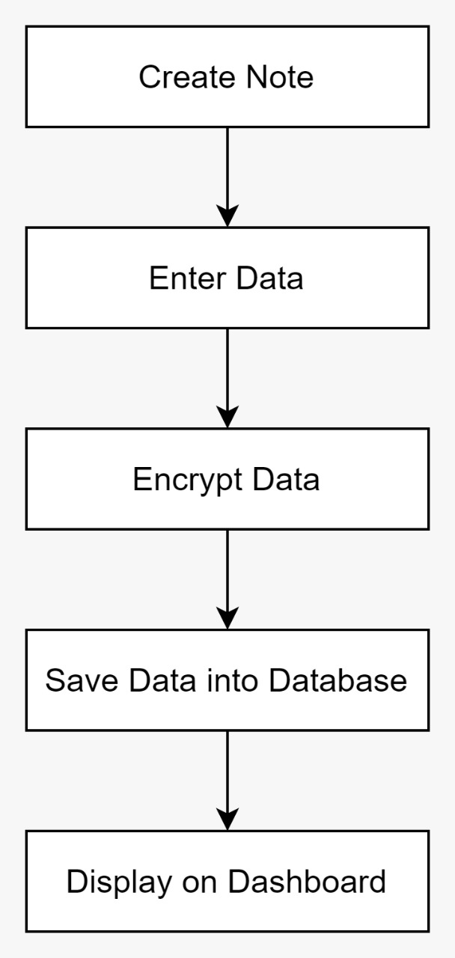
BASIC BLOCK DIAGRAM
Figure 1

Slide 8
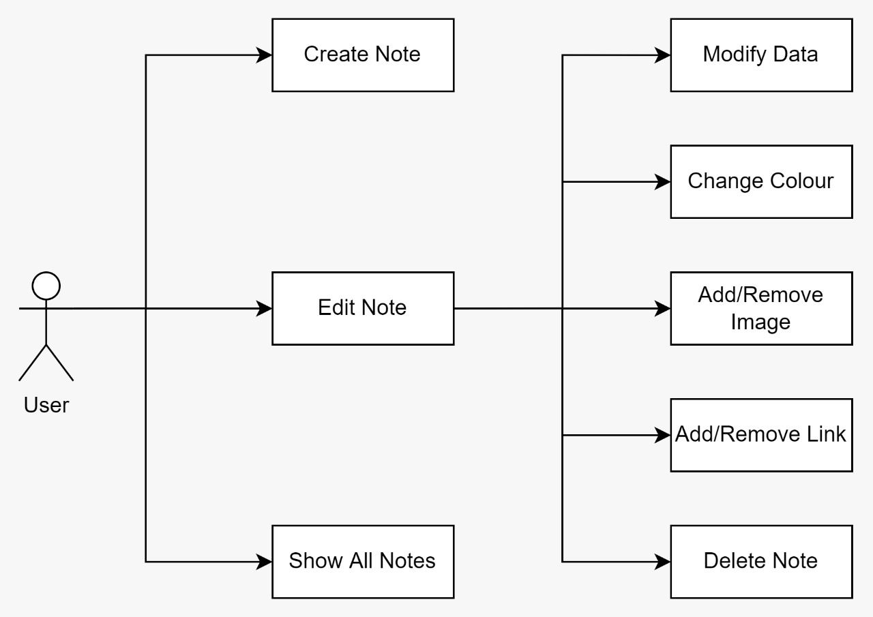
USE CASE DIAGRAM
Figure 2

Slide 9
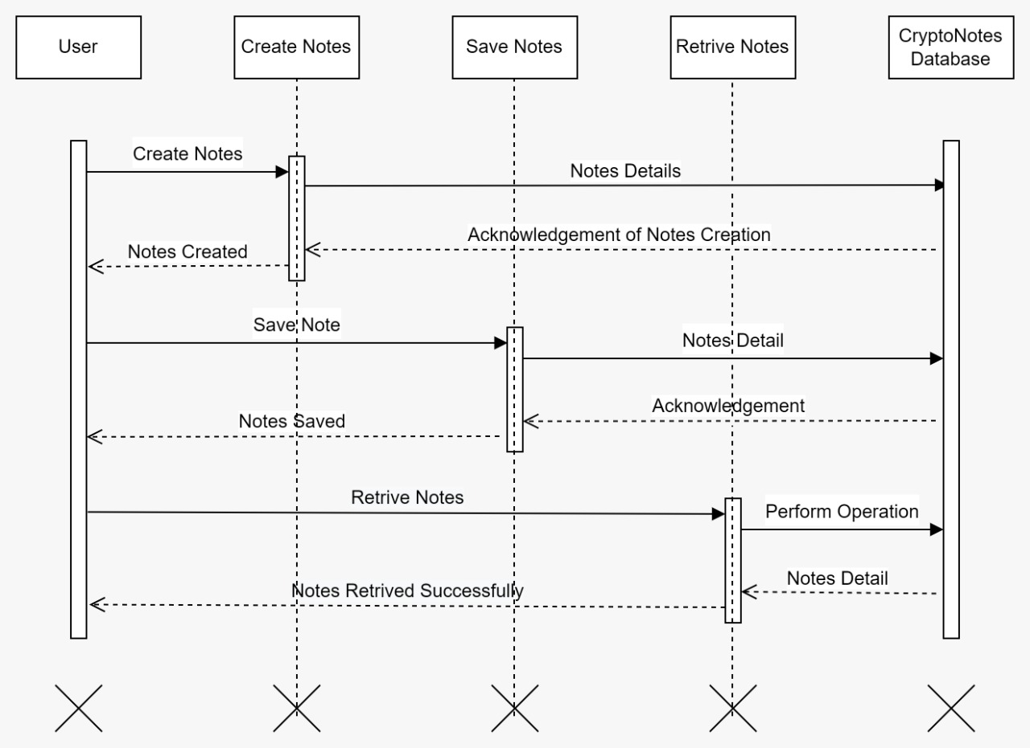
SEQUENCE DIAGRAM
Figure 3

Slide 10
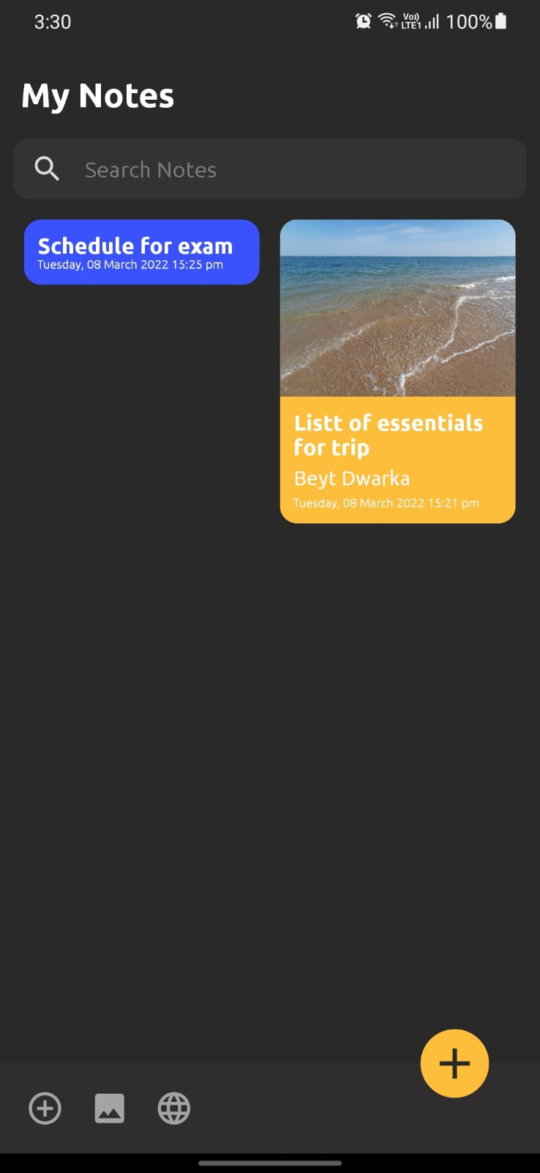
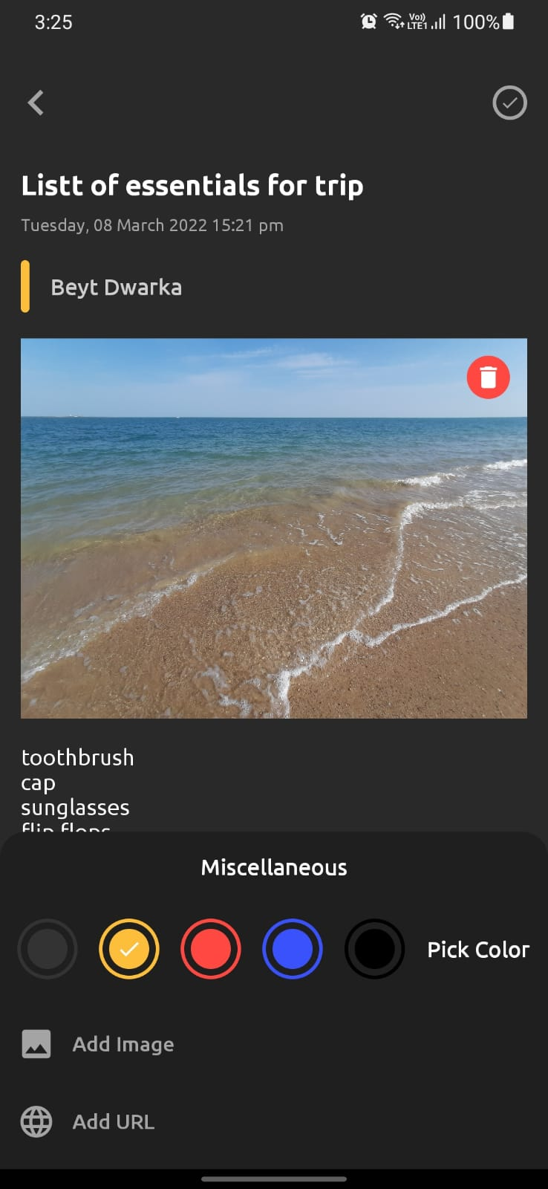
IMPLEMENTATION

Slide 11
APPLICATION
As a note taking application
Great for write down your credentials
Very handy for some quick important text

Slide 12
Conclusion
CryptoNotes will help people to store crucial information without being tense. So it aims to store the notes in the local storage.
Free Forever.

Slide 13
REFERENCES
https://developer.android.com/
https://android-developers.googleblog.com/
https://www.visual-paradigm.com/

Slide 14
THANK YOU

