Slide 1

Project II - BCSE498J
Final Review
Early Warning System for
Lifestyle-Related Health Risks
Using Text Analytics
Supervisor Dr. Yoganand S
Assistant Professor Sr. Grade 1
School of Computer Science and Engineering (SCOPE)
Vellore Institute of Technology, Vellore
April 2026
Team Members Abhay Singh (22BCE0490)
Manas Joshi (22BCE2573)
Yagnit Mahajan (22BCE2588)

Slide 2
Contents
01
Introduction & Problem Statement
06
Vocabulary Leakage Analysis
Background, motivation, and the healthcare gap
AUC 0.4912 collapse proves model learns vocabulary
02
System Architecture
07
Silver Label Analysis
Two-layer hybrid design and HLD overview
Feature-based validation across 7 categories
03
Data & Methodology
08
Explainability
19,080 Reddit posts — EDA and preprocessing
SHAP, LIME, and frontend transparency tools
04
Two-Layer Hybrid Scoring
09
Live Demo
Core novel contribution — text + clinical features
Four pre-tested scenarios
05
Results & Performance
10
Conclusion & Future Work
93–95% accuracy across three production models
Findings, limitations, and next steps

Slide 3
1.1 Background
Introduction
Lifestyle Health Crisis
The Healthcare Gap
Our Approach
Diabetes, obesity, and heart disease develop silently over years. Poor diet, inactivity, inadequate sleep, and chronic stress are the primary drivers — yet most people receive no warning until clinical threshold is crossed.
Healthcare systems treat diseases after onset. Routine checkups happen only when symptoms appear. Vast amounts of self-reported lifestyle text go completely unanalysed for early risk signals.
NLP and machine learning applied to Reddit lifestyle discourse. A two-layer hybrid scoring architecture combining text ensemble classification with SHAP-validated clinical feature scoring.
Key Risk Factors:
● Poor Diet
● Inactivity
● Sleep Deprivation
● Chronic Stress
● Smoking & Alcohol

Slide 4
1.2 Motivation
Introduction
Preventive Healthcare
Academic Opportunity
The growing burden of lifestyle diseases demands early-detection systems that act before clinical thresholds are crossed — reducing both human and economic cost.
Applying NLP, machine learning, and data analytics to real-world health data bridges theoretical knowledge and practical impact in a high-value domain.
Healthcare Trends
Social Impact
Personalized, data-driven approaches are reshaping medicine. AI systems that interpret lifestyle patterns align directly with where evidence-based healthcare is heading.
Technology that helps individuals understand their own health trajectory — before a condition develops — empowers proactive, informed lifestyle choices.

Slide 5
Problem Statement & Research Gaps
Introduction
Gaps Identified in Literature
Our Solution
Existing models rely on structured clinical data - not self-reported lifestyle text
Reddit-sourced lifestyle text (unstructured data)
NLP models trained on health text risk learning subreddit vocabulary, not true risk signals
Two-layer hybrid: NLP ensemble + clinical feature scoring
No cross-modal validation between text-based and feature-based scoring
Vocabulary leakage test proves model validity
Limited explainability for end-users in healthcare AI tools
SHAP + LIME explainability + interactive dashboard

Slide 6
Literature Review
Project Description & Goals
Approach
Strength
Key Limitation
AUC Range
Traditional ML (LR, RF, SVM)
Interpretable, effective on structured health data
Requires manual feature engineering; poor on unstructured text
0.82–0.88
Deep Learning (CNN-LSTM)
Captures temporal and sequence patterns; strong for mental health text
Needs large labelled datasets; low interpretability
0.85–0.91
BERT / Transformers
Context-aware text understanding; state-of-art on EHR text
Computationally heavy; not designed for short social media posts
+5–10%
Hybrid NLP + Rules
Combines vocabulary features with domain knowledge
Vocabulary leakage risk — learns subreddit keywords, not true risk
Varied
Key Insight: Using NLP text ensemble with SHAP-derived clinical feature scoring and validating via vocabulary leakage testing is a novel approach.

Slide 7
System Architecture
Design
Final Score = 0.50 × Text Ensemble Score + 0.50 × Clinical Feature Score
Reddit
Text Input
NLP
Preprocessing
Text Ensemble
(50%)
Clinical Feature
Score (50%)
Final Risk
Score
19,080 posts
7 categories
Tokenize · Lemmatize
244 stopwords removed
TF-IDF LR · TF-IDF RF
SBERT+SVM
SHAP-weighted:
Smoke·Sleep·Stress…
+ Behavioral Override
+ Groq Narrative
Core Components Built
TF-IDF + Logistic Regression
TF-IDF + Random Forest
SBERT + SVM (Tuned)
Baseline text classifier · AUC 0.9837
Ensemble variant · AUC 0.9737
Best model · AUC 0.9883
Clinical Feature Scoring Layer
Behavioral Override
Groq Narrative Generation
SHAP-derived weights · 6 features
Conservative floor when 2+ signals
Natural language risk explanation

Slide 8
Data Collection & EDA
Methodology
19,080
7
3 Years
145 words
Reddit Posts
Health Categories
Apr 2023 – Jan 2026
Average Post Length
Dataset Composition by Category
Engagement Insights
Highest Engagement:
Weight management posts
Lowest Engagement:
Sleep-related posts
Most Active Source:
Running subreddit
Post Length Range:
50–3,000+ characters
Label Distribution:
Skewed — imbalance handled via stratified split

Slide 9
Text Preprocessing Pipeline
Methodology
01
02
03
04
Text Cleaning
Tokenization
Stopword Removal
Lemmatization
Removed URLs, HTML tags, special characters, and Reddit formatting artefacts
Split cleaned text into individual tokens using NLTK word tokenizer
Customized list of 244 domain-specific stopwords — preserving health signal terms
WordNet lemmatizer — normalized all tokens to base form to reduce vocabulary sparsity
Processing Results
41.3%
51.2%
19,060
1.35M
40,800
0.855
Character Reduction
Word Reduction
Final Posts
Total Words
Unique Terms
Lexical Diversity

Slide 10
Two-Layer Hybrid Scoring — Core Novel Contribution
Layer 1 — Text Ensemble (50%)
Layer 2 — Clinical Feature Score (50%)
TF-IDF LR → P₁ = p(high | TF-IDF features)
Smoking
0.28
Sleep
0.24
TF-IDF RF → P₂ = p(high | TF-IDF features)
⊕
Stress
0.20
Alcohol
0.14
SBERT+SVM → P₃ = p(high | SBERT embeddings)
Diet
0.08
Exercise
0.06
TextScore = (0.4*P₁ + 0.25*P₂ + 0.35*P₃) / 3
Final Score = 0.50 × TextScore + 0.50 × ClinicalScore
Clinical feature weights derived from Kaggle SHAP analysis

Slide 11
Model Performance Results
Results
TF-IDF + LR
TF-IDF + RF
SBERT + SVM Tuned
93.81%
90.45%
94.94%
Accuracy
Accuracy
Accuracy
0.9382
0.9050
0.9494
F1-Score
F1-Score
F1-Score
0.9837
0.9737
0.9883
AUC-ROC
AUC-ROC
AUC-ROC
★ Best Model
Error Analysis — Test Set (3,812 samples)
133
103
6.19%
3,576
False Positives
False Negatives
Overall Error Rate
Correct Predictions
Per-category accuracy: Fitness 99.0% (best) · Diabetes 88.9% (most challenging — clinical management vocabulary present)

Slide 12
Vocabulary Leakage Analysis
Experiment
Accuracy
AUC-ROC
Interpretation
Original Labels
93.81%
0.9837
Strong performance — model trained correctly
Label Swap
95.07%
0.9841
Labels swapped between two categories — still high — vocabulary leaked
Random Shuffle
54.56%
0.4912
Complete collapse - model learned vocabulary, not risk signals
Interpretation
Random label shuffling collapses performance to chance, confirming text models learned subreddit vocabulary patterns rather than true health risk signals.
This directly motivated the clinical feature scoring layer - ensuring the final score reflects actual risk indicators validated through SHAP analysis.

Slide 13
Silver Label Analysis
Results — Validation
Category
Agreement
Avg Siler Score
Label Type
Key
Finding
Health Category | Original Label (Subreddit Basis) | Silver Label Mean Score (Feature Basis) | Silver Label Predominant Risk | Agreement % | Disagreement Status
Fitness | Low Risk | 0.39 | Low Risk | 100.00% | Agrees
Weight Management | Low Risk | 0.44 | Low Risk | 100.00% | Agrees
Diet | Low Risk | 0.28 | Low Risk | 99.30% | Agrees
Sleep | Low Risk | 0.53 | Low Risk | 97.20% | Agrees
Substance Use | High Risk | 2.97 | Low Risk | 19.60% | Disagrees
Mental Health | High Risk | 0.64 | Low Risk | 5.60% | Disagrees
Diabetes | High Risk | 0.22 | Low Risk | 0.00% | Disagrees
Feature-based silver labels confirm Low Risk categories are correctly labelled.
High Risk categories — particularly Diabetes — contain clinical management vocabulary (insulin dosing, medication adherence) rather than active lifestyle risk signals.
This explains the 0% agreement and validates the need for hybrid scoring.

Slide 14
Explainability
SHAP - Structured Feature Importance
LIME - Top Text Predictors
BMI: strongest predictor
Age: second highest SHAP value
Smoking status: third most impactful
7 of 8 features confirmed in TF-IDF coefficients
HIGH RISK words: diabetes +0.026, insulin +0.025, diagnosed +0.022
LOW RISK words: keto −0.077, goal −0.034, fasting −0.032
Cross-modal: LIME lexical findings confirm SHAP structured features
Cross-Modal Validation
Frontend Explainability Tools
7 of 8 SHAP-identified structured features appear as high-weight TF-IDF terms
Vocabulary leakage test confirms signal integrity
Clinical feature weights verified against literature benchmarks
Word Highlighter — risk-contributing terms highlighted in post text
Score Breakdown — text vs. clinical contribution shown separately
What-If Simulator — toggle lifestyle features to see score change
Provenance Panel — full scoring trace shown per prediction

Slide 15
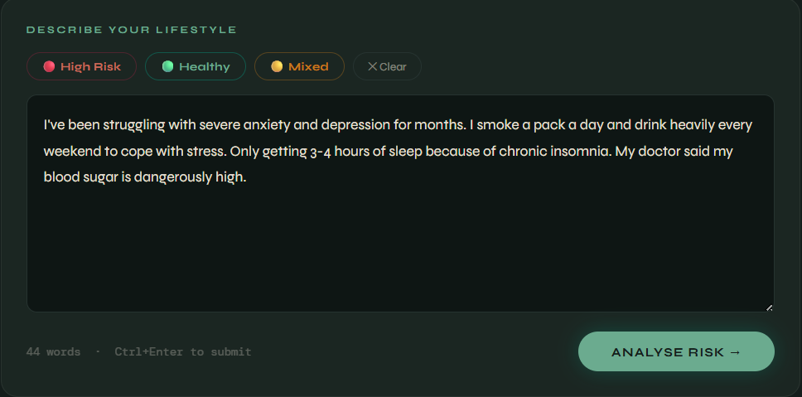
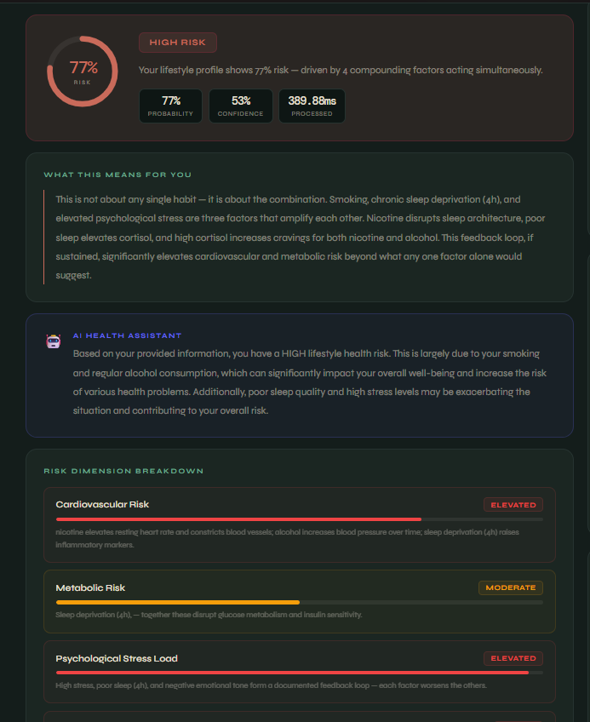
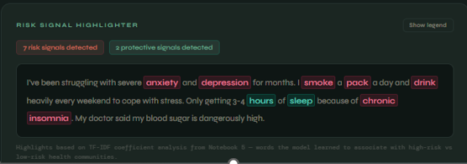
Live Demo

Slide 16
Conclusion & Future Work
What Was Achieved
Future Work
Two-layer hybrid scoring architecture combining NLP ensemble (3 models) with SHAP-validated clinical feature scoring - achieving up to 94.94% accuracy and AUC 0.9883
Clinical gold standard annotation — replace Reddit-derived silver labels with expert-validated clinical risk labels for supervised benchmarking
1
1
Vocabulary leakage proof demonstrating text models learn subreddit patterns - directly motivating and validating the clinical scoring layer
Semantic feature extraction — move from TF-IDF bag-of-words to contextual embeddings that capture risk semantics rather than community vocabulary
2
2
Cross-modal validation: 7 of 8 SHAP-identified structured features independently confirmed in TF-IDF term weights
Multilingual support — extend preprocessing and model training to support non-English lifestyle discourse for broader population coverage
3
3

