Slide 1
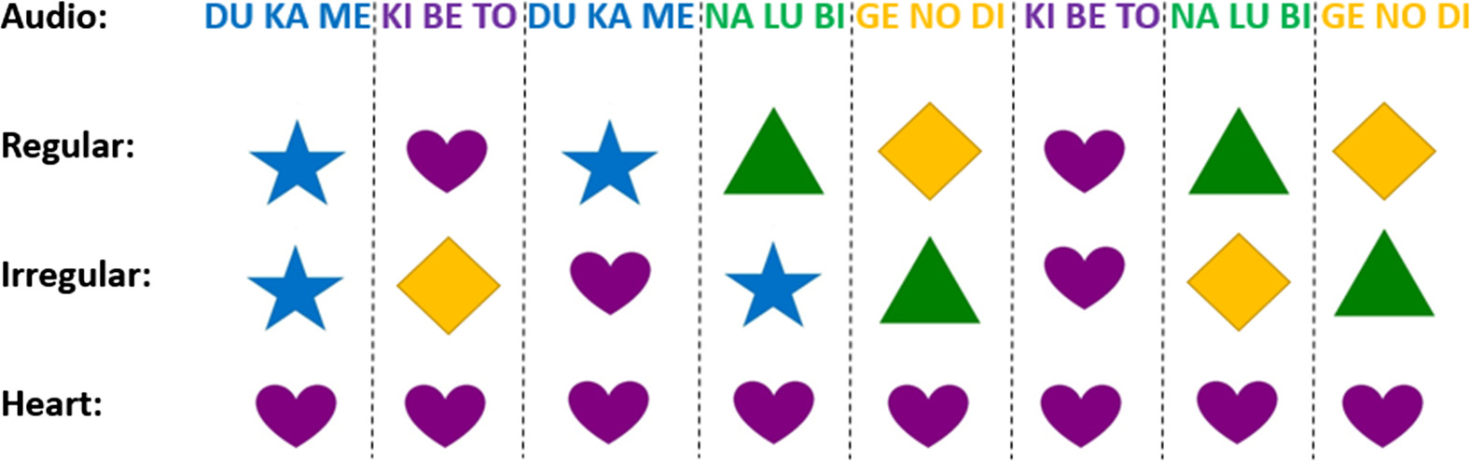
Developmental Differences Between Children and Adults in the Use of Visual Cues for Segmentation
Cognitive Science, Volume: 42, Issue: S2, Pages: 606-620, First published: 28 September 2017, DOI: (10.1111/cogs.12528)
Notes:
An illustration of the three video conditions.
IF THIS IMAGE HAS BEEN PROVIDED BY OR IS OWNED BY A THIRD PARTY, AS INDICATED IN THE CAPTION LINE, THEN FURTHER PERMISSION MAY BE NEEDED BEFORE ANY FURTHER USE. PLEASE CONTACT WILEY'S PERMISSIONS DEPARTMENT ON PERMISSIONS@WILEY.COM OR USE THE RIGHTSLINK SERVICE BY CLICKING ON THE 'REQUEST PERMISSIONS' LINK ACCOMPANYING THIS ARTICLE. WILEY OR AUTHOR OWNED IMAGES MAY BE USED FOR NON-COMMERCIAL PURPOSES, SUBJECT TO PROPER CITATION OF THE ARTICLE, AUTHOR, AND PUBLISHER.

