Slide 1
AMG + AMP + Loki Demo
Yagr Xu

Slide 2







Demo Architecture
AWS Account
Logs
VPC
Metrics and traces
http://world:5000/
FluentBit
Loki
Metrics:
- EKS Cluster Performance Metrics
Logs:
- Cluster stout/stderr
Traces:
- auto-instrumentation
Hello
world
generates
./tf/collector/collector.yaml
ADOT Collector
ADOT Controller
Manager
AWS X-Ray
Amazon managed Prometheus
Amazon managed Grafana

Slide 3
Limitations Found in the Demo (2023.02.03)
Span to Logs navigation
OpenTelemetry Python Platform resource detection

Slide 4
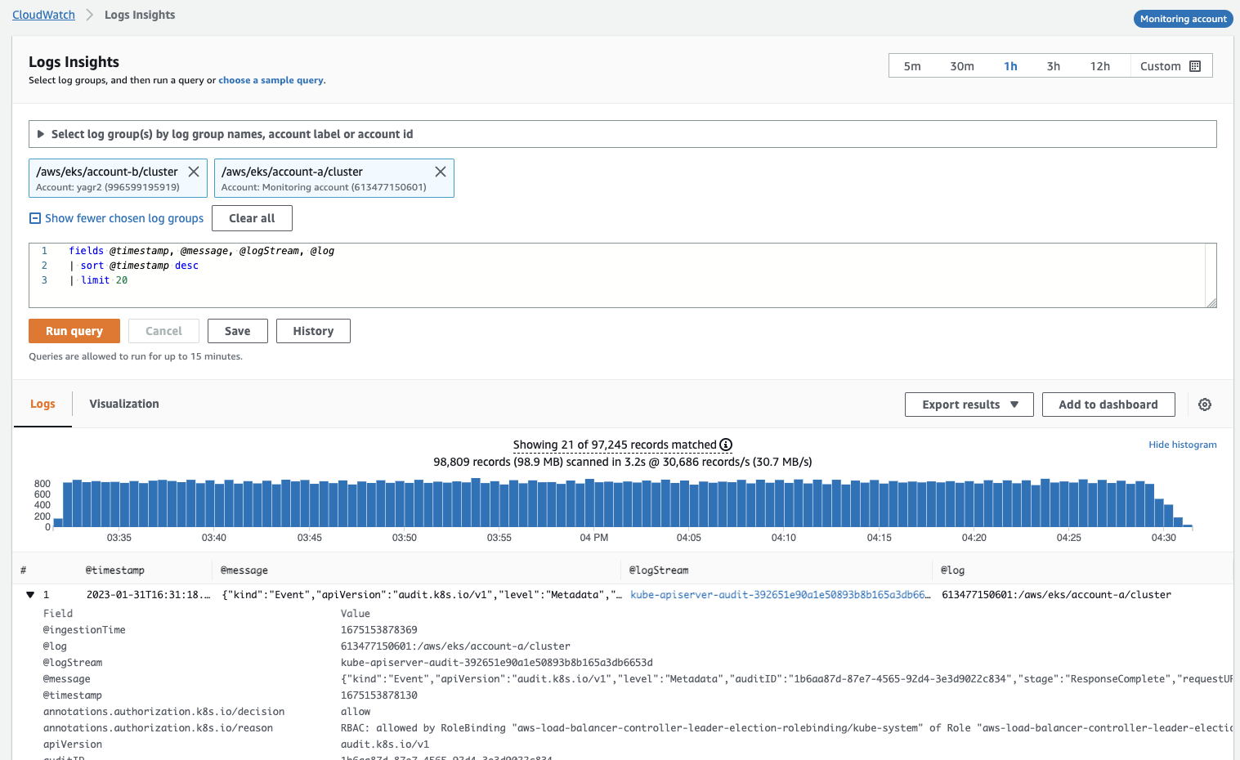
Logs

Slide 5
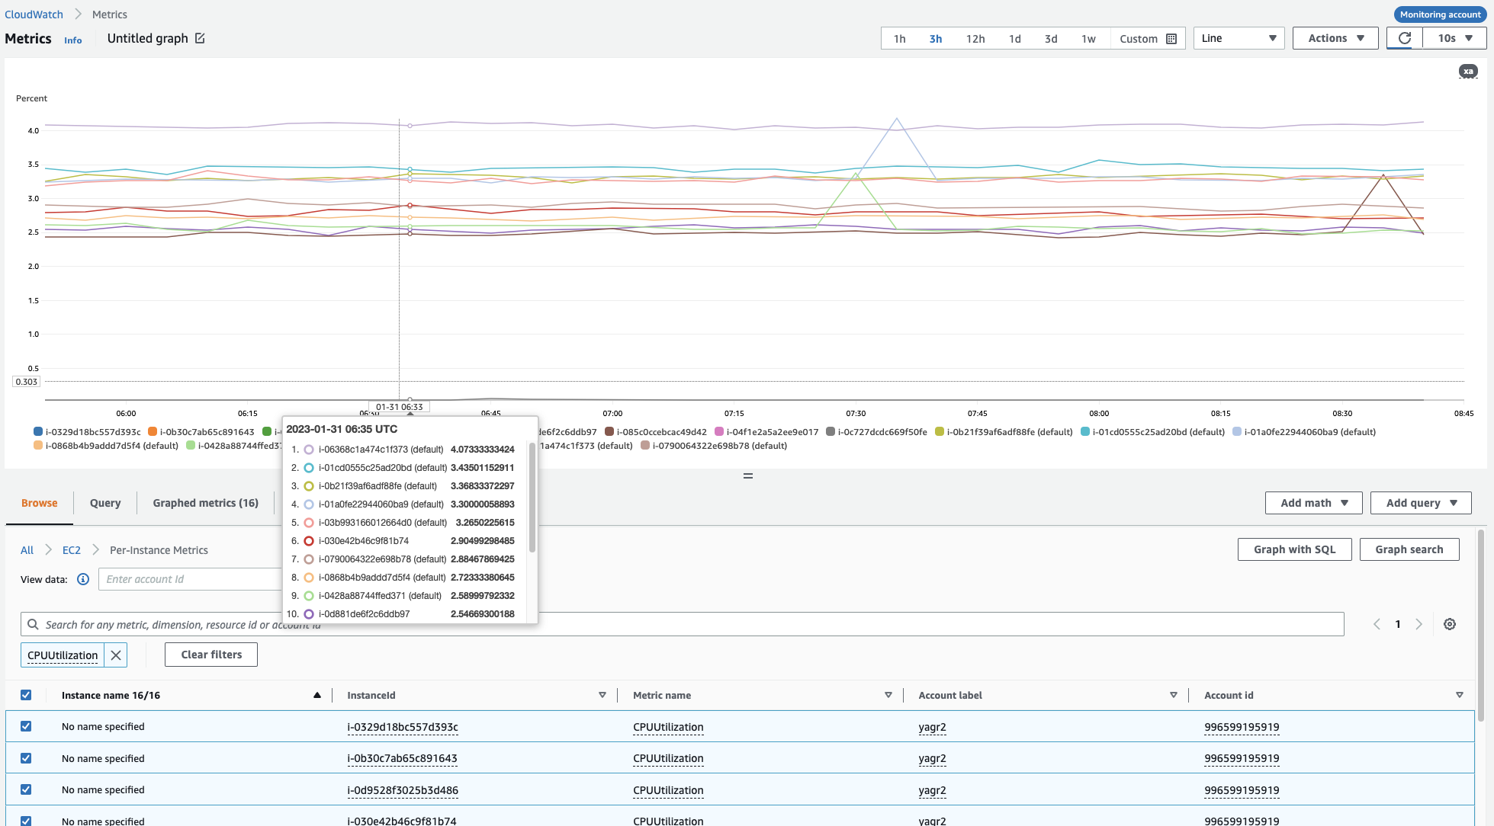
Metrics

Slide 6
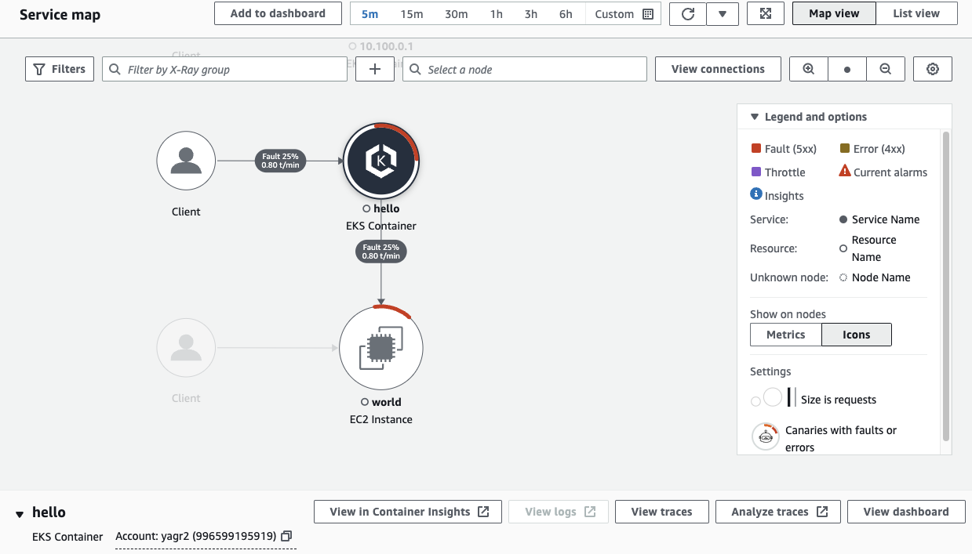
Traces

Slide 7
Configurations

