Slide 1
CloudWatch Cross-Account Demo Architecture
Yagr Xu

Slide 2
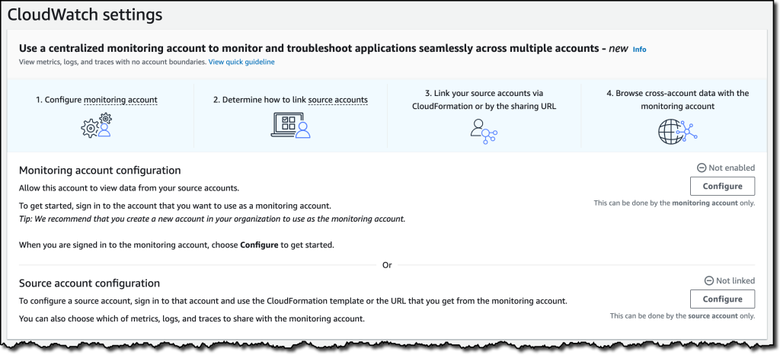
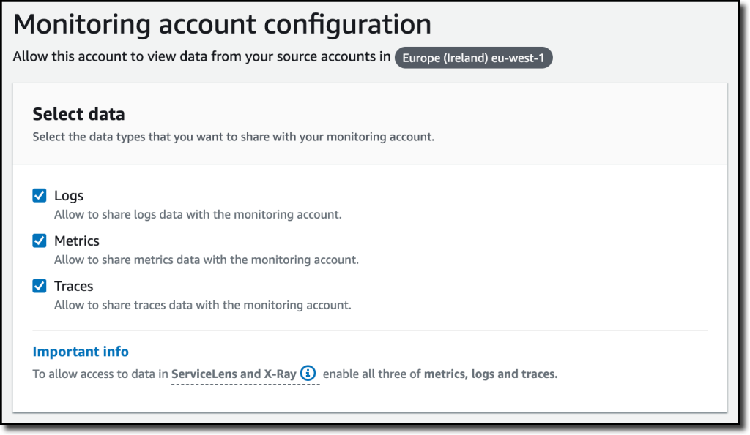
How to Configure
https://aws.amazon.com/blogs/aws/new-amazon-cloudwatch-cross-account-observability/
Configure the current account to be monitoring account and source account (One account can be monitoring and source account at the same time)
Share Logs/Metrics/Traces with monitoring account

Slide 3


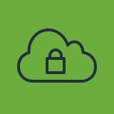
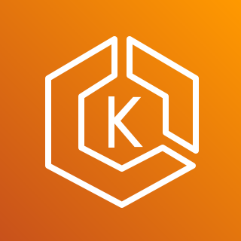

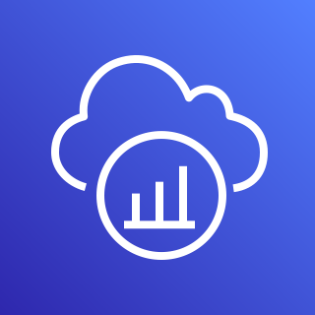


Demo Architecture
AWS Account A
AWS Account B
Transit Gateway
VPC
VPC
ADOT Collector
FluentBit
Caller Service
Callee Service
FluentBit
ADOT Collector
AWS X-Ray
Metrics Insights
Logs
Logs
Metrics Insights
AWS X-Ray

Slide 4
Account Privilege Management
{
"Version": "2012-10-17",
"Statement": [
{
"Effect": "Allow",
"Principal": {"AWS": "996599195919"},
"Action": ["oam:CreateLink", "oam:UpdateLink"],
"Resource": "*",
"Condition": {
"ForAllValues:StringEquals": {
"oam:ResourceTypes": [
"AWS::Logs::LogGroup",
"AWS::CloudWatch::Metric",
"AWS::XRay::Trace"
]
}
}
}
]
}
Source Account can configure the categories to be shared (metrics, logs, traces). If a catetory is shared, all information under the category can be collected from Monitoring Account
Monitoring Account can control resource access by IAM (X-Ray and CloudWatch Logs). Metrics in CloudWatch cannot be controlled by IAM.

Slide 5
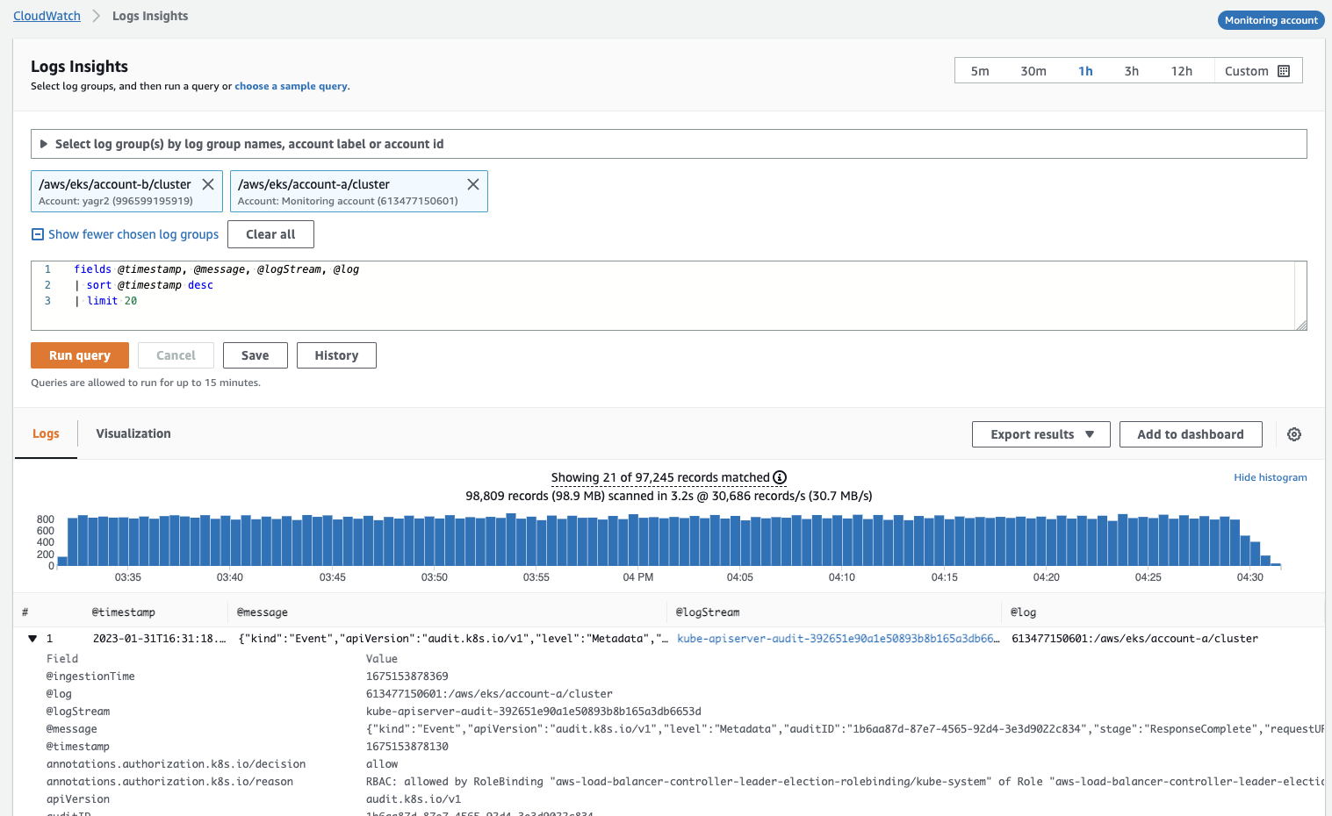
Logs

Slide 6
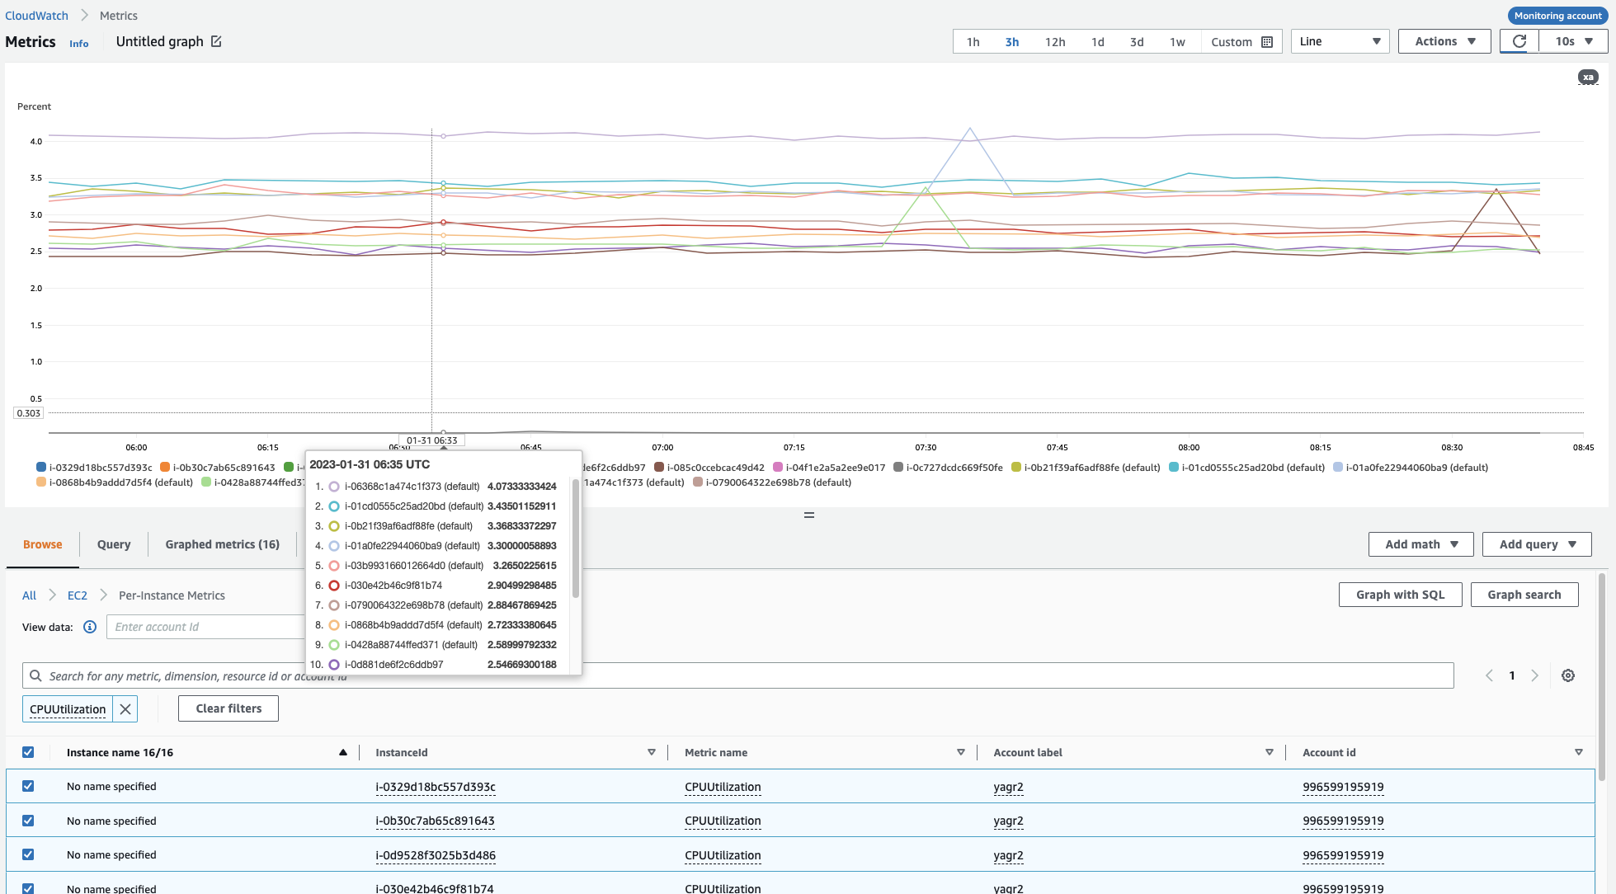
Metrics

Slide 7
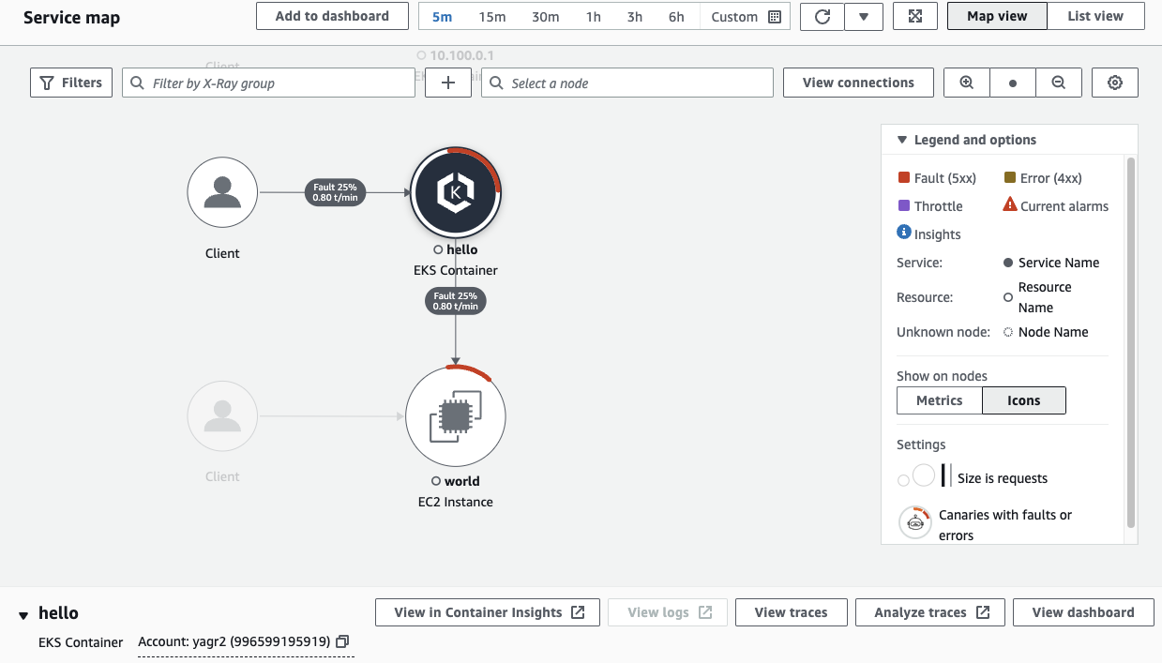
Traces

