Slide 1
01
Wajbati
A Website for Personalized Dietary Assessment
and AI-Assisted Calorie Tracking
Benamrouche Yahia Abdeljallil • Bensmira Hamza Abdarrahmane
Supervisor: Dr. Bechinia Hadjer | June 2026
University of Abdelhamid Mehri – Constantine 2 | NTIC Faculty | IFA Department

Slide 2
02 | Introduction
⚠️
📊
💡
Global Obesity Crisis
Calorie Tracking Challenge
Our Solution
Over 1 billion people worldwide live with obesity. Poor diet habits remain the leading cause, demanding smarter nutritional tools.
Manual logging is tedious and inaccurate. Existing apps rely on text search with no image-based automation or clinical guidance.
An AI-powered web platform combining food image recognition, personalized diet plans, and nutritionist consultations in one place.

Slide 3
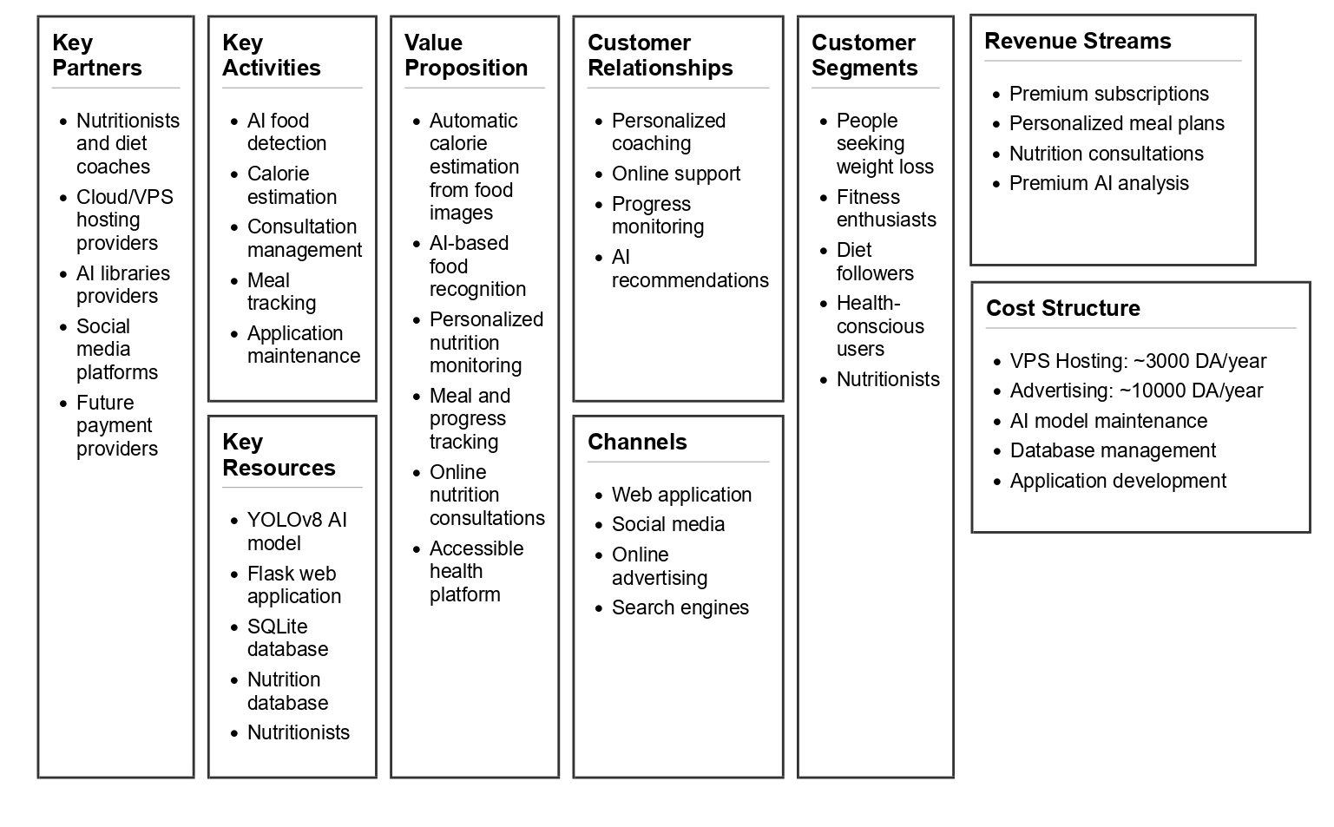
03 | Introduction (Business Model Canvas)

Slide 4
04 | Related Work
Method | Approach | Limitation | Our Advantage
Sathish et al. (2022) | CNN Classification | Single food, no segmentation | ✓
Tjandra et al. (2025) | Mobile CNN App | Classification only | ✓
Saad et al. (2025) | YOLO + Database | No instance masks | ✓
Shao et al. (2023) | RGB-D Fusion | Requires depth sensor | ✓
Wimalasiri (2024) | 2D Weight Est. | No calorie output | ✓
Gautam et al. (2025) | Recipe Recognition | No portion estimation | ✓
Our approach is the only one combining multi-food segmentation + calorie estimation + web deployment.

Slide 5
05 | Proposed Platform
Wajbati — Key Features
AI Food Detection
Calorie Tracking
Automatic calorie & macro estimation using USDA FoodData Central database
YOLOv8s-seg detects & segments food items from uploaded meal photos
📈
Progress Dashboard
Track daily calories consumed/burned and weight evolution over time
👨‍⚕️
Nutritionist Booking
Clients book consultations with certified nutritionists via the platform
🎥
Video Meetings
Built-in Jitsi meeting rooms for client-nutritionist video sessions
💳
Premium Subscription
Chargily payment gateway integration for premium access simulation
Chef Chatbot
A chef chatbot to give delicious cooking recipes

Slide 6
06 | AI-Based Calorie Estimation
1
2
3
4
Data Acquisition
Preprocessing
Food Detection
Calorie Estimation
FoodInsSeg
7,118 images
103 food classes
COCO format
COCO → YOLO
Polygon normalize
data.yaml
Train/Val split
YOLOv8s-seg
CSPDarknet
PANet FPN
Seg. head
Mask area →
portion size
USDA DB lookup
Kcal + macros
Output per detected food item: Food Name | Calories (kcal) | Protein (g) | Carbs (g) | Fat (g)

Slide 7
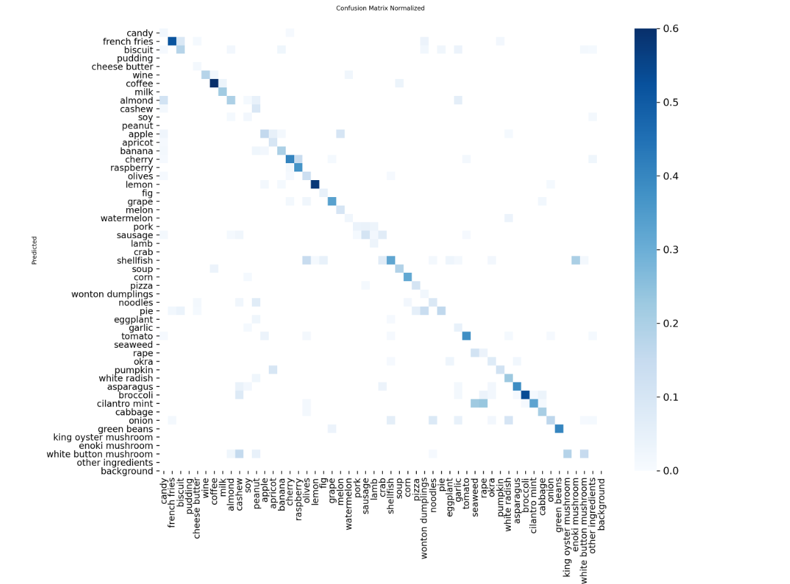
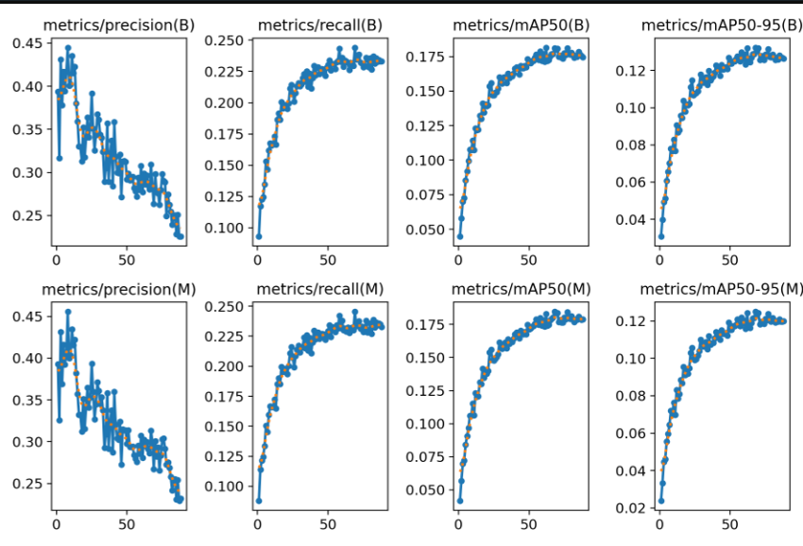
07 | Experiments & Results (Model 1)
Training Environment: Kaggle • 2× NVIDIA Tesla T4 • Python + PyTorch
Training: 100 epochs max, early stopping patience=20, stopped at epoch 68 after 6 hours
Base model: YOLOv8s-seg pretrained on COCO, freeze=5 layers
Model | Classes | maP@0.5 mAP@0.5:0.95 | Precision | Recall | Epochs
Model 1 — Full Training | 103 | 0.1845 0.1243 | 0.2988 | 0.2302 | 68 / 100

Slide 8
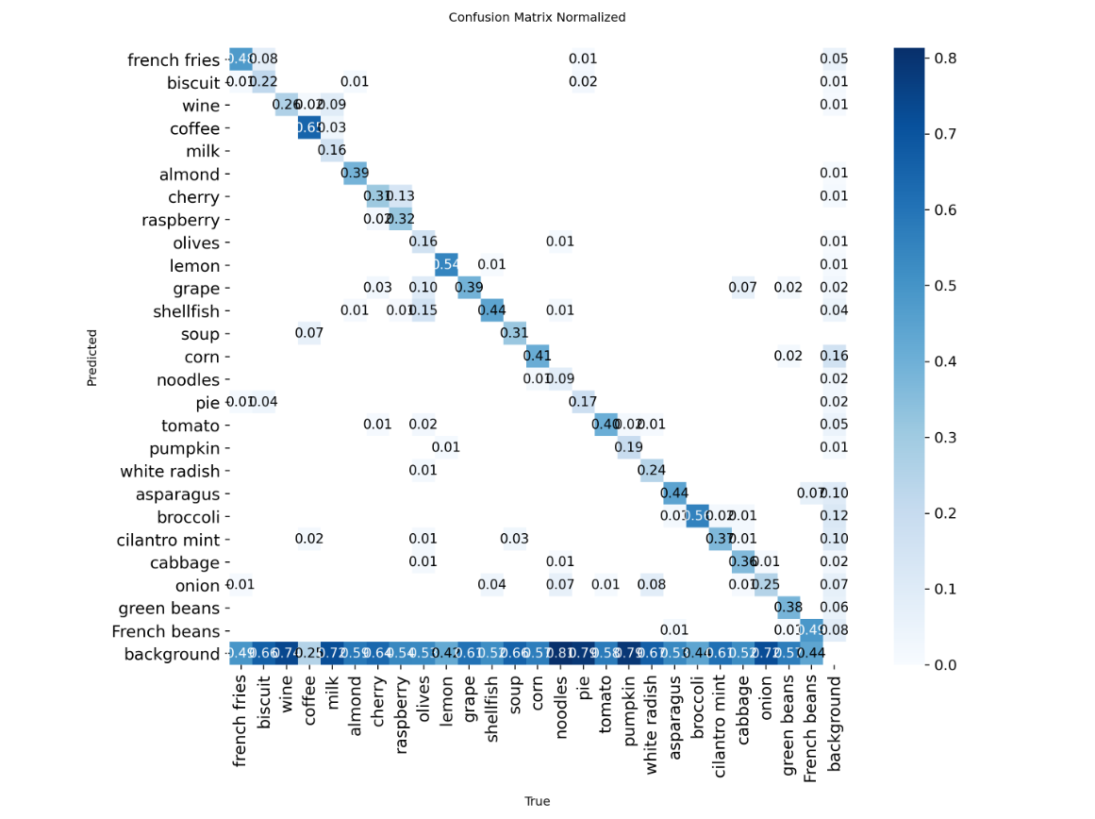
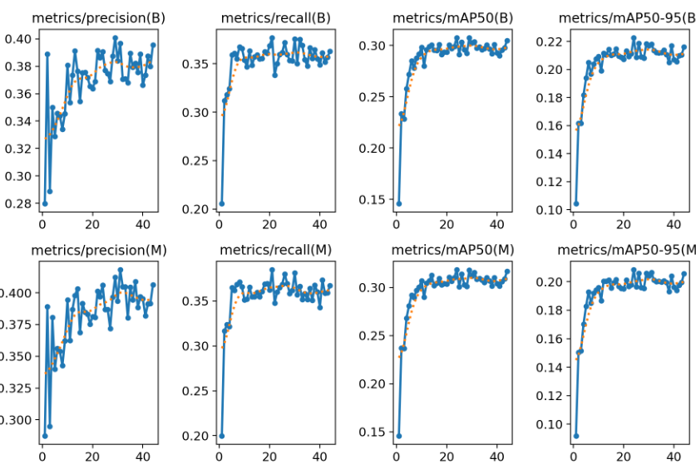
08 | Experiments & Results (Model 2)
Training Environment: Kaggle • 2× NVIDIA Tesla T4 • Python + PyTorch
Fine-tuned from Model 1 weights using transfer learning
- Reduced to 26 most common food classes, freeze=3 layers, lr=0.0003
- Training: 60 epochs max, early stopping, converged at epoch 45
Model | Classes | maP@0.5 mAP@0.5:0.95 | Precision | Recall | Epochs
Model 2 — Fine-tuned | 26 | 0.3180 0.2 | 0.3900 | 0.3500 | 45 / 60

Slide 9
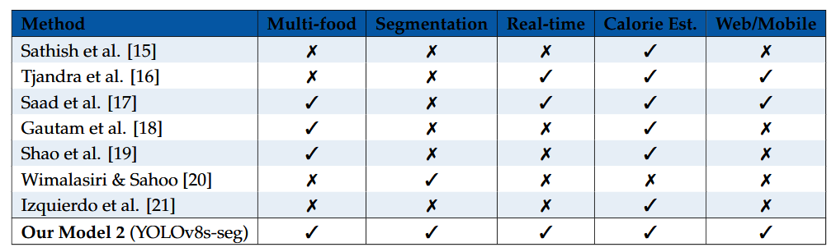
09 | Experiments & Results (Comparison and Observations)
Model | Classes | maP@0.5 mAP@0.5:0.95 | Precision | Recall | Epochs
Model 1 — Full Training | 103 | 0.1845 0.1243 | 0.2988 | 0.2302 | 68 / 100
Model 2 — Fine-tuned ✦ | 26 | 0.3180 0.2 | 0.3900 | 0.3500 | 45 / 60
Model 1 Observation: Many classes underrepresented, large background misclassification rate
Model 2 Observations:
+72% mAP@0.5 over Model 1
Strong diagonal in confusion matrix exp: coffee 0.60, lemon 0.54, broccoli 0.50, asparagus 0.44
General Comparison and observation
- Model 1 vs Model 2 comparison table: 103 classes mAP=0.1845 vs 26 classes mAP=0.3180
- Class reduction from 103 to 26 increased samples per class and improved learning
- Transfer learning from food-domain weights enabled faster convergence
Early stopping prevented overfitting in both models
General Comparison with other projects

Slide 10
10 | Future Perspectives
Larger Model Backbone
Expanded Dataset
Advanced Augmentation
Upgrade to YOLOv8m-seg or YOLOv8l-seg for greater representational capacity and improved accuracy on complex scenes.
Incorporate additional food image datasets and synthetic data generation to address the limited samples per class issue and add other cuisines as Arabic etc.
Apply mixup, copy-paste, and style transfer augmentations to better handle visually similar food categories.
RGB-D Integration
Developing an App
Migration to An Algerian VPS
Integrate depth sensors for precise 3D portion size estimation, enabling clinically accurate calorie quantification.
Converting Wajbati into a mobile app would improve accessibility and user experience by enabling instant meal capture and easier calorie tracking. It would also support push notifications, health integrations, and future real-time AI features directly on smartphones.
Future improvements may include migrating the website from a local deployment to a scalable cloud-based architecture. This migration would improve performance, reliability, and the ability to support a larger number of simultaneous users.

Slide 11
11
Conclusion
Designed and developed a full-stack AI-powered dietary assessment web platform named Wajbati.
Trained YOLOv8s-seg on FoodInsSeg (103 classes) achieving mAP@0.5 = 0.1845 as a food-domain baseline.
Fine-tuned on 26 selected classes via transfer learning, improving mAP@0.5 to 0.318 — a 72% gain.
Delivered a working client-server system with nutritionist booking, calorie tracking, and progress monitoring.
Identified clear directions for future improvement including larger backbones and expanded datasets.
Thank you for your attention

