Slide 1
Natural Mongo
Yahav Izhak & Valeriya Zelikovich
67788 - Advanced OS and Cloud Technologies

Slide 2
About
Natural Mongo allows users to change permissions on a database by writing requests in natural language.

Slide 3
How does it work?

Slide 4
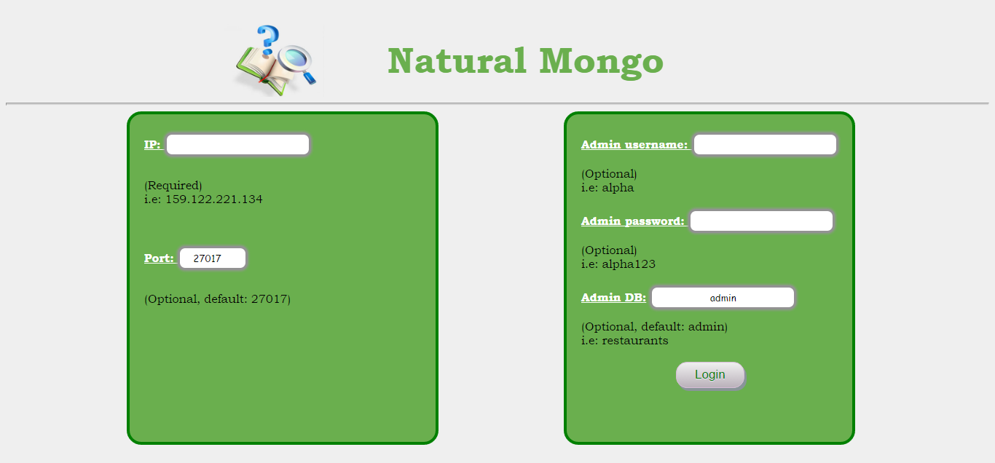
Login first

Slide 5
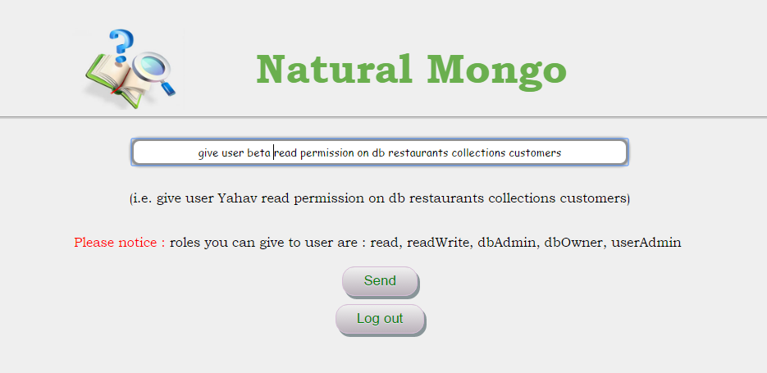
Write request

Slide 6
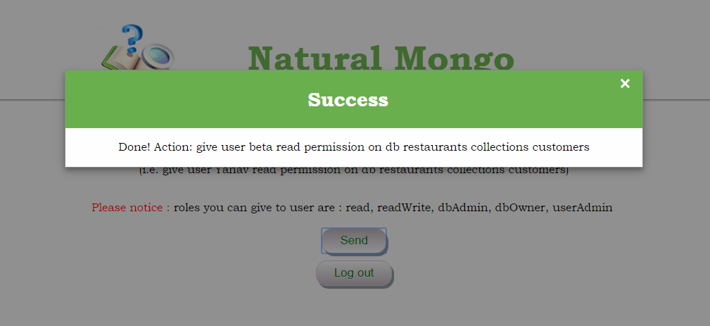
Result

Slide 7
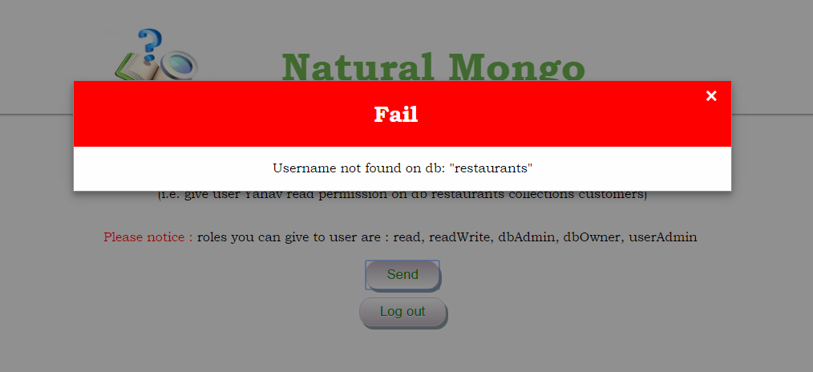
Result

Slide 8
Request examples:
give user beta readWrite permission on db restaurants
let alpha be the userAdmin on db restaurants on collection customers
allow gamma to be the dbOwner on db restaurants
enable beta readWrite on restaurants
disallow gamma to readWrite in db restaurants
delete dbAdmin permissions from alpha in db restaurants collection restaurants
prevent gamma from dbOwner in db restaurants

Slide 9
Questions?

