Slide 1

PandaX
CRA-ready
firmware evidence
Notes:
Audience: prospective industrial and networking equipment customers. No investment request. Brand logo supplied by the user and preserved unchanged.

Slide 2



Security failures become legal costs
$575M+
EQUIFAX
$148M
_{UBER}
$5.8M
RING
€6.31B in tracked GDPR fines
02
Notes:
The visible headlines are unaltered image clippings captured from official government article pages. These U.S. matters illustrate the legal cost of missing vulnerability, evidence, and reporting controls. They are not CRA cases and the settlement structures are not directly comparable. Equifax: https://www.ftc.gov/news-events/news/press-releases/2019/07/equifax-pay-575-million-part-settlement-ftc-cfpb-states-related-2017-data-breach . Uber: https://www.oag.ca.gov/news/press-releases/california-attorney-general-becerra-san-francisco-district-attorney-gasc%C3%B3n . Ring: https://www.ftc.gov/news-events/news/press-releases/2023/05/ftc-says-ring-employees-illegally-surveilled-customers-failed-stop-hackers-taking-control-users . GDPR Enforcement Tracker statistics, refreshed 20 August 2026: 3,206 tracked cases across 32 countries and €6.31 billion in tracked fines: https://enforcementtracker.com/statistics

Slide 3

Vulnerabilities become legal exposure
20%
of breaches began with
vulnerability exploitation
+34%
Year over year
30%
Third-party involvement
VERIZON 2025 DBIR
03
Notes:
Verizon's 2025 Data Breach Investigations Report analyzed 12,195 confirmed breaches. Exploitation of vulnerabilities accounted for 20% of breaches as an initial-access step and grew 34% year over year; third-party involvement doubled to 30%. Source: https://www.verizon.com/about/news/2025-data-breach-investigations-report . ENISA's independent EU dataset reports vulnerability exploitation as 21.3% of observed intrusion access points: https://www.enisa.europa.eu/publications/enisa-threat-landscape-2025 . Generated cybersecurity visual created for this deck.

Slide 4
24 hours to act
24H
72H
€15M
Early warning
Notification
or 2.5%
Technical evidence must be ready before legal review
04
Notes:
CRA Article 14 establishes staged notifications for actively exploited vulnerabilities and severe incidents, including an early warning within 24 hours and a notification within 72 hours. Article 64 provides fines up to €15,000,000 or 2.5% of worldwide annual turnover for specified non-compliance, whichever is higher. Reporting obligations apply from 11 September 2026. Annex VII specifies technical-documentation content. Sources: https://eur-lex.europa.eu/eli/reg/2024/2847/oj/eng ; https://digital-strategy.ec.europa.eu/en/policies/cra-reporting . PandaX supports evidence and workflow preparation; legal reportability and submission remain human-authorized.

Slide 5

The manual alternative
Evidence gathering
Legal translation
Manual reporting
Multiple approvals
The 24-hour clock keeps running
05
Notes:
Illustrative manual compliance workflow based on the user-supplied problem framing. The slide makes no measured claim about average legal-response duration. Generated lawyer visual created specifically for this deck.

Slide 6
One continuous automation loop
Extraction
AUTOMATED
Evidence
Detection
06
Notes:
PandaX continuously extracts firmware components, detects reachable vulnerabilities, and produces CRA-ready evidence before repeating on the next firmware state.

Slide 7
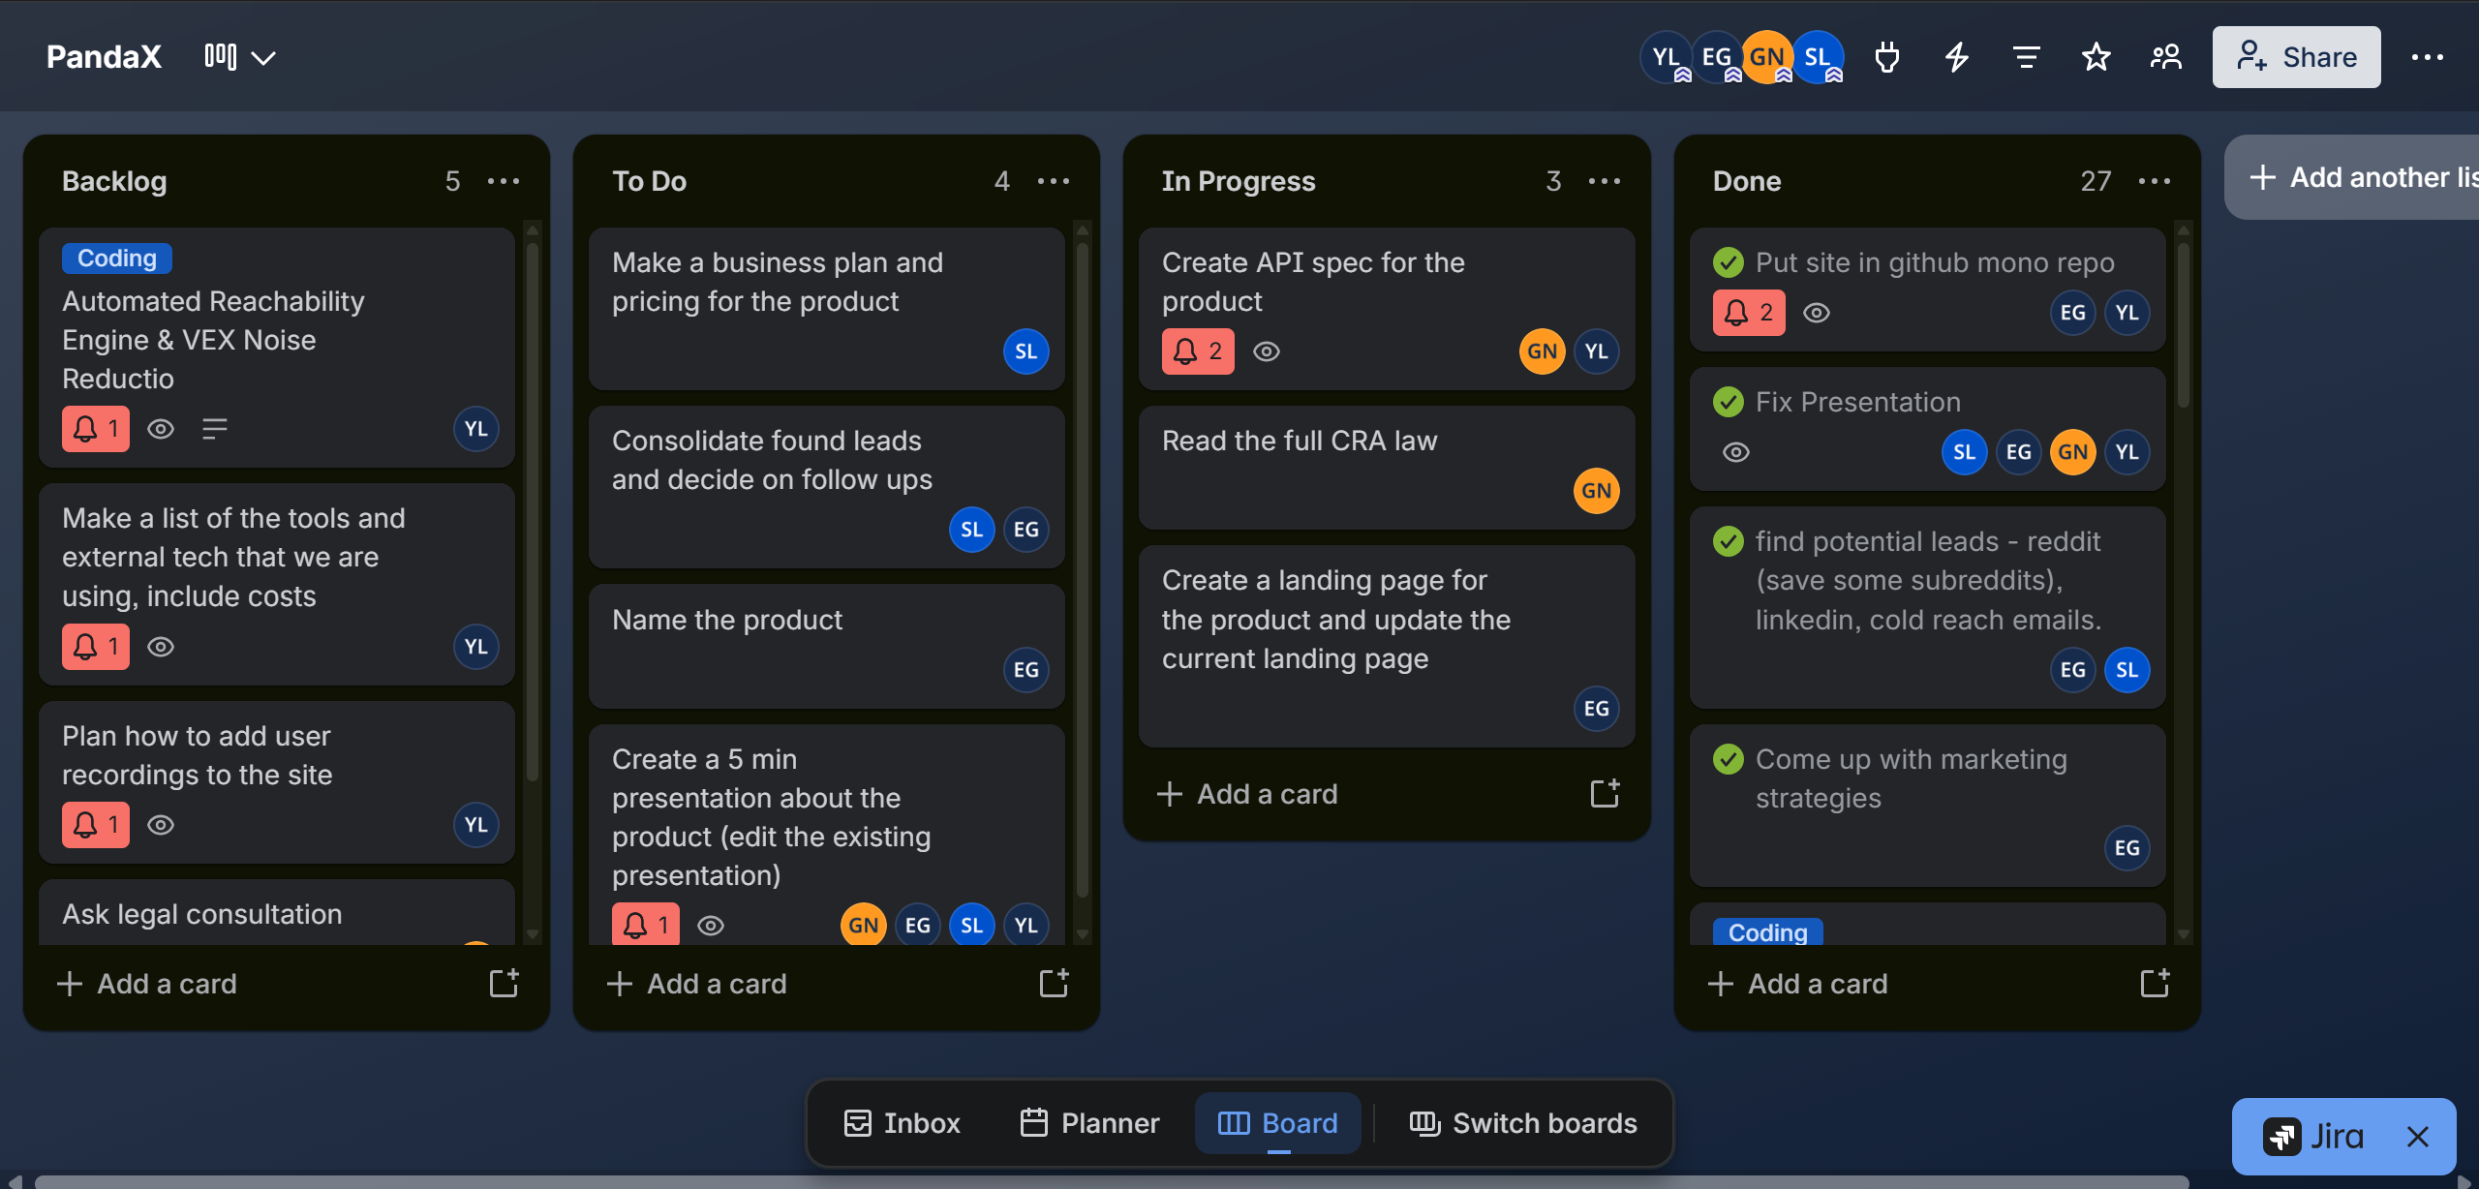
PandaX Kanban
07

Slide 8
08

Slide 9
Pilot PandaX
One product line
One SKU
One firmware image
CRA-ready
evidence
Simon Levy
Yaheli Levit
Guy Nevo
Eden Gulko
CEO
CTO
CPO
CMO
09
Notes:
Founding team and roles supplied by the user. Closing ask: prospective customer pilot. No funding ask.

