Slide 1
ASCIICODE and UNICODE

Slide 2
Overview : Unicode and ASCII are the most popular character encoding standards that are currently being used all over the world. Unicode is the universal character encoding used to process, store and facilitate the interchange of text data in any language while ASCII is used for the representation of text such as symbols, letters, digits, etc. in computers.

Slide 3
ASCII :
It is a character encoding standard for electronic communication. American Standard Code for Information Interchange(ASCII) and was first launched in 1963. ASCII codes are used to represent text in computers and telecom devices.
ASCII is used for representing 128 English characters in the form of numbers, with each letter being assigned to a specific number in the range 0 to 127. For e.g., the ASCII code for uppercase A is 65, uppercase B is 66, and so on. Check out the following table for some more examples.
Most computers are using ASCII encoding for text representation, which makes transferring data from one device to another a lot easier.

Slide 4
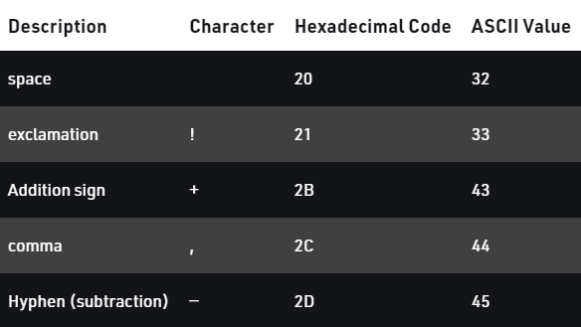

Slide 5
Unicode :
Unicode provides a unique way to define every character in every spoken language of the world by assigning it a unique number. The Unicode standard is maintained by the Unicode Consortium and defines more than 1,40,000 characters from more than 150 modern and historic scripts along with emoji.
Unicode can be defined with different character encoding like UTF-8, UTF-16, UTF-32, etc. Among these UTF-8 is the most popular as it used in over 90% of websites on the World Wide Web as well as on most modern Operating systems like Windows.

Slide 6
ASCII Vs Unicode : Now that we have seen what ASCII and Unicode are, let’s go ahead and see how are they different from each other.
Key factor-1 : Size –
It is obvious by now that Unicode represents far more characters than ASCII. ASCII uses a 7-bit range to encode just 128 distinct characters. Unicode on the other hand encodes 154 written scripts. And did I mention emoji? Those too.
So, we can say that, while Unicode supports a larger range of characters it also takes up a lot more space than ASCII.
Key factor-2 : ASCII == UNICODE?
For backward compatibility, the first 128 Unicode characters point to ASCII characters. And since UTF-8 encodes each of those characters using 1-byte.
ASCII is essentially just UTF-8, or we can say that ASCII is a subset of Unicode. Vice versa isn’t true.

Slide 7
Conclusion : In conclusion, both Unicode and ASCII are the standards for text encoding, and they hold the utmost significance in modern communications. Both have their advantages and disadvantages, but a more universal solution for encoding will always facilitate and create ease in communication in the future.

Slide 8
Team member→
يحيي زكريا كامل
يوسف عصام
-غادة هلال
فاطمه محمودشريف
-فاطمه محمود عبد الراتب

