Slide 1
PYTHON
Programming
Level 1 - Lesson(1)

Slide 2
Level 1 Full Content
Introduction to Programming.
Python – Basic programming Concepts
Variables – Data Types – User Inputs
Building Formulas using Python
- Collections = sequences
1. Lists
2. Tuples
3. Dictionary
- Strings
- Loops
- Functions

Slide 3
Level 1 Full Content
- Graphics using Turtles
- Exception Handling
- Handling Date Time in Python
- Files Handling in Python, OS Module in Python
- Using Git and Git Hub

Slide 4
Let’s Learn Programming خلينا نتعلم برمجة
What’s Programming ? تعريف البرمجة
هى عملية إعطاء أوامر برمجية ( كتابة أكواد برمجية ) للحاسب لحل مشكلة معينة أو لبناء التطبيقات البرمجية
What are the applications ( Programs ) تعريف التطبيقات البرمجية ؟
هى البرمجيات المستخدمة في الكمبيوتر وعلى الإنترنت أو على الموبايل سواء استخدام شخصى او استخدام الشركات
Applications Types أنواع التطبيقات
تطبيقات ديسكتوب – تطبيقات ويب – تطبيقات موبايل – تطبيقات ألعاب ..

Slide 5
Let’s Learn Programming خلينا نتعلم برمجة
Examples for programming languages ? أمثلة عن لغات البرمجة
C | C++ | C # | PHP | Java | Java Script | Python
Which programming language I shall choose to learn ?
أى لغة برمجة يفضل انى اتعلمها ؟
- ابدأ باللغة السهلة
- اللغة اللى لها مصادر تعليمية كثيرة
- اللغة التى تتطور باستمرار
- اللغة المستخدمة في العديد من أنواع التطبيقات المختلفة
- المهم تبدأ وتستمر

Slide 6
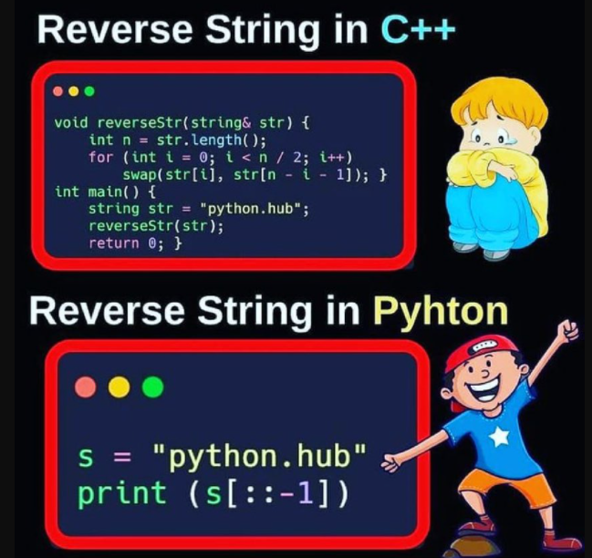
Python vs C++
Top 16 differences

Slide 7
What Is Pythonلغة برمجة البايثون
What is Python?
من اشهر لغات البرمجة التى انتشرت بسرعة كبيرة
It was created by Guido van Rossum, and released in 1991.
لغة سهلة كثيراً للإستخدام والبدء في تعلم البرمجة
تحوي العديد والعديد من المكتبات التى تساعدك في حل مشكلات برمجية كثيرة
تستخدم من خلال العديد من الأشخاص الغير مبرمجين – مثل : علماء البيانات وعلماء الرياضيات ومحللى البيانات ومهندسى الشبكات والمحاسبين
تستخدم في العديد من المجالات البرمجية والرياضيات مثل
(Desktop | Web | Mobile Apps – Data Analysis – Machine Learning – AI Artificial Intelligence – Cyber Security – Networking Apps – Data Visualization )

Slide 8
Enterprises use Pythonأمثلة كبرى لاستخدام البايثون
Organizations using Python ؟
https://jaydevs.com/top-companies-that-use-python/

Slide 9
Start Python Coding ابدأ برمجة البايثون
What we need to start
Laptop or Mobile
Download and install python https://www.python.org/downloads/
Download and install IDE ( Integrated Development Environment ) like ( Pycharm – Anaconda – Visual Studio Code .. ). We will use Pycharm Community edition https://www.jetbrains.com/pycharm/download/
Just Create a new project, then print(‘Hello World’)

Slide 10
Start Python Coding ابدأ برمجة البايثون
What we need to start
Print(‘ ‘) - Variables
Comments
Data types ( Numeric [ int – float ], string, boolean, date & time )
Type( )
Arithmetic Operators ( + - * / % ** )
Comparison Operators ( == > < >= <= != )
Getting user input
Increment, Decrement - import math module
round casting remainder %

Slide 11
Variables
A variable can have a short name (like x and y) or a more descriptive name (age, car_name, total_volume). Rules for Python variables:
A variable name must start with a letter or the underscore character
A variable name cannot start with a number
A variable name can only contain alpha-numeric characters and underscores (A-z, 0-9, and _ )
Variable names are case-sensitive (age, Age and AGE are three different variables)

Slide 12
Variables
For numbers, with type integers ( int )
x = 5 y = 10 print(x + y)
For numbers, with type float
x = 5.6 y = 10.88 print(x + y)
For text, with type str
name = “Ahmed” address = “Cairo” print(name+ “ lives in “+address)

Slide 13
Data Types
Built-in Data Types
In programming, data type is an important concept.
Variables can store data of different types, and different types can do different things.
Python has the following data types built-in by default, in these categories:
Text Type: str
Numeric Types: int, float
Boolean Type: bool

Slide 14
Basic Examples
يالا نكتب كود

Slide 15
Simple Examples (1)
Ex No. 1 : first_program ( variables – data types)
print('Welcome to Python')
# Comment x, y ,z are variables
# x, y, z are variables of data type ( int )
x = 5
y = 6
y = 20
z = x + y
print(z)
print('---------------')
# student_mark is a variable of datatype ( float )
student_mark = 97.45
print(student_mark)
print(type(student_mark))
print('---------------')

Slide 16
Simple Examples (1) Cont.
Ex No. 1 : first_program ( variables – data types) - Cont.
# student_name is a variable of data type ( String ) ( str )
student_name = 'Ibrahim Mohamed'
print(student_name)
print(type(student_name))
print('------------------')
student_address = '13 Makram Ebeid - Nasr City'
print(student_address)
print(type(student_address))
print('------------------')
print(student_name +' lives at '+ student_address)

Slide 17
Simple Examples (2)
Ex No. 2 : Print employee data with Casting data types(conversion)
employee_id = 101 # int
employee_name = 'Ahmed Eissa' # string
employee_salary = 7000.55 # float
employee_email = 'ahmed.eissa@gmail.com' # string
employee_address = 'Cairo - Nasr city' # string
print(employee_name + ' lives at '+employee_address)
print(employee_name +' takes salary '+str(employee_salary)) # convert to string
print(employee_name +' with id '+str(employee_id) ) # convert to string
# employee salary with no decimal : Convert to int
no_decimal_salary = int(employee_salary) # convert to int
print(employee_name + ' takes salary = '+ str(no_decimal_salary) ) # convert to string

Slide 18
Formula Examples
برامج معادلات رياضية

Slide 19
Formulas Examples (1)
Ex No. 1 : Calculate Average between 3 numbers
# average = sum of all values / count of values
first_number = 3
second_number = 6
third_number = 9
average = (first_number + second_number + third_number) / 3
print('avg = '+ str(average))

Slide 20
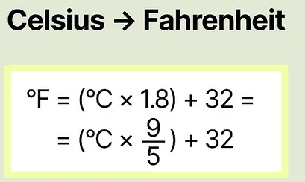

Formulas Examples (2)
Ex No. 2 : Calculate temperature in Fahrenheit based
on temp in Celsius
# Fahrenheit to Celsius conversion
tempC = 38
tempF = tempC * 9 / 5 + 32
print('Temp in F = '+ str(tempF) )

Slide 21
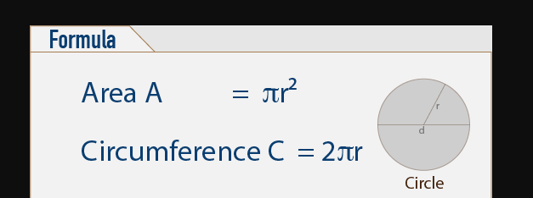
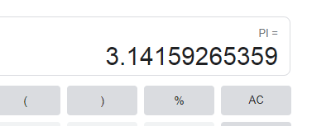
Formulas Examples (3)
Ex No. 3 : Calculate Perimeter, Area of a circle based on its radius
# Calculate Perimeter and Area of the circle
# Area = PI * r ^ 2
# Perimeter = 2 * PI * r
import math
radius = 7
perimeter = 2 * math.pi * radius
area = math.pi * math.pow( radius, 2)
print('Perimeter of the circle = '+str(perimeter))
print('area of the circle = '+ str(area))

Slide 22

Formulas Examples (4)
Ex No. 4 : Solve this complex formula
# solve Complex formula
x, y, a, b, c = 2, 3, 4, 5, 6
my_result1 = (3 + 4 * x) / 5
my_result2 = 10 * (y - 5) * (a + b + c) / x
my_result3 = 9 * (4 / x + (9 + x) / y)
final_result = my_result1 - my_result2 + my_result3
print('final result = '+str(final_result))

Slide 23
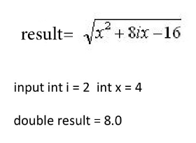
Formulas Examples (5)
Ex No. 5 : Solve this equation with square root
# solve this equation
import math
i = 2
x = 4
result = math.sqrt( math.pow(x, 2) + 8 * i * x - 16 )
print('result = '+ str(result))

Slide 24
Homework assignments
واجبات في البيت

Slide 25
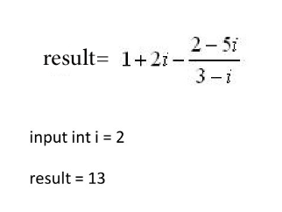
Formulas Assignment (1) - beginner
H.W No. 1 : Solve this formula

Slide 26
Formulas Assignment (2) - beginner
H.W No. 2 : Solve this formula
Result = ((n * 2) + 10) / (n + 1)
n = 2
Result = 4.666666666666667

Slide 27
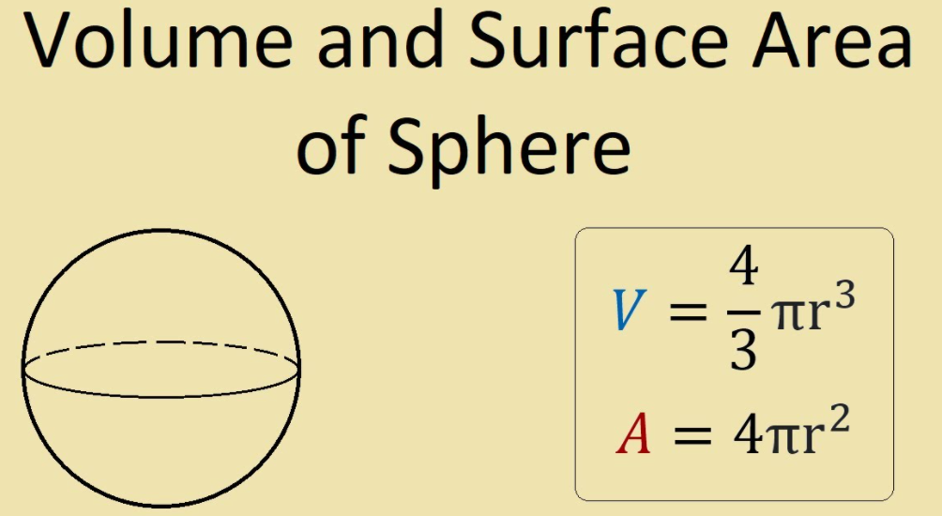
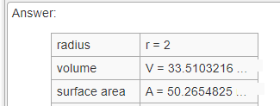
Formulas Assignment (3) - beginner
H.W No. 3 : Solve this formula

Slide 28
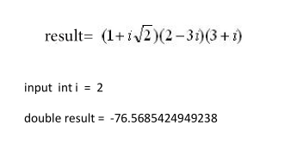
Formulas Assignment (4) - beginner
H.W No. 4 : Solve this formula

Slide 29
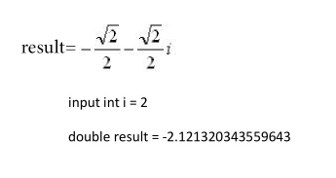
Formulas Assignment (5) - beginner
H.W No. 5 : Solve this formula

Slide 30
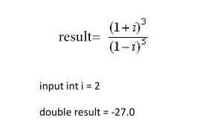
Formulas Assignment (6) - beginner
H.W No. 6 : Solve this formula

Slide 31
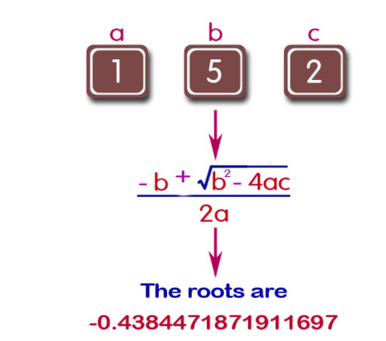
Formulas Assignment (7) - intermediate
H.W No. 7 : Solve this Quadratic formula

Slide 32
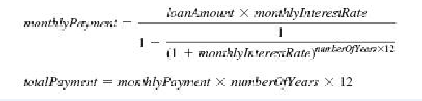
Formulas Assignment (8) - Advanced
H.W No. 8 : Solve this Loan formula
( Homework assignment )
Inputs :
loanAmount = 100000;
monthlyInterestRate = 0.01;
noYears = 7;
Output :
monthly payment = 1765.27
total payment = 148282.68

