Slide 1

Yahia Momtaz
Python Programming
Diploma
+201090873748 | +201097003465

Slide 2
Making Decisions
Conditional Statements
Lesson(2)

Slide 3
Python If ... Else
Python Conditions and If statements
An "if statement" is written by using the if keyword.
Python supports the usual logical conditions from mathematics:
Equals: a == b
Not Equals: a != b
Less than: a < b
Less than or equal to: a <= b
Greater than: a > b
Greater than or equal to: a >= b
These conditions can be used in several ways, most commonly in "if statements" and loops.

Slide 4
Python If ... Else
Python Conditions and If statements
emp_salary = 2500 if emp_salary < 5000: print(“emp salary is low")
emp_salary = 2500 if emp_salary < 5000: print(“emp salary is low") # you will get an error

Slide 5
Python If ... Else
Elif
The elif keyword is pythons way of saying "if the previous conditions were not true, then try this condition".
emp_salary = 2500 if emp_salary < 5000: print(“emp salary is low") elif emp_salary == 2500: print(“emp salary is normal")

Slide 6
Python If ... Else
Else
The else keyword catches anything which isn't caught by the preceding conditions.
emp_salary = 2500 if emp_salary < 5000: print(“emp salary is low") elif emp_salary > 5000: print(“emp salary is high") else: print(“emp salary is normal")

Slide 7
Basic Examples
يالا نكتب كود

Slide 8
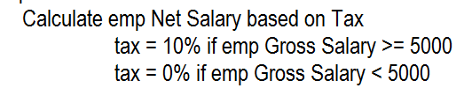
Simple Examples (1)
Ex No. 1 : Calculate emp monthly | annual net salary based on his gross salary, tax will be 10% if the gross salary >= 5000; otherwise no tax is used
emp_id = 101
emp_name = 'yahia momtaz'
emp_gross_salary = 7000.23
if emp_gross_salary >= 5000:
tax = 10
else:
tax = 0
print(tax)
emp_monthly_net_salary = emp_gross_salary - (emp_gross_salary * tax / 100)
print('Monthly net salary = '+str(emp_monthly_net_salary))
annual_net_salary = emp_monthly_net_salary * 12
print('Annual net salary '+str(annual_net_salary))

Slide 9
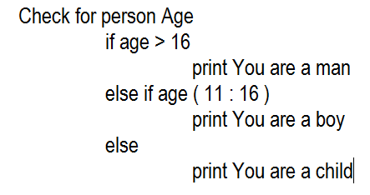
Simple Examples (2)
Ex No. 2 : Check for person Age ( age is input by keyboard ) if age > 16;print You are a man | if age ( 11 : 16 ); print you are a boy| if age < 11; print you are a child
personName = input('Enter your name : ')
personAge = int(input('Enter your age : '))
if personAge > 16:
print('You are a man')
elif personAge >= 11:
print('You are a boy')
else:
print('You are a child')

Slide 10
Simple Examples (3)
Ex No. 3 : Check for a number; if this number is Even زوجى > print it is even no – if this number is odd > print it is odd no
mod = modulos = remainder باقى القسمة
num = 8
if num % 2 == 0:
print('It is Even number')
else:
print('It is Odd number')

Slide 11
Simple Examples (4)
Ex No. 4 : check if a number is divisible by 2 & 3 & 6 or not
num = 12
if num % 2 == 0 and num % 3 == 0 and num % 6 == 0:
print('Number is divisible by 2 and 3 and 6')
else:
print('It is not divisible by 2 and 3 and 6')

Slide 12
Simple Examples (5)
Ex No. 5: Order_Discount
variables : item_cost = 500.0 item_qty = 3
special_client = 1 >> special_client = 1, not a special = 0
discount_pct = 0.0 discount_val = 0.0
> Create a program with the above variables
that calculate total_order_cost = item_cost * item_qty
if ( total_order_cost >= 1000 )
check for this client
if ( special )
total_order_cost will have discount of 20%
if ( not special )
total_order_cost will have discount of 10%
print discount_pct, discount_val, total_order_cost before discount and after discount

Slide 13
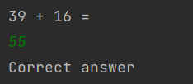
Simple Examples (6)
Ex No. 6 : Create a Random Game
import random
firstNumber = random.randint(1, 100)
secondNumber = random.randint(1, 100)
print(str(firstNumber) + ' + ' + str(secondNumber) + ' = ')
result = int(input())
if result == firstNumber + secondNumber:
print('Correct answer')
else:
print('Wrong answer')

Slide 14
Homework assignments
واجبات في البيت

Slide 15
H.W Assignment No. 1
Ex No. 1 : Print suitable grade for a grade apprev.
A > Excellent
B > V. Good
C > Good
D > Pass
E > Fail
Others > Invalid

Slide 16
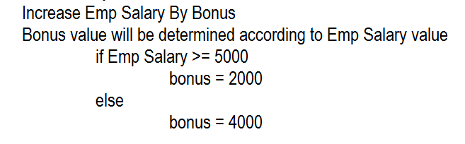
H.W Assignment No. 2
Ex No. 2 : Increase bonus based on salary _ if emp_salary >= 5000 ; increase the salary by bonus of 2000 otherwise by 4000
And print the salary after raise

Slide 17
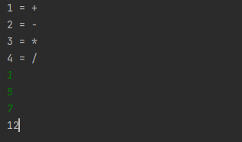
H.W Assignment No. 3
Ex No. 3 : conditional equation
Write a program to ask the user for the operator
Then ask the user to enter two values
Print the result of the equation according to the user input

