Slide 1

Yahia Momtaz
Python Programming
Diploma
+201090873748 | +201097003465

Slide 2
Collections [ Sequences]
Lists in Python
Lesson(3)

Slide 3
Python Lists
Create a List : -
Python Lists are just like dynamically sized arrays,
declared in other languages (vector in C++ and ArrayList in Java).
In simple language, a list is a collection of things,
enclosed in [ ] and separated by commas.
numbers_list = [15, 16, 20, 3, 15, 20]
strings_list = ['python', 'java','oracle']
mixed_list = ['ahmed', 'omar', 15, 6000.44,'cairo']

Slide 4
Accessing Elements in List
Access element using index: -
Start index in list = 0
print(strings_list[0])
print(strings_list[1])
print(strings_list[2])
Change the element by index: -
strings_list[0] = ‘python programming'

Slide 5
Functions in List : append | extend | insert
> append function
append new elements to the last of the list
student_name = 'Ahmed Omar‘
> extend function
to add a list to end of a list
list3 = ['mongo', 'react','angular']
strings_list.extend(list3)

Slide 6
Functions in List : insert | len
> insert function
addition of elements at the end of the List, for the addition of elements at the desired position
strings_list.insert(0, 'basic programming')
strings_list.insert(0, list3)
print(strings_list)
> Len function
Get the length of the list
print(len(strings_list))

Slide 7
Functions in List : remove | pop
> remove function
Remove the first occurrence of the searched element
strings_list.remove('mongo')
strings_list.remove('react')
strings_list.remove('angular')
> pop function
# removes only the last element of the list,
to remove an element from a specific position of the List
removed_item = strings_list.pop()
removed_item = strings_list.pop(0)

Slide 8
Functions in List : reverse | sort
> reverse function
To reverse a list
strings_list.reverse()
> sort function
# to sort a list asc or desc
numbers_list.sort()
numbers_list.sort(reverse=True)

Slide 9
Functions in List : max() min() sum()
> max() function, min() function, sum() function
print(max(numbers_list))
print(min(numbers_list))
print(sum(numbers_list))

Slide 10
Slicing a list
numbers_list = [16, 5, 20, 13, 2, 14, 30, 20, 70, 20]
print(numbers_list[0]) # the first index : 16
print(numbers_list[-1]) # the last index : 20
print(numbers_list[0:5]) # from index 0 to 4 : [16, 5, 20, 13, 2]
print(numbers_list[:5]) # from index 0 to 4 : [16, 5, 20, 13, 2]
print(numbers_list[:-1]) # from the index 0 to the index before the #last [16, 5, 20, 13, 2, 14, 30, 20, 70]
print(numbers_list[6:]) # from index 6 to end : [30, 20, 70, 20]]
print(numbers_list[-4:]) # from index -4 to end : [30, 20, 70, 20]
print(numbers_list[0:8:2]) # from index 0 to 7 - step 2 : [16, 20, 2, 30]
print(numbers_list[:]) # from 0 to end - same copy : [16, 5, 20, 13, # 2, 14, 30, 20, 70, 20]
print(numbers_list[::-1]) # from 0 to end - step - 1 = print string in # reverse order : [20, 70, 20, 30, 14, 2, 13, # 20, 5, 16]

Slide 11
Nested Lists
> Nested Lists
my_nested_list = [[101,'ahmed','Cairo'],[102, 'mostafa','Alex']]
print(my_nested_list)
print(my_nested_list[0][1]) # ahmed
print(my_nested_list[1][1]) # mostafa

Slide 12
Loop over the List : for i loop | for each loop
Loop Over the List
numbers_list = [15, 16, 20, 3, 15, 20]
# 1) loop over a list using index ( for i loop )
for i in range(len(numbers_list)):
print(numbers_list[i])
print('------------------------------')
# 2) loop over a list ( for each loop )
for item in numbers_list:
print(item)

Slide 13
Basic Examples
يالا نكتب كود

Slide 14
Simple Examples (1)
Ex No. 1 : # get the sum, average between elements in a list
# get the sum between elements in a list
numbers_list = [15, 16, 20, 3, 15, 20]
sum_items = 0
for item in numbers_list:
sum_items = sum_items + item
print('sum = '+str(sum_items))
average = sum_items / len(numbers_list)
print('average = '+str(average))
print(sum(numbers_list))

Slide 15
Simple Examples (2)
Ex No. 2 : # get the sum, count of positive, negative and zeros
numbers_list = [15, -16, 20, -3, 0, 20]
sum_positive, sum_negative, count_positive, count_negative, count_zeros = 0, 0, 0, 0, 0
_{for item in numbers_list:}
_{if item > 0:}
sum_positive = sum_positive + item
count_positive = count_positive + 1
_{elif item < 0:}
sum_negative = sum_negative + item
count_negative = count_negative + 1
_{else:}
_{count_zeros = count_zeros + 1}
_{print(sum_positive)}
_{print(count_positive)}
_{print(sum_negative)}
_{print(count_negative)}
_{print(count_zeros)}

Slide 16
Simple Examples (3)
Ex No. 3 : # print only numbers from the list that are divisible by 3 and 5
numbers_list = [15, 30, 20, 45, 16, 20]
for item in numbers_list:
if item % 3 == 0 and item % 5 == 0:
print(item)

Slide 17
Simple Examples (4)
Ex No. 4 : # The task is to generate another list, which contains only the duplicate elements
lis = [1, 2, 1, 2, 3, 4, 5, 1, 1, 2, 5, 6, 7, 8, 9, 9]
uniqueList = []
duplicateList = []
for item in lis:
if item not in uniqueList:
uniqueList.append(item)
elif item not in duplicateList:
duplicateList.append(item)
print(uniqueList)
print(duplicateList)

Slide 18
Simple Examples (5)
Ex No. 5 : # Swap the first and last element of the list
newList = [12, 35, 9, 56, 24]
size = len(newList)
# Swapping
temp = newList[0]
newList[0] = newList[size - 1]
newList[size - 1] = temp
print(newList)

Slide 19
Homework assignments
واجبات في البيت

Slide 20
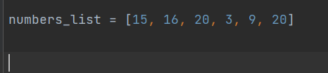
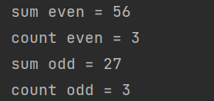
H.W Assignment No. 1
H.w No. 1: # get the sum, count of even numbers, odd numbers from a list

Slide 21
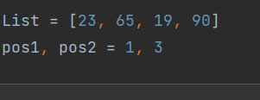
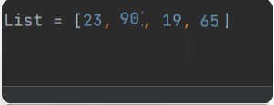
H.W Assignment No. 2
H.w No. 2: Create a program to swap 2 elements at given positions

Slide 22
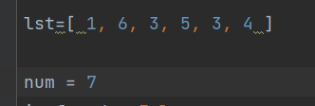

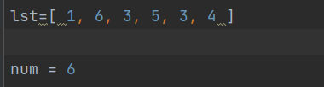

H.W Assignment No. 3
H.w No. 3 : Check if an element exists in a list in Python

Slide 23


H.W Assignment No. 4
H.w No. 4 : Count occurrence of a number in a list

Slide 24
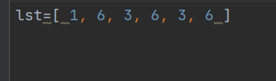

H.W Assignment No. 5
H.w No. 5 : # Multiply each element of the list by 2 and store them again in the list

Slide 25
H.W Assignment No. 6
H.w No. 6 : # Find the Max and Min element from a list
Max = 90
Min = 19

