Slide 1

Yahia Momtaz
Python Programming
Diploma
+201090873748 | +201097003465

Slide 2
Lesson 04
Collections – Cont.
Tuples in details

Slide 3
Tuples
Tuples Agenda
Tuples description
Creating a tuple
Access a tuple
Concat Tuple
slicing a tuple
unpacking tuple
List of Tuples
Tuples benefits

Slide 4
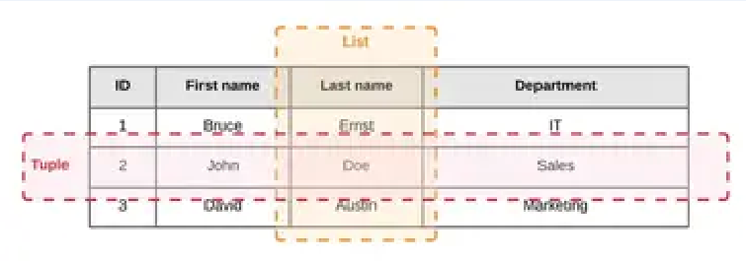
Tuples
Tuples description
Tuple is a collection of Python elements much like a list.
Tuples are indexed by integers like the list
Tuples are like records ( rows of a table )
Tuple is a collection which is unchangeable ( immutable )
Tuples are heterogeneous data structures (i.e., their entries have different meanings)
Lists are for looping, tuples are for structures
person_tuple = (101, 'Ahmed Esam', 5000.0, 'Cairo‘)
print(person_tuple)

Slide 5
Tuples : Create, Access element, Concat Tuple
Create a Tuple
Access a Tuple element by index
Concat Multi tuples
person_tuple = (101, 'Ahmed Esam', 5000.0, 'Cairo', '0127454104')
print(person_tuple)
print(type(person_tuple))
print('person name : '+person_tuple[1])
person_job_tuple = ('python developer', 'senior')
# this will not edit the tuple : will create a new one
person_tuple = person_tuple + person_job_tuple
print(person_tuple)

Slide 6
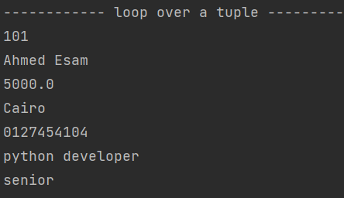
Tuples : Loop over a tuple
Loop over a Tuple using for i loop
Loop over a Tuple using for in loop ( each loop )
for i in range(len(person_tuple)):
print(person_tuple[i])
for person_value in person_tuple:
print(person_value)

Slide 7

Tuples : List of Tuples
List of Tuples
ips_List = [
('192.168.0.15', ‘y’),
('192.168.0.22', ‘y’),
('192.168.0.14', ‘y’),
('192.168.0.24', ‘n’),
('192.168.0.81', ‘n’),
('192.168.0.11', ‘y’)
]

Slide 8
Tuples : Slicing Tuples
Slicing Tuples
Same like lists

Slide 9

Tuples : unpacking Tuple
Unpacking a Tuple
person_id, person_name, person_salary, person_address, person_mobile, \
person_job, job_position = person_tuple
print(person_name+' lives in '+person_address)

Slide 10
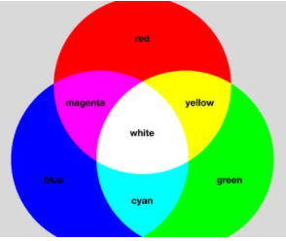
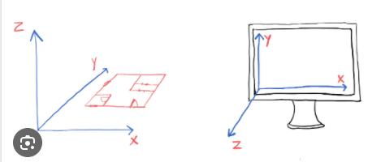
Tuples – Main Benefits
person_tuple = (101, 'Ahmed Esam', 5000.0, 'Cairo‘)
coordinate_tuple = ( 123, 160, 220)
color_rgb_code = ( 255, 202, 110)
Tuples Main Benefits
1- Tuples are immutable ( cannot be changed )
2- Slight performance improvement
3- Unpacking on tuples
4- Function Return Values of type Tuple
5- Tuples are like records ( rows of a table )
6- They're more used for some purposes, e.g. an ordered pair of coordinates
7- They can be used as keys in a dictionary

Slide 11
Homework assignments
واجبات في البيت

Slide 12
H.W Assignment No. 1
H.w No. 1: # Remove Duplicates From a List of Tuples : Make it unique List
ips_List = [
('192.168.0.15', ‘y’),
('192.168.0.22', ‘y’),
('192.168.0.14', ‘y’),
('192.168.0.24', ‘n’),
('192.168.0.15', ‘y’),
('192.168.0.11', ‘y’)
]
ips_List = [
('192.168.0.15', ‘y’),
('192.168.0.22', ‘y’),
('192.168.0.14', ‘y’),
('192.168.0.24', ‘n’),
('192.168.0.11', ‘y’)
]

Slide 13
H.W Assignment No. 2
H.w No. 2: # Print Sum of salary of all employees – from tuples in a list
company_employees = [
(101, 'Ahmed Esam', 10000.0, 'Cairo‘),
(102, ‘Ibrahim Ahmed', 9000.0, 'Cairo‘),
(103, ‘Adham Aly', 5000.0, 'Cairo‘),
(104, ‘Islam Hassan', 7000.0, 'Cairo‘)
]
Sum = 31000

Slide 14
H.W Assignment No. 3
H.w No. 3 # Count and print no. of Male, no. of Female in the list of Tuples
company_employees = [
(101, ‘Hayam Esam', 10000.0, ‘Engineer‘, ‘F’),
(102, ‘Ibrahim Ahmed', 9000.0, ‘Accountant‘, ‘M’),
(103, ‘Adham Aly', 5000.0, ‘Engineer‘,’M’),
(104, ‘Islam Hassan', 7000.0, ‘Sales‘,’M’),
(105, ‘Marwa Esam', 7000.0, ‘Marketer‘,’F’),
(106, ‘Ola Hassan', 7000.0, ‘Engineer‘,’F’)
]
Male Count = 3
Female Count = 3

Slide 15
Collections – Cont.
Dictionaries in details

Slide 16
Dictionaries Agenda
Dictionary Agenda
Create a dictionary
Adding / modifying element in a dictionary
Access element based on a key
Access all dict keys and all dict values and dict items
Remove item from dictionary
Loop over a dictionary
Examples
Assignments

Slide 17
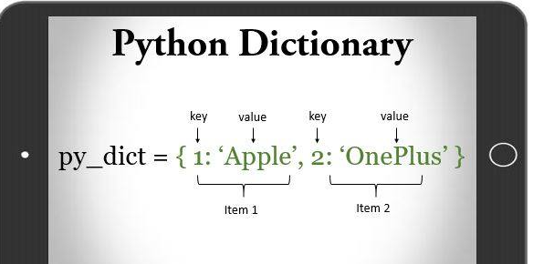
Dictionaries
Dictionaries description
Dictionary in Python is a collection of keys values, used to store data values like a map, which, unlike other data types which hold only a single value as an element.
Dictionary are mutable [ can be changed ]
Dictionary holds key:value pair. Key-Value is provided in the dictionary to make it more optimized.
Dictionaries in Python are a well designed version of a very common
data structure called a hash map.
week_days_dict = {1: 'Sat', 2: 'Sun', 3: 'Mon',
4 : 'Tue', 5:'Wed', 6:'Thr', 7:'Fri'}

Slide 18
Dictionaries : Create, Adding, Modifying, Access element
Create a Dict
Adding / Modifying element in a Dict
Access element
week_days_dict = {1: 'Sat', 2: 'Sun', 3: 'Mon', 4 : 'Tue', 5:'Wed', 6:'Thr', 7:'Fri'}
order_status = {1: 'Pending', 2: 'Shipping', 3: 'Cancelled', 4:'Received'}
gender_type = {'M': 'Male', 'F':'Female'}
shopping_prices_dict = {'milk': 30.0, 'eggs': 120.0, 'butter': 60.0, 'bread': 10.0}
shopping_prices_dict[‘Nescafe'] = 45.5
shopping_prices_dict['milk'] = 39.0
nescafe_price = shopping_prices_dict[‘Nescafe']
print(nescafe_price)

Slide 19
Dictionaries : removing element from a dictionary
Concat multi dicts
Removing element from a dictionary
Concat Multi dictionaries
shopping_prices_dict.pop(‘bread')
print(shopping_prices_dict)
dict1 = {101 : 'Ahmed', 102 :'Ola', 103:'Omar'}
dict2 = {104 : 'Ibrahim', 105 :'Sayed', 106:'Fathy'}
dict1.update(dict2)

Slide 20
Dictionaries : Loop over a dictionary
Loop over a dict. : extract Keys
for item_key in shopping_prices_dict:
print(item_key)
print(shopping_prices_dict[item_key])
print('---')
Loop over a dict. : extract Keys & values
for item_key, item_value in shopping_prices_dict.items():
print(item_key)
print(item_value)
print('---')

Slide 21
Dictionaries : removing element from a dictionary
Dictionary vs a List vs a Tuple
Lists vs Dictionary vs Tuple
shopping_list = ['milk, eggs, butter, bread'] # represent a column
shopping_prices_dict = {'milk': 30.0, 'eggs': 120.0, 'butter': 60.0, 'bread': 10.0} # represent pairs key, value
shopping_tuple = (1, ‘milk’, ‘2 Litre’, ‘pure milk’) # represent a row

Slide 22

Simple Examples (1)
Ex No. 1 : # Merge 2 Lists into a single Dictionary with key values
emp_ids_list = [101, 102, 103]
emp_names_list = ['Ahmed', 'Omar', 'Sarah']
people_dict = {}
for i in range(len(emp_ids_list)):
people_dict [emp_ids_list[i] ] = emp_names_list[i]
print(people_dict)

Slide 23
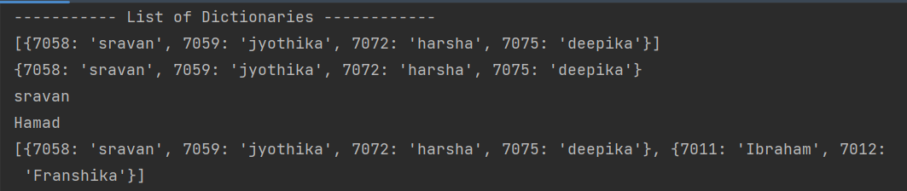
Simple Examples (2)
Ex No. 2 : # List of Dictionaries : create a list of dictionary with student id as key and name as value
data_list = [{7058: 'sravan', 7059: 'jyothika', 7072: 'harsha', 7075: 'deepika'}]
# display the list
print(data_list)
# display the first index of the list which is the whole dict
print(data_list[0])
# display data of key 7058
print(data_list[0][7058])
# adding another dict to the list
data_list.append({7011: 'Hamad', 7012: 'Franshika'})
print(data_list[1][7011])
# update the value of dict of index 1 in the list with the key 7011
data_list[1][7011] = 'Ibraham'
print(data_list)

Slide 24
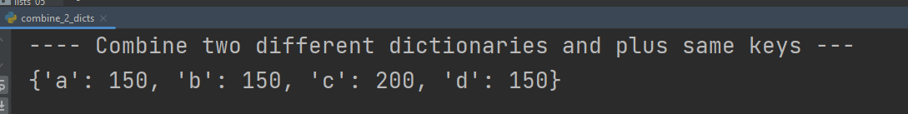
Simple Examples (3)
Ex No. 3 : # Combine two different dictionaries and plus same keys
dict1 = {'a': 100, 'b': 150, 'c': 100}
dict2 = {'a': 50, 'c': 100, 'd': 150}
for key in dict2:
if key in dict1:
dict1[key] = dict1[key] + dict2[key]
else:
dict1[key] = dict2[key]
print(dict1)

Slide 25
Homework assignments
واجبات في البيت

Slide 26
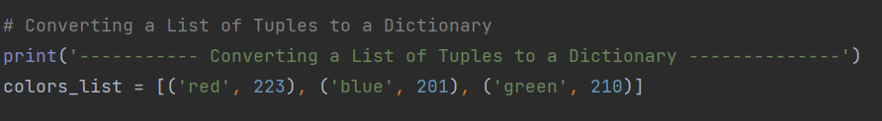

H.W Assignment No. 1
H.w No. 1: # Converting a List of Tuples to a Dictionary – Beginner (Google)

Slide 27
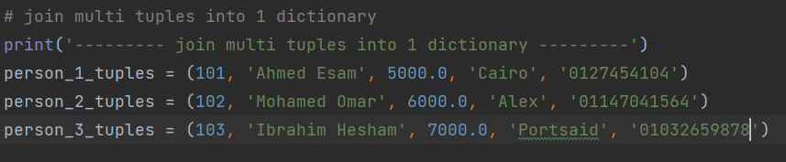
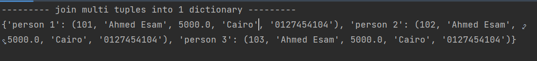
H.W Assignment No. 2
H.w No. 2: # Join multi tuples into 1 dictionary - Beginner

Slide 28

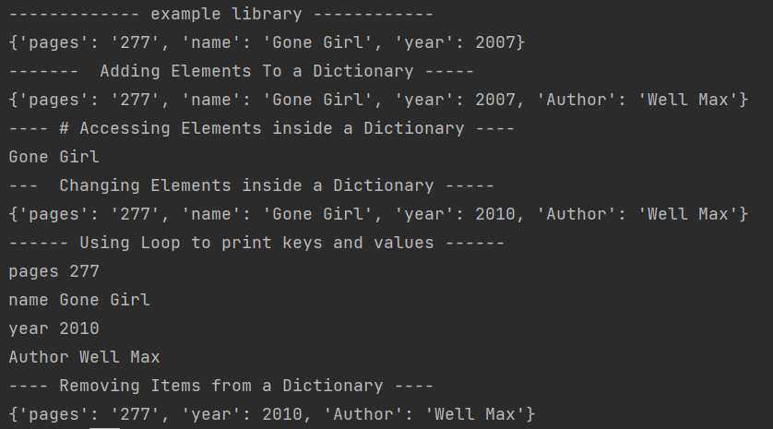
H.W Assignment No. 3
H.w No. 3: # Library example - Beginner
Adding new element ( author ) To a Dictionary
Accessing Elements ( name ) inside a Dictionary
Changing Elements inside a Dictionary year to 2010
Use Loop to print keys and values
Removing Item ( name ) from a Dictionary

Slide 29
H.W Assignment No. 4
H.w No. 4: # loop over all keys and raise the prices 10%
Print sum of all the values after raise 10%
Add vat 14$ to the total and print the net value
shopping_cart_dict = {'milk': 20.0, 'bread': 10.0, 'eggs': 145.0}
After 10% raise : shopping_cart_dict = {'milk': 22.0, 'bread': 11.0, 'eggs': 159.5}
Total = 192.5
Total net = 192.5 + 14% vat = 192.5 + 26.95 = 219.45

