Slide 1

Yahia Momtaz
Python Programming
Diploma
+201090873748 | +201097003465

Slide 2
Lesson05
Python Strings
in details

Slide 3
Strings Agenda
Strings Agenda
What are strings
Strings functions:
upper(), lower(), startswith(), endwith(), isupper(), islower(), isalpha(), isnumeric(), isalnum(), index(), title(), strip(), replace(), count(), swapcase(), find(), split(), join()
Loop over a string characters
Slicing a string
Examples
assignments

Slide 4
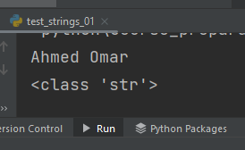
String Class
Create a String variable : -
String is a collection of alphabets, words or other characters. It is one of the python primitive data types and can be considered as a data structure for many programming languages. Python has a built-in string class named str. It is an immutable data type, meaning that once you have created a string, you cannot change it.
A few of its imperative applications are Spell Checkers, Spam Filters, Intrusion Detection System, Search Engines, Bioinformatics, Digital Forensics and Information Retrieval Systems etc.
student_name = 'Ahmed Omar'
print(student_name)
print(type(student_name))

Slide 5
Functions in String : upper| lower| startswith | endswith
> upper | lower functions
letters converted to upper case or lower case
student_name = 'Ahmed Omar'
print(student_name.upper())
print(student_name.lower())
> startswith(), endswith() functions
returns True if a string starts or ends with the given prefix
student_mobile = '01147041564'
if student_mobile.startswith('012'):
print('Orange phone')
file_path = 'C:\\my_files\\learn_python.pdf'
if file_path.endswith(‘pdf'):
print('it is a book')

Slide 6
Functions in String : isupper(), islower()| isalpha()| isnumeric()
> isupper() | islower() functions
to check if characters are upper or lower
print(upper_student_name.isupper())
print(upper_student_name.islower())
> isalpha(), isnumeric(), isalnum() functions
return true if all the characters in the string is alpha with no spaces | isdigits | isalpha or digits
student_name = 'Ahmed'
print(student_name.isalpha())
print(student_mobile.isnumeric())
txt = "Company12"
print( txt.isalnum() )

Slide 7
Functions in String :index(), title(), strip()
> index() functions
Returns the position of the first occurrence of substring in a string
student_name = 'Ahmad Omar'
print(student_name.index('a'))
> title() | strip() functions
convert the first character in each word to uppercase | both leading and
# trailing white spaces removed or custom parameter removed
print(student_name.title())
student_address = ' addr : Cairo '
student_address = student_address.strip('addr :')

Slide 8
Functions in String : replace(), count(), swapcase()
> replace() functions
returns a copy of the string where occurrences of a substring are replaced
student_information = 'He is Ahmed, Ahmed lives in cairo, Ahmed plays football'
student_information = student_information.replace('Ahmed','Esam')
> count() | swapcase() functions
# returns the number of occurrences of a substring in the given string.
# converts all uppercase characters to lowercase and vice
print(student_information.count('Esam'))
stud_info = student_information.swapcase()
print(stud_info)

Slide 9
Functions in String : find(), rfind(), split()
> find(), rfind() functions
Return the lowest, highest indexing a sub string.
print(student_information.find('Esam'))
print(student_information.rfind('Esam'))
> split() function Convert from string to list
Return a list of the words of the string
words_list = student_information.split(' ')
print(type(words_list ))
print(words_list )

Slide 10
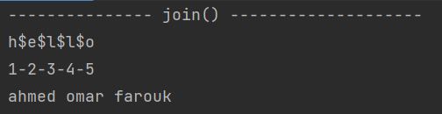
Functions in String : join()
> join() function
used to join elements of the sequence separated by a string separator.
str = 'hello'
print('$'.join('hello'))
str = '12345'
print('-'.join(str))
my_list = ['ahmed','omar','farouk']
# convert list to string
names = ' '.join(my_list)
print(names)

Slide 11
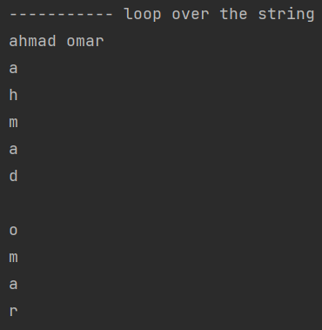
Loops over String : for loop
> for loop
Loop over the string characters by index
for i in student_name:
print(i)

Slide 12
Slicing a string
student_name = 'Ahmed Omar‘
Same like lists

Slide 13
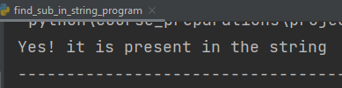
Simple Examples (1)
Ex No. 1 : # find sub string is found in a string – ignore case
string1 = "Ahmed is a good employee, who works as engineer"
if "ahmed" in string1.lower():
print("Yes! it is present in the string")
else:
print("No! it is not present")

Slide 14

Simple Examples (2)
Ex No. 2 : # Swap commas and dots in a String
str1 = 'He is Ahmed, Ahmed lives in cairo, Ahmed plays football.'
print(str1)
str1 = str1.replace(', ', '* ')
str1 = str1.replace('.', ', ')
str1 = str1.replace('*', '.')
print(str1)

Slide 15
Simple Examples (3)
Ex No. 3 : # password validation
Minimum 8 characters.
At least one alphabet should be of Lower Case [a-z] At least one alphabet should be of Upper Case [A-Z]
At least 1 number or digit between [0-9]. At least 1 character from [ _ or @ or $ ].
count_lower, count_upper, count_special, count_digits = 0, 0, 0, 0
str = "sr@m@_f0rtu9e$._2023"
if (len(str) >= 8):
for letter in str:
# counting lowercase alphabets
if letter.islower():
count_lower = count_lower + 1
# counting uppercase alphabets
elif letter.isupper():
count_upper = count_upper + 1
# counting digits
elif letter.isnumeric():
count_digits = count_digits + 1
# counting the mentioned special characters
elif not letter.isalnum():

Slide 16
Simple Examples (3)
Ex No. 3 : # password validation
Minimum 8 characters.
At least one alphabet should be of Lower Case [a-z] At least one alphabet should be of Upper Case [A-Z]
At least 1 number or digit between [0-9]. At least 1 character from [ _ or @ or $ ].
count_special = count_special + 1
if (count_lower >= 1 and
count_upper >= 1 and
count_special >= 1 and
count_digits >= 1):
print("Valid Password")
else:
print("Invalid Password")

Slide 17
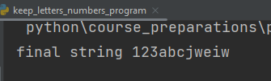
Simple Examples (4)
Ex No. 4 : # Remove all special characters except letters and numbers
statement = "123abcjw:, .@! eiw"
new_statement = ''
for letter in statement:
if letter.isalnum():
new_statement = new_statement + letter
print('final string = ', new_statement)

Slide 18
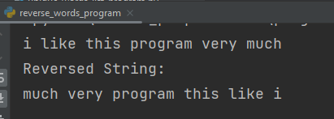
Simple Examples (5)
Ex No. 5 : # program to reverse a string words
str = "i like this program very much"
print(str)
words_list = str.split(' ')
reversed_list = []
for word in words_list:
reversed_list.insert(0, word)
# convert the reversed list to string
rev_str = " ".join(reversed_list)
print("Reversed String:")
print(rev_str)

Slide 19
Homework assignments
واجبات في البيت

Slide 20
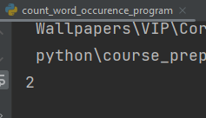

H.W Assignment No. 1
H.w No. 1: # Count occurrences of a word in string: without using builtin function

Slide 21

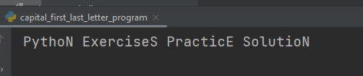
H.W Assignment No. 2
H.w No. 2: # Write a Python program to capitalize the first and last letters of each word in a given string.

Slide 22
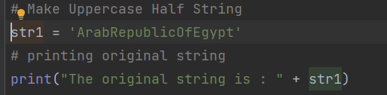
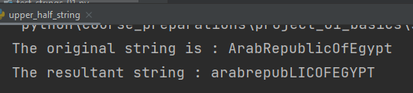
H.W Assignment No. 3
H.w No. 3 # Make Uppercase Half String

Slide 23

H.W Assignment No. 4
H.w No. 4 # Write a program to Remove duplicated words – just leave unique words in a string – ignore case sensitive

Slide 24


H.W Assignment No. 5
H.w No. 5 # Develop a program that checks whether a given string is a palindrome or not. A palindrome is a string that reads the same forwards and backwards.

Slide 25
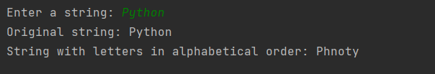
H.W Assignment No. 6
H.w No. 6 #Write a program that takes an input string and displays its letters in alphabetical order. For instance, if the input is "Python", the output should be "Phnoty".

Slide 26
Python Loops
in details

Slide 27
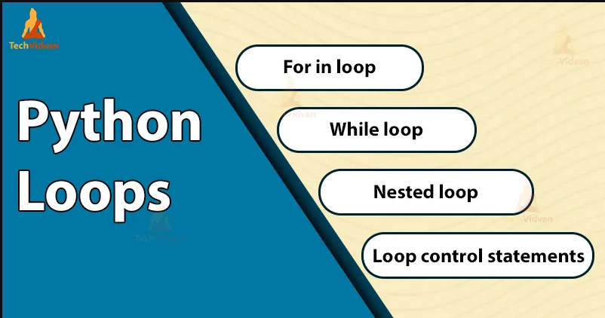
Loops in Python

Slide 28
For i Loop
For i Loop
Loop these statements from i = 0 to i < 4
It will print
0
1
2
3
n = 4
for i in range(0, n):
print(i)
n = 4
for i in range(n):
print(i)

Slide 29
For i Loop
Python For Loop with a step size
Loop step size of 2
This will print
0
2
4
6
n = 8
for i in range(0, n, 2):
print(i)

Slide 30
For i Loop
Python For Loop ( nested Loops )
This will print
1 1
1 2
1 3
2 1
2 2
2 3
3 1
3 2
3 3
for i in range(1, 4):
for j in range(1, 4):
print(i, j)

Slide 31
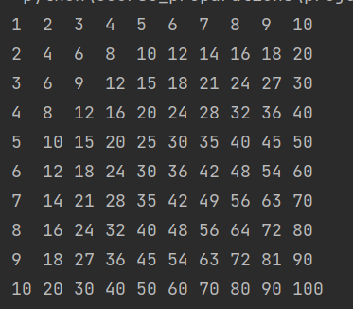
For i Loop
Python For Loop ( nested Loops ) : Multiplication table
for i in range(1, 11):
for j in range(1, 11):
if i * j < 10:
print(i * j, end=' ')
else:
print(i * j, end=' ')
print()

Slide 32
Using Loops with List
For i loop ( that use List index )
This will print
0 red
1 yellow
2 green
colors_list = ["red", "yellow", "green"]
for i in range( len(colors_list) ):
print(i, colors_list[i] )
For each ( in ) loop ( that use list element ) not index
This will print
red
yellow
green
colors_list = ["red", "yellow", "green"]
for item in colors_list:
print( item )

Slide 33
Using Loops with Tuples
For i loop ( that use Tuple index )
This will print
0 101
1 Ahmed
2 6000
3 Cairo
person_tuple = (101, ‘Ahmed’, 6000, ‘Cairo’)
for i in range(len(person_tuple ) ):
print(i, person_tuple [i] )
For each ( in ) loop ( that use tuple element ) not index
This will print
101
Ahmed
6000
Cairo
person_tuple = (101, ‘Ahmed’, 6000, ‘Cairo’)
for item in person_tuple:
print( item )

Slide 34
Using Loops with Dictionary
For each (in) loop ( loop over keys )
This will print
Milk 30.0
Eggs 120.0
Butter 60.0
shopping_prices_dict = {'milk': 30.0, 'eggs': 120.0, 'butter': 60.0}
for item_key in shopping_prices_dict:
print(item_key, shopping_prices_dict[item_key])
For each (in) loop ( loop over both keys, values )
This will print
Milk 30.0
Eggs 120.0
Butter 60.0
shopping_prices_dict = {'milk': 30.0, 'eggs': 120.0, 'butter': 60.0}
for item_key, item_value in shopping_prices_dict.items():
print(item_key, item_value)

Slide 35
Using Loops with String
For each (in) loop ( loop over String)
Loop over the string characters by index
student_name = 'ahmad omar'
for letter in student_name:
print(letter)

Slide 36
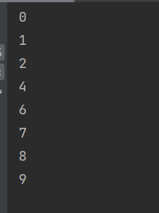

Control Statements for loops : continue - break
Loop and use Continue
for i in range(10):
if i in (3, 5):
continue
print(i)
Loop and use Break
for i in range(10):
if i == 3:
break
print(i)

Slide 37
While Loop
While Loop
Loop these statements from i = 0 to i < 4
It will print
0 Hello World
1 Hello World
2 Hello World
3 Hello World
i = 0
while (i < 4):
print(i, "Hello World")
i = i + 1

Slide 38
Infinite While Loop
Infinite While Loop ( Take CARE )
Loop these statements infinity
It will print
Infinity
infinity
infinity
infinity
infinity
infinity
infinity
infinity
infinity
infinity
infinity
infinity
infinity
i = 0
while (i < 4):
print(i, "Hello World")

Slide 39
Homework assignments
واجبات في البيت

Slide 40
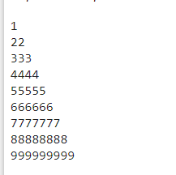
H.W Assignment No. 1
H.w No. 1: # Write a Python program to construct the following pattern

Slide 41
H.W Assignment No. 2
H.w No. 2: # Write a Python program to find those numbers which are divisible by 7 and multiples of 5, between 1500 and 2700 (both included).
Result :

Slide 42
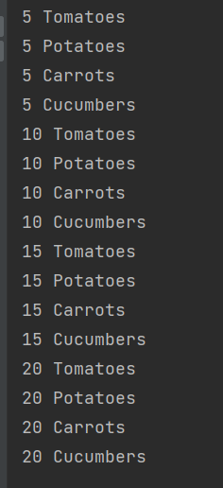
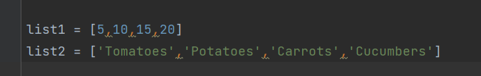
H.W Assignment No. 3
H.w No. 3: # Loop over 2 lists, and print this result

