Slide 1
Lesson 06
Python Functions
in details

Slide 2
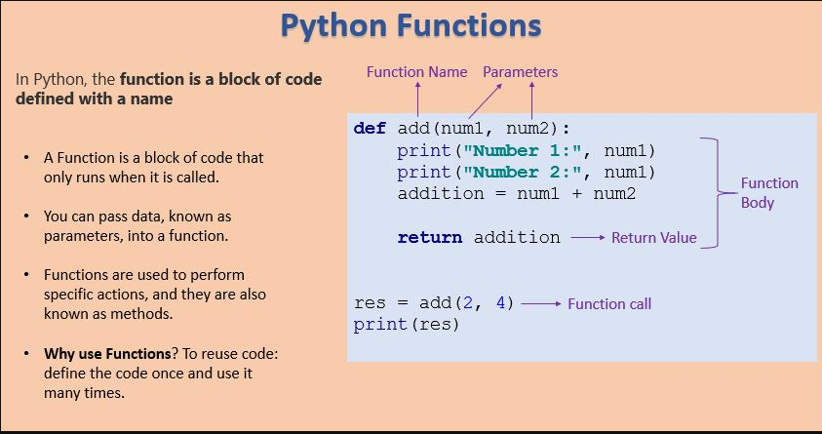
What is a Function

Slide 3
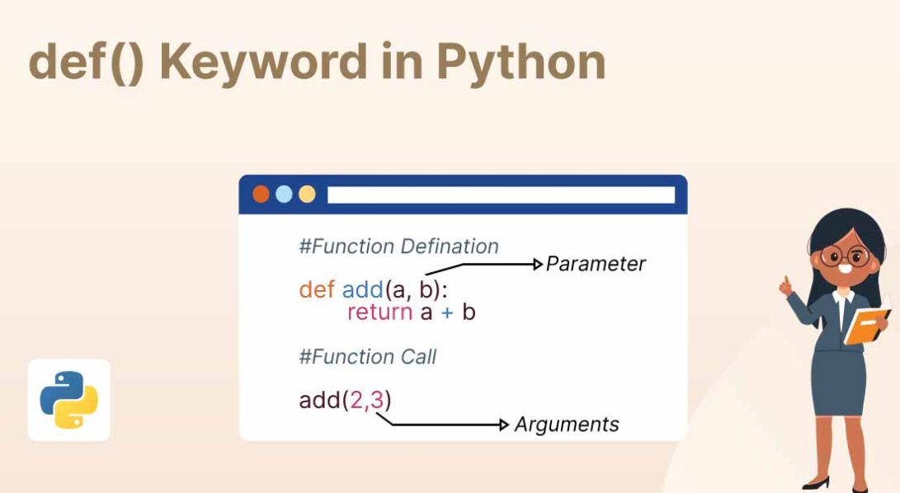
What is a Function

Slide 4
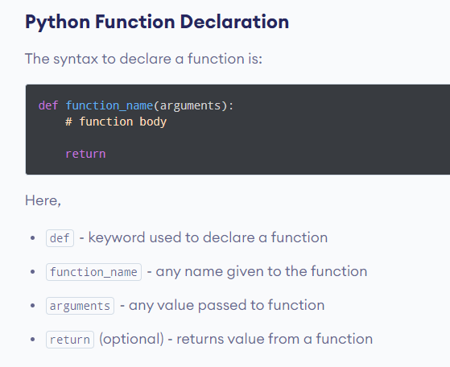
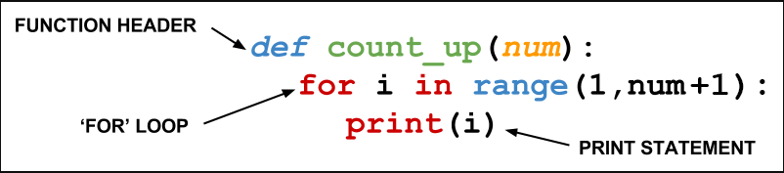
What is a Function
Function without return

Slide 5
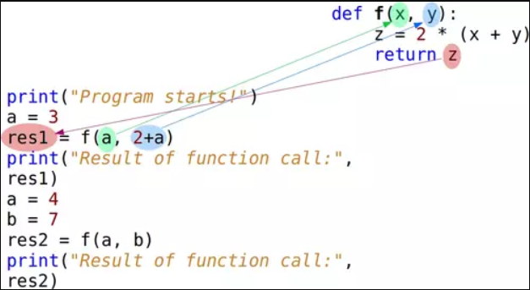
What is a Function

Slide 6
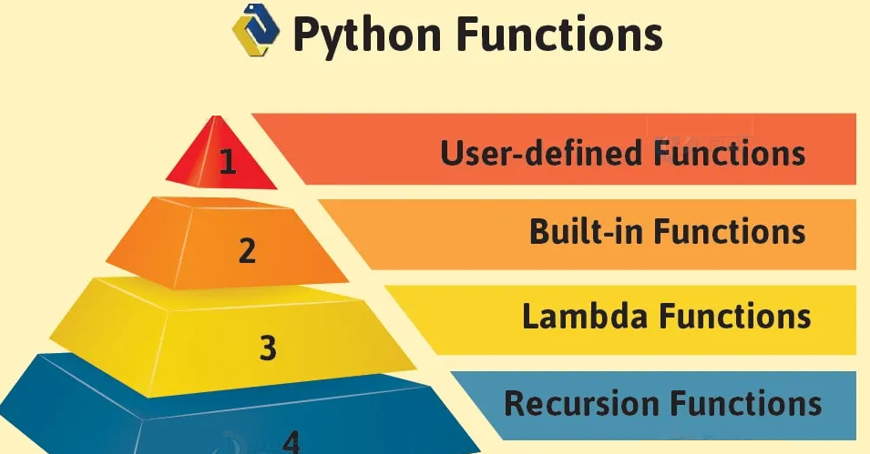
Function types

Slide 7
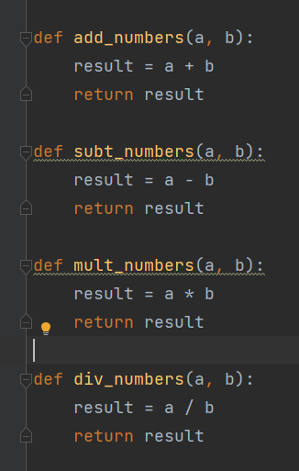
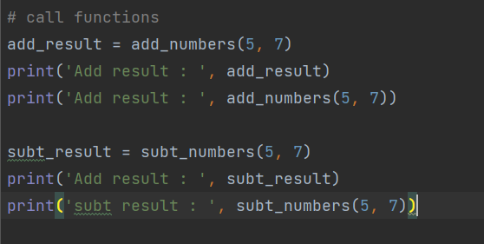
Simple Examples (1)
Ex No. 1 : Create 4 functions :
add_numbers(a, b)
subt_numbers(a, b)
mult_numbers(a, b)
div_numbers(a, b)

Slide 8
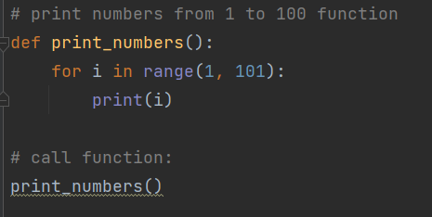
Simple Examples (2)
Ex No. 2 : # print numbers from 1 to 100 function

Slide 9
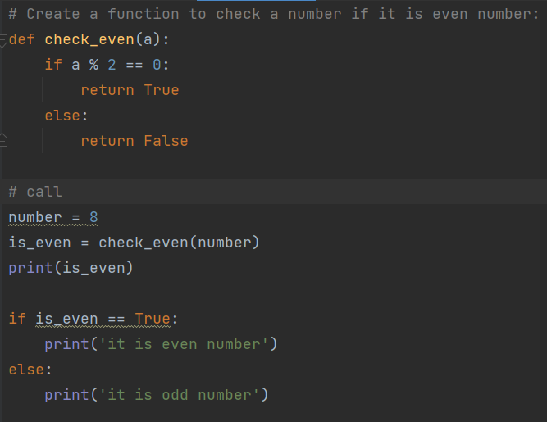
Simple Examples (3)
Ex No. 3 : # Create a function to check a number if it is even number:

Slide 10
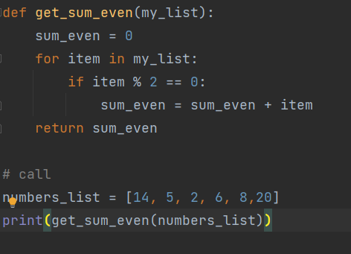
Simple Examples (4)
Ex No. 4 : # create a function to return sum of even numbers from a list

Slide 11
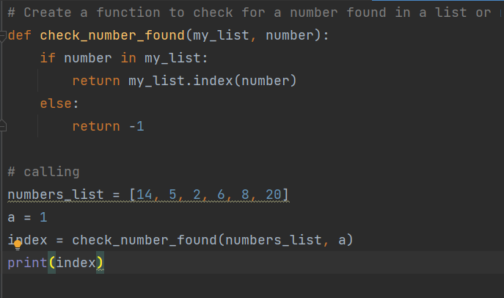
Simple Examples (5)
Ex No. 5 : # Create a function to check for a number found in a list or not - return its index or -1

Slide 12
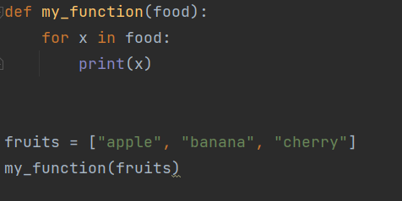
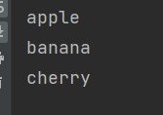
Passing a List as a function argument
You can send any data types of argument to a function (string, number, list, dictionary etc.).
And it will be treated as the same data type inside the function.

Slide 13
Types of Arguments
Types of Python Function Arguments:
Python supports various types of arguments that can be passed at the time of the function call. In Python,
we have the following 4 types of function arguments.
Positional arguments
Keyword arguments (named arguments)
Default argument
Arbitrary arguments (variable-length arguments *args and **kwargs)

Slide 14
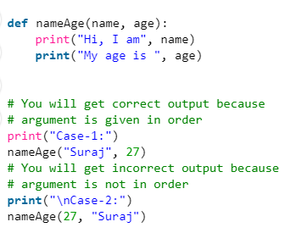
Types of Arguments : Positional arguments
Positional arguments
We used the Position Argument during the function call so that the first argument (or value) is assigned to name and the second argument (or value) is assigned to age. By changing the position, or if you forget the order of the positions, the values can be used in the wrong places,

Slide 15
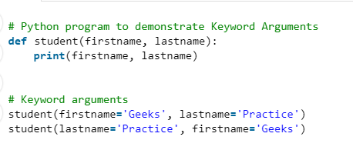
Types of Arguments : Keyword arguments (named arguments)
Keyword arguments (named arguments)
The idea is to allow the caller to specify the argument name with values so that the caller does not need to remember the order of parameters.

Slide 16
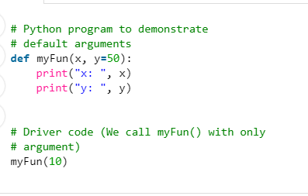
Types of Arguments : Default argument
Default argument
A default argument is a parameter that assumes a default value if a value is not provided in the function call for that argument.

Slide 17
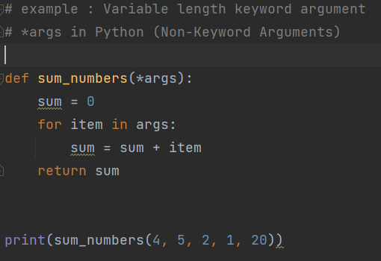

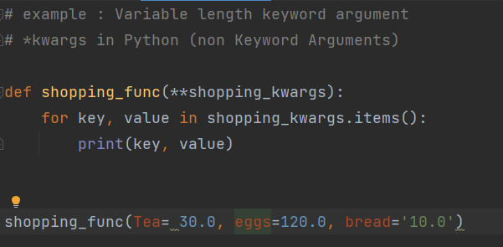

Types of Arguments
Arbitrary keyword arguments
(variable-length arguments
*args and **kwargs)
Arbitrary Keyword Arguments
In Python Arbitrary Keyword Arguments, *args, and **kwargs can pass a variable number of arguments to a function using special symbols. There are two special symbols:
*args (Non-Keyword Arguments)
**kwargs (Keyword Arguments)

Slide 18
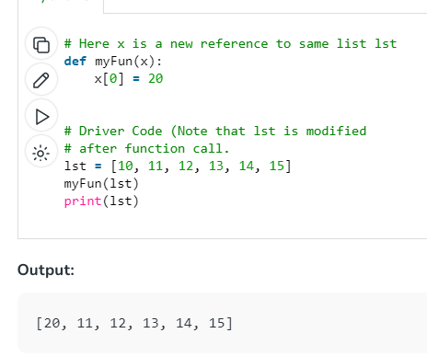
Pass by Reference
Passing By reference:
Python every variable name is a reference. When we pass a variable to a function, a new reference to the object is created.

Slide 19
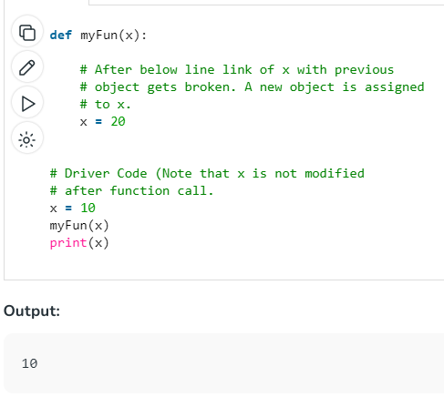
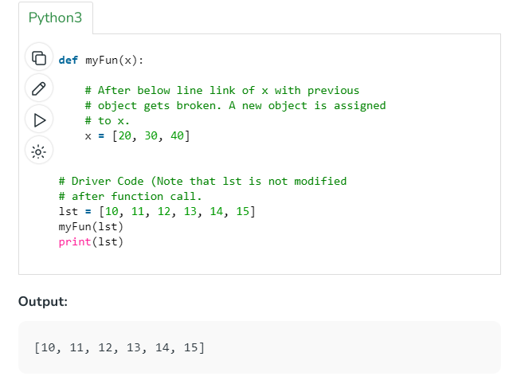
Pass by Reference
Passing By reference: Python every variable name is a reference. When we pass a variable to a function, a new reference to the object is created.
example demonstrates that the reference link is broken if we assign a new value (inside the function).

Slide 20
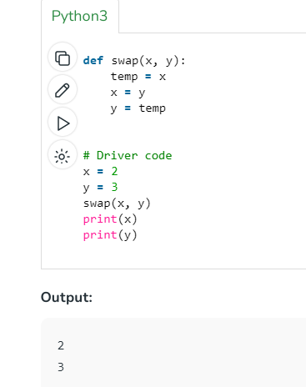
Pass by Reference
Passing By reference:
example demonstrates that the reference
link is broken if we assign a new value
(inside the function).

Slide 21
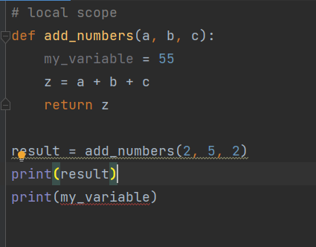
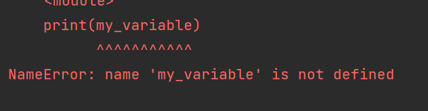
Local Scope vs Global scope of variables
Local Scope-
A variable that’s declared inside a function has a local scope. In other words, it is local to that function.

Slide 22
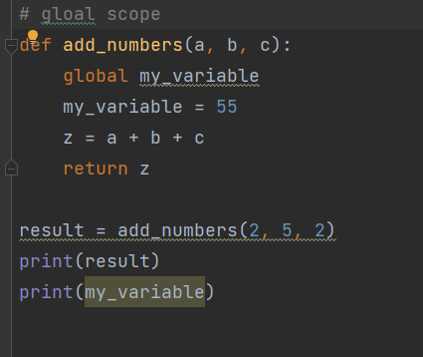

Local Scope vs Global scope of variables
Global Scope-
When you declare a variable outside python function, or anything else, it has global scope. It means that it is visible everywhere within the program.

Slide 23
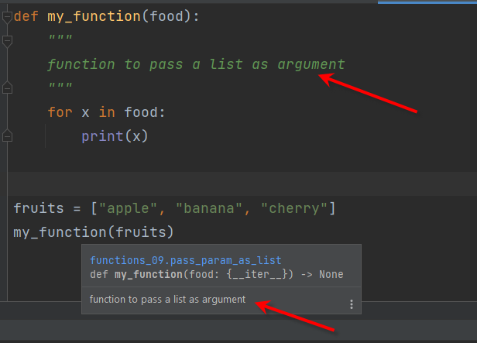
Functions documentations
Global docs
The first string after the function is called the Document string or Docstring in short. This is used to describe the functionality of the function. The use of docstring in functions is optional but it is considered a good practice.

Slide 24
Homework assignments
واجبات في البيت

Slide 25

H.W Assignment No. 1
H.w No. 1: # Create a Python function to calculate the area of a rectangle given its length and width as parameters

Slide 26

H.W Assignment No. 2
H.w No. 2: # Create a Python function to check if a string is a palindrome
Return True or False

Slide 27

H.W Assignment No. 3
H.w No. 3: # Create a Python function that checks if a number is a prime number.

Slide 28
H.W Assignment No. 4
H.w No. 4: #
Write a function sum_positive_numbers() that is used to
> return sum of Positive Numbers of a List
inputs ( parameters ) : 1 List of Integers
output ( return type ) : int
Write a function count_positive_numbers() that is used > return count of Positive Numbers of a List
inputs ( parameters ) : 1 List of Integers
output ( return type ) : int

Slide 29
H.W Assignment No. 5
H.w No. 5: #
Write a function get_max_num() that is used to
> return Max no of a List
inputs ( parameters ) : 1 List of Integers
output ( return type ) : int
Write a method get_min_num() that is used to
> return Min no of List
inputs ( parameters ) : 1 List of Integers
output ( return type ) : int

