Slide 1
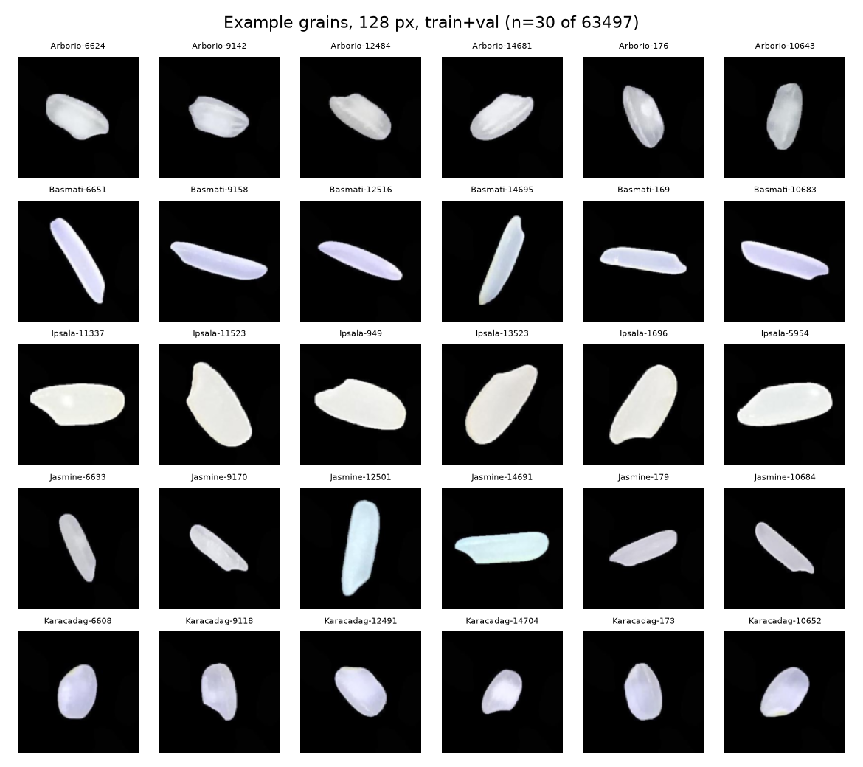
Numbers and pictures both sort five rice varieties near perfectly.
74703
grains left after linking 75000 images to 106 numeric columns and dropping 297 duplicate pairs
Five varieties: Arborio, Basmati, Ipsala, Jasmine, Karacadag.
Question: do measured numbers or raw images classify the same grains better?
Split 70/15/15 by class and lot: train 52292, validation 11205, test 11206.
We also ask what near-perfect scores depend on.
F20DL Group 16 · slide 1/5 · Speaker 1: ______

Slide 2
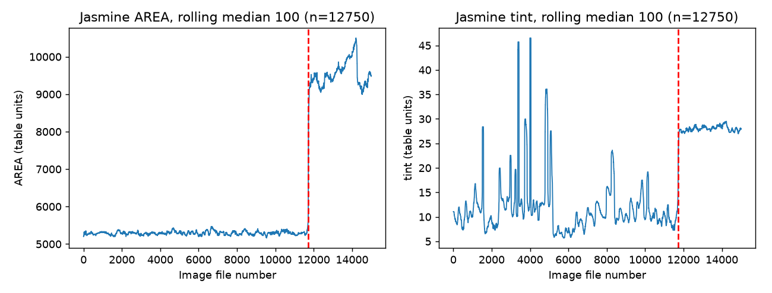
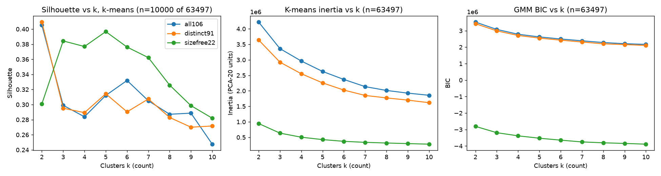
A late Jasmine lot hides inside the data.
×1.81
median grain area of late Jasmine against early Jasmine (3283 grains, tint ×2.64). Cause not established.
All 75000 row-to-image links rebuilt one-to-one.
297 exact duplicate pairs, all Ipsala, dropped.
k-means at k=6 puts a share 0.9896 of the late lot in one cluster.
Best GMM k=5, ARI 0.9437; best k-means k=6, ARI 0.8934.
F20DL Group 16 · slide 2/5 · Speaker 2: ______

Slide 3
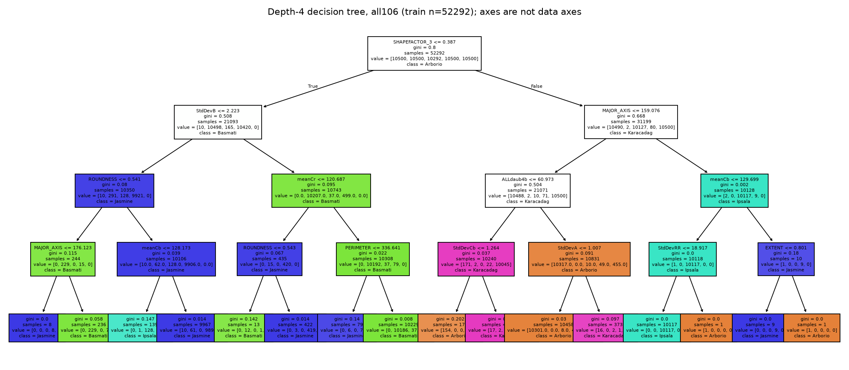
A depth-four tree, readable by hand, still scores 99.03 percent.
99.03%
depth-four tree, test accuracy. Best baseline, HGB: 99.88% (13 errors in 11206 test grains)
Tuned on validation only, code frozen, exactly 3 logged test reads.
Shape alone: HGB 97.99. Colour alone: HGB 99.14.
Tree splits on SHAPEFACTOR_3, MAJOR_AXIS, PERIMETER: pixel-scale size, so camera scale matters.
Use: readable first stage with a familiarity check, recalibrated per camera.
Model (test accuracy, %) | all106
HGB | 99.88
MLP, seed mean | 99.92
CNN on images, seed mean | 99.69
Logistic regression | 99.83
kNN | 99.79
Perceptron | 99.67
Naive Bayes | 99.05
Decision tree, depth four | 99.03
F20DL Group 16 · slide 3/5 · Speaker 3: ______

Slide 4
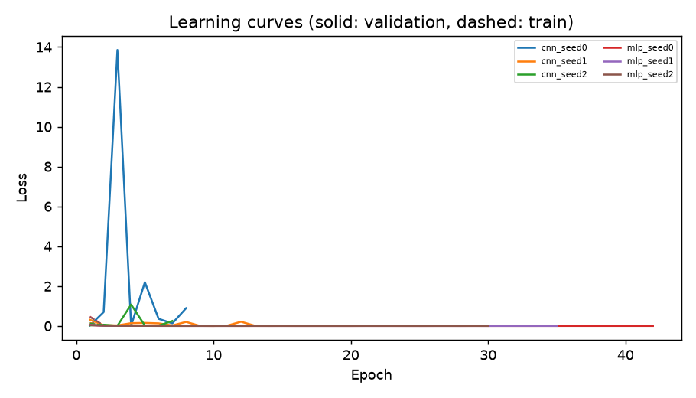
MLP and HGB tie; the CNN gap depends on the seed.
99.92%
MLP test accuracy, seed mean (11, 9, 8 errors), against HGB 99.88%
HGB against MLP: no significant difference on any seed (exact McNemar, Holm).
CNN makes 15 to 50 errors across three seeds; mean 99.69%.
HGB beats the CNN for seeds zero and two, not seed one.
Routing answers a share 0.9797 of test grains with 2 errors; optimistic.
Holm-adjusted p | Seed 0 | Seed 1 | Seed 2
HGB vs MLP | 0.7266 | 0.7895 | 0.2266
HGB vs CNN | 4.74e-7 | 0.8318 | 1.38e-4
F20DL Group 16 · slide 4/5 · Speaker 4: ______

Slide 5
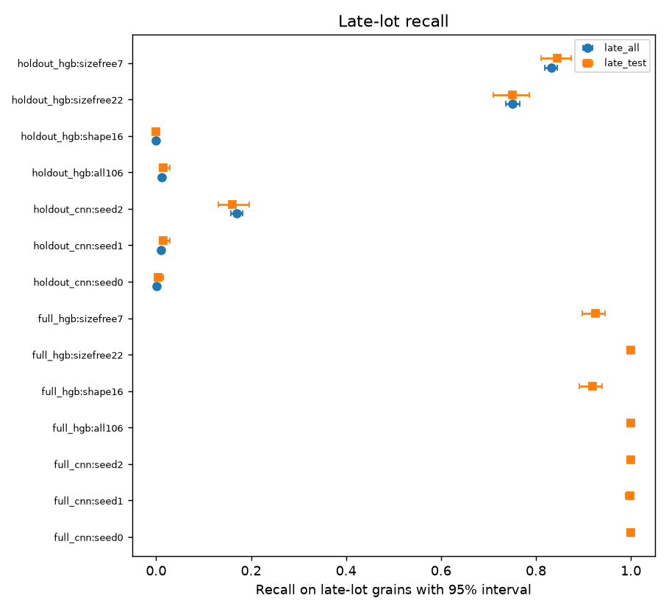
Test accuracy hides a lot the models have never seen.
1.42%
HGB recall on 492 late Jasmine test grains when the lot is held out (mean confidence 0.9263)
CNN seeds recover 0.41%, 1.42%, 16.06%; size-free HGB keeps 84.55%.
Removing tint cuts CNN recall from 99.93% to 4.00%; colour and size stay mixed.
Limits: one camera, cause unknown, routing floors set in-sample.
Takeaway: add a familiarity check; do not trust test accuracy alone.
F20DL Group 16 · slide 5/5 · Speaker 5: ______

