Slide 1
Walmart Sales Forecasting

Slide 2
Introduction
Walmart needs to know:
How much products customers will buy next week
Which departments will sell more
When demand increases during holidays
If predictions are wrong:
Stores may run out of products
Or buy too much inventory and lose money

Slide 3

Data Preparation and Preprocessing
Walmart historical sales data from Kaggle.
The dataset includes:
Store ID
Department ID
Weekly sales
Temperature
Fuel price
CPI
Unemployment
Holiday information
Markdown discounts

Slide 4
Data Preparation and Preprocessing : Data Cleaning
1. Handling Missing Values
Some markdown values were missing.
We replaced them with 0 because:
Missing markdown usually means no promotion existed.
2. Converting Dates
We changed dates into proper datetime format.
Dates, numbers

Slide 5
Data Preparation and Preprocessing : Data Cleaning
3. Merging Files
We combined:
train.csv
features.xlsx
stores.csv
Into one full dataset.
4. One-Hot Encoding
We converted categories like:
Store
Department
Store Type
Into machine-readable columns.
The model cannot understand words directly, so we translate them into numbers

Slide 6
Data Preparation and Preprocessing : Data Cleaning
5. Outlier Handling
Some values were unrealistically high or low.
We capped them using IQR.

Slide 7
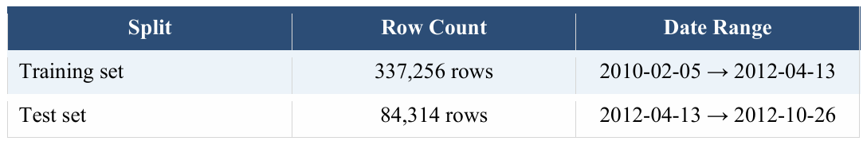
Train/Test Split
Old weeks → Training
New weeks → Testing

Slide 8
Models Chosen : Supervised Models
Model | Purpose | Approach
Linear Regression | Simple baseline | draw a straight relationship between inputs and sales
Random Forest | Strong non-linear prediction | Random Forest creates many decision trees and combines their predictions.
XGBoost | Advanced boosting model | Each new tree learns from previous errors

Slide 9
Normalization
Normalization scales numbers into a smaller range.
Example:
Temperature = 70
CPI = 200
After normalization:
Both become values between 0 and 1
Normalization helped Linear Regression.
But it made almost no difference for Random Forest.
XGBoosting does not need normalization

Slide 10
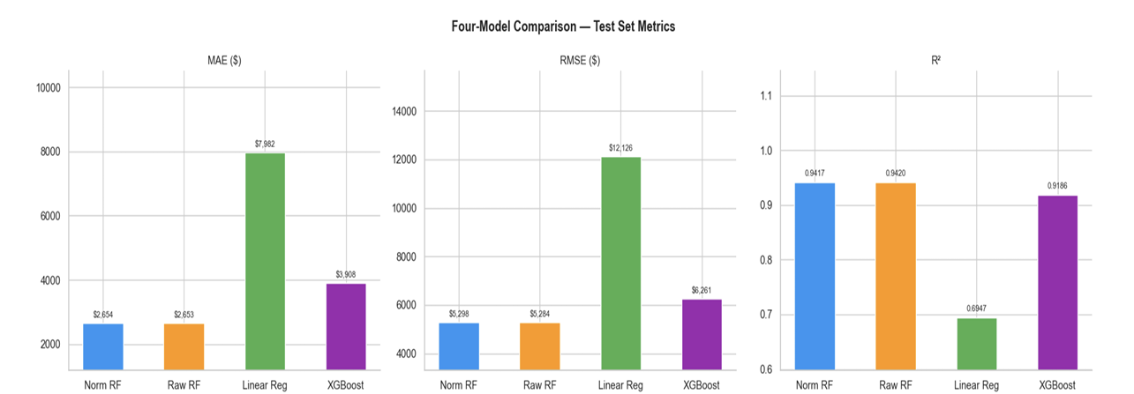
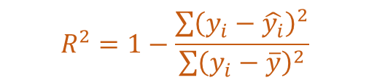
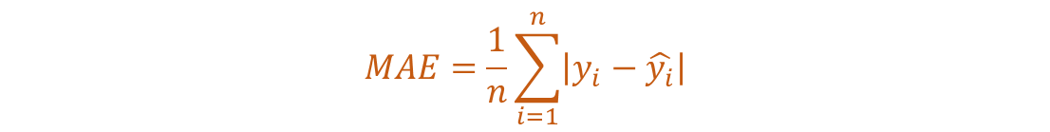
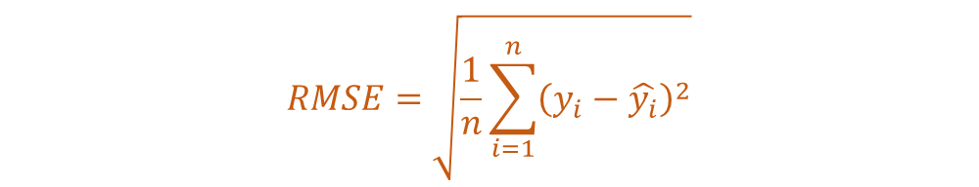
Results
$$MAE=\frac{1}{n}\sum_{i=1}^{n}{\left|y_{i}−\hat{y_{i}}\right|}$$
$$RMSE=\sqrt{\frac{1}{n}\sum_{i=1}^{n}{{\left(y_{i}−\hat{y_{i}}\right)}^{2}}}$$
Model Performance Comparison
Lower MAE/RMSE = fewer mistakes
Higher R² = better predictions
$$R^{2}=1−\frac{\sum{{\left(y_{i}−\hat{y_{i}}\right)}^{2}}}{\sum{{\left(y_{i}−\overline{y}\right)}^{2}}}$$

Slide 11
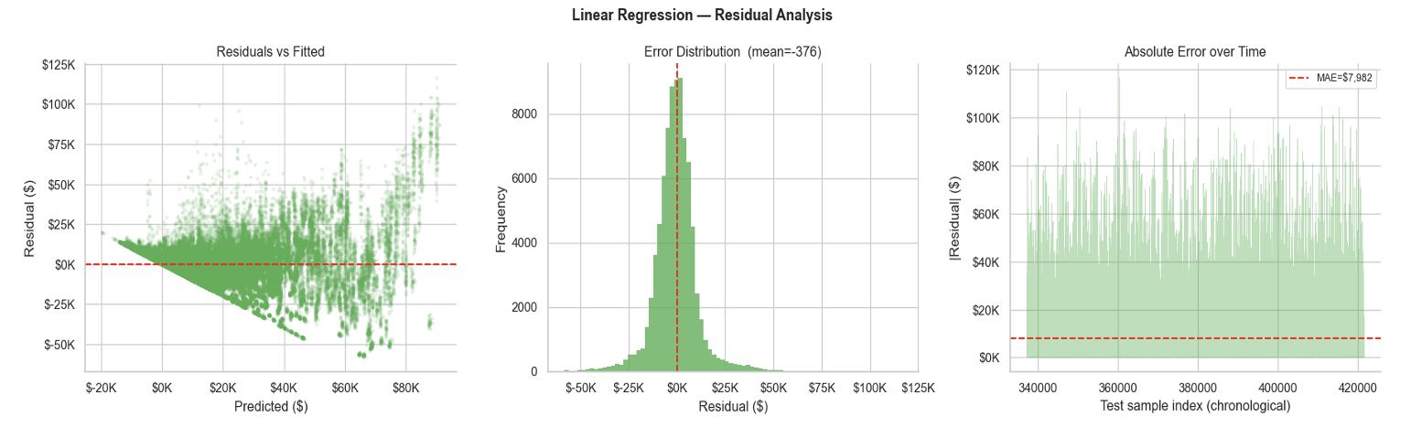
Results : Why is Linear regression is too bad
Dataset is mostly non-linear

Slide 12
Results : Discussion
Random Forest achieved the best performance with the highest Test R² and lowest prediction errors (MAE and RMSE).
This indicates that the dataset contains nonlinear relationships that were better captured by Random Forest compared to Linear Regression.
XGBoost performed well, but Random Forest produced more accurate and stable predictions on the test data, due to the justifiable outliers in holidays and promotions
The small difference between normalized and raw RF results shows that feature scaling had little effect on tree-based models.

Slide 13
Deployment with Streamlit
1. User enters:
Store number
Department
Economic data
Markdown value
↓
2. App prepares data
↓
3. Same preprocessing is applied
↓
4. Model predicts weekly sales
↓
5. Prediction displayed instantly

Slide 14
Free Topic
How XGBoost Thinks
It takes the dataset and makes a baseline guess.
Then it measures how wrong the predictions are using (gradients + confidence of error).
When building the tree, it chooses splits using a gain score
ignores weak splits to avoid overfitting.
The new tree’s contribution is scaled down using a learning rate
All trees are combined together to produce the final improved prediction.

Slide 15
Thank You

