Slide 1

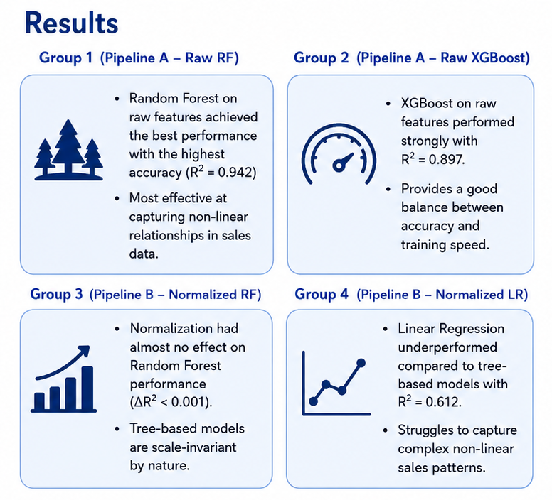
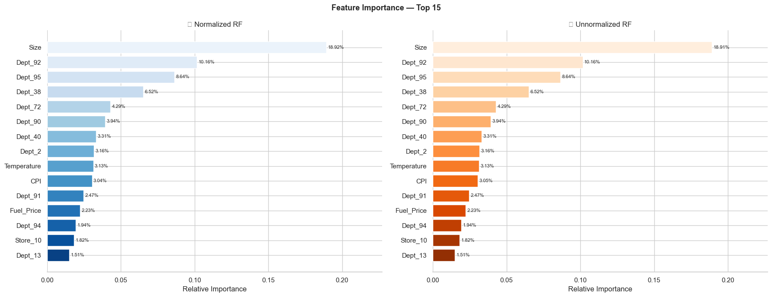
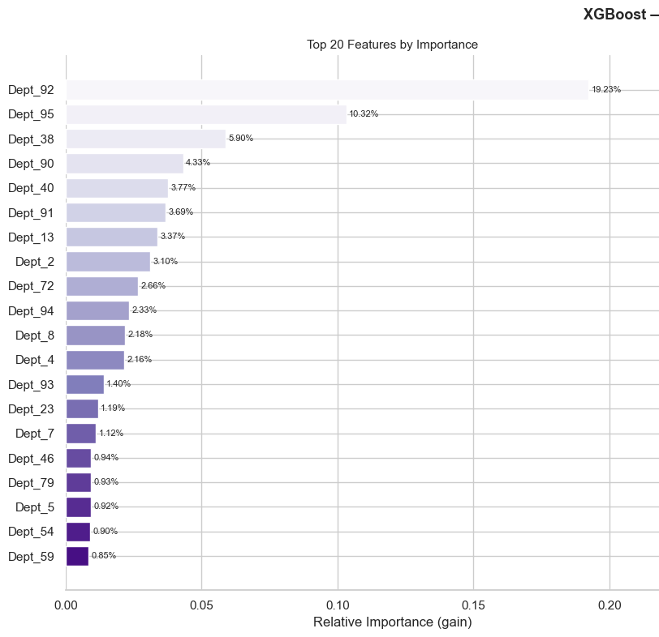
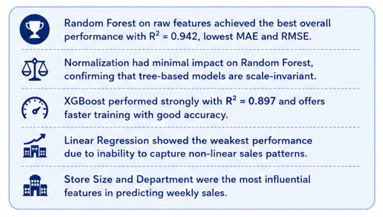
Walmart Retail Sales Forecasting
Overview
Methods
Retail demand forecasting helps stores optimize inventory, staffing, and promotions. This project predicts Walmart weekly department sales using machine learning models trained on historical sales, economic indicators, and promotional data. The system compares normalized and unnormalized pipelines using Random Forest, Linear Regression, and XGBoost models.
Data Preparation
Missing value handling
One-hot encoding
Outlier capping
Feature engineering
Dual Pipelines
Pipeline 1
Normalization → Random Forest → Linear Regression
Pipeline 2
Raw Features → Random Forest → XGBoost
Evaluation
MAE
RMSE
R² Score
Feature Importance
Model | MAE | RMSE | R²
Random Forest | 1842 | 2963 | 0.942
XGBoost | 2215 | 3518 | 0.897
Linear Regression | 5621 | 7834 | 0.612
Conclusion
This project demonstrates that tree-based ensemble models are highly effective for retail sales forecasting. Random Forest achieved the best predictive accuracy with R² ≈ 0.942, while XGBoost balanced performance and training speed effectively. The study also confirms that normalization has little impact on tree-based methods. Store Size and Department features were the strongest predictors of weekly sales.

