Slide 1
MMsuit: Simple GUI application for computing and simulating Michaelis-Menten and related equations
Presented by: Yahia Saad
BIOEN537 Au2024

Slide 2
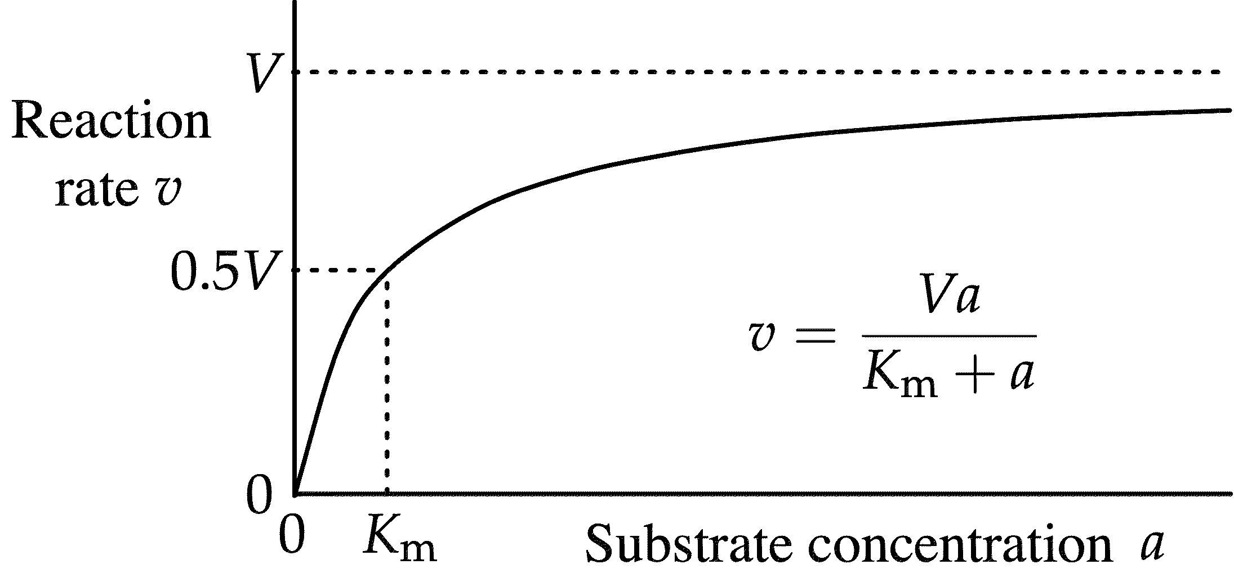
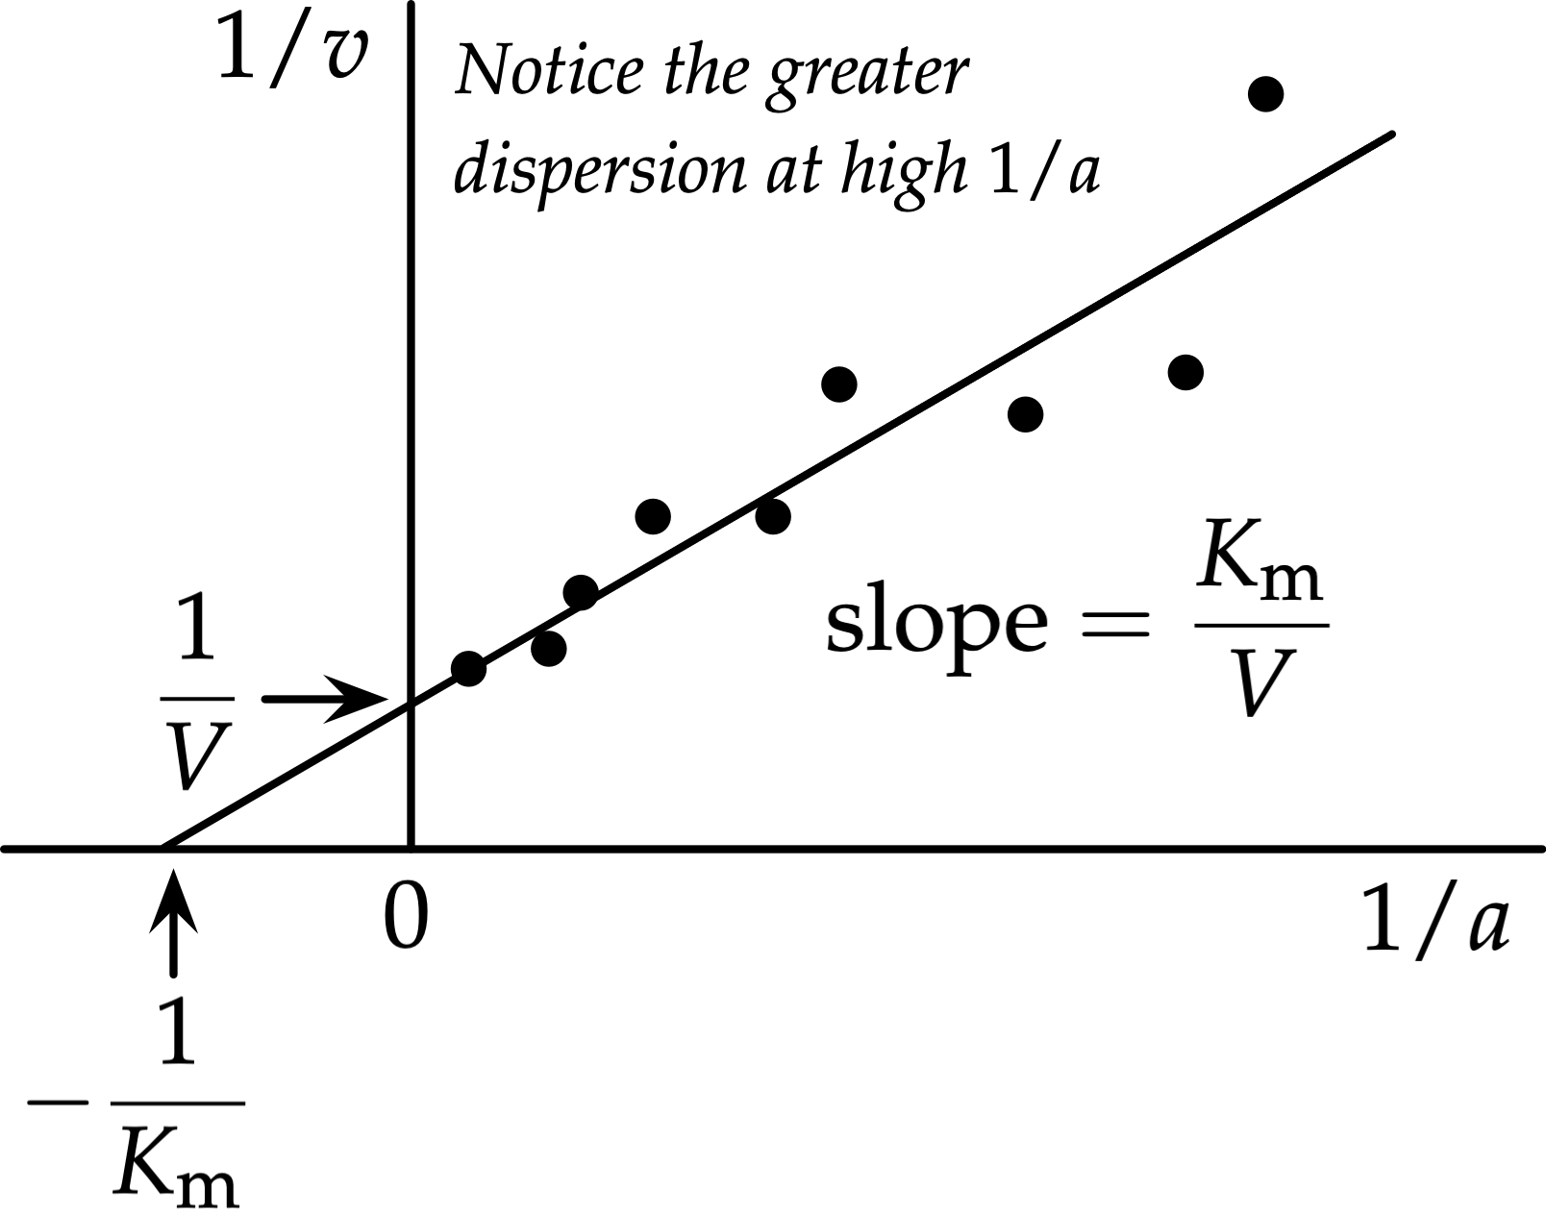

Background
Michaelis-Menten Equation: (1913)
Lineweaver – Burk Equation: (1913)

Slide 3
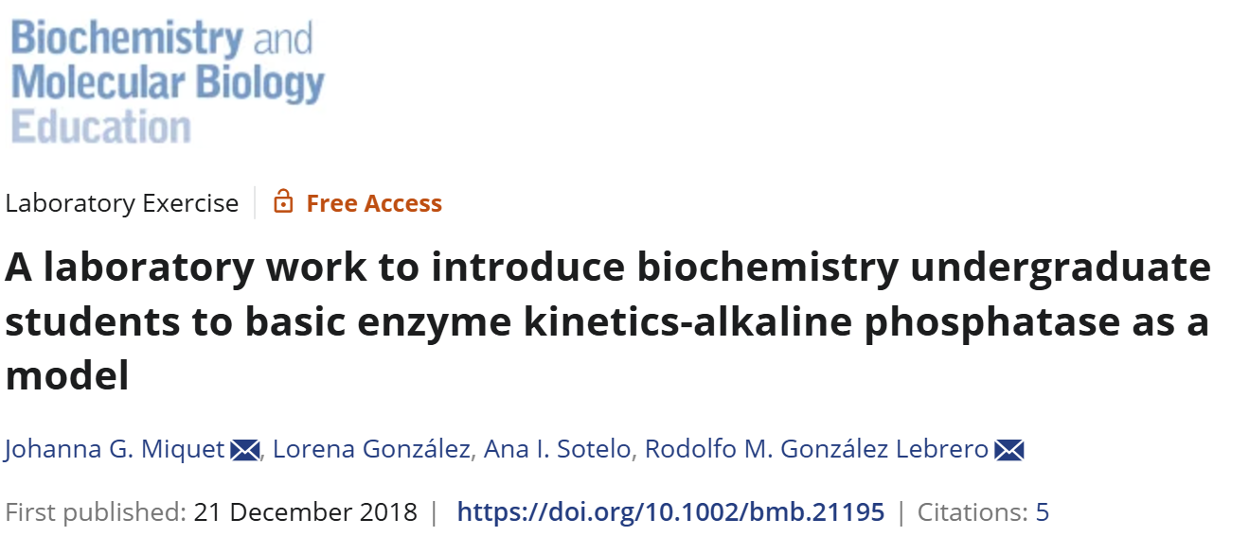
Educational Case Study
Learning Objectives:
Obtain and analyze time courses of product release to estimate the time interval to measure initial rate and its dependence with enzyme concentrations.
Determine the dependence of initial rate with substrate and enzyme concentrations.
Employ nonlinear regression to obtain KM, Vmax, and Kcat values of the Michaelis–Menten equation.
General Michaelis-Menten Usage

Slide 4
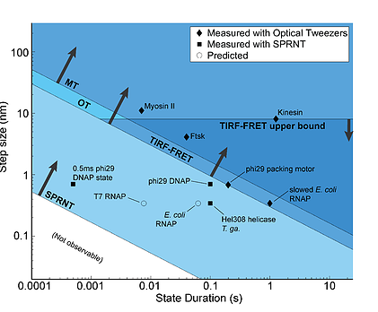
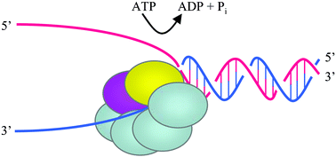
Helicases & Polymerases Kinetics studies
Vindigni A et al. Mol BioSyst, 2007
Laszlo et al. Methods, 2016.
The velocity by which the helicase unwinds DNA
ATP hydrolysis studies
Helicase inhibition and drug testing

Slide 5
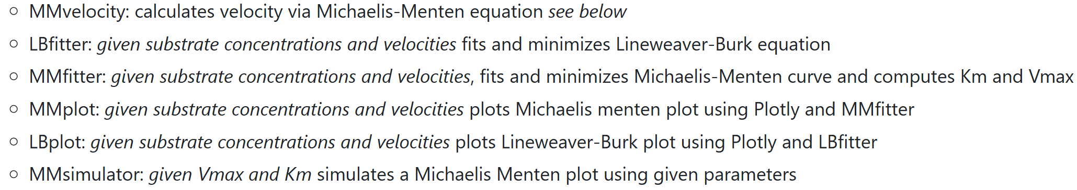
Minimalist Application
Experiment Executer: Upload CSV with substrate concentration and velocities
MM simulator: Insert equation parameters and generate the curve
Download data and save plots
Can be used as CUI to be implemented in python code
Contains the following functions

Slide 6
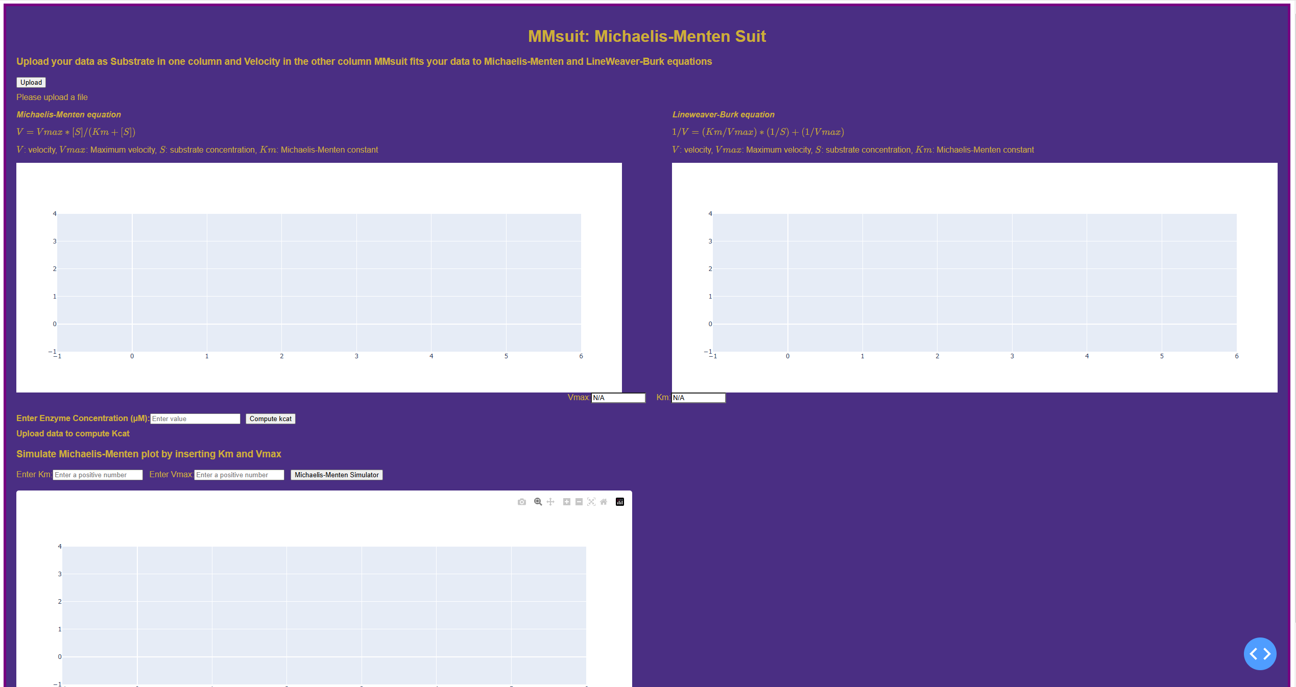

Slide 7
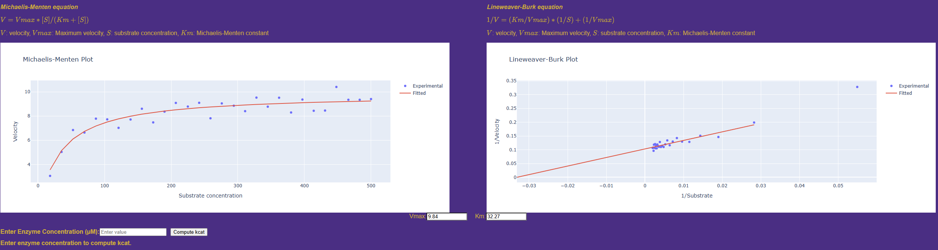

Slide 8
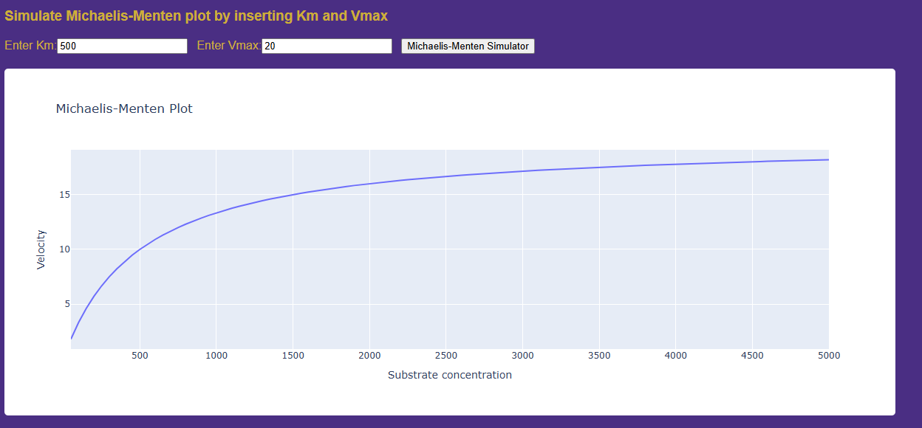

Slide 9
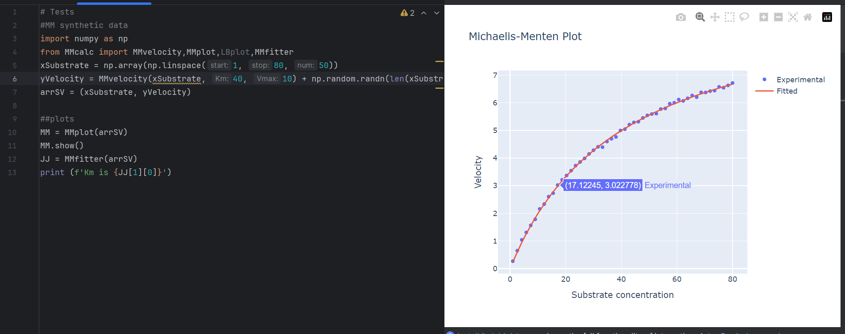

Slide 10
Strengths
Easy to use and implement by python users
Interactive graphs and Easy to use GUI
No complicated installation and can be developed as web interface
Easily modified to be implemented for different kinetics experiments

Slide 11
Challenges and Limitations
Not general-purpose application for enzyme kinetics
Lacks many features present in other commercial applications usually used

Slide 12
Progress . . .
Adding tests using dash.testing for GUI
More error handling
Packaging
Download fitted data from GUI
(Optional)
Make the interface only two plots and allow user to choose between simulation and experiment
Add Velocity terms and concentrations

Slide 13
References
Michaelis L, Menten ML, Johnson KA, Goody RS. The original Michaelis constant: translation of the 1913 Michaelis-Menten paper. Biochemistry. 2011 Oct 4;50(39):8264-9. doi: 10.1021/bi201284u
Johnson KA. A century of enzyme kinetic analysis, 1913 to 2013. FEBS Lett. 2013 Sep 2;587(17):2753-66. doi: 10.1016/j.febslet.2013.07.012. Epub 2013 Jul 12. PMID: 23850893; PMCID: PMC4624389.
Miquet, J.G., González, L., Sotelo, A.I. and González Lebrero, R.M. (2019), A laboratory work to introduce biochemistry undergraduate students to basic enzyme kinetics-alkaline phosphatase as a model. Biochem Mol Biol Educ, 47: 93-99. https://doi.org/10.1002/bmb.21195
Laszlo AH, Derrington IM, Gundlach JH. MspA nanopore as a single-molecule tool: From sequencing to SPRNT. Methods. 2016 Aug 1;105:75-89. doi: 10.1016/j.ymeth.2016.03.026. Epub 2016 Apr 1. PMID: 27045943

