Slide 1

Natural Language Processing
ظ
ع
ن
ض
ء
Chatbot for General Saudi Department of Traffic
ي
ن
Ghadeer Ali
Ghalia Maher
Jamilah Rabeh
Mohammed Alajmi
Mohammed Almalki
Yehya Alyoubi
ع
ج
Supervised by Dr.Mejda AlQahtani
ص

Slide 2
Project Workflow
ض
أ
ي
Problem Definition
Exploration and Pre-processing
NMF Model
ن
01
02
03
04
05
06
Dataset
LDA Model
BERTopic Model
We create our own Dataset

Slide 3
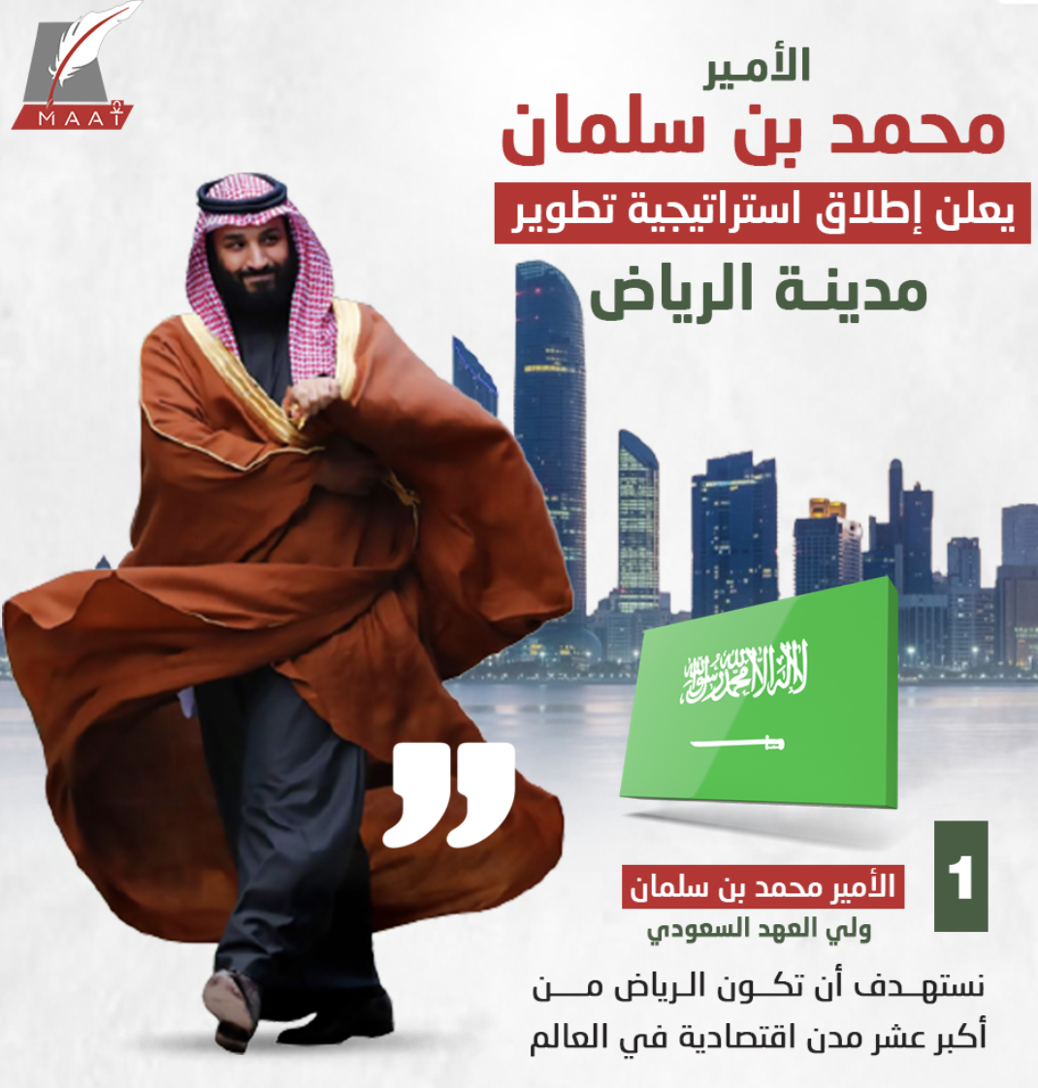
Problem Definition:
أ
ي
2030 vision of developing Riyadh city
Improper parking which consider the most common causes of traffic.
ن
ض

Slide 4
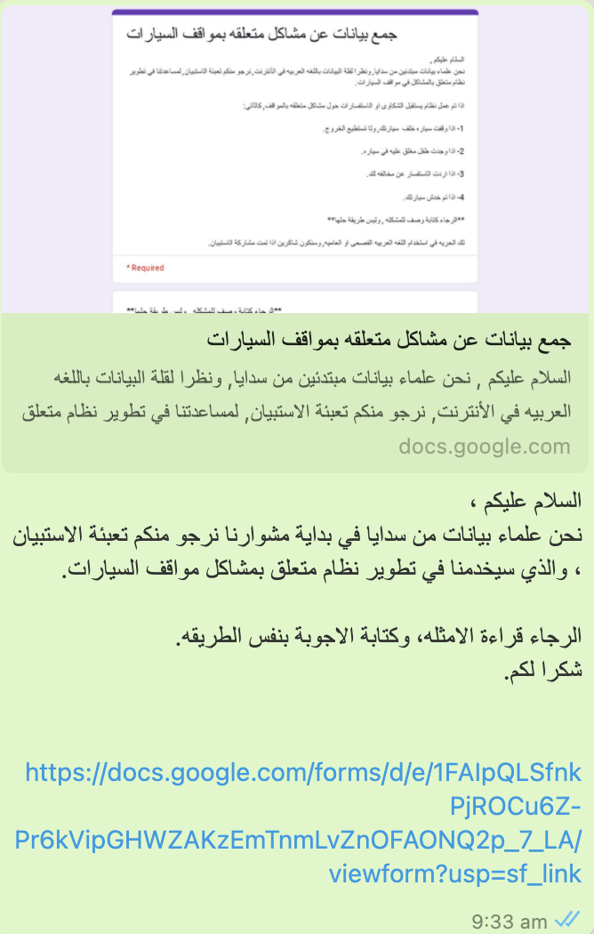
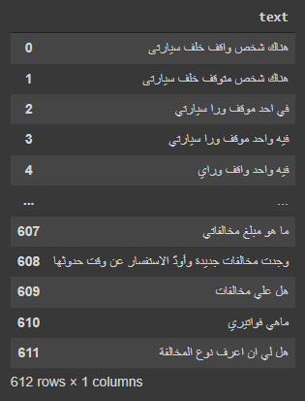
Data Collection:
أ
ي
Surveys.
Web scraping from articles and writing data all collected in Excel File.
ن
ض

Slide 5
Exploration and Pre-processing :
أ
ي
Remove number and punctuation.
Create stop word dictionary “prepositions and pronouns” and then remove them all from the dataset.
Replace the word “وراي” by the word “خلفي”.
Normalize the following by CAmel tool:
All "أ، إ ، آ" with “ ا ”
All “ ه ” to “ ة ”
All “ ى ” to “ ي”
ن
ض

Slide 6
Exploration and Pre-processing :
أ
ي
Stemming from farasapy library
Part of speech (P.O.S) using CAmel tool
CAMeL-Lab/bert-base-arabic-camelbert-mix-pos-glf
لقيت سيارتي مصدومه
لقيت فعل
ن
ض

Slide 7
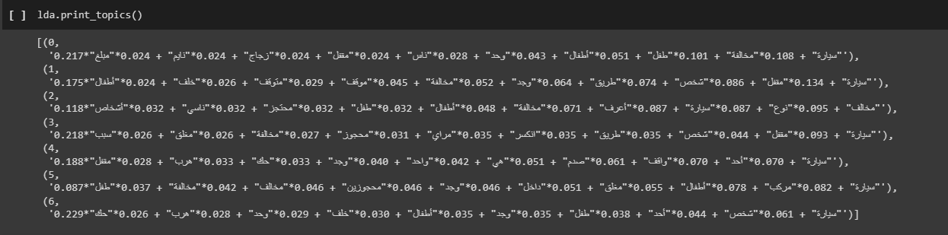
First Model LDA (Latent Dirichlet Allocation)
أ
ي
ن
ض

Slide 8
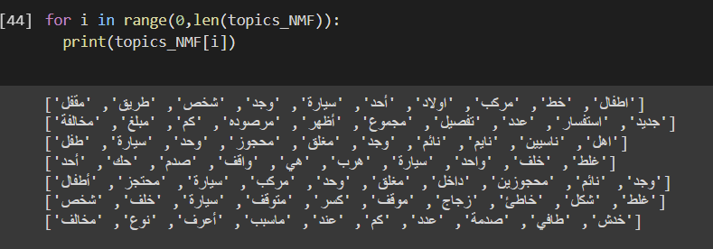
Second Model NMF ( Non-negative Matrix Factorization )
أ
ي
ن
ض

Slide 9
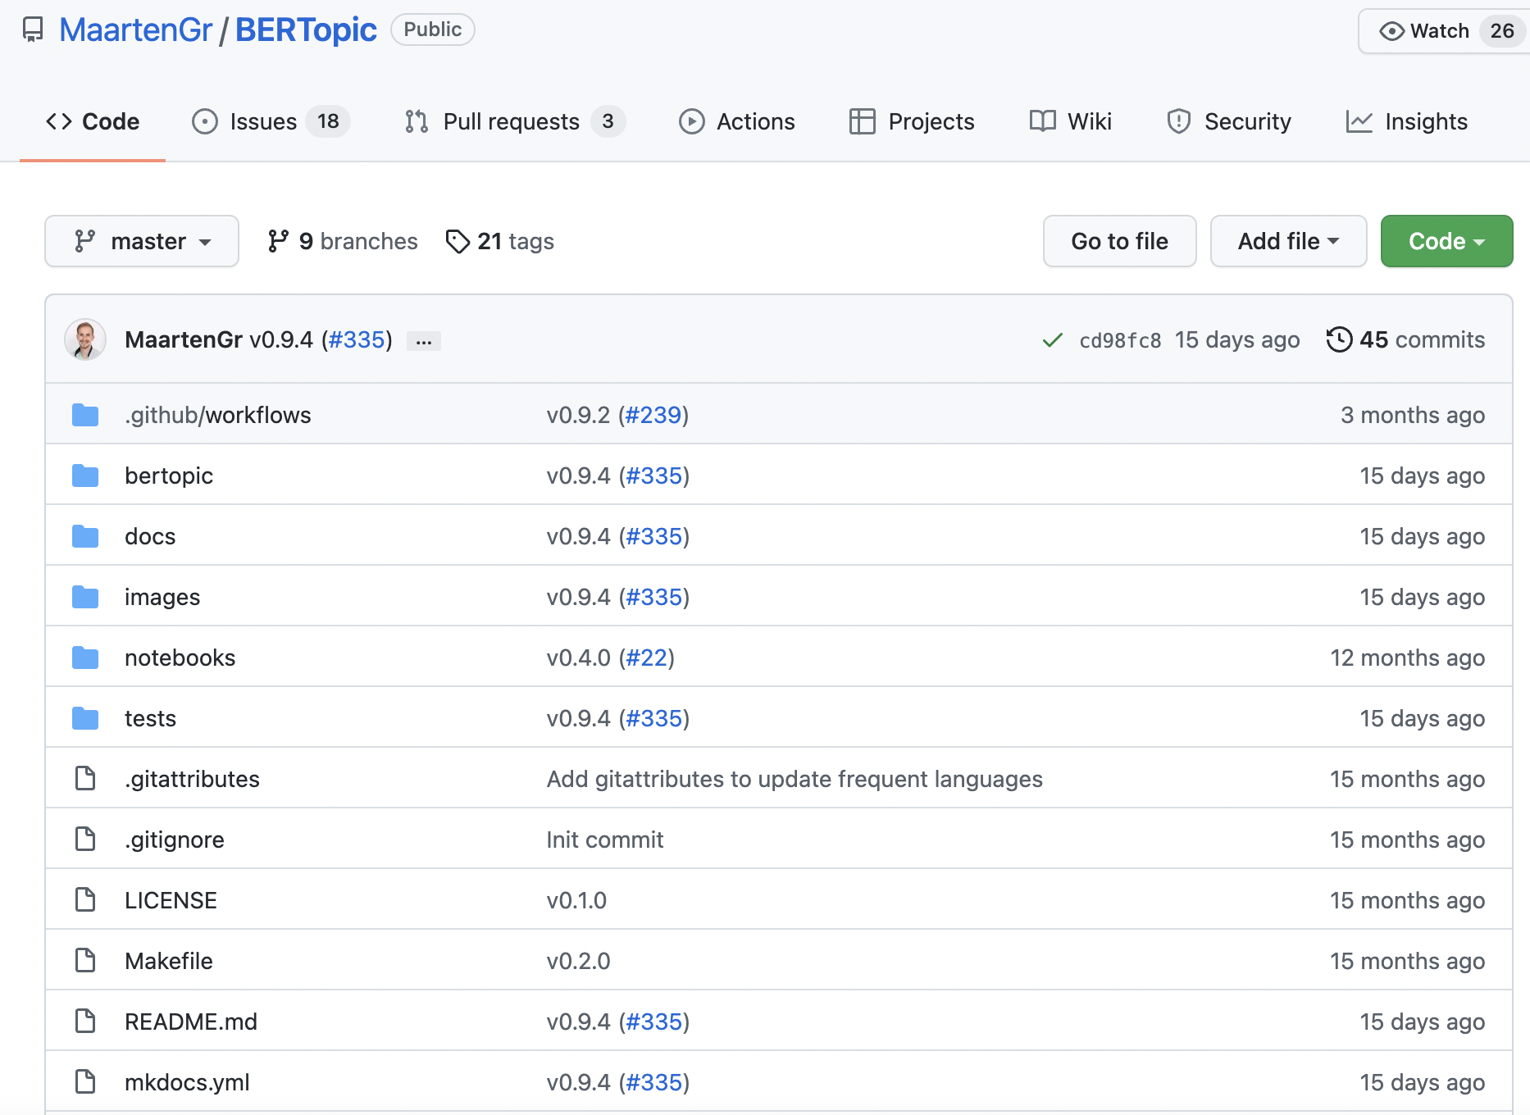
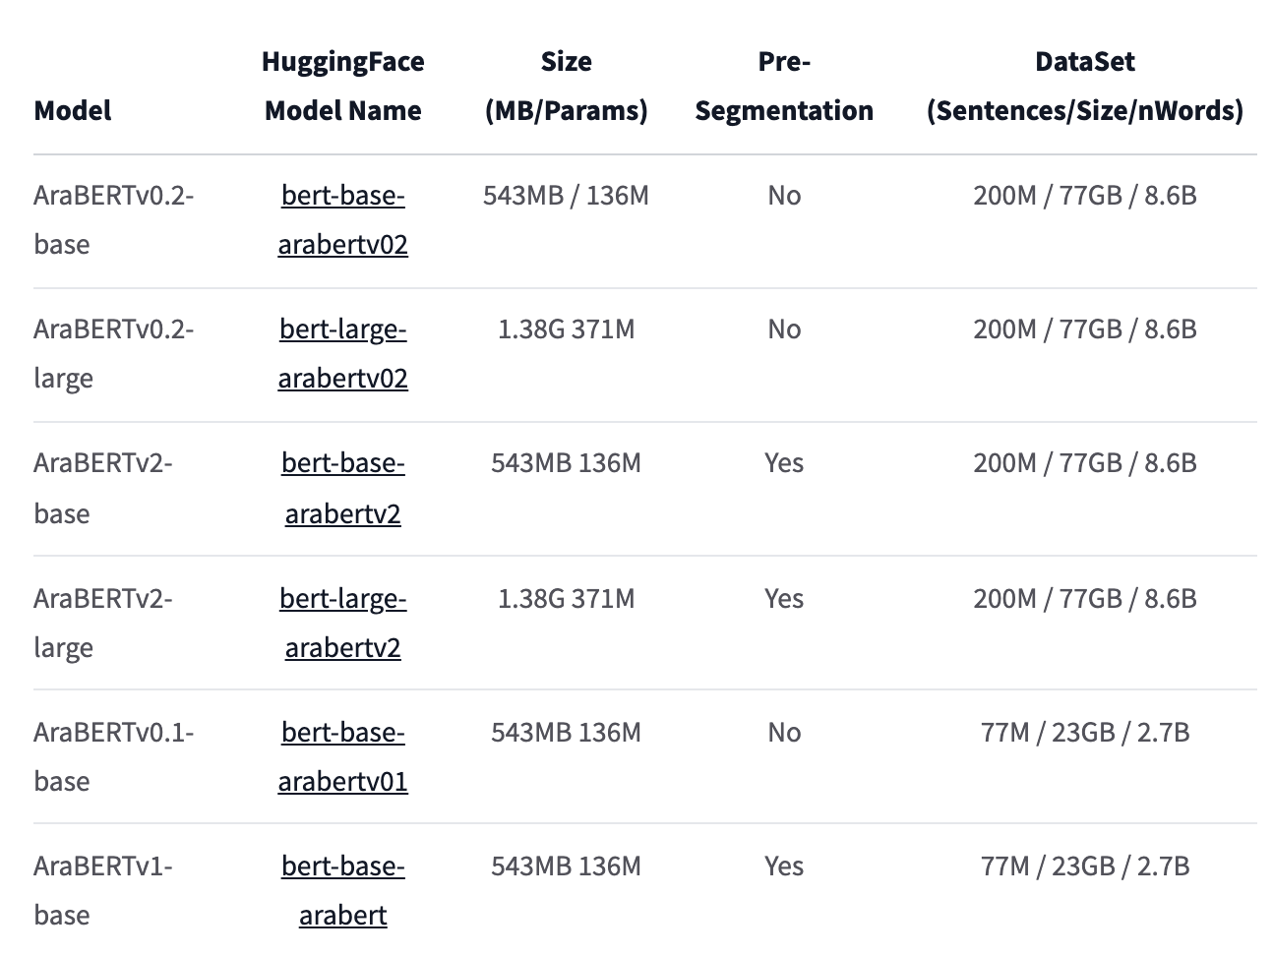
Third Model BERT_for_Arabic_Topic_Modeling_ACLing2021
أ
Embedded pre-trained model with over 1,5 billions word and so many articles
ي
ن
ض

Slide 10
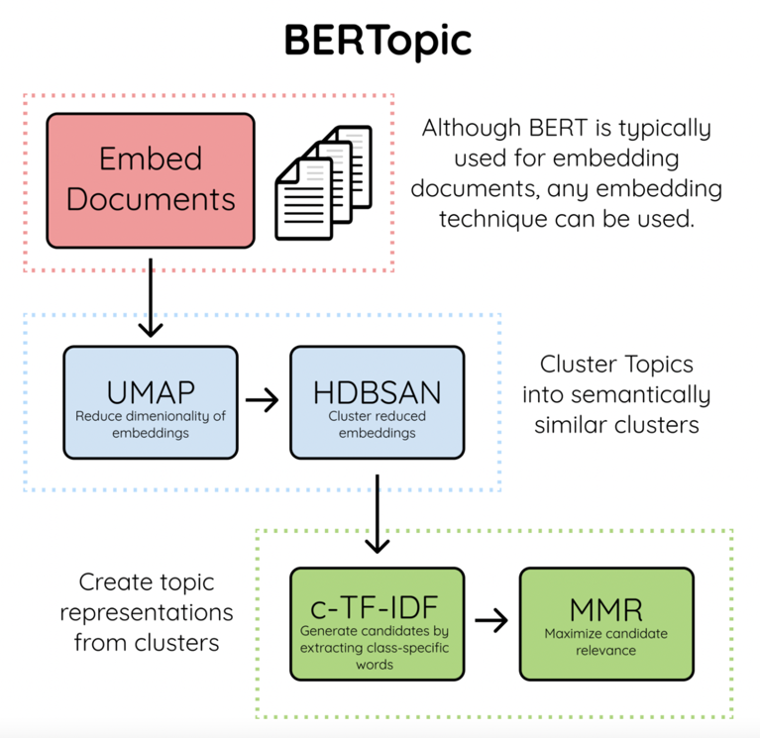
Third Model BERT_for_Arabic_Topic_Modeling_ACLing2021
أ
ي
ن
ض

Slide 11
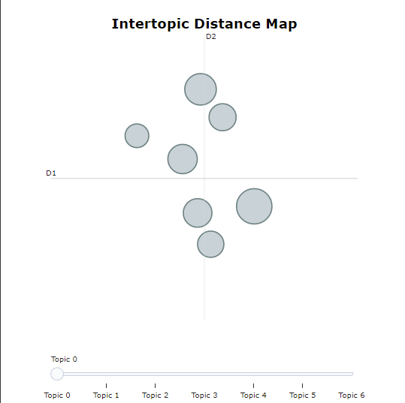
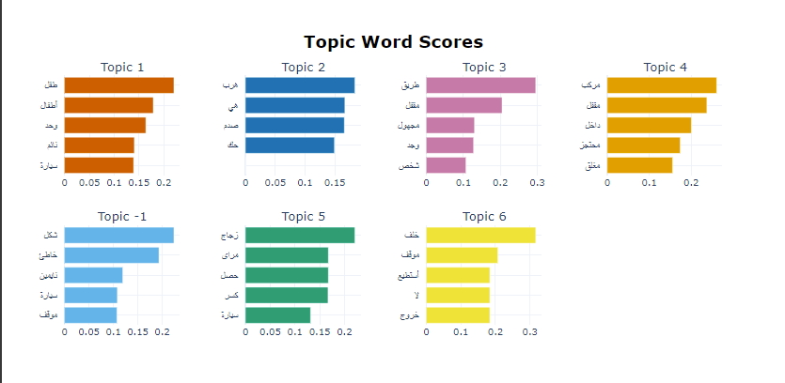
Third Model BERT_for_Arabic_Topic_Modeling_ACLing2021
أ
ي
ن
ض

Slide 12
Future Work :
أ
ي
The future work will be presented in the final project in few weeks, See you then ☺
ن
ض

Slide 13
Thanks For Listening..
أ
ي
ن
ض
بكِ تاجُ فخري وانطلاقُ لساني
و مرورُ أيامي ودفءُ مكاني
لغة الجدودِ ودربُنا نحوَ العُلا
و تناغمُ الياقوتِ والمَرجان ِ

