Slide 1
Knowledge graph using protege
YAHOUI Soheib

Slide 2
Agenda
Example: The “AfricanWildlife” ontology
3
Creation of classes , subclasses and properties
4
5
Restrictions on properties and classes
Creating class instances
10
Run a Sparql queries , Reasoning , and visualization of the graph
13

Slide 3
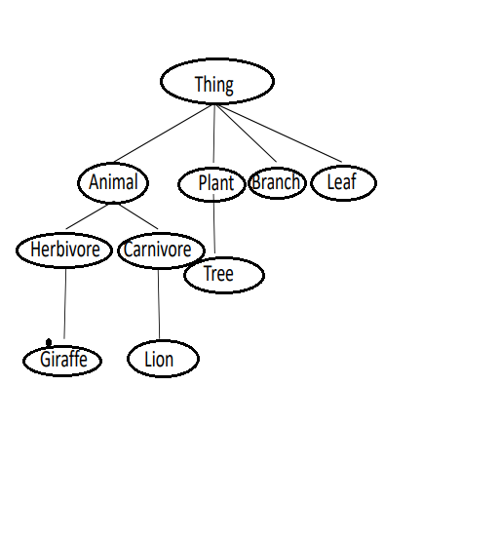
“AfricanWildlife” ontology class hierarchy
3

Slide 4
Creation of classes , subclasses and properties
3
<owl:Class rdf:ID="Animal"/>
<owl:Class rdf:ID="Herbivore">
<rdfs:subClassOf rdf:resource="#Animal"/>
</owl:Class>
<owl:Class rdf:ID="Carnivore">
<rdfs:subClassOf rdf:resource="#Animal"/>
</owl:Class>
<owl:Class rdf:ID="Lion">
<rdfs:subClassOf rdf:resource="#Carnivore"/>
</owl:Class>

Slide 5
Creation of classes , subclasses and properties
3
<owl:Class rdf:ID="Lion">
<rdfs:subClassOf rdf:resource="#Carnivore"/>
</owl:Class>
<owl:Class rdf:ID="Giraffe">
<rdfs:subClassOf rdf:resource="#Herbivore"/>
</owl:Class>
<owl:Class rdf:ID="Plant"/>
<owl:Class rdf:ID="Tree">
<rdfs:subClassOf rdf:resource="#Plant"/>
</owl:Class>
<owl:Class rdf:ID="Branch"/>
<owl:Class rdf:ID="Leaf"/>

Slide 6
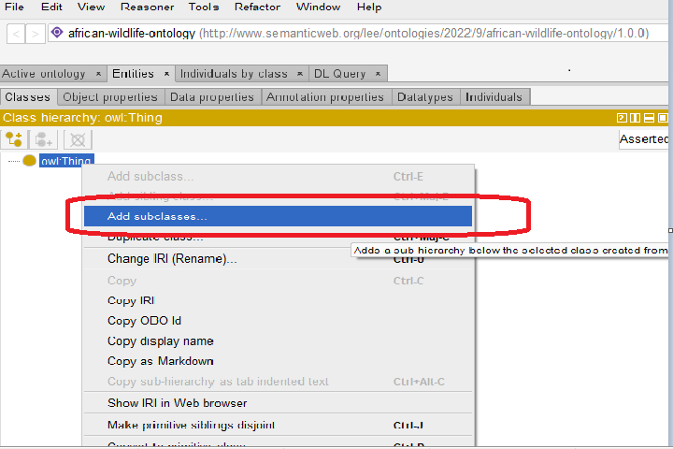
Creation of classes , subclasses and properties
3
Entities > classes >
add subclasses >
write the hierarchy .

Slide 7
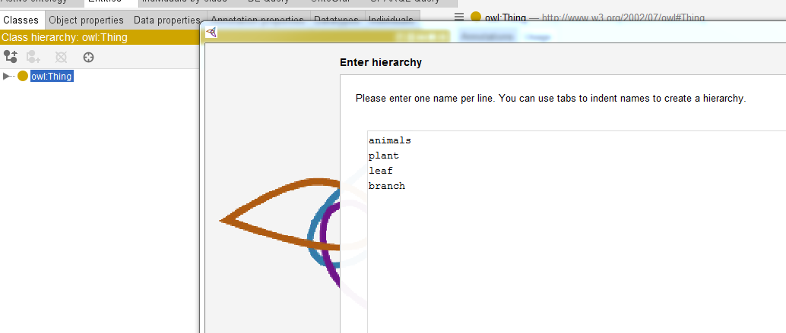
Creation of classes , subclasses and properties
3
<owl:Class rdf:ID="Plant">
<rdfs:comment>Plants
are disjoints from animals
</rdfs:comment>
<owl:disjointWith
rdf:resource="#animals"/>
</owl:Class>

Slide 8
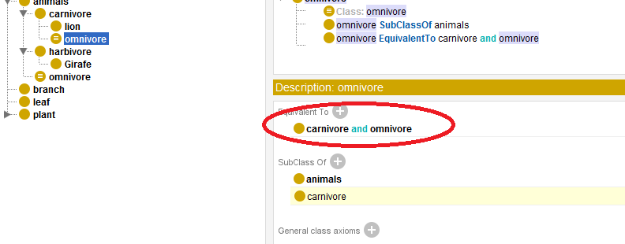
intersectionOf
3
<owl:Class rdf:ID="Omnivore">
<owl:equivalentClass>
<owl:Class>
<owl:intersectionOf rdf:parseType="Collection">
<owl:Class rdf:about="#Herbivore"/>
<owl:Class rdf:about="#Carnivore"/>
</owl:intersectionOf>
</owl:Class>
</owl:equivalentClass>

Slide 9
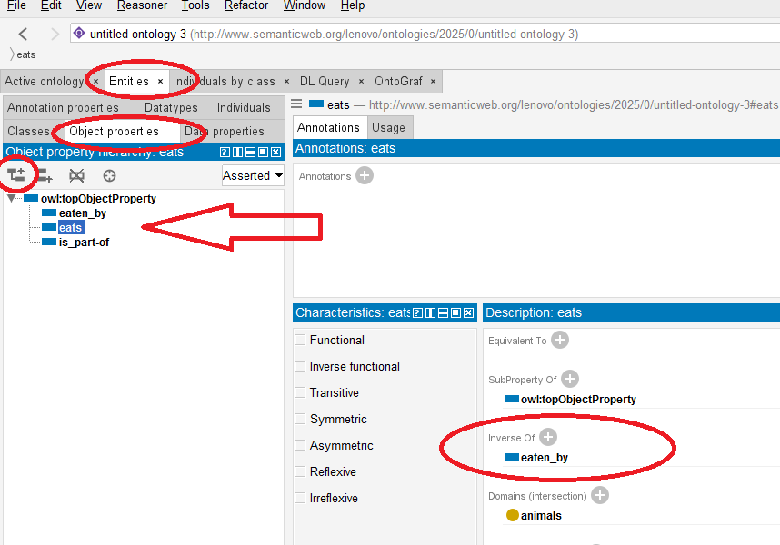
Creation of classes , subclasses and properties
3
<owl:ObjectProperty rdf:ID="eats">
<rdfs:domain rdf:resource="#Animal"/>
</owl:ObjectProperty>
<owl:ObjectProperty rdf:ID="eaten-by">
<owl:inverseOf rdf:resource="#eats"/>
<rdf:type rdf:resource=
"&owl;#ReflexiveProperty"/>
</owl:ObjectProperty>

Slide 10
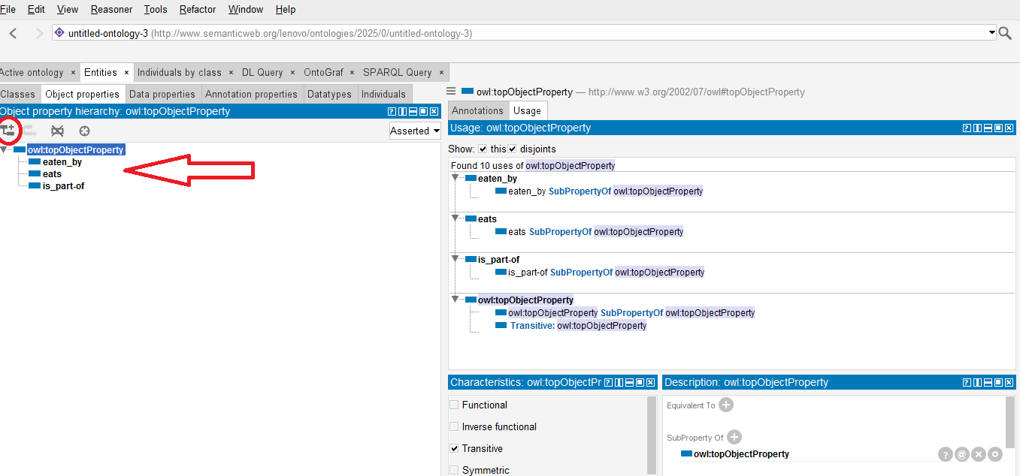
properties

Slide 11
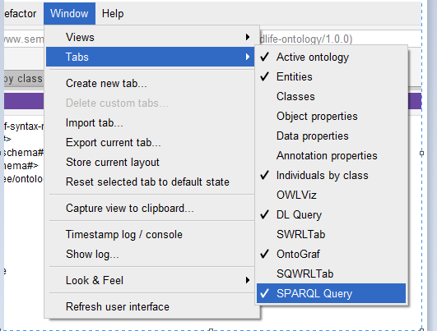
Tools
3
Window > Tabs > SPARQL query
+ OntoGraph.

Slide 12
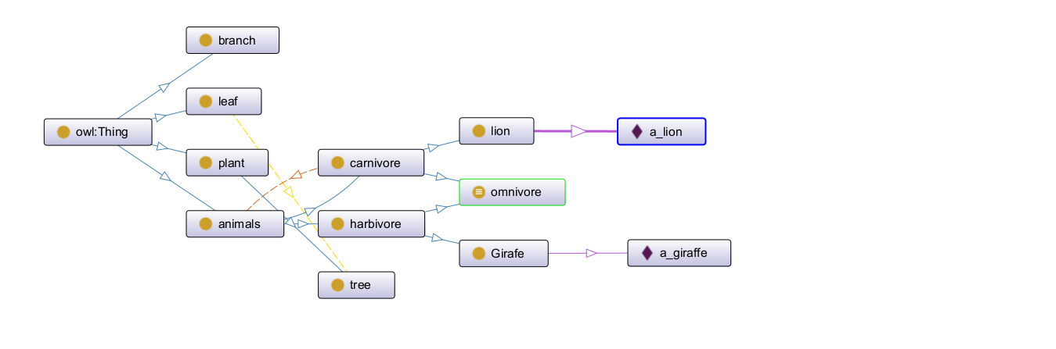
Visualization of the graph
3
Window > Tabs >
OntoGraph

Slide 13
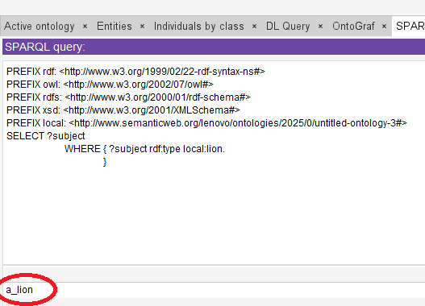
Runing a Sparql Query
3
PREFIX rdf:
<http://www.w3.org/1999/02/22-rdf-syntax-ns#>
PREFIX owl: <http://www.w3.org/2002/07/owl#>
PREFIX rdfs: <http://www.w3.org/2000/01/rdf-schema#>
PREFIX xsd: <http://www.w3.org/2001/XMLSchema#>
PREFIX local: <http://www.semanticweb.org/lenovo/ontologies/2025/0/untitled-ontology-3#>
SELECT ?subject
WHERE { ?subject rdf:type local:lion. }

Slide 14
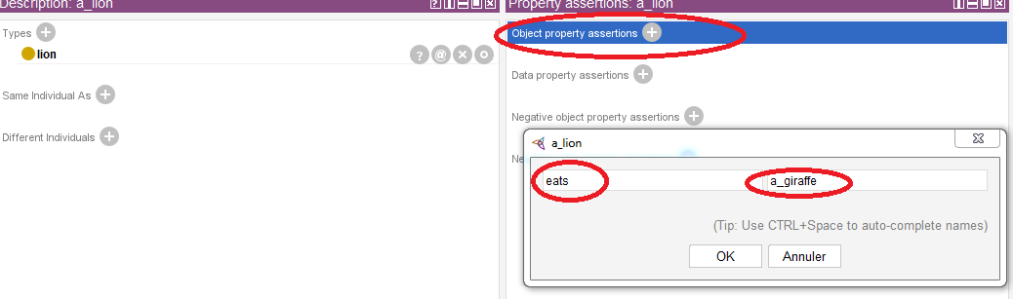
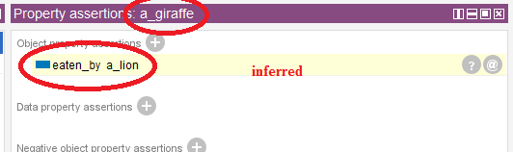
Reasoner
3
Reasoner > Hermit 1,4 >
start reasoner
We add a new triplet “a_lion eats a_giraffe “
we inferred
“a_Giraffe
Is eaten by
a_Lion “

Slide 15
Thank you
YAHOUI Soheib
soheibyahoui@gmail.com
https://github.com/yahoui2001/knowledge-graph/tree/main

