Slide 1
Lightweight Speech Recognition for mTDS
Yung-An Hsieh

Slide 2
Outline
Introduction
Speech Recognition Framework
Testing and Modification
Demonstration

Slide 3
Outline
Introduction
Speech Recognition Framework
Testing and Modification
Demonstration

Slide 4
Goal
A lightweight supervised speech recognition algorithm that can be implemented on wearable assistive devices such as Multimodal Tongue Drive System (mTDS)
Aims to classify at least 20 words from the speech signal in real time by using the microcontroller

Slide 5
Word list
21 words for mTDS
Wheelchair | Computer | Smartphone
Off , Start , Stop
Left , Right
Turn | Up , Down
Forward , Backward | Scroll
 | Zoom
 | Select
 | Hold (for drag/drop…)
 | Keyboard
 | Return
 | Home | Click

Slide 6
Data Set
A single WAV file (Fs = 44100Hz) contains a 2 second record with a single word
Each word has about 40 recorded files
The files are recorded by three different people

Slide 7
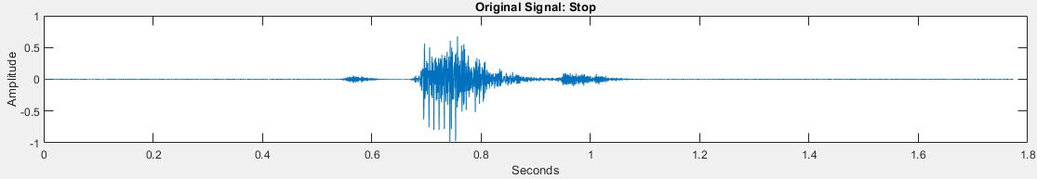
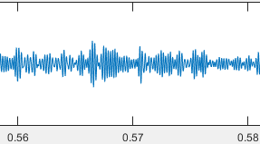
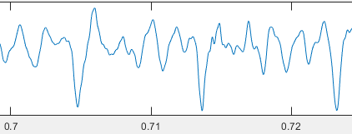
Speech Signal
Voiced: Periodic source, created by vocal cords
Unvoiced: Aperiodic and noisy
Pitch: Fundamental frequency of the vocal cords vibration
(Only voiced sound has well defined pitch)
Unvoiced
Voiced

Slide 8
Phonemes
The basic sounds of a language that distinguish one word from another
Important feature for speech recognition

Slide 9
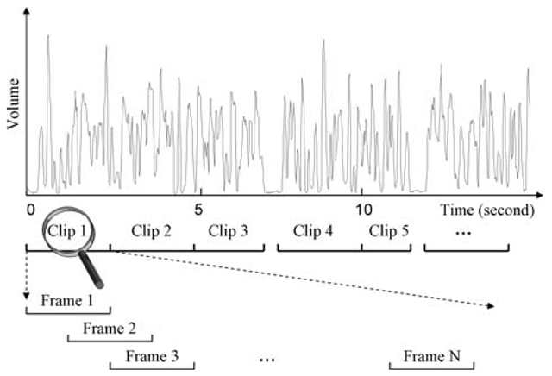
Audio Features
Short-term frame-level and long-term clip-level
Both frames and clips may overlap with their previous ones
Clips length is usually 1 to 2 seconds,
for single word detection, I focused
on frame-level features
Reference: http://what-when-how.com/video-search-engines/audio-features-audio-processing-video-search-engines/

Slide 10
Frame-level features
Volume - Silence detection
Zero-Crossing Rate – Unvoiced Speech detection
Pitch - Long-term variation (over more than one phoneme)
Linear Predicative Code (LPC)
Spectral Features – e.g. Mel-frequency cepstral coefficients (MFCC)

Slide 11
Outline
Introduction
Speech Recognition Framework
Testing and Modification
Demonstration

Slide 12
Framework
Speech Signal
Low-pass Filter
Speech Extracting
Signal Framing
LPC Coefficients
SVM
Training
Testing

Slide 13
Speech Signal
Low-pass Filter
Speech Extracting
Signal Framing
LPC Coefficients
SVM
Training
Testing

Slide 14
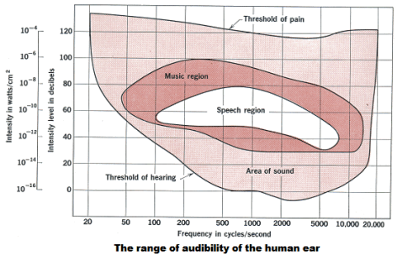
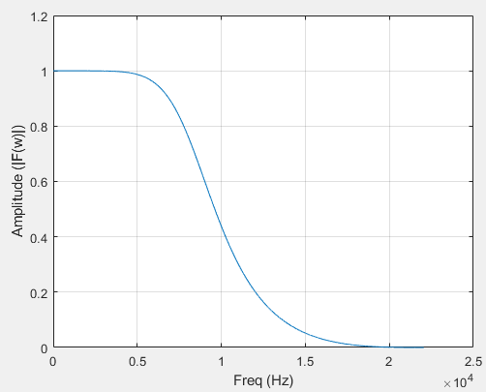
Low-pass filter
Signal Normalization
Passband frequency: 5kHz
Reference: https://universe-review.ca/R12-03-wave03a.htm

Slide 15
Speech Signal
Low-pass Filter
Speech Extracting
Signal Framing
LPC Coefficients
SVM
Training
Testing

Slide 16
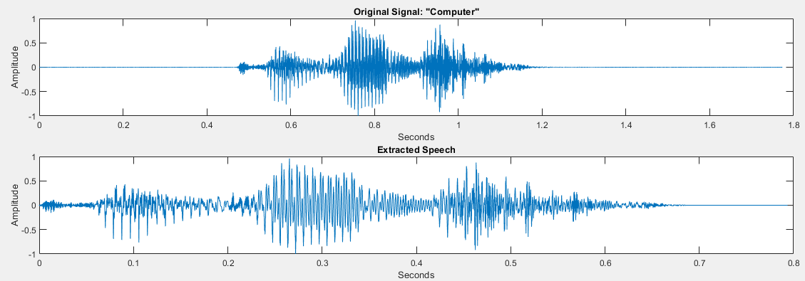
Speech Extracting
Sample amplitude
Mean amplitude
Zero-crossing rate

Slide 17
Speech Signal
Low-pass Filter
Speech Extracting
Signal Framing
LPC Coefficients
SVM
Training
Testing

Slide 18

Signal Framing
Input: WAV file (Fs = 44100Hz)
Frame length: 2000 samples ($≈$45ms)
Frame overlap: 500 samples (1/4 frame overlap)
Frame number: 23 frames ($≈$0.8sec)

Slide 19
Speech Signal
Low-pass Filter
Speech Extracting
Signal Framing
LPC Coefficients
SVM
Training
Testing

Slide 20
Speech Production
Vocal tract acts as a resonator that spectrally shapes the periodic input, and the shape of the vocal tract determines the sounds we make
A simple model of a steady-state vowel regards the vocal tract as a linear time-invariant (LTI) filter with a periodic impulse-like input
Voiced
Pulse Train
Unvoiced
Vocal Tract
Speech
White Noise

Slide 21
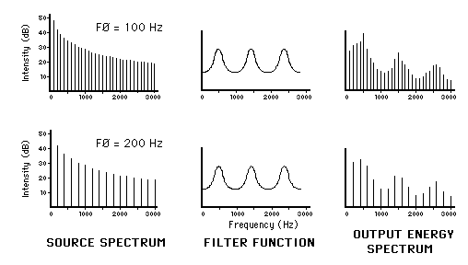
Speech Production
Under a vocal tract linearity and time-invariance (LTI) assumption, the speech waveform can be expressed as the convolution of the glottal flow input and vocal tract impulse response
Reference: http://www.animations.physics.unsw.edu.au/jw/voice.html

Slide 22
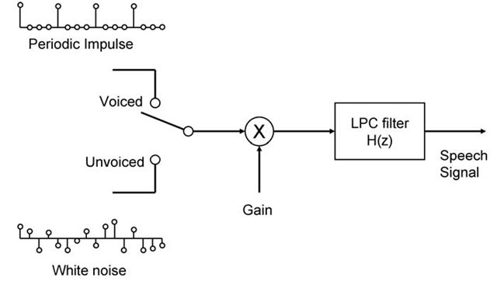
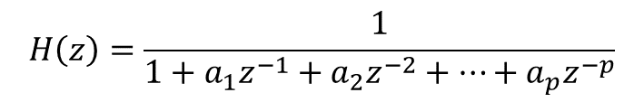
Linear Predictive Code
H(z) represents a smoothed spectrum of the original speech signal
The model predicts the current sample by a linear combination of its previous P samples
By minimizing the prediction error, the LPC coefficients (a1, a2 … ap) can be determined
$$H\left(z\right)=\frac{1}{1+a_{1}z^{−1}+a_{2}z^{−2}+…+a_{p}z^{−p}}$$
Reference: http://what-when-how.com/video-search-engines/audio-features-audio-processing-video-search-engines/

Slide 23
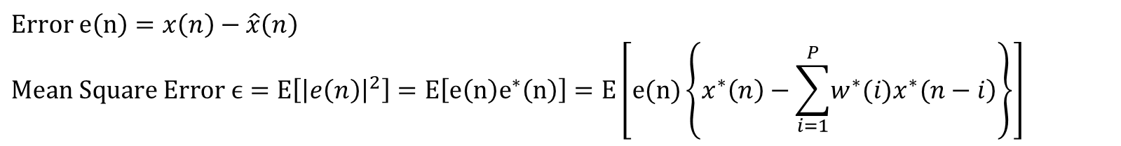




Linear Predictive Code
Predicts the current sample by a linear combination of its previous P samples
$$\hat{x}\left(n\right)=\sum_{i=1}^{P}{w(i)x(n−i)}$$
$$x\left(n\right):Input Signal$$
$$\hat{x}\left(n\right):Predicted Signal$$
$$w\left(i\right):Weights$$
Prediction
$$x\left(n−p\right)$$
$$x\left(n−1\right)$$
…
…
$$\hat{x}\left(n\right)$$
$$Error e\left(n\right)=x\left(n\right)−\hat{x}\left(n\right)$$
$$Mean Square Error ϵ=E\left[{\left|e\left(n\right)\right|}^{2}\right]=E\left[e\left(n\right)e^{∗}\left(n\right)\right]=E\left[e(n)\left\{x^{∗}\left(n\right)−\sum_{i=1}^{P}{\left.w^{∗}(i)x^{∗}(n−i\right)}\right\}\right]$$

Slide 24

$$To minimize ϵ, set \frac{δε}{δw^{∗}(k)}=0, where k=1,2,…P$$
$$∴E\left[\frac{δ}{δw^{∗}(k)}\left\{e(n)x^{∗}\left(n\right)\right\}−\frac{δ}{δw^{∗}(k)}\left\{e(n)\sum_{i=1}^{P}{w^{∗}(i)x^{∗}(n−i)}\right\}\right]=0$$
$$→E\left[−e(n)x^{∗}(n−k)\right]=E\left[e(n)x^{∗}(n−k)\right]=0, k=1,2,…P$$
$$→E\left[\left\{x\left(n\right)−\sum_{i=1}^{P}{w(i)x(n−i)}\right\}x^{∗}(n−k)\right]=E\left[x(n)x^{∗}(n−k)\right]−\sum_{i=1}^{P}{w\left(i\right)E\left[x\left(n−i\right)x^{∗}\left(n−k\right)\right]=0}$$

Slide 25
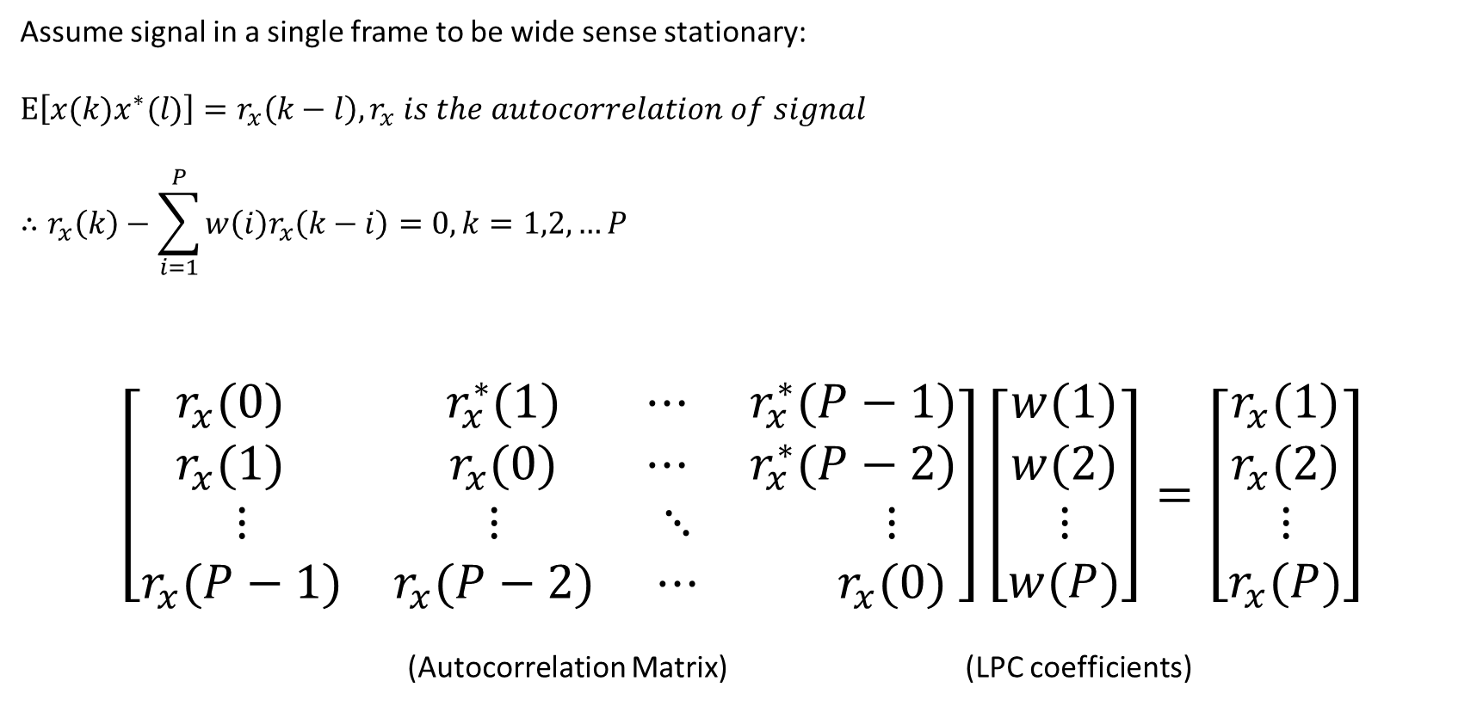
Assume signal in a single frame to be wide sense stationary:
$$E\left[x(k)x^{∗}(l)\right]=r_{x}\left(k−l\right), r_{x} is the autocorrelation of signal$$
$$∴r_{x}\left(k\right)−\sum_{i=1}^{P}{w\left(i\right)r_{x}\left(k−i\right)=0, k=1,2,…P}$$
$$\left[\begin{matrix}\begin{matrix}r_{x}(0) & r_{x}^{∗}(1) \\ r_{x}(1) & r_{x}(0)\end{matrix} & \begin{matrix}⋯ & r_{x}^{∗}(P−1) \\ ⋯ & r_{x}^{∗}(P−2)\end{matrix} \\ \begin{matrix}⋮ & ⋮ \\ r_{x}(P−1) & r_{x}(P−2)\end{matrix} & \begin{matrix}⋱ & ⋮ \\ ⋯ & r_{x}(0)\end{matrix}\end{matrix}\right]\left[\begin{matrix}\begin{matrix}w(1) \\ w(2)\end{matrix} \\ \begin{matrix}⋮ \\ w(P)\end{matrix}\end{matrix}\right]=\left[\begin{matrix}\begin{matrix}r_{x}(1) \\ r_{x}(2)\end{matrix} \\ \begin{matrix}⋮ \\ r_{x}(P)\end{matrix}\end{matrix}\right]$$
(Autocorrelation Matrix) (LPC coefficients)

Slide 26
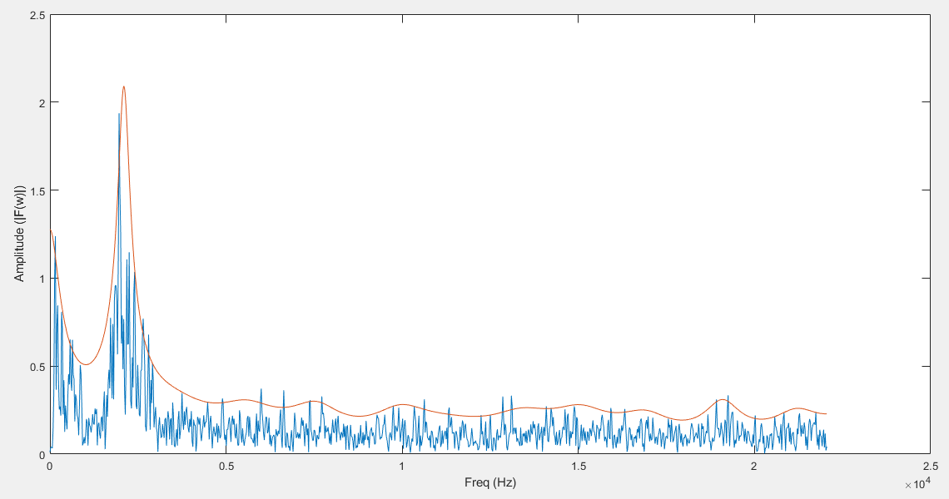
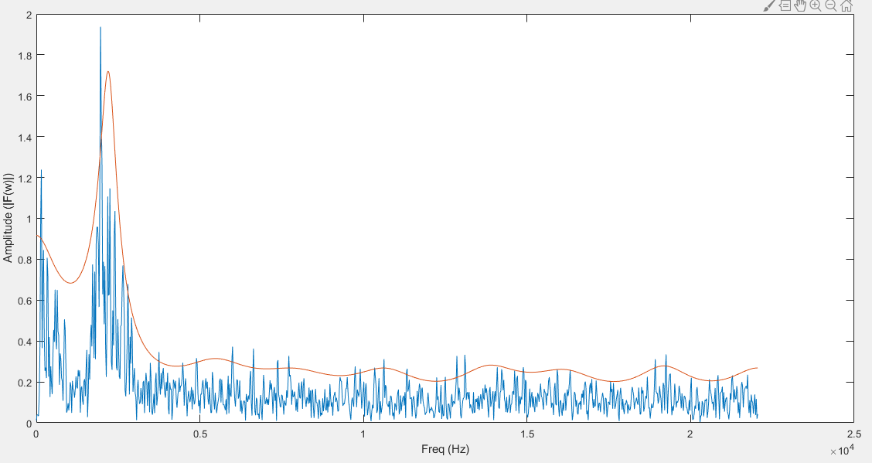
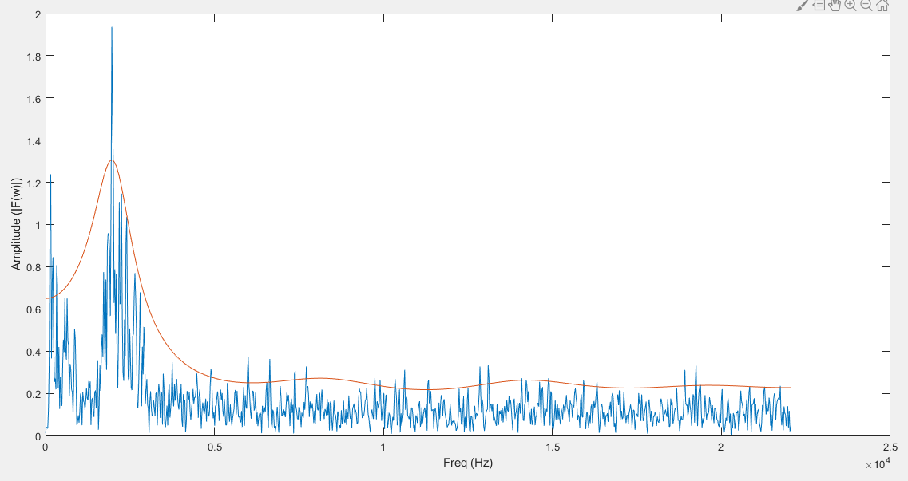
LPC Coefficients
H(z) represents a smoothed spectrum of the original speech signal
With more extracted coefficients, the spectrum of H(z) matches better to the spectrum of original signal
K=24
K=16
K=8

Slide 27
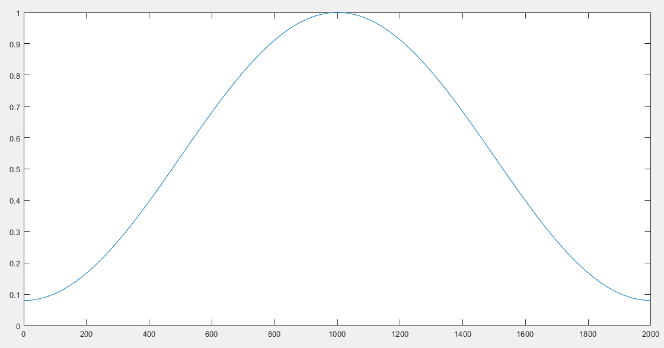
Hamming Window
Minimize the signal discontinuities at the beginning and end of each frame
Overlapping frames in order to accommodate all the information correctly

Slide 28
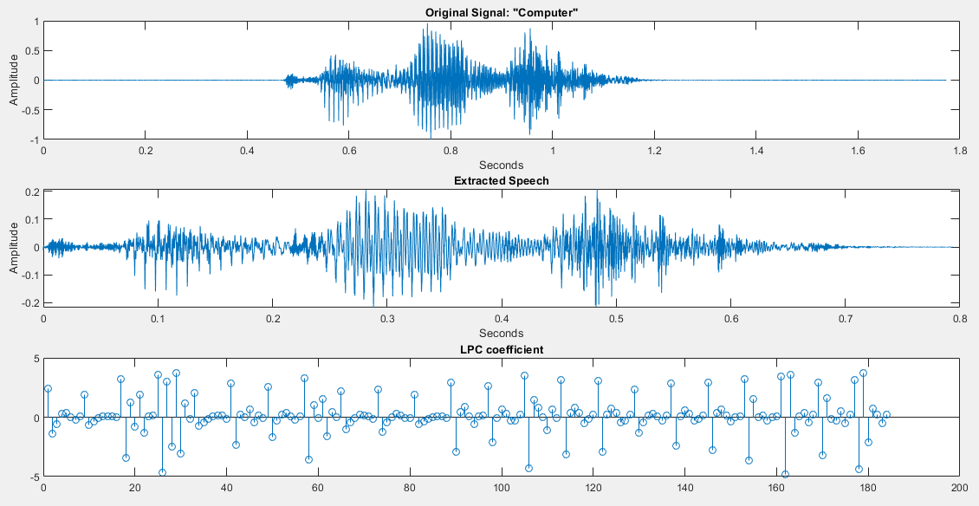
K = 8

Slide 29
Speech Signal
Low-pass Filter
Speech Extracting
Signal Framing
LPC Coefficients
SVM
Training
Testing

Slide 30
Support Vector Machine (SVM)
Computationally less expensive
Requires less memory
Radial basis function kernel
LibSVM
Reference:
Chih-Chung Chang and Chih-Jen Lin, LIBSVM : a library for support vector machines. ACM Transactions on Intelligent Systems and Technology, 2:27:1--27:27, 2011.
Software available at http://www.csie.ntu.edu.tw/~cjlin/libsvm

Slide 31
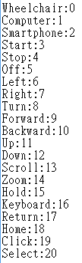

Support Vector Machine (SVM)
21 labels
(23 frames)$×$(8 LPC/frame) = 184 features

Slide 32
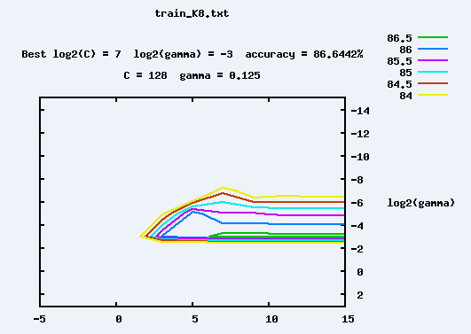
Support Vector Machine (SVM)
Penalty Parameter – How much optimization to avoid misclassifying training examples
Kernel Parameter – How far the influence of single training data reaches
Cross Validation and Grid Search

Slide 33
Outline
Introduction
Speech Recognition Framework
Testing and Modification
Demonstration

Slide 34
Testing and Modification
Speech extraction method
High-pass filter
Low-pass filter passband frequency
Accuracy vs Run Time

Slide 35
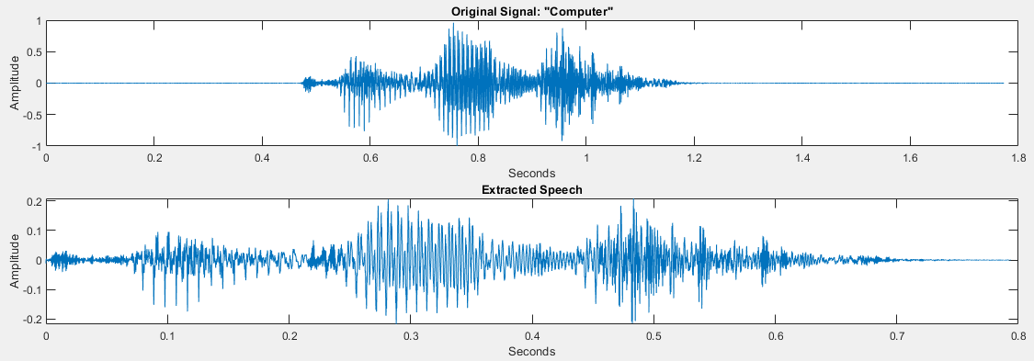
Speech extraction method
Direct extraction using sample amplitude threshold
Get 23 frames

Slide 36
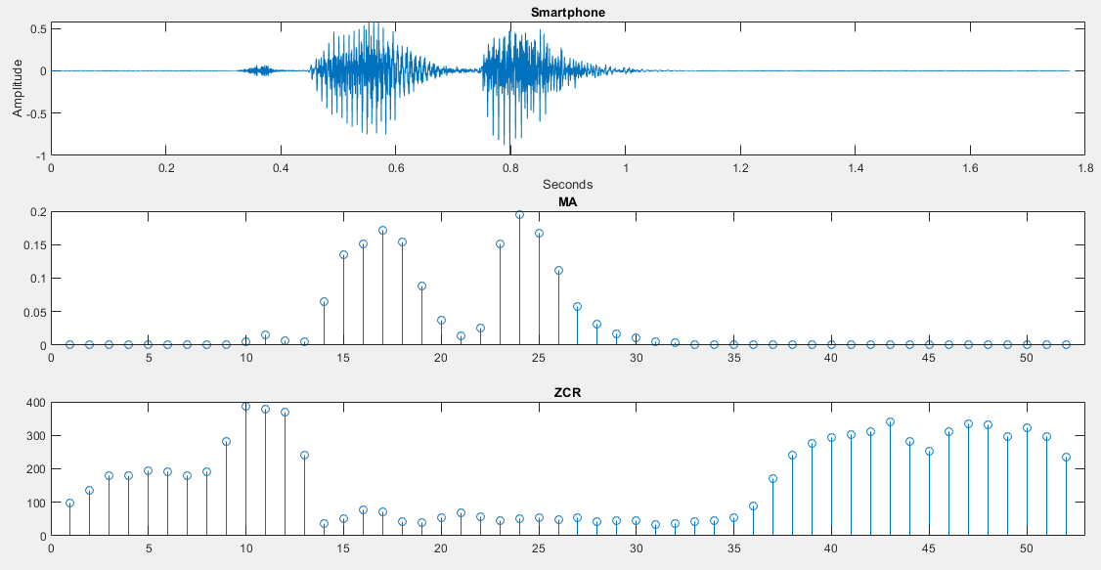
Speech extraction method
Mean amplitude (MA) and zero-crossing rate (ZCR) of each frame
Unvoiced
Voiced
Silent

Slide 37
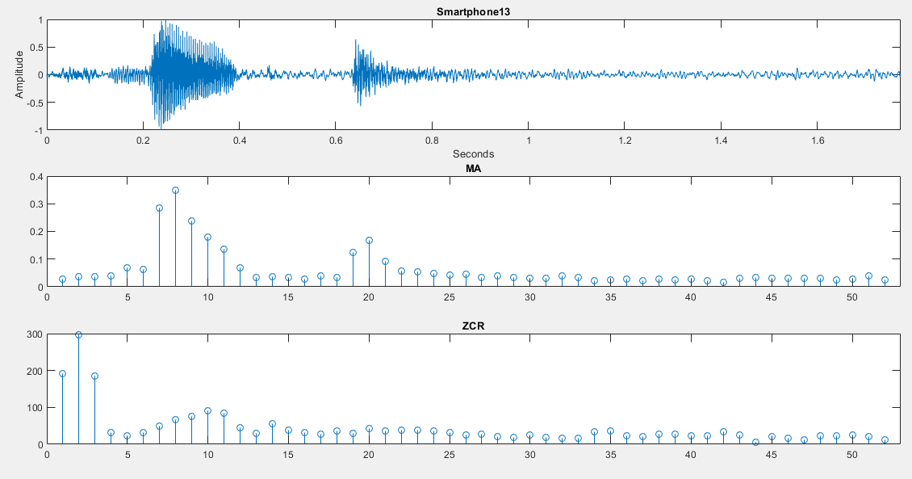
Noise

Slide 38
MA and ZCR
Voiced Sound: High MA, low ZCR
Unvoiced Sound: Low MA, high ZCR
Noisy background: Low MA, low ZCR
Nearly silent: Very low MA, high ZCR

Slide 39
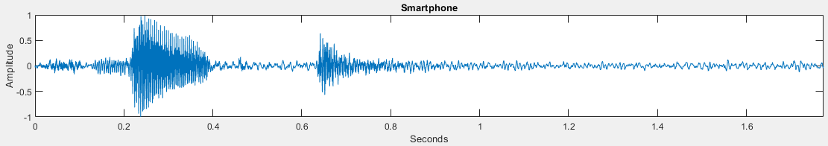
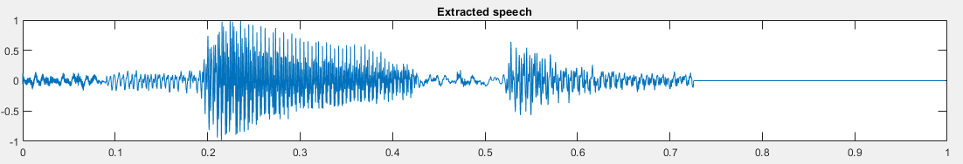
MA and ZCR

Slide 40
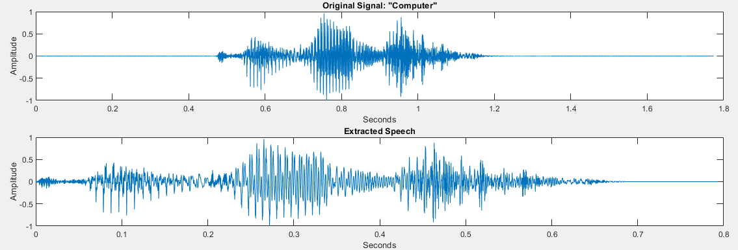
Speech extraction method
Amplitude thresholding for every sample
Eliminate samples below the threshold

Slide 41
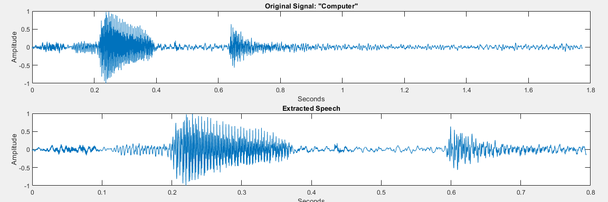
Amplitude thresholding

Slide 42
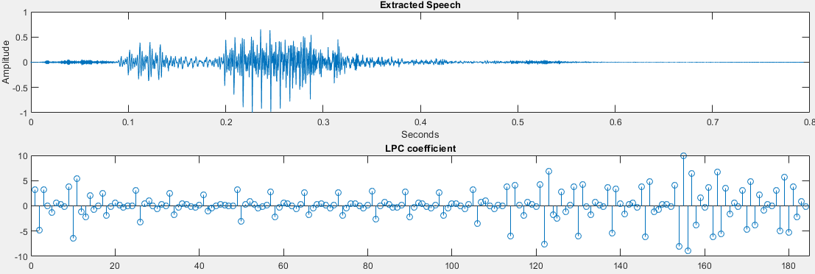
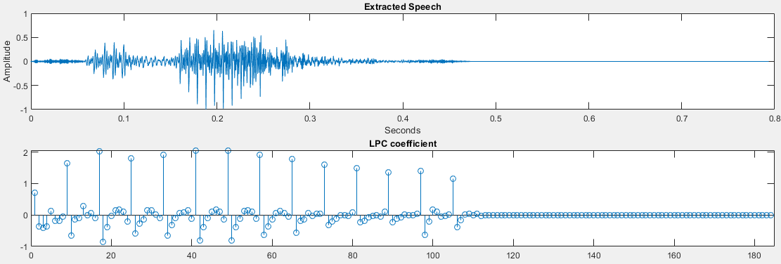
Original Signal
Unvoiced
Voiced
Silent
Amplitude Threshold
Unvoiced
Voiced
Silent

Slide 43
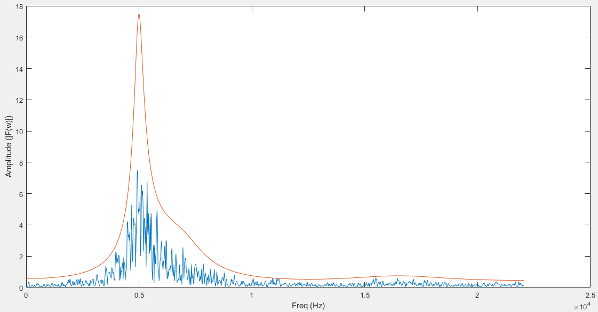
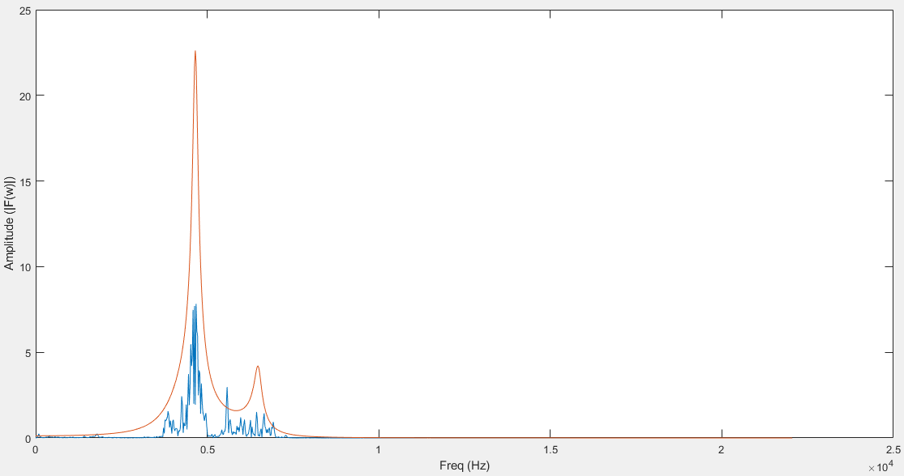
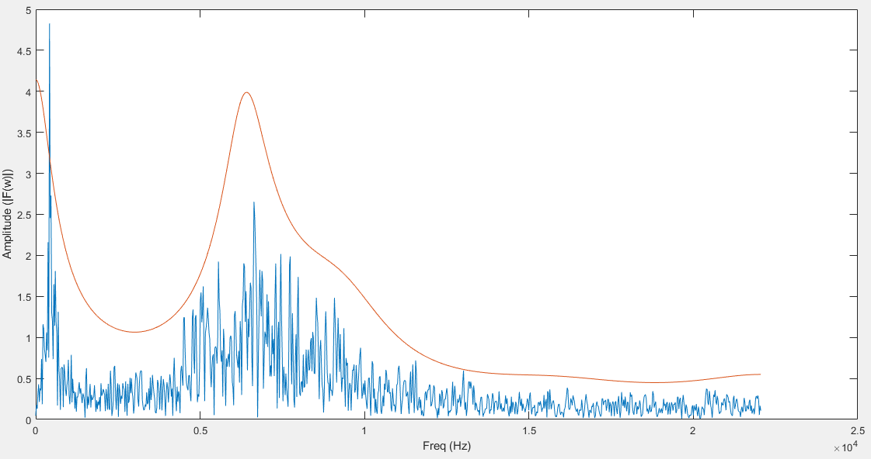
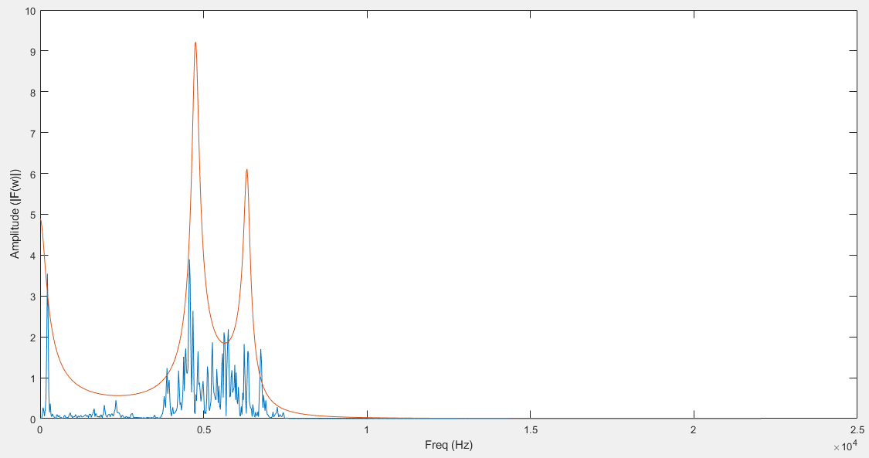
Unvoiced
Amplitude Threshold
Original Signal

Slide 44
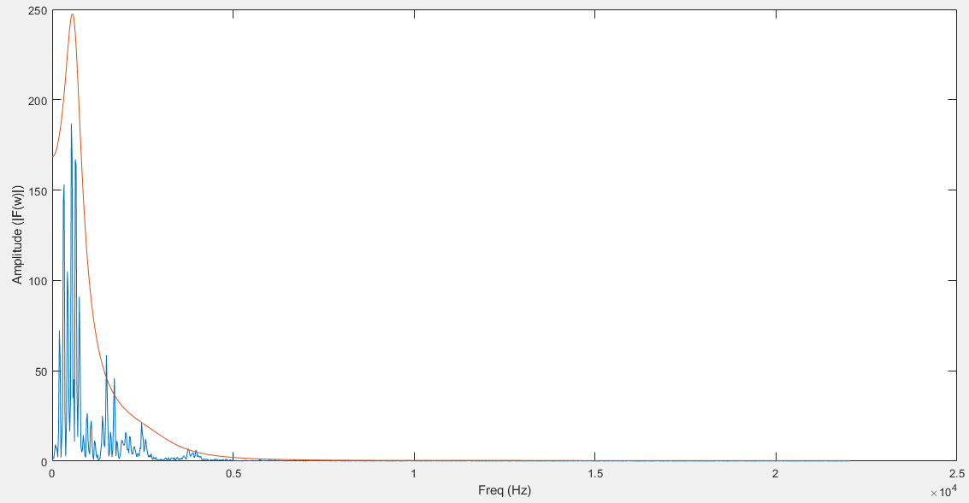

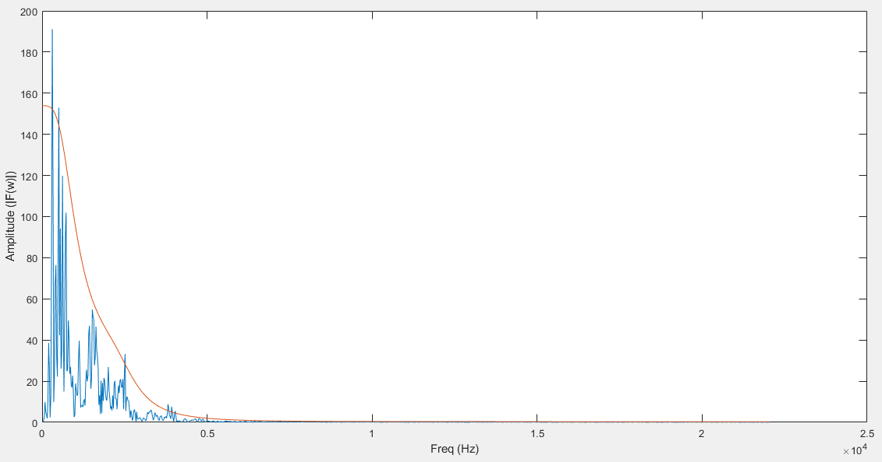
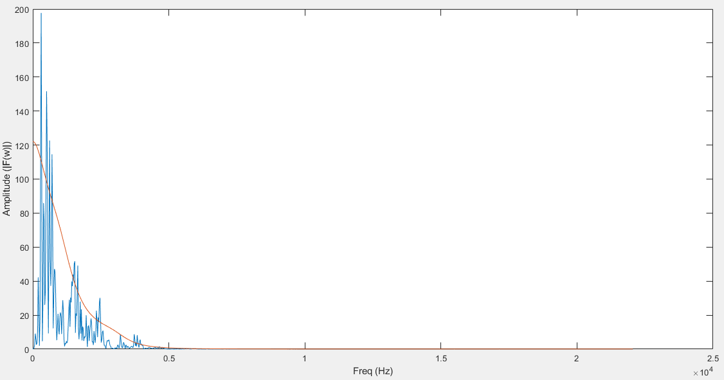
Voiced
Amplitude Threshold
Original Signal

Slide 45
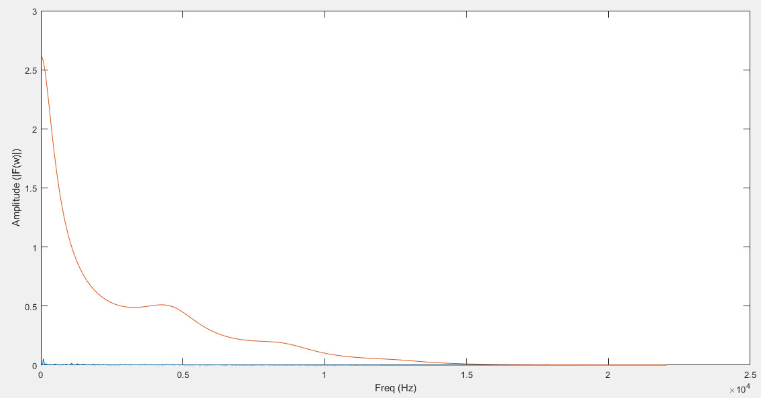
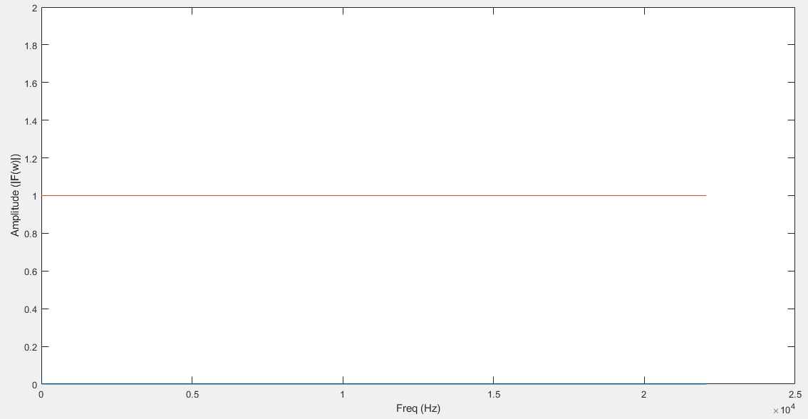
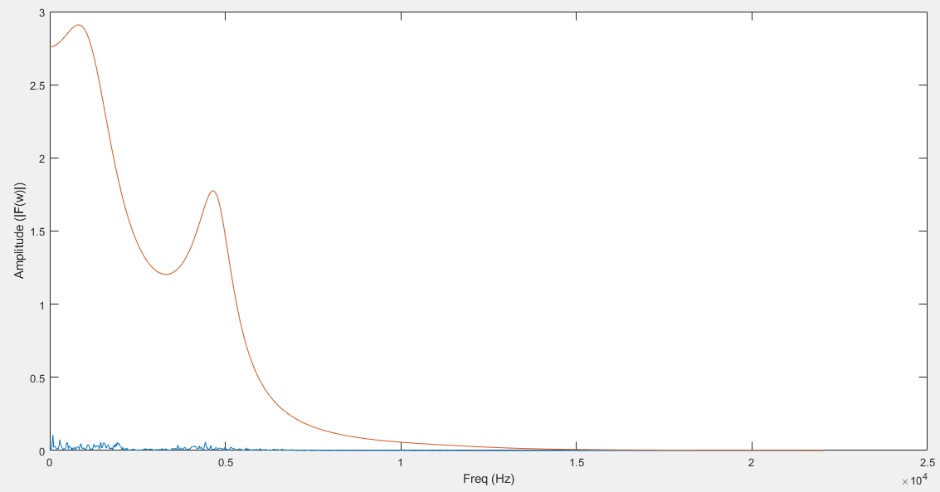
Silent
Original Signal
Amplitude Threshold

Slide 46
Unvoiced Sound
Voiced Sound
Silent

Slide 47
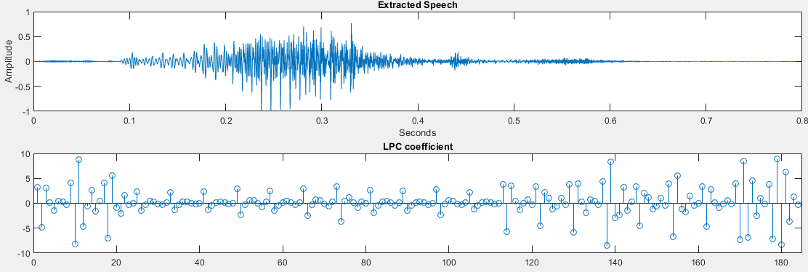
Original Signal

Slide 48
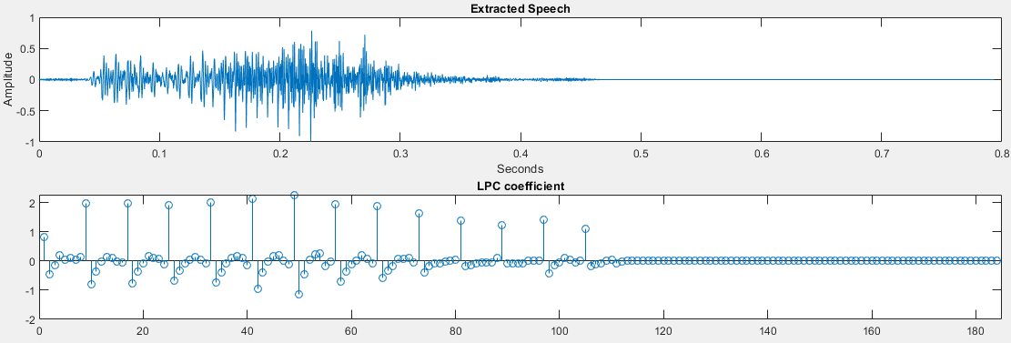
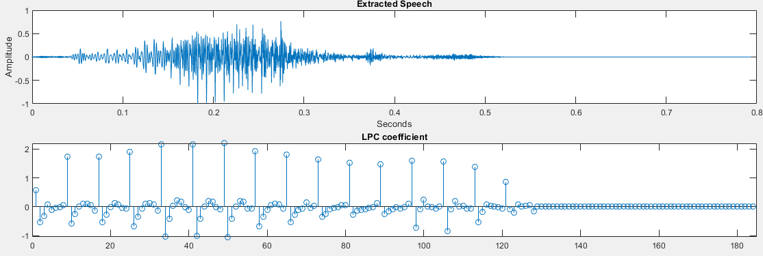
Amplitude Threshold

Slide 49
Speech extraction method
Five-fold Cross-Validation accuracy
K=8, FrameNum = 23, FrameLen = 2000, FrameOverlap = 500
Low-pass filter: Passband frequency = 5kHz
 | Direct Extraction | MA and ZCR | Amplitude Threshold
Accuracy | 52.53% | 58.81% | 77.55%
(Single word recognition, with only 21 words)

Slide 50
High-pass filter
High frequency components are more susceptible to noise and have lower amplitude
Boost the high frequency components after the speech is extracted
Low-pass Filter
Speech Extracting
High-pass Filter
Signal Framing
Speech Signal
LPC Coefficients
SVM
Training
Testing

Slide 51
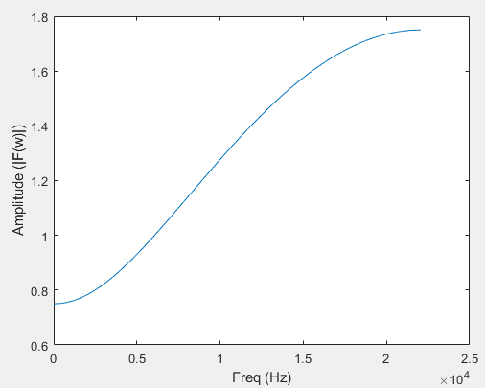
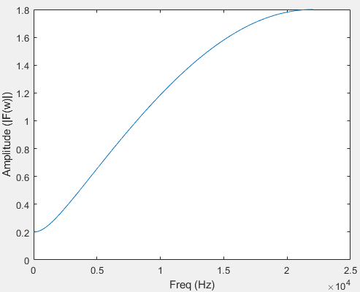
High-pass filter
Balance between low and high frequency components
Hpf1
Hpf2

Slide 52
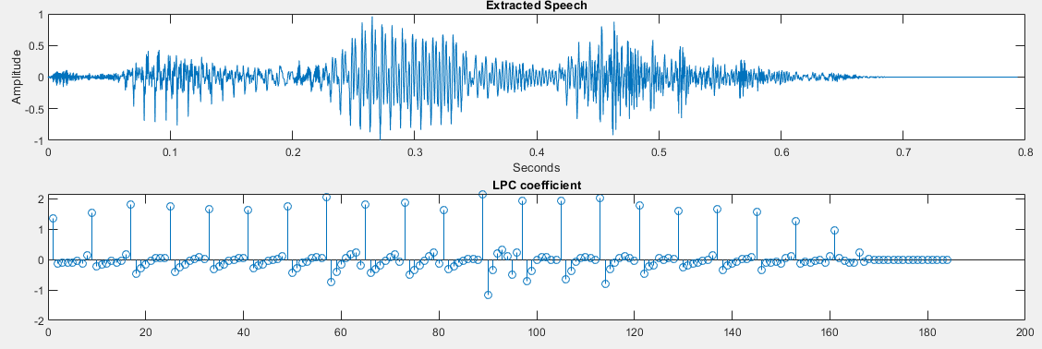
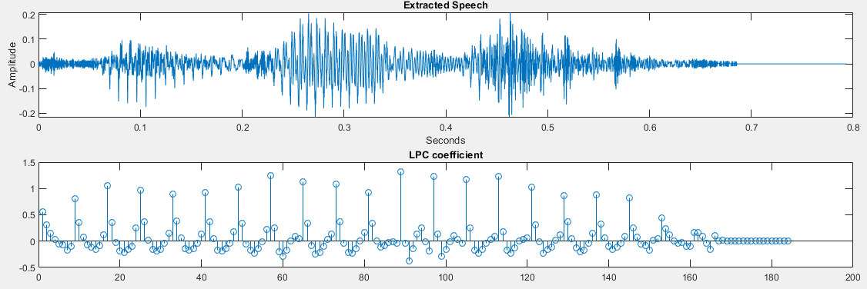
With High-pass filter

Slide 53
High-pass filter
K=8, FrameNum = 23, FrameLen = 2000, FrameOverlap = 500
Low-pass filter: Passband frequency = 5kHz
 | No Hpf | Hpf1 | Hpf2
Accuracy | 77.55% | 83.50% | 86.08%

Slide 54
Low-pass filter passband frequency
High bandwidth: More speech information but also more noise
K=8, FrameNum = 23, FrameLen = 2000, FrameOverlap = 500, with Hpf2
Passband frequency | 500Hz (Voiced sound only) | 2000Hz | 5000Hz | 8000Hz
Accuracy | 74.86% | 81.14% | 86.08% | 85.30%

Slide 55
Accuracy vs Run Time
LPC coefficients per frame
Frame length

Slide 56
Testing set
Three sets, 5 files per word for each set (210 files per set)
Set1: My own voice (major speech files in training set)
Set2: A speaker in training set (minor speech files), with non-ideal records
Set3: A speaker not in training set, with non-ideal records

Slide 57
LPC coefficients per frame
FrameNum = 23, FrameLen = 2000, FrameOverlap = 500
With low-pass filter (5kHz) and Hpf2
Frame = 23 | 5-Fold Cross Validation | Test_set1 | Test_set2 | Test_set3 | Run Time (per prediction)
K4 (92 lpc – Set1) | 83.28% | 78.10% | 44.76% | 21.90% | 0.0187sec
K8 (184 lpc – Set2) | 86.08% | 83.81% | 38.10% | 23.81% | 0.0262sec
K12 (276 lpc – Set3) | 85.52% | 89.52% | 41.90% | 23.81% | 0.0341sec
K16 (368 lpc – Set4) | 86.20% | 91.43% | 42.86% | 21.90% | 0.0434sec

Slide 58
Frame length
FrameNum = 31, FrameLen = 1500, FrameOverlap = 375
With low-pass filter (5kHz) and Hpf2
Frame = 31 | 5-Fold Cross Validation | Test_set1 | Test_set2 | Test_set3 | Run Time (per prediction)
K3 (93 lpc) | 81.82% | 82.86% | 43.81% | 22.86% | 0.0209sec
K6 (186 lpc) | 85.19% | 84.76% | 32.38% | 25.71% | 0.0287sec
K9 (279 lpc) | 85.86% | 88.57% | 40.95% | 21.90% | 0.0360sec
K12 (372 lpc) | 86.08% | 88.57% | 40.00% | 27.62% | 0.0443sec

Slide 59
Frame length
FrameNum = 46, FrameLen = 1000, FrameOverlap = 250
With low-pass filter (5kHz) and Hpf2
Frame = 46 | 5-Fold Cross Validation | Test_set1 | Test_set2 | Test_set3 | Run Time (per prediction)
K2 (92 lpc) | 78.45% | 79.05% | 37.14% | 20.95% | 0.0220sec
K4 (184 lpc) | 81.59% | 83.81% | 42.86% | 17.14% | 0.0288sec
K6 (276 lpc) | 86.42% | 81.90% | 35.24% | 19.05% | 0.0364sec
K8 (368 lpc) | 86.42% | 88.57% | 35.24% | 20.00% | 0.0448sec

Slide 63
Poor Record Condition
Combine MA-ZCR method and threshold method

Slide 64
LPC Num = 184 (LPC Set2) | 5-Fold Cross-Validation | Test_set1 | Test_set2 | Test_set3 | Run Time (per prediction)
23 Frames | 80.36% | 71.43% | 28.57% | 25.71% | 0.0693sec
31 Frames | 75.76% | 72.38% | 34.29% | 31.43% | 0.0809sec
46 Frames | 67.68% | 72.38% | 38.10% | 36.19% | 0.1023sec
LPC Num = 276 (LPC Set3) | 5-Fold Cross-Validation | Test_set1 | Test_set2 | Test_set3 | Run Time (per prediction)
23 Frames | 80.58% | 78.10% | 28.57% | 24.76% | 0.0783sec
31 Frames | 78.68% | 71.43% | 34.29% | 26.67% | 0.0893sec
46 Frames | 73.85% | 69.52% | 36.19% | 31.43% | 0.1043sec

Slide 67
Outline
Introduction
Speech Recognition Framework
Testing and Modification
Demonstration

Slide 68
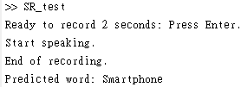
Demo - Matlab

Slide 69
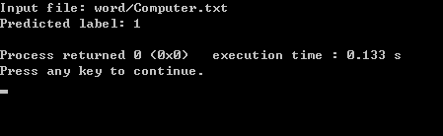
Demo – C++
Test on CodeBlocks
Input signal samples as array

Slide 70
Thanks

