Slide 1

Probability Game Analysis
Exploring Strategies and Outcomes
By – Yahya Adhikari 19 November 2024

Slide 2

The Ball Drawing Game: Strategy and Probability
Analyzing Optimal Decisions and Long-Term Outcomes The Ball Drawing Game: Strategy and Probability Analyzing Optimal Decisions and Long-Term Outcomes

Slide 3
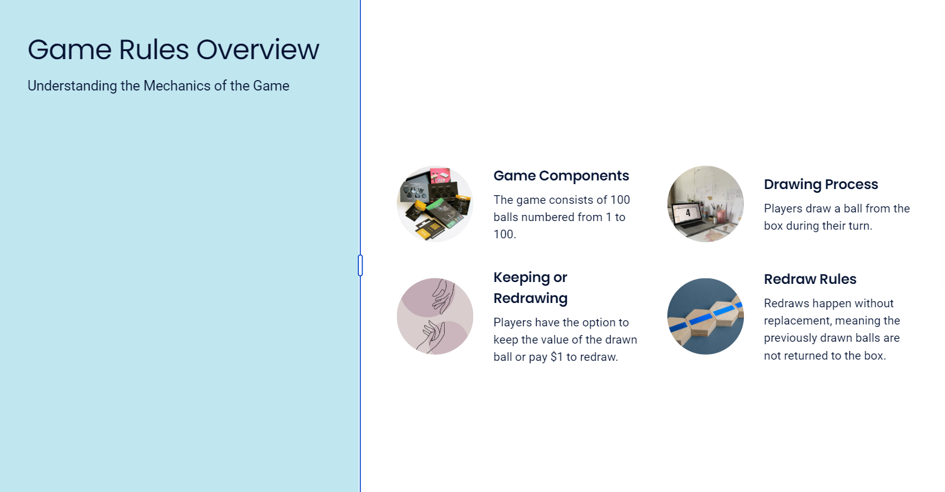

Slide 4
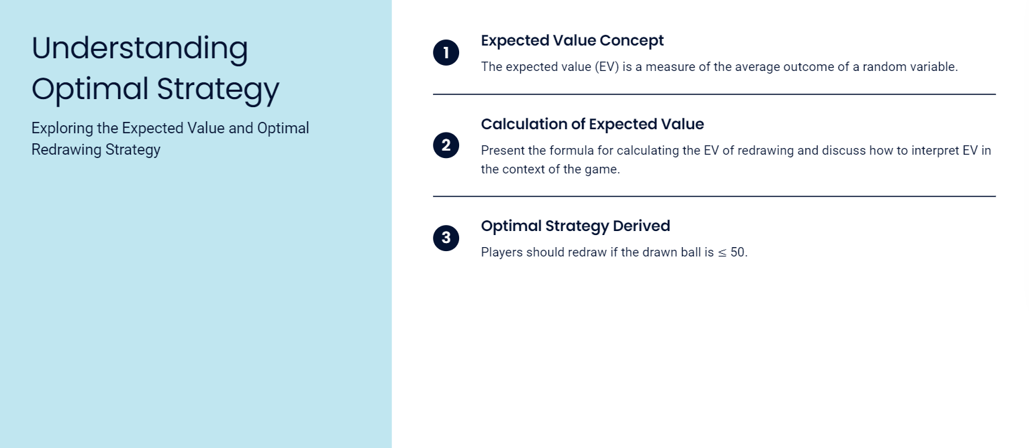

Slide 5


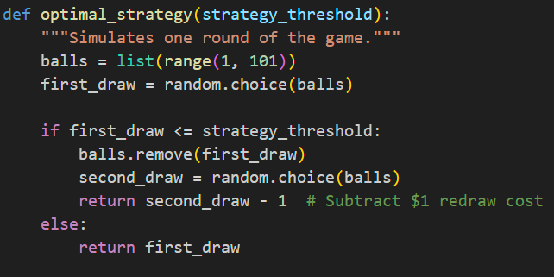

Slide 6
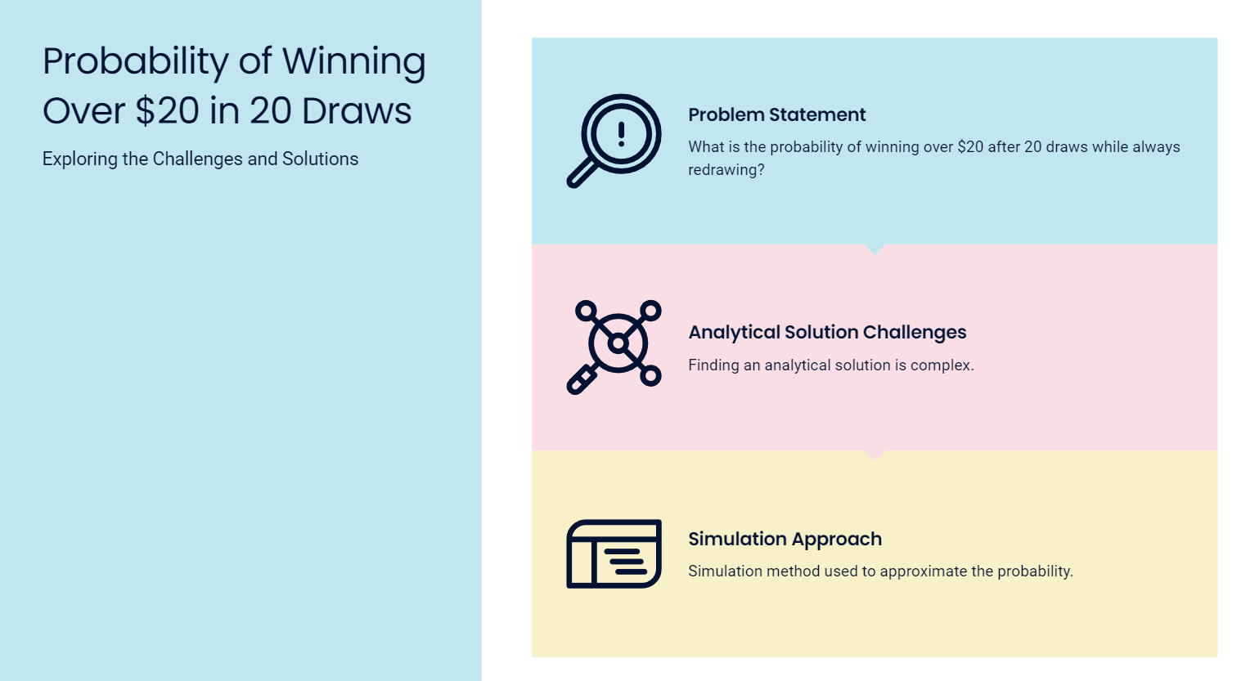

Slide 7
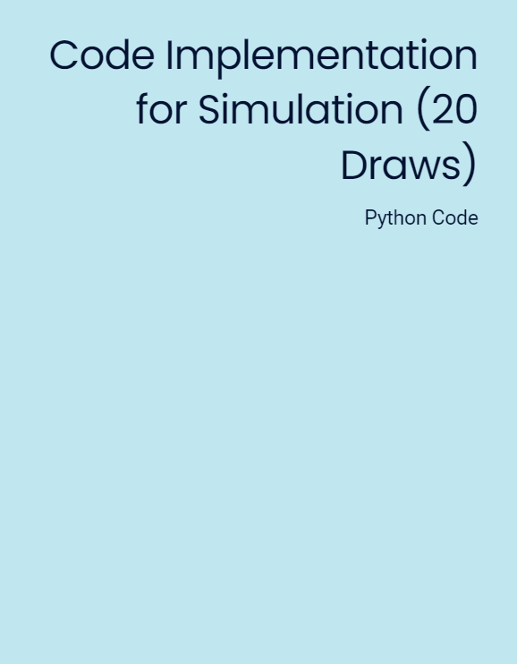
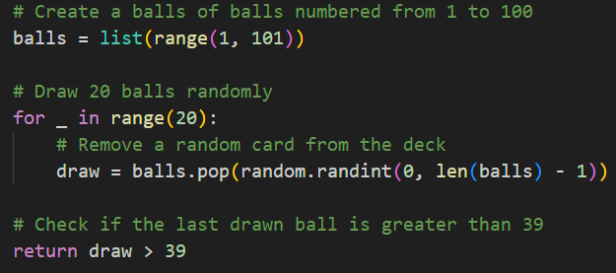


Slide 8
