Slide 1

Music store Data analysis
Using SQL
By Yahya Saukatali

Slide 2
Introduction
My name is Yahya Saukatali, and I have used 11 datasets and addressed 11 key questions in this project. This project showcases an extensive use of SQL to analyze data and derive insights from a dataset. The queries in this project aim to answer business-critical questions such as identifying top-performing employees, customer preferences, and revenue patterns. The goal is to demonstrate proficiency in SQL through practical applications like grouping, joining tables, calculating aggregates, and using advanced features such as Common Table Expressions (CTEs) and window functions.
The dataset primarily revolves around a music store, with tables capturing information about customers, invoices, tracks, artists, genres, and employees. Through this analysis, actionable insights are generated to improve decision-making processes and strategies.
The project is structured into various queries categorized by their difficulty levels: Beginner, Intermediate, and Advanced. Each query represents a step in solving real-world data problems effectively and efficiently.

Slide 3
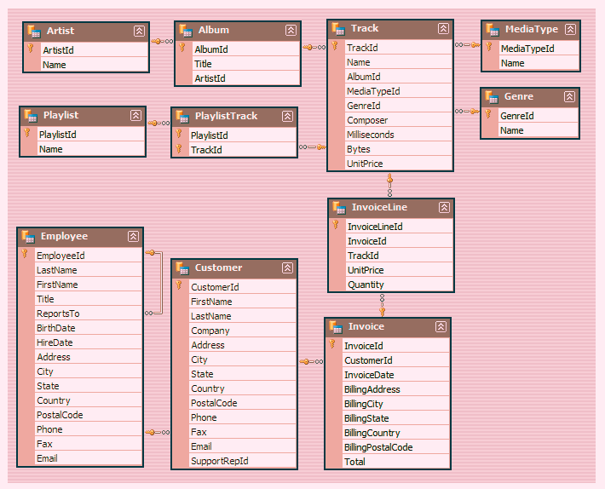
Schema

Slide 4
SQL Queries Overview
Q1: who is the senior most employee based on the job title?
Q2:which countries have the most invoices?
Q3:what are the top 3 values of total invoice.
Q4: Which city has the best customers? We would like to throw a promotional Music Festival in the city we made the most money. Write a query that returns one city that has the highest sum of invoice totals. Return both the city name & sum of all invoice totals.
Q5: Who is the best customer? The customer who has spent the most money will be declared the best customer. Write a query that returns the person who has spent the most money.
Q6: Write query to return the email, first name, last name, & Genre of all Rock Music listeners. Return your list ordered alphabetically by email starting with A.
Q7: Let's invite the artists who have written the most rock music in our dataset. Write a query that returns the Artist name and total track count of the top 10 rock bands.
Q8: Return all the track names that have a song length longer than the average song length
Return the Name and Milliseconds for each track. Order by the song length with the longest
songs listed first.
Q9: find how much amount spent by each customers on artists? write a query to return customer name artist name and total spent
Q10: we want to find out the most popular music genre for each country. (we determine the most popular genre as the genre with the highest amount?
Q11: write a query that determines the customer that has spent the most on music for EACH country. write a query that returns the country along with the top customer and how much they spent. for countries where the top amount spent is shared, provide all customers who spent this amount.

Slide 5
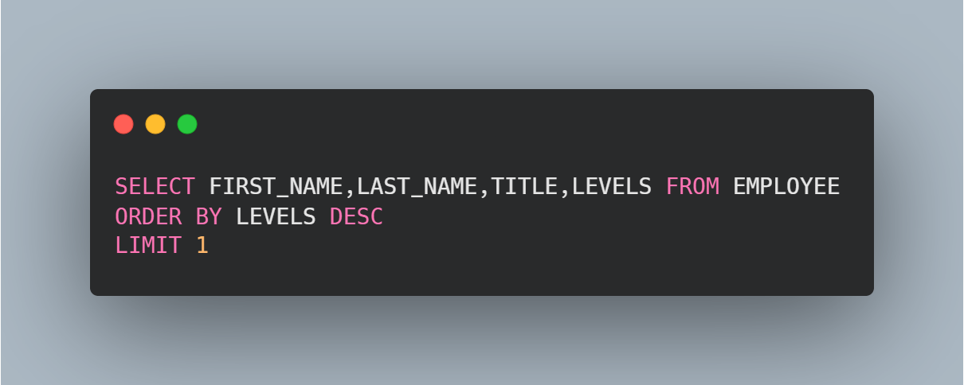

Q1: who is the senior most employee based on the job title?

Slide 6
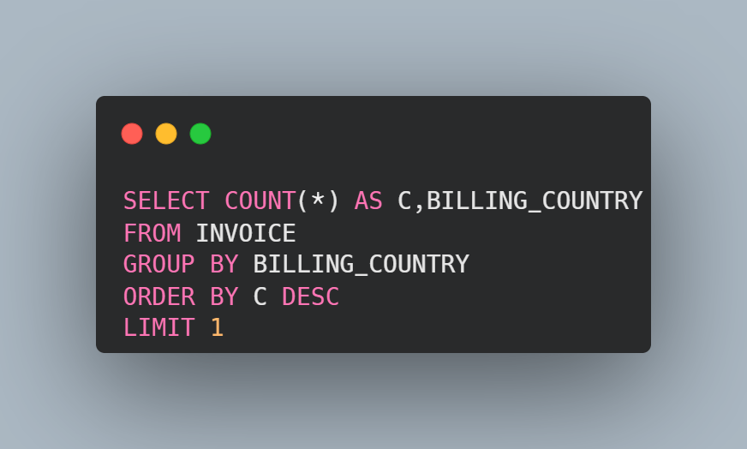

Q2:which countries have the most invoices?

Slide 7
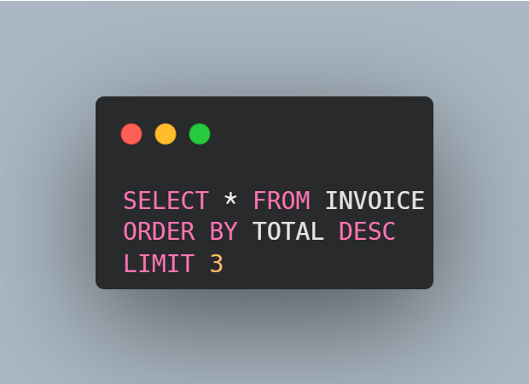
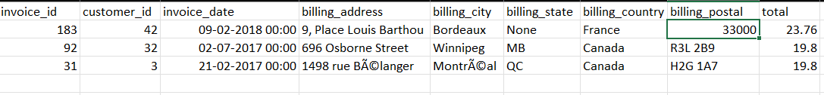
Q3:what are the top 3 values of total invoice

Slide 8
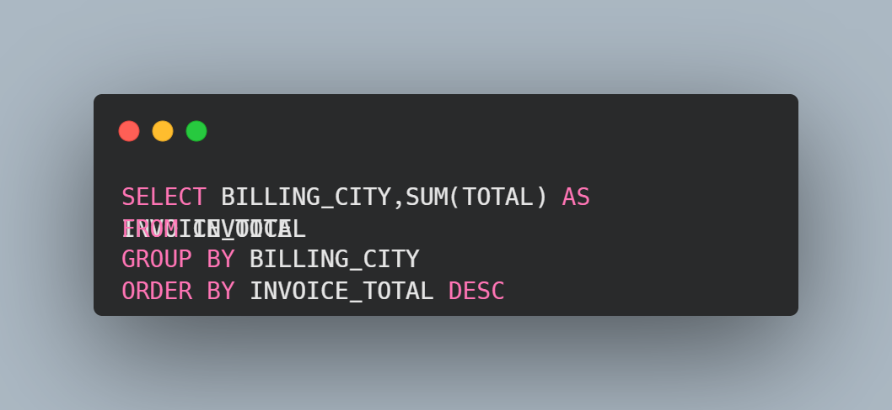
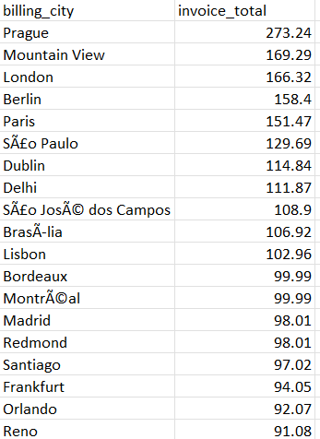
Q4: Which city has the best customers? We would like to throw a promotional Music Festival in the city we made the most money. Write a query that returns one city that has the highest sum of invoice totals. Return both the city name & sum of all invoice totals

Slide 9
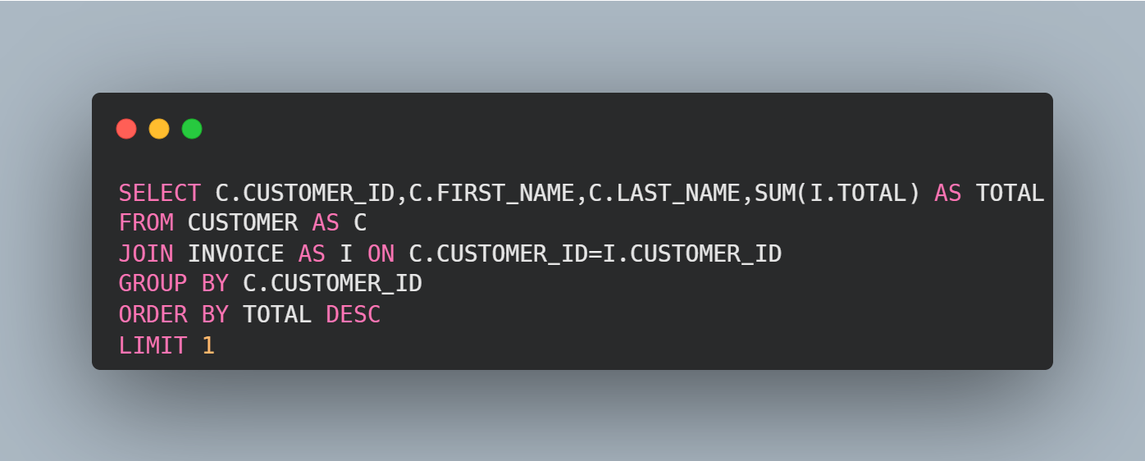

Q5: Who is the best customer? The customer who has spent the most money will be declared the best customer. Write a query that returns the person who has spent the most money.

Slide 10
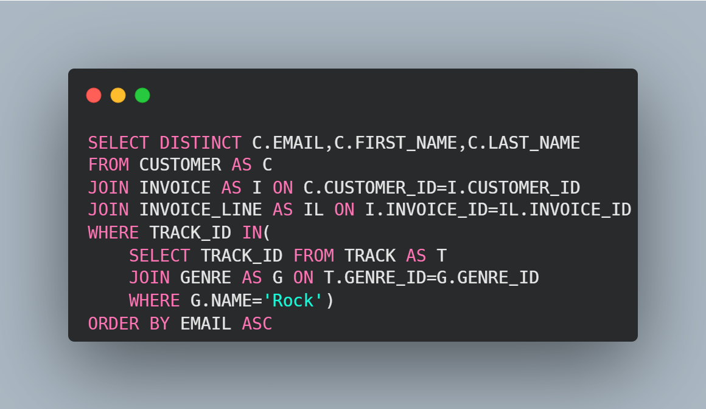
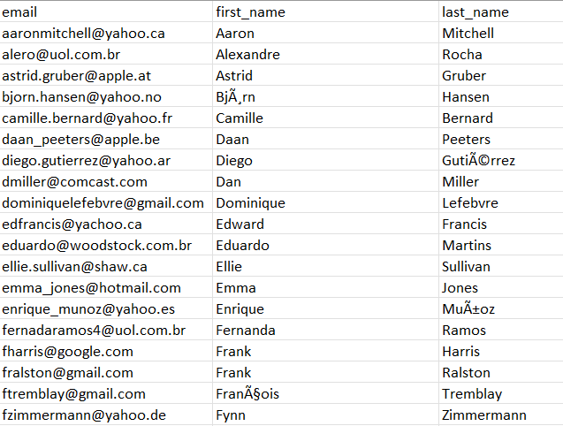
Q6: Write query to return the email, first name, last name, & Genre of all Rock Music listeners. Return your list ordered alphabetically by email starting with A.

Slide 11
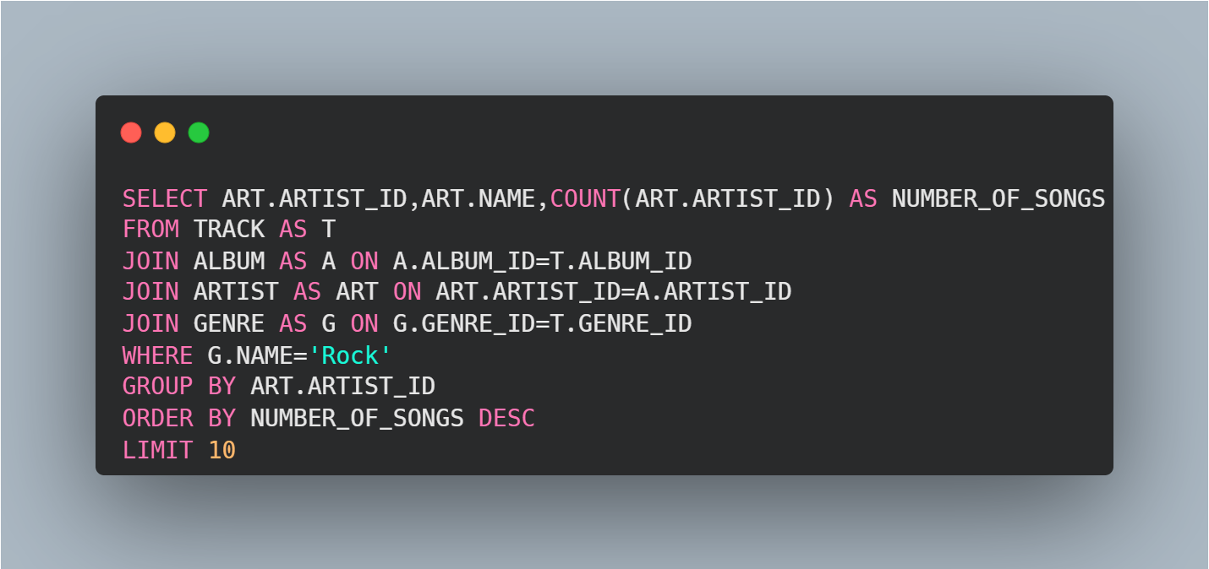
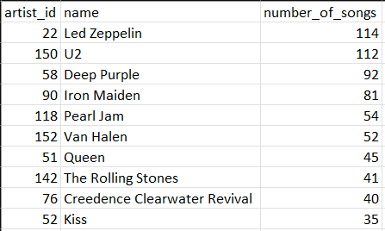
Q7: Let's invite the artists who have written the most rock music in our dataset. Write a query that returns the Artist name and total track count of the top 10 rock bands

Slide 12
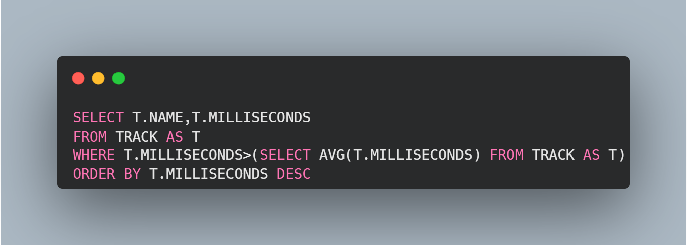
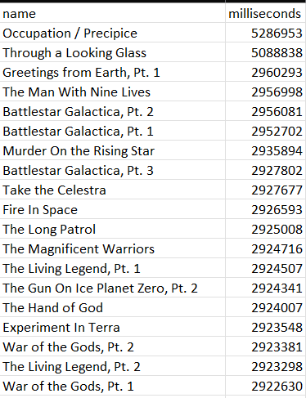
Q8: Return all the track names that have a song length longer than the average song length Return the Name and Millisecond for each track. Order by the song length with the longest songs listed first

Slide 13
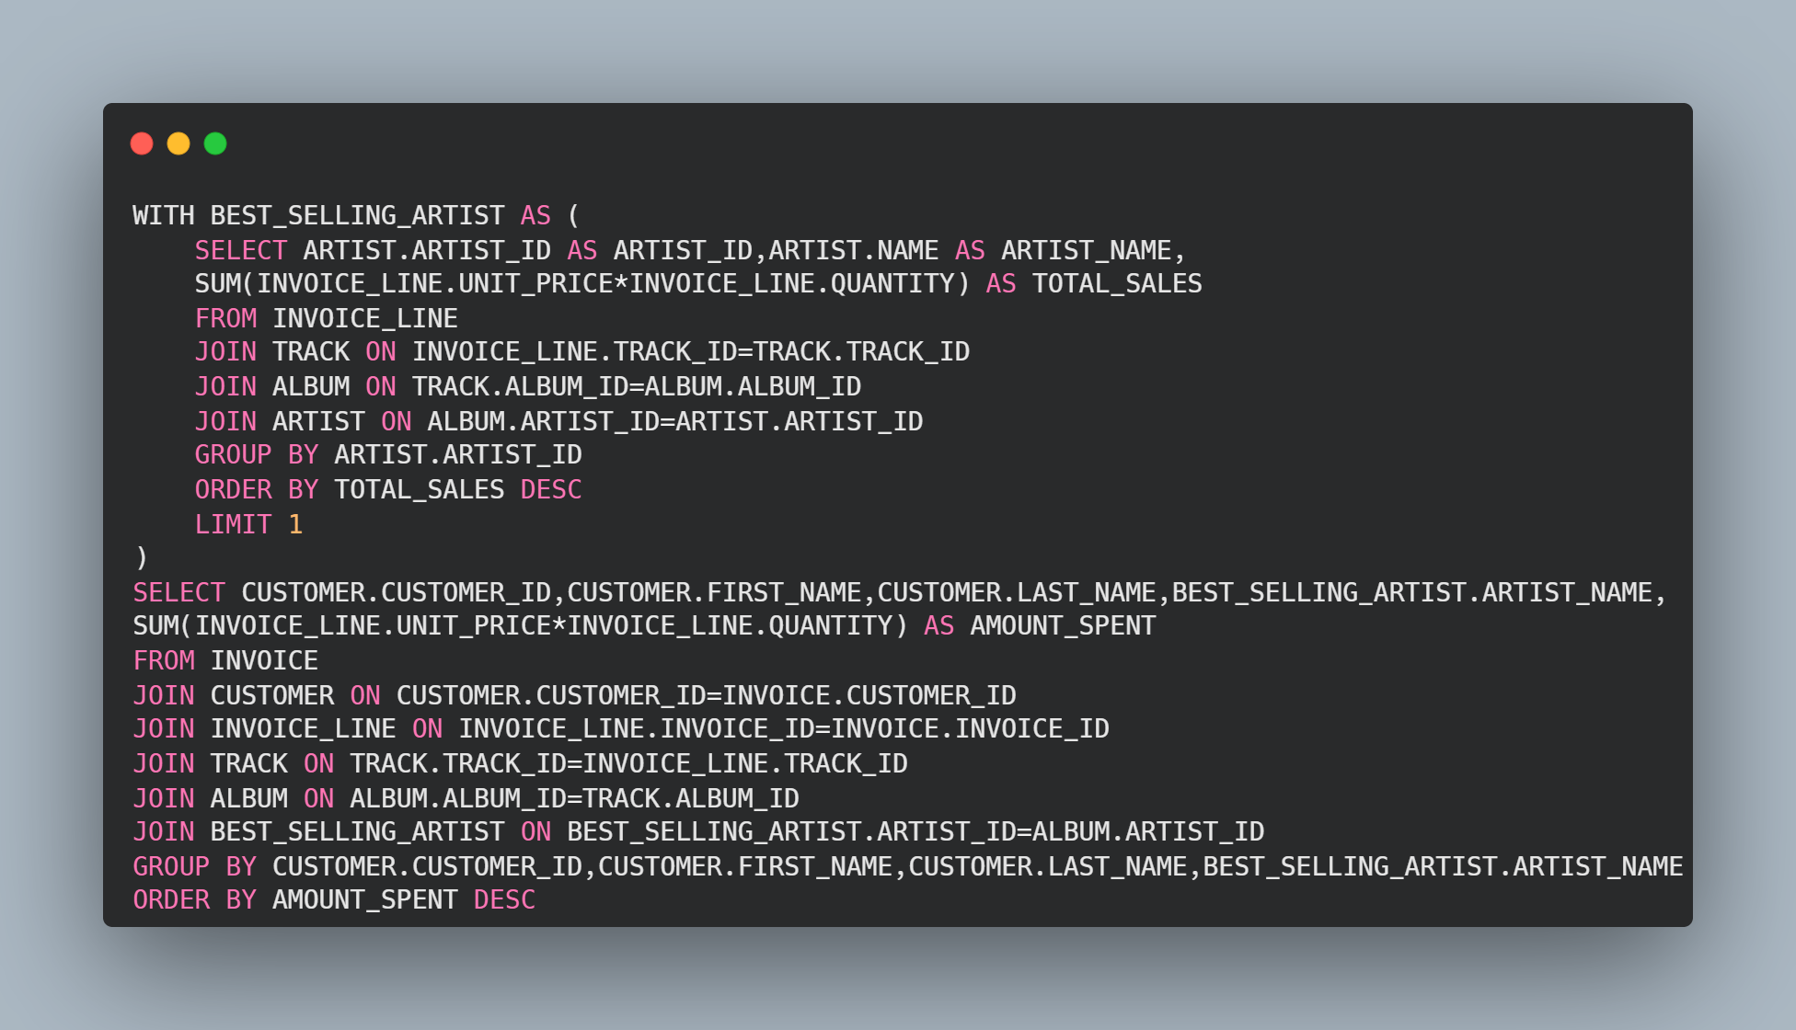
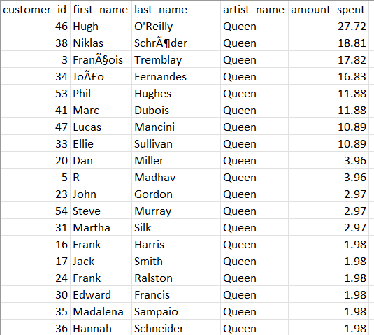
Q9: find how much amount spent by each customers on artists? write a query to return customer name artist name and total spent

Slide 14
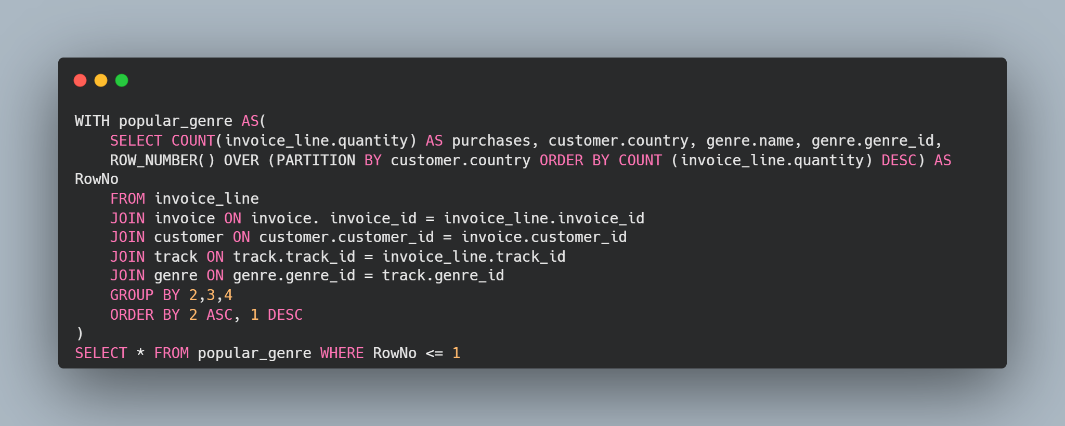
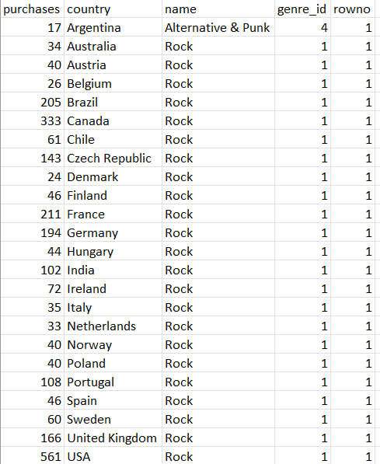
Q10: we want to find out the most popular music genre for each country. (we determine the most popular genre as the genre with the highest amount)

Slide 15
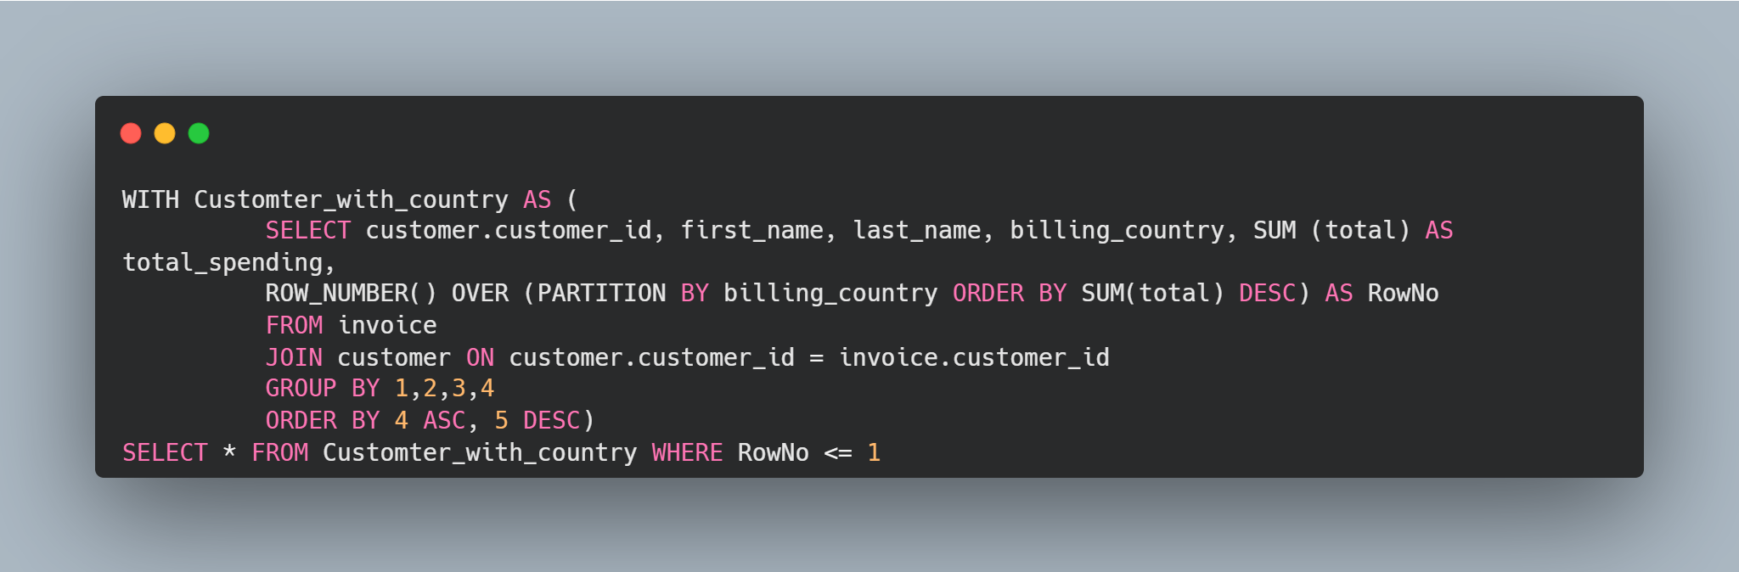
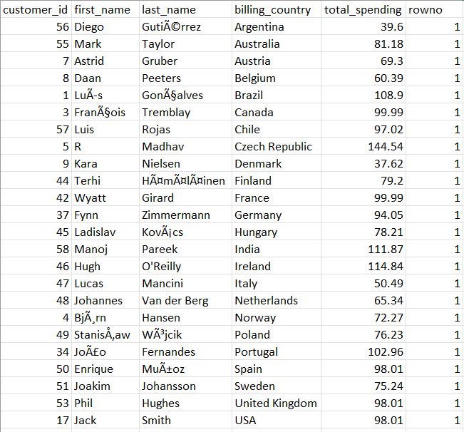
Q11: write a query that determines the customer that has spent the most on music for EACH country. write a query that returns the country along with the top customer and how much they spent. for countries where the top amount spent is shared, provide all customers who spent this amount.

Slide 16
Project Overview
This project analyzes data from a music store database using SQL queries. It answers business-related questions such as identifying top customers, cities with the best revenue, and popular music genres by country.
Thank you

