Slide 1

Faculty of science - menofia university
Jul 2, 2024
Hydropower forecasting
based on
machine learning model
Prepared by Yahya Ebrahim Elkholy
Supervised by Dr. Mohammed Nasef

Slide 2

Faculty of science - menofia university
Jul 2, 2024
Project Objective
In this project, we aim to forecast hydro power inflow for the next five years (2019-2024) for Norway. using the latest time series prediction techniques. We will employ two primary models [Facebook prophet – statistical models]
Idowu Koyenikan

Slide 3
Faculty of science - menofia university
Jul 2, 2024
Project Outlines
1
Time-series Forecasting.
3
Case study
importing libraries and data
data pre-processing
exploratory data analysis
Modeling
2
Time-series Forecasting Technique.

Slide 4

Faculty of science - menofia university
Jul 2, 2024
Time-series Forecasting (TSF)
Time-series Forecasting (TSF) occurs when you make scientific predictions based on historical time stamped data.
1
Applications :
stock keeping unit (SKU) Sales Forecasting
Predicting the number of COVID-19 cases
Forecasting
Stock
Prices
Weather forecasting
Astronomy
Social Science

Slide 5
Faculty of science - menofia university
Jul 2, 2024
2
TSF Technique :
Classical / Statistical Models
ARIMA
Machine Learning
Facebook
Prophet
Deep Learning
Neural Prophet

Slide 6
Faculty of science - menofia university
Jul 2, 2024
Let's begin!
Are you ready?

Slide 7
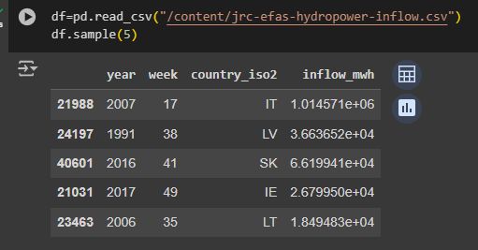
Faculty of science - menofia university
Jul 2, 2024
3
Reading and sample of data
Case study
I have a dataset of water flow for
27 European countries from 1991 to 2019
with weekly readings, consisting of
four columns:
Column 1: Year
Column 2: Week
Column 3: Country Code
Column 4: Water Flow Quantity
Importing Libraries: Importing necessary libraries for data analysis and visualization [ numpy – pandas – matplotlib – seaborn – plotly ].
Importing Data: Loading the hydro power inflow data.
Data Mapping : interactive_map.html

Slide 8
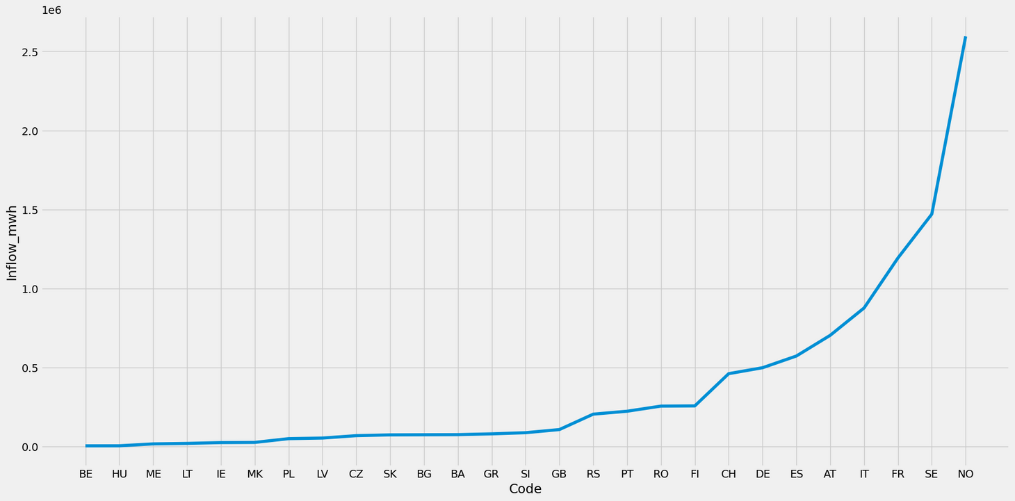
Faculty of science - menofia university
Jul 2, 2024
Data Analysis
Sorting countries by inflow

Slide 9
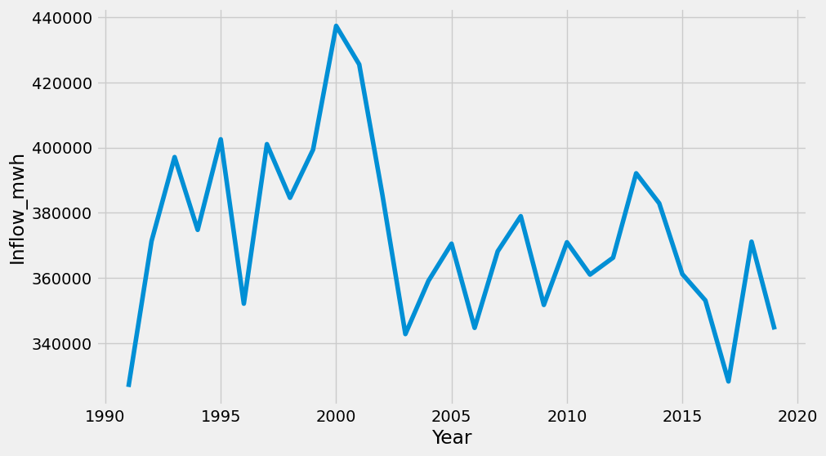
Faculty of science - menofia university
Jul 2, 2024
Data Analysis
Sorting Inflow by Year

Slide 10
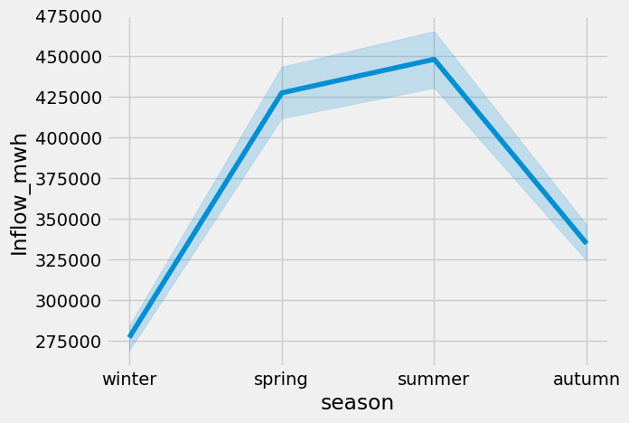
Faculty of science - menofia university
Jul 2, 2024
Data Analysis
Sorting Inflow by Season

Slide 11
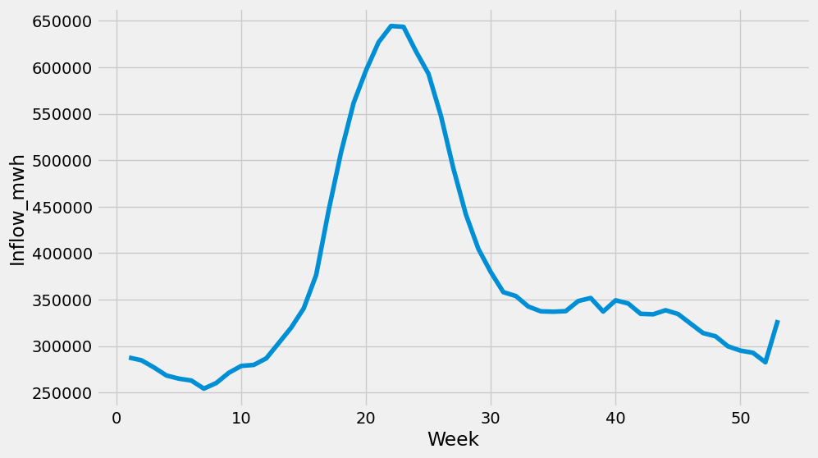
Faculty of science - menofia university
Jul 2, 2024
Data Analysis
Sorting Inflow by Week

Slide 12
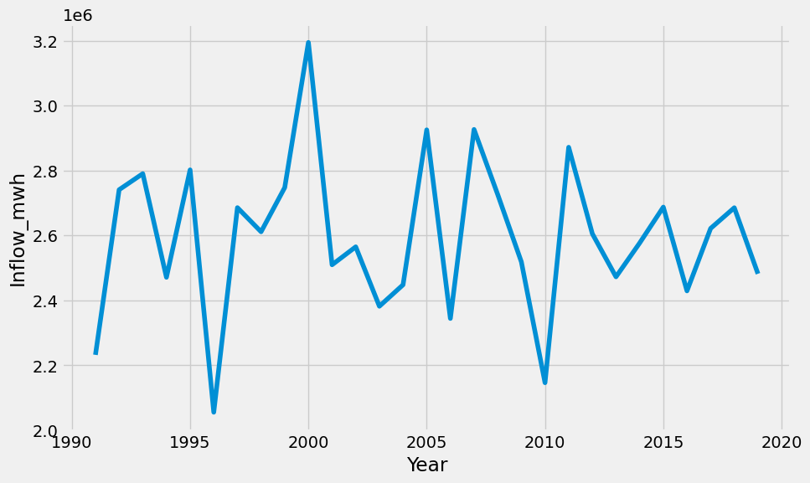
Faculty of science - menofia university
Jul 2, 2024
Data Analysis
Sorting Inflow by Year
for Norway

Slide 13
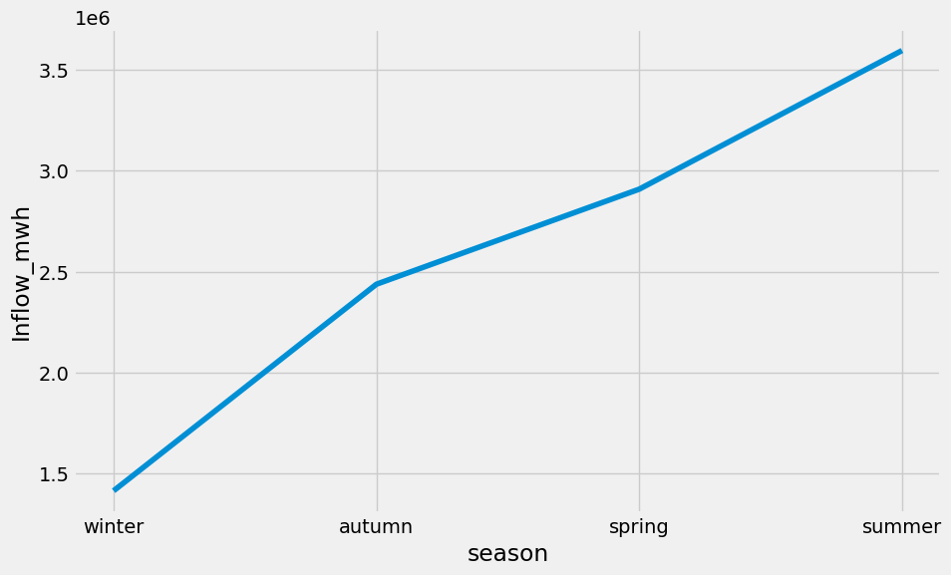
Faculty of science - menofia university
Jul 2, 2024
Data Analysis
Sorting Inflow by Season
for Norway

Slide 14
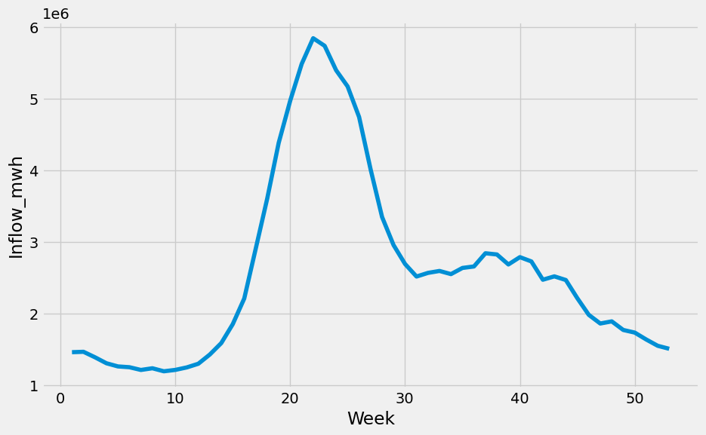
Faculty of science - menofia university
Jul 2, 2024
Data Analysis
Sorting Inflow by Week
for Norway

Slide 15
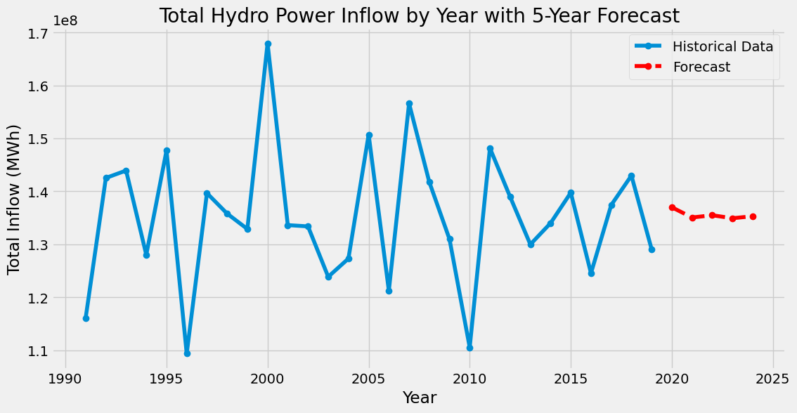
Faculty of science - menofia university
Jul 2, 2024
Modeling
(ARIMA)
Line plot for forecasting data
for Norway

Slide 16
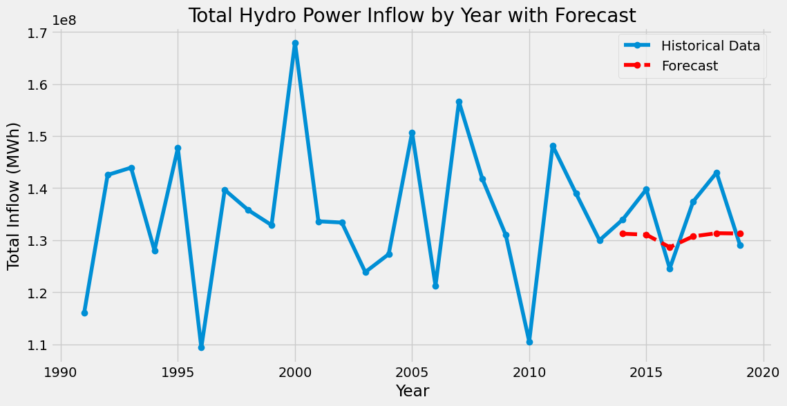
Faculty of science - menofia university
Jul 2, 2024
Modeling
(ARIMA)
Line plot for Evaluation data
for Norway

Slide 17
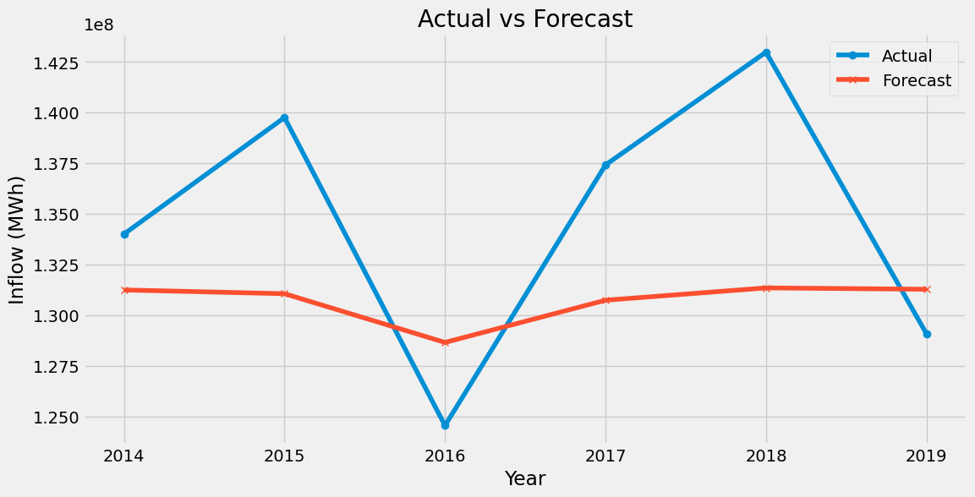
Faculty of science - menofia university
Jul 2, 2024
Modeling
(ARIMA)
Line plot for Actual vs Forecast data
for Norway

Slide 18
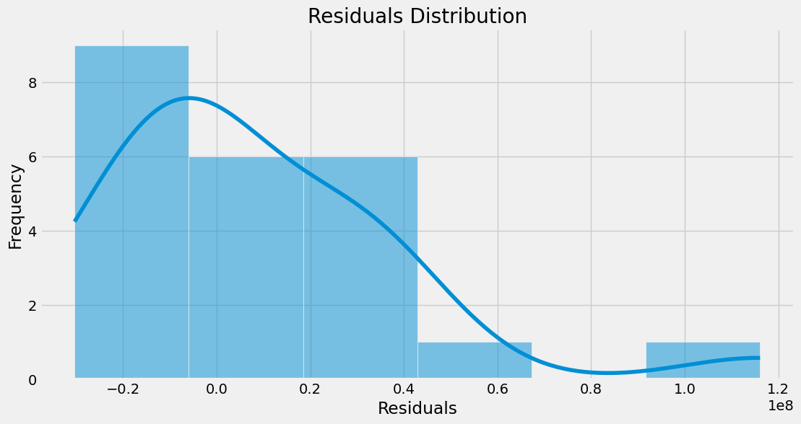
Faculty of science - menofia university
Jul 2, 2024
Modeling
(ARIMA)
Line plot for residual
for Norway

Slide 19
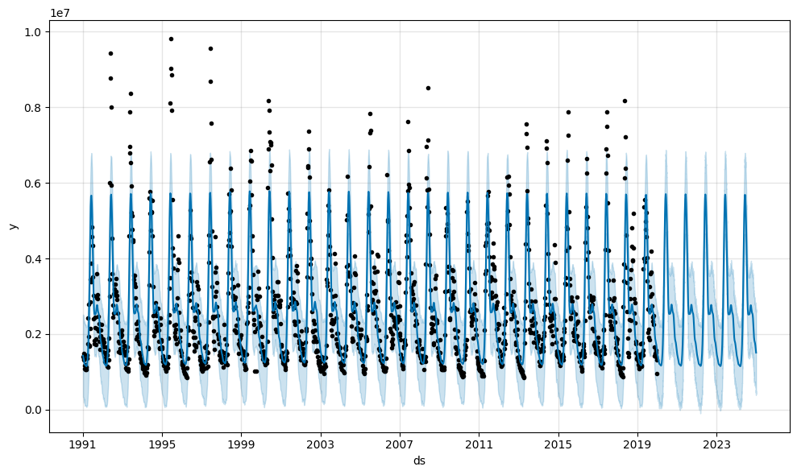
Faculty of science - menofia university
Jul 2, 2024
Modeling
(Prophet)
Line plot for forecasting data
for Norway

Slide 20
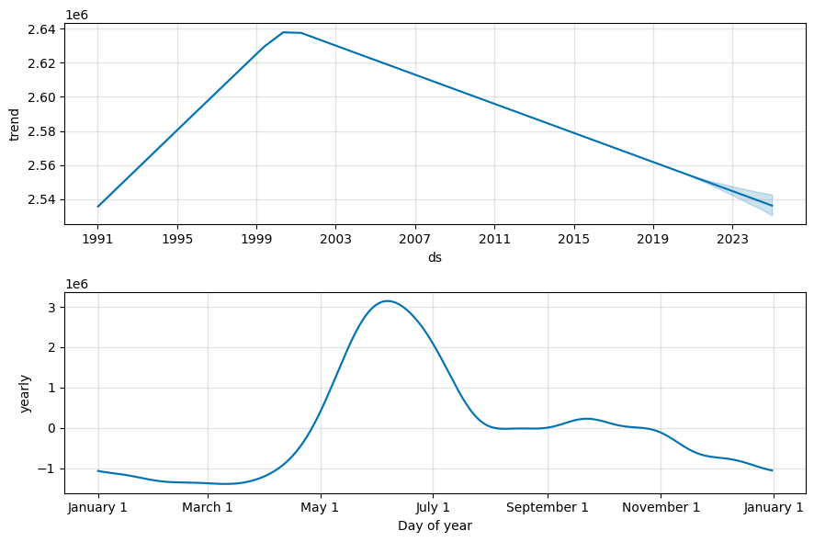
Faculty of science - menofia university
Jul 2, 2024
Modeling
(Prophet)
components of forecast
for Norway

Slide 21
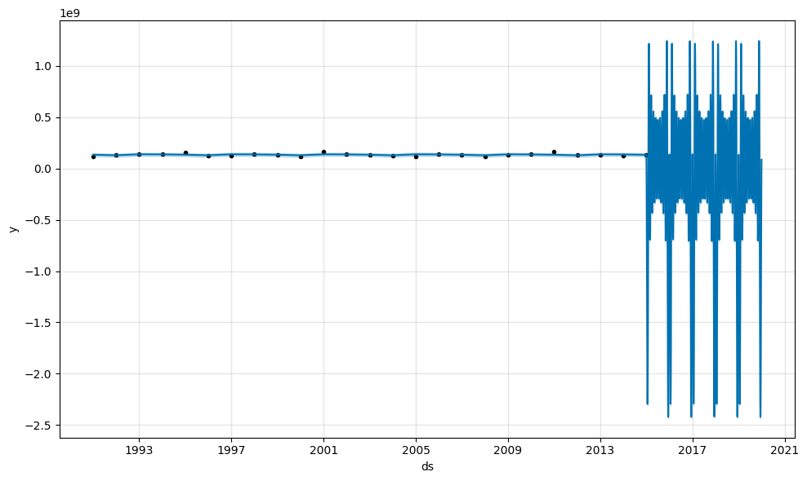
Faculty of science - menofia university
Jul 2, 2024
Modeling
(Prophet)
Line plot for Evaluation data
for Norway

Slide 22
Faculty of science - menofia university
Jul 2, 2024
Comparison result prediction between ARIMA model and prophet model.
Model performance metric | ARIMA | Prophet
MAE | 6,013,296.22 | 2,572,479.40
MSE | 47,502,549,861,569.48 | 14,722,721,937,004.97
RMSE | 6,892,209.36 | 3,837,019.93
MAPE | 4.38% | 1.82%

Slide 23
Faculty of science - menofia university
Jul 2, 2024
Thank you!
for
Watching

