Slide 1
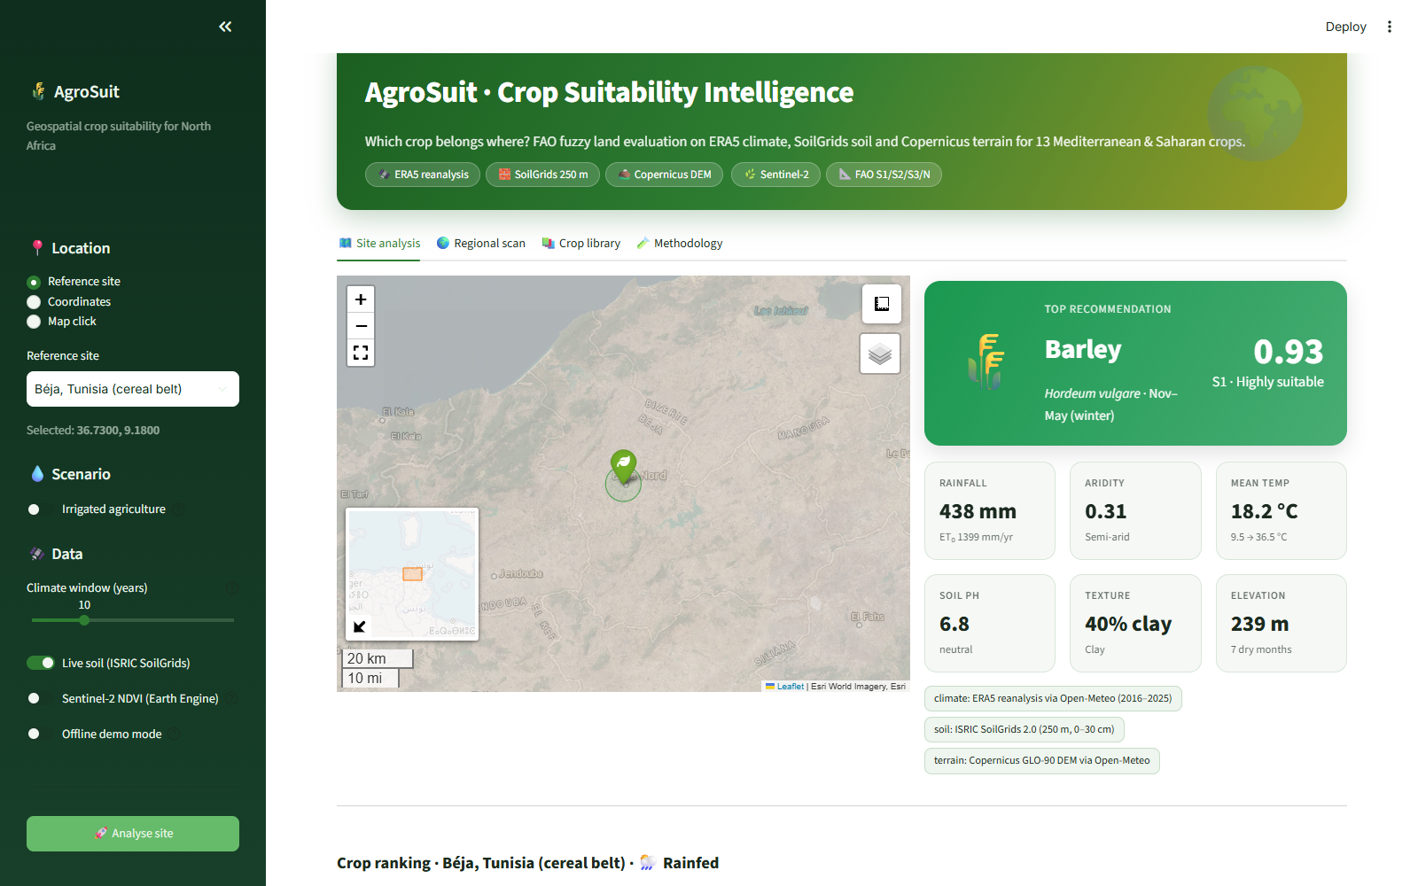
AgroSuit
Crop suitability intelligence for North Africa
FAO fuzzy land evaluation on ERA5 climate, SoilGrids soil and Copernicus terrain for 13 Mediterranean and Saharan crops
Yahya Houimdi
ENIT · Geospatial AI project · 2026
Notes:
AgroSuit is a geospatial decision-support system that tells you which crop fits a given location in North Africa, and explains why. It combines free global climate, soil and terrain data with the FAO land-evaluation method.

Slide 2



North African farming sits on a steep water gradient
Béja
Sfax
Tozeur
438 mm
204 mm
85 mm
rain per year · aridity index 0.31 (semi-arid)
rain per year · aridity index 0.12 (arid)
rain per year · aridity index 0.04 (hyper-arid)
Best rainfed crop
Barley · 0.93 S1
Best rainfed crop
Olive · 0.73 S2
Best rainfed crop
Date palm · 0.92 S1
Evaporative demand exceeds rainfall at every site, by up to 24 times in the Djerid oases. The wrong crop wastes water and years of investment.
Notes:
Within about 300 km, annual rainfall falls from over 400 mm in the north-west to under 100 mm in the oases. Values are ERA5 averages for 2016 to 2025.

Slide 3



AgroSuit answers three questions for any point
What grows best here?
Why not the others?
What would change it?
Ranks 13 crops with a 0–1 score and an FAO class: S1, S2, S3 or N.
Shows the limiting factor of every crop and the score of each of its 7 factors.
Turns each gap into an action, such as an irrigation deficit in mm, liming or frost protection, and compares rainfed with irrigated.
Notes:
The goal is not only a ranking, but an explanation and an action plan. No black box: every number traces back to a data source and a requirement range.

Slide 4




Built entirely on free, global, open data
Climate · ERA5 reanalysis
10-year daily series via Open-Meteo: temperature, rainfall and FAO-56 evapotranspiration
~25 km
Soil · ISRIC SoilGrids 2.0
pH, clay, sand and organic carbon, thickness-weighted over 0–30 cm
250 m
Terrain · Copernicus GLO-90
Elevation; also used to mask sea cells in regional scans
90 m
Vegetation · Sentinel-2 (optional)
Spring NDVI, SAVI and NDMI through Google Earth Engine, shown as context
10–20 m
Notes:
Everything comes from public APIs, so the system works anywhere without data preparation. Responses are cached on disk, and every layer has a fallback.

Slide 5



From coordinates to recommendation in five steps
1
2
3
4
5
Fetch
Engineer
Score
Aggregate
Explain
ERA5, SoilGrids and DEM for the point, with caching and retries
Monthly climatology, ET₀, aridity index, dry months, GDD
Fuzzy membership of each factor against the crop's trapezoid
Weighted geometric mean with a centrality bonus gives S
FAO class, limiting factor and management advice
Delivered through
Streamlit dashboard
Command-line tool
GIS-ready exports
Notes:
The dashboard, the CLI and the notebook all call the same two pipeline functions: analyze_site and scan_region.

Slide 6
Fuzzy membership replaces brittle thresholds
0
outside the absolute limits: the crop fails (below 250 or above 1100 mm)
1
inside the optimum: the crop thrives (400–700 mm)
0→1
linear in between: 330 mm scores 0.53 instead of a hard yes/no
Irrigated scenario: a rain shortage scores 1, but excess rain still counts against the crop.
Notes:
Each of the 13 crops has a trapezoid (a, b, c, d) for each of the 7 factors, adapted from FAO ECOCROP. Fuzzy scores avoid the classic problem where 399 mm is rejected and 400 mm accepted.

Slide 7
One weak factor caps the score: the law of the minimum
0.83
Simple average → would say S1, hiding a 460 mm water deficit
0.69
AgroSuit weighted geometric mean → S2, limited by rainfall
Score = weighted geometric mean × centrality bonus
Notes:
A geometric mean lets one bad factor pull the whole score down, unlike an arithmetic mean. Weights are crop-specific. C-bar is a centrality bonus, up to 15 percent, that prefers sites in the middle of the optimum. Any factor at zero forces class N.

Slide 8
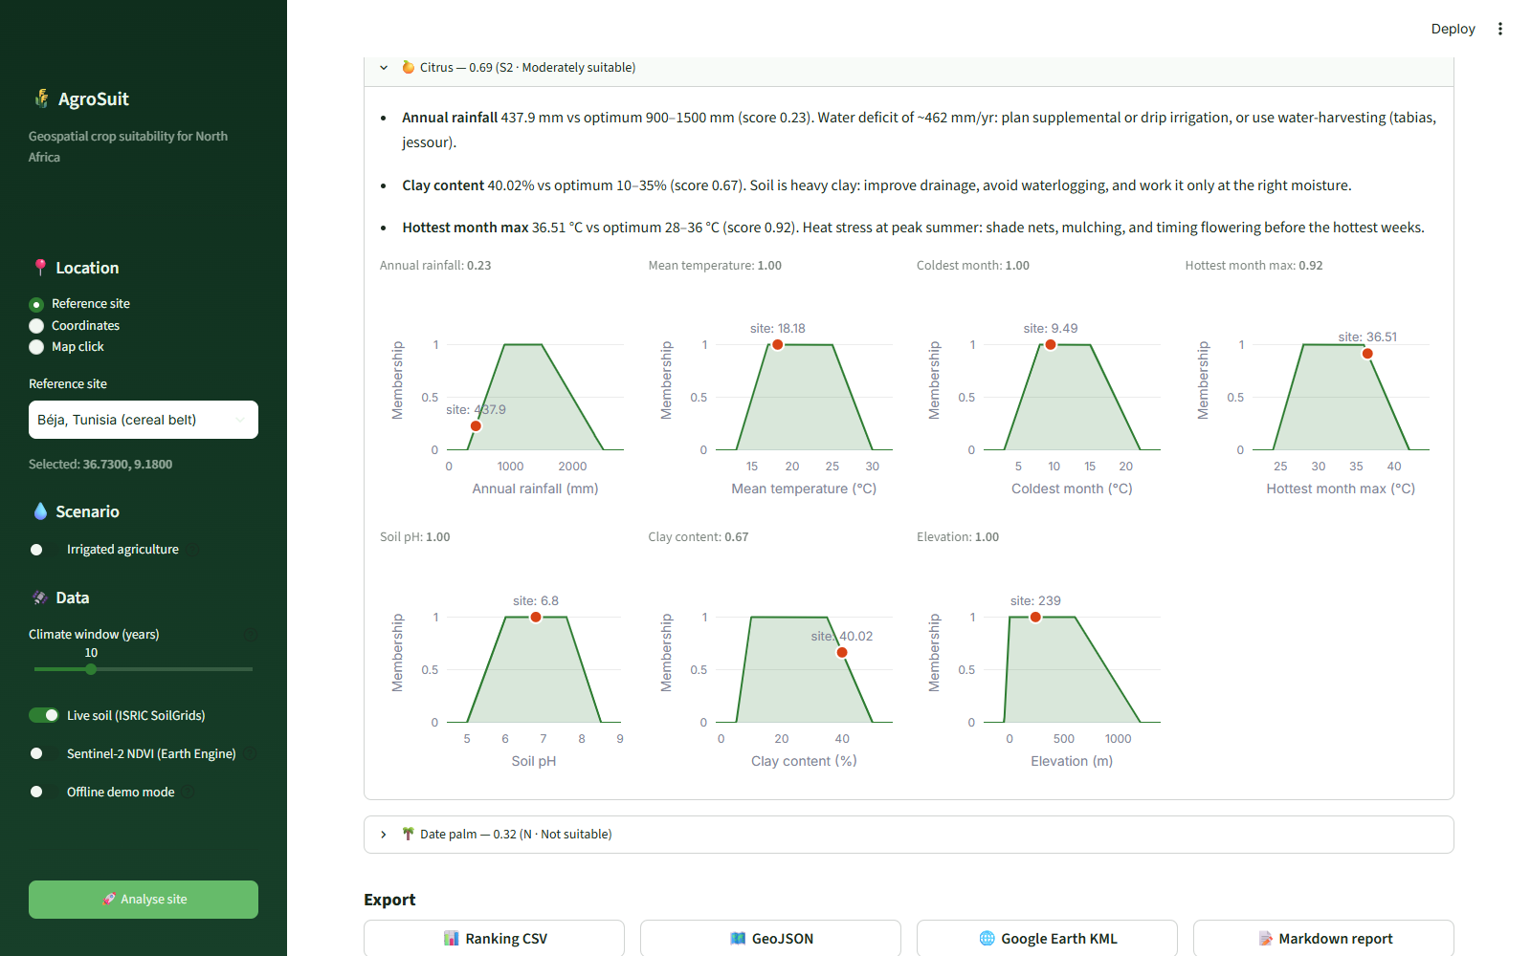



Every score comes with its reasons
Water deficit
“~462 mm/yr short: plan drip irrigation or water harvesting (tabias, jessour)”
Heavy clay
“Improve drainage, avoid waterlogging”
Heat stress
“Shade nets, mulching, flower before the hottest weeks”
Notes:
Factors below 0.98 are listed by severity with a quantified gap and an action. Membership curves show where the site falls for each requirement.

Slide 9




An interactive dashboard for any point on the map
Click-to-analyse satellite map
KPIs, ranking, radar, climograph, water balance
Rainfed vs irrigated toggle
One-click CSV, GeoJSON, KML and report
Notes:
Built with Streamlit, Plotly and Folium. The sidebar selects location, scenario, climate window and data sources. Each result shows which data source fed each layer.

Slide 10
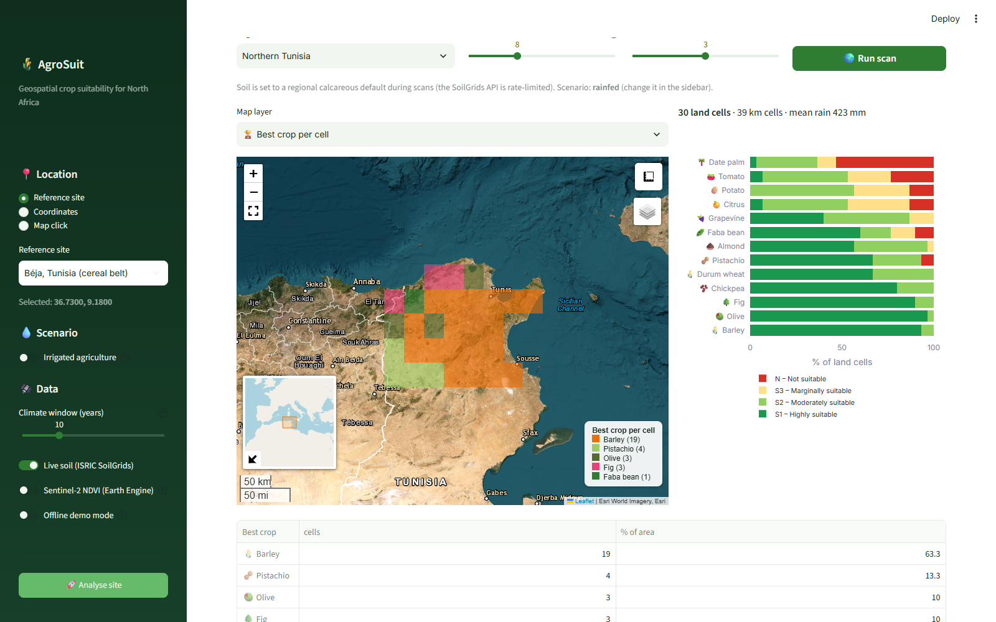
Regional scans map the best crop for every cell
30
land cells of ~39 km in northern Tunisia
19
cells where barley is the best crop
97%
of cells where olive is S1, the most robust crop
Notes:
Climate for up to ten grid points is fetched per request. Sea cells are removed using elevation. Pistachio wins the dry south-west around Kasserine. Scans use a default soil because of the SoilGrids rate limit.

Slide 11
Results match the region's agricultural geography
Site | Rain (mm) | Aridity | Best crop, rainfed | Best crop, irrigated
Meknès | 489 | 0.33 Semi-arid | Chickpea 0.95 (S1) | Chickpea 0.95 (S1)
Béja | 438 | 0.31 Semi-arid | Barley 0.93 (S1) | Barley 0.93 (S1)
Tunis | 406 | 0.29 Semi-arid | Barley 0.92 (S1) | Barley 0.92 (S1)
Sétif | 395 | 0.28 Semi-arid | Barley 0.94 (S1) | Barley 0.94 (S1)
Nabeul | 361 | 0.26 Semi-arid | Barley 0.91 (S1) | Citrus 0.92 (S1)
Kasserine | 277 | 0.18 Arid | Pistachio 0.96 (S1) | Pistachio 0.96 (S1)
Kairouan | 276 | 0.17 Arid | Barley 0.88 (S1) | Barley 0.89 (S1)
Sfax | 204 | 0.12 Arid | Olive 0.73 (S2) | Fig 0.88 (S1)
Tozeur | 85 | 0.04 Hyper-arid | Date palm 0.92 (S1) | Date palm 0.92 (S1)
Citrus in irrigated Cap Bon, olive around Sfax, pistachio in Kasserine and date palm in the Djerid oases: the model reproduces the known crop map without site-specific rules.
Notes:
Live ERA5 climate 2016 to 2025 for nine reference sites in Tunisia, Algeria and Morocco. These are plausibility checks, not a formal validation: crop ranges come from the literature.

Slide 12
Irrigation widens the choice most in the arid south
1 → 7
suitable crops at Tozeur (85 mm) once irrigated
4 → 12
suitable crops at Sfax (204 mm); the north barely changes
Notes:
Crops that stay unsuitable under irrigation at Tozeur, such as tomato, potato and faba bean, are limited by heat or soil, not water. The model separates water constraints from the others.

Slide 13


Engineered like a product, not a notebook
13
crops
7
factors per crop
47
automated tests
3
interfaces
Modular src/ package
Docker + compose
GitHub Actions CI
On-disk API cache
Rate-limit back-off
Offline demo mode
GeoJSON for QGIS
KML for Google Earth
Notes:
The dashboard, CLI and notebook share one pipeline. Tests cover the maths, the data processing, the fallbacks and every export format, and run in CI on Python 3.10 and 3.12.

Slide 14


Honest limits and a clear roadmap
Current limitations
Next steps
Crop ranges from the literature, not yet calibrated on local yields
ERA5 (~25 km) underestimates mountain rainfall
Default soil in regional scans (SoilGrids rate limit)
No salinity, slope or groundwater yet
Slope and aspect from the DEM
Salinity layer and salt tolerance per crop
Calibration on Sentinel-2 crop-type maps
CMIP6 projections for 2050 suitability maps
Notes:
The agreement with the real crop map is encouraging but is not a formal validation. The roadmap focuses on calibration and on climate-change scenarios.

Slide 15
Thank you
Try it
pip install -r requirements.txt
streamlit run app/app.py
python main.py analyze --site Sfax
docker compose up --build
Questions and discussion
Open data + transparent FAO fuzzy model = explainable crop recommendations for North Africa.
Yahya Houimdi
ENIT · Geospatial AI project
Notes:
Thank you. The full report is in docs/AgroSuit_Report.pdf and the code, tests and README are in the repository.

