Slide 1

TSFE
Two-Stage Feature Enhancement
for Remote Sensing Image Captioning
Guo, Li, Song & Chi · Remote Sensing, 2024 · Xidian University
Encoder–Decoder
Attention Mechanisms
Multi-Scale Features
LSTM Decoder
Notes:
1

Slide 2
OVERVIEW
What We Will Cover
01
The Problem
06
Feature Interaction Decoder
What is Remote Sensing Image Captioning and why it is hard
Global feature alignment, LSTM decoding, MLP fusion
02
Prior Work & Limitations
07
Training Strategy
Single-stage methods, decoding strategies, and their gaps
Fine-tuning task, SmoothL1 loss, GradNorm balancing
03
TSFE Architecture
08
Experiments & Results
Full pipeline: AMFF → LFSE → FID
Datasets, metrics, ablation study, qualitative analysis
04
Stage 1 · AMFF
09
Key Takeaways
Adaptive multi-scale feature fusion using Swin Transformer + SENet
Summary and future directions
05
Stage 2 · LFSE
Local feature squeeze and enhancement with multi-head attention
Notes:
2

Slide 3
01 · THE PROBLEM
Remote Sensing Image Captioning (RSIC)
What is RSIC?
Why is RSIC Challenging?
Given a satellite or aerial image, automatically generate a natural language sentence that describes its content, objects, and spatial relationships.
1
Scale diversity
Objects range from cars (tiny) to airports (huge). One feature scale cannot capture all of them.
Example output:
2
Spatial relationships
"Three baseball fields are surrounded by many green trees."
The relative position of objects matters: 'trees on both sides of a river' ≠ 'trees near a river'.
3
Global vs local tension
Real-world applications
Captions need both fine-grained detail AND overall scene understanding simultaneously.
→ Environmental monitoring & disaster detection
4
Domain gap
→ Land surveying & urban planning
Satellite imagery looks very different from natural photos used to pre-train most vision models.
→ Traffic control & infrastructure analysis
5
Modality mismatch
→ Military & security intelligence
Visual feature vectors and text embedding vectors live in different semantic spaces.
Notes:
3

Slide 4
02 · PRIOR WORK
Existing Methods and Their Limitations
TRADITIONAL
Template-based
⚠ Limitation
Extract key words from image, insert into fixed sentence templates.
Fixed templates → rigid, repetitive, low diversity output.
TRADITIONAL
Retrieval-based
⚠ Limitation
Compute similarity between image and all sentences in a dataset, return the best match.
Limited to pre-collected sentences; fails on novel scenes.
DEEP LEARNING
CNN + LSTM
⚠ Limitation
Convolutional Neural Network encodes the image; Long Short-Term Memory network decodes to text.
Single-scale features; no spatial relationship modeling.
DEEP LEARNING
Vision Transformer (ViT)
⚠ Limitation
Flatten the 2-D feature map into a 1-D sequence, apply transformer self-attention.
Flattening destroys 2-D spatial structure; O(N²) attention cost.
DEEP LEARNING
Single-stage fusion
⚠ Limitation
Concatenate feature maps from multiple CNN layers before decoding (e.g., MLAT, GVFGA, RASG).
Channel imbalance; no region-to-region relationship modeling.
Notes:
4

Slide 5
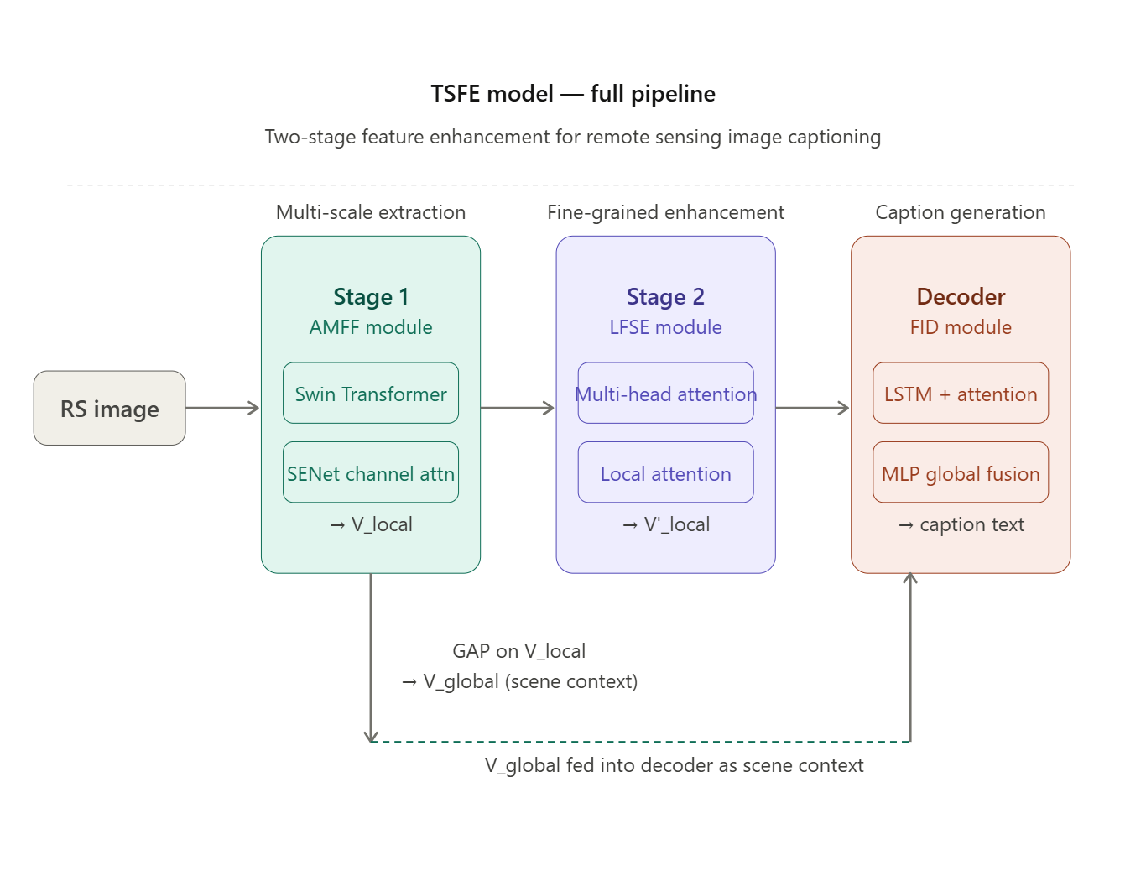
03 · ARCHITECTURE

Slide 6
04 · AMFF MODULE
Stage 1: Adaptive Multi-Scale Feature Fusion
1
Step 1: Feature extraction
Key equations
Swin Transformer (ST) processes the image and produces 4 hierarchical feature maps: F1, F2, F3, F4. F1 is discarded (too low-level). F2 has medium detail, F4 has global semantics.
F = c(F2, F3, F4) [concatenation]
Fs = SENet(F, θ) [channel attention]
2
Step 2: Multi-scale concatenation
V_local = w1·F4 + w2·Fs [fusion]
F2, F3, F4 are stacked along the channel dimension:
F = c(F2, F3, F4)
where c = concatenation. This merges detail at 3 scales.
V_global = (1/H·W) Σ V_local[i,j] [GAP]
3
Step 3: Channel attention (SENet)
Why SENet matters
Squeeze-and-Excitation Network recalibrates channel weights. It globally average-pools each channel to a scalar, then uses two FC layers + sigmoid to produce per-channel weights ω. This suppresses redundant channels and amplifies important ones.
Without SENet: F4 (768 channels) dominates over F2 (192 channels). SENet normalises importance across all channels so no single scale drowns out the others.
4
Step 4: Learnable weighted fusion
Two trainable scalars w1 and w2 (init = 1, updated via backprop) blend the SENet output Fs with the deepest map F4:
V_local = w1·F4 + w2·Fs
F4 anchors global structure; Fs adds balanced multi-scale detail.
Outputs of AMFF
V_local — detailed local features (H × W × 2048)
V_global — scene-level context vector (dim 300)
5
Step 5: Global average pooling
V_global = mean over all spatial positions in V_local.
Since V_local already contains multi-scale info, V_global captures complete scene context — not just the deepest layer's semantics.
Swin Transformer (ST) — Hierarchical vision transformer using shifted windows. Unlike ViT, it preserves spatial 2-D structure through windowed attention across 4 resolution stages.
Notes:
6

Slide 7
05 · LFSE MODULE
Stage 2: Local Feature Squeeze and Enhancement
Motivation: V_local contains rich multi-scale features but treats every spatial position independently. To describe "trees on both sides of a river", the model must understand how regions relate to each other across the full image.
Horizontal & Vertical Squeeze
Depthwise Conv. Refinement
Local Attention Module
Multi-head attention on the full H×W sequence costs O(H²·W²) — too slow.
Instead, compress:
• Horizontally: average all columns → row strip (W × C)
• Vertically: average all rows → column strip (H × C)
Attention runs on these 1-D strips separately, then results are summed:
Va(i,j) = Σ softmax(q(h)ᵀk(h)) · v(h)
+ Σ softmax(q(v)ᵀk(v)) · v(v)
Models which rows and which columns are related — at a fraction of the cost.
The squeeze operation loses fine-grained local structure (exact pixel neighborhoods).
A parallel branch applies:
1. Concatenate Q, K, V projections of V_local
2. 3×3 depthwise separable convolution + Batch Normalization (BN)
3. 1×1 Conv + BN to compress dimensions
4. These detail-weights are multiplied element-wise onto Va
DW-conv = applies separate filter per channel → very efficient. Recovers texture and local edge information lost by squeezing.
Even with the conv branch, long-distance spatial structure (e.g. which end of the runway a building is at) may be lost due to sequence serialization.
N soft-attention maps α[n] are learned over the full spatial grid. Each map focuses on a different region. GAP is applied per map to produce N local feature vectors V'_local.
α̅[n,i,j] = (1/C)Σ Vs[i,j,k]·w[n,k]
α[n,i,j] = softmax over (i,j) of α̅
This restores long-range spatial structure in a learnable, interpretable way.
Abbreviations: Q = Query, K = Key, V = Value (standard attention projections) · BN = Batch Normalization · GAP = Global Average Pooling · DW-conv = Depthwise Separable Convolution
Output → V'_local Spatially-aware, fine-grained feature set that captures both long-range region relationships and fine local structure. Fed into the FID decoder as the primary visual input.
Notes:
7

Slide 8
06 · FID DECODER
Feature Interaction Decoder (FID)
Word-by-word decoding process
1
1. Spatial attention over V'_local
LSTM gate glossary
At each timestep t, the LSTM hidden state hₜ₋₁ is compared to every spatial position in V'_local using dot-product similarity:
aₜ = V'_localᵀ · W · hₜ₋₁ / √d
αₜ = softmax(aₜ) [attention weights]
vₜ = αₜ * V'_local [attended visual context]
This steers the decoder to relevant image regions for each word.
iₜ (input gate) Which new info to store
fₜ (forget gate) Which old info to erase
oₜ (output gate) What to expose from cell
2
2. Global feature fusion via MLP
V_global (the scene vector from AMFF) is combined with the embedding sₜ₋₁ of the previously generated word using a Multi-Layer Perceptron (MLP):
M(V_global, sₜ₋₁)
MLP aligns image and text features into a shared semantic space. This prevents the 'scene misalignment' problem where the model ignores the overall context.
cₜ (cell state) Long-term memory buffer
hₜ (hidden state) Short-term working memory
3
3. LSTM recurrence
Why global context in the decoder?
The LSTM input at each step:
xₜ = concat[vₜ, M(V_global, sₜ₋₁)]
Standard LSTM gates: input (iₜ), forget (fₜ), output (oₜ), cell (cₜ):
cₜ = fₜ ⊙ cₜ₋₁ + iₜ ⊙ tanh(Wc·[xₜ, hₜ₋₁])
hₜ = oₜ ⊙ tanh(cₜ) → next word embedding
Without V_global:
→ Decoder sees only local patches
→ Misses the overall scene type
→ Generates incoherent words (e.g. 'bridge' in a desert scene)
With V_global:
→ Scene-level semantic anchor
→ Generates contextually consistent captions
4
4. Continuous output (no softmax)
Instead of predicting a word probability distribution (softmax), the LSTM outputs a continuous embedding vector. This is matched to GloVe target embeddings using SmoothL1 loss. Continuous output better captures global semantic similarity and avoids treating all wrong words as equally bad.
LSTM = Long Short-Term Memory · MLP = Multi-Layer Perceptron · GloVe = Global Vectors for Word Representation · ⊙ = element-wise (Hadamard) product
Notes:
8

Slide 9
07 · TRAINING
Training Strategy & Objective Functions
Phase 1 — Fine-tuning the AMFF encoder
SmoothL1 (Huber) Loss
SmoothL1(x, y) =
½(x−y)² if |x−y| ≤ 1
|x−y| − ½ otherwise
Quadratic for small errors → sensitive to fine differences. Linear for large errors → robust to outliers. Better than MSE for embedding regression tasks.
!
Problem A — Domain gap
Swin Transformer was pre-trained on ImageNet (natural photos). Satellite imagery is completely different in texture, perspective, and object distribution.
!
Problem B — Modality gap
Image feature vectors and text (GloVe) embeddings live in different semantic spaces. Direct fusion causes semantic mismatch.
✓
Solution — Fine-tuning task
Train AMFF to minimise the distance between V_global and the averaged GloVe embedding of all caption words. Averaging over all captions covers all objects in the scene. Uses SmoothL1 loss. Encoder parameters are then frozen for main training.
GradNorm
Phase 2 — End-to-end model training
Automatically balances gradient magnitudes across multiple loss terms. Prevents one loss from dominating training. L1 and L2 may have very different scales — GradNorm normalises them so both contribute equally to learning.
L1 (word-level): SmoothL1(ê_t, e_t) — predicted vs target embedding at each timestep
L2 (sentence-level): SmoothL1(avg(ê_t), avg(e_t)) — overall sentence semantic coherence
GradNorm automatically balances weights between L1 and L2 during training.
GloVe = word embedding trained on co-occurrence. Adam = adaptive gradient optimizer. FC = Fully Connected layer.
Notes:
9

Slide 10
08 · EXPERIMENTS
Datasets and Evaluation Metrics
Benchmark Datasets
Evaluation Metrics
RSICD
Remote Sensing Image Caption Dataset
BLEU-N (Bilingual Evaluation Understudy)
224 × 224 px · 30 scene types (city, river, airport…) · 5 per image
Measures N-gram precision between generated and reference sentences (N=1,2,3,4). Higher N = stricter matching. Standard in MT/NLG.
10,921
images
Largest RSIC benchmark
UCM-Captions
UC Merced Land-Use Captions
METEOR (Metric for Evaluation of Translation with Explicit ORdering)
256 × 256 px · 21 land-use categories (100 images each) · 5 per image
Harmonic mean of unigram precision and recall, with synonym matching. Better correlation with human judgment than BLEU.
2,100
images
Balanced class distribution
Sydney-Captions
Sydney Urban Dataset Captions
ROUGE-L (Recall-Oriented Understudy for Gisting Evaluation — Longest)
500 × 500 px · 7 urban categories · 5 per image
Based on longest common subsequence (LCS) between generated and reference. Rewards recall and sentence fluency.
613
images
Smallest — tests generalisation
CIDEr (Consensus-based Image Description Evaluation)
Designed specifically for image captioning. Uses TF-IDF weighting so visually distinctive words count more. Most informative single metric for RSIC.
Notes:
10

Slide 11
08 · RESULTS
Quantitative Results vs State-of-the-Art
RSICD Dataset
Key findings
Method | BLEU-1 | BLEU-4 | METEOR | ROUGE-L | CIDEr
SAT | 73.36 | 44.02 | 35.49 | 64.19 | 224.86
Up-Down | 76.79 | 49.62 | 35.34 | 65.90 | 260.22
RASG | 77.29 | 50.62 | 36.23 | 66.91 | 275.49
MSISA | 78.36 | 50.42 | 36.72 | 67.30 | 284.36
CASK | 79.65 | 52.24 | 37.45 | 68.33 | 293.43
MGTN | 80.42 | 54.14 | 39.37 | 70.58 | 298.39
TSFE (Ours) | 80.54 | 54.86 | 37.93 | 70.20 | 305.70
RSICD — BLEU-4
54.86 (+0.72 vs MGTN)
RSICD — CIDEr
305.70 (+2.45% vs MGTN)
RSICD — ROUGE-L
70.20 (competitive)
UCM — BLEU-1
89.85 (+0.55% vs MGTN)
UCM — ROUGE-L
88.00 (+2.5% vs MGTN)
UCM-Captions Dataset
Sydney — BLEU-4
Method | BLEU-1 | BLEU-4 | METEOR | ROUGE-L | CIDEr
MGTN | 89.36 | 76.50 | 50.81 | 85.86 | 389.92
TSFE (Ours) | 89.85 | 76.45 | 48.93 | 88.00 | 367.01
62.90 (SOTA across most metrics)
SAT = Show & Tell · RASG = Recurrent Attention & Semantic Gate · MSISA = Multi-Source Interactive Stair Attention · CASK = Consensus-Aware Semantic Knowledge · MGTN = Mask-Guided Transformer Network
Notes:
11

Slide 12
08 · ABLATION
Ablation Study — Contribution of Each Module
Each module is added incrementally on all three datasets to isolate its individual contribution:
RSICD
Configuration | BLEU-1 | BLEU-4 | METEOR | ROUGE-L | CIDEr | Δ CIDEr
Baseline (Swin + LSTM) | 75.57 | 47.40 | 34.23 | 65.97 | 264.40 | —
+ Fine-tuning (AMFF) | 77.68 | 52.10 | 35.74 | 69.00 | 278.61 | +14.21
+ LFSE module | 78.54 | 53.80 | 36.78 | 70.24 | 294.60 | +15.99
+ FID decoder (full TSFE) | 80.54 | 54.86 | 37.93 | 70.20 | 305.70 | +11.10
Cumulative CIDEr gain on RSICD:
Module contributions
Fine-tuning
Baseline
264.40
264.40
Largest single jump. Domain adaptation is the #1 bottleneck.
+ Fine-tuning
278.61
LFSE
278.61
+ LFSE
294.60
+5.7% CIDEr. Spatial relations add meaningful accuracy.
FID
+ FID (full TSFE)
305.70
294.60
+3.7% CIDEr. Global context improves coherence.
Notes:
12

Slide 13
08 · QUALITATIVE
Qualitative Analysis — Generated Captions
Comparing Baseline (Swin + LSTM) vs TSFE outputs across 6 image types:
Baseball fields
Object count
Commercial area
Object completeness
GT: Three baseball fields are surrounded by green trees.
GT: Many buildings and some green trees are in a commercial area.
Base: Many green trees are around a baseball field.
Base: Many buildings are in a commercial area area.
TSFE: Three baseball fields are surrounded by many green trees.
TSFE: Many buildings and some green trees are in a commercial area.
Curved river
Spatial relationship
Storage tanks
Correct identification
GT: Many green plants are in two sides of a curved river.
GT: Two storage tanks are surrounded by several buildings and bare land.
Base: Many green trees are in a sides of a river.
Base: Many storage tanks are near a bridge.
TSFE: Many green trees are in two sides of a curved river.
TSFE: Several storage tanks are near several buildings and bare land.
Building shape
Color/shape accuracy
Bridge & trees
Positional detail
GT: Some green trees are near an oval white building.
GT: Several green trees are in two sides of a river with a bridge over it.
Base: Many green trees are around a rectangular building.
Base: A bridge is near a river with some green trees.
TSFE: Many green trees are around a white building.
TSFE: A bridge is on a river with some green trees in two sides of it.
GT = Ground Truth reference caption · Red = Baseline output · Green = TSFE output
Notes:
13

Slide 14
09 · DESIGN RATIONALE
Key Design Choices vs Alternatives
Why Swin Transformer instead of ViT?
✓ TSFE: Swin uses windowed shifted attention → preserves 2-D spatial structure and scales efficiently to high-resolution images.
✗ Alternative: ViT flattens H×W into a 1-D sequence, destroying spatial locality. O(N²) attention cost is prohibitive for large RS images.
Why squeeze-attention instead of full attention?
✓ TSFE: Horizontal + vertical squeeze reduces cost from O(H²W²) to O(H²+W²). Depthwise conv branch recovers local detail lost by squeezing.
✗ Alternative: Full self-attention on the whole feature map is computationally infeasible and causes convergence difficulties.
Why average GloVe embeddings for fine-tuning?
✓ TSFE: Averaging over all caption words covers all objects present at all scales in the scene. More complete supervision signal.
✗ Alternative: MGTN uses a single label → misses most objects in complex multi-object RS images. Limits accuracy and generalisation.
Why continuous output (no softmax)?
✓ TSFE: SmoothL1 on continuous embeddings preserves semantic distances — 'car' is closer to 'truck' than to 'river' in embedding space.
✗ Alternative: Softmax cross-entropy treats all wrong words as equally bad regardless of semantic similarity. Loses global semantic coherence.
Why GAP on V_local (not on F4)?
✓ TSFE: V_local already contains fused multi-scale features. GAP then produces a global vector that sees all object scales — small and large.
✗ Alternative: GAP on F4 only sees large-scale semantics. Small objects (cars, people) are invisible to deep layers → incomplete scene context.
Notes:
14

Slide 15
Summary & Takeaways
1
Two-stage enhancement is key
4
Domain + modality alignment matter
Stage 1 (AMFF) gets balanced multi-scale features. Stage 2 (LFSE) learns spatial relationships. Neither alone is sufficient.
Fine-tuning the encoder on RS data with GloVe targets closes both the domain gap (ImageNet→RS) and the modality gap (image→text).
2
Efficient attention via squeezing
5
State-of-the-art on 3 benchmarks
H×V squeeze reduces quadratic cost to linear while the conv branch recovers local detail — a practical innovation for high-res RS images.
TSFE outperforms MGTN and 8 other methods on RSICD (largest dataset). +2.45% CIDEr on RSICD vs previous best.
3
Global context improves coherence
Injecting V_global into the LSTM decoder ensures captions stay consistent with the overall scene semantics, not just local patches.
Future work: Integrate auxiliary tasks (object detection, scene classification) to further improve caption quality and reduce the gap between automatic metrics and human evaluation.
Notes:
15

Slide 16
REFERENCE
Complete Abbreviation Glossary
RSIC
Remote Sensing Image Captioning
MLA
Multi-Level Attention
TSFE
Two-Stage Feature Enhancement
LAM
Label-Attention Mechanism
AMFF
Adaptive Multi-Scale Feature Fusion
GVFGA
Global Visual Feature-Guided Attention
LFSE
Local Feature Squeeze and Enhancement
GLCM
Global–Local Captioning Model
FID
Feature Interaction Decoder
MLAT
Multi-Layer Aggregated Transformer
CNN
Convolutional Neural Network
RASG
Recurrent Attention and Semantic Gate
LSTM
Long Short-Term Memory
MSISA
Multi-Source Interactive Stair Attention
RNN
Recurrent Neural Network
VRTMM
Variational Autoencoder + RL Two-stage Multi-task Model
GAP
Global Average Pooling
CASK
Consensus-Aware Semantic Knowledge
ViT
Vision Transformer
MGTN
Mask-Guided Transformer Network
ST
Swin Transformer
BLEU
Bilingual Evaluation Understudy (N-gram precision metric)
SENet
Squeeze-and-Excitation Network
ROUGE-L
Recall-Oriented Understudy — Longest Common Subsequence
MLP
Multi-Layer Perceptron
METEOR
Metric for Evaluation of Translation with Explicit ORdering
BN
Batch Normalization
CIDEr
Consensus-based Image Description Evaluation
DW-conv
Depthwise Separable Convolution
GradNorm
Gradient Normalization for adaptive loss balancing
Q/K/V
Query / Key / Value (attention projections)
Adam
Adaptive Moment Estimation (optimizer)
GloVe
Global Vectors for Word Representation (word embedding)
TF-IDF
Term Frequency – Inverse Document Frequency
NIC
Natural Image Captioning
FC
Fully Connected (layer)
Notes:
16

