Slide 1
Automatic Detection of Absence Seizures from EEG Signals
Data Mining mini-project
National School of Engineering of Tunis (ENIT)
Yahya Houimdi · Brahim Elmi
Class 3A Info 1 · October 2026
Notes:
Introduce the team and the subject: detecting absence seizures automatically in EEG recordings, from the raw signal to the start and end time of each seizure.

Slide 2
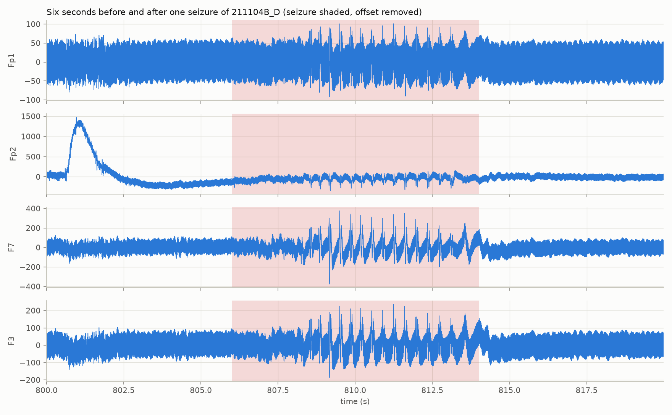
A seizure lasts seconds inside a 20-minute recording
An absence seizure is a brief loss of awareness, visible on the EEG as spikes and waves at about 3 Hz on all channels at once
Finding these episodes by eye is slow: a few seconds to locate in recordings of 20 to 60 minutes
Goal: a complete Data Mining chain, from the raw EEG to the start and end time of each seizure
A binary classification problem: class 0 = no seizure, class 1 = seizure
Notes:
The figure shows four channels, six seconds before and after one seizure. The shaded zone is the annotated seizure: about three spikes per second, on every channel, starting and stopping abruptly.

Slide 3
The pipeline: from raw signal to seizure intervals
1
Explore
2
Annotate
3
Label
4
Segment
Load, measure, plot
Excel times to seconds
Class 0 / 1 per sample
1 s and 2 s windows, 50% overlap
5
Extract
6
Split
7
Train
8
Reconstruct
8 temporal + 4 frequency features per channel
Whole recordings: train, validation, test
6 models on balanced training sets
Merge windows into seizures
Steps 1 to 5: interactive Streamlit application. Steps 5 to 8: reproducible Python pipeline with 40 automated tests.
Notes:
The first row is the data preparation, done in our Streamlit application. The second row is the modelling, done with scripts so that every number can be regenerated.

Slide 4
The data: 18 usable recordings and 71 seizures
18 of 22
7.2 h
71
3.7%
recordings with valid annotations
of EEG at 256 Hz
annotated seizures
of the time is seizure
Only one annotation source is usable
Four recordings excluded
The h files list events but their time column is only a row number.
Annotations.xlsx gives real clock times, converted to seconds:
t = (event time − start of trace) × 86 400
Three are missing from the annotation file.
One has a seizure entered as lasting six hours in a 52-minute recording; it was left out rather than trained on with a wrong label.
Notes:
Out of 22 recordings, 18 have fully valid annotations. Seizures occupy less than 4% of the time: the classes are very unbalanced. We checked every annotation against the duration of the signal, which is how we found the six-hour seizure.

Slide 5
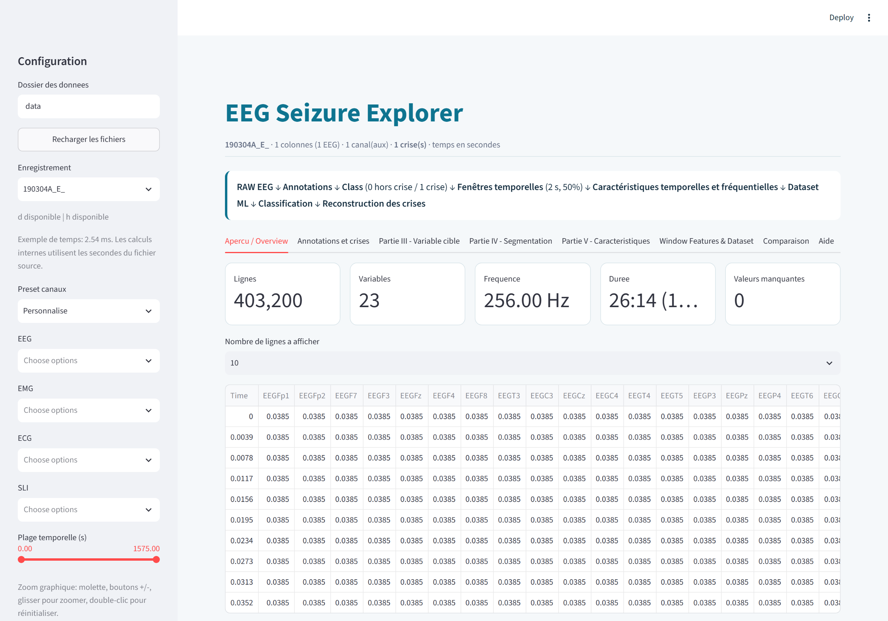
Questions 1 and 2: exploring a recording
Recording 211104B_D
Rows | 309,760
Variables | 22 (Time, 19 EEG, SLI, ECG)
Sampling frequency | 256 Hz
Duration | 20 min 10 s
Missing values | 0
A 50 Hz interference and a slow drift dominate the raw signal
Seizures become clear only when zooming: 3 spikes per second on all channels
Notes:
Our Streamlit application answers Questions 1 to 8 for any recording. The sampling frequency is measured from the time column, not assumed. Visually, the raw trace is dominated by mains interference; the seizure pattern is visible when zooming.

Slide 6
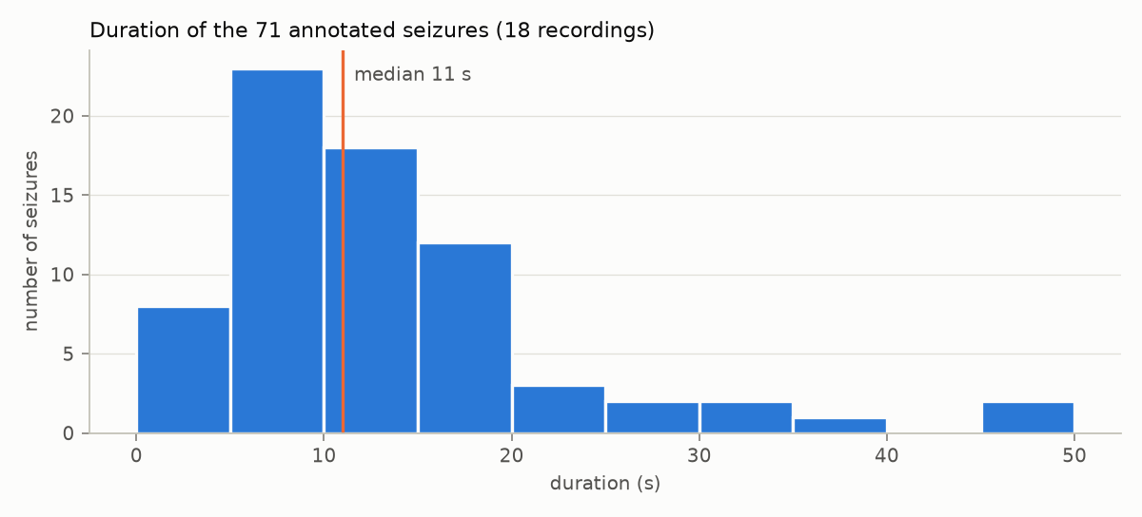
Questions 3 to 6: seizures are short and rare
Class of each sample, recording 211104B_D
Within one recording, durations are similar (6 to 10 s, CV 0.16)
Across recordings they are not: 3 to 49 s, median 11 s, CV 0.68
96.7% of samples are outside a seizure
Consequence: accuracy is misleading and the training data must be rebalanced
Notes:
Question 4: seizures of one patient look alike, but durations vary a lot between patients. Question 6: the imbalance is strong, about 29 normal samples for one seizure sample.

Slide 7
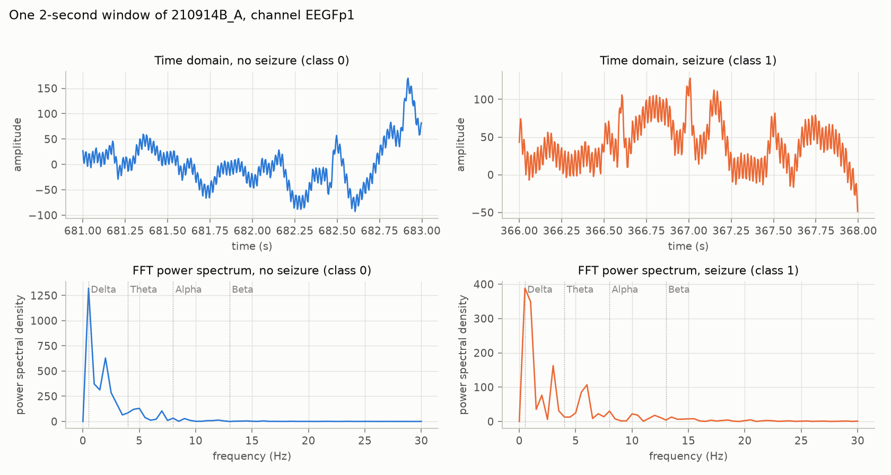
Questions 7 to 9: windows and 228 features
Windows
2 s = 512 samples, 50% overlap
Class 1 if at least 50% is seizure
8 temporal features
Mean, Std, Variance, Min, Max, Amplitude, RMS, Energy
4 frequency features
FFT power in Delta, Theta, Alpha and Beta bands (0.5 to 30 Hz)
25,874 windows of 2 s: 24,873 normal and 1,001 seizure. The seizure window shows peaks at 3 Hz and 6 Hz.
Notes:
Each window is described by 12 features per EEG channel, 228 in total for 19 channels. The spectrum of a seizure window shows the 3 Hz discharge and its harmonic at 6 Hz.

Slide 8
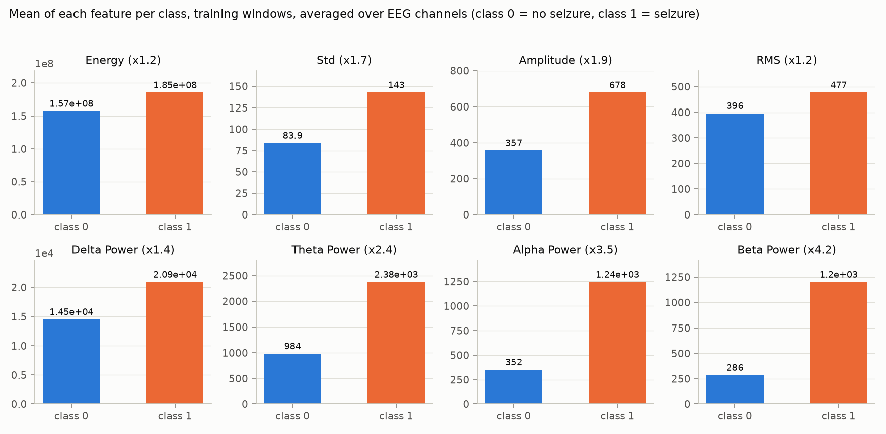
Questions 10 and 11: band powers separate the classes
How well does one feature alone separate the classes?
Seizure windows have 1.4 to 4.2 times more power in every band; Energy and RMS barely change.
AUC of each feature used alone (0.5 = no information). Variance and Energy are exact duplicates of Std and RMS.
Notes:
Question 10: band powers differ most between the classes. Question 11: RMS and Energy, and Std and Variance, are perfectly correlated, so they are redundant. The most discriminant features are the four band powers.

Slide 9
Split by recording, balance only the training set
Why not a random 80/20 split of windows?
Validation chooses hyperparameters and thresholds.
The test set is used once.
Windows overlap by 50%. A random split puts near-copies of training windows in the test set and inflates every score.
Train
Validation
Test
11 recordings
46 seizures
3 recordings
13 seizures
4 recordings
12 seizures
Undersampling
Oversampling
Hybrid
Class 0 reduced to the size of class 1
1,162 windows per class
Class 1 resampled up to the size of class 0
31,657 windows per class
Both classes brought to the midpoint
16,409 windows per class
Notes:
The assignment suggests a stratified 80/20 split. We kept the idea but applied it to whole recordings, because overlapping windows would leak between train and test. Balancing is applied to the training rows only; validation and test keep the real 4% of seizures.

Slide 10
Question 12: six models, 36 training runs
Decision Tree
Random Forest
KNN
Selection procedure
Depth and leaf size searched
300 trees
5 to 21 neighbours, standardised
Fit on the balanced training set
Choose the decision threshold that maximises F1 on validation
Keep the candidate with the best validation F1 (recall breaks ties)
Score the test set once
SVM
1D-CNN
LSTM
RBF kernel, C searched
Sequence of 5 windows
Sequence of 5 windows
Four models requested by the assignment, plus two neural networks as an improvement. Each is trained on 2 window sizes × 3 balancing methods.
Notes:
We trained the four requested models and added a 1D-CNN and an LSTM that look at five consecutive windows. Everything is selected on the validation recordings; the test recordings are scored once at the end.

Slide 11
Test results: the LSTM and the Random Forest lead
0.73
best F1-score: LSTM, 1 s windows
0.94
best recall: Random Forest
Random Forest: most stable in cross-validation (F1 0.61 ± 0.08)
SVM: few false alarms but misses 43% of seizure windows
Notes:
Each model is shown with its best training set, chosen on validation. The LSTM has the best F1-score, the Random Forest the best recall and it is almost as good overall. With only 12 test seizures, the gap between them is within the uncertainty that cross-validation shows.

Slide 12
Question 13: accuracy says nothing here
96.0%
1. Recall
A missed seizure is the costly error: the event goes unrecorded.
accuracy of a model that always answers “no seizure”
95 to 98%
2. Precision
Each false alarm costs the clinician time; too many and the detector is ignored.
accuracy of all six models
Accuracy is dominated by the easy, numerous normal windows. The SVM has the second-best accuracy and the worst recall.
3. F1-score
Combines both and cannot be maximised by predicting one class. Our selection criterion, with recall to break ties.
Notes:
A model that never detects anything already has 96% accuracy. All our models are within three points of it, so accuracy cannot rank them. We select on F1-score and prefer recall, because missing a seizure is worse than a false alarm.

Slide 13
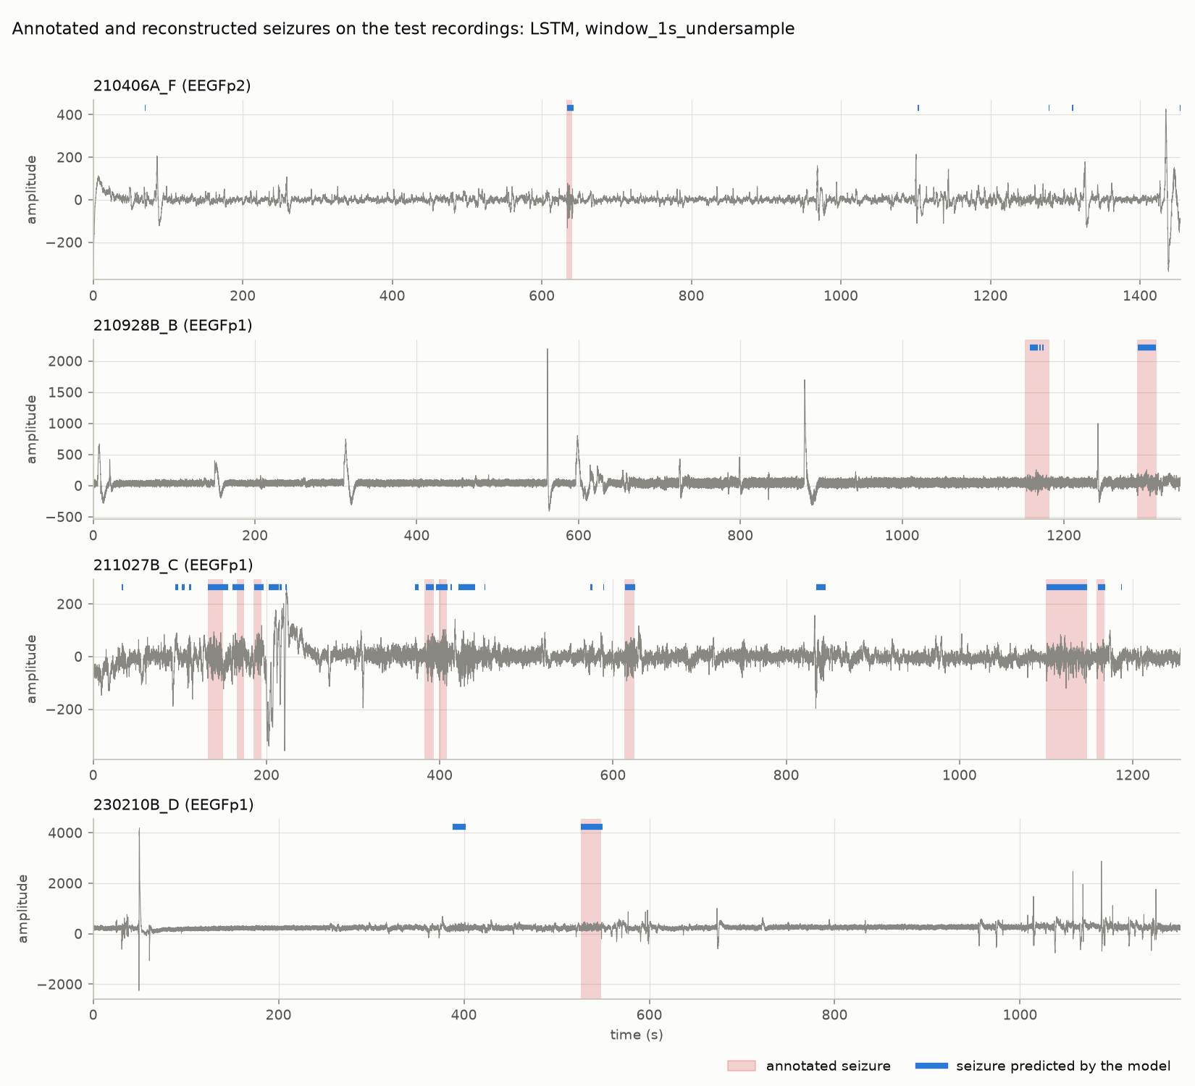
Question 14: all 12 test seizures are found
12 / 12
seizures detected
+0.4 s
mean error on the start time
21
false alarms (14.5 per hour)
Notes:
Consecutive positive windows are merged into intervals. A seizure is detected when a predicted interval overlaps it. Shaded zones are the real seizures, blue bars the predictions. All twelve are found; nine of twelve starts are within two seconds.

Slide 14
Error analysis: sensitive, but too many short false alarms
False positives: 195 windows
79% are in one recording, often just before or after a real seizure.
Short false alarms
12 of the 21 false alarms last 2 s or less; real seizures last at least 3 s.
False negatives: 68 windows
69% are in one recording: a seizure found but only half covered. No seizure is missed.
Notes:
True positives: 352 of 420 seizure windows. True negatives: 9,817 of 10,012. Most false positives come from one recording, and most false alarms are very short. False negatives shorten a detected seizure but never hide one.

Slide 15
Improvements: what we did and what comes next
Implemented
Proposed
Frequency-band features: best classical F1 from 0.49 to 0.72
Three balancing strategies on the training set
Two window sizes compared (1 s and 2 s)
Hyperparameters and threshold tuned on validation
Deep learning: 1D-CNN and LSTM on sequences
Reject detections shorter than a minimum duration: removes over half of the false alarms
Filter the 50 Hz interference and normalise each recording
Features aimed at the 3 Hz discharge (2.5 to 4 Hz band)
Remove redundant features (Variance, Energy)
More recordings, with patient identifiers
0.49 → 0.72
98%
12 of 21
best classical F1 after adding band powers
of raw signal variance is 50 Hz interference
false alarms last 2 s or less
Notes:
The first gain compares the same four classical models before and after adding frequency features; the earlier run used a different test set, so it is indicative. The first proposed improvement was seen on the test set and deliberately not applied there.

Slide 16
Conclusion
12/12
A complete chain from raw EEG to seizure intervals, with an application and a reproducible pipeline
Frequency features and an honest evaluation protocol mattered more than the choice of model
All 12 test seizures detected, at the price of 14 false alarms per hour: an aid for the clinician, not yet an autonomous detector
Limits: 12 test seizures, no patient identifier, small hyperparameter search
Thank you. Questions?
Notes:
Summarise: the chain works end to end, the key ingredients were frequency features and a leakage-free evaluation, and the result is a sensitive detector that still raises too many false alarms.

