Slide 1

Sightector v2
Obfuscation-robust online harassment detection with deep learning
Final-year engineering project · IEEE ENIT SIGHT Group · École Nationale d'Ingénieurs de Tunis
Notes:
Introduce the project: Sightector is a browser extension that tells a user whether a text they read is harassment. This presentation covers why the first version failed, how we rebuilt it end-to-end with deep learning, and the measured results.

Slide 2
The problem: harassment hides behind spelling
Harassers deliberately disguise words to slip past keyword filters. A word-level model sees only unknown tokens.
Masking
Inserted symbols
Leetspeak
f**k · b*tch
fu*ck · f-u-c-k
1d10t · sh!t
Elongation
Spacing
Look-alike letters
iiidiot · stuuupid
f u c k you
ѕtupid · іdiot
Notes:
These are the real tricks our users see. Version 1 missed most of them: the client reported that typing fu*ck or iiidiot was not detected.

Slide 3



Audit of v1: three root causes
Inference bug
Data leakage
Blind features
The server called fit_transform() on every message: the learned IDF weights were thrown away.
pd.concat([df, df]) before the split: ~80 % of test rows were also in training. The reported 97 % was memorisation.
Word-only TF-IDF + a 1 081-word stop-list (it deleted words like "bad"). Disguised words became unknown tokens.
Re-tested honestly, v1 scores 0.63 macro-F1 on our hand-written challenge set and recognises only 27 % of obfuscated insults.
Notes:
We read the v1 code before changing anything. Three defects, each enough on its own to explain the bad behaviour. The 97 percent accuracy in the notebook was an artefact of data leakage.

Slide 4
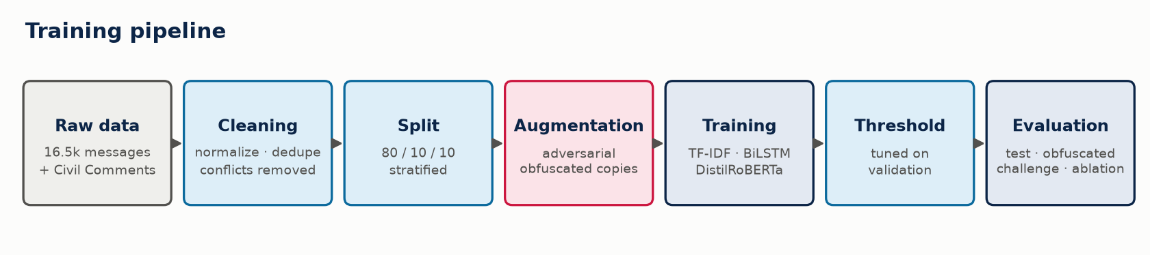
Our approach: an end-to-end pipeline
Clean
Robust
Deep
Explainable
leakage-free data, enriched with real threats
de-obfuscation + adversarial augmentation
BiLSTM and a fine-tuned Transformer vs a strong baseline
severity + the words behind each decision
Notes:
The pipeline goes from raw data to evaluation. Every stage is a module of the sightector Python package and runs from one CLI.

Slide 5
Data: cleaned, de-duplicated and enriched
25,833
messages after cleaning
9,449
added from Civil Comments
106
duplicates removed after normalisation
80/10/10
stratified train / val / test
Notes:
Error analysis of the first models showed almost no threats in the original Wikipedia data. We enriched it with 9.4k real annotated comments: threats, identity attacks, and hard negatives, i.e. clean comments that use words like kill or die harmlessly. Duplicates are removed after normalisation so F*CK YOU and fuck you can never sit on both sides of the split.

Slide 6
Obfuscation-aware normaliser
Input | What the model reads
you are a fu*ck iiidiot | you are a fuck idiot
f u c k you | fuck you
u r a m0r0n | u r a moron
sh!t head | shithead
ѕtupid (Cyrillic) | stupid
kill the process | kill the process (unchanged)
How it works
Unicode folding and look-alike letters
Join spaced letters
Leetspeak, masks and wildcards
Collapse letter elongation
Re-join split words
Every repair validated against a 145-term lexicon: clean text is never rewritten
Notes:
The same function runs at training and at inference. The key design choice is safety: a repair is only applied if the result is a known offensive term, so 4you, class or kill the process are left alone. The decision itself is always made by the neural model.

Slide 7

Adversarial augmentation and honest evaluation
Augmentation
Test
2,584 held-out messages
One obfuscated copy of each harassment message
Noisy copies of half the clean messages: no "weird spelling = toxic" shortcut
20,666 → 33,314 training messages
Obfuscated test
every offensive word disguised (unseen seed)
Challenge
78 hand-written sentences: threats, sexism, tricky clean text
you are an idiot → you are an 1d!0t
Ablation
normaliser × augmentation
Notes:
The challenge set was written by hand and is independent of every dataset. We deliberately did not tune on it, so it remains an honest test of real-world behaviour.

Slide 8



Three models, one interface
TF-IDF + LogReg
BiLSTM + Attention
DistilRoBERTa
Baseline
Deep learning from scratch
Fine-tuned Transformer (deployed)
word 1-2-grams + character 2-5-grams
embeddings → BiLSTM → additive attention · 7.2 M params
6-layer self-attention, byte-level BPE · 82 M params
25 s training
49 s training
7 min on RTX 4060
Shared training loop: BCE loss · AdamW · warm-up · fp16 · gradient clipping · early stopping · threshold tuned on validation
Notes:
All three models implement the same predict_proba interface, so the API and evaluation never depend on a specific model. Self-attention lets the Transformer read each word in context: kill the process versus I will kill you.

Slide 9
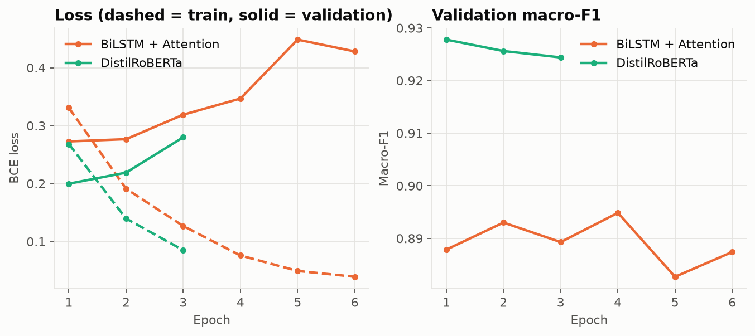
Training: early stopping against noisy labels
Overfits early
Why
Fix
validation loss rises after epoch 1 (Transformer) and epoch 4 (BiLSTM)
label noise in the source data (see error analysis)
early stopping restores the best weights automatically
Notes:
Dashed lines are training loss, solid lines validation loss. The model quickly starts memorising mislabelled examples, so stopping early matters.

Slide 10
Results: DistilRoBERTa is best on every set
92.6 %
test accuracy
0.972
ROC-AUC
0.71 → 0.91
macro-F1 on obfuscated text (v1 → v2)
Notes:
All numbers are measured on data never used for training or model selection. The axis starts at 0.5 to make the differences visible. The legacy model was re-run exactly as it was deployed, including the IDF bug.

Slide 11
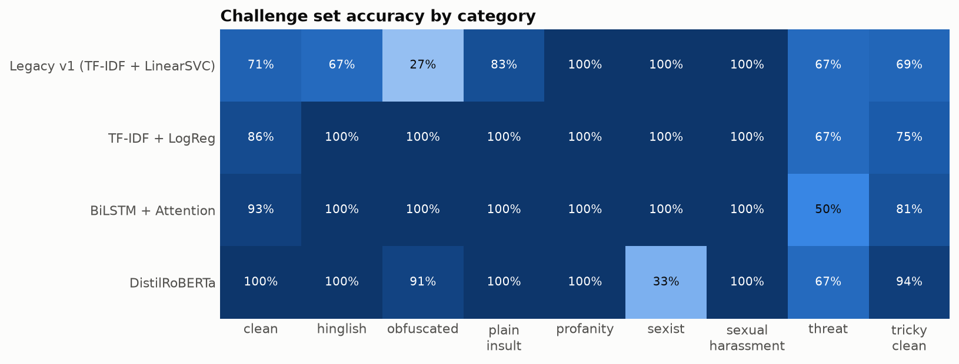
Where each model succeeds: challenge set
Obfuscation: v1 27 % → v2 91-100 %. Context: only the Transformer is right on 94 % of tricky clean sentences. Still hard: implicit threats and stereotype sexism.
Notes:
Precision matters for a tool people trust: on the challenge set DistilRoBERTa reaches 0.977 precision. The keyword-driven models flag kill the process; the Transformer does not.

Slide 12
Ablation: the normaliser is the key component
Normaliser: +5 to +10 points on obfuscated text, no cost on clean text
Augmentation: +2.8 on the challenge set but slightly lower on test: within noise
Next step: several seeds and a larger challenge set
Notes:
We report the augmentation result honestly: it is not a clear win. The augmented copies are normalised before training, so most of the disguise is already removed. The deployed configuration was fixed before the experiment; choosing on the challenge set would turn it into a training signal.

Slide 13


Error analysis: the model often beats the labels
Label noise
Genuine weaknesses
17 of the 31 most confident "false positives" contain explicit insults but are labelled clean in the source data:
Implicit threats: "i know where you live…"
Stereotype sexism: "women belong in the kitchen"
Violent idioms: "shoot me an email"
Fix: targeted data, not better spelling rules
"you fing rat you ratted me out you little prick" → labelled clean
Notes:
Reading the errors one by one shows that many are labelling mistakes in the original dataset; the real error rate is lower than measured. The remaining genuine errors are semantic.

Slide 14
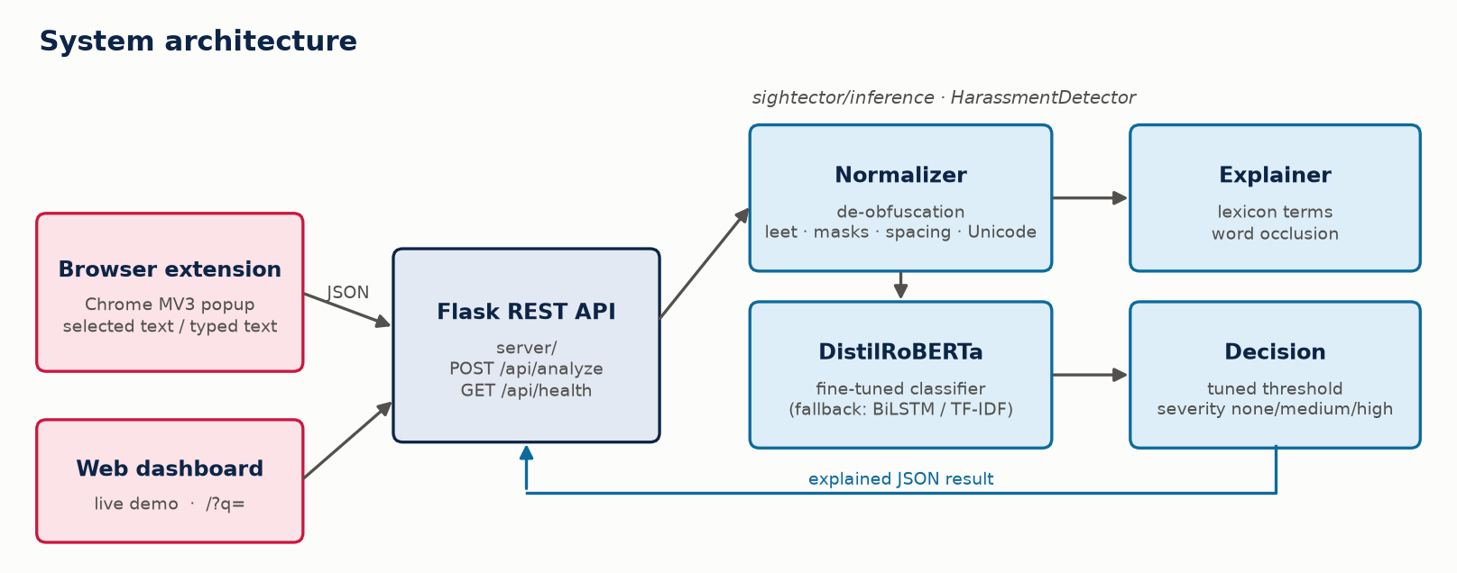
Clean architecture, from model to browser
Layers: text → data → models → training → inference → API
One TextClassifier interface; model fallback
Flask app factory with dependency injection
31 pytest tests · 18 ms per message on CPU
POST /api/analyze → harassment · score · severity · de-obfuscated words · highlights
Notes:
The browser extension and the web dashboard call the same REST API. The detector is injected into the Flask app, which makes the API testable with a fake model in under a second.

Slide 15
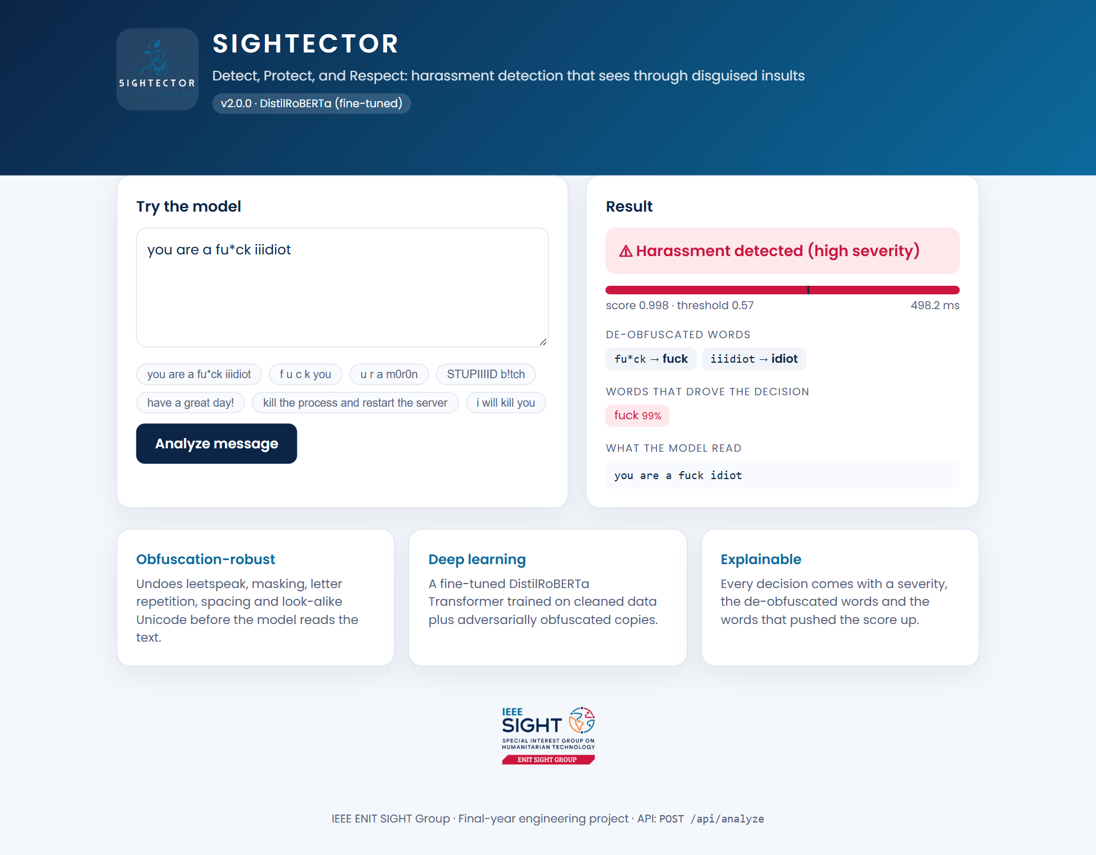
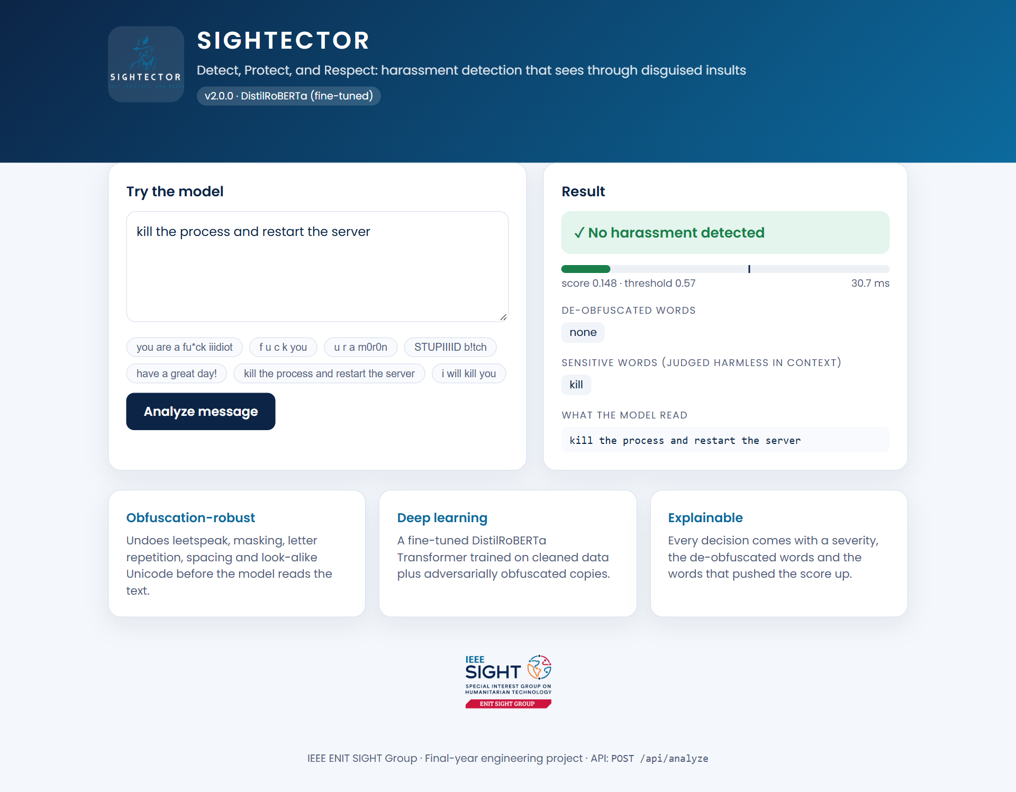
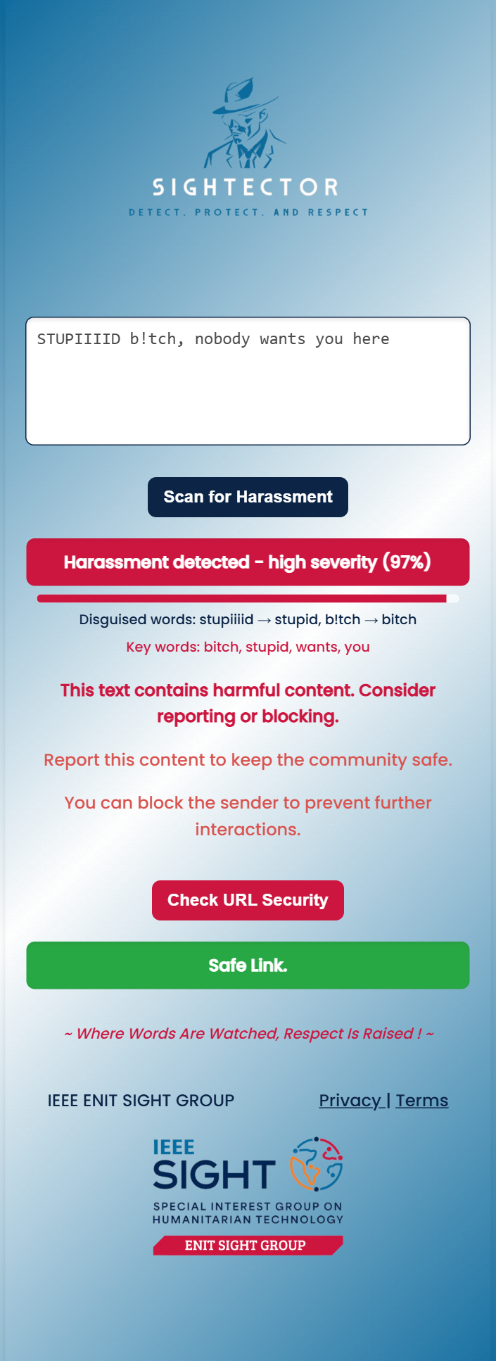
Demo: dashboard and browser extension
fu*ck iiidiot: detected, words decoded
"kill the process": harmless in context
Notes:
Live demo: run python -m server, open the dashboard, and try the example chips. Then load the unpacked extension, select text on any page and click Scan.

Slide 16
Conclusion and future work
Obfuscated text: 0.71 → 0.91 macro-F1; challenge set: 0.63 → 0.91
Next: relabel noisy data, collect implicit threats, add Arabic / French / Tunisian Derja
Next: multi-label heads, larger encoders, in-browser ONNX inference
Thank you · Questions?
Notes:
Summarise: concrete root causes found and fixed, honest evaluation, and a deployable explainable system. Then open questions.

