Slide 1
Site E-commerce
Presentation by yahya Naim

Slide 2
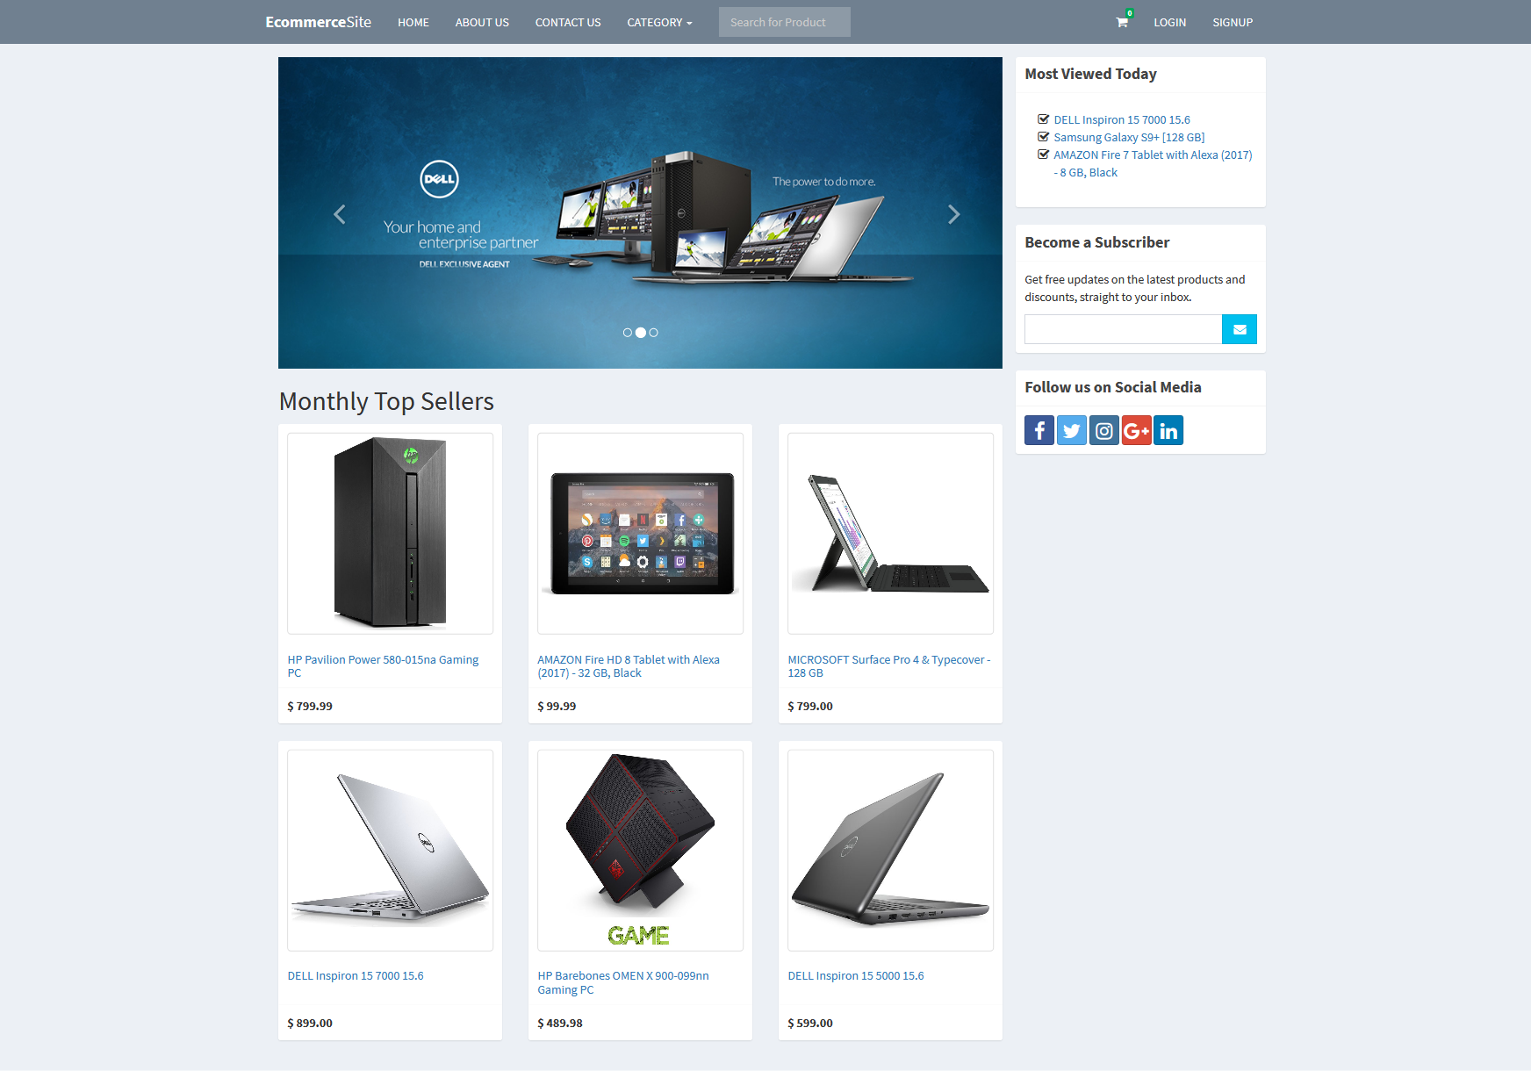
Interface
Home page it content the Monthly Top sellers

Slide 3
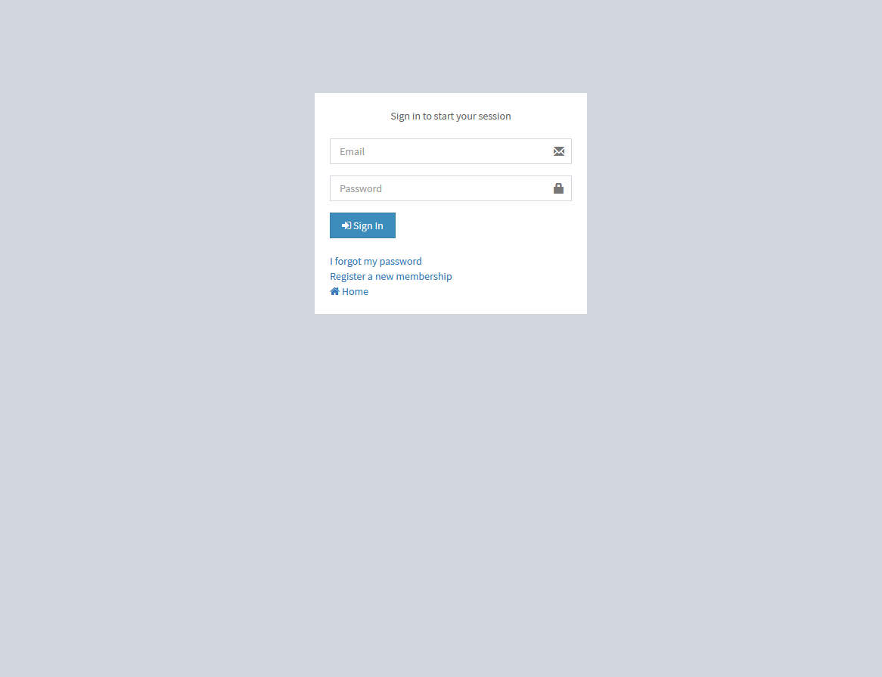
Login
This interface will be actual interface through which the user will communication with the application and perform the desired tasks

Slide 4
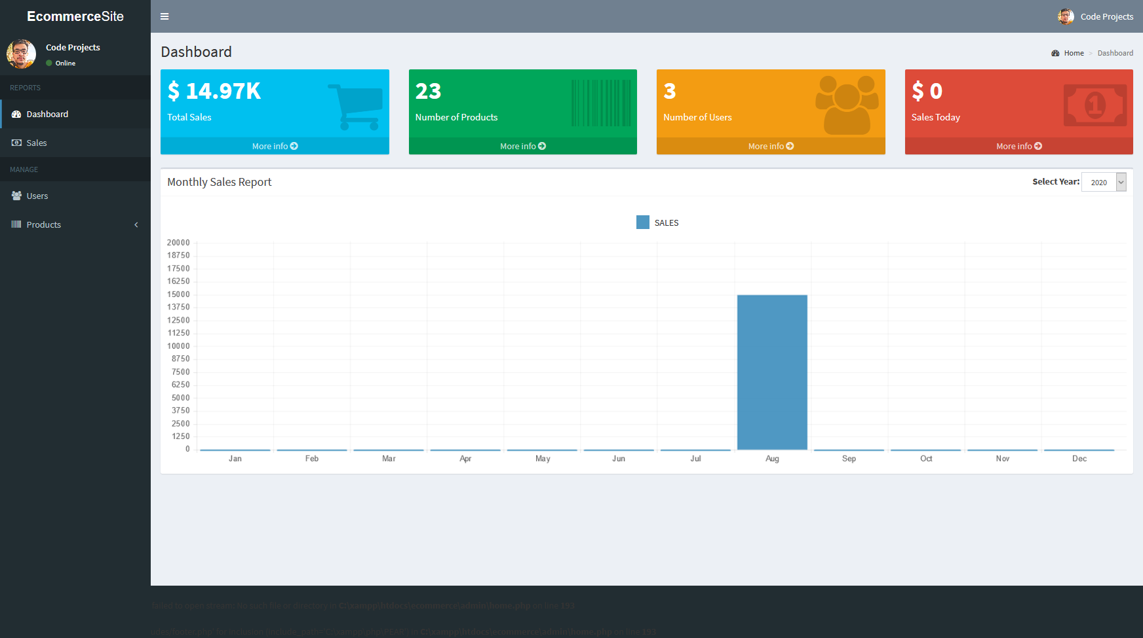
Admin Page
The admin page show the different detail like information
about users and add products ..

Slide 5
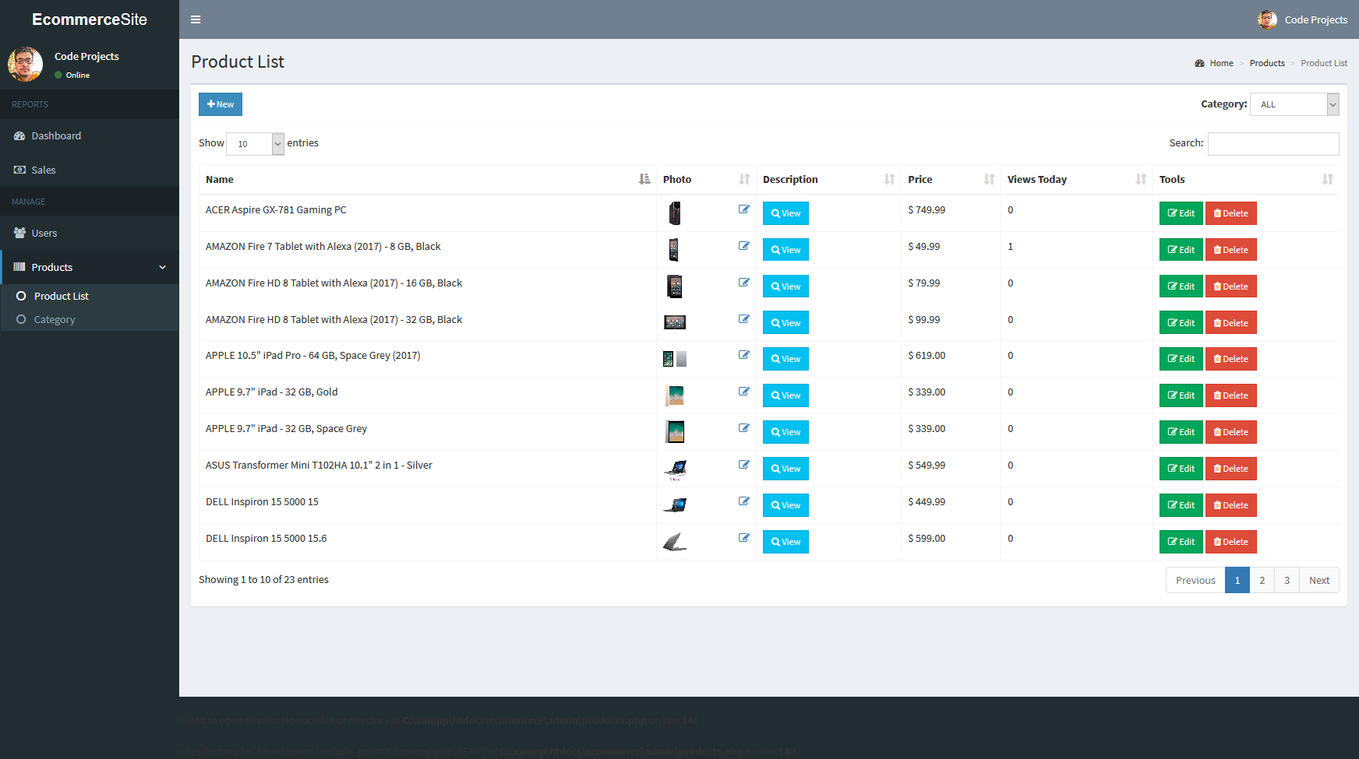
Categories list
This page show the categories and Products list

