Slide 1

00
REPOSITORY REVIEW · PYTHON APPLICATION
Hospital Appointment Management System
A lightweight workflow for patient records, hospital services, and appointment scheduling.
Branch history, architecture, functionality, testing, and demonstration path
INSTRUCTOR PRESENTATION

Slide 2

01
PROJECT RATIONALE
One workflow for a small hospital
PROBLEM
Scheduling is easy to fragment.
Patient details, service definitions, and appointments become difficult to coordinate when they are maintained separately or manually.
RESPONSE
Make the workflow explicit.
The system joins patient records, hospital services, and appointment actions in one lightweight local application.
VALUE
Prevent avoidable errors.
Validation, future-date checks, conflict prevention, and two interfaces make the core process easier to execute consistently.
Repository README: project scope and stated key features.
WHY THIS PROJECT EXISTS

Slide 3

02
FUNCTIONAL SCOPE
Three modules form the core workflow
01
02
03
Patients
Services
Appointments
Register, view, update, and delete records with basic name, phone, and email validation.
Create and manage clinical services with consultation fees and session durations.
Book, list, cancel, resolve IDs to names, and reject invalid or conflicting bookings.
RELIABLE PATIENT DIRECTORY
CONFIGURABLE SERVICE CATALOG
SAFER SCHEDULING PROCESS
End-to-end: register the patient → define the service → book or cancel the appointment.
Source: README key features and module implementations on the final main branch.
WHAT THE SYSTEM DOES

Slide 4
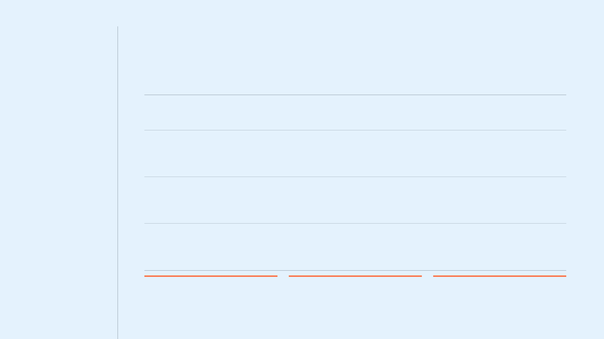
03
TECHNICAL DESIGN
Layered architecture keeps responsibilities separate
01 · INTERFACE
Tkinter GUI + Terminal menus
Collect user actions and display records.
↓
REQUESTS
Validate input, enforce scheduling rules, and coordinate use cases.
02 · RULES
Service classes
↓
READ / WRITE
03 · PERSISTENCE
File handlers
Perform CRUD operations and serialize application records.
↓
STORED LOCALLY
04 · DATA
Text and CSV files under /data
customers.txt · services.txt · appointments.txt
MODELS
STORAGE PATHS
TESTS
Dataclasses define the patient/customer, service, and appointment records passed between layers.
A shared module creates the data directory and exposes centralized file locations.
Unittest modules exercise models, persistence, business rules, and terminal behavior.
HOW THE SYSTEM IS BUILT
Source: final main-branch package structure and README architecture section.

Slide 5

04
DOMAIN MODEL
The model is small, explicit, and connected
ENTITY 01
CONNECTOR ENTITY
ENTITY 03
Patient record
Appointment
Service
id, customer_id
CUSTOMER_ID
service_id
SERVICE_ID
id, name
id, name
date, start time
price
phone, email
status
duration_minutes
Stored by the code as Customer
PERSISTENCE
Patient and service records use pipe-delimited local text files; appointments use CSV rows, preserving the link through identifiers and a status field.
Source: models, file handlers, storage paths, and appointment service on the final main branch.
DATA STRUCTURE

Slide 6

05
APPOINTMENT SERVICE
Booking logic protects data quality
01
Check valid identifiers
STATE BEHAVIOR
Patient and service IDs must be positive integers before the booking process continues.
02
Check date and time format
Scheduled
The service accepts only YYYY-MM-DD and HH:MM input patterns.
Valid appointments are stored in the CSV file and continue to reserve their service-specific slot.
03
Reject past appointments
The combined appointment date and start time must be later than the current local date and time.
↓
04
Confirm linked records exist
Injected checker functions verify that the selected patient and service are available in their own modules.
Cancelled
05
Prevent active slot conflicts
Cancellation preserves the record for history but removes it from future slot-conflict checks.
An active booking cannot reuse the same service, date, and start time combination.
06
Persist a traceable status
Design implication: the system preserves operational history without permanently blocking a reusable time slot.
A successful record starts as scheduled; cancellation updates the same record to cancelled.
Source: app/services/appointment_service.py and app/file_handlers/appointment_file_handler.py on the final main branch.
BUSINESS RULES IN ACTION

Slide 7

06
ACCESS MODES
Two interfaces share the same business rules
DESKTOP WORKFLOW
COMMAND WORKFLOW
Tkinter GUI
Terminal menus
Notebook tabs organize Patients, Services, and Appointments. Treeviews make records readable; buttons and dialogs communicate actions and validation feedback.
Interactive menus route users through the same patient, service, booking, cancellation, update, and listing tasks using clear prompts and printed outcomes.
Tabs · forms · tables · confirmation dialogs
Menus · prompts · lists · validation messages
SHARED CORE
Both paths call the service layer.
Validation and persistence are centralized in the service and file-handler classes, so the underlying scheduling behavior stays consistent even when the user experience changes.
Source:
main.py
,
app/gui/
,
app/terminal/
, and
app/services/
on the final main branch.
USER EXPERIENCE

Slide 8

07
REPOSITORY EVOLUTION
Branches show incremental team delivery
The commit history moves from a GUI skeleton to integrated patient, service, and appointment
management—then documents the final system on
main
.
12 AUG 2026
15 AUG 2026
15 AUG 2026
15 AUG 2026
15 AUG 2026
developer-1-
feature/
developer-2-
developer-3-
main
customer
updates
service
appointment
Merged feature work and finalized README scope, architecture, and setup guidance.
Established the Tkinter GUI skeleton and application entry point.
Corrected patient persistence logic, terminal behavior, and unit tests.
Integrated service management with its interface and test work.
Refined appointment interfaces and standardized user-facing Patient terminology.
INTEGRATION
Five branches, 17 commits, one final application. Switching through branch tips makes the collaborative progression visible and traceable.
Source: Git branch tips and commit history reviewed from the public repository.
HOW THE TEAM DELIVERED

