Slide 1
Road Pothole Detection System
IoT + AI Based Smart Road Monitoring Device

Slide 2
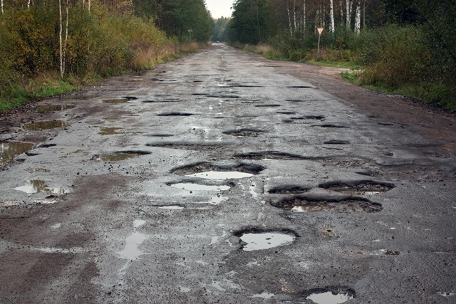
The Obvious Problem
• Potholes pose serious safety risks to vehicles and road users
• Manual inspection is slow, costly, and difficult to scale
• Many potholes go unreported until accidents occur
• Need for automated, real-time road condition monitoring
Our Solution
Build a low-cost system that automatically detects potholes, records their GPS coordinates, estimates their severity, and displays them on a digital map.

Slide 3
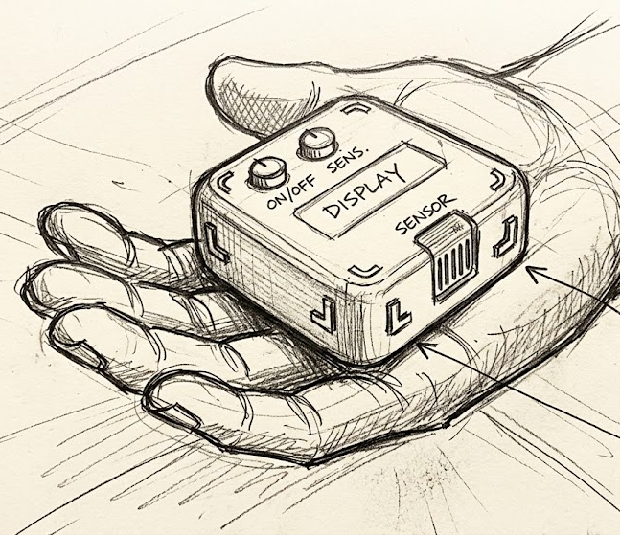
Primary Objectives of RPDS
• Detect potholes using vehicle vibration data (MPU6050)
• Capture precise location using GPS module
• Transmit detection events to backend server via Wi-Fi/4G
• Visualize pothole locations on interactive digital map
• Classify potholes by severity using ML techniques
• Reduce false detections through signal processing

Slide 4
Basic Working Architecture
Vehicle-mounted IoT system detects/identifies the abnormal vertical acceleration caused by road potholes and associates each detected event with its GPS location, sending the event to the backend server to process and visualize in map.
Vehicle
Accelerometer
ESP32
GPS
Wi-Fi/4G/BLUETOOTH
Database
Backend Server
Dashboard

Slide 5
Hardware Used
Component | Purpose
ESP32 | Main Microcontroller & Wi-Fi
MPU6050 | 3-Axis Accelerometer
NEO-6M GPS | Location Tracking
OLED Display | Status Display
Buzzer | Local Alert
Power Bank / Battery | Portable Power Supply

Slide 6
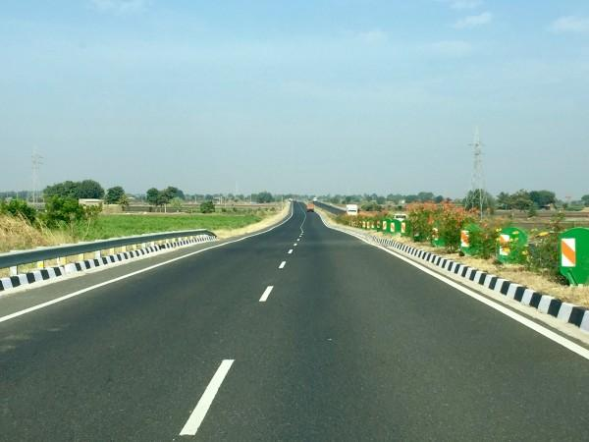
Working Principle
The accelerometer (MPU6050) detects sudden changes in vertical acceleration (Z-axis) when there is a pothole on the road. These changes are further processed in the backend for a clear identification of the pothole.
Detection Axes:
• X-axis: Longitudinal
• Y-axis: Lateral
• Z-axis: Vertical (Critical)
No Pothole Spike
False Positive Sources:
• Speed breakers
• Braking/Acceleration
• Rough roads
Pothole Spike
• Sharp turns

Slide 7

Data & ML Approach in RPDS
Dataset Format
timestamp, ax, ay, az, speed, lat, lon, label
• NORMAL
• POTHOLE
• SPEED BREAKER
• ROUGH ROAD
ML Model: Random Forest
• Small dataset friendly
• Fast & interpretable
• Low compute overhead
• Suitable for prototype

Slide 8
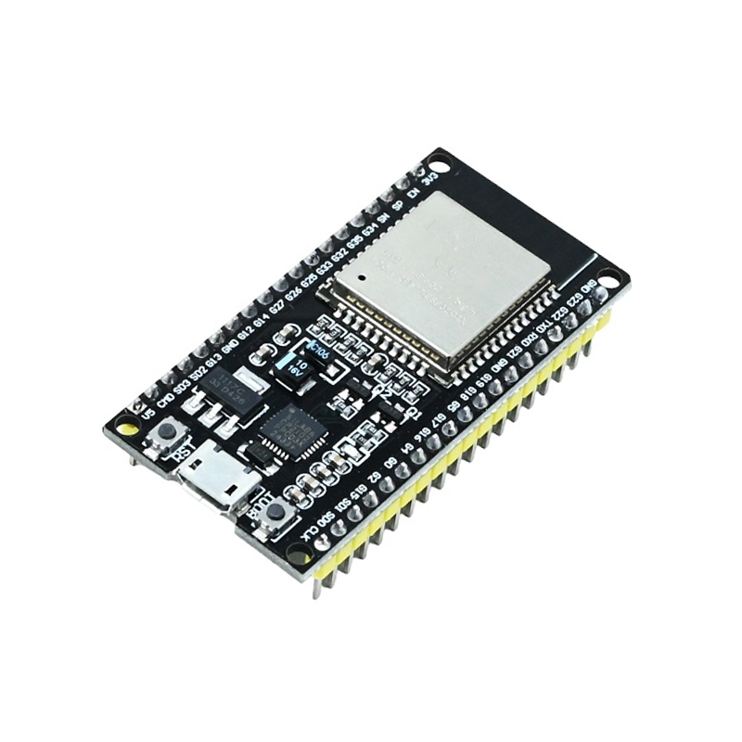



Technology Stack of RPDS
IoT/Hardware
ESP32, MPU6050, GPS, OLED
Backend
Python, FastAPI
Database
Appwrite Cloud
Frontend
React, mapcn, tailwind, Vite
ML
scikit-learn, Random Forest
Comm.
Wi-Fi / 4G / Bluetooth

Slide 9
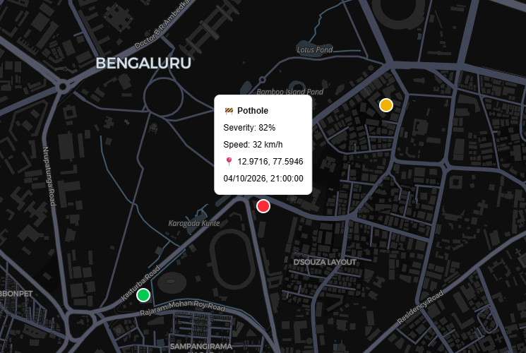
Sample Dashboard & Visualization
Pothole Event JSON
{
"event": "pothole",
"lat": 12.9716,
"lon": 77.5946,
"severity": 0.82,
"speed": 32,
"timestamp": "2026-10-04T21:00:00"
}
Features
• Real-time location plotting
• Historical data view
• Date/Severity filtering
• Interactive map UI

Slide 10
Major Advantages of RPDS
• Low-cost & affordable solution
• Automated & real-time detection
• Accurate GPS tagging
• Scalable IoT architecture
• Improves with more data
• Practical for smart city applications

Slide 11
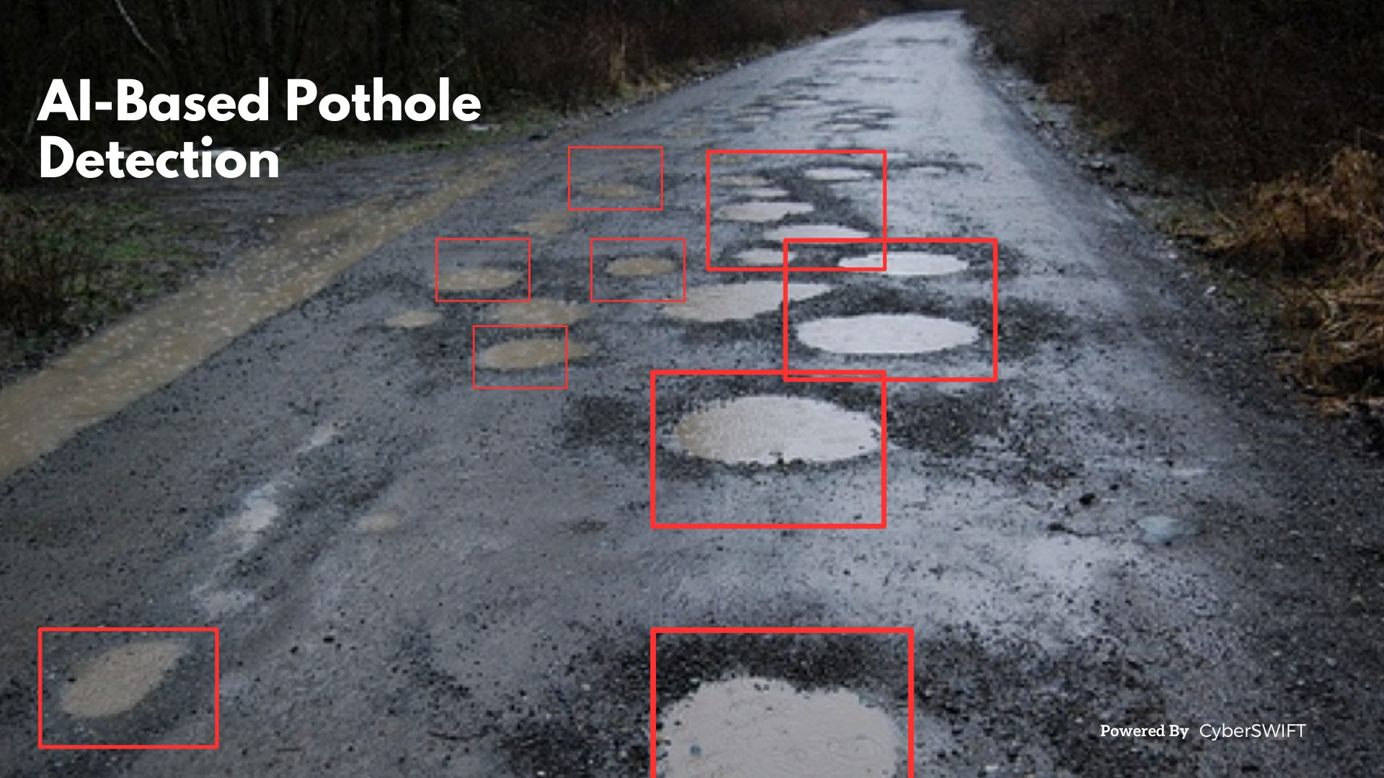
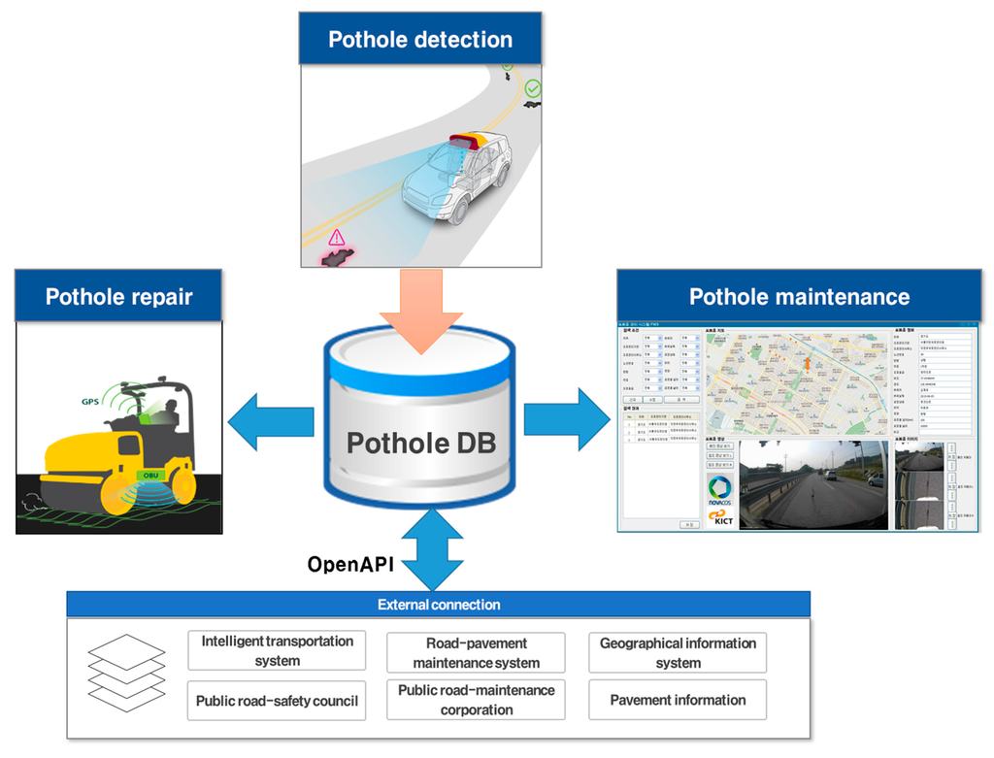
Major Challenges & Future Scope
Challenges
• False positives
• Vehicle variations
• GPS accuracy
• Limited training data
Future Scope
• Camera + YOLO (Sensor Fusion)
• Edge AI optimization
• Crowdsourced reporting
• Road quality heatmaps
• Log to Government

Slide 12
SDG 11 - Sustainable Cities and Communities. Pot-Hole detection and possible remedies
SDG 9: Industry, Innovation, and Infrastructure
​Justification: RPDS leverages IoT hardware (ESP32, MPU6050 accelerometer, NEO-6M GPS) and Machine Learning (Random Forest) to upgrade public road infrastructure monitoring. Replacing manual, slow, and expensive inspections with automated, data-driven, real-time mapping directly builds resilient transport infrastructure.
​SDG 11: Sustainable Cities and Communities
​Justification: Target 11.2 focuses on providing access to safe, affordable, accessible, and sustainable transport systems for all and improving road safety. RPDS identifies hazardous road defects and maps them on a digital dashboard in real time, allowing municipal authorities to perform proactive repairs and protect road users.
​SDG 3: Good Health and Well-Being
​Justification: Target 3.6 aims to halve the number of global deaths and injuries from road traffic accidents. Unreported potholes frequently cause sudden vehicle loss of control, severe accidents, and physical injuries. RPDS reduces collision risks by enabling early detection and rapid repair.

Slide 13
Conclusion
• Combines IoT sensors, GPS, ML & mapping effectively
• Cost-effective solution for road condition monitoring
• Enables proactive road maintenance
• Scalable with clear enhancement path
• Start simple → Collect data → Improve continuously

Slide 14
Thank You

