Slide 1


TEXLINK TECHNOLOGIES
STRATEGIC DTV
Ai-Native
Manufacturing
Intelligence
Platform.
AI MIP
Factory-tested for 5 years inside live production — opening its gates June 2026.
YAI · INVESTOR PLAN · JUNE 2026

Slide 2
01 / EXECUTIVE SUMMARY
TEXLINK TECHNOLOGIES
STRATEGIC DTV
Executive Summary
Yai is Ai MIP — Agentic Manufacturing Intelligence. A three-layer platform that modernises production from whole-paper-based to executive Ai.
AI AGENTS
ENGINEERS
10
20
Stand ready
From Cambodia
DEVELOPMENT
INDUSTRY XP
36 mo
40 yrs
Factory-tested
Tech + management
Yai · Investor Plan · June 2026

Slide 3
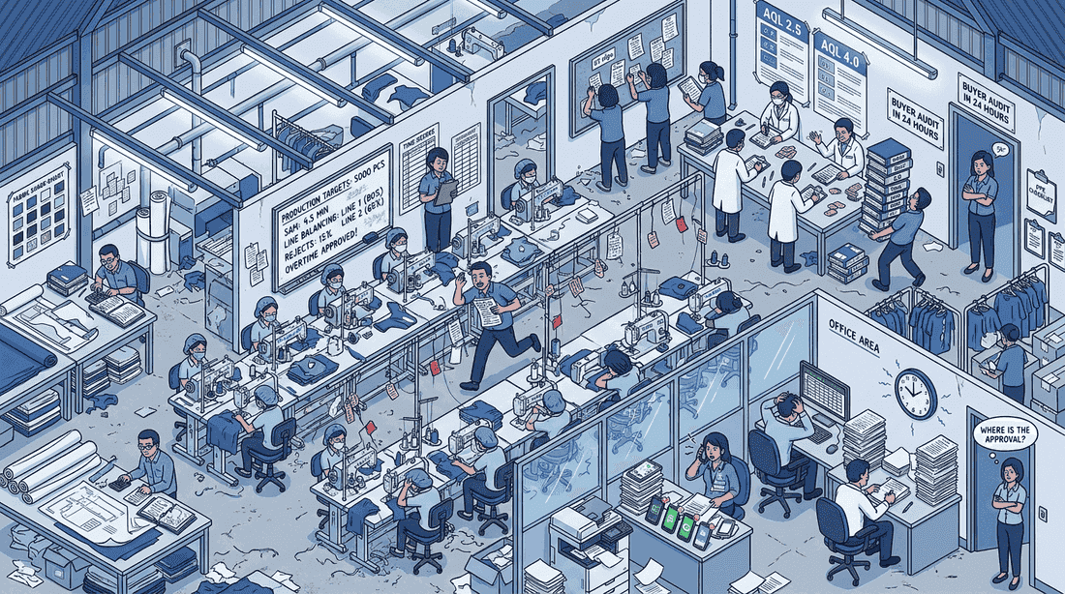
02 / THE PROBLEM
TEXLINK TECHNOLOGIES
STRATEGIC DTV
The Sandwich.
Cambodia's garment industry is squeezed between Chinese ownership / management practices and Western buyer audits — paper, Excel and 4 chat apps in the middle.
FLOOR CHAOS
LEGACY ATTEMPTS
Paper
$2M
Tally sheets, defect tags
~20 systems · none integrated
COMPLIANCE
TIME COST
Mandate
24 hr
Ministry of Environment
Audit-panic binder runs
Yai · Investor Plan · June 2026

Slide 4

03 / THE SOLUTION
TEXLINK TECHNOLOGIES
STRATEGIC DTV
An Ai Platform that Saves Jobs.
One Ai-native platform consolidates legacy systems. Workers keep their jobs — the work gets smarter.
One database — barcodes, QR, AIoT sensors, mobile apps. Single source of truth.
Agentic layer — Claude / GPT / Gemini agents speak Khmer + run workflows for workers.
Full-Ai layer — solar-powered Ai Server enables own-LLM inference + 5G bonding.
Worker-respecting — every screen + voice assistant in Khmer. No HR detour.
Compliance-ready — EMR, worker, tax, labour data filed digitally on time.
Yai · Investor Plan · June 2026

Slide 5
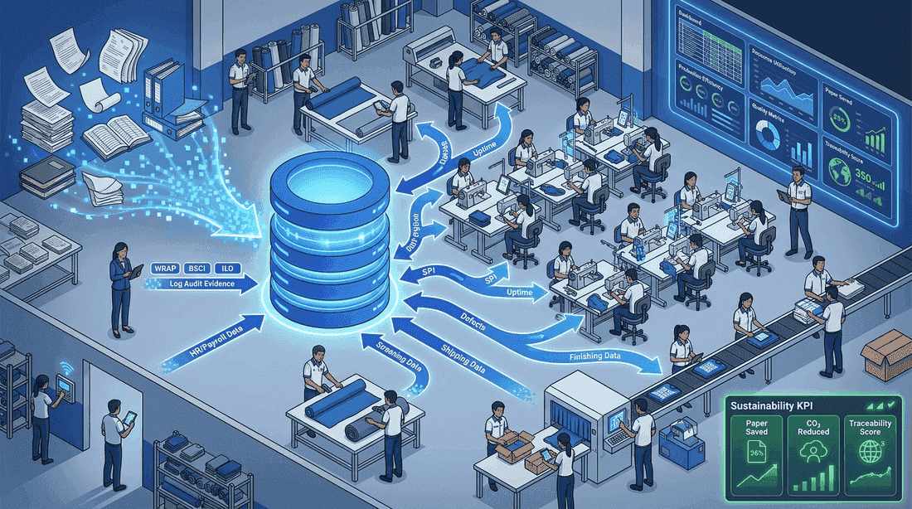
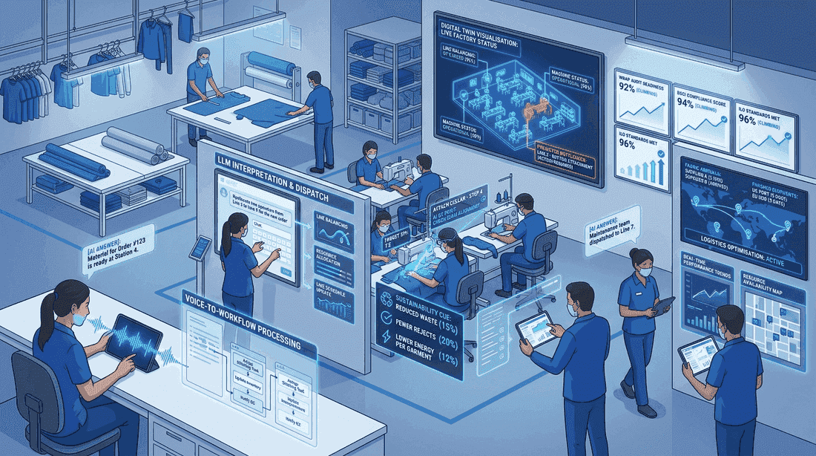
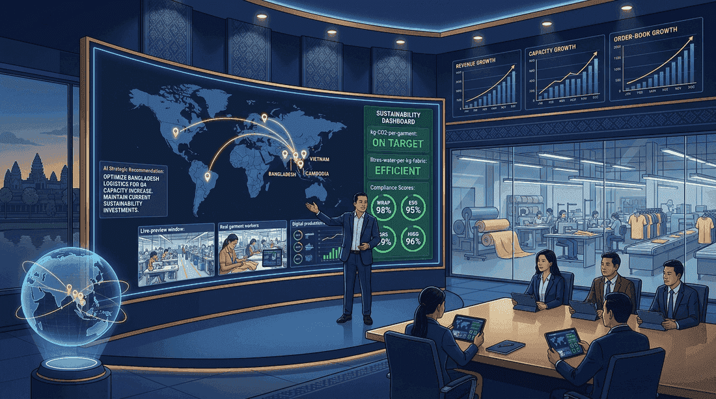
04 / PRODUCT ARCHITECTURE
TEXLINK TECHNOLOGIES
STRATEGIC DTV
From Paper to Full Ai — Three Yai Layers.
LAYER 1
LAYER 2
LAYER 3
Digitalisation
Agentic
Full Ai
Centralised data — Excel + paper records flow into ONE database. Barcode + QR, AIoT, mobile apps. One source of truth.
LLM-powered agents. Voice-to-workflow, text interpretation, logistics optimisation, real-time Ai guidance.
Strategic management. Predictive growth, multi-factory orchestration, business expansion, global growth.
Yai · Investor Plan · June 2026

Slide 6







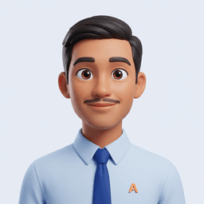

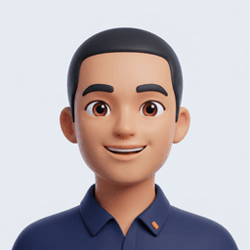
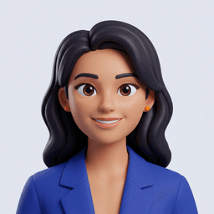




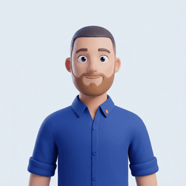








05 / AGENTS & SKILLS
TEXLINK TECHNOLOGIES
STRATEGIC DTV
The Agents & Their Skills.
17 module families across Administration + Operations — each with its own Ai agents.
ADMINISTRATION
PLATFORM
OPERATIONS
AGENTIC ★
9 modules
1 module · core
8 modules
2 live
Yai · Investor Plan · June 2026

Slide 7
06 / PRICING & PACKAGING
TEXLINK TECHNOLOGIES
STRATEGIC DTV
Pricing & Packaging.
Six-step staircase — land at $120 / yr, expand step by step to $5K Big Ai Brain.
STEP 1
STEP 3
STEP 5
Cloud Starter
STEP 2
Cloud Enterprise
STEP 4
Agentic Add-on
STEP 6
$120 / yr
Cloud Growth
$1,200 / yr
Ai Server + Tools
$5,000 / yr
Big Ai Brain
$750 / yr
$2.5K + $3.5K
$5,000 / yr
5 key members
300 → 1,000 users
10 agents + 35 mini
5 → 300 users
1,000+ users · Admin + Ops Tools
Boss · 5 factories · 1 chat
Yai · Investor Plan · June 2026

Slide 8
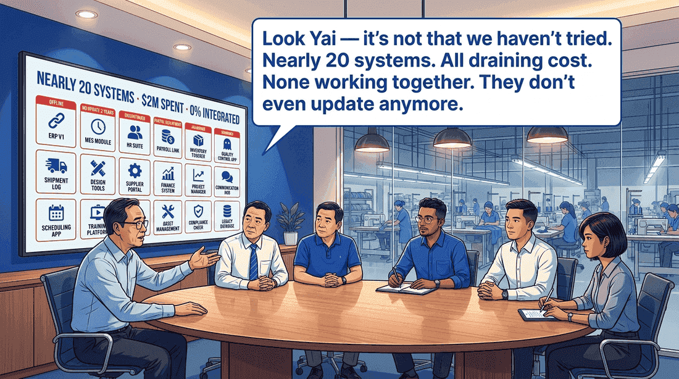
07 / TARGET CUSTOMERS
TEXLINK TECHNOLOGIES
STRATEGIC DTV
Target Customers.
HK / Cambodian factory owners running 1–5 garment sites — already burned $2M+ on legacy ERPs.
ANCHOR
PROFILE
Cambodia
1–5 sites
300+ factories
$2M+ legacy
WORKERS
MARKETS
100K+
ASEAN 3×
Garment workers
Vietnam · BD · ID
Yai · Investor Plan · June 2026

Slide 9

08 / TECHNOLOGY STACK
TEXLINK TECHNOLOGIES
STRATEGIC DTV
Technology Stack.
Backbone — Laravel + MongoDB (Ai-native shape). Write-heavy factory telemetry.
Mobile — native Android + iOS, built for low-end devices on the floor.
AIoT — MQTT + TUYA · SMART Gate · SMART Camera · 5G bonding for rural sites.
Ai layer — LLM APIs (Claude · GPT · Gemini); agentic chat in mobile app.
Edge — solar-powered mini-PC Ai Server (Step 4) for own-LLM inference.
Connectivity — 5G internal WiFi mesh for workers on the floor.
Yai · Investor Plan · June 2026

Slide 10



















09 / TEAM
TEXLINK TECHNOLOGIES
STRATEGIC DTV
Engineering — 5 Clusters · 20 Engineers.
Texlink Admin
3 engineers
Architecture
4 engineers
Neural Net + Finance
4 engineers
Mobile Apps
3 engineers
Operations Systems
5 engineers
Cambodia-anchored · 20 engineers + Sophy + Bonus pool · ASEAN expansion Year 2.
Yai · Investor Plan · June 2026

Slide 11

10 / CAPITAL EFFICIENCY
TEXLINK TECHNOLOGIES
STRATEGIC DTV
The Capital Efficiency Story.
$205K of Cambodia engineering built what Singapore prices at $5M and the US at $10M+.
CAMBODIA 🇰🇭
$205K
Through Q2 2026 — actual build
SINGAPORE · 3×
$5M
Equivalent at SEA-tier rates
UNITED STATES · 8×
$10M+
Equivalent at US engineering rates
Yai · Investor Plan · June 2026

Slide 12

11 / GO-TO-MARKET MILESTONES
TEXLINK TECHNOLOGIES
STRATEGIC DTV
Go-to-Market Milestones.
1
Q1 · FOUNDATION
3–5 paid contracts · Anthropic CPN review cleared.
2
Q2 · VALIDATION
10+ customers · Ministry pilot signed.
3
Q3 · EXPANSION
20+ customers · regional ASEAN pilot.
4
Q4 · SCALE
30+ customers · CCAF cert · Stage 3 scoped.
Yai · Investor Plan · June 2026

Slide 13
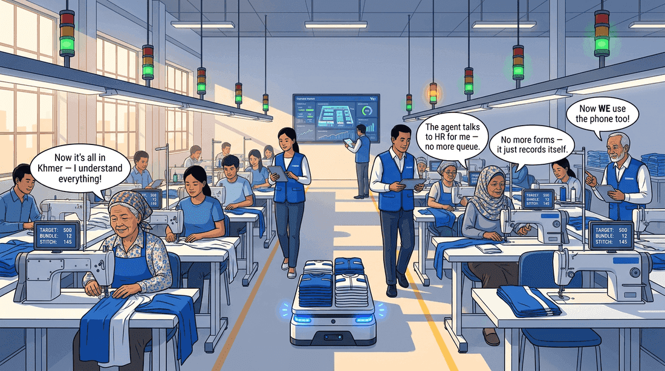
12 / TRACTION & PILOTS
TEXLINK TECHNOLOGIES
STRATEGIC DTV
Traction & Pilots.
5 years inside live garment-factory production. Real workers. Real shifts. Real defects.
PILOT SITES
YEARS RUNNING
2
5 yrs
Anonymised live
Continuous
AGENTIC ★
MODULE FAMILIES
2
18
Car Booking · YPM/CE
All exercised on floor
Yai · Investor Plan · June 2026

Slide 14
13 / OC & LIVE BUDGET
TEXLINK TECHNOLOGIES
STRATEGIC DTV
OC & Live Budget Update.
Live P&L roll-up · sourced from admin (Sales · Salaries · Capex).
01 · INCOME
02 · EXPENSES
11 streams
20 active
8 SaaS + 3 e-com · Jun 2026 start
Engineers · salary base
03 · CAPEX
04 · NET
7 cats
Live
Computers · Villa · Ai Fees
Income − (Salaries + Capex)
Yai · Investor Plan · June 2026

Slide 15
14 / COMPETITIVE LANDSCAPE
TEXLINK TECHNOLOGIES
STRATEGIC DTV
Competitive Landscape.
INCUMBENT ERPs
DEFAULT TOOL
YAI
SAP · Oracle
Excel + Chat
Ai-Native MIP
English-only · $millions · 18+ months deploy · no factory floor.
Zero cost, zero integration. The chaos Yai replaces.
Khmer-first · factory-native · Ai from day one · solar-powered Ai Server.
Yai · Investor Plan · June 2026

Slide 16
15 / RISKS & MITIGATIONS
TEXLINK TECHNOLOGIES
STRATEGIC DTV
Risks & Mitigations.
Adoption / change resistance
Government compliance mandate + buyer audits — paper isn't optional.
Technical complexity
5 years of live pilot validation. Architecture proven before commercial open.
Capital intensity Year 1–2
$205K capital efficiency proves scale on modest funding. <$1M raise needed.
Geographic concentration
Cambodia is anchor not ceiling. ASEAN Year 2; global Year 4–5.
LLM cost / dependency
Step 4 own-Ai-Server (solar-powered) cuts inference cost + data sovereignty.
Yai · Investor Plan · June 2026

Slide 17

16 / RESOURCE REQUIREMENTS
TEXLINK TECHNOLOGIES
STRATEGIC DTV
Resource Requirements.
Modest funding ask — Year 1–2 path to commercial open + 30+ paying customers.
RAISE TARGET
$1M
Year 1 runway · team scale + first 10 customers
HEADCOUNT GROWTH
20 → 60
Year 1 → 3 · Cambodia-anchored
BURN PACE
$30–40K
Per month from Jun 2026
Yai · Investor Plan · June 2026

Slide 18
17 / APPENDIX
TEXLINK TECHNOLOGIES
STRATEGIC DTV
Appendix.
Supporting material — demos, diagrams, references, and contact.
A1. Demo screenshots — admin dashboard + mobile agentic chat (live demos in the portal).
A2. Architecture diagrams — three-layer stack + AIoT mesh.
A3. Pilot factory references — anonymised, available on request under NDA.
A4. Founder bio — Gamini K, Director, Texlink Technologies Co., Ltd. (Cambodia).
Live portal · yai-plan-production.up.railway.app · admin feeders + investor view
Yai · Investor Plan · June 2026

