Slide 1
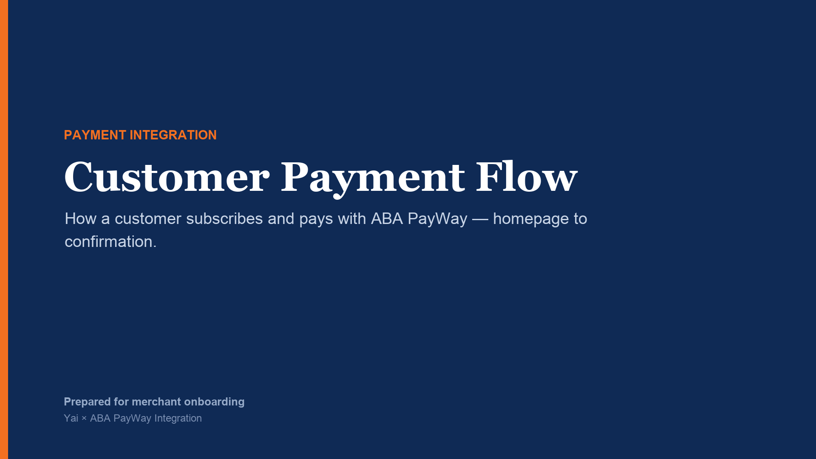

Slide 2
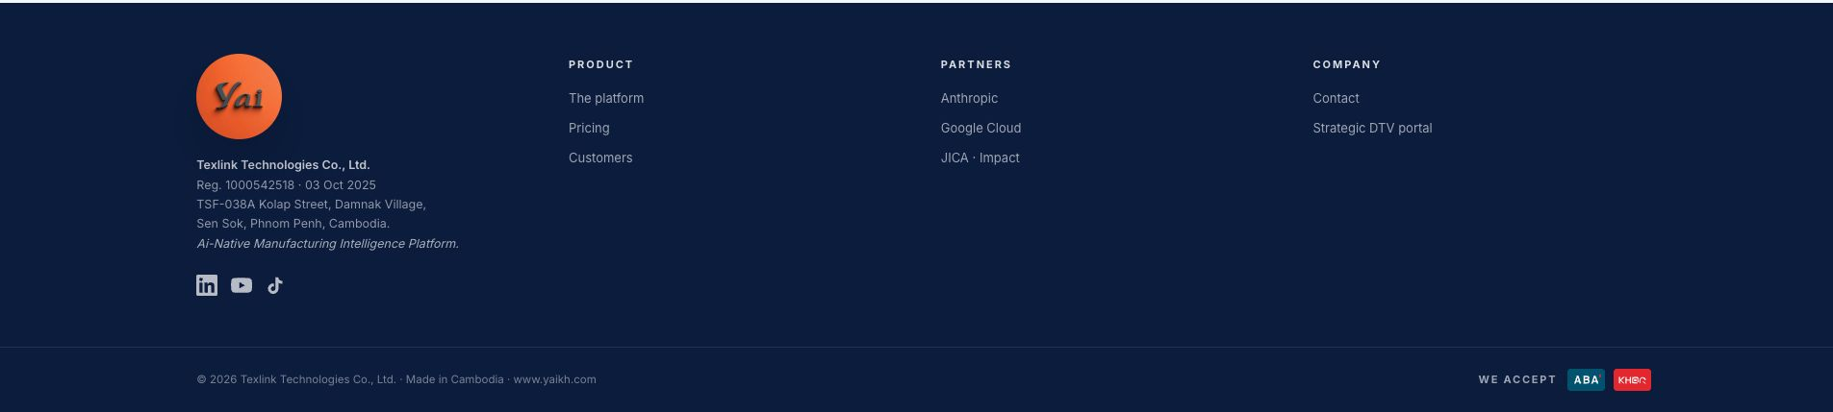
We accept label footer
Notes:
[Sources]
- Yai website footer: local application capture.

Slide 3


Slide 4
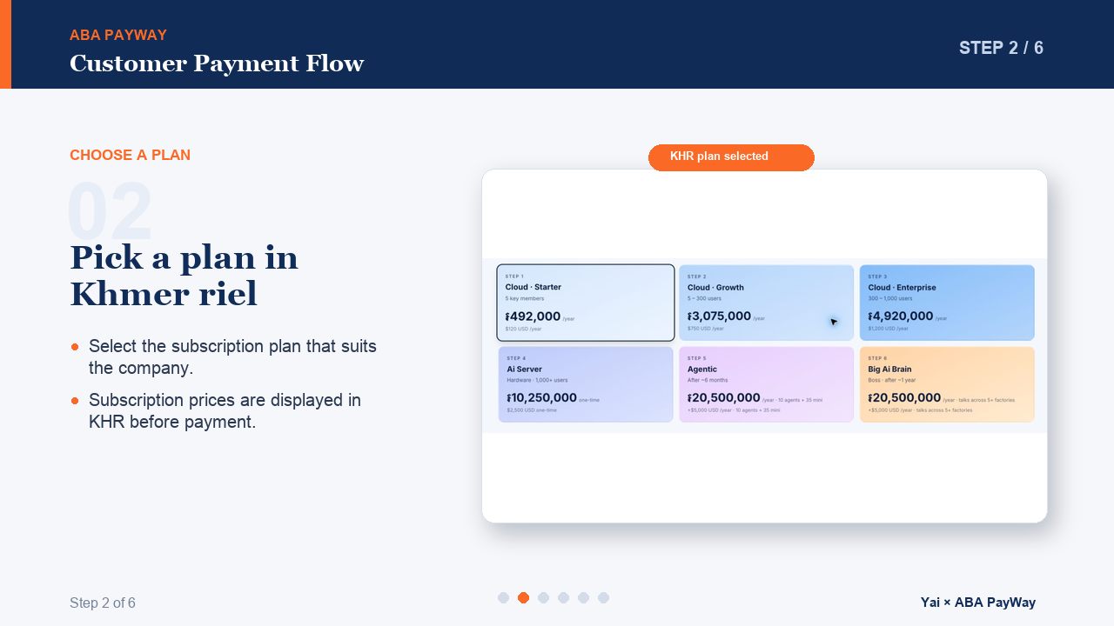
Notes:
[Sources]
- Yai KHR checkout, thank-you page, and footer: local application captures.
- ABA PayWay QR, scanned, and success states: user-provided screenshots.

Slide 5
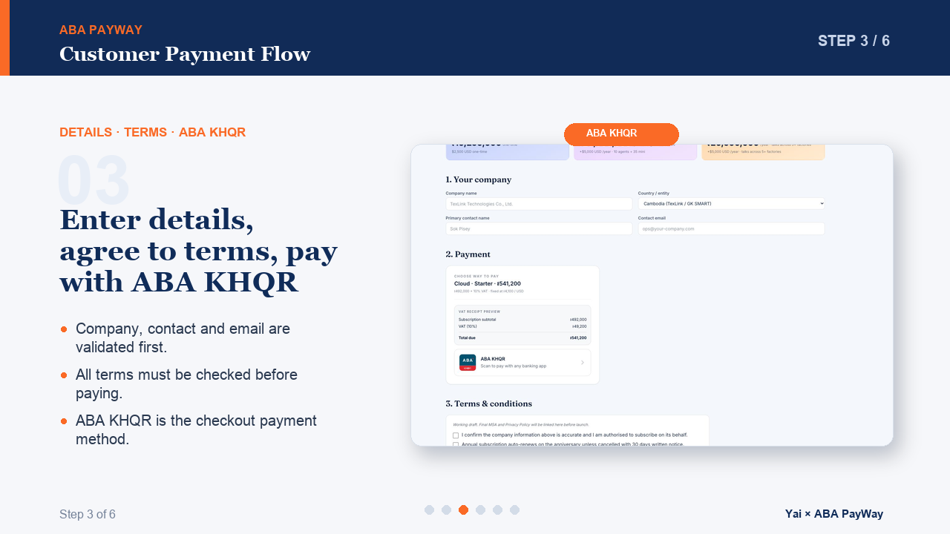
Notes:
[Sources]
- Yai KHR checkout, thank-you page, and footer: local application captures.
- ABA PayWay QR, scanned, and success states: user-provided screenshots.

Slide 6
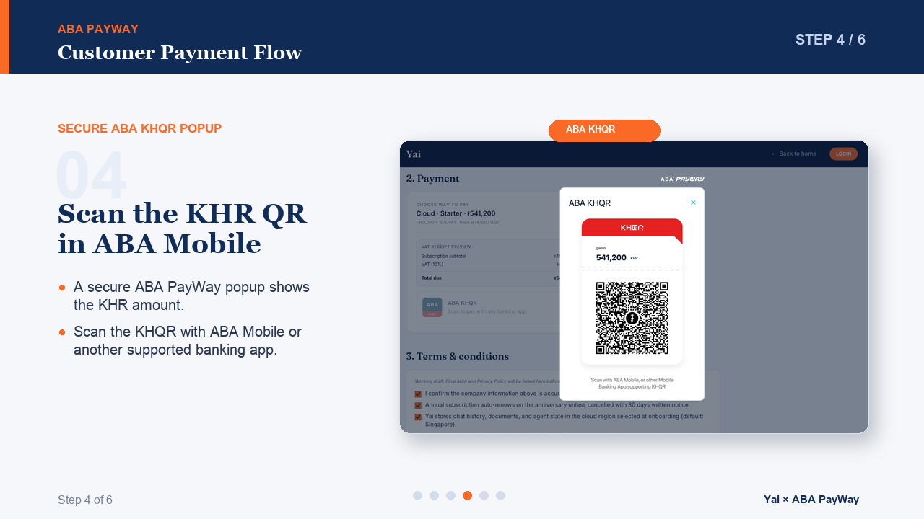
Notes:
[Sources]
- Yai KHR checkout, thank-you page, and footer: local application captures.
- ABA PayWay QR, scanned, and success states: user-provided screenshots.

Slide 7
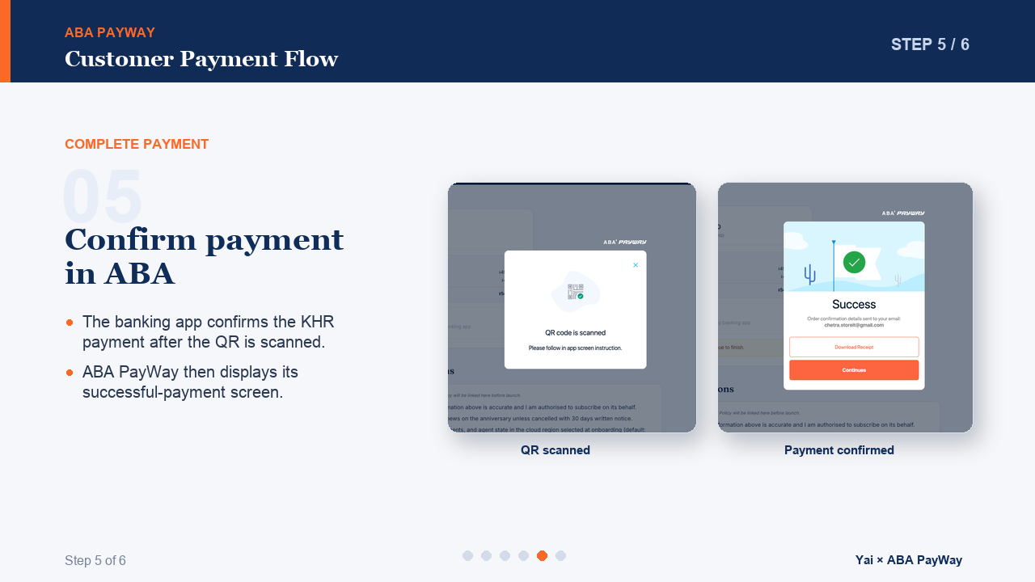
Notes:
[Sources]
- Yai KHR checkout, thank-you page, and footer: local application captures.
- ABA PayWay QR, scanned, and success states: user-provided screenshots.

Slide 8
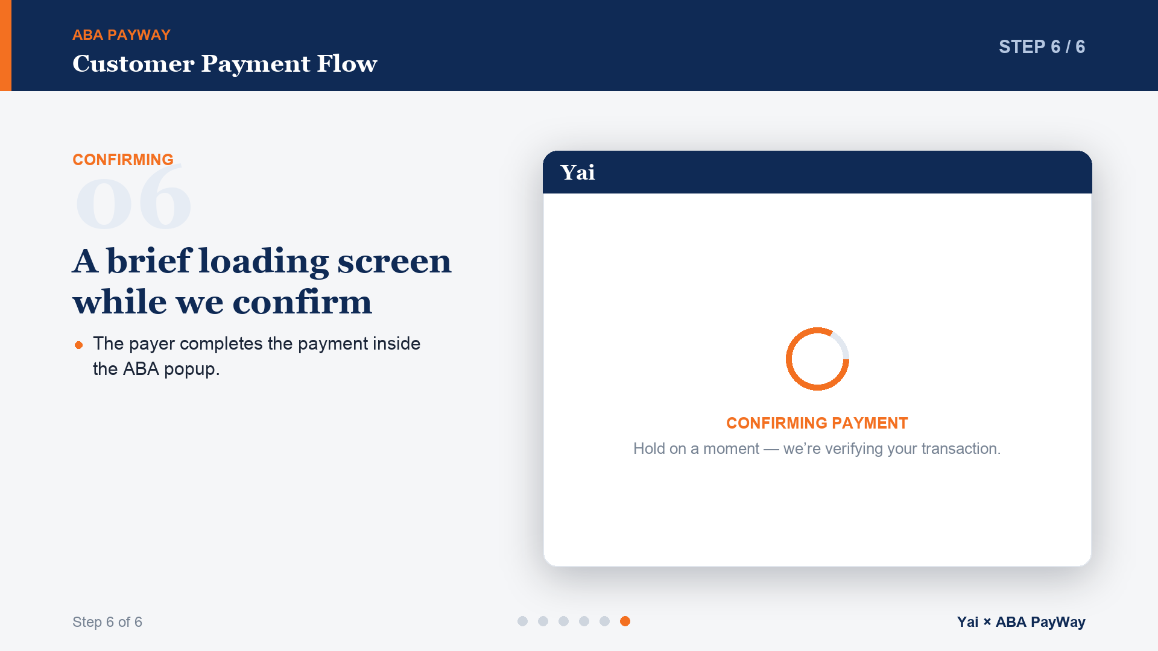

Slide 9

Notes:
[Sources]
- Yai KHR checkout, thank-you page, and footer: local application captures.
- ABA PayWay QR, scanned, and success states: user-provided screenshots.

Slide 10
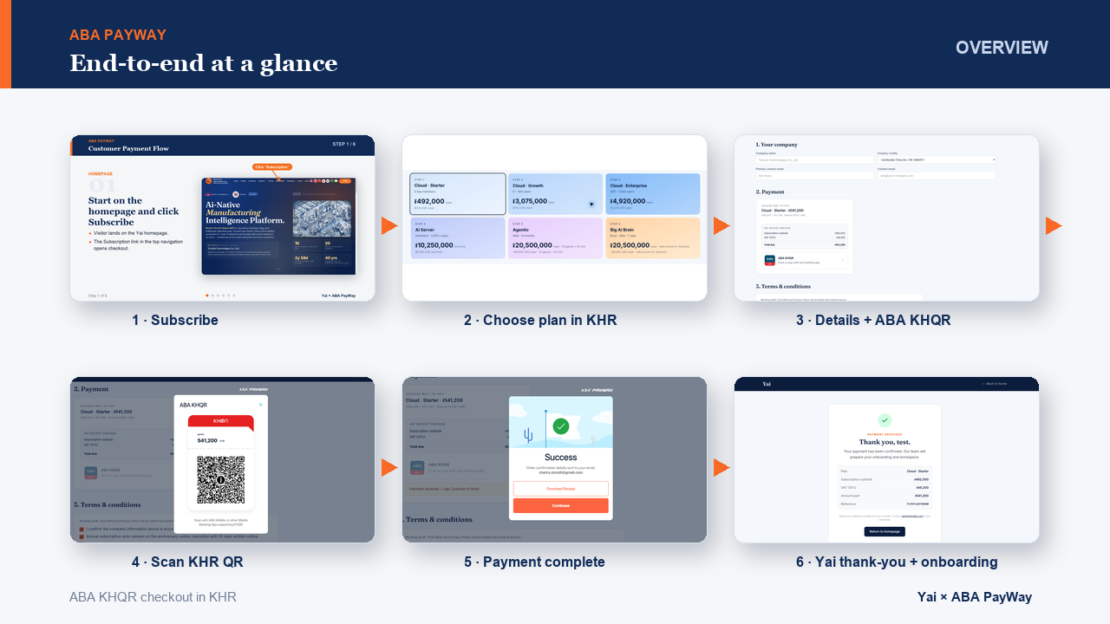
Notes:
[Sources]
- Yai KHR checkout, thank-you page, and footer: local application captures.
- ABA PayWay QR, scanned, and success states: user-provided screenshots.

