Slide 1
תכנות בשפת Python
חלק ב': העתקת ושיתוף אובייקטים מורכבים, קלט/פלט, משפטי בקרה, פונקציות, OOP

Slide 2
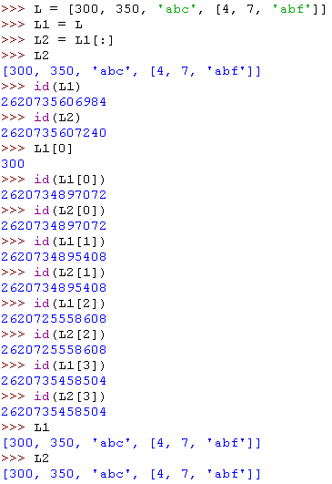
Shallow Copy: Sharing substructures
L
300
350
‘abc’
[4, 7, ’abf’]

Slide 3
Shallow Copy: Sharing substructures
Aliasing
L
L1
300
350
‘abc’
[4, 7, ’abf’]

Slide 4
Shallow Copy: Sharing substructures
L
L1
Shallow copy
300
350
‘abc’
[4, 7, ’abf’]
L2

Slide 5

Shallow Copy: Sharing substructures
L
L1
300
350
‘abc’
[4, 7, ’abf’, 10]
L2

Slide 6

Shallow Copy: Sharing substructures
L
L1
300
350
‘abc’
[4, 7, ’abf’, 10]
[1, 3, ‘abg’]
L2

Slide 7
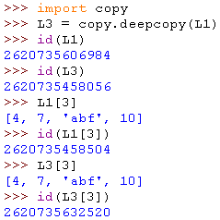
Deep Copy
L
L1
300
350
‘abc’
[4, 7, ’abf’, 10]
[4, 7, ‘abf’, 10]
L3

Slide 8
Files: Input
inflobj = open(‘data’, ‘r’) | Open the file ‘data’ for input
S = inflobj.read() | Read whole file into one String
S = inflobj.read(N) | Reads N bytes (N >= 1)
L = inflobj.readlines() | Returns a list of line strings

Slide 9
Files: Output
outflobj = open(‘data’, ‘w’) | Open the file ‘data’ for writing
outflobj.write(S) | Writes the string S to the file
outflobj.writelines(L) | Writes each of the strings in list L to the file
outflobj.close() | Closes the file

Slide 10
משפטי בקרה

Slide 11
No braces!
Python uses indentation instead of braces to determine the scope of expressions in control flow statements, function definitions, class definitions, etc.
All lines must be indented the same amount to be part of the scope (or indented more if part of an inner scope)
This forces the programmer to use proper indentation since the indenting is part of the program!
Proper indentation must be tab-based or spaces-based, but it cannot be a mixture of tabs and spaces.

Slide 12
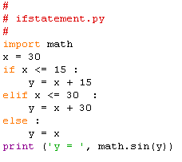

if Statement
if booleanExpr1:
………
………
[[elif booleanExpr2:
………
………]
[elif booleanExprN:
………
………]
[elif booleanExprN:
………
………]
[else:
………
………]
]
Run result

Slide 13
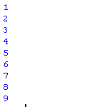
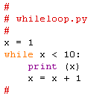
while Loop
while booleanExpr:
………
………
the Loop body
Run result

Slide 14
Loop Control Statements
break | Jumps out of the closest enclosing loop
continue | Jumps to the top of the closest enclosing loop
pass | Does nothing, empty statement placeholder

Slide 15
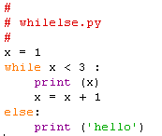
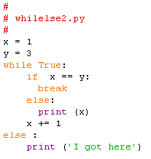


The while Loop else Clause
The optional else clause runs only if the loop exits normally (not by break)
while booleanExpr:
………
………
else:
………
………
Run result
Run result

Slide 16
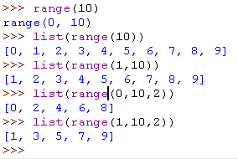
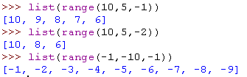
Python for Loops
for loopVar in iterable:
………
………
the Loop body
Looping over the values provided by a range iterator
range([i,] j [,k])
Ascending range (i < j, k > 0)
range(i. j. k) -- generates a range iterator that represents the range of numbers i, i+k, i+2k, …, (<= j-1)
range(i, j) -- equivalent to range(i, j, 1)
range(j) -- equivalent to range(0,j)
Descending range (i > j, k < 0)
range(i. j. k) -- generates a range iterator that represents the range of numbers i, i+k, i+2k, …, (>= j+1)

Slide 17
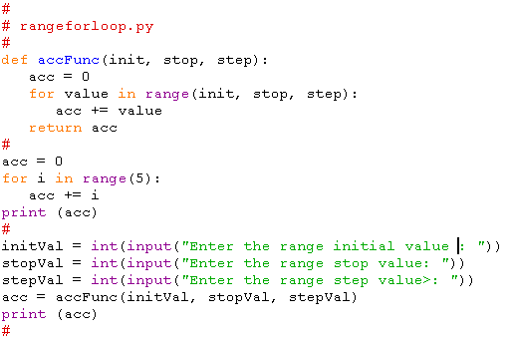
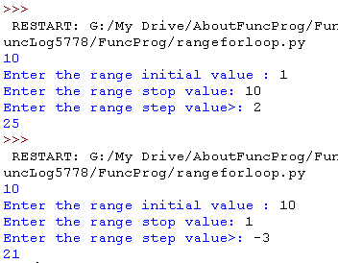
Python for Loops
for loopVar in iterable:
………
………
the Loop body
Looping over the values provided by a range iterator

Slide 18
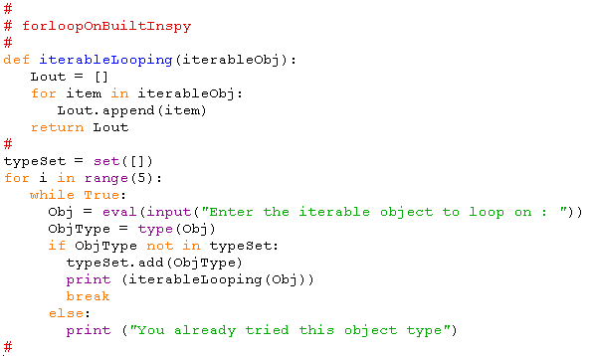
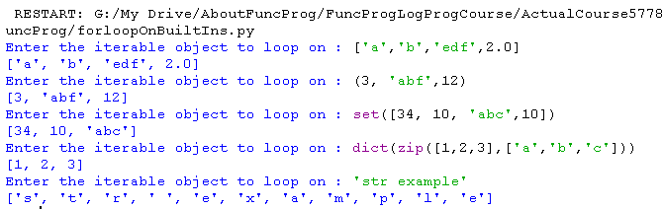
Python for Loops
for loopVar in iterable:
………
………
the Loop body
Looping over the values provided by a Python built-in iterable

Slide 19
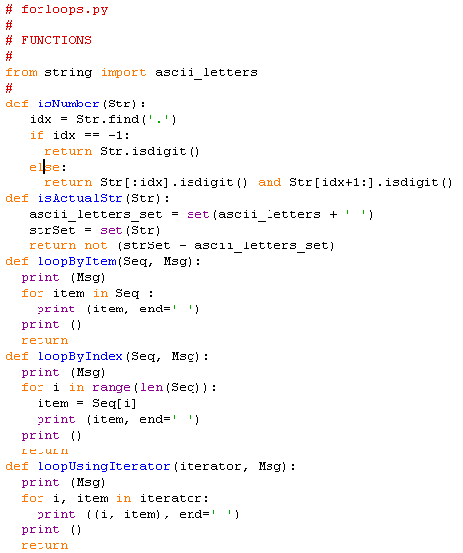
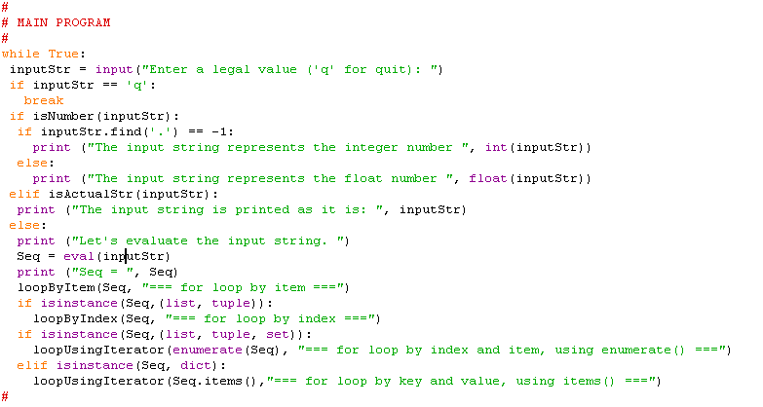
Python for Loops
Looping over the values provided by iterables and iterators
Let’s run this program now and analyze what it does.

Slide 20
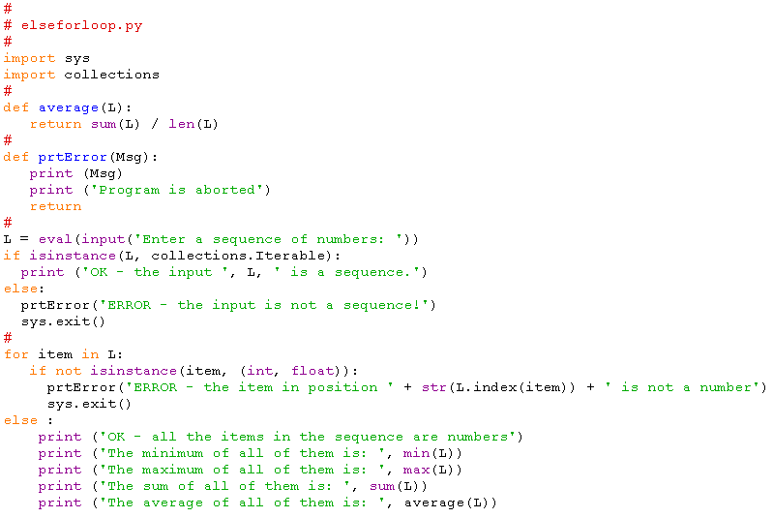
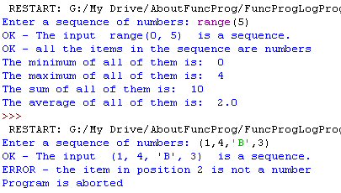
The for Loop else Clause
Looping over the values provided by iterables and iterators

Slide 21
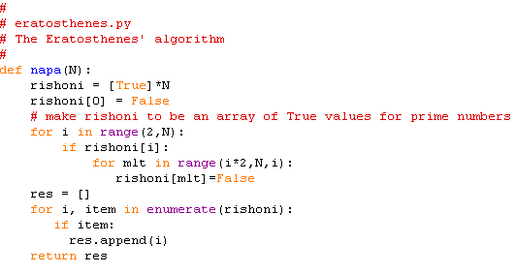
דוגמה: הנפה של ארטוסתנס (Eratosthenes)

Slide 22
פונקציות

Slide 23
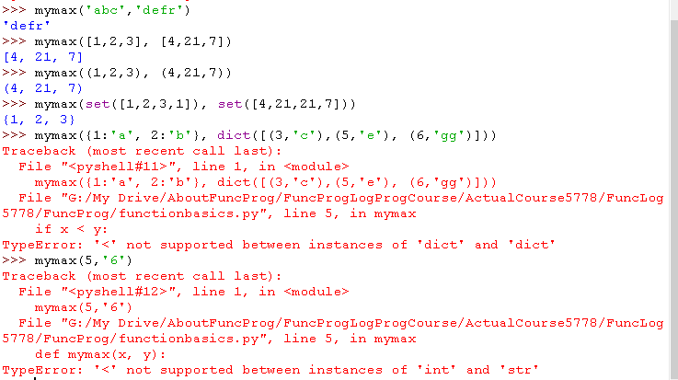
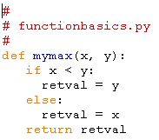
Function Basics
def funcName ([arg0, arg1, …, argN]):
………
………
[return [retValue]]
the Function body

Slide 24
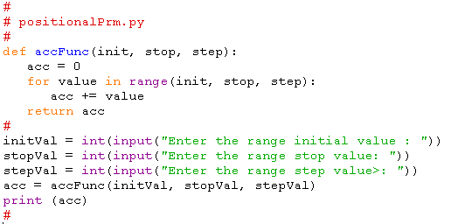
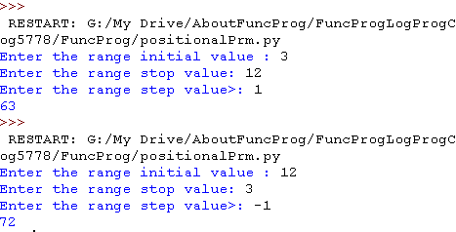
Function Basics: Positional Parameters
Actual Parameters are passed to Formal Parameters by their position in the parameters list.
When a function is called, the Formal Parameters are assigned the Actual Parameters by position.

Slide 25
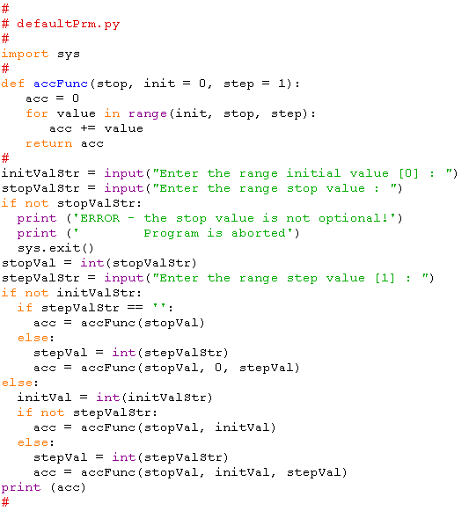
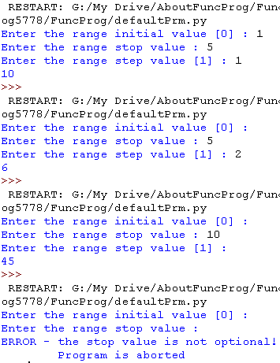
Function Basics: Default Parameters
Parameters can be assigned default values.
They are overridden if actual parameters are given for them.
Default formal parameters must come after all the positional formal parameters.

Slide 26
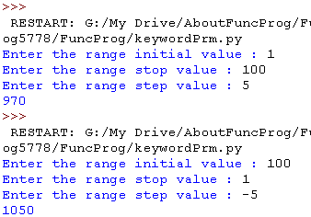
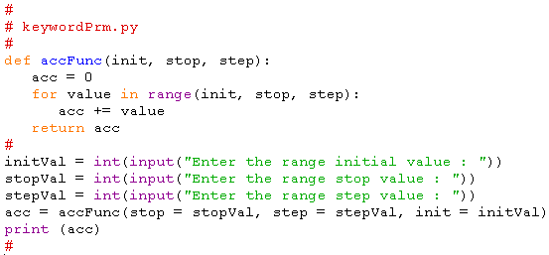
Function Basics: Keyword Parameters
Call by name (CBN)
Keyword (actual) parameters syntax: formalParamName = ActualParamValue
Any positional arguments must come before named ones in a call to the function.
Keyword actual parameters may come in any order in a call to the function.

Slide 27
Function Basics: *args - Non-keyworded unlimited parameters
*args as formal parameter
It may be used to allow passing an unlimited number of positional actual parameters to a function.
It may be used when the programmer does not know in advance how many actual parameters will the caller pass to the function.
At runtime, the actual parameter values passed by the caller, are received as part of a tuple.
*args is only a convention; any name may be used.
*args as actual parameter
It may be used to allow the elements of a sequence to be passed as actual parameters to a function.
It may be used when the programmer wants to decompose a sequence and pass all its elements as actual parameters to a function.
At runtime, the actual number of elements in the sequence (its length) needs to be in accordance to the number of actual parameters the function expects to receive.

Slide 28
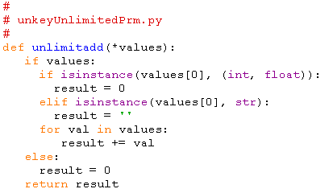
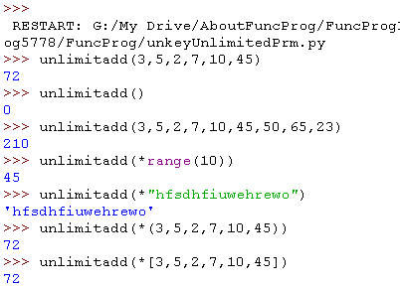
Function Basics: *args - Non-keyworded unlimited parameters

Slide 29
Function Basics: **kwargs - Keyworded unlimited parameters
**kwargs as formal parameter
it may be used to allow passing an unlimited number of keyword parameters to a function.
it may be used when the programmer does not know in advance how many keyword parameters will the caller pass to the function.
At runtime, the keyword parameters are received as part of a dictionary, where the keys are the formal parameter names, and the values are the actual parameter values passed by the caller.
**kwargs is only a convention; any name may be used.
*kwargs as actual parameter
It may be used to allow the pairs of a dictionary to be passed as actual keyword parameters to a function.
It may be used when the programmer wants to decompose a dicitonary and pass all its pairs as actual keyword parameters to a function.
At runtime, the actual number of pairs in the dictionary (its length) needs to be in accordance to the number of actual parameters the function expects to receive.

Slide 30
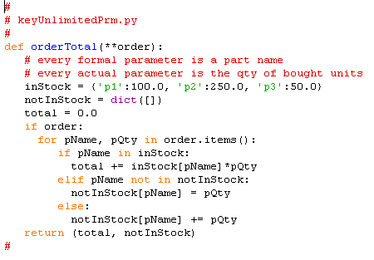
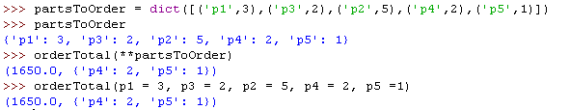
Function Basics: **kwargs - Keyworded unlimited parameters

Slide 31
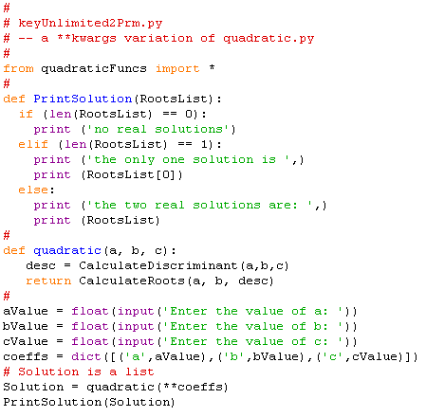
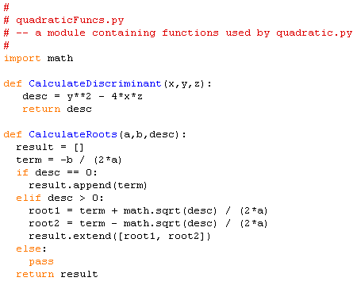
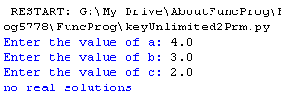
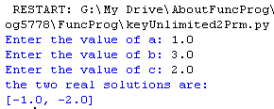
Function Basics: **kwargs - Keyworded unlimited parameters

Slide 32
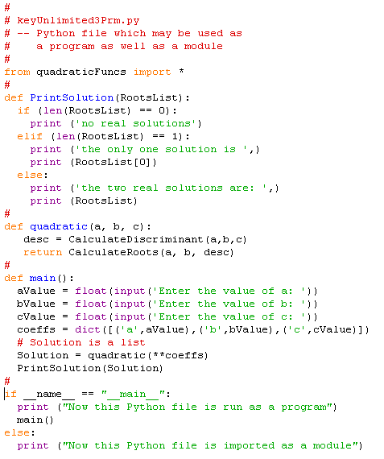
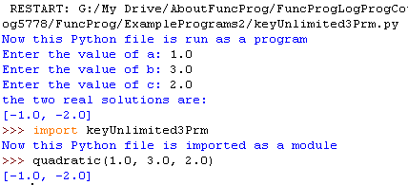
module, program, or both: if __name == “__main__”

Slide 33

Read-Eval-Print Loop (REPL): how does the Python Shell work?
READ
READ
EVAL
PRINT

Slide 34
Read-Eval-Print Loop (REPL): how does the Python Shell work?
READ
EVAL
EVAL
PRINT

Slide 35
Read-Eval-Print Loop (REPL): how does the Python Shell work?
READ
PRINT
EVAL
PRINT

Slide 36
Read-Eval-Print Loop (REPL): how does the Python Shell work?
READ
EVAL
READ
PRINT

Slide 37
מחלקות

Slide 38
Python is Object-Oriented
Everything in Python are objects.
A class is a collection of data and methods that act on that data.

Slide 39
Class Syntax
class myclass :
def __init__(self, val) :
self.x = val
def printit(self) :
print (self.x)
Every method in a class takes a self-pointer as the first parameter
(self is a convention) like this in Java or C++
__init__ is a built-in function that you override as the initializer of an object of the class (it is not a constructor like in Java or C++)

Slide 40
Class Method Calls
>>> from classbasic import *
>>> x = myclass(3)
>>> x.printit()
3
self is automatically added as the first parameter when a method is called on an instance of a class.
Internally, self must be explicitly passed.

Slide 41
Class Inheritance
class c1 :
x = 10
class c2 :
x = 20
y = 15
class c3(c1,c2) :
z = 2
>>> from classinherit import *
>>> x = c3()
>>> obj = c3()
>>> obj.z
2
>>> obj.x
10
>>> obj.y
15
Super classes are listed in brackets after the name of the class.
Python allows multiple inheritance.
Name resolution is bottom to top, left to right.

Slide 42
Explicit Call to a Super-class Method
class Person:
def __init__(self, first, last):
self.firstname = first
self.lastname = last
def toString(self):
return self.firstname + " " + self.lastname
class Employee(Person):
def __init__(self, first, last, staffnum):
Person.__init__(self, first, last)
self.staffnumber = staffnum
def toString(self):
return Person.toString(self) + ", " + str(self.staffnumber)
>>> from lomda import *
>>> person1 = Person('avraham','cohen')
>>> person2 = Employee('yisaac','levi',1234)
>>> person1.toString()
'avraham cohen'
>>> person2.toString()
'yisaac levi, 1234'
lomda.py

Slide 43
Instance Variables
Created as they are assigned
Referenced as self.<variable>
Classes as Objects
Classes exist as objects and contain their own variables.
Name resolution starts looking in the instance of the class for a variable, then walks up the inheritance tree.
Variables don’t exist in the instance until they are assigned there.
>>> class myclass :
... x = 10
...
>>> a = myclass()
>>> b = myclass()
>>> a.x, b.x, myclass.x
(10, 10, 10)
>>> a.x = 15
>>> a.x, b.x, myclass.x
(15, 10, 10)
>>> myclass.x = 20
>>> a.x, b.x, myclass.x
(15, 20, 20)
>>> a.x = myclass.x
>>> a.x, b.x, myclass.x
(20, 20, 20)
>>> myclass.x = 99
>>> a.x, b.x, myclass.x
(20, 99, 99)

Slide 44
דוגמאות תכנותיות עם מחלקות בפייתון

Slide 45
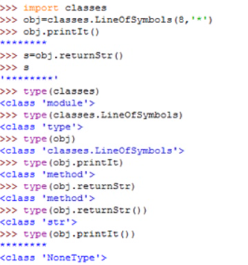
דוגמה של מחלקה ב-Python
class LineOfSymbols:
def __init__(self, ln, symb) :
self.len = ln
self.symb = symb
def printIt(self):
print(self.returnStr())
def returnStr(self):
return self.symb * self.len

Slide 46
דוגמא לשימוש במילון כשדה בתוך מופע של מחלקה
class Graph:
def __init__(self,V,E):
self.V=V
self.VertexList={}
for vertex in V:
self.VertexList[vertex]=[]
for edge in E:
self.VertexList[edge[0]].append([edge[1]])
def printGraph(self):
for i in self.V:
str=i + ': '
for edge in self.VertexList[i]:
str = str + '({},{})'.format(i,edge[0])
print(str)

Slide 47
דוגמא: DFS
def DFS(self):
self.VertexDict={}
self.timer=0
returnedVal = False
for u in self.V:
if (not (u in self.VertexDict)):
self.timer = self.timer + 1
self.VertexDict[u]=('',self.timer, 'gray')
self.DFSrec(u)
def DFSrec(self,u):
for v in self.VertexList[u]:
if not(v in self.VertexDict):
print ('Edge ({},{}) is a Tree-edge'.format(u,v))
self.timer = self.timer + 1
self.VertexDict[v]=(u, self.timer, 'gray')
self.DFSrec(v)
else:
if (self.VertexDict[v][2] == 'gray'):
print ('A circle found. Edge ({},{}) is a backword edge'.format(u,v))
else:
if (self.VertexDict[u][1] < self.VertexDict[v][1]):
print ('Edge ({},{}) is a forward edge'.format(u,v))
else:
print ('Edge ({},{}) is a cross edge'.format(u,v))
self.timer = self.timer + 1
parentOfU=self.VertexDict[u][0]
self.VertexDict[u]=(parentOfU,self.timer, 'black')

Slide 48
דוגמת הרצה
>>> import graph1
>>> g=graph1.Graph(['a','b','c','d'],[('a','b'),('b','c'),('c','a'),('c','d')])
>>> g.DFS()
Edge (a,b) is a Tree-edge
Edge (b,c) is a Tree-edge
A circle found. Edge (c,a) is a backword edge
Edge (c,d) is a Tree-edge
>>>

Slide 49
דוגמא: איתור מעגלים
def DFSCircle(self):
self.Color={}
returnedVal = False
for u in self.V:
if (not (u in self.Color)):
self.Color[u]='gray'
if (self.DFSrec(u)):
returnedVal = True
return returnedVal
def DFSrec(self,u):
returnedValue=False
for v in self.VertexList[u]:
if not(v in self.Color):
self.Color[v]='gray'
if (self.DFSrec(v)):
returnedValue = True
else:
if (self.Color[v] == 'gray'):
returnedValue = True # a circle recognized
self.Color[u]='black'
return returnedValue

Slide 50
דוגמא: מערכת סטודנטים
class Student:
def __init__(self, name, grades, age):
self.name = name
self.grades = grades
self.age = age
def __repr__(self):
return repr((self.name, self.age))
def average_grade(self):
return sum(self.grades) / len(self.grades)
>>> from student import *
>>> student_objects = [
Student('john', [70,80,90], 15),
Student('jane', [60,70,60], 12),
Student('dave', [89], 10)]
>>> student_objects
[('john', 15), ('jane', 12), ('dave', 10)]
>>> student_objects.sort(key=lambda stu: stu.age)
>>> student_objects
[('dave', 10), ('jane', 12), ('john', 15)]
>>> milgaim=[x for x in student_objects if x.average_grade() >= 80]
>>> milgaim
[('dave', 10), ('john', 15)]
>>> names = [x.name for x in milgaim]
>>> names
['dave', 'john']

Slide 51
דוגמא: לומדה לתרגילי חשבון בסיסיים
from random import *
class Lomda:
def __init__(self, numberSize, numEx) :
self.size = numberSize
self.numExercises = numEx
self.initializeExercises()
def initializeExercises(self):
self.exercises = [('+',lambda x,y : x + y),
('-',lambda x,y : x - y),
('*',lambda x,y : x * y),
('/',lambda x,y : x / y)]

Slide 52
def generateExercise(self):
self.number1 = randint(0,self.size)
self.number2 = randint(0,self.size)
opNumber= randint(0,3)
self.operator = self.exercises[opNumber]
def printExercise(self):
print('{} {} {} = ?'.format(self.number1, self.operator[0], self.number2))
def checkExercise(self, sol):
return (int(sol*1000) ==
int(self.operator[1](self.number1, self.number2)*1000))

Slide 53
def loopExercises(self):
self.grade=0
self.name = input("What's your name? ")
print('Hello {}. Please answer the following {} exercises '.format(self.name, self.numExercises))
for i in range(0,self.numExercises):
self.generateExercise()
self.printExercise()
sol = float(input('What is the answer? '))
if (self.checkExercise(sol)):
print('very good!')
self.grade = self.grade + 1
else:
print('{}, you are wrong that time... '.format(self.name))
print('Dear {}, your final grade is {}. ByeBye'.format(self.name, int(self.grade*100/self.numExercises)))

Slide 54
Functional Programming Concepts and their Implementation in Python

Slide 55
Functional Programming Concepts
What is Functional Programming?
Pure Functions and Referential Transparency
Data Immutability IN, Side-Effects OUT
What is a Variable?
Expressing Iteration as Recursion
Functions as First Class Objects
Lambda Expressions / Anonymous Functions
The Concept of Closure
High-Order Functions
Lazy Evaluation and Python Generators
Currying
Pipelines

Slide 56
תכנות פונקציונלי בשפת פייתון
(המשך יבוא במצגת הבאה ...)

