Slide 1
תכנות פונקציונלי בשפת פייתון

Slide 2
Functional Python Programming
Python has not been designed to be a Functional Programming Language, but it supports a good deal of Functional Programming concepts.
In what follows we will learn Functional Programming concepts and how they are expressed and used in the Python Programming Language.

Slide 3
Functional Programming Concepts
What is Functional Programming?
Pure Functions and Referential Transparency
Data Immutability IN, Side-Effects OUT
What is a Variable?
Functions as First Class Objects
Lambda Expressions / Anonymous Functions
The Concept of Closure
Expressing Iteration as Recursion
High-Order Functions
Lazy Evaluation and Python Generators
Currying
Pipelines

Slide 4
What is Functional Programming?
Functional Programming by Wikipedia:
“Functional Programming is a programming paradigm that treats computation as the evaluation of mathematical functions and avoids state and mutable data.”
In other words, a functional program is a description of the evaluation of a mathematical function, instead of an imperative program which is a set of statements to be executed in sequence.
- Functional programming promotes stateless computation (immutable data -> variables are assigned only once, and code does not have side effects).
- Imperative programming emphasizes change of state.
Functional programming is a more abstract approach, more focused on what to compute than how to compute.

Slide 5
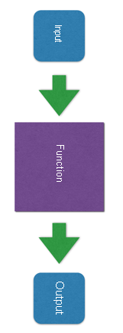
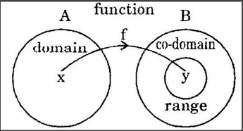
What is Functional Programming?
A Mathematical Function
doesn’t change its input
its output depends only on its input.
can act on other functions (function composition)
A Functional Program (actually, a Pure Function)
doesn’t change its input
its output depends only on its input.
no side effects: no external state is changed by the function.
If we can avoid internal state, even better.

Slide 6
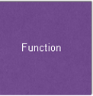
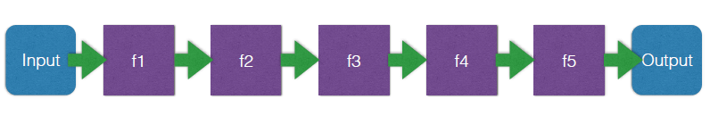
What is Functional Programming?
The Functional Programming Approach to programming
Decompose the problem into a set of subproblems, each one solved by a function: f1, f2, f3, f4, f5
All those functions are pure functions, making the whole function pure too.
A functional program (our Function) will actually be a pipeline of function applications.
Actually, the Function above is implemented as f5(f4(f3(f2(f1 Input))))

Slide 7
Referential Transparency
Immutable Data
Pure Function
Referential Transparency
Referential Transparency
Functions called with the same input, always return the same result.
If we call a function with the same parameters’ values,
we know for sure that the output will be always the same
(there is no state anywhere that would change it).
Expressions/Function Calls can be replaced by their values.
The Substitution Model of Computation

Slide 8
Referential Transparency
Advantages of Referential Transparency
Idempotence: Same results, no matter how many times we call a function with the same input.
Ease of debugging: Functions’ outputs depend only on their inputs; so, they are very easy to debug.
Memoization: Results from previous function calls can be cached to be reused, promoting a potential run time speedup.
Modularization: Functions are actual black boxes that we may tie together, promoting bottom-up programming.

Slide 9
Referential Transparency
Advantages of Referential Transparency
Parallelization: Function calls appearing in the same expression are independent, promoting parallelization in different processes, CPUs, etc.
func1 and func2 may be executed in parallel because a is not changed by anyone of those two functions.
Concurrence: There is no shared (global) data, promoting concurrency without semaphores, locks, race conditions, or deadlocks.
result = func1(a,b) + func2(a,c)

Slide 10
What is a variable?
A variable in Mathematics:
A name given to a value of some kind – atomic values (integers, rationals, reals, complexes, etc) or compound values (vectors, matrices, sets, etc.): <name, value, kind>
A variable in Imperative Programming:
A name bound to a memory address where a value of some type is stored: <name, address, value, type>
Changing the value does not affect the binding name-address.
A variable in Functional Programming:
A name bound to a value of some type: <name, value, type>
Changing the value affects the binding name-value, generating a new variable with the same name, changing the semantics of the variable name.
Thus, changing a variable’s value is nonsense in Functional Programming.

Slide 11
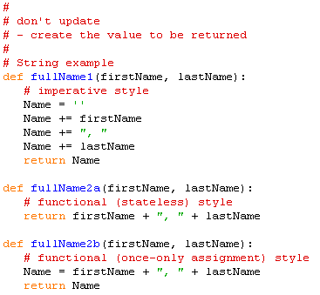
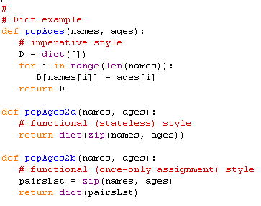
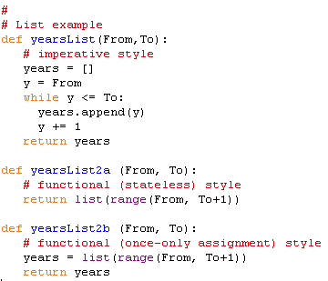
Stateless Computation

Slide 12
Functions are first class objects
Functions are treated like any other value
can be the value of a variable.
the semantics of the def statement is similar to that of the assignment statement - it, simply, binds a name to a function object.
can be passed as an actual parameter of a function.
can be returned from a function.
can be a component of any data structure.

Slide 13
Function names are like any variable name
Functions are first class objects
Functions are objects.
The same reference rules hold for functions as for other objects.
>>> x = 10
>>> x
10
>>> def y(name):
print ("Hello", name)
>>> y
<function y at 0x000002385A7A5A60>
>>> y("Anna")
Hello Anna
>>> z = 'Sarah'
>>> z
'Sarah'
>>> y(z)
Hello Sarah
>>> z = y
>>> z
<function y at 0x000002385A7A5A60>
>>> z("Anna")
Hello Anna

Slide 14
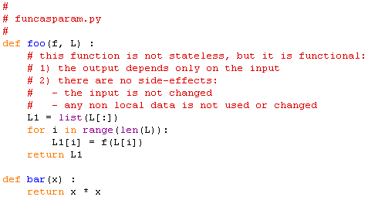
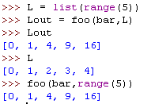
Functions are first class objects
Functions as Parameters
The function foo takes two parameters:
the first parameter f is expected to be a function.
the second parameter L is expected to be a sequence (or, more generally, an iterator).
The list L1 is returned -- its elements are the result of applying f on the elements of L.
A function, like foo, that receives function object(s) as parameter(s) is a High-Order Function.

Slide 15
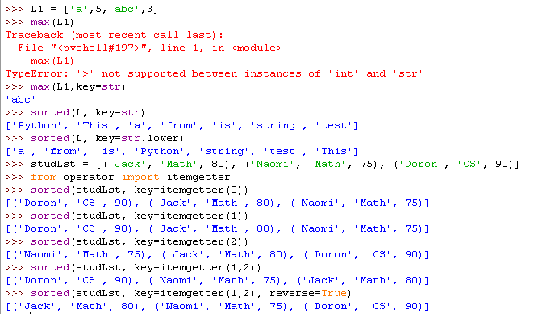
Functions are first class objects
Functions as Parameters
The str function is passed to the max function (and to the sorted function) to allow the internal conversion of every element of the list L to string. Then, they are sorted as strings.

Slide 16
Functions are first class objects
Functions as Parameters
The str.lower method is passed to the sorted function to allow the internal conversion of every word in the list L to lowercase.
Then, they are sorted as lowercase words.

Slide 17
Functions are first class objects
Functions as Parameters
The itemgetter method from the operator module, allows to sort a list of tuples (or list of lists) according to one, or more, of the elements of each tuple.
Usage examples:
key=itemgetter(0) – sort according to the value of element 0 of each tuple.
key=itemgetter(1,2) – sort according to the value of element 1 of each tuple, and for each duplicatevalue, sort according to the value of element 2.

Slide 18
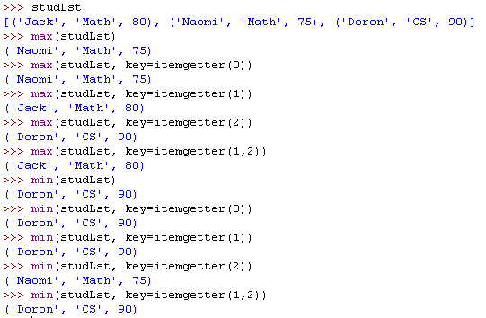
Functions are first class objects
Functions as Parameters
Usage examples:
key=itemgetter(0) – find the maximum (or the minimum) according to the value of element 0 of each tuple.
key=itemgetter(1,2) – find the maximum (or the minimum) according to the value of element 1 of each tuple; if for the maximum (or minimum) there are duplicates, find the maximum (or the minimum) according to the value of element 2.

Slide 19
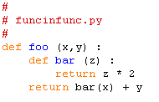

Functions are first class objects
Functions inside Functions
Since functions are like any other object, and
a function definition is like an assignment statement,
we can have functions inside functions.
A variable, local to the function foo, is created:
The variable name is the function name bar.
The variable value is the function object created by the nested function definition.
Note that the function bar can only be used locally, inside the scope of the function foo.

Slide 20
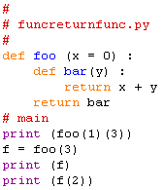

Functions are first class objects
Functions returning Functions
Note that the value of the variable bar, which is a function object, is the value returned by the function foo.
A function, like foo, that returns function object(s) is a High-Order Function.

Slide 21
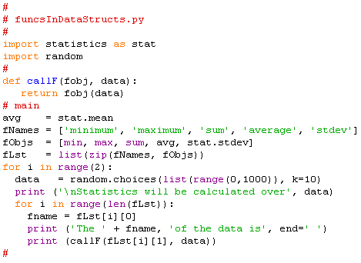
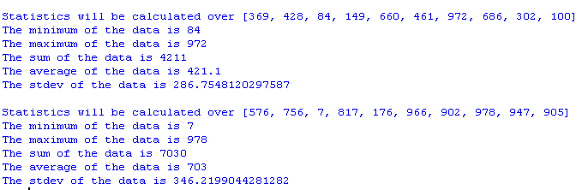
Functions are first class objects
Functions as components of Data Structures
List of tuples (function name, function object)
A list of 10 randomly chosen numbers in [0,1000)

Slide 22
Lambda Expressions and Anonymous Functions
A lambda expression returns a value of type function - a function object.
The body of a lambda expression can only be an expression, not a statement.
Lambda expressions are constructors of function objects.
Function objects created by lambda expressions are anonymous functions.
Python Lambda Expression: lambda a₁,a₂,…,a_{n} : bodyExpression
λa₁a₂…a_{n} . bodyExpression
λ-Calculus Abstraction:
λa₁.(…(λa_{n-1}.(λa_{n} . bodyExpression))…)

Slide 23
Lambda Expressions and Anonymous Functions
A lambda expression returns a value of type function - a function object.
The body of a lambda expression can only be an expression, not a statement.
Lambda expressions are constructors of function objects.
Function objects created by lambda expressions are anonymous functions.
Python Lambda Application: (lambda a₁,a₂,…,a_{n} : bodyExpression) (p₁,p₂,…,p_{n} )
λ-Calculus Application
(λa₁a₂…a_{n} . bodyExpression) p₁ p₂ … p_{n}
λa₁.(…(λa_{n-1}.(λa_{n} . bodyExpression p_{n}) p_{n-1})…) p₁
Note that (1) the basic λ-Abstraction creates a 1-argument function.
(2) the basic λ-Application is defined on a basic λ-Abstraction.
(3) a syntactic extension allows multi-argument functions (like above).

Slide 24
Lambda Expressions and Anonymous Functions
A lambda expression returns a value of type function - a function object.
The body of a lambda expression can only be an expression, not a statement.
Lambda expressions are constructors of function objects.
Function objects created by lambda expressions are anonymous functions.
>>> f = lambda x,y : x + y
>>> f(2,3)
5
>>> lst = ['one', lambda x : x * x, 3]
['one', <function <lambda> at 0x0000023BCBBF6AE8>, 3]
>>> lst[1](4)
16
>>> f2 = lst[1]
>>> f2(4)
16
f = λxy.(+ x y)
f 2 3 5
(λxy.(+ x y) 2 3 5

Slide 25
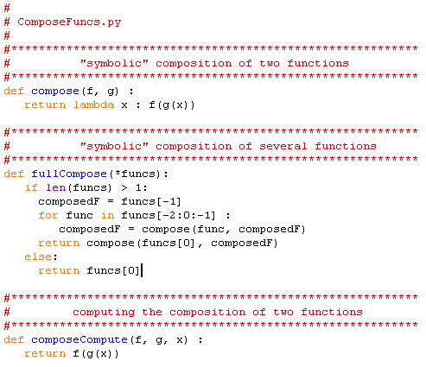
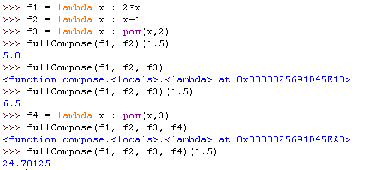
Lambda Expressions and Anonymous Functions
“Symbolic” Composition of Functions

Slide 26
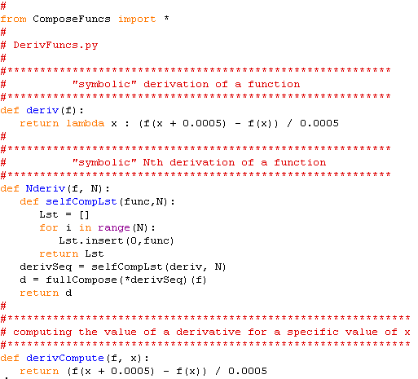
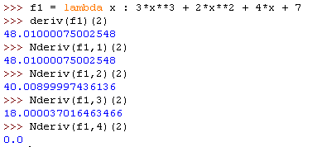
Lambda Expressions and Anonymous Functions
“Symbolic” Derivativation of a Function
f1’(2)
f1’’(2)
f1’’’(2)
f1’’’’(2)

Slide 27
The Concept of Closure
A closure is a dynamically generated anonymous function that encapsulates the context which was in existence at the time of its definition.
As soon as it is defined, a closure will be able to access (or modify) variables bound inside its scope - its arguments and its local variables.
Closures accomplish the same as classes, from fundamentally different points of view:
logic and data are in the same object
Closures may be seen as “operations with data attached”
- closures emphasize immutability and pure functions.
Classes may be seen as “data with operations attached”
- classes emphasize mutable or rebindable state.
But, in Python those differences are not absolute.

Slide 28
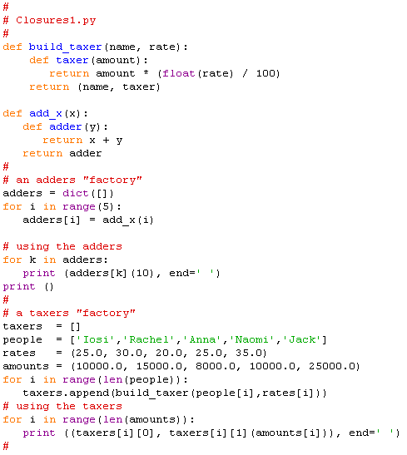
The Concept of Closure
A few rules for the definition of a useful closure:
The encapsulated state should not be mutated, just stored for later use.
Return just one method, unless there is a really good reason.
Once it exists, such a closure behaves in a purely functional way.
These rules will allow us to choose closures over classes in certain cases.

Slide 29
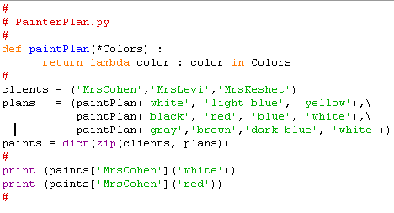

The Concept of Closure
Closure Example: the Painter’s Work Plan

Slide 30
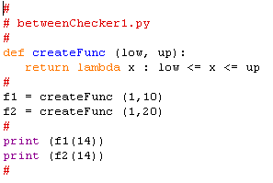
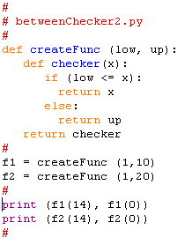


The Concept of Closure
Closure Example: the between checker

Slide 31
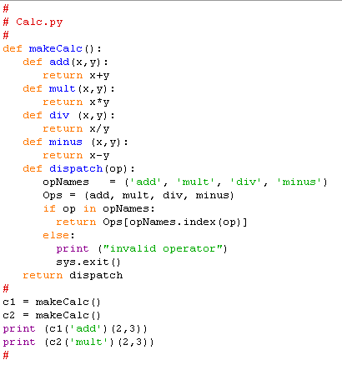

The Concept of Closure
Closure Example: a pocket calculator

