Slide 1



Workshop in Information Security
By: Yair Ben David
21/5/24

Slide 2


Part One: The Vulnerability

Slide 3
WordPress
WordPress is an open source website platform designed to allow for
easy website creation and administration. It's considered the most
powerful and extensible website content management system (CMS) in
existence today.
Lots of extension and plugins (ie: Elementor, WooCommerce, etc’).
Very easy and user friendly.
Free to use.

Slide 4
WooCommerce Payments
WooCommerce Payments is a plugin specifically designed for WordPress that transforms a regular website into a fully functional online store.
Useful for users to create their own personalize online store
Open Source and Free to Use

Slide 5
The Weak Link: WooCommerce’s User Management
WooCommerce utilizes WordPress's built-in user management system.
Different levels of user each with different permissions such as Administrator, Editor, Customer, etc.
Provides User Management tools that allows adding new users, assigning roles, and editing user information.

Slide 6
Sounds good… where is the problem?
As mentioned before, WooCommerce has different levels of users.
The vulnerability that I chose is one that allow regular users get auth bypass and create an admin account.
Super Critical with 9.8 rate that affected more than 500,000 user.

Slide 7
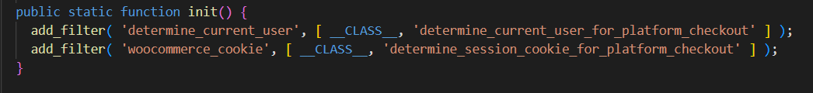
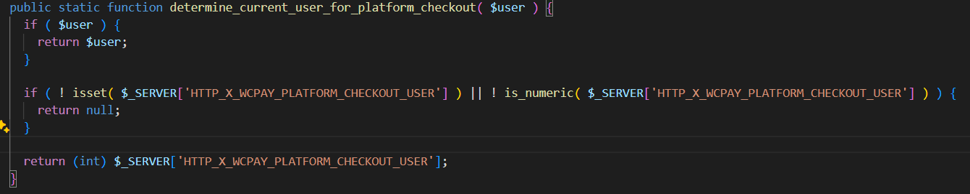
How Does It Work?
Notes:
The init() function adds two WordPress filters whereof the determine_current_user is the most interesting one (line 25). When looking up the hook in WordPress’s official documentation, it becomes quite clear that it ultimately does what its name stands for: determining the current user.
All the (vulnerable) magic happens in the function (lines 36 to 46), where the plugin checks for the existence of the X-WCPAY-PLATFORM-CHECKOUT-USER request header and if it is present it simply returns the header’s value. Since the returned value represents the “determined” user, we can now trick WordPress into thinking that we’re correctly authenticated as the given userId.

Slide 8
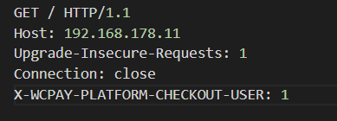
Never Trust The User!
To Trigger the bypass, we just need to set the X-WCPAY-PLATFORM-CHECKOUT-USER and point to user ID 1, which is the admin account.
Simple as that!

Slide 9
Protection
Observation: As we can see in determine_current_user_for_platform_checkout(), determining the user from the request is only optional. The server can determine the user using its own database.
Mitigation: Instead of blocking malicious attackers, we can just strip the header from the packet and let the server determine which ID the user is.

Slide 10

Part Two: Data Leak Prevention

Slide 11
Insights About Languages
Like any language, C has its own syntax and writing-style.
Identifying characteristics of languages include: Common words, Character Frequency Charts, Length of words, and more!
Some of the bold characteristics of C are:
Unique keywords such as ‘char’, ‘int’ ‘while’, ‘return’…
Special character usage like ‘_’, ‘;’, ‘{‘, ‘}’, ‘#’ are very common!
Semicolons at the end of each statement!
So, I tried to use those characteristics to detect the language of the text (English or C)

Slide 12
Statistics!
First, I had to get and extract a lot of statistics from English and C code, and for that I used big DataBases from the internet.
For each English or C example, I computed the following properties.
The average length of a line (usually, C lines are shorter than in plain English).
The Fraction of C unique keywords within the words in the text.
The Fraction of special characters in the text.
The Fraction of lines that end with semicolons.

Slide 13
Learning the Statistics: SVC
Model: To use those statistics and properties, I decided to use SVC – a variant of SVM (presented in previous courses)
Dataset Creation: I extracted the features I showed before and created feature vectors for each English/C-example to train my model.
A lot of mails and Wikipedia Pages for regular English text
A C-program database with more than 1.5M Lines of C code.
Training: I used 80% of the dataset for training (leaving 20% for testing)
Performance Evaluation: using the 20% of the dataset left, I evaluated the accuracy of the model. Additionally, I also tested the model on wiki fandom (a different dataset)
Accuracy: The Accuracy of the model reached 99.83%.

Slide 14

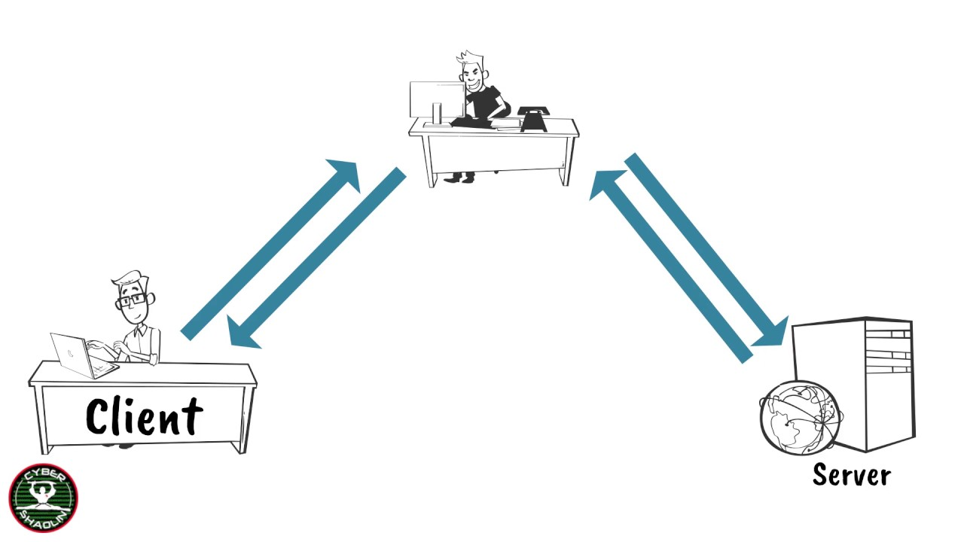

My Challenges During The Wokrshop

